Slide 1


IEEE 802.11 WLAN
Bhupendra Pratap Singh

Slide 2


Slide 3
Wireless?
A wireless LAN or WLAN is a wireless local area network that uses radio waves as its carrier.
The last link with the users is wireless, to give a network connection to all users in a building or campus.
The backbone network usually uses cables

Slide 4
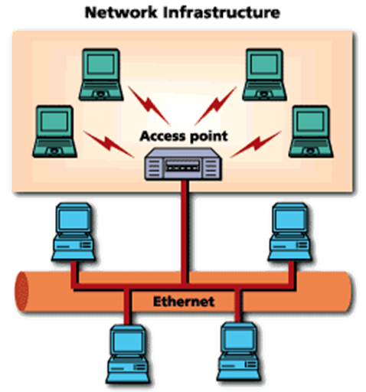
Common topologies
The wireless LAN connects to a wired LAN
There is a need of an access point that bridges wireless LAN traffic into the wired LAN.
The access point (AP) can also act as a repeater for wireless nodes, effectively doubling the maximum possible distance between nodes.

Slide 5
History
FCC decided to authorize public use of ISM band in
mid-80s
  No need to obtain FCC licenses
This resulted in substantial growth of WLAN products
Due to lack of standards proprietary products appeared
  Divided the market
  Parts were incompatible
Working group IEEE 802.11 was established
  Defined physical and MAC sub-layer standards in
June 1997
FCC: Federal Communications Commission

Slide 6
802.11 Family
 | 802.11 | 802.11a | 802.11b | 802.11g | 802.11n
Freq. Band | 2.4GHz | 5 GHz | 2.4 GHz | 2.4 GHz | 2.4GHz
Max. data rate | 2Mbps | 54Mbps | 11Mbps | 54 Mbps | 248Mbps
Another standard HIPERLAN was developed in Europe
It offered rates between 2 and 25Mbps in 5.2 GHz

Slide 7
802.11 FAMILY
 | 802.11ac | 802.11ax
FREQUENCY BAND | 5GHz | 2.4GHz and 5GHz
MAXIMUM DATA RATE | 867 Mbps (wave-1), 1.73 Gbps (wave-2) | 2.4Gbps
Wi-fi-Standards cont..
New nomenclature by Wi-Fi alliance :
October 3, 2018, the Wi-Fi Alliance announced that it added a new naming
802.11n | Wi-Fi4
802.11ac | Wi-Fi5
802.11ax | Wi-Fi6

Slide 8




IEEE 802.11p {DSRC}
Dedicated short-range communications (DSRC) are one-way or two-way short-range to medium-range wireless communication channels specifically designed for automotive use and a corresponding set of protocols and standards.
IEEE 802.11p is an approved amendment to the IEEE 802.11 standard to add wireless access in vehicular environments (WAVE), a vehicular communication system.
To support Intelligent Transportation Systems (ITS) applications.
Data exchange between high-speed vehicles and between the vehicles and the roadside infrastructure, also called V2X communication.
Licensed ITS band of 5.9 GHz (5.85–5.925 GHz). IEEE 1609 is a higher layer standard based on the IEEE 802.11p.

Slide 9
Benefits of Wireless LANs
Some jobs require people to physically move while using an appliance, which exchanges information with another appliance or central computer
  Wired LANs poses difficulty in implementation
  WLAN is technology of choice
Reduction in infrastructure and operating cost
Useful where wiring is not possible
Fast deployment
No cable faults: reduced downtime

Slide 10
WLAN applications
LAN Extension
  WLAN cannot substitute existing wired network
  Suitable for flexible extension of wired networks
Cross-building interconnection
  Connecting wired LANs located in nearby buildings
  Point-to-point link controlled by a device that incorporates a router functionality

Slide 11
WLAN applications
Nomadic access
  Employee transferring data on return from a tour,
from his laptop to the server
  Students accessing information offered by university server from anywhere in the campus
Ad hoc networking
  A peer-to-peer network, setup to satisfy a temporary need
  Conference room or business meetings where participants use portable computers to form a network in order to share information

Slide 12
802.11 Network Architecture
802.11 defines a hierarchical Network architecture
  Allows WLAN equipment to be configured in a
variety of ways
  End-points are called stations, have a NIC
  Simplest configuration is called as BSS
    Supports direct communication between
members
  Using BSS, we can build
    Independent BSS, Infrastructure BSS, Extended service set

Slide 13
WLAN Components
Wireless LAN Station
  The station (STA) is the most basic component of the
wireless network.
  A station is any device that contains the functionality of the
802.11 protocol, that being MAC, PHY, and a connection to the wireless media.
Typically, the 802.11 functions are implemented in the
hardware and software of a network interface card (NIC)
A station could be a laptop PC, handheld device, or an Access Point.
Stations may be mobile, portable, or stationary
Basic Service Set (BSS)
  basic building block of an 802.11 wireless LAN.
  The BSS consists of a group of any number of stations.

Slide 14
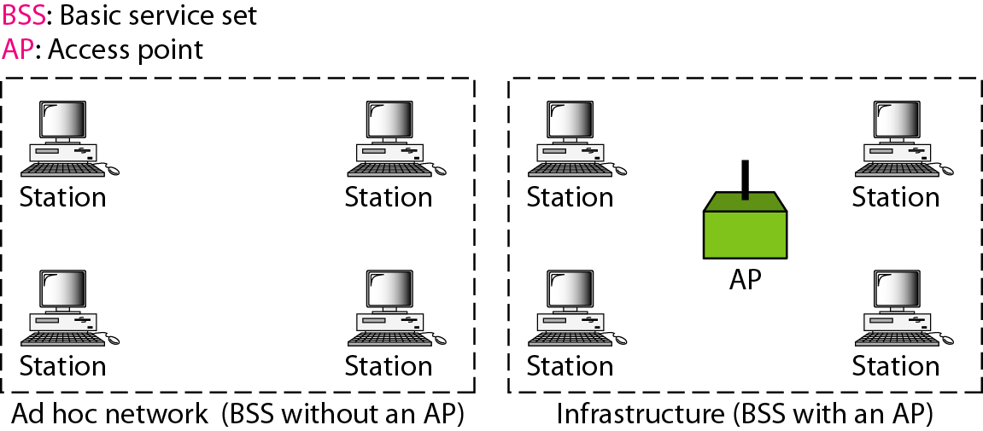
Basic Service Sets

Slide 15
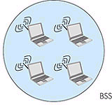
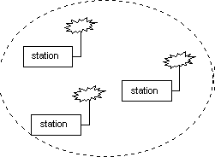
Independent Basic Service Set
ad-hoc network

Slide 16
IBSS
A set of stations, which have recognized each other and are connected via the wireless media in a peer- to-peer fashion.
Also called an Ad-hoc network.
The mobile stations communicate directly with each
other.
There are no relay functions in an IBSS therefore all stations need to be within range of each other and communicate directly.
Effective for a temporary need
No provision to access wired network

Slide 17
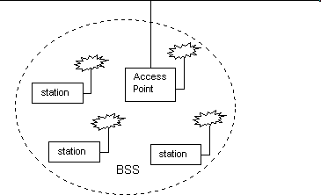
Infrastructure BSS
Backbone

Slide 18
Infrastructure BSS
BSS with a component called an Access Point (AP).
The access point provides a local relay function for
the BSS.
All stations in the BSS communicate with the access point and do not communicate directly.
All frames are relayed between stations by the
access point.
This local relay function effectively doubles the range of the IBSS.
The access point may also provide connection to a
distribution system.

Slide 19
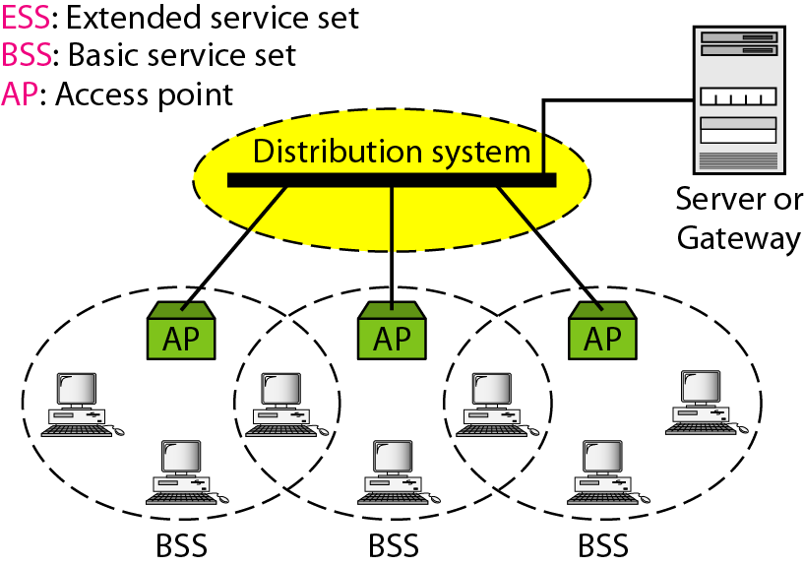
Extended Service Set

Slide 20
ESS
Extends the range of mobility to an arbitrary range
Set of infrastructure BSS’s, where the access points communicate amongst themselves to forward traffic from one BSS to another
The access point performs this communication through the distribution system, which may be constructed of either a wired LAN or wireless network.
The distribution system is a thin layer in each access point that
determines the destination for traffic received from a BSS.
  relayed back to a destination in the same BSS
  forwarded on the distribution system to another access point
  sent into the wired network to a destination not in the extended service set.

Slide 21
ESS
Communications received by an access point from the distribution system are transmitted to the BSS to be received by the destination mobile station.
Network equipment outside of the extended service set views the ESS and all of its mobile stations as a single MAC-layer network where all stations are physically stationary.
ESS hides the mobility of the mobile stations from everything outside the ESS.
This level of indirection provided by the 802.11 architecture allows existing network protocols that have no concept of mobility to operate correctly with a wireless LAN where there is mobility.

Slide 22
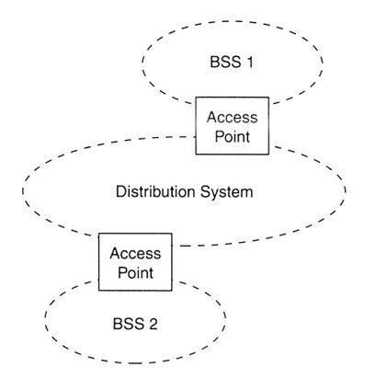
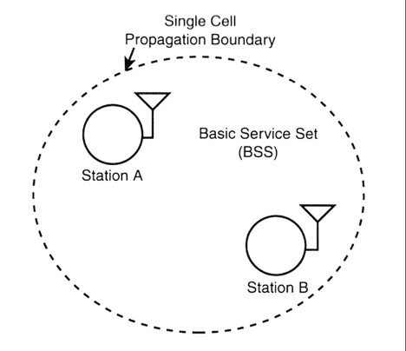
BSS and ESS
Basic (independent) service set (BSS)
Extended service set (ESS)

Slide 23
Network Services
Distribution
  Used by mobile stations in Infrastructure BSS,
every time they send data.
  Once a frame has been access by access point, it uses distribution service to deliver the frame
    This is true even for two mobile stations
associated with same access point
Integration
  Service provided by the distribution system
  It allows connection of the distribution system to the non-IEEE 802.11 network

Slide 24
Network Services
Association
  Request from client and response from AP.
  Finalizes security options
  Finalizes bit rate options
  Sets up data link
  Client learns the access point MAC address (BSSID)
  Delivery of frames to mobile stations is possible because they register or associate with access point
  The distribution system uses the registration information to determine which access point to use for a mobile station
– Unassociated stations are not “on the network”

Slide 25
Network Services
Reassociation
  When a mobile station moves between BSS areas, within a single ESS, it evaluates signal strength and may switch the access point with which it is associated.
  Reassociations are initiated by STA, when signal conditions indicate that a association with a different AP is beneficial
  After Reassociation is complete, distribution system
updates it location records

Slide 26
Network Services
Disassociation
  Used for terminating an existing association
  Mobility data stored in the distribution system is revoked
  A polite task to do during STA shutdown
  MAC is designed to handle STA that leave network
without disassociating

Slide 27
Network Services
Authentication
  Wireless networks cannot offer same level of
physical security as wired LAN
    Network attachment points in wired LAN can be secured in locked closets
  Additional authentication routines are required to
ensure only authorised users are allowed
  In practice, many access points are configured for “open system” authentication

Slide 28
Network Services
Privacy
  Eavesdropping on wireless network can be comparatively simpler by using correct antenna and modulation methods
  Optional privacy service Wired Equivalent Privacy
  (WEP) is available.
    Uses encryption techniques
    WEP is not iron clad security
    WPA – Wi-Fi protected Access-
      AES and Temporal Key Integrity Protocol (TKIP) encryption techniques
      AES is more preferred over TKIP with WPA

Slide 29
802.11b Security Features
Wired Equivalent Privacy (WEP) – A protocol to protect link-level data during wireless transmission between clients and access points.
Services:
  Authentication: provides access control to the network by denying access to client stations that fail to authenticate properly.
  Confidentiality: intends to prevent information compromise from casual eavesdropping
  Integrity: prevents messages from being modified while in transit between the wireless client and the access point.

Slide 30
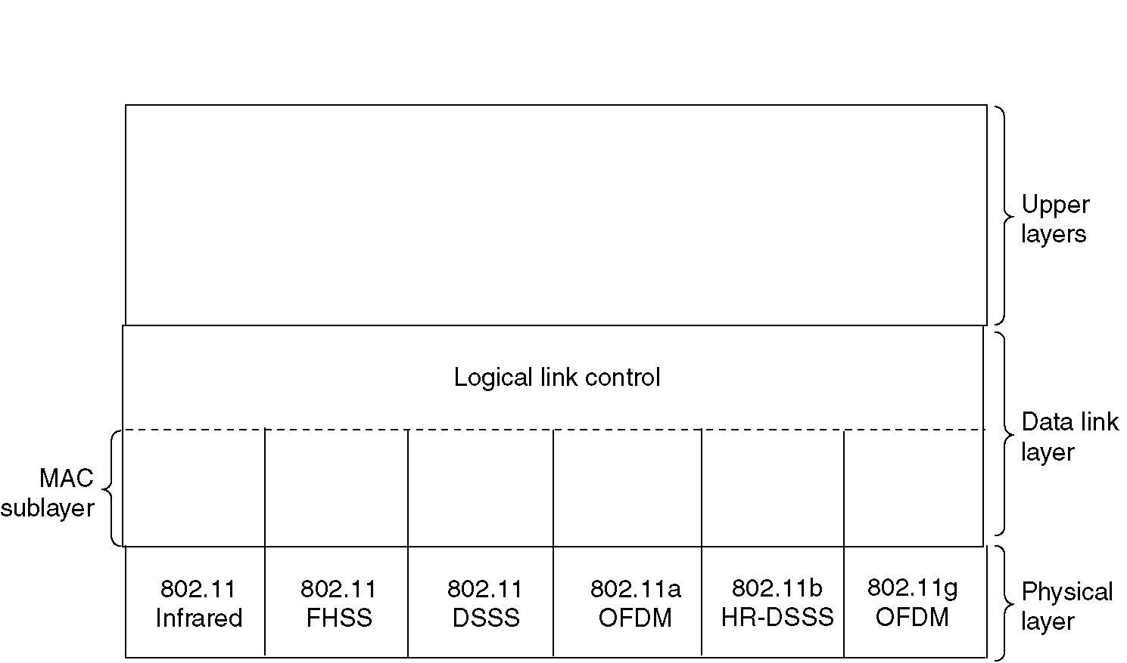
Part of the 802.11 Protocol Stack

Slide 31
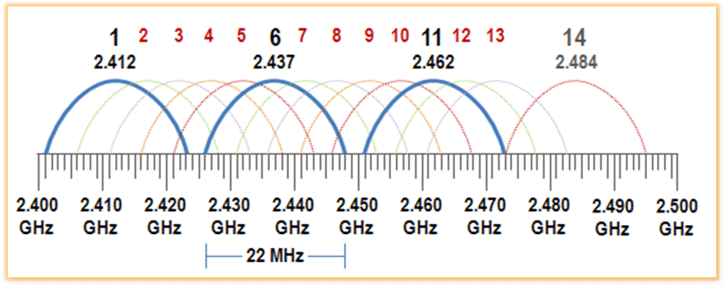
Wi-Fi Channels (total no. 14)
If there routers/AP(s) are working in the same vicinity select channel 1 (AP1),
6 (AP2) and 11 (AP3) to avoid any interference and data corruption

Slide 32
Wireless Physical Layer
Physical layer conforms to OSI (five options)
  1997: 802.11 infrared, FHSS, DHSS
– 1999: 802.11a OFDM and 802.11b HR-DSSS
– 2001: 802.11g OFDM
802.11 Infrared
  Two capacities 1Mbps or 2Mbps.
  Cannot penetrate walls.
802.11 FHSS (Frequency Hopping Spread Spectrum)
  79 channels, each 1Mhz wide at low end of 2.4 GHz
ISM band.
  Same pseudo-random number generator used by all stations.

Slide 33
Wireless Physical Layer
802.11 DSSS (Direct Sequence Spread Spectrum)
  Spreads signal over entire spectrum using pseudo-random sequence (similar to CDMA)
  Each bit transmitted as 11 chips (Barker seq.), PSK at 1Mbaud
  1 or 2 Mbps
802.11a OFDM (Orthogonal Frequency Divisional Multiplexing)
  Compatible European HiperLan2
  54Mbps in wider 5.5 GHz band
  Uses 52 FDM channels (48 for data; 4 for synchronization)
  Encoding is complex ( PSM up to 18 Mbps and QAM above this
capacity)
84

Slide 34
Wireless Physical Layer
802.11b HR-DSSS (High Rate Direct Sequence Spread
Spectrum)
  11a and 11b shows a split in the standards committee
  11b approved and hit the market before 11a.
  Up to 11Mbps in 2.4 GHz band using 11 million
chips/sec.
  Note in this bandwidth all these protocols have to deal with interference from microwave ovens, cordless phones and garage door openers.
  Range is greater than 11a.
  11b and 11a are incompatible!!

Slide 35
Wireless Physical Layer
802.11g OFDM(Orthogonal Frequency Division
Multiplexing)
  Supports 54Mbps
  Uses 2.4 GHz frequency for greater range

Slide 36
LLC Overview
LLC provides functions like traditional data link
protocol like High-level Data Link Control (HDLC).
LLC provides addressing and data link control
  It is independent of MAC and PHY layer chosen
Higher layers like TCP/IP pass user data and expect
error-free transmission
It provides following 3 services to a network layer
  Unacknowledged connectionless service
  Connection oriented service
  Acknowledged connectionless service

Slide 37
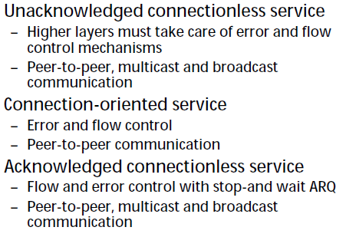
LLC Services

Slide 38
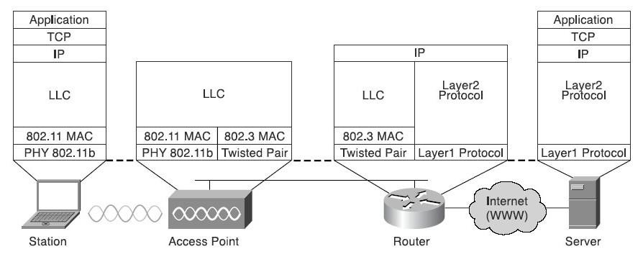
Protocol Stack across Network

Slide 39
Inter Frame Spacing
Distributed Inter-frame Space (DIFS)
  Distributed coordination function (DCF) is a mandatory technique used to prevent collisions in IEEE 802.11-based WLAN standard (Wi-Fi). It is a medium access control (MAC) sublayer technique used in areas where carrier-sense multiple access with collision avoidance (CSMA/CA) is used.
  Using DCF technique, a station needs to sense the status of the wireless channel before it can place its request to transmit a frame. The time interval that a station should wait before it sends its request frame is known as DCF Interframe Spacing (DIFS). DISF is calculated as the sum of SISF and twice the slot time.
PCF Inter-frame Space (PIFS)
  Point coordination function (PCF) is an optional technique used to prevent collisions in centralized controlled WLANs. PCF is used additionally along with the mandatory distributed coordination function (DCF).
  The Access Point (AP) which coordinates the communications centrally, waits for PIFS duration to grasp the channel. Since PIFS is less than DIFS duration, the AP always has the priority to access the channel over the other stations. PISF is calculated as the sum of SISF and slot time.
Short Inter-frame Space (SIFS)
  Short Inter-frame Spacing (SIFS), is the time interval required by a wireless device in between receiving a frame and responding to the frame. It is used in Distributed coordination function (DCF) scheme, which is a mandatory technique used to prevent collisions.
  The duration of SIFS is equal to the sum of delays in radio frequency (RF), Physical Layer Convergence Procedure (PLCP) and processing delay of MAC (medium access control) layer.
  In IEEE 802.11 networks, SIFS is the inter-frame spacing maintained before and after the transmission of an acknowledgment frame and Clear To Send (CTS) frame. The duration of SISF is usually 10 μs.

Slide 40
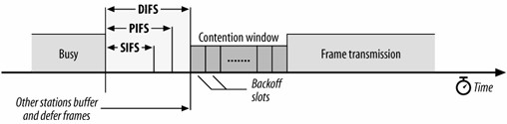
Interframe Spacing
Interframe spacing plays a large role in coordinating
access to transmission medium
STAs delay transmissions until medium becomes idle
Varying interframe space create different priority
levels for different types of traffic
Short InterFrame Space (SIFS)
– Used for highest priority transmissions
– CTS/RTS, acknowledgements
9
7

Slide 41
Interframe Spacing
PCF Interframe Space (PIFS)
  STAs with data to transmit in the contention-free period can transmit after PIFS is elapsed
DCF InterFrame Space (DIFS)
  Minimum idle time for contention-based services
  STA can have immediate access to the medium if it is free for period longer than DIFS
Extended InterFrame Space(EIFS)
  It is used when there is error during transmission

Slide 42
802.11 MAC Sublayer Protocol
In 802.11 wireless LANs, “seizing channel” does not
exist as in 802.3 wired Ethernet.
Two additional problems:
  Hidden Terminal Problem
  Exposed Station Problem
To deal with these two problems 802.11 supports two modes of operation DCF (Distributed Coordination Function) and PCF (Point Coordination Function).
All implementations must support DCF, but PCF is optional.

Slide 43


IEEE 802.11: multiple access
avoid collisions: 2⁺ nodes transmitting at same time
802.11: CSMA - sense before transmitting
  don’t collide with ongoing transmission by other node
802.11: no collision detection!
  difficult to receive (sense collisions) when transmitting due to weak received signals (fading)
  can’t sense all collisions in any case: hidden terminal, fading
  goal: avoid collisions: CSMA/C(ollision)A(voidance)
A
B
C
C
A’s signal
strength
C’s signal
strength
B
A
space

Slide 44
IEEE 802.11 MAC Protocol: CSMA/CA
802.11 sender
1 if sense channel idle for DIFS then
  transmit entire frame (no CD)
2 if sense channel busy then
  start random backoff time
  timer counts down while channel idle
  transmit when timer expires
  if no ACK, increase random backoff interval, repeat 2
802.11 receiver
- if frame received OK
return ACK after SIFS (ACK needed due to hidden terminal problem)
sender
receiver
DIFS
data
SIFS
ACK

Slide 45
Avoiding collisions (more)
idea: allow sender to “reserve” channel rather than random access of data frames: avoid collisions of long data frames
sender first transmits small request-to-send (RTS) packets to BS using CSMA
  RTSs may still collide with each other (but they’re short)
BS broadcasts clear-to-send CTS in response to RTS
CTS heard by all nodes
  sender transmits data frame
  other stations defer transmissions
avoid data frame collisions completely
using small reservation packets!

Slide 46
Collision Avoidance: RTS-CTS exchange
A
B
AP
RTS(B)
RTS(A)
reservation collision
RTS(A)
CTS(A)
CTS(A)
DATA (A)
defer
time
ACK(A)
ACK(A)

Slide 47
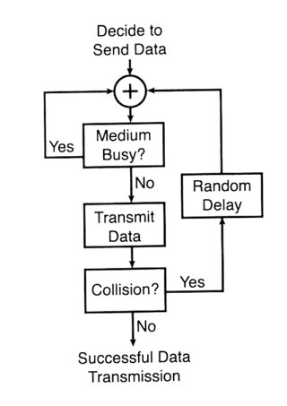
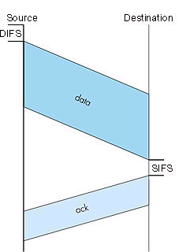
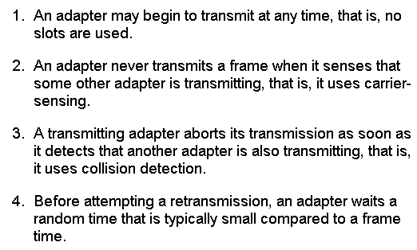
IEEE 802.11 Media
Access Control (MAC)
Carrier-sense multiple access protocol
with collision avoidance (CSMA/CA)
DIFS: Distributed Inter-Frame Spacing
SIFS: Short Inter-Frame Spacing
ack: Acknowledgement

Slide 48
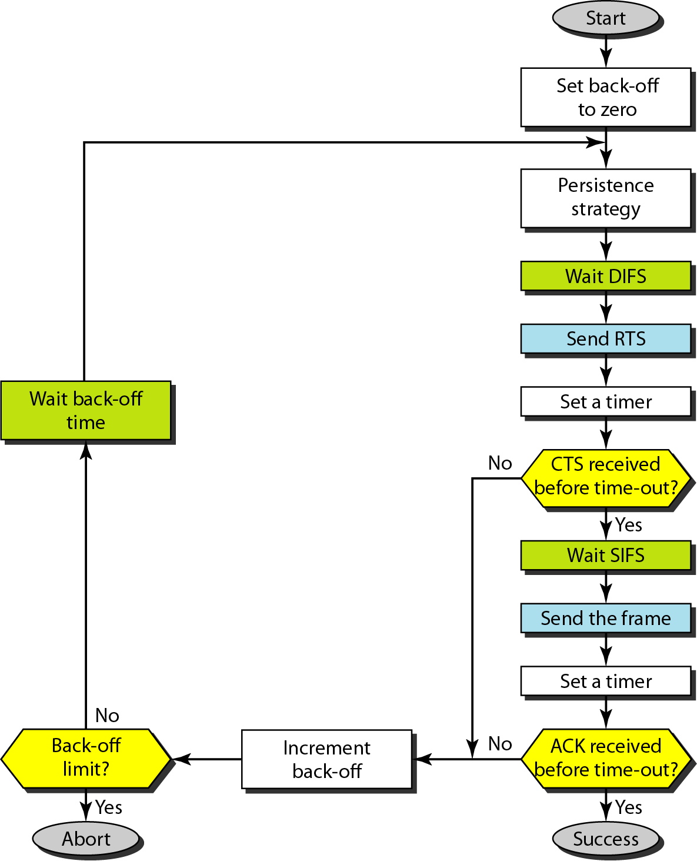
Figure 14.4 CSMA/CA flowchart
Short Interframe Space (SIFS),
is the amount of time in microseconds
required for a wireless interface
to process a received frame
and to respond with a response frame

Slide 49
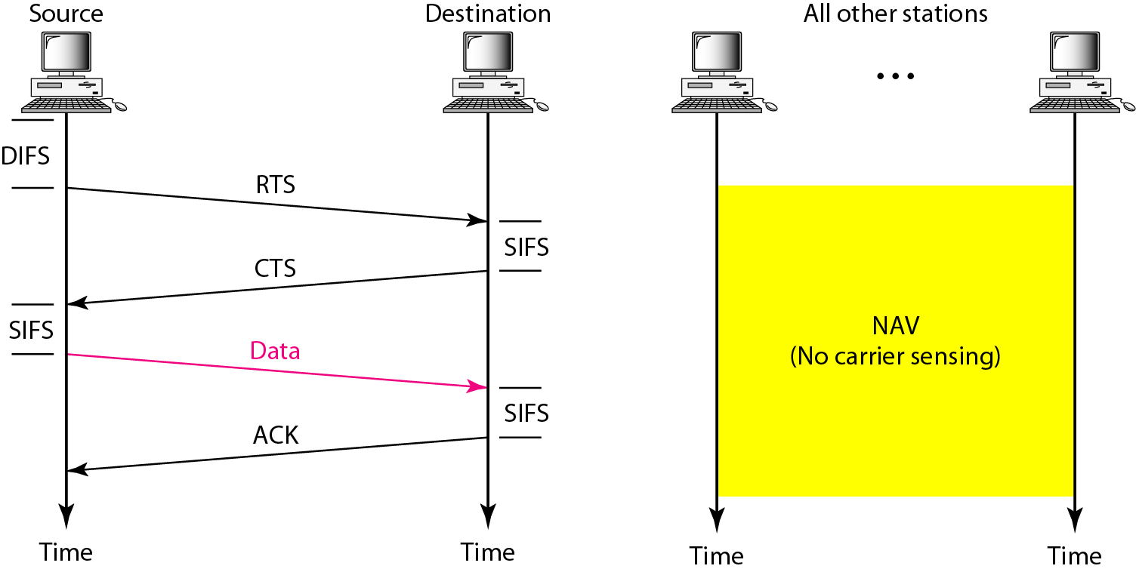
Figure 14.5 CSMA/CA and NAV

Slide 50
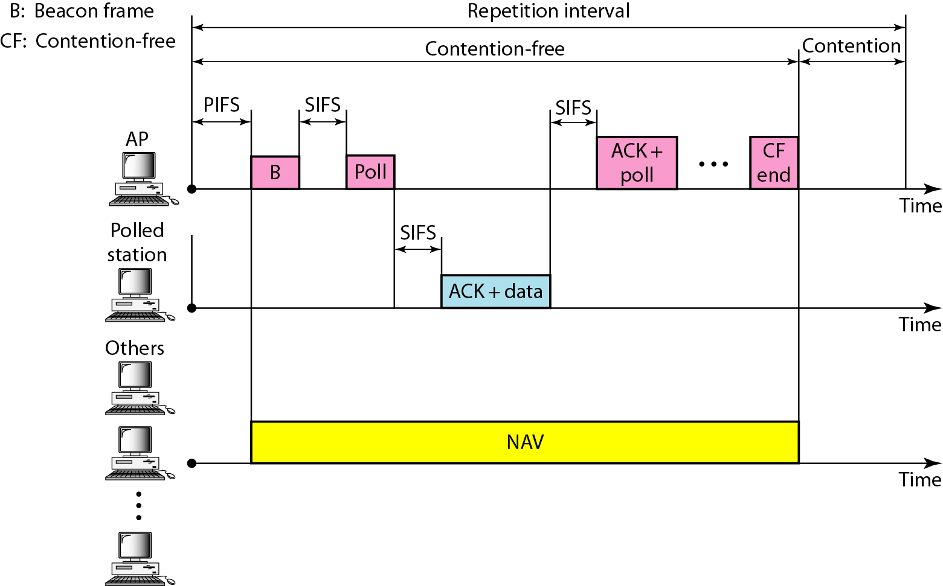
Figure 14.6 Example of repetition interval
PCF Interframe Space (PIFS) is one of the interframe space used in IEEE 802.11 based Wireless LANs. PCF enabled access point wait for PIFS duration rather than DIFS to occupy the wireless medium. PIFS duration is less than DIFS and greater than SIFS (DIFS > PIFS > SIFS)
What is a beacon frame in WIFI?
A beacon frame allows an access point to advertise its existence, and the frequency channel it is operating on, to devices that want to connect to an access point. A beacon frame allows a mobile device to signal that it is ready to receive a frame

Slide 51
NAV
Virtual carrier-sensing is provided by the Network Allocation Vector (NAV).
Most 802.11 frames carry a duration field, which can be used to reserve the medium for a fixed time period.
The NAV is a timer that indicates the amount of time the medium will be reserved. Stations set the NAV to the time for which they expect to use the medium, including any frames necessary to complete the current operation.
Other stations count down from the NAV to 0. When the NAV is nonzero, the virtual carrier-sensing function indicates that the medium is busy; when the NAV reaches 0, the virtual carrier-sensing function indicates that the medium is idle

Slide 52
Multiple Access (Nutshell)
DCF uses Carrier Sense Multiple Access / Collision
Avoidance (CSMA / CA).
  Each station to listen for other users. If the channel is idle, the station may transmit.
  If it is busy, each station waits until transmission stops,
and then enters into a random back off procedure.
PCF provides contention free service
  Special stations called point coordinators are used
  They reside in APs, so restricted to Infrastructure BSS
  In some way it resembles token access protocol

Slide 53
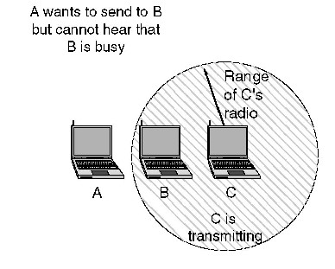
Hidden Node
A is not in transmitting range of C
A detects no carrier and starts transmission
If C was in middle of transmission, the two packets would collide
B will notice the collision
A cannot receive the
collision
A and C are hidden from each other

Slide 54
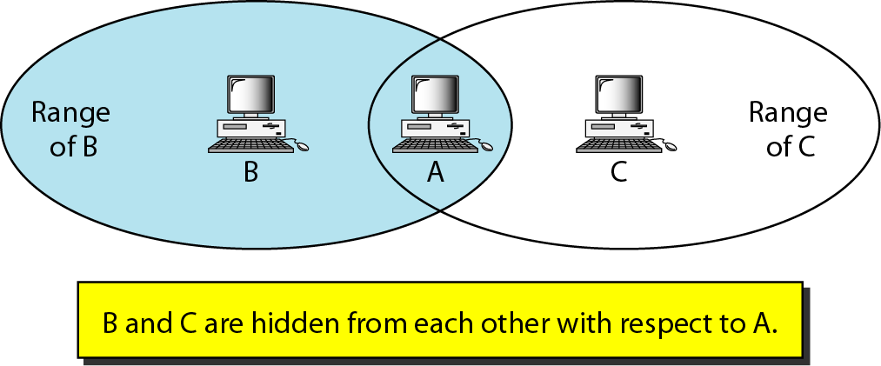
Hidden Node Problem

Slide 55
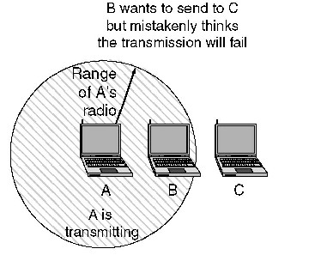
Exposed Node
A is transmitting
B detects carrier from A
B wants to transmit to C
B defers transmission
B falsely assumes that it cannot send to C, while A is transmitting

Slide 56
Hidden Node Problem
Virtual Carrier Sense enables a station to reserve the medium for a specified period of time through the use of RTS/CTS frames.
STA-A sends an RTS frame to the AP.
The RTS will not be heard by STA-B.
The RTS frame contains a duration/ID field
The reservation information is stored in the Network Allocation Vector (NAV) of all stations detecting the RTS frame
Upon receipt of the RTS, the AP responds with a
CTS frame, which also contains a duration/ID field

Slide 57
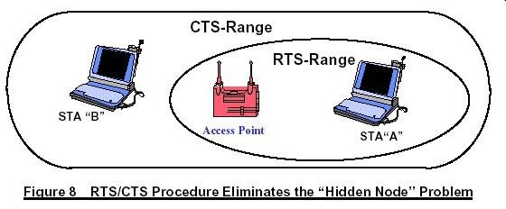
Hidden Node problem
While STA-B did not detect the RTS, it will detect the CTS and update its NAV accordingly
Thus, collision is avoided even though some nodes
are hidden from other stations.

Slide 58
Carrier-Sensing Functions and the Network Allocation Vector
Two types of carrier-sensing functions in 802.11 manage this process: the physical carrier-sensing and virtual carrier-sensing functions.
Physical carrier-sensing functions are provided by the physical layer in question and depend on the medium and modulation used.
It is difficult (or, more to the point, expensive) to build physical carrier-sensing hardware for RF-based media, because transceivers can transmit and receive simultaneously only if they incorporate expensive
electronics. Furthermore, with hidden nodes potentially lurking everywhere, physical carrier-sensing cannot provide all the necessary information.

Slide 59

WLAN concerns
Increased BER
Inward Interference comes from devices transmitting
in frequency spectrum used by WLAN
  Spread spectrum techniques help
  Narrowband interference only affects part of the
  signal causing few or no errors at all
  Wideband interference like microwave ovens can have disastrous effects
  Techniques in physical and MAC layers, like Automatic Repeat Requests (ARQ) and Forward Error Correction (FEC) are used

Slide 60
WLAN concerns
Interference
Fully connected topology between all WLAN nodes
cannot be assumed (like wired nodes)
  Hidden nodes
  Exposed nodes

Slide 61
Wireless Concerns
Collision detection is difficult to implement
– Own transmission would swamp out incoming
Power management for portable devices
Performance of protocols adapted from wired networks degrade over WLANs
Factors affecting signal propagation needs to be
considered while installing

Slide 62

THANK
YOU !!

