Slide 1
Neural network components and learning
Yadunandan Mandalaneni
Model Development
AIML 501 Assignment 2.4
Structure, computation, and evidence from TensorFlow Playground
01
Notes:
AIML 501 Assignment 2.4. A visual explanation of six neural network components, supported by six actual TensorFlow Playground runs. Yadunandan Mandalaneni. Model Development. November 12, 2026.
Sources
TensorFlow Playground
https://playground.tensorflow.org/

Slide 2
Architecture and data flow
Input layer
Hidden layer 1
Hidden layer 2
Output layer
x1
ŷ
x2
Features enter at the left. Each layer passes its activations to the next layer.
Architecture shown 2 inputs, hidden widths 4 and 2, one output. Biases omitted from the drawing.
02
Notes:
Layers group neurons. Inputs hold supplied features. Hidden layers transform intermediate representations. The output layer produces the prediction. This schematic matches the 2 input, 4 neuron, 2 neuron, 1 output architecture in runs A to C. Lines show trainable connections. Biases also belong to every non-input neuron. The diagram is schematic and does not reproduce learned weights.
Sources
Google ML Crash Course Neural network nodes and hidden layers
https://developers.google.com/machine-learning/crash-course/neural-networks/nodes-hidden-layers
TensorFlow Playground source Neurons loss and weight updates
https://github.com/tensorflow/playground/blob/master/src/nn.ts

Slide 3
Neurons weights and bias
x1 = 0.8
w1 = 0.6
Weighted sum
z = Σ wi xi + b
Activation
a = f(z)
x2 = 0.2
w2 = −0.5
Bias b = 0.1 shifts the sum
Illustrative calculation
z = (0.6 × 0.8) + (−0.5 × 0.2) + 0.1 = 0.48
a = tanh(0.48) ≈ 0.446
03
Notes:
A neuron computes a weighted sum plus a bias and then applies an activation. Weights scale contributions and can change their sign. Bias shifts the response even when inputs are zero. This numeric example is illustrative rather than a value measured from a trained model. z = 0.6 times 0.8 minus 0.5 times 0.2 plus 0.1 = 0.48. tanh(0.48) is approximately 0.446.
Sources
Google ML Crash Course Neural network nodes and hidden layers
https://developers.google.com/machine-learning/crash-course/neural-networks/nodes-hidden-layers
TensorFlow Playground source Neurons loss and weight updates
https://github.com/tensorflow/playground/blob/master/src/nn.ts

Slide 4
Layers and model capacity
Depth counts hidden stages. Width counts the neurons in each stage.
Observed architecture | Trainable parameters | Runs
2 inputs, 4 then 2 hidden, 1 output | 25 | A B C
2 raw inputs, 2 hidden, 1 output | 9 | E F
2 squared inputs, no hidden, 1 output | 3 | D
Count for the larger network
(2 + 1) × 4 + (4 + 1) × 2 + (2 + 1) × 1 = 25
04
Notes:
A layer is a group of units at the same stage of computation. Hidden width and depth affect the functions a network can express and the work per training step. Parameter counts include all dense weights and all non-input biases, using (inputs + 1) times outputs for each adjacent pair of layers. Engineered features are computed outside the learned network. Counts are calculated from the recorded architecture, not reported by the Playground UI.
Sources
Google ML Crash Course Neural network nodes and hidden layers
https://developers.google.com/machine-learning/crash-course/neural-networks/nodes-hidden-layers
TensorFlow Playground source Neurons loss and weight updates
https://github.com/tensorflow/playground/blob/master/src/nn.ts

Slide 5
Activation functions
Linear f(z) = z
Tanh range −1 to 1
Sigmoid range 0 to 1
ReLU max(0, z)
The menu changes hidden activations. Playground classification keeps tanh at the output.
05
Notes:
An activation maps the summed input to the neuron output. Nonlinear hidden activations allow compositions that express curved boundaries. The curves here are calculated from the standard mathematical functions. In Playground classification the output activation stays tanh, while the activation menu changes hidden units. A linear hidden network still has a straight classification boundary in the raw two-dimensional inputs. The no-hidden run makes the hidden activation menu irrelevant.
Sources
Google ML Crash Course Neural network nodes and hidden layers
https://developers.google.com/machine-learning/crash-course/neural-networks/nodes-hidden-layers
TensorFlow Playground source Training loop and output activation
https://github.com/tensorflow/playground/blob/master/src/playground.ts
TensorFlow Playground source Neurons loss and weight updates
https://github.com/tensorflow/playground/blob/master/src/nn.ts

Slide 6
Loss functions
Loss measures prediction error
Playground
L = average of ½(ŷ − y)²
Class targets are −1 and +1
Illustrative example
Target y = +1 and prediction ŷ = 0.6
Loss = ½(0.6 − 1)² = 0.08
Binary cross entropy
For probability p and label y in {0, 1}
−[y log(p) + (1 − y) log(1 − p)]
Training loss guides fitting. Held-out test loss checks performance on other samples.
06
Notes:
A loss measures disagreement between predictions and targets and gives training an objective. Playground uses the average half squared error, with class labels minus one and plus one. Its displayed loss is not accuracy. Binary cross entropy is another common objective for a model that outputs class probabilities and uses labels zero and one. The example squared error is hypothetical. No binary cross entropy experiment was run.
Sources
TensorFlow Playground source Training loop and output activation
https://github.com/tensorflow/playground/blob/master/src/playground.ts
TensorFlow Playground source Neurons loss and weight updates
https://github.com/tensorflow/playground/blob/master/src/nn.ts

Slide 7
Optimization algorithms
Forward pass
Compute loss
Backpropagation
Update weights
Gradient step θnew = θold − learning rate × gradient
Algorithm | Update behavior
Mini-batch gradient descent | Uses an averaged gradient from a batch
Momentum SGD | Carries a velocity based on earlier gradients
Adam | Adapts updates using first and second gradient moments
Observed runs use learning rate 0.03 and batch size 10. Adam is a conceptual comparison.
07
Notes:
Optimization algorithms update weights and biases to reduce the objective. Backpropagation computes gradients using the chain rule. The optimizer applies updates using those gradients. Playground uses averaged mini-batch gradient updates. With batch size 10, every 10 training samples trigger an update. Momentum uses a running velocity. Adam uses estimates of first and second gradient moments to adapt the updates. Only Playground mini-batch gradient descent was used in this artifact.
Sources
Google ML Crash Course Training using backpropagation
https://developers.google.com/machine-learning/crash-course/neural-networks/backpropagation
TensorFlow Playground source Training loop and output activation
https://github.com/tensorflow/playground/blob/master/src/playground.ts
TensorFlow Playground source Neurons loss and weight updates
https://github.com/tensorflow/playground/blob/master/src/nn.ts
Keras SGD optimizer
https://keras.io/api/optimizers/sgd/
Keras Adam optimizer
https://keras.io/api/optimizers/adam/

Slide 8
Playground experiment design
Run | Data | Noise | Hidden widths | Inputs | Activation | Train / test loss
A | Circle | 0 | 4, 2 | x1 x2 | linear | 0.485 / 0.541
B | Circle | 0 | 4, 2 | x1 x2 | tanh | 0.005 / 0.008
C | Circle | 30 | 4, 2 | x1 x2 | tanh | 0.118 / 0.159
D | Circle | 0 | None | x1² x2² | N/A | 0.003 / 0.002
E | Circle | 0 | 2 | x1 x2 | tanh | 0.218 / 0.267
F | Gaussian | 0 | 2 | x1 x2 | tanh | 0.000 / 0.000
Shared budget 200 epochs
Learning rate 0.03, batch size 10, 50% training data, no regularization
Single runs with recorded seeds. Loss values are rounded. Data changes can also change the sample.
08
Notes:
Six exploratory classification runs were performed on November 12, 2026. Each run used 200 epochs, learning rate 0.03, batch size 10, a 50 percent training split, and no regularization. The menu activation describes hidden units. Run D has no hidden layer, so its menu activation has no effect. The output is tanh in every classification run. Changes to data controls regenerate samples and change the seed. These are single-run observations rather than replicated causal estimates. A and B share a dataset seed, but initialization is not controlled independently. The UI reports losses rounded to three decimals. URLs preserve settings and seeds but not trained weights.
Sources
TensorFlow Playground
https://playground.tensorflow.org/
TensorFlow Playground source Training loop and output activation
https://github.com/tensorflow/playground/blob/master/src/playground.ts
TensorFlow Playground source Neurons loss and weight updates
https://github.com/tensorflow/playground/blob/master/src/nn.ts

Slide 9
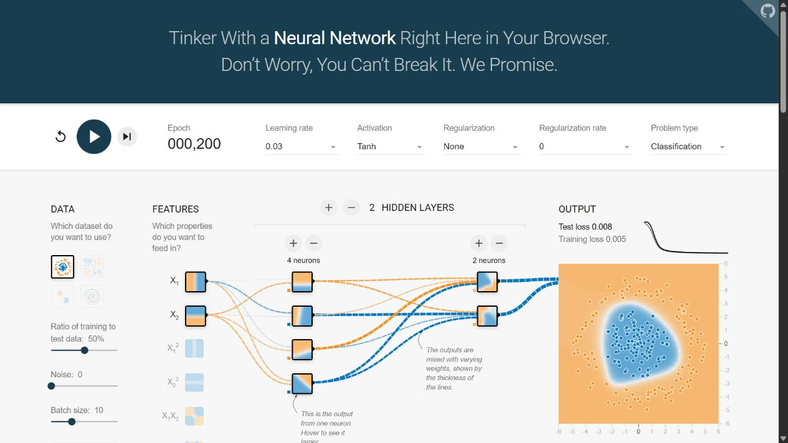
Nonlinearity changes the circle fit
Linear hidden units
Train 0.485
Test 0.541
Tanh hidden units
Train 0.005
Test 0.008
Run B at 200 epochs. The curve encloses the central class.
09
Notes:
Actual screenshots and displayed losses from runs A and B. Both runs use circle data, noise zero, raw x1 and x2 inputs, hidden layers 4 and 2, the same visible seed 0.50685, and 200 epochs. Hidden activation changes from linear to tanh. A tanh output remains fixed in both. The screenshot shows B. The nonlinear hidden features allow the network to form an enclosed boundary. Random initial weights were not paired independently, so the measured difference should not be treated as a replicated causal effect.
Sources
TensorFlow Playground
https://playground.tensorflow.org/
TensorFlow Playground source Training loop and output activation
https://github.com/tensorflow/playground/blob/master/src/playground.ts

Slide 10
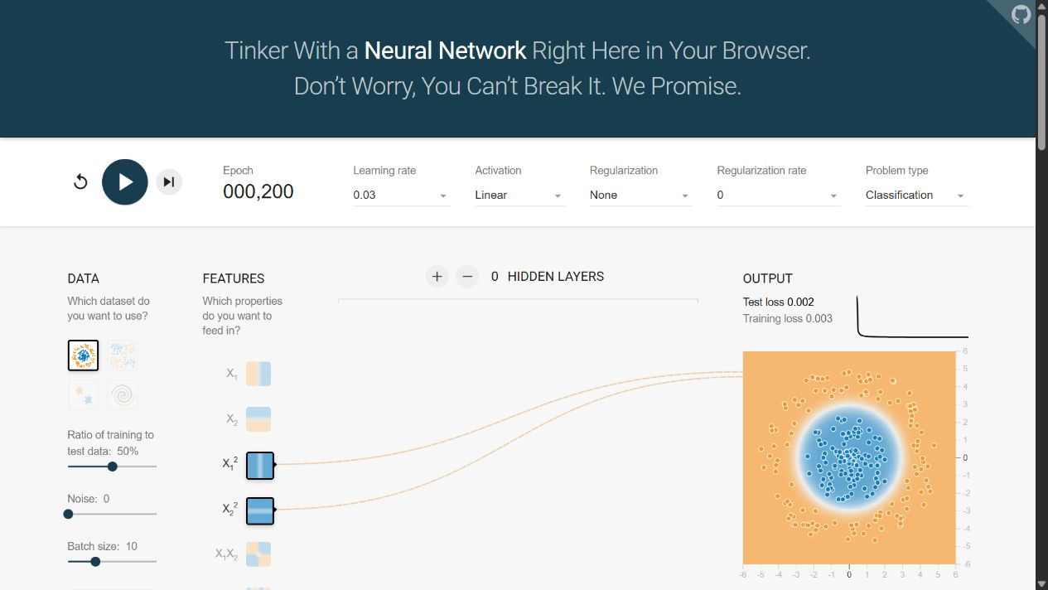
Features can simplify the architecture
Squared inputs
x1² and x2²
No hidden layer
3 parameters
Train 0.003
Test 0.002
A sum of squared coordinates can describe an enclosed boundary in the original input space.
10
Notes:
Run D uses squared inputs x1 squared and x2 squared, no hidden layers, circle data with zero noise, and a tanh output. At 200 epochs the displayed training loss is 0.003 and test loss is 0.002. Only three trainable parameters remain, including the output bias. A weighted sum of squared coordinates can express an ellipse or circle in the original coordinates. This fits the radial structure of the chosen task. Multiple settings and the seed differ from A, so this is a representation example rather than an isolated one-factor comparison.
Sources
TensorFlow Playground
https://playground.tensorflow.org/
TensorFlow Playground source Training loop and output activation
https://github.com/tensorflow/playground/blob/master/src/playground.ts
TensorFlow Playground source Neurons loss and weight updates
https://github.com/tensorflow/playground/blob/master/src/nn.ts

Slide 11
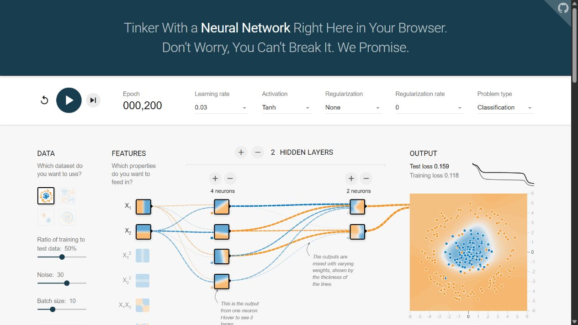
Noise and limited capacity
Noise 30
4 then 2 neurons
Train 0.118
Test 0.159
Clean circle
2 hidden neurons
Train 0.218
Test 0.267
Run C shown. More hidden units cannot remove uncertainty caused by overlapping observations.
11
Notes:
Screenshot of run C with noise 30. It returns training loss 0.118 and test loss 0.159 after 200 epochs, using hidden layers 4 and 2 with tanh. The noisy points overlap more than in the clean case. Run E uses the clean circle task with one hidden layer of two neurons and returns 0.218 and 0.267. Its boundary leaves visible errors. The runs illustrate different reasons for poor fit. Noise can make examples less separable. Limited capacity can restrict the decision boundary. Data seeds and initialization differ, so the study does not quantify their independent causal effects.
Sources
TensorFlow Playground
https://playground.tensorflow.org/

Slide 12
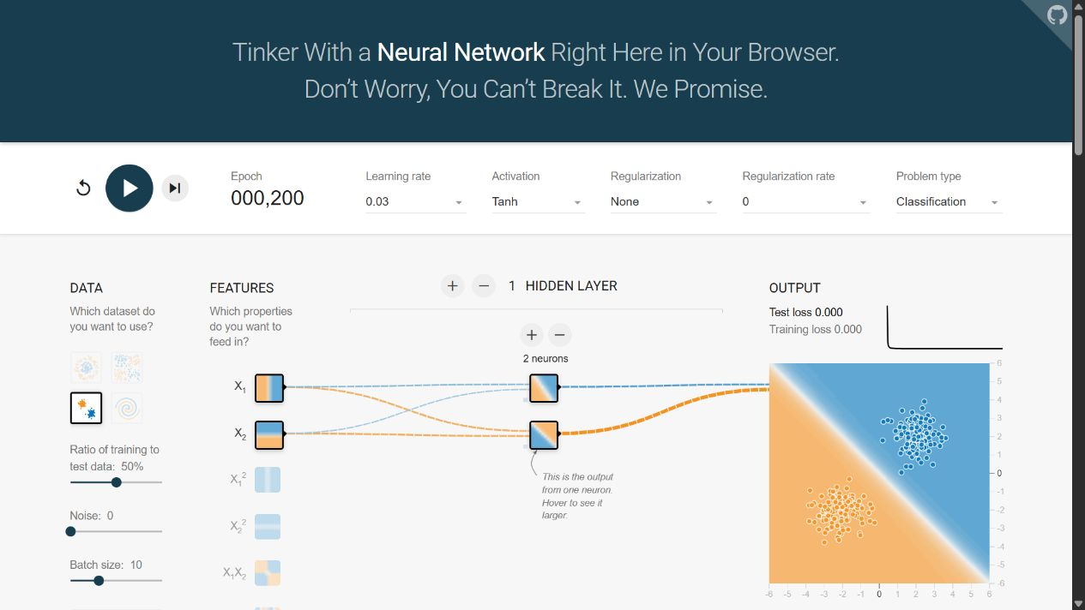
Dataset difficulty affects the fit
2 hidden neurons
9 parameters
Train 0.000
Test 0.000
Displayed values
round to 3 decimals
Run F shown. The same small width struggled with the circle task in run E.
12
Notes:
Run F keeps a two-neuron hidden layer and raw inputs, but changes to Gaussian data with zero noise. At 200 epochs both displayed losses round to 0.000. The classes are separated by a near straight boundary. E and F demonstrate that a small architecture can work well on an easier geometry while struggling with a circle. The seed changes with the dataset. A rounded zero is not proof of exactly zero error, nor evidence that this architecture generalizes to other datasets. Screenshot from actual run F.
Sources
TensorFlow Playground
https://playground.tensorflow.org/
TensorFlow Playground source Training loop and output activation
https://github.com/tensorflow/playground/blob/master/src/playground.ts

Slide 13
Interpreting the experiments
Same epoch budget, different fits
Each run completed 200 epochs. The training budget alone did not determine performance.
Parameter counts range from 3 to 25. Feature choice changes what those parameters can express.
Browser interaction time includes display overhead. These runs compare epochs and complexity rather than measured compute speed.
Repeated seeds and controlled initialization would strengthen a future comparison.
13
Notes:
Training time can mean wall-clock time or the number of optimization passes. This exploration controls epoch budget and compares network parameter counts as a complexity indicator. It does not benchmark elapsed training time because browser rendering and automated step interactions add overhead. All runs reached 200 epochs, but loss values differed. A stronger future evaluation would fix data and initialization deliberately, repeat seeds, compare learning curves and wall-clock compute, and hold back a final untouched evaluation set. Test data here serve exploratory feedback, so these losses should not be represented as final unbiased performance estimates.
Sources
TensorFlow Playground
https://playground.tensorflow.org/
TensorFlow Playground source Training loop and output activation
https://github.com/tensorflow/playground/blob/master/src/playground.ts

Slide 14
References
TensorFlow Playground
https://playground.tensorflow.org/
Google ML Crash Course Neural network nodes and hidden layers
https://developers.google.com/machine-learning/crash-course/neural-networks/nodes-hidden-layers
Google ML Crash Course Training using backpropagation
https://developers.google.com/machine-learning/crash-course/neural-networks/backpropagation
TensorFlow Playground source Training loop and output activation
https://github.com/tensorflow/playground/blob/master/src/playground.ts
TensorFlow Playground source Neurons loss and weight updates
https://github.com/tensorflow/playground/blob/master/src/nn.ts
Keras SGD optimizer
https://keras.io/api/optimizers/sgd/
Keras Adam optimizer
https://keras.io/api/optimizers/adam/
14
Notes:
Sources consulted for concepts and the implementation details. Playground screenshots are original captures of the actual experiments. Source links and recorded configuration URLs are also provided on the portfolio page.
Sources

Slide 15
Summary
A diagram connects the components
Layers organize neurons. Weights and biases shape each response. Activations enable nonlinear hidden transformations.
Loss measures the mismatch. Backpropagation computes gradients, and optimization updates the parameters.
The observed fits depend on the task, the input representation, and the network capacity.
Visual inspection and held-out loss together make model behavior easier to explain.
15
Notes:
Visualizing a network connects individual computations with the overall decision boundary. Layers organize computations. Neurons combine weighted inputs and bias then apply an activation. Loss supplies the fitting objective and optimization changes the parameters. The experiments show the roles of nonlinear hidden units, appropriate input features, data noise, and network capacity. The artifact focuses on neural network mechanisms and evidence, complementing the first portfolio artifact which compares algorithm families. ChatGPT/Codex assisted with research synthesis, operating the Playground, generating the presentation and implementing the portfolio page.
Sources
TensorFlow Playground
https://playground.tensorflow.org/
Google ML Crash Course Neural network nodes and hidden layers
https://developers.google.com/machine-learning/crash-course/neural-networks/nodes-hidden-layers
Google ML Crash Course Training using backpropagation
https://developers.google.com/machine-learning/crash-course/neural-networks/backpropagation

