Slide 1
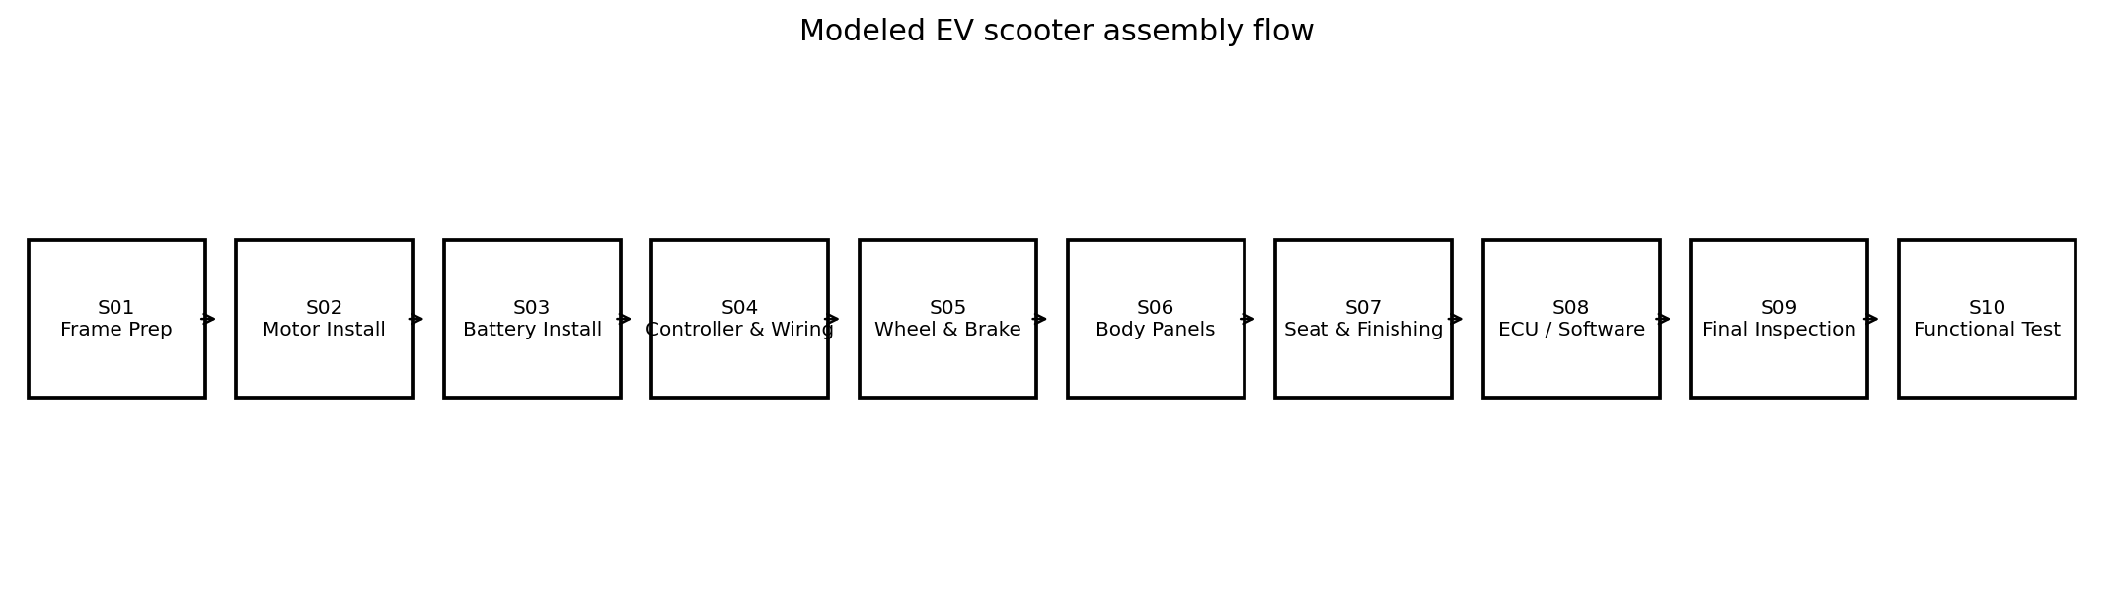
EV Scooter Assembly Line Optimization
Lean Manufacturing + OEE + Bottleneck Analysis
30 production days | 600 station-shift records
Synthetic / simulated data - not Ather factory data

Slide 2
Executive summary
Final plan attainment
74.6%
Good yield
97.1%
S10 OEE
69.0%
S05 CT
117.5s
Takt
100.8s
S05 Wheel & Brake is the primary cycle-time constraint (117.5s vs 100.8s takt).
Material shortage = 20.8% of unplanned downtime; fitment/alignment = 31.6% of defects.
Improvement sequence: S05 cycle time/tooling -> S04 wiring/poka-yoke -> visual daily control.

Slide 3
Current-state process flow
Use cycle time vs takt to identify constraints.
Use OEE to explain availability, performance and quality losses.
Use Pareto to focus improvement effort on the largest recurring loss families.

Slide 4
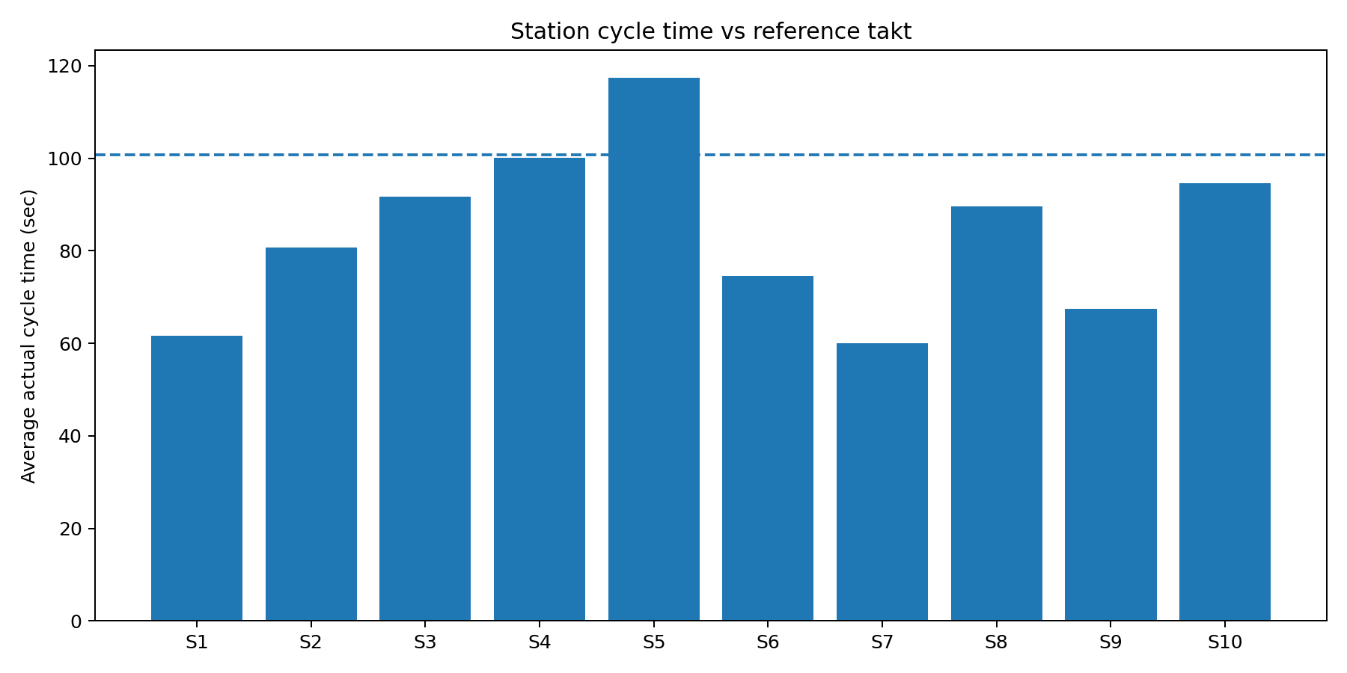
Line balance: S05 is above takt
S05 average actual CT = 117.5s.
Gap vs takt = +16.7s (+16.6%).
S04 is the next tight constraint at 100.1s.
Bottleneck selection is based on the cycle-time constraint, not simply the lowest OEE.

Slide 5
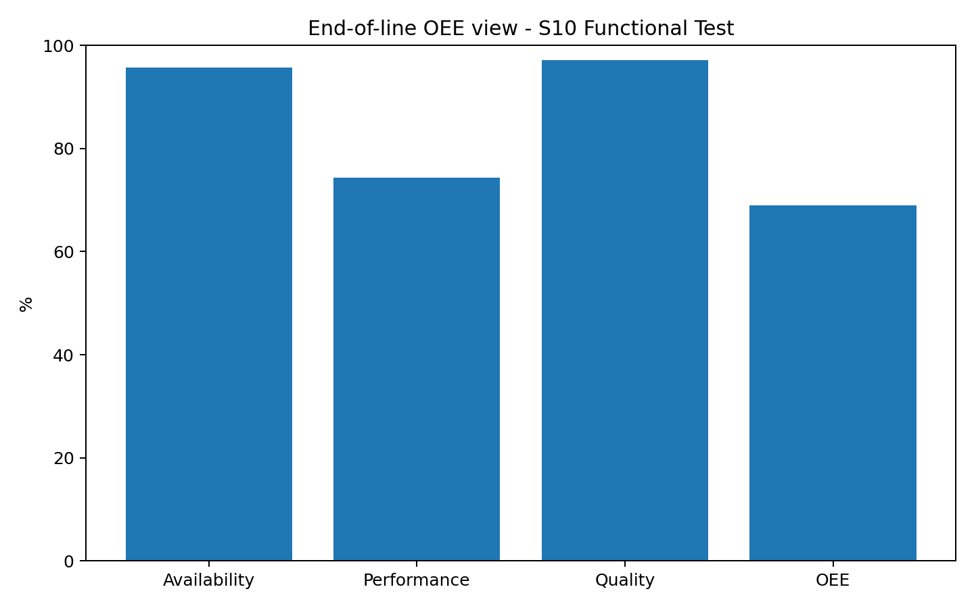
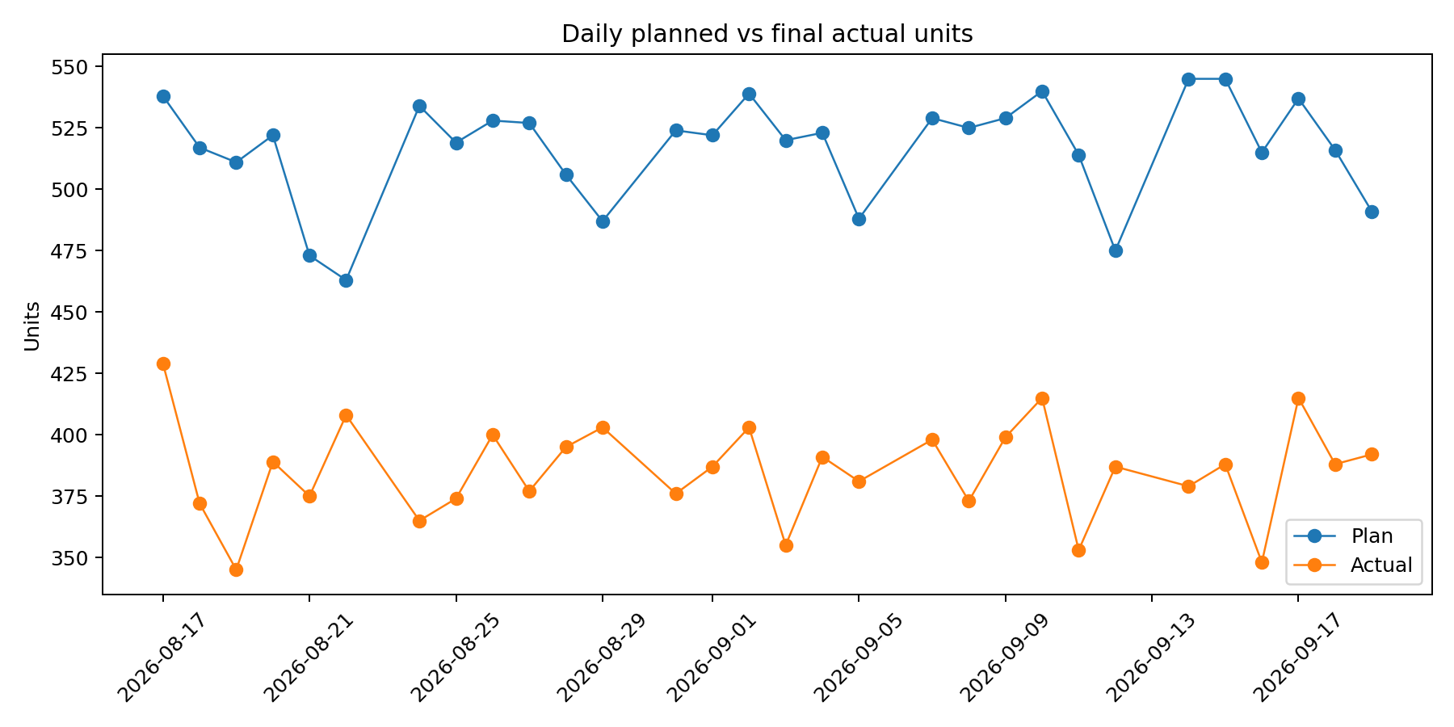
OEE and throughput
Final actual units = 11,560 vs 15,502 planned.
Good units = 11,225; yield remains 97.1%.
Performance is the largest OEE component drag at S10.

Slide 6
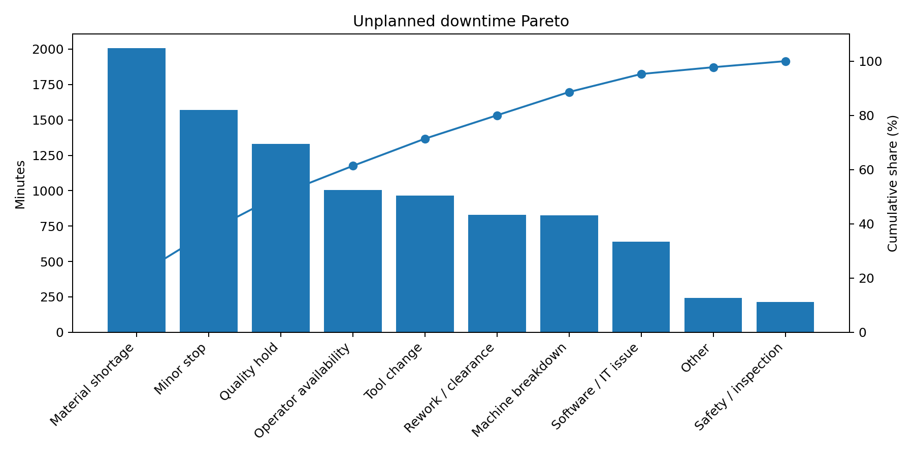
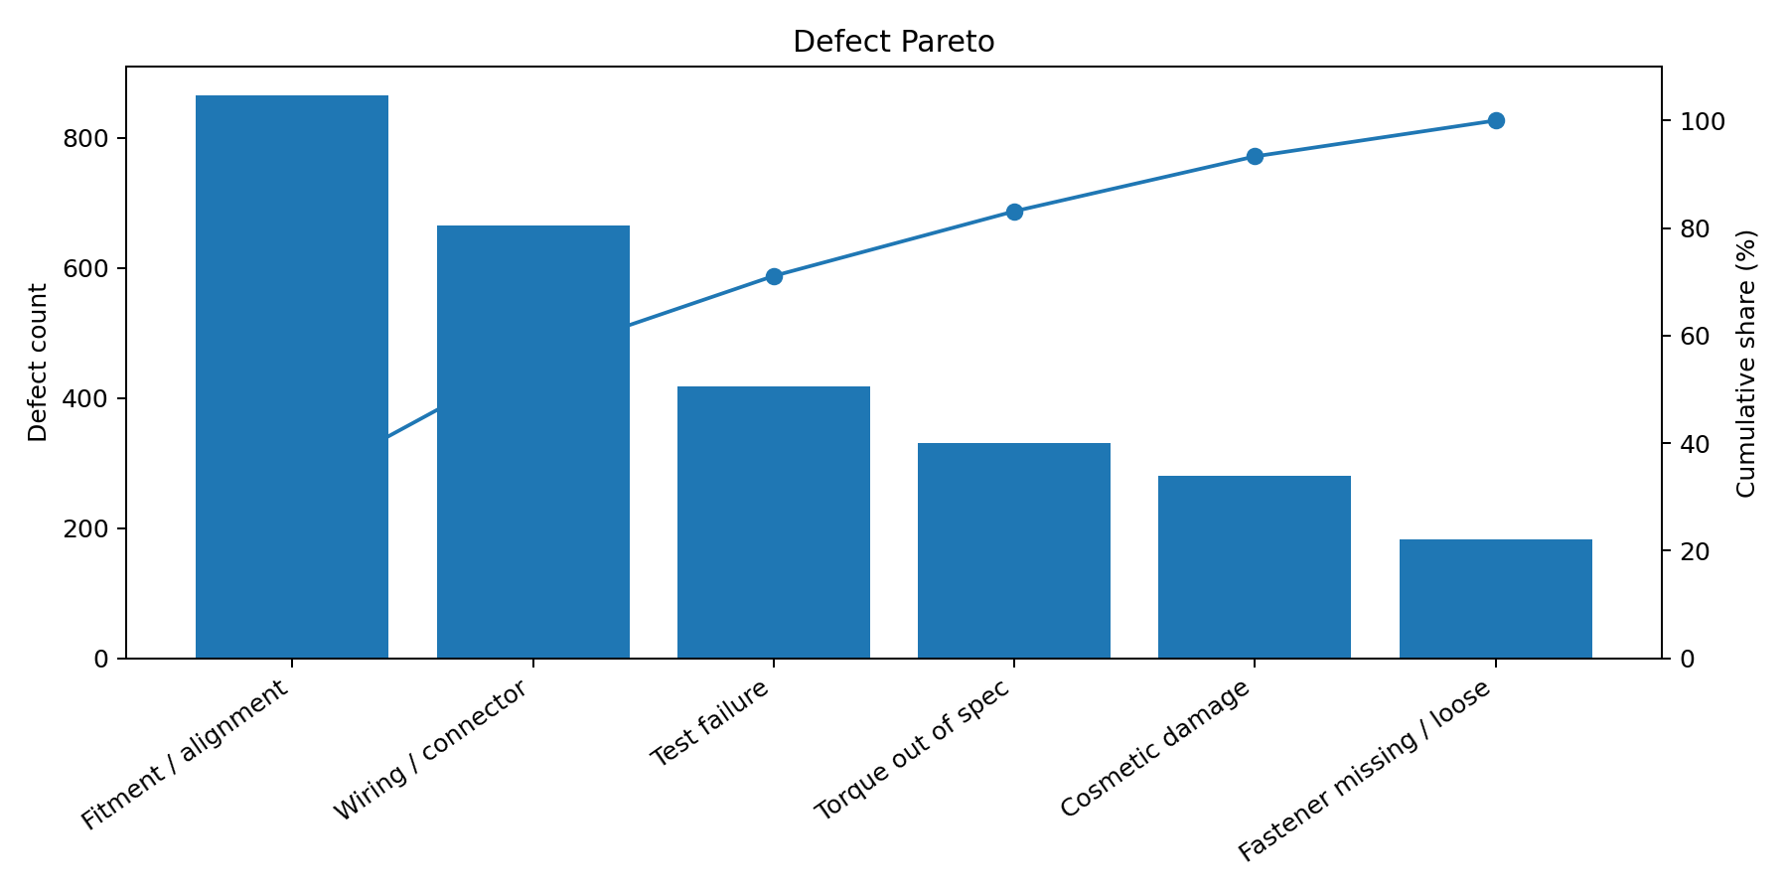
Loss analysis: focus on the largest recurring buckets

Slide 7
Root cause + PFMEA logic
Problem: S05 CT is above takt.
Hypothesis: tooling / fixture variation + fitment adjustment + tool-change time add critical-path work.
Controls: locator / poka-yoke, torque verification, quick-change tooling, first-piece checks.
Escalation: review CT and defects daily; update PFMEA/control plan after pilot evidence.

Slide 8
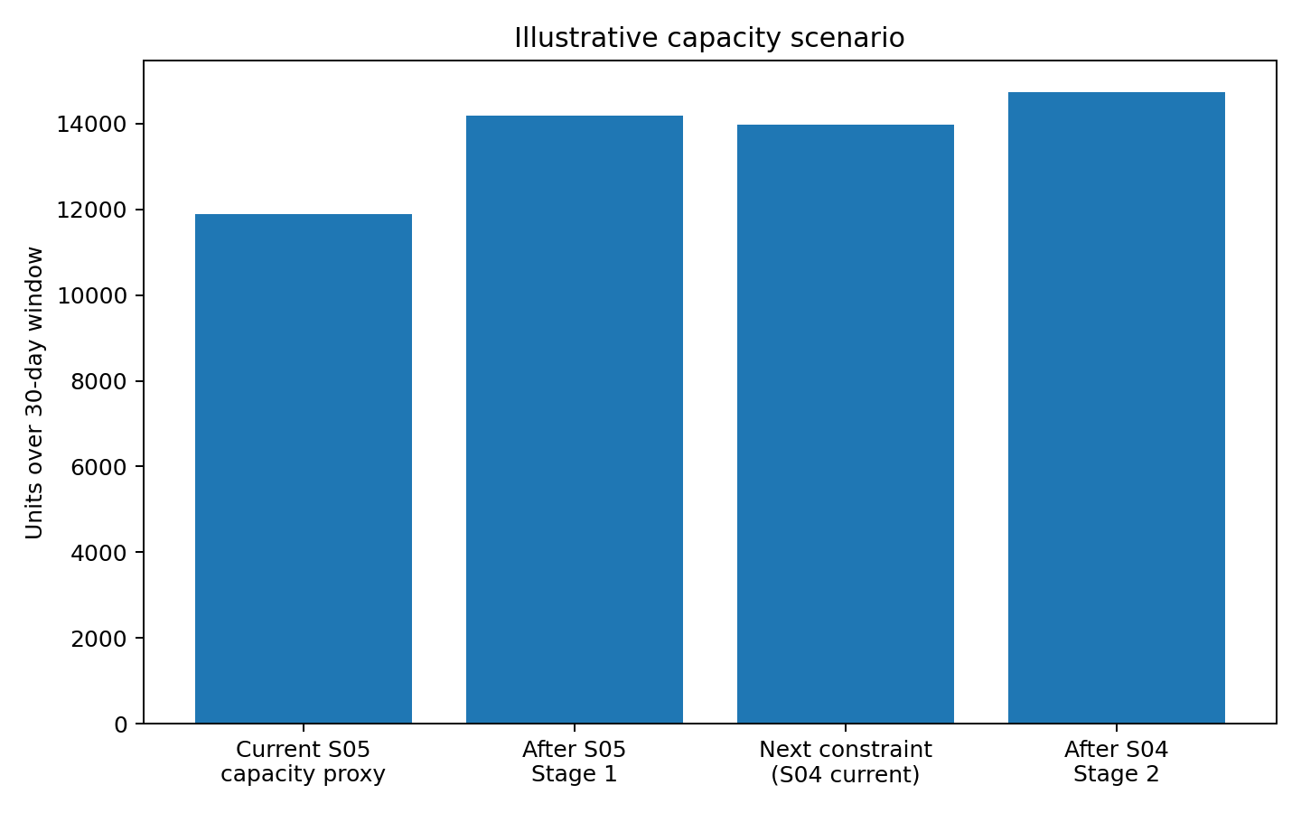
Future-state improvement model
Stage 1 target: S05 CT 117.5s -> 99.5s and unplanned downtime -25%.
S05 capacity proxy rises to ~14,182 units; S04 becomes next constraint at ~13,980.
Stage 2 target: move S04 toward 95s and attack wiring defects.
This is an illustrative capacity scenario, not a production forecast.

Slide 9
Implementation roadmap
Week 1 - Gemba + time study: element-level CT, spaghetti map, defect confirmation.
Week 2 - Quick wins: fixture locator, torque sequence, kitting, quick-change.
Week 3 - Pilot: verify CT distribution, OEE, defects and rework; update PFMEA/control plan.
Week 4 - Control: visual dashboard, escalation rule, review next constraint.

Slide 10
Interview-ready takeaway
“I mapped the line, quantified the losses, identified the cycle-time bottleneck, linked it to quality/tooling hypotheses, and designed a pilot-driven Lean improvement system.”
Demonstrates Lean thinking
Demonstrates data / Excel / visualization skills
Demonstrates manufacturing program execution and root-cause thinking

