Slide 1
13
Exception Handling

Slide 2
It is common sense to take a method and try it. If it fails, admit it frankly and try another. But above all, try something.
  Franklin Delano Roosevelt
O! throw away the worser part of it, And live the purer with the other half.
  William Shakespeare
If they’re running and they don’t look where they’re going I have to come out from somewhere and catch them.
  Jerome David Salinger
O infinite virtue! com’st thou smiling from the world’s great snare uncaught?
  William Shakespeare

Slide 3
OBJECTIVES
In this chapter you will learn:
How exception and error handling works.
To use try, throw and catch to detect, indicate and handle exceptions, respectively.
To use the finally block to release resources.
How stack unwinding enables exceptions not caught in one scope to be caught in another scope.
How stack traces help in debugging.
How exceptions are arranged in an exception class hierarchy.
To declare new exception classes.
To create chained exceptions that maintain complete stack trace information.

Slide 4
13.1 Introduction
13.2 Exception-Handling Overview
13.3 Example: Divide By Zero Without Exception Handling
13.4 Example: Handling ArithmeticExceptions and InputMismatchExceptions
13.5 When to Use Exception Handling
13.6 Java Exception Hierarchy
13.7 finally block
13.8 Stack Unwinding
13.9 printStackTrace, getStackTrace and getMessage
13.10 Chained Exceptions
13.11 Declaring New Exception Types
13.12 Preconditions and Postconditions
13.13 Assertions
13.14 Wrap-Up

Slide 5
13.1 Introduction
Exception – an indication of a problem that occurs during a program’s execution
Exception handling – resolving exceptions that may occur so program can continue or terminate gracefully
Exception handling enables programmers to create programs that are more robust and fault-tolerant

Slide 6
Error-Prevention Tip 13.1
Exception handling helps improve a program’s fault tolerance.

Slide 7
13.1 Introduction
Examples
  ArrayIndexOutOfBoundsException – an attempt is made to access an element past the end of an array
  ClassCastException – an attempt is made to cast an object that does not have an is-a relationship with the type specified in the cast operator
  NullPointerException – when a null reference is used where an object is expected

Slide 8
13.2 Exception-Handling Overview
Intermixing program logic with error-handling logic can make programs difficult to read, modify, maintain and debug
Exception handling enables programmers to remove error-handling code from the “main line” of the program’s execution
Improves clarity
Enhances modifiability

Slide 9
Performance Tip 13.1
If the potential problems occur infrequently, intermixing program and error-handling logic can degrade a program’s performance, because the program must perform (potentially frequent) tests to determine whether the task executed correctly and the next task can be performed.

Slide 10
13.3 Example: Divide By Zero Without Exception Handling
Thrown exception – an exception that has occurred
Stack trace
  Name of the exception in a descriptive message that indicates the problem
  Complete method-call stack
ArithmeticException – can arise from a number of different problems in arithmetic
Throw point – initial point at which the exception occurs, top row of call chain
InputMismatchException – occurs when Scanner method nextInt receives a string that does not represent a valid integer

Slide 11
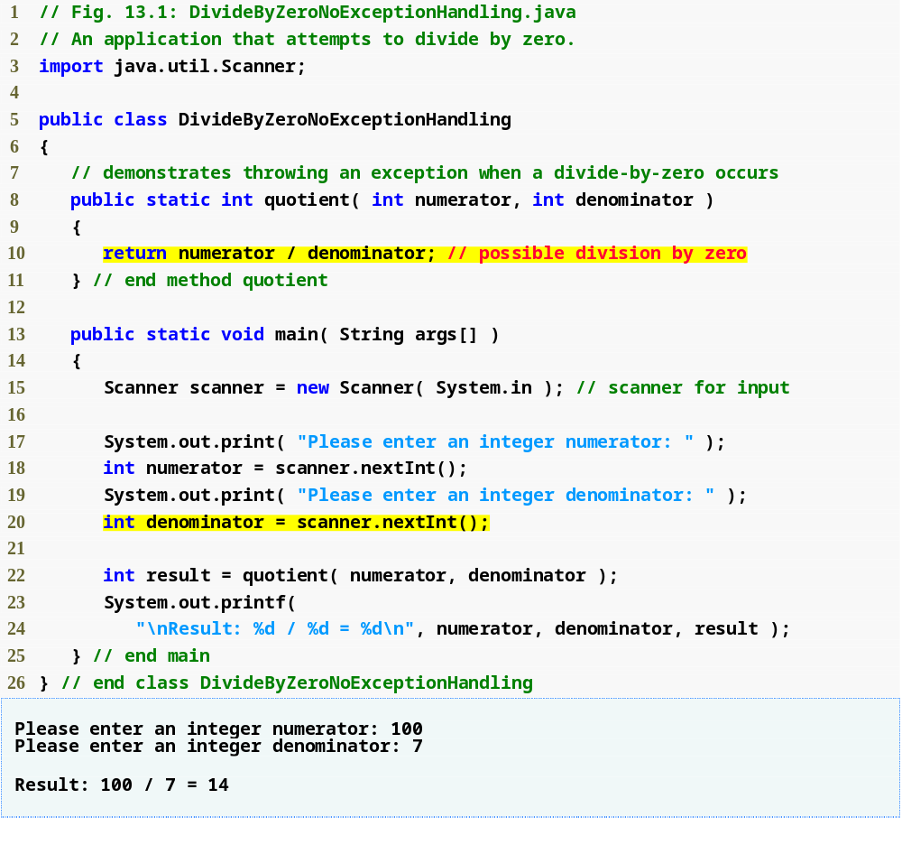
Attempt to divide; denominator may be zero
Read input; exception occurs if input is not a valid integer

Slide 12
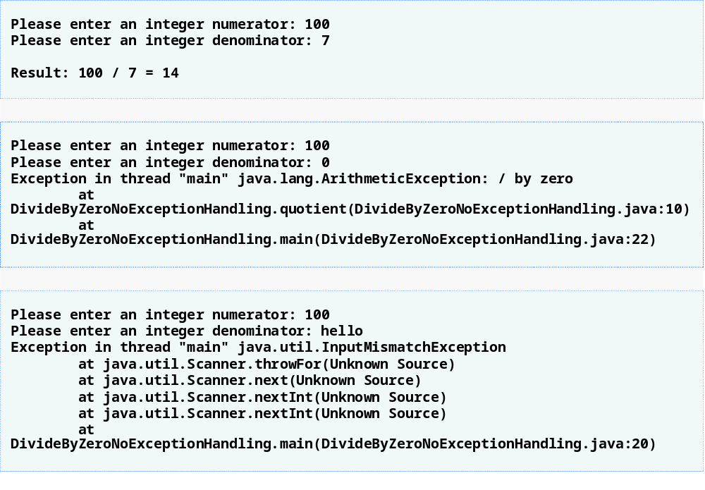

Slide 13
13.4 Example: Handling ArithmeticExceptions and InputMismatchExceptions
With exception handling, the program catches and handles (i.e., deals with) the exception
Next example allows user to try again if invalid input is entered (zero for denominator, or non-integer input)

Slide 14
Enclosing Code in a try Block
try block – encloses code that might throw an exception and the code that should not execute if an exception occurs
Consists of keyword try followed by a block of code enclosed in curly braces

Slide 15
Software Engineering Observation 13.1
Exceptions may surface through explicitly mentioned code in a try block, through calls to other methods, through deeply nested method calls initiated by code in a try block or from the Java Virtual Machine as it executes Java bytecodes.

Slide 16
Catching Exceptions
catch block – catches (i.e., receives) and handles an exception, contains:
  Begins with keyword catch
  Exception parameter in parentheses – exception parameter identifies the exception type and enables catch block to interact with caught exception object
  Block of code in curly braces that executes when exception of proper type occurs
Matching catch block – the type of the exception parameter matches the thrown exception type exactly or is a superclass of it
Uncaught exception – an exception that occurs for which there are no matching catch blocks
  Cause program to terminate if program has only one thread; Otherwise only current thread is terminated and there may be adverse effects to the rest of the program

Slide 17
Common Programming Error 13.1
It is a syntax error to place code between a try block and its corresponding catch blocks.

Slide 18
Common Programming Error 13.2
Each catch block can have only a single parameter—specifying a comma-separated list of exception parameters is a syntax error.

Slide 19
Termination Model of Exception Handling
When an exception occurs:
  try block terminates immediately
  Program control transfers to first matching catch block
After exception is handled:
  Termination model of exception handling – program control does not return to the throw point because the try block has expired; Flow of control proceeds to the first statement after the last catch block
  Resumption model of exception handling – program control resumes just after throw point
try statement – consists of try block and corresponding catch and/or finally blocks

Slide 20
Common Programming Error 13.3
Logic errors can occur if you assume that after an exception is handled, control will return to the first statement after the throw point.

Slide 21
Error-Prevention Tip 13.2
With exception handling, a program can continue executing (rather than terminating) after dealing with a problem. This helps ensure the kind of robust applications that contribute to what is called mission-critical computing or business-critical computing.

Slide 22
Good Programming Practice 13.1
Using an exception parameter name that reflects the parameter’s type promotes clarity by reminding the programmer of the type of exception being handled.

Slide 23
Using the throws Clause
throws clause – specifies the exceptions a method may throws
  Appears after method’s parameter list and before the method’s body
  Contains a comma-separated list of exceptions
  Exceptions can be thrown by statements in method’s body of by methods called in method’s body
  Exceptions can be of types listed in throws clause or subclasses

Slide 24
Error-Prevention Tip 13.3
If you know that a method might throw an exception, include appropriate exception-handling code in your program to make it more robust.

Slide 25
Error-Prevention Tip 13.4
Read the online API documentation for a method before using that method in a program. The documentation specifies the exceptions thrown by the method (if any) and indicates reasons why such exceptions may occur. Then provide for handling those exceptions in your program.

Slide 26
Error-Prevention Tip 13.5
Read the online API documentation for an exception class before writing exception-handling code for that type of exception. The documentation for an exception class typically contains potential reasons that such exceptions occur during program execution.

Slide 27
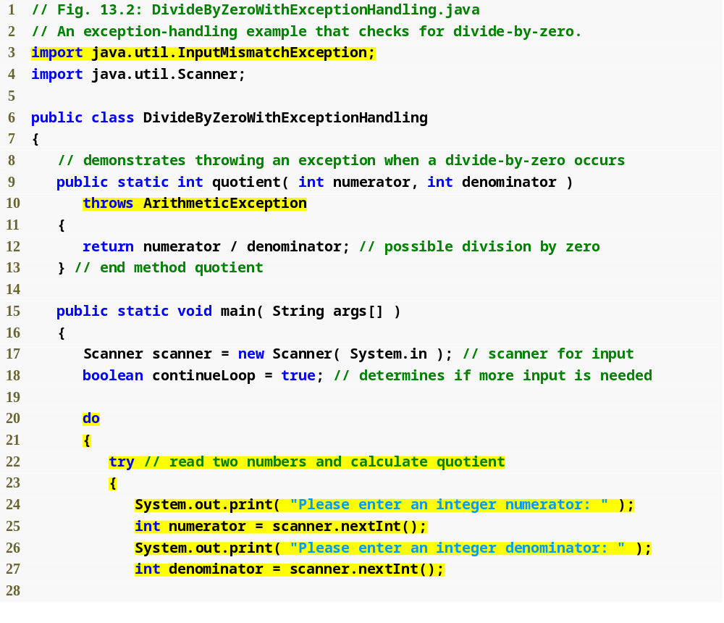
throws clause specifies that method quotient may throw an ArithmeticException
Repetition statement loops until try block completes successfully
try block attempts to read input and perform division
Retrieve input; InputMismatchException thrown if input not valid integers

Slide 28
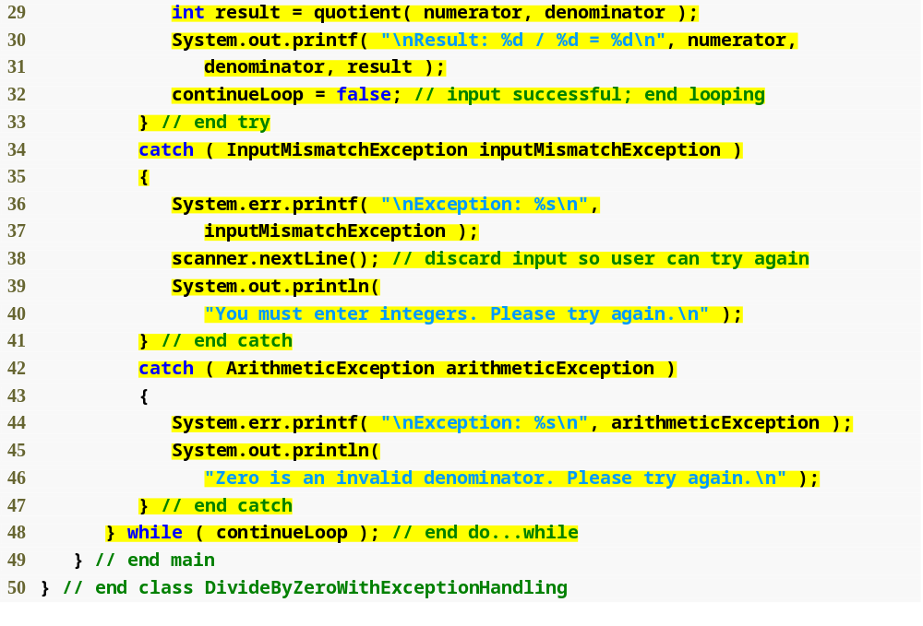
Call method quotient, which may throw ArithmeticException
If we have reached this point, input was valid and denominator was non-zero, so looping can stop
Catching InputMismatchException (user has entered non-integer input)
Exception parameters
Read invalid input but do nothing with it
Notify user of error made
Catching ArithmeticException (user has entered zero for denominator)
If line 32 was never successfully reached, loop continues and user can try again

Slide 29
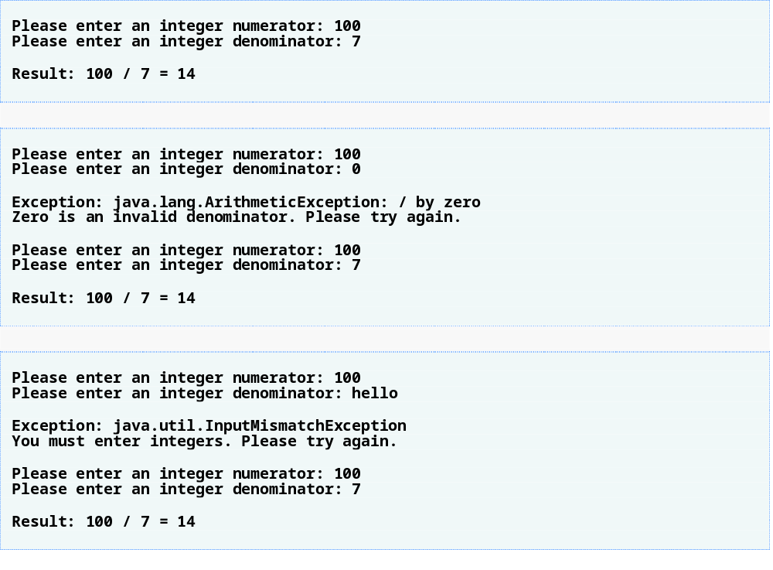

Slide 30
13.5 When to Use Exception Handling
Exception handling designed to process synchronous errors
Synchronous errors – occur when a statement executes
Asynchronous errors – occur in parallel with and independent of the program’s flow of control

Slide 31
Software Engineering Observation 13.2
Incorporate your exception-handling strategy into your system from the design process’s inception. Including effective exception handling after a system has been implemented can be difficult.

Slide 32
Software Engineering Observation 13.3
Exception handling provides a single, uniform technique for processing problems. This helps programmers working on large projects understand each other’s error-processing code.

Slide 33
Software Engineering Observation 13.4
Avoid using exception handling as an alternate form of flow of control. These “additional” exceptions can “get in the way” of genuine error-type exceptions.

Slide 34
Software Engineering Observation 13.5
Exception handling simplifies combining software components and enables them to work together effectively by enabling predefined components to communicate problems to application-specific components, which can then process the problems in an application-specific manner.

Slide 35
13.6 Java Exception Hierarchy
All exceptions inherit either directly or indirectly from class Exception
Exception classes form an inheritance hierarchy that can be extended
Class Throwable, superclass of Exception
  Only Throwable objects can be used with the exception-handling mechanism
  Has two subclasses: Exception and Error
    Class Exception and its subclasses represent exception situations that can occur in a Java program and that can be caught by the application
    Class Error and its subclasses represent abnormal situations that could happen in the JVM – it is usually not possible for a program to recover from Errors

Slide 36
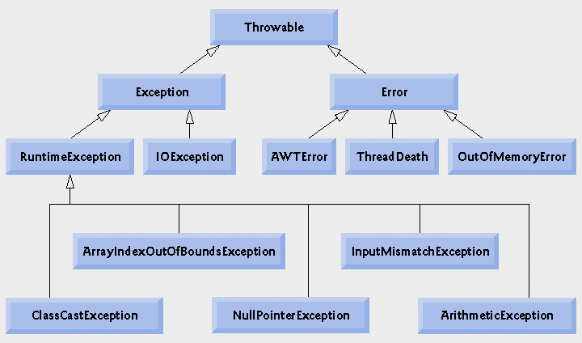
Fig. 13.3 | Portion of class Throwable’s inheritance hierarchy.

Slide 37
13.6 Java Exception Hierarchy
Two categories of exceptions: checked and unchecked
Checked exceptions
  Exceptions that inherit from class Exception but not from RuntimeException
  Compiler enforces a catch-or-declare requirement
  Compiler checks each method call and method declaration to determine whether the method throws checked exceptions. If so, the compiler ensures that the checked exception is caught or is declared in a throws clause. If not caught or declared, compiler error occurs.
Unchecked exceptions
  Inherit from class RuntimeException or class Error
  Compiler does not check code to see if exception is caught or declared
  If an unchecked exception occurs and is not caught, the program terminates or runs with unexpected results
  Can typically be prevented by proper coding

Slide 38
Software Engineering Observation 13.6
Programmers are forced to deal with checked exceptions. This results in more robust code than would be created if programmers were able to simply ignore the exceptions.

Slide 39
Common Programming Error 13.4
A compilation error occurs if a method explicitly attempts to throw a checked exception (or calls another method that throws a checked exception) and that exception is not listed in that method’s throws clause.

Slide 40
Common Programming Error 13.5
If a subclass method overrides a superclass method, it is an error for the subclass method to list more exceptions in its throws clause than the overridden superclass method does. However, a subclass’s throws clause can contain a subset of a superclass’s throws list.

Slide 41
Software Engineering Observation 13.7
If your method calls other methods that explicitly throw checked exceptions, those exceptions must be caught or declared in your method. If an exception can be handled meaningfully in a method, the method should catch the exception rather than declare it.

Slide 42
Software Engineering Observation 13.8
Although the compiler does not enforce the catch-or-declare requirement for unchecked exceptions, provide appropriate exception-handling code when it is known that such exceptions might occur. For example, a program should process the NumberFormatException from Integer method parseInt, even though NumberFormatException (a subclass of RuntimeException) is an unchecked exception type. This makes your programs more robust.

Slide 43
13.6 Java Exception Hierarchy
catch block catches all exceptions of its type and subclasses of its type
If there are multiple catch blocks that match a particular exception type, only the first matching catch block executes
It makes sense to use a catch block of a superclass when all the catch blocks for that class’s subclasses will perform the same functionality

Slide 44
Error-Prevention Tip 13.6
Catching subclass types individually is subject to error if you forget to test for one or more of the subclass types explicitly; catching the superclass guarantees that objects of all subclasses will be caught. Positioning a catch block for the superclass type after all other subclass catch blocks for subclasses of that superclass ensures that all subclass exceptions are eventually caught.

Slide 45
Common Programming Error 13.6
Placing a catch block for a superclass exception type before other catch blocks that catch subclass exception types prevents those blocks from executing, so a compilation error occurs.

Slide 46
13.7 finally block
Programs that obtain certain resources must return them explicitly to avoid resource leaks
finally block
  Consists of finally keyword followed by a block of code enclosed in curly braces
  Optional in a try statement
  If present, is placed after the last catch block
  Executes whether or not an exception is thrown in the corresponding try block or any of its corresponding catch blocks
  Will not execute if the application exits early from a try block via method System.exit
  Typically contains resource-release code

Slide 47
Error-Prevention Tip 13.7
A subtle issue is that Java does not entirely eliminate memory leaks. Java will not garbage collect an object until there are no more references to it. Thus, memory leaks can occur, if programmers erroneously keep references to unwanted objects.

Slide 48
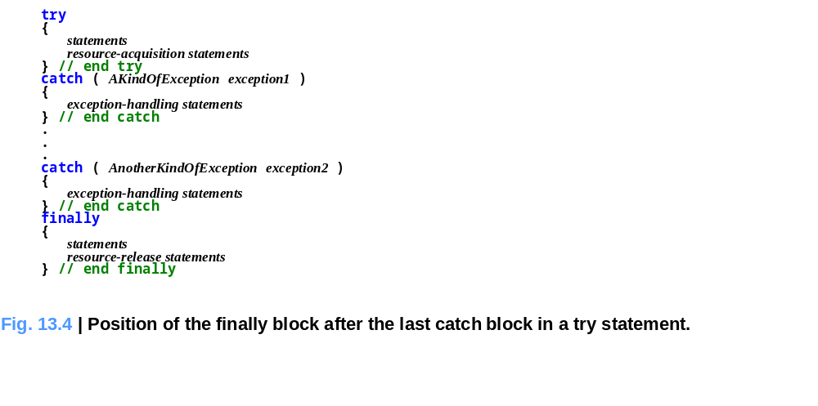
Outline

Slide 49
13.7 finally block
If no exception occurs, catch blocks are skipped and control proceeds to finally block.
After the finally block executes control proceeds to first statement after the finally block.
If exception occurs in the try block, program skips rest of the try block. First matching the catch block executes and control proceeds to the finally block. If exception occurs and there are no matching catch blocks, control proceeds to the finally block. After the finally block executes, the program passes the exception to the next outer the try block.
If catch block throws an exception, the finally block still executes.

Slide 50
Performance Tip 13.2
Always release each resource explicitly and at the earliest possible moment at which it is no longer needed. This makes resources immediately available to be reused by your program or by other programs, thus improving resource utilization.

Slide 51
Error-Prevention Tip 13.8
Because the finally block is guaranteed to execute whether or not an exception occurs in the corresponding try block, this block is an ideal place to release resources acquired in a try block. This is also an effective way to eliminate resource leaks. For example, the finally block should close any files opened in the try block.

Slide 52
13.7 finally block
Standard streams
  System.out – standard output stream
  System.err – standard error stream
System.err can be used to separate error output from regular output
System.err.println and System.out.println display data to the command prompt by default

Slide 53
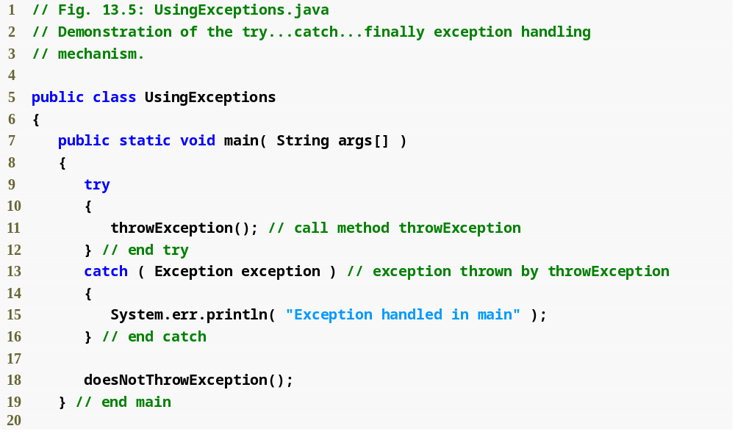
Call method that throws an exception

Slide 54
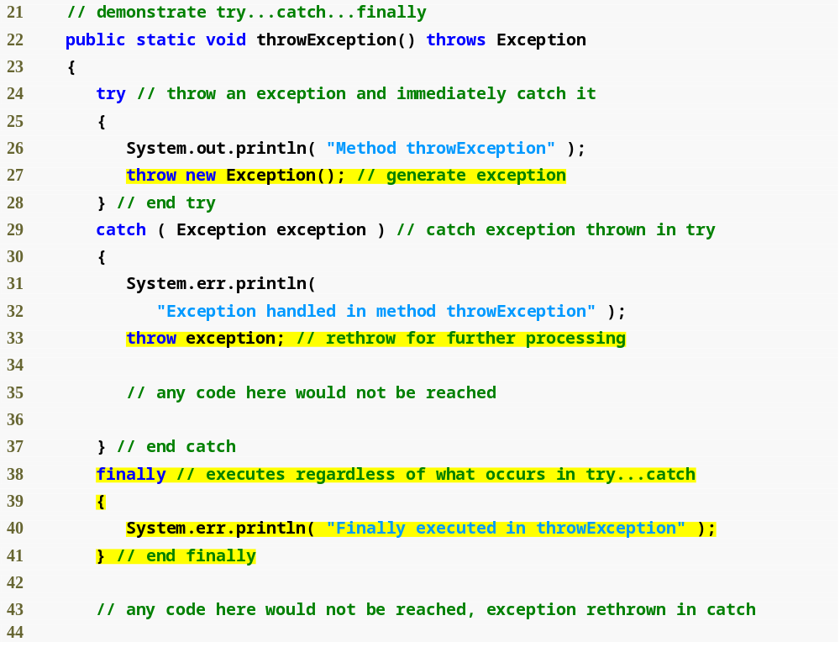
Create new Exception and throw it
Throw previously created Exception
finally block executes even though exception is rethrown in catch block

Slide 55
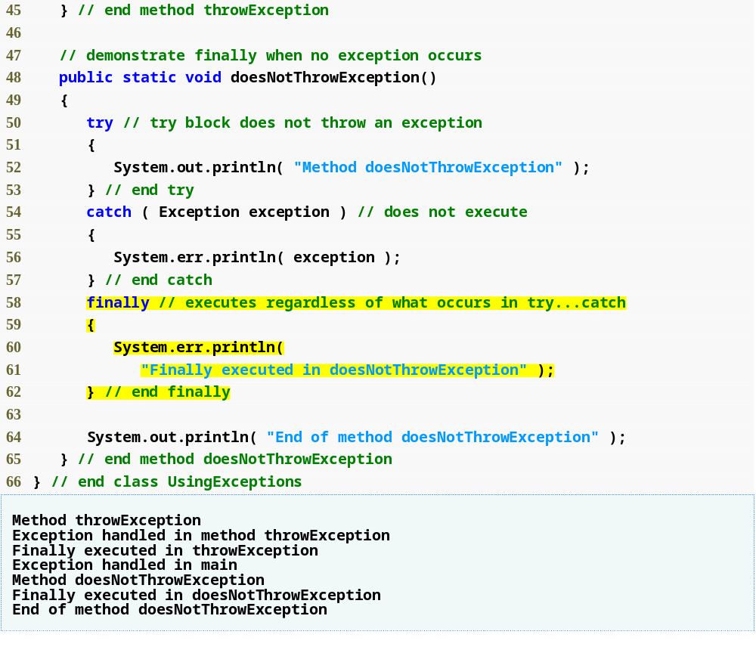
finally block executes even though no exception is thrown

Slide 56
Throwing Exceptions Using the throw Statement
throw statement – used to throw exceptions
Programmers can thrown exceptions themselves from a method if something has gone wrong
throw statement consists of keyword throw followed by the exception object

Slide 57
Software Engineering Observation 13.9
When toString is invoked on any Throwable object, its resulting string includes the descriptive string that was supplied to the constructor, or simply the class name if no string was supplied.

Slide 58
Software Engineering Observation 13.10
An object can be thrown without containing information about the problem that occurred. In this case, simple knowledge that an exception of a particular type occurred may provide sufficient information for the handler to process the problem correctly.

Slide 59
Software Engineering Observation 13.11
Exceptions can be thrown from constructors. When an error is detected in a constructor, an exception should be thrown rather than creating an improperly formed object.

Slide 60
Rethrowing Exceptions
Exceptions are rethrown when a catch block decides either that it cannot process the exception or that it can only partially process it
Exception is deferred to outer try statement
Exception is rethrown by using keyword throw followed by a reference to the exception object

Slide 61
Common Programming Error 13.7
If an exception has not been caught when control enters a finally block and the finally block throws an exception that is not caught in the finally block, the first exception will be lost and the exception from the finally block will be returned to the calling method.

Slide 62
Error-Prevention Tip 13.9
Avoid placing code that can throw an exception in a finally block. If such code is required, enclose the code in a try statement within the finally block.

Slide 63
Common Programming Error 13.8
Assuming that an exception thrown from a catch block will be processed by that catch block or any other catch block associated with the same try statement can lead to logic errors.

Slide 64
Good Programming Practice 13.2
Java’s exception-handling mechanism is intended to remove error-processing code from the main line of a program’s code to improve program clarity. Do not place try... catch finally... around every statement that may throw an exception. This makes programs difficult to read. Rather, place one try block around a significant portion of your code, follow that try block with catch blocks that handle each possible exception and follow the catch blocks with a single finally block (if one is required).

Slide 65
13.8 Stack Unwinding
Stack unwinding – When an exception is thrown but not caught in a particular scope, the method-call stack is “unwound,” and an attempt is made to catch the exception in the next outer try block.
When unwinding occurs:
  The method in which the exception was not caught terminates
  All local variables in that method go out of scope
  Control returns to the statement that originally invoked the method – if a try block encloses the method call, an attempt is made to catch the exception.

Slide 66
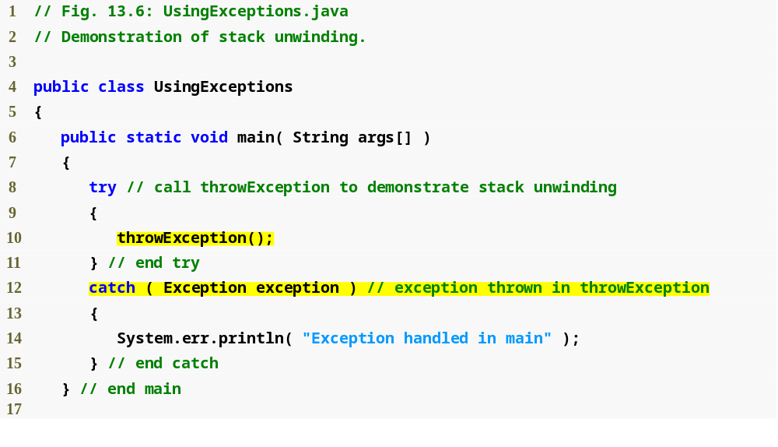
Call method that throws an exception
Catch exception that may occur in the above try block, including the call to method throwException

Slide 67
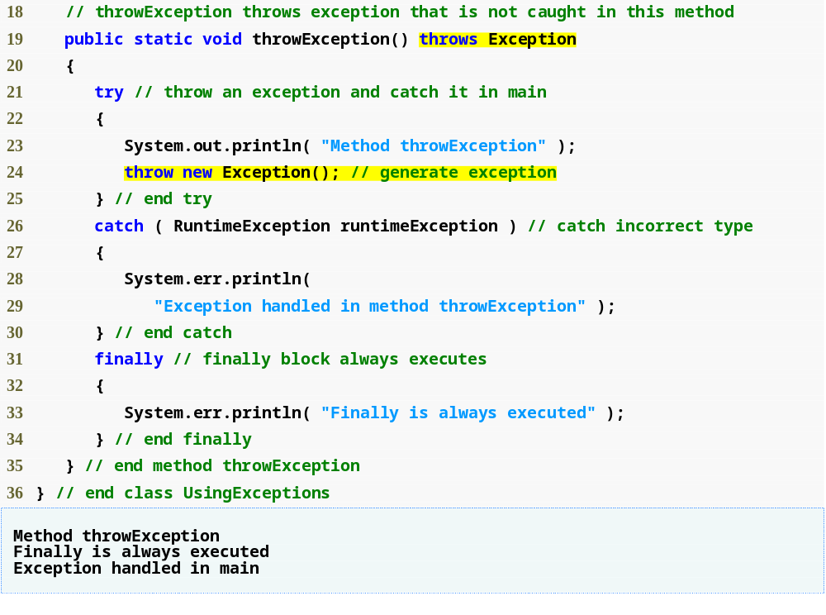
Method throws exception
Throw new exception; Exception not caught in current try block, so handled in outer try block
finally block executes before control returns to outer try block

Slide 68
13.9 printStackTrace, getStackTrace and getMessage
Methods in class Throwable retrieve more information about an exception
  printStackTrace – outputs stack trace to standard error stream
  getStackTrace – retrieves stack trace information as an array of StackTraceElement objects; enables custom processing of the exception information
  getMessage – returns the descriptive string stored in an exception

Slide 69
Error-Prevention Tip 13.10
An exception that is not caught in an application causes Java’s default exception handler to run. This displays the name of the exception, a descriptive message that indicates the problem that occurred and a complete execution stack trace. In an application with a single thread of execution, the application terminates. In an application with multiple threads, the thread that caused the exception terminates.

Slide 70
Error-Prevention Tip 13.11
Throwable method toString (inherited by all Throwable subclasses) returns a string containing the name of the exception’s class and a descriptive message.

Slide 71
13.9 printStackTrace, getStackTrace and getMessage
StackTraceElement methods
  getClassName
  getFileName
  getLineNumber
  getMethodName
Stack trace information follows pattern – className.methodName(fileName:lineNumber)

Slide 72
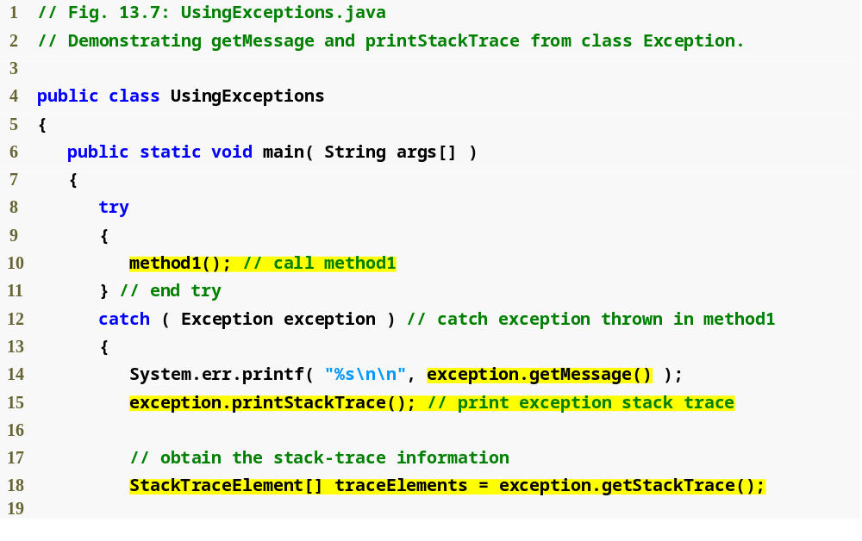
Call to method1, method1 calls method2, method2 calls method3 and method3 throws a new Exception
Display descriptive string of exception thrown in method3
Retrieve stack information as an array of StackTraceElement objects
Display stack trace for exception thrown in method3

Slide 73
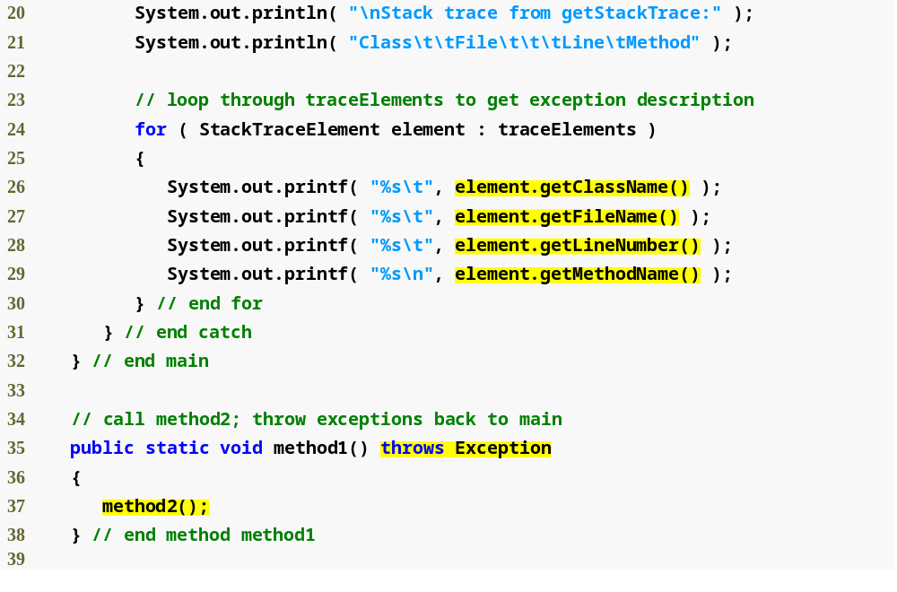
Retrieve class name for current StackTraceElement
Retrieve file name for current StackTraceElement
Retrieve line number for current StackTraceElement
Retrieve method name for current StackTraceElement
method1 calls method2, method2 calls method3 and method3 throws an Exception

Slide 74
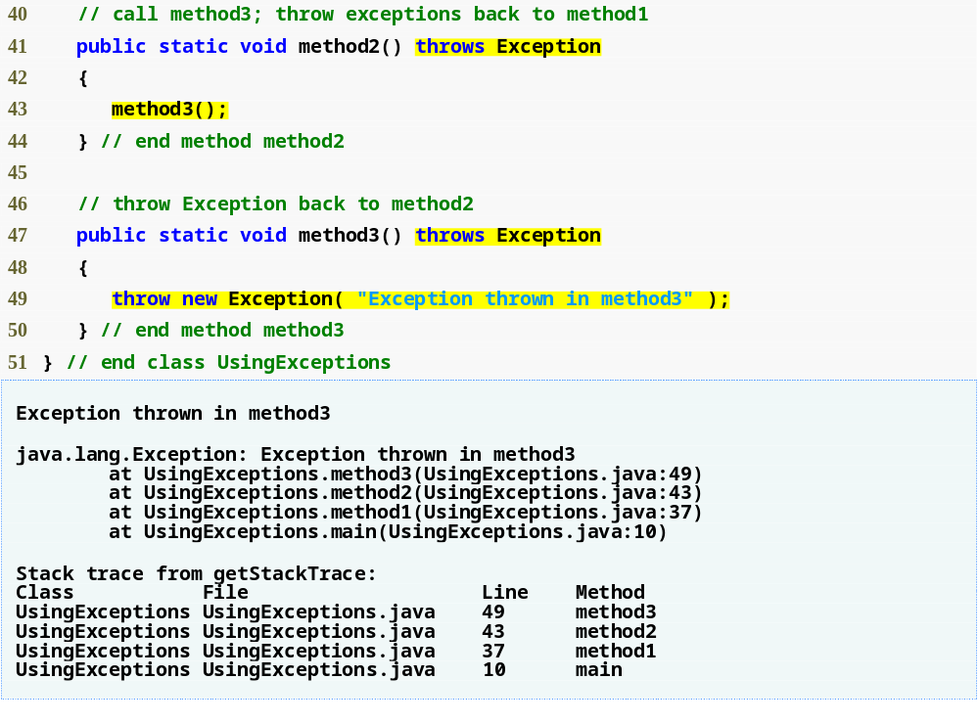
method2 calls method3, which throws an Exception
Exception created and thrown

Slide 75
Software Engineering Observation 13.12
Never ignore an exception you catch. At least use printStackTrace to output an error message. This will inform users that a problem exists, so that they can take appropriate actions.

Slide 76
13.10 Chained Exceptions
Chained exceptions enable an exception object to maintain the complete stack-trace information when an exception is thrown from a catch block
Users can retrieve information about original exception
Stack trace from a chained exception displays how many chained exceptions remain

Slide 77
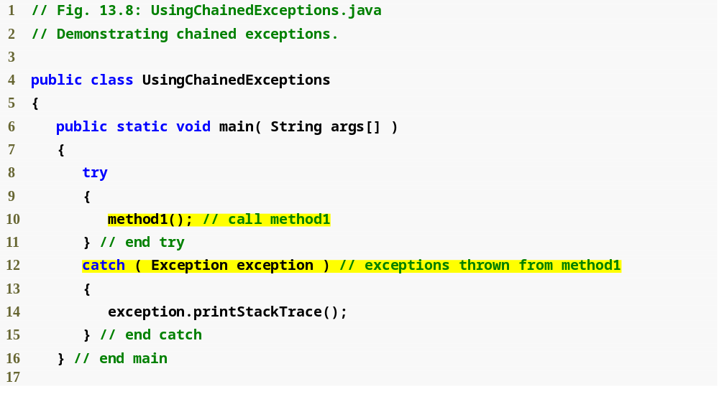
Catch exception from method1 as well as any associated chained exceptions

Slide 78
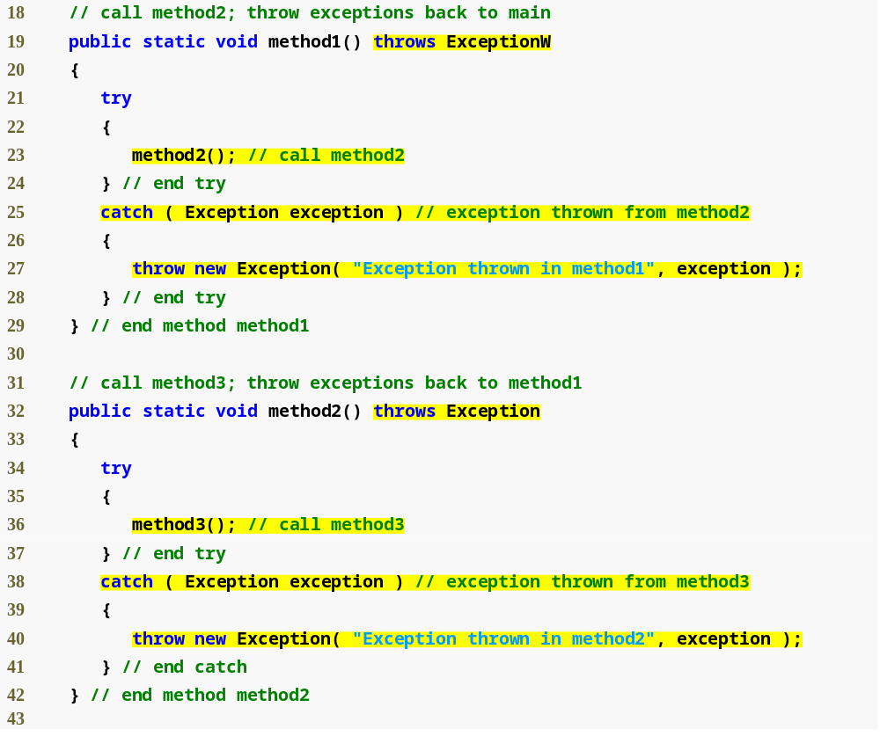
Catch exception from method2, throw new exception to be chained with earlier exceptions
Catch exception from method3, throw new exception to be chained with earlier exceptions

Slide 79
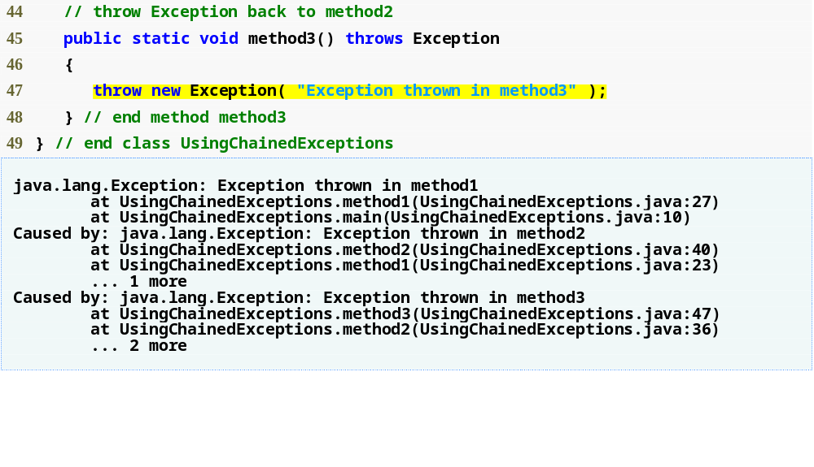
Original thrown exception

Slide 80
13.11 Declaring New Exception Types
You can declare your own exception classes that are specific to the problems that can occur when another program uses your reusable classes
New exception class must extend an existing exception class
Typically contains only two constructors
  One takes no arguments, passes a default exception messages to the superclass constructor
  One that receives a customized exception message as a string and passes it to the superclass constructor

Slide 81
Software Engineering Observation 13.13
If possible, indicate exceptions from your methods by using existing exception classes, rather than creating new exception classes. The Java API contains many exception classes that might be suitable for the type of problem your method needs to indicate.

Slide 82
Good Programming Practice 13.3
Associating each type of serious execution-time malfunction with an appropriately named Exception class improves program clarity.

Slide 83
Software Engineering Observation 13.14
When defining your own exception type, study the existing exception classes in the Java API and try to extend a related exception class. For example, if you are creating a new class to represent when a method attempts a division by zero, you might extend class ArithmeticException because division by zero occurs during arithmetic. If the existing classes are not appropriate superclasses for your new exception class, decide whether your new class should be a checked or an unchecked exception class. (cont…)

Slide 84
Software Engineering Observation 13.14
The new exception class should be a checked exception (i.e., extend Exception but not RuntimeException) if possible clients should be required to handle the exception. The client application should be able to reasonably recover from such an exception. The new exception class should extend RuntimeException if the client code should be able to ignore the exception (i.e., the exception is an unchecked exception).

Slide 85
Good Programming Practice 13.4
By convention, all exception-class names should end with the word Exception.

Slide 86
13.12 Preconditions and Postconditions
Preconditions and postconditions are the states before and after a method’s execution
Used to facilitate debugging and improve design
You should state the preconditions and postconditions in a comment before the method declaration

Slide 87
13.12 Preconditions and Postconditions
Preconditions
  Condition that must be true when the method is invoked
  Describe method parameters and any other expectations the method has about the current state of a program
  If preconditions not met, method’s behavior is undefined
Postconditions
  Condition that is true after the method successfully returns
  Describe the return value and any other side-effects the method may have
  When calling a method, you may assume that a method fulfills all of its postconditions

Slide 88
13.13 Assertions
Assertions are conditions that should be true at a particular point in a method
Help ensure a program’s validity by catching potential bugs
Preconditions and Postconditions are two kinds of assertions
Assertions can be stated as comments or assertions can be validated programmatically using the assert statement

Slide 89
13.13 Assertions
assert statement
  Evaluates a boolean expression and determines whether it is true or false
  Two forms
    assert expression; -- AssertionError is thrown if expression is false
    assert expression1 : expression2; -- AssertionError is thrown if expression1 is false, expression2 is error message
  Used to verify intermediate states to ensure code is working correctly
  Used to implement preconditions and postconditions programmatically
By default, assertions are disabled
Assertions can be enabled with the –ea command-line option

Slide 90
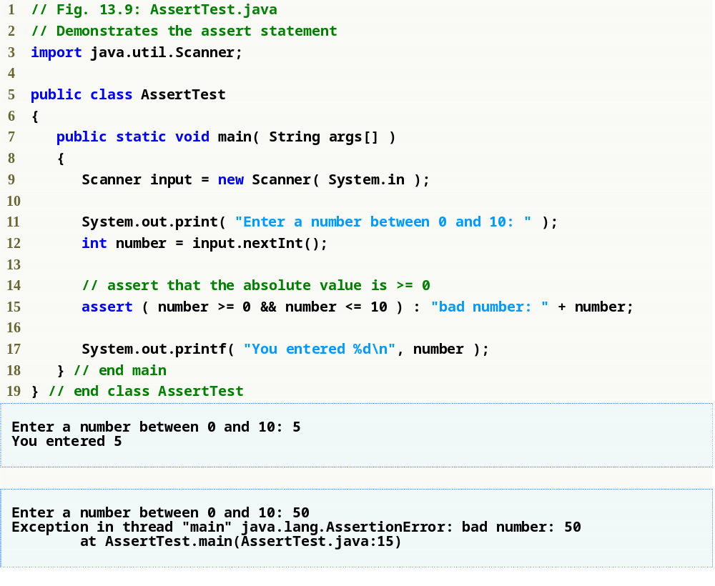
Message to be displayed with AssertionError
assert statement
If number is less than 0 or greater than 10, AssertionError occurs

