Slide 1
18
Generics

Slide 2
Every man of genius sees the world at a different angle from his fellows.
  Havelock Ellis
…our special individuality, as distinguished from our generic humanity.
  Oliver Wendell Holmes, Sr.
Born under one law, to another bound.
  Lord Brooke
You deal in the raw material of opinion, and, if my convictions have any validity, opinion ultimately governs the world.
  Woodrow Wilson

Slide 3
OBJECTIVES
In this chapter you will learn:
To create generic methods that perform identical tasks on arguments of different types.
To create a generic Stack class that can be used to store objects of any class or interface type.
To understand how to overload generic methods with non-generic methods or with other generic methods.
To understand raw types and how they help achieve backwards compatibility.
To use wildcards when precise type information about a parameter is not required in the method body.
The relationship between generics and inheritance.

Slide 4
18.1 Introduction
18.2 Motivation for Generic Methods
18.3 Generic Methods: Implementation and Compile-Time
Translation
18.4 Additional Compile-Time Translation Issues:
18.5 Overloading Generic Methods
18.6 Generic Classes
18.7 Raw Types
18.8 Wildcards in Methods That Accept Type Parameters
18.9 Generics and Inheritance: Notes
18.10 Wrap-Up
18.11 Internet and Web Resources

Slide 5
18.1 Introduction
Generics
  New feature of J2SE 5.0
  Provide compile-time type safety
    Catch invalid types at compile time
  Generic methods
    A single method declaration
    A set of related methods
  Generic classes
    A single class declaration
    A set of related clases

Slide 6
Software Engineering Observation 18.1
Generic methods and classes are among Java’s most powerful capabilities for software reuse with compile-time type safety.

Slide 7
18.2 Motivation for Generic Methods
Overloaded methods
  Perform similar operations on different types of data
  Overloaded printArray methods
    Integer array
    Double array
    Character array
  Only reference types can be used with generic methods and classes

Slide 8
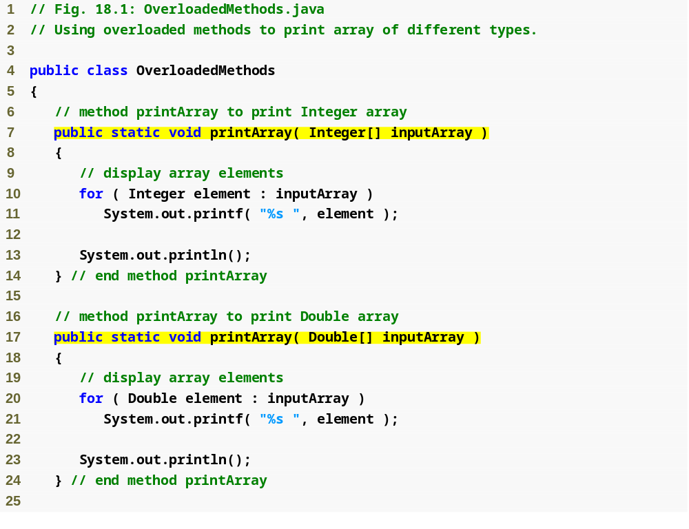
Method printArray accepts an array of Integer objects
Method printArray accepts an array of Double objects

Slide 9
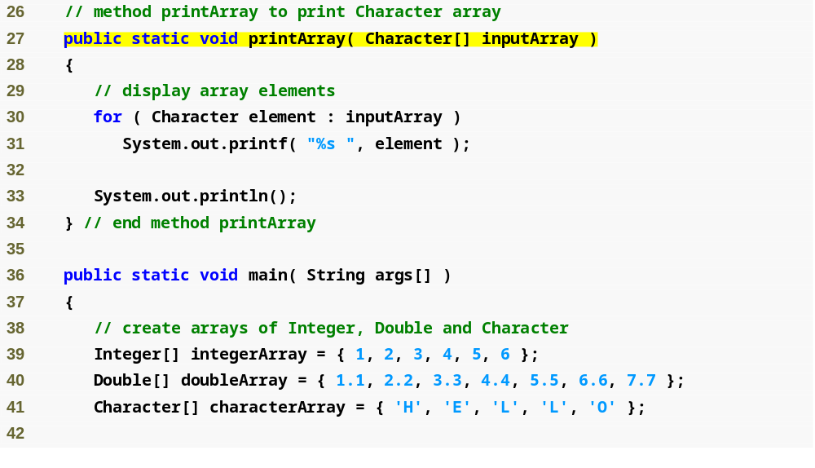
Method printArray accepts an array of Character objects

Slide 10
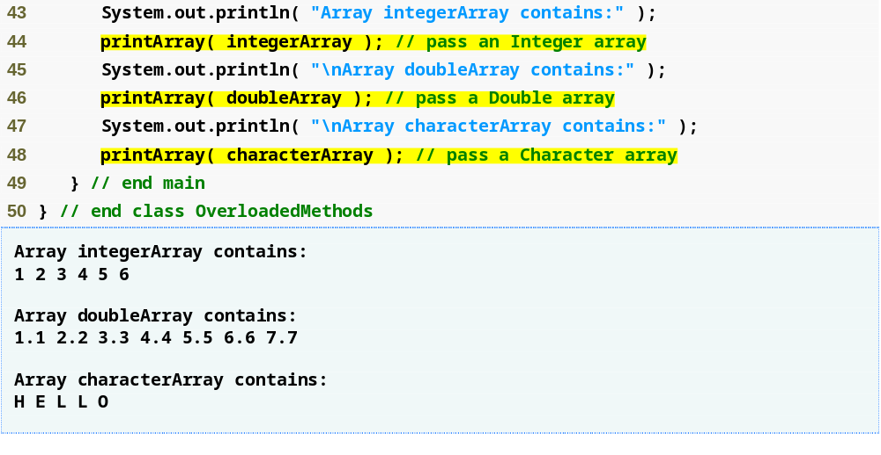
At compile time, the compiler determines argument integerArray’s type (i.e., Integer[]), attempts to locate a method named printArray that specifies a single Integer[] parameter (lines 7-14)
At compile time, the compiler determines argument doubleArray’s type (i.e., Double[]), attempts to locate a method named printArray that specifies a single Double[] parameter (lines 17-24)
At compile time, the compiler determines argument characterArray’s type (i.e., Character[]), attempts to locate a method named printArray that specifies a single Character[] parameter (lines 27-34)

Slide 11
18.2 Motivation for Generic Methods (Cont.)
Study each printArray method
  Array element type appears in two location
    Method header
    for statement header
Combine three printArray methods into one
  Replace the element types with a generic name E
  Declare one printArray method
    Display the string representation of the elements of any array

Slide 12
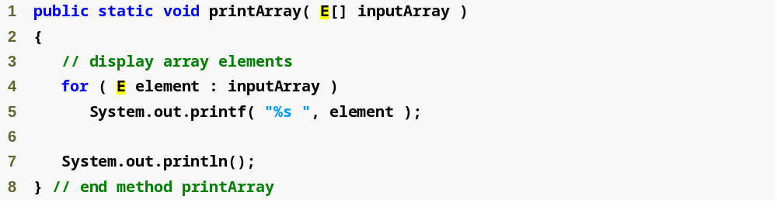
Replace the element type with a single generic type E
Replace the element type with a single generic type E
Fig. 18.2 | printArray method in which actual type names are replaced by convention with the generic name E.

Slide 13
18.3 Generic Methods: Implementation and Compile-Time Translation
Reimplement Fig. 18.1 using a generic method
  Method calls are identical
  Outputs are identical
Generic method declaration
  Type parameter section
    Delimited by angle brackets ( < and > )
    Precede the method’s return type
    Contain one or more type parameters
      Also called formal type paramters

Slide 14
18.3 Generic Methods: Implementation and Compile-Time Translation
Type parameter
  Also known as type variable
  An identifier that specifies a generic type name
  Used to declare return type, parameter types and local variable types
  Act as placeholders for the types of the argument passed to the generic method
    Actual type arguments
  Can be declared only once but can appear more than once
    public static < E > void printTwoArrays(
    E[] array1, E[] array2 )

Slide 15
Common Programming Error 18.1
When declaring a generic method, failing to place a type parameter section before the return type of a method is a syntax error—the compiler will not understand the type parameter name when it is encountered in the method.

Slide 16
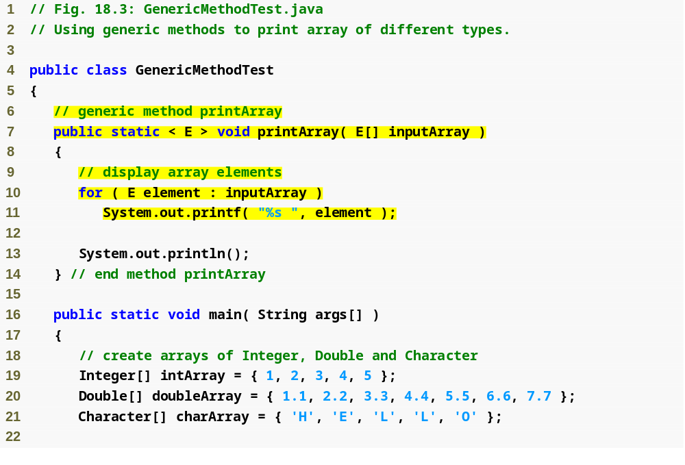
Use the type parameter to declare method printArray’s parameter type
Type parameter section delimited by angle brackets (< and > )
Use the type parameter to declare method printArray’s local variable type

Slide 17
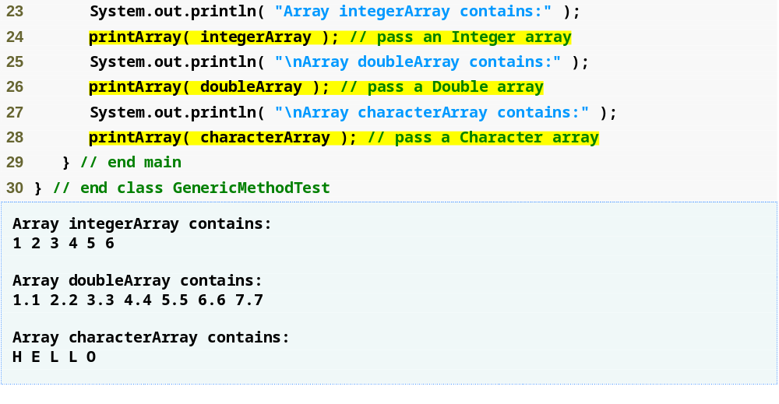
Invoke generic method printArray with an Integer array
Invoke generic method printArray with a Double array
Invoke generic method printArray with a Character array

Slide 18
Good Programming Practice 18.1
It is recommended that type parameters be specified as individual capital letters. Typically, a type parameter that represents the type of an element in an array (or other collection) is named E for “element.”

Slide 19
Common Programming Error 18.2
If the compiler cannot match a method call to a non-generic or a generic method declaration, a compilation error occurs.

Slide 20
Common Programming Error 18.3
If the compiler does not find a method declaration that matches a method call exactly, but does find two or more generic methods that can satisfy the method call, a compilation error occurs.

Slide 21
18.3 Generic Methods: Implementation and Compile-Time Translation (Cont.)
Compile-time translation
  Erasure
    Remove type parameter section
    Replace type parameters with actual types
    Default type is Object

Slide 22
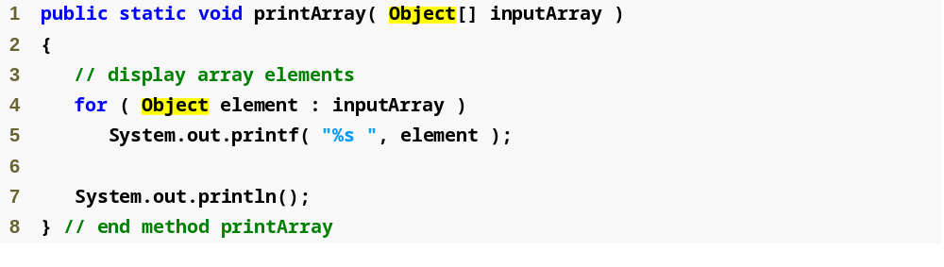
Remove type parameter section and replace type parameter with actual type Object
Replace type parameter with actual type Object
Fig. 18.4 | Generic method printArray after erasure is performed by the compiler.

Slide 23
18.4 Additional Compile-Time Translation Issues: Methods That Use a Type Parameter as the Return Type
Application of Fig. 18.5
  Generic method
  Use Type parameters in the return type and parameter list
Generic interface
  Specify, with a single interface declaration, a set of related types
  E.g., Comparable< T >
    Method integer1.compareTo( integer2 )
      Compare two objects of the same class
      Return 0 if two objects are equal
      Return -1 if integer1 is less than integer2
      Return 1 if integer1 is greater than integer2

Slide 24
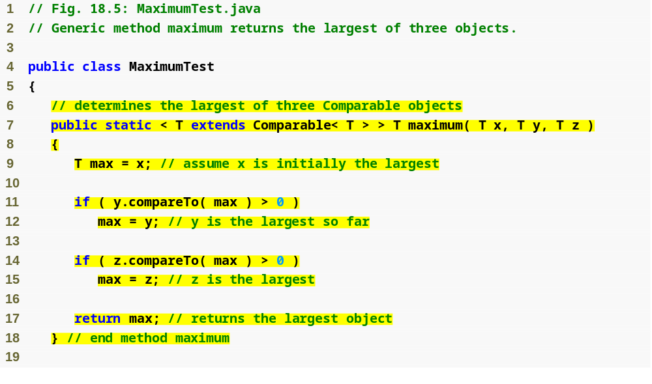
Type parameter section specifies that only object of classes that implement interface Comparable can be used with this method
Type parameter is used in the return type of method maximum
Assign x to local variable max
Invokes method compareTo method Comparable to compare y and max
Invokes method compareTo method Comparable to compare z and max

Slide 25
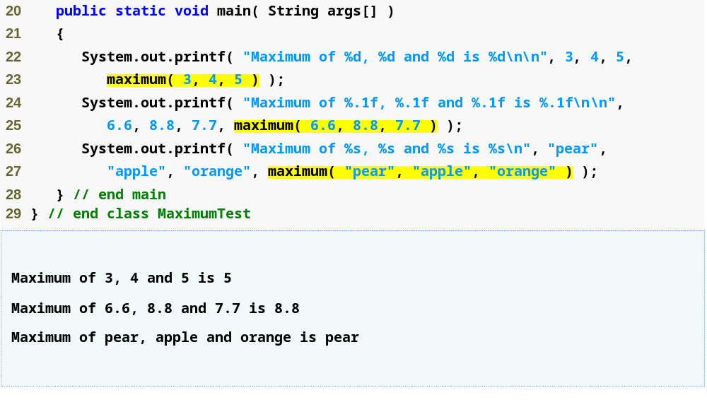
Invoke generic method maximum with three doubles
Invoke generic method maximum with three strings
Invoke generic method maximum with three integers

Slide 26
18.4 Additional Compile-Time Translation Issues: Methods That Use a Type Parameter as the Return Type (Cont.)
Upper bound of type parameter
  Default is Object
  Always use keyword extends
    E.g., T extends Comparable< T >
  When compiler translates generic method to Java bytecode
    Replaces type parameter with its upper bound
    Insert explicit cast operation
    e.g., line 23 of Fig. 18.5 I preceded by an Integer cast
    (Integer) maximum( 3, 4, 5 )

Slide 27
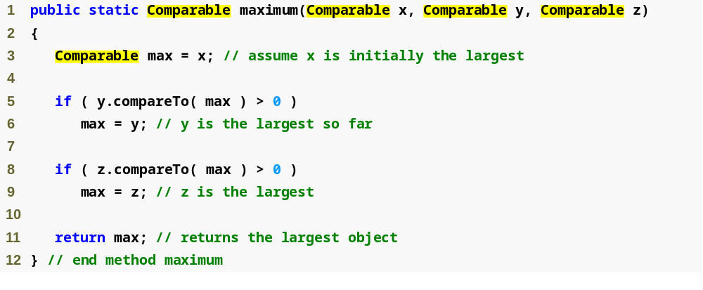
Erasure replaces type parameter T with its upper bound Comparable
Erasure replaces type parameter T with its upper bound Comparable

Slide 28
18.5 Overloading Generic Method
Generic method may be overloaded
  By another generic method
    Same method name but different method parameters
  By non-generic methods
    Same method name and number of parameters
When compiler encounters a method call
  Search for most precise matching method first
    Exact method name and argument types
  Then search for inexact but applicable matching method

Slide 29
18.6 Generic Classes
Generic classes
  Use a simple, concise notation to indicate the actual type(s)
  At compilation time, Java compiler
    ensures the type safety
    uses the erasure technique to enable client code to interact with the generic class
Parameterized classes
  Also called parameterized types
  E.g., Stack< Double >

Slide 30
18.6 Generic Classes (Cont.)
Generic class declaration
  Looks like a non-generic class declaration
  Except class name is followed by a type parameter section
The –Xlint:unchecked option
  Compiler cannot 100% ensure type safety

Slide 31
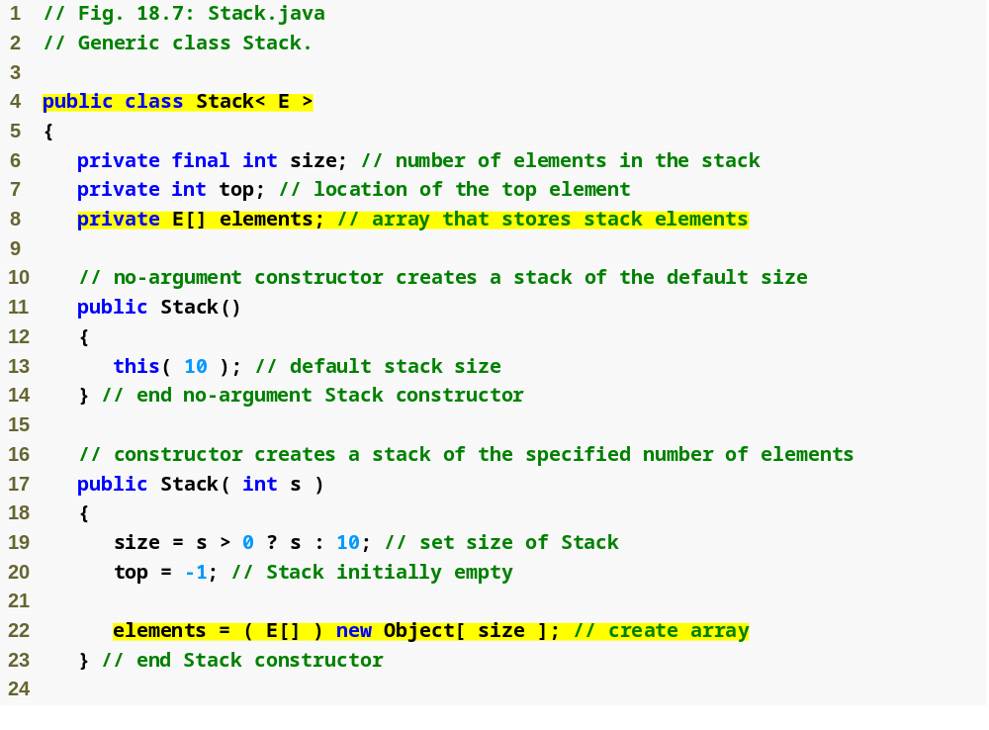
Generic class declaration, class name is followed by a type parameter section
Declare elements as an array that stores objects of type E
Create an array of type E. The generic mechanism does not allow type parameter in array-creation expressions because the type parameter is not available at runtime

Slide 32
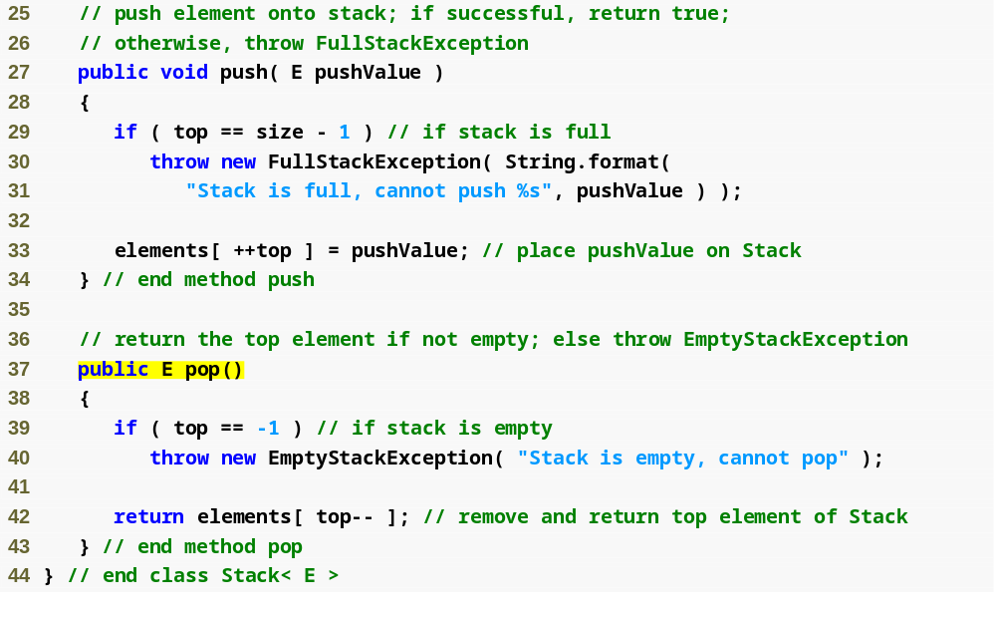
Method push pushes element of type E onto stack
Method pop returns the top element, which is of type E

Slide 33
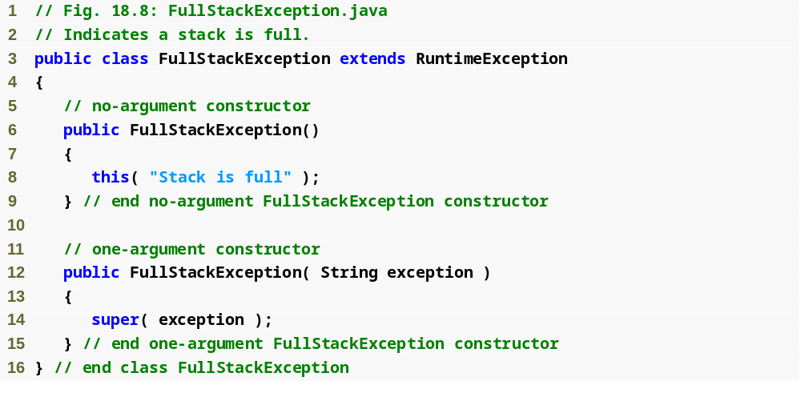

Slide 34
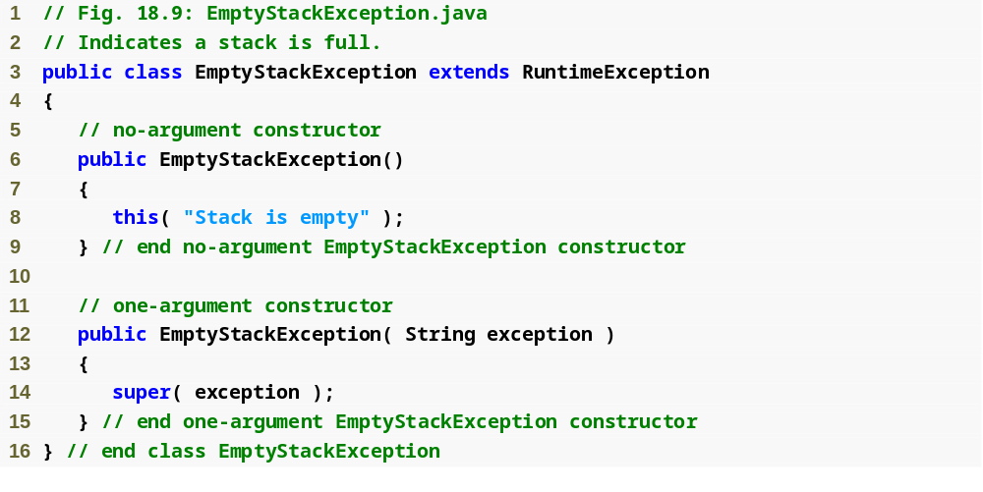

Slide 35
18.6 Generic Classes (Cont.)
Generic class at compilation time
  Compiler performs erasure on class’s type parameters
  Compiler replaces type parameters with their upper bound
Generic class test program at compilation time
  Compiler performs type checking
  Compiler inserts cast operations as necessary

Slide 36
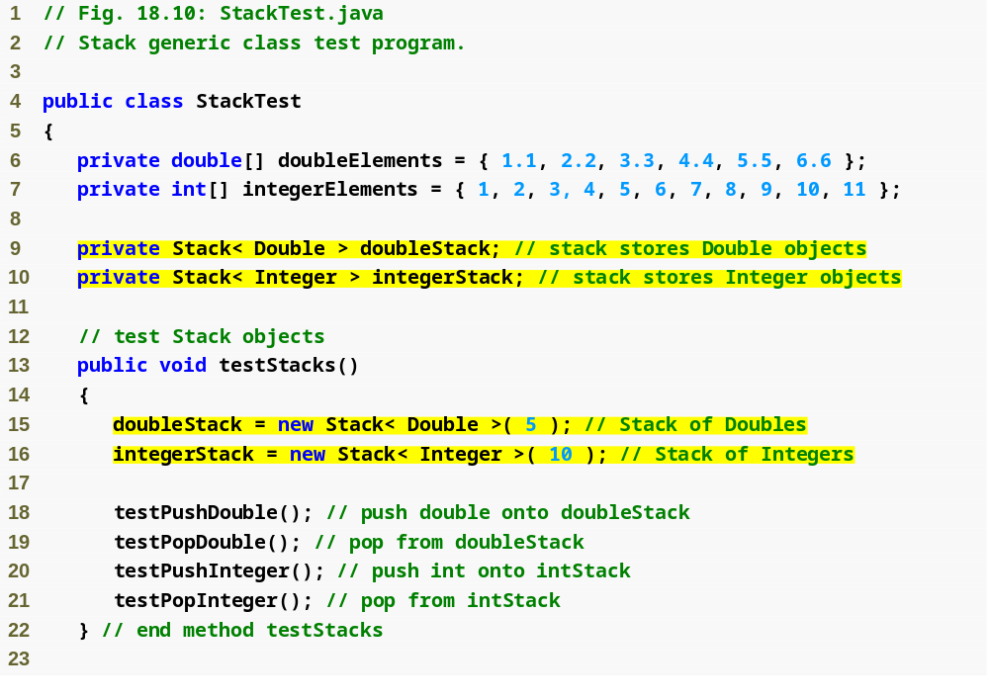
Generic class Stack’s type argument is Double
Generic class Stack’s type argument is Integer
Instantiate object doubleStack of size 5 and ingeterStack of size 10

Slide 37
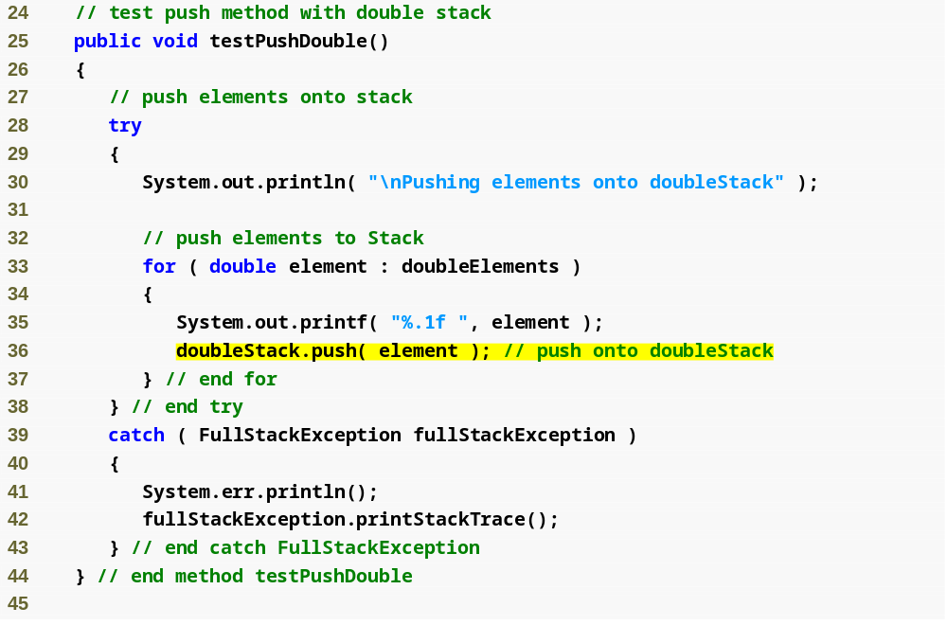
Invoke Stack’s method push to place a double value onto doubleStack

Slide 38
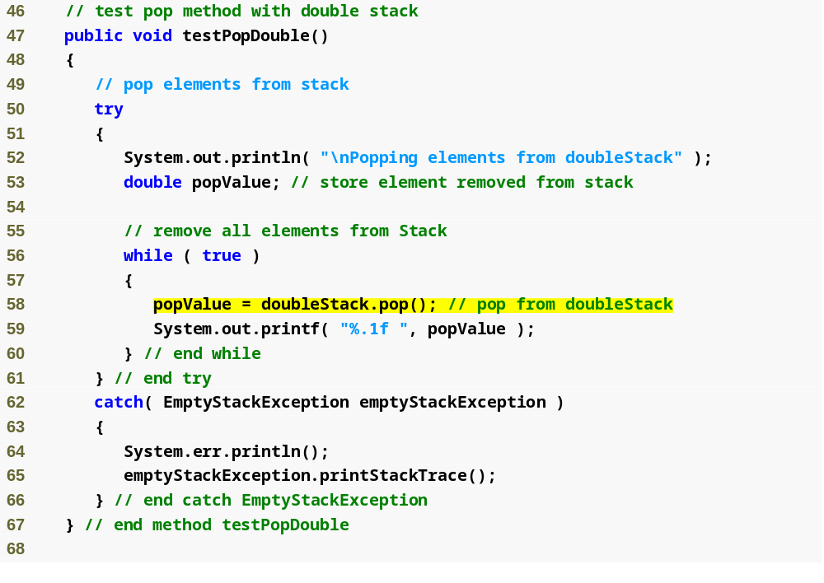
Auto-unboxing occurs when the value returned by pop (Double) is assigned to a double primitive variable

Slide 39
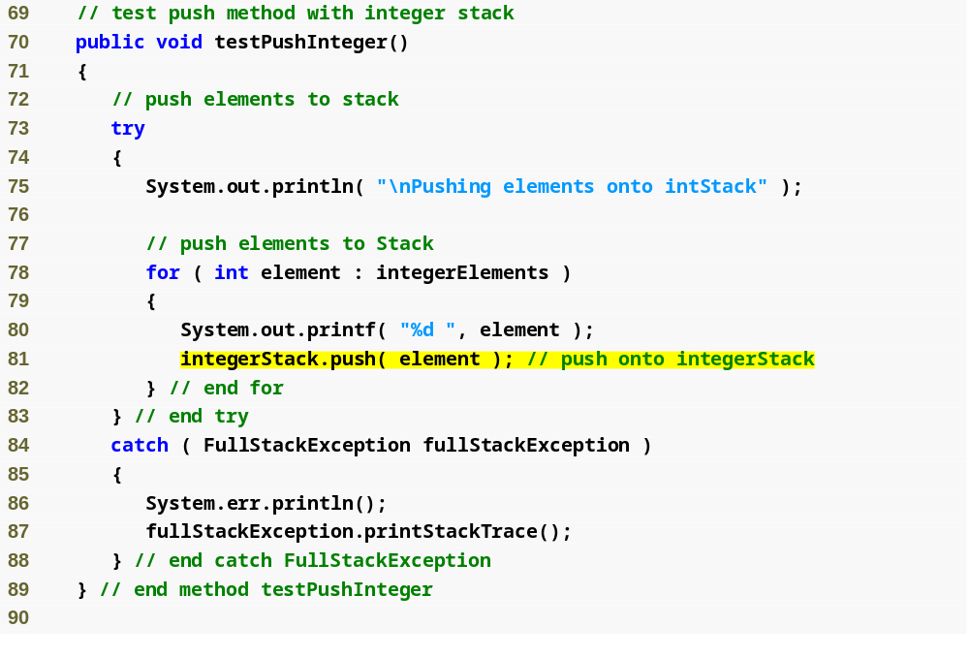
Invoke Stack’s method push to place an int value onto integerStack

Slide 40
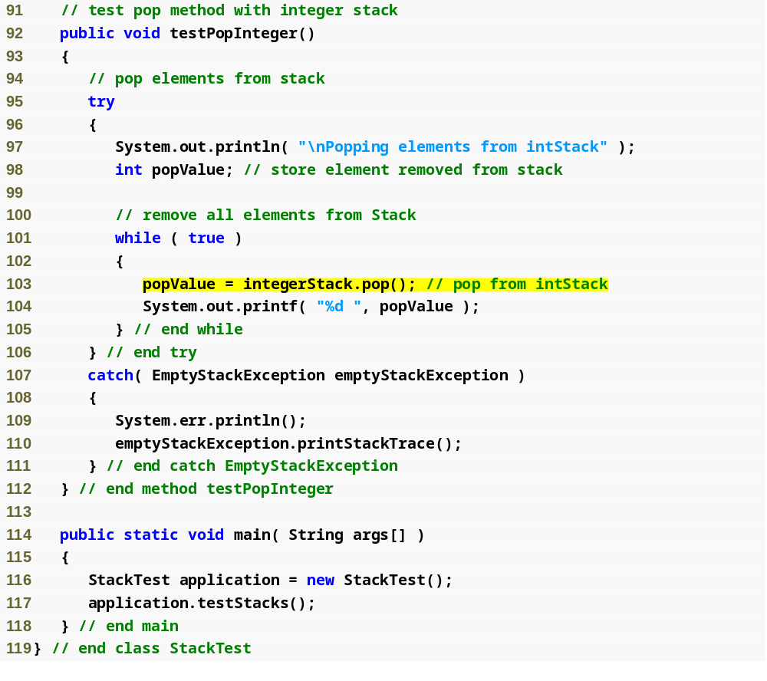
Auto-unboxing occurs when the value returned by pop (Integer) is assigned to an int primitive variable

Slide 41
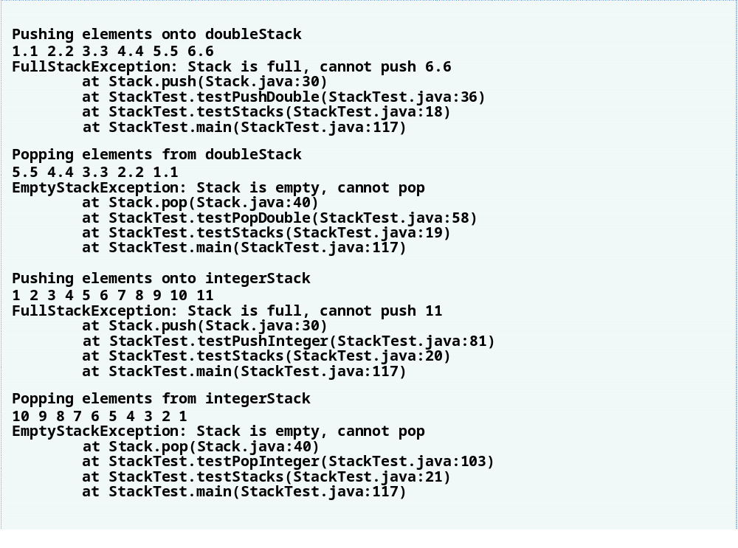

Slide 42
18.6 Generic Classes (Cont.)
Creating generic methods to test class Stack< E >
  Method testPush
    Perform same tasks as testPushDouble and testPushInteger
  Method testPop
    Perform same tasks as testPopDouble and testPopInteger

Slide 43
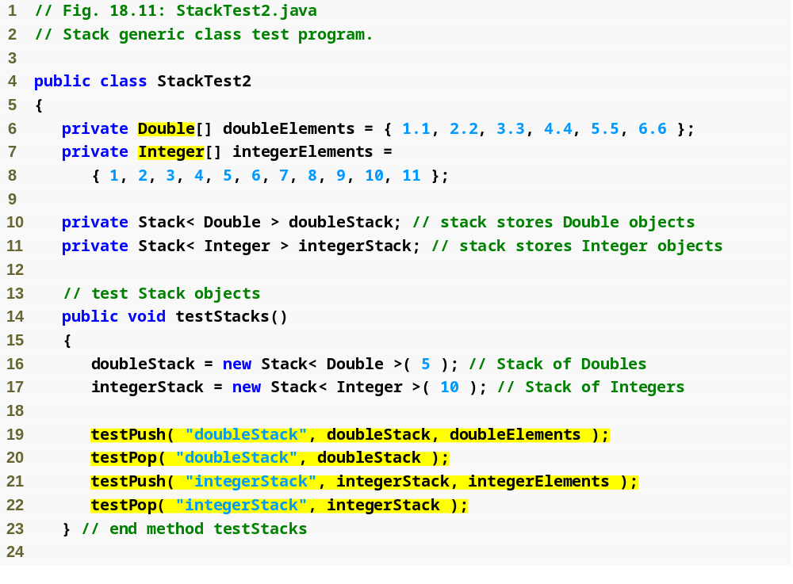
Invoke generic methods testPush and testPop to push elements onto stack and pop elements from stack

Slide 44
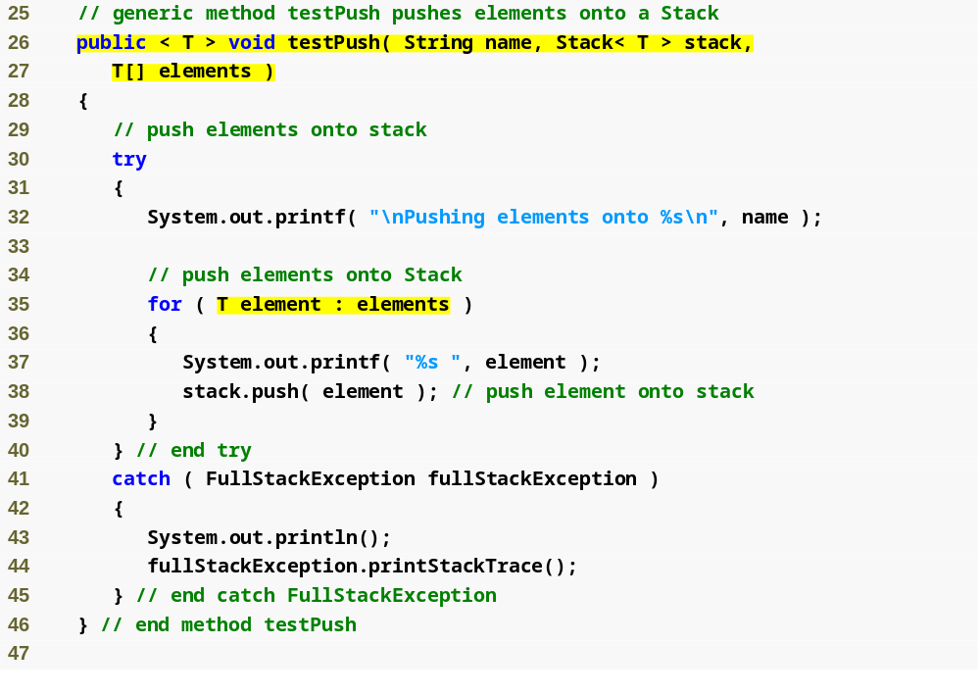
Generic method testPush replaces testPushDouble and testPushInteger
Replace element type Double/Integer with type parameter T

Slide 45
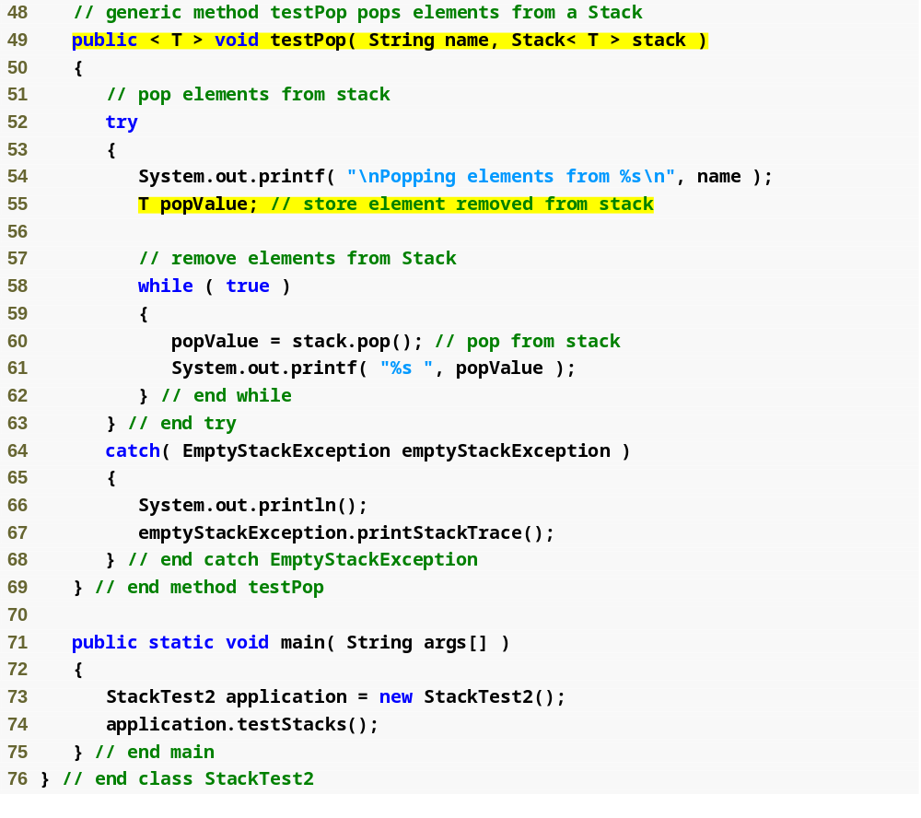
Generic method testPop replaces testPopDouble and testPopInteger
Replace element type Double/Integer with type parameter T

Slide 46
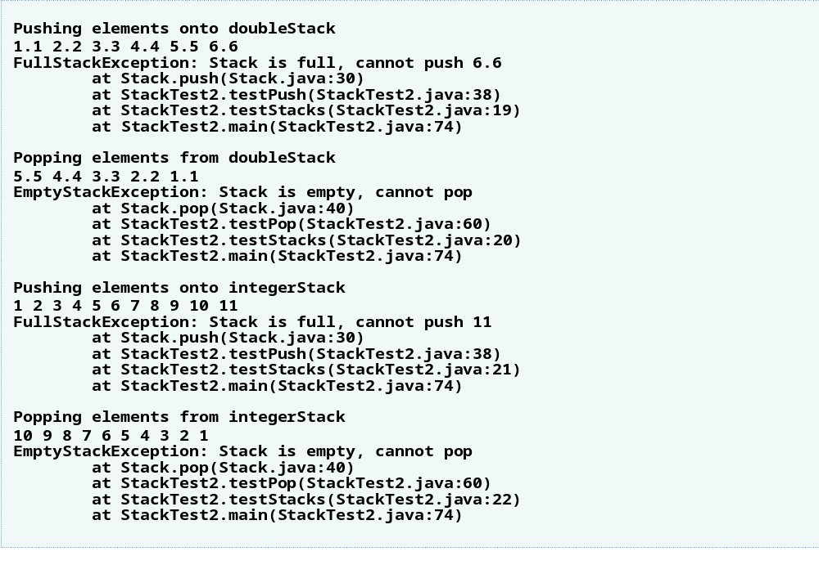

Slide 47
18.7 Raw Types
Raw type
  Enables to instantiate generic class without specifying a type argument
  e.g., Stack objectStack = new Stack( 5 );
  objectStack is said to have a raw type
  Important for backwards compatibility with prior versions
  A raw type Stack variable can be assigned a Stack that specifies a type argument
  A Stack variable that specifies a type argument can be assigned a raw type Stack
    Permitted but unsafe
    Use the –Xlint:unchecked option to compile

Slide 48
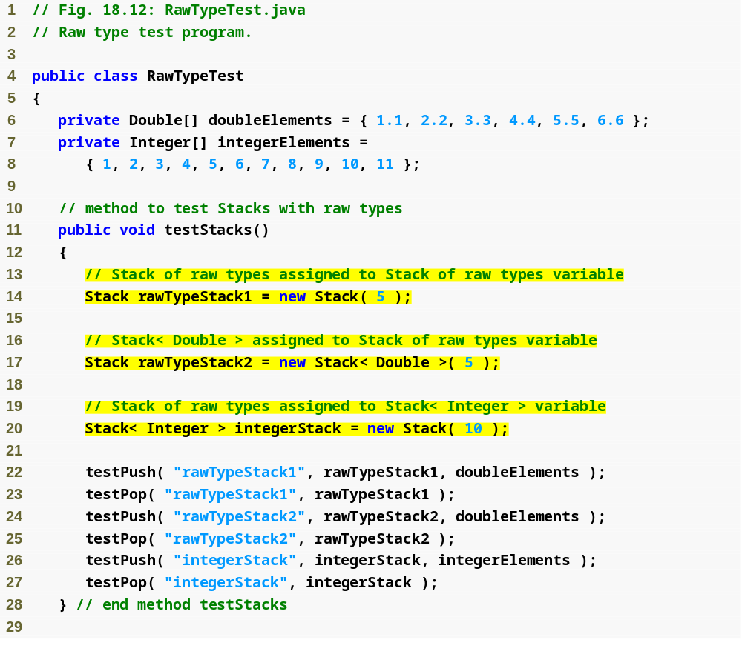
Instantiate generic class Stack with raw type
Assign a Stack< Double > to variable rawTypeStack2
Assign a Stack of raw type to Stack< Integer >. Legal but unsafe

Slide 49
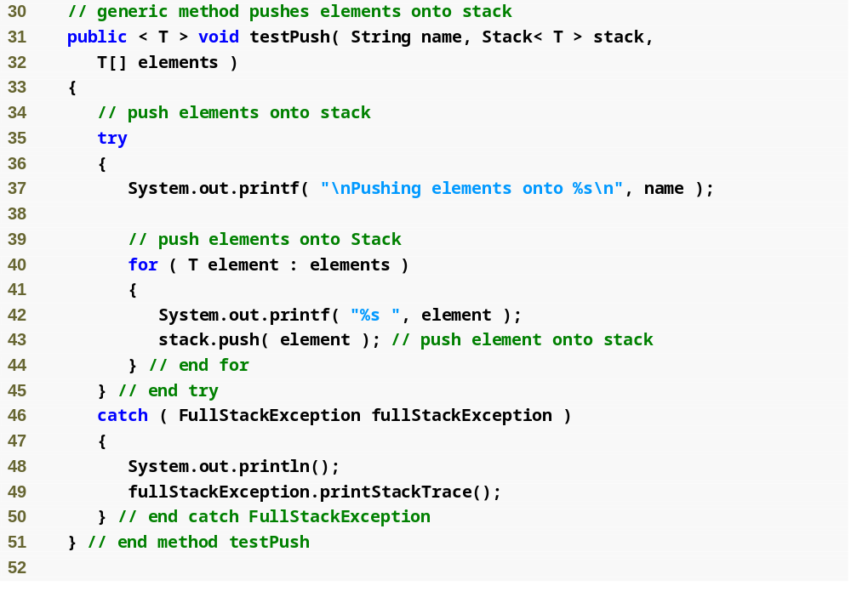

Slide 50
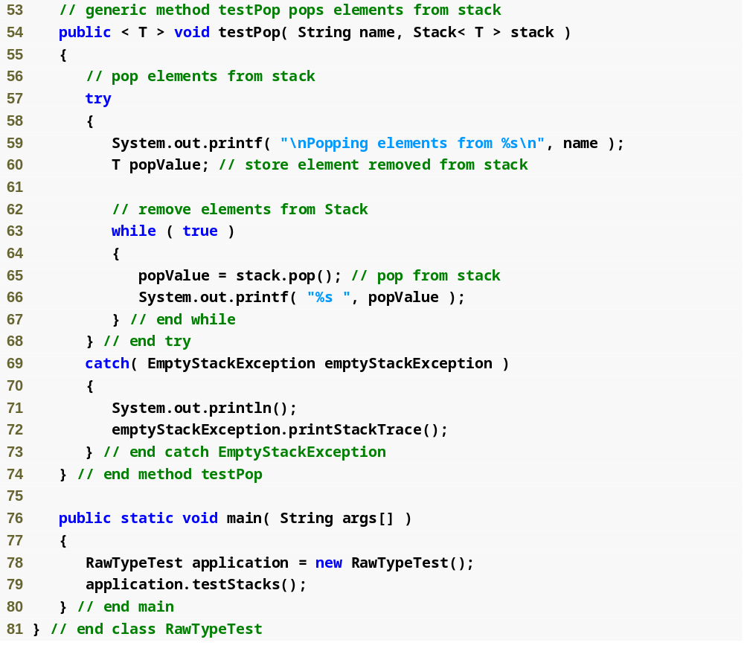

Slide 51
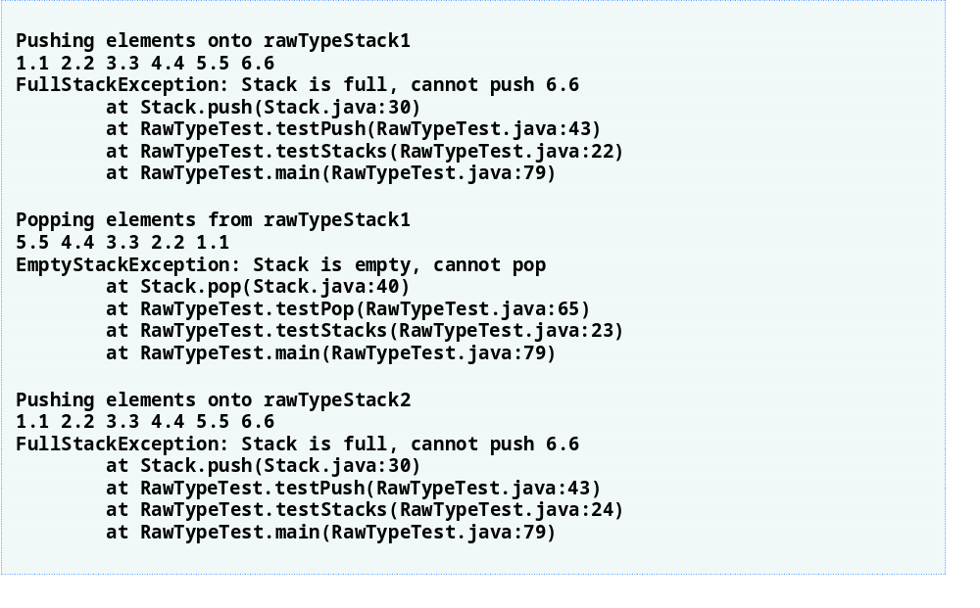

Slide 52
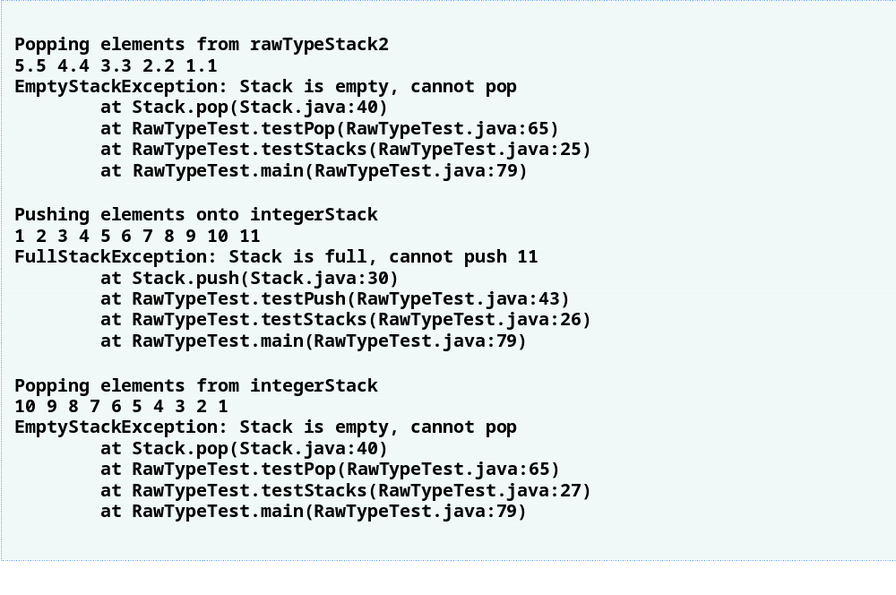

Slide 53
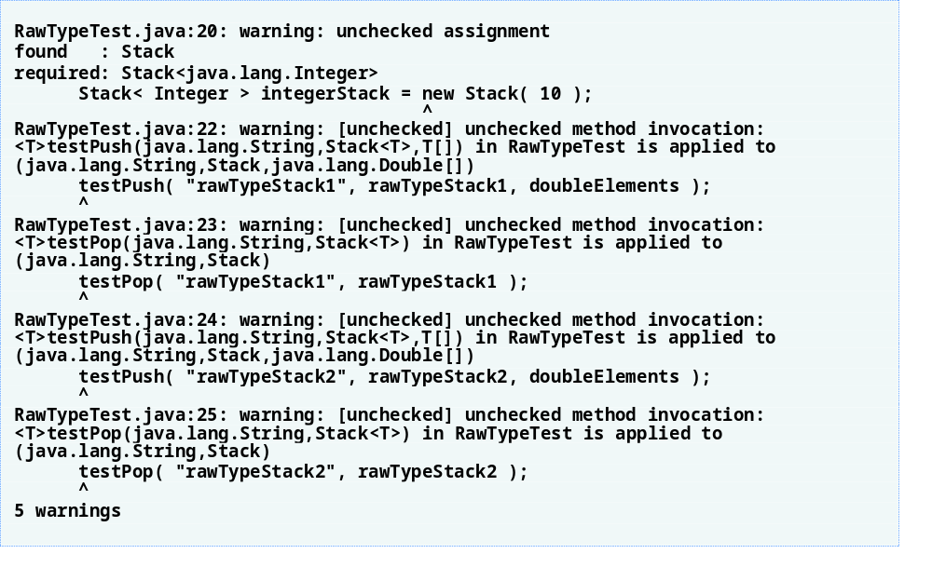
Fig. 18.13 | Warning message from the compiler.

Slide 54
18.8 Wildcards in Methods That Accept Type Parameters
Data structure ArrayList
  Dynamically resizable, array-like data structure
  Method add
  Method toString
Motivation for using wildcards
  Implement a generic method sum
    Total the numbers in a collection
    Receive a parameter of type ArrayList< Number >
    Use method doubleValue of class Number to obtain the Number’s underlying primitive value as a double value

Slide 55
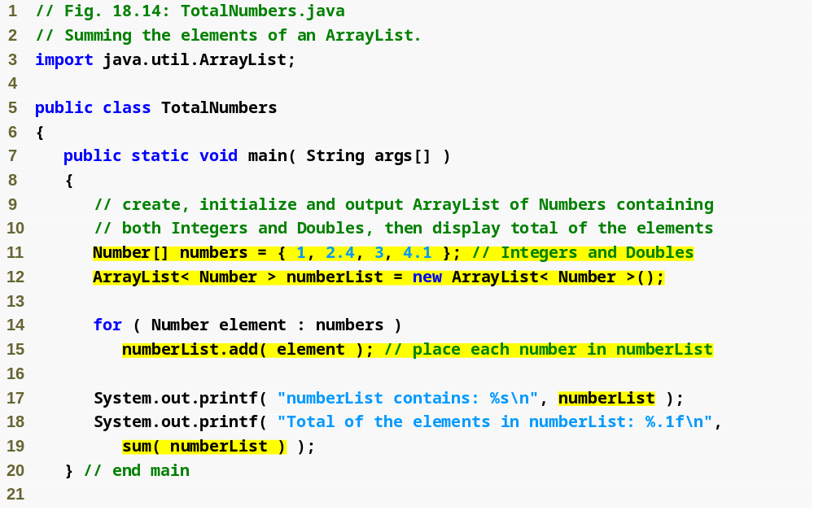
Declare and initialize array numbers
Declare and initialize numberList, which stores Number objects
Add elements in numbers array to ArrayList numberList
Invoke method sum to calculate the total of the elements stored in numberList

Slide 56
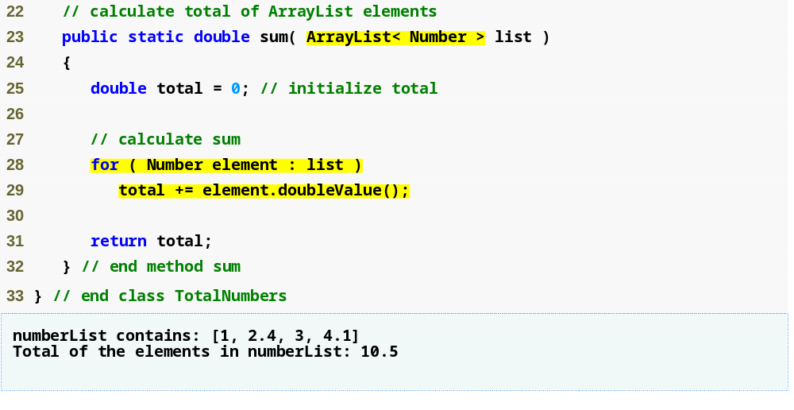
Method sum accepts an ArrayList that stores Number objects
Use method doubleValue of class Number to obtain the Number’s underlying primitive value as a double value

Slide 57
18.8 Wildcards in Methods That Accept Type Parameters (Cont.)
Implementing method sum with a wildcard type argument in its parameter
  Number is the superclass of Integer
  ArrayList< Number > is not a supertype of ArrayList< Integer >
  Cannot pass ArrayList< Integer > to method sum
  Use wildcard to create a more flexible version of sum
    ArrayList< ? extends Number >
    ? Represents an “unknown type”
    Unknown type argument must be either Number or a subclass of Number
    Cannot use wildcard as a type name through method body

Slide 58
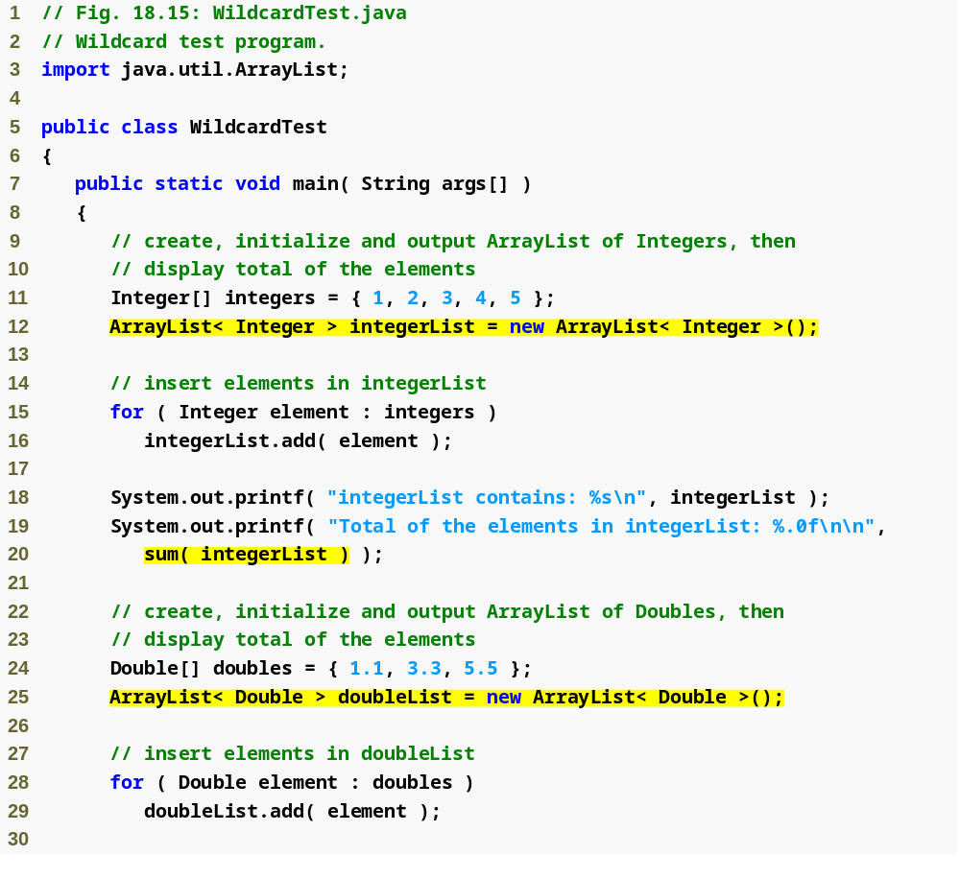
Declare and create ArrayList integerList to hold Integers
Invoke method sum to calculate the total of the elements stored in integerList
Declare and create ArrayList doubleList to hold Doubles

Slide 59
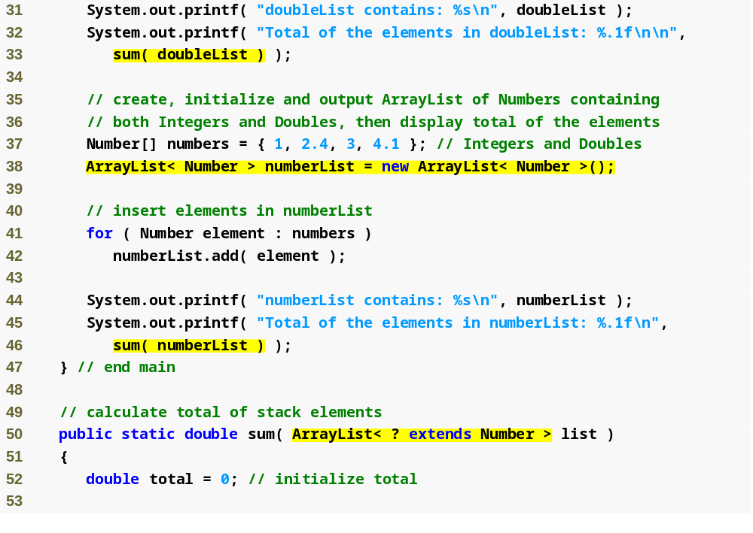
Invoke method sum to calculate the total of the elements stored in doubleList
Declare and create ArrayList integerList to hold Numberss
Invoke method sum to calculate the total of the elements stored in numberList
The ArrayList argument’s element types are not directly known by the method, they are known to be at least of type Number

Slide 60
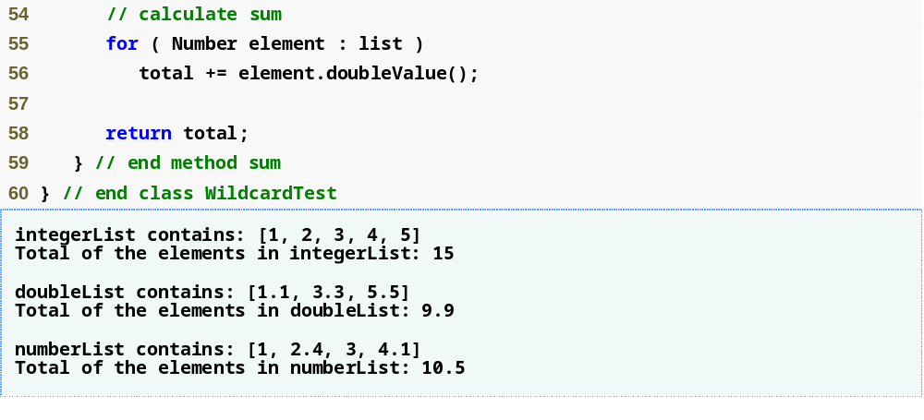

Slide 61
Common Programming Error 18.4
Using a wildcard in a method’s type parameter section or using a wildcard as an explicit type of a variable in the method body is a syntax error.

Slide 62
18.9 Generics and Inheritance: Notes
Inheritance in generics
  Generic class can be derived from non-generic class
  e.g., class Object is superclass of every generic class
  Generic class can be derived from another generic class
  e.g., Stack is a subclass of Vector
  Non-generic class can be derived from generic class
  e.g., Properties is a subclass of Hashtable
  Generic method in subclass can override generic method in superclass
    If both methods have the same signature

