Slide 1

Coursera Capstone
IBM APPLIED DATA SCIENCE CAPSTONE
Setting up Caffe in Ahmedabad , India
By
Nandan Kakadiya

Slide 2
Business Problem
Location of the Caffe or Food Stall is one of the most important decisions that will determine whether it will be a success or a failure.
Objective: To analyse and select the best locations in the city of Ahmedabad to open a new caffe.
Business question:-
In the city of Hyderabad, if a property developer is looking to open a new shopping mall, where would you recommend that they open it?

Slide 3
Data
Source of the data
List of neighbourhoods in Hyderabad
Latitude and longitude coordinates of the neighbourhoods
Venue data, particularly data related to Caffes, its neighbourhood, longitude and latitude
Wikipedia page for neighbourhoods (https://en.wikipedia.org/wiki/Category:Neighbourhoods_in_Hyderabad,_India)
Geocoder package for latitude and longitude coordinates
Foursquare API for venue data

Slide 4
Methodology
Scraping Wikipedia page for neighbourhoods list using python libraries
Get latitude and longitude coordinates using Geocoder
Use Foursquare API to get venue data
Group data by neighbourhood
Filter venue category by Caffe and other food stores
Perform clustering on the data by using unsupervised machine learning algorithm k-means clustering
Visualize the clusters in a map using Folium

Slide 5
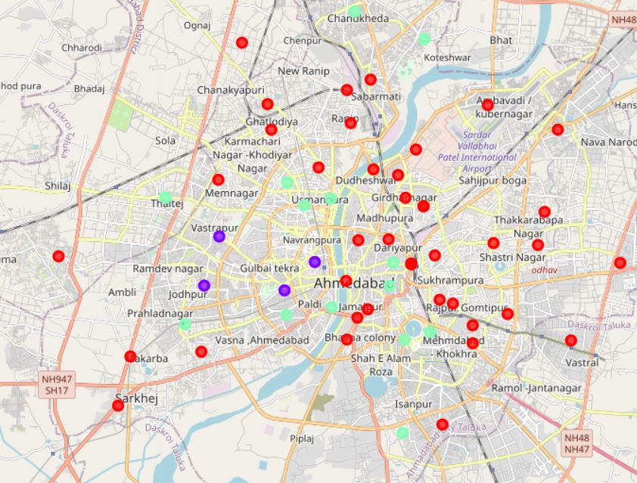
Results
• Using k means we are able to categorize the neighbourhoods into 3 clusters :
Cluster 0: Neighbourhoods with very less or Zero number of Caffes
Cluster 1: Neighbourhoods with very high number of caffes
Cluster 2: Neighbourhoods with a moderate concentration of caffes and food stall

Slide 6
Conclusion
The neighbourhoods in cluster 0 are the most preferred locations to open a new Caffes
The results also show that the oversupply of Cafe mostly happened in the central area of the city near river, with the some area still have very few Caffes.
Findings of this project will help the relevant stakeholders to capitalize on the opportunities on high potential locations while avoiding overcrowded areas in their decisions to open a new shopping mall.

Slide 7
FUTURE WORK
In this project, we only consider one factor i.e. frequency of occurrence of shopping malls
There are other factors such as population and income of residents that could influence the location decision and also rating of other restaurants. However, to the best of this researcher's knowledge, such data are not available at the neighborhood level that this project requires.
Future study could develop a mechanism for estimating such data, which could then be used in the clustering process to select the best sites for a new Cafe to operate

Slide 8
Thanking You!

