Slide 1
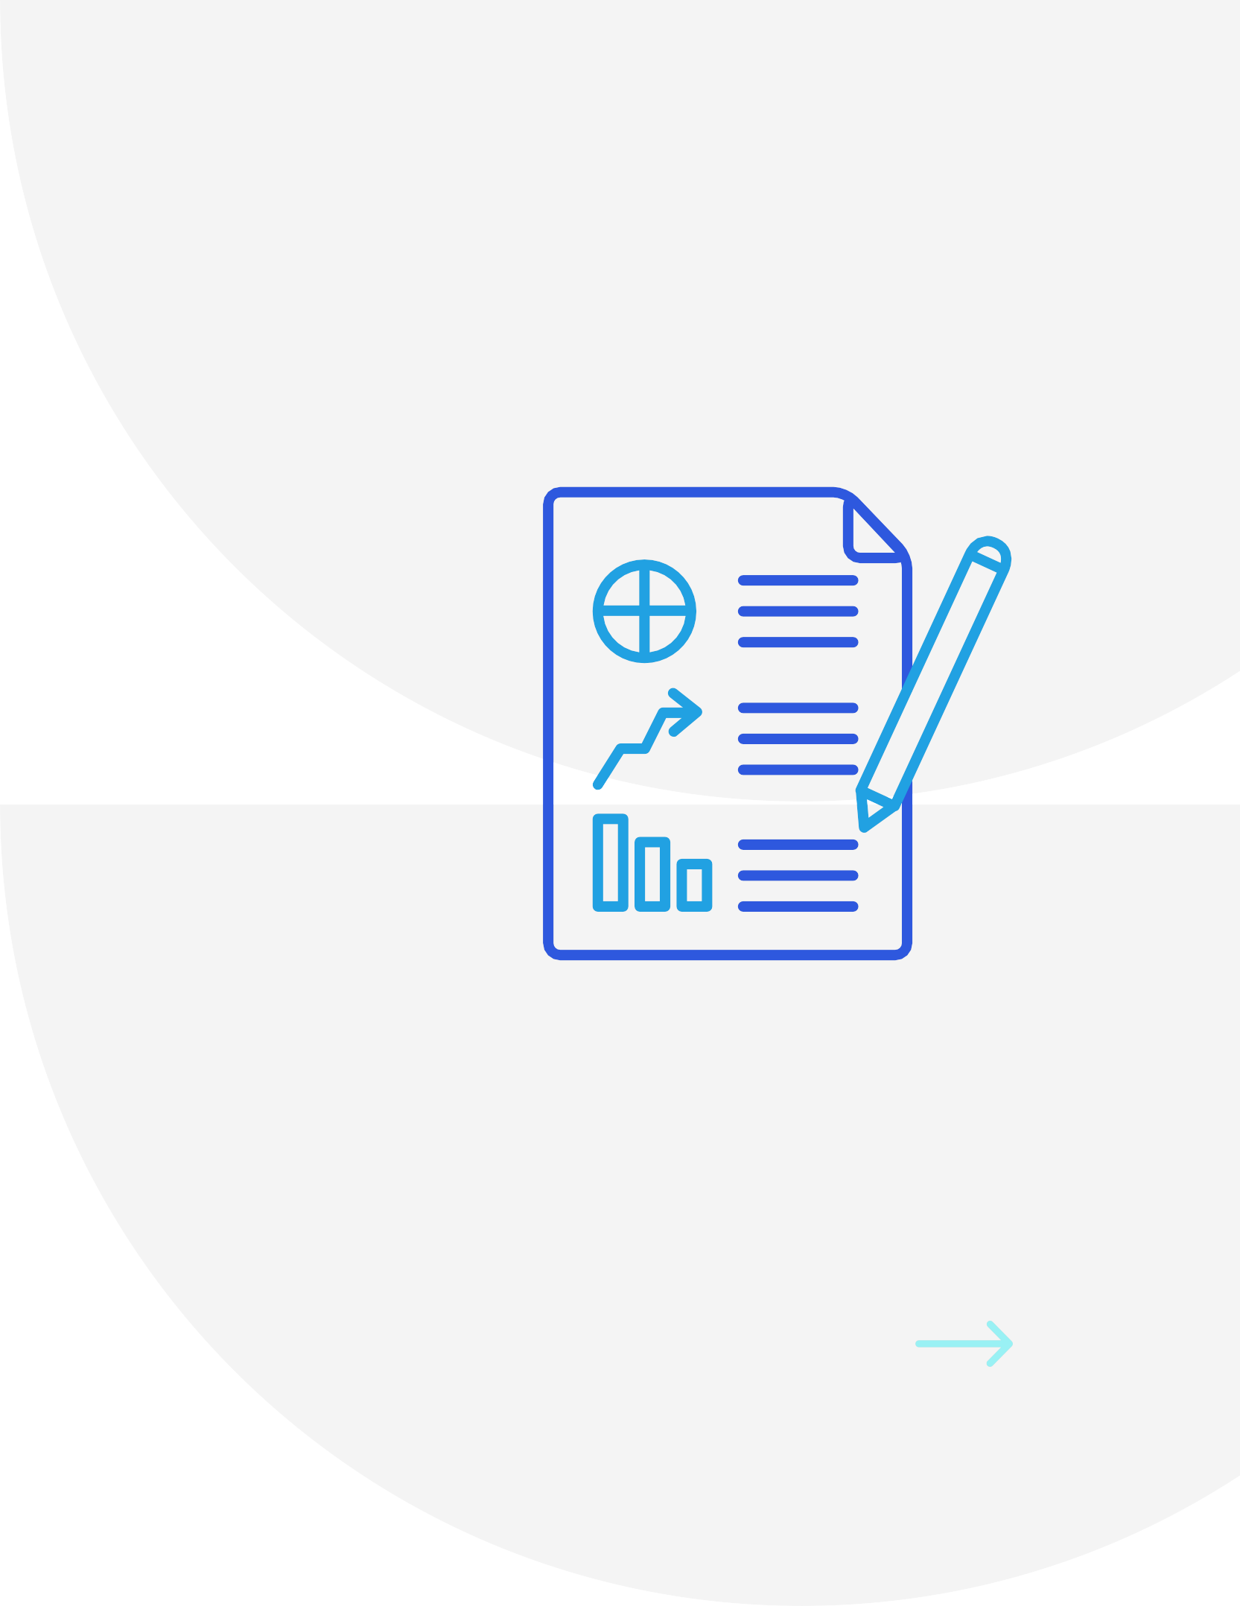
INDUSTRIAL ORIENTATION
19BIT083 - NAMRA SHAH
19BIT084 - NANDAN KAKADIYA
19BIT095 - PARIKSHIT AGARWAL
19BIT096 - PARV PATEL
19BIT097 - POOJAN AGRAWAL

Slide 2
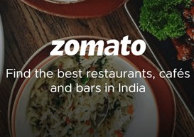
OUR COMPANY - ZOMATO
Zomato is an Indian multinational restaurant aggregator and food delivery company. Zomato is used by consumers to discover, rate and review restaurants, as well as create their own personal network of foodies for trusted recommendations

Slide 3
S
High awareness – Top of the mind product Global presence - 25 countries
Superior technology & strong workforce
SWOT ANALYSIS
W
Competition from search engines Similar apps leads limited growth
Opportunity to expand Increasing internet penetration Rapid technology development
0
T
Intense competition
Lack of clear rules and regulations Business model can be easily imitated

Slide 4
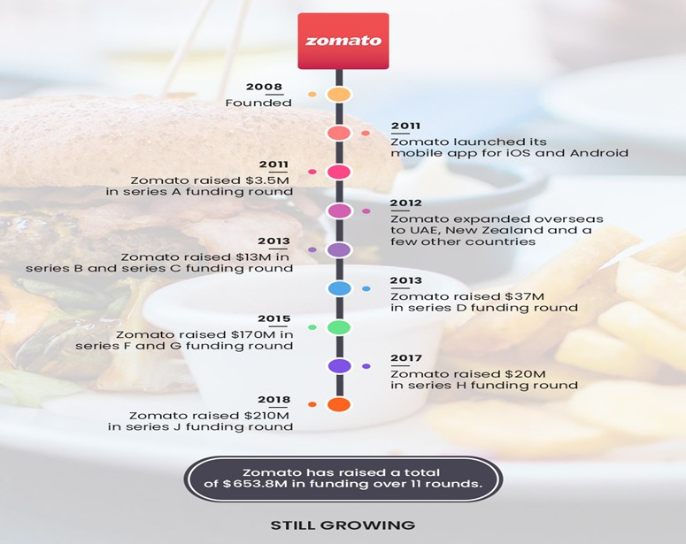
History and Emerging of the industry

Slide 5
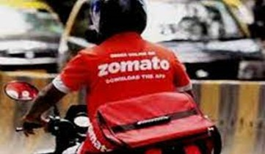
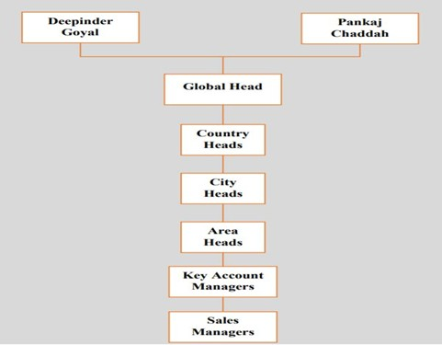
Man Power
Around 5000 employees
More than 200000 delivery partners Available in more than 500 cities across India.
Organizational Hierarchy
Sales Managers
Key Account Managers Area Heads
City Heads Country Heads

Slide 6
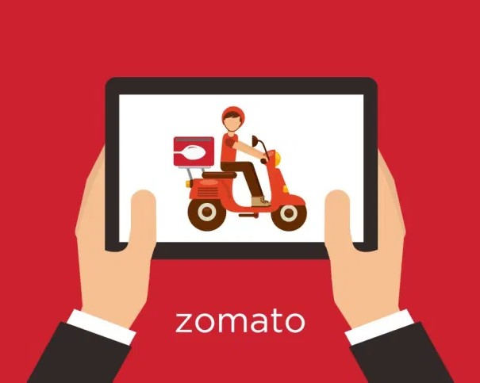
Introduction to the selected product
The company caters to two different segments of the market:
the Restaurants and their customers. Different product services:
Advertisement sales,
Online ordering services and
Zomato infrastructure.
Different services for Consumers: Zomato Gold, Zomato Red and Zomato Treats

Slide 7

Applications and significance of the products
Zomato is focusing on developing an entire ecosystem for foodies in the country, with delivery and dine-out options available for users.
Zomato App
Zomato Business App Zomato Kitchens

Slide 8

Zomato uses 38 technology products and services including HTML5, Google Analytics, and jQuery, according to G2 Stack.
Zomato App was made using Java but is shifting to a newer and better framework kotlin

Slide 9
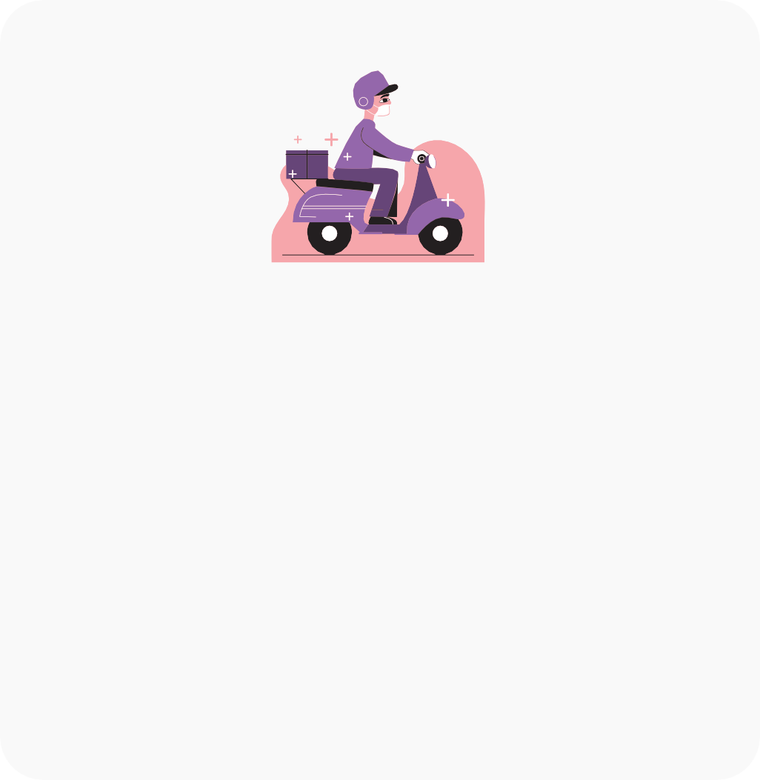
Components Of Zomato App
Customer side
Restaurant side
Delivery side
Interface for customer to search and order food from restaurants
Interface for restaurant owner to operate the process of order placed by customer
In this Interface, Features to check, accept or reject order, geolocation, etc. are provided to Delivery executive

Slide 10




Logistics and layout process
Authentication
User Interface
Order Acceptance
Estimated Time
Food Delivery
User Login
Customer can explore and order food
Restaurant and delivery executive receive the notificaiton of the order
Food preparation time pops up on users screen through different estimation
Food is delivered by the executive and he got his pay cut as per the criteria

Slide 11
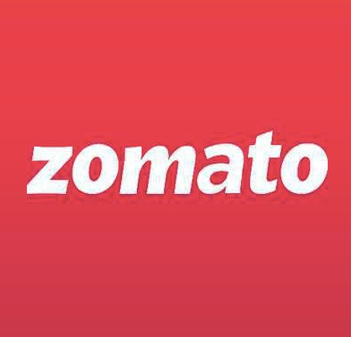
TECHNOLOGICAL AND BUSINESS CHALLENGES
TECHNOLOGICAL CHALLENGES
Building the Dish Database Span Control
Lower server Latency for our Geographically widespread traffic
BUSINNESS CHALLENGES
The AOV Hurdle
Small Towns for Big Gains COVID-19 Safety

Slide 12
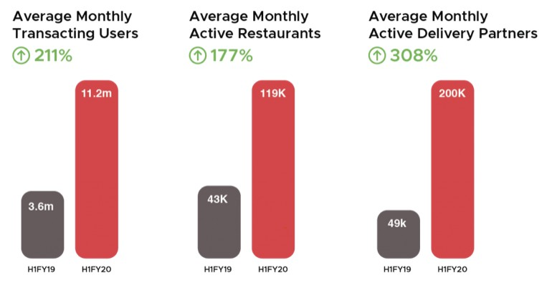
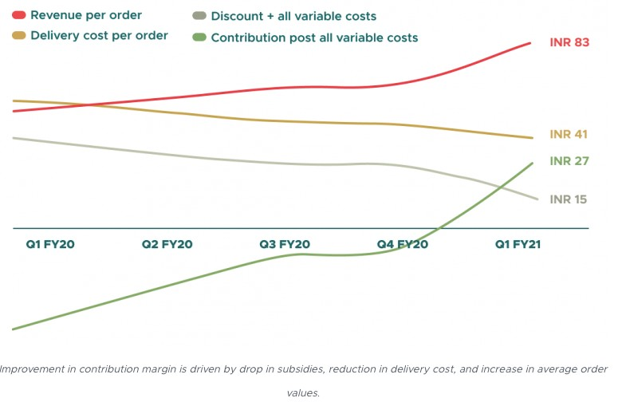
PRESENT STATE IN TERMS OF MARKET DEMANDS AND WAY FORWARD
Delivery partners: 1,69,802.
Active restaurant listings: 3,89,932.
Active food delivery restaurants: 1,48,384. Present in 525 cities in India and 23 countries outside India. 15 lakh Zomato Pro members and 25,443 Pro restaurant subscribers.
Zomato recorded 32.1 million average monthly active users (MAUs), of which 6.8 million MTUs (monthly transacting users) placed transactions. It is present in 525 cities in India, with almost 150,000 active food delivery restaurant listings and 170,000 active delivery partners

Slide 13

Environmental impact
Zomato also looks forward to the key concerns of its service towards environmental impacts and takes valuable steps towards it such as: -
Reduce plastic waste,
Electric vehicles and
Reducing packages.
Thus the company is taking baby steps to reduce their impact on the environment.

Slide 14
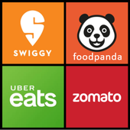
Competitors and other threats for existence
there are many competitors in this online food delivery services market with an already established platform providing equally good service such as: -
Swiggy Uber Eats FoodPanda
and many others

Slide 15
Thanking You!

