Slide 1
A CONTROLLED STUDY OF FORGETTING POLICIES
IN LLM AGENT MEMORY
DRIFT: Decay Rates in Forgetful Bitemporal Memory
Nandan Hemanth
Advisor: Dr. Hao Wang · Reader: Dr. Joseph Helsing
Master of Science — Applied Artificial Intelligence
Stevens Institute of Technology

Slide 2
THE PROBLEM
Memory that never forgets keeps answering with facts that are no longer true
“I live in Boston.”
session 1
“I moved to Seattle.”
session 47, three months later
“Where do I live?”
Both facts are retrieved — similar, both recent enough.
Answer: “Boston.”
This is not a retrieval failure — the correct fact was found and stored. It is a failure of memory hygiene: nothing in the system ever marked the old fact as no longer current, and nothing removed it.
The failure compounds with time. An agent running for a year accumulates thousands of facts — an increasing fraction superseded.
DRIFT — Nandan Hemanth — Stevens Institute of Technology
1

Slide 3
WHY THIS HASN'T BEEN SETTLED
Production memory systems address storage and retrieval — not forgetting
MemGPT
Zep
Mem0
A-MEM
Pages context in and out like an OS — treats the window as physical memory.
Temporal knowledge graph for agent memory — records validity, doesn't compare policies for acting on it.
Scalable long-term store, aimed at production deployment cost and latency.
An LLM agentically decides memory structure and linking.
In every one of these, the treatment of superseded information is secondary — and where a forgetting mechanism exists, it was chosen by the system's authors, not measured against alternatives.
The confound: compare two published systems and a difference could come from the substrate, retrieval, extraction, prompt, or model — not the forgetting rule. What's missing is a controlled comparison.
DRIFT — Nandan Hemanth — Stevens Institute of Technology
2

Slide 4
HYPOTHESIS & RESEARCH QUESTIONS
One question, isolated
H: Selective forgetting grounded in bitemporal structure improves an agent's answer quality and cost profile relative to append-only memory and to structure-blind or novelty-based forgetting.
RQ1
Does append-only memory measurably surface superseded facts?
RQ2
Which forgetting policy offers the best accuracy / staleness / cost trade-off?
RQ3
Does bitemporal structure specifically win, or would any graph-aware consolidation do?
RQ4
Do policy rankings survive multi-agent use, where the reader isn't the writer?
DRIFT — Nandan Hemanth — Stevens Institute of Technology
3

Slide 5
NOVELTY & POSITIONING
Not a new data structure — a new experimental design
Bitemporal modeling is decades old in database research, and Zep already applies a version of it to agent memory. The novelty is in what a controlled design makes visible.
N1
Forgetting policy as the isolated variable
N2
The bitemporal-vs-structure-blind ablation
First study holding substrate, extraction, retrieval, answer model, and judge fixed — varying only the forgetting rule across seven conditions.
P5 is exactly as structure-aware as P2, minus valid time. This isolates bitemporal semantics from graph structure in general.
N3
Novelty gating named as a measured failure mode
N4
A negative result about the standard benchmarks
First controlled demonstration that write-side novelty gating trades a bounded saving for an unbounded correctness liability.
LoCoMo and LongMemEval carry zero superseded-answer annotations — they cannot support this measurement at all.
DRIFT — Nandan Hemanth — Stevens Institute of Technology
4

Slide 6
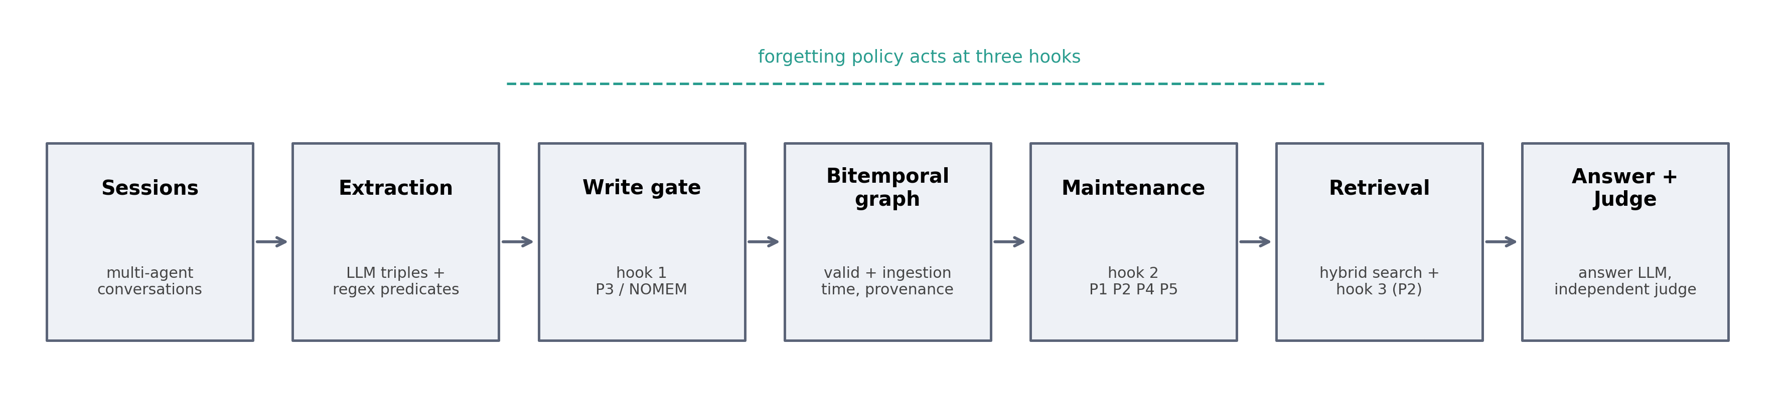
METHOD
The pipeline: one substrate, one variable
extraction → policy.on_write() → bitemporal graph → policy.after_session()
→ hybrid retrieval → policy.on_retrieve() → answer → judge
DRIFT — Nandan Hemanth — Stevens Institute of Technology
5

Slide 7
METHOD
A policy is exactly three hooks over a bitemporal fact
Every fact carries two timelines
class Policy:
t_valid_start when the fact became true of the world
t_invalid_at when it stopped being true — null while current
def on_write(fact, graph) -> bool:
t_ingested when the agent learned it
# False rejects the write
t_pruned when a policy removed it — null while retained
def after_session(graph, provider, now):
provenance which agent wrote it
# periodic maintenance
Contradictions on functional predicates close the old window — non-destructively. The fact stays; only a policy removes or hides data. This is what guarantees any measured difference comes from the policy.
def on_retrieve(facts, now) -> list:
# filter or rerank
Adding a policy = one subclass + one registry line.
The runner, substrate, providers, and analysis code
never need to change.
DRIFT — Nandan Hemanth — Stevens Institute of Technology
6

Slide 8
METHOD
Seven policies, one substrate
Policy | Mechanism | Role
NOMEM | Retrieval returns nothing | floor baseline
P0 | Append-only; nothing gated, pruned, or filtered | ceiling baseline
P1 | TTL decay — prune facts older than ttl_days by valid time | classical
P2 | Exclude superseded facts at retrieval; prune after 7-day grace | bitemporal (recommended)
P3 | Reject writes whose neighborhood cosine exceeds 0.9 | after SAGE
P4 | Every 3rd session an LLM decides keep/drop, plus dedup merge | after Zhang et al.
P5 | Resolve conflicts by corroboration count — denied valid time | ablation partner to P2
DRIFT — Nandan Hemanth — Stevens Institute of Technology
7

Slide 9
EXPERIMENTAL SETUP
The benchmark negative result, and the two that work
Staleness requires knowing the wrong (superseded) answer for each question. Auditing the field's standard benchmarks:
Benchmark | Questions | stale_answer coverage | Used?
LoCoMo | 300 | 0 percent | no
LongMemEval | 150 | 0 percent | no
FactConsolidation | 100 | 65 percent | yes
MQuAKE-T | 96 | 100 percent | yes
On the first campaign, staleness read 0.000 across all 42 cells. Briefly looked like a finding — it wasn't: the metric structurally couldn't fire on that data.
FactConsolidation
Later facts overwrite earlier ones on the same subject+predicate. Gold answers are counterfactual — parametric knowledge is actively unhelpful.
MQuAKE-T
Real Wikidata snapshots, April 2021 vs. April 2023. Updates are real, not injected — the generalization test.
DRIFT — Nandan Hemanth — Stevens Institute of Technology
8

Slide 10
EXPERIMENTAL SETUP
Models, providers, and what was actually configurable
DRIFT trains nothing. It evaluates already-trained models as pipeline components.
Role | Models
Answer | GLM-5.2, MiniMax-M3 (OpenRouter)
Extraction | GLM-5.2, MiniMax-M3, gpt-oss-120b, Llama-3.3-70B, Llama-3.1-8B, Mistral Small
Judge | gpt-oss:20b, gpt-oss-20b, Command-R7B — different family than the answer model
Embedding | nomic-embed-text, 768-dim, local via Ollama
Held fixed across every cell:
Retrieval weighting (0.6 cosine + 0.3 lexical + 0.1 recency), k = 25 — never varied as a condition.
The one thing a new deployment must configure:
functional_predicates — which relations in a domain are single-valued. Quantified precisely in the ablation (slide 17).
DRIFT — Nandan Hemanth — Stevens Institute of Technology
9

Slide 11
RESULTS
Headline results — MQuAKE-T, pooled across both answer models
Policy | Accuracy | Staleness | Tok/q | Facts
NOMEM | 0.000 | 0.000 | 233 | n/a
P0 | 0.969 | 0.052 | 816 | 382
P1 (TTL 20d) | 0.870 | 0.026 | 807 | 251
P2 | 0.969 | 0.036 | 716 | 357
P3 | 0.792 | 0.161 | 805 | 351
P4 | 0.953 | 0.057 | 804 | 372
P5 | 0.802 | 0.214 | 816 | 365
+0.000
P2 minus P0 accuracy, MQuAKE-T — statistically equivalent
–12%
tokens per question, P2 vs. P0
6.5–15%
fewer facts stored, P2 vs. P0
DRIFT — Nandan Hemanth — Stevens Institute of Technology
10

Slide 12
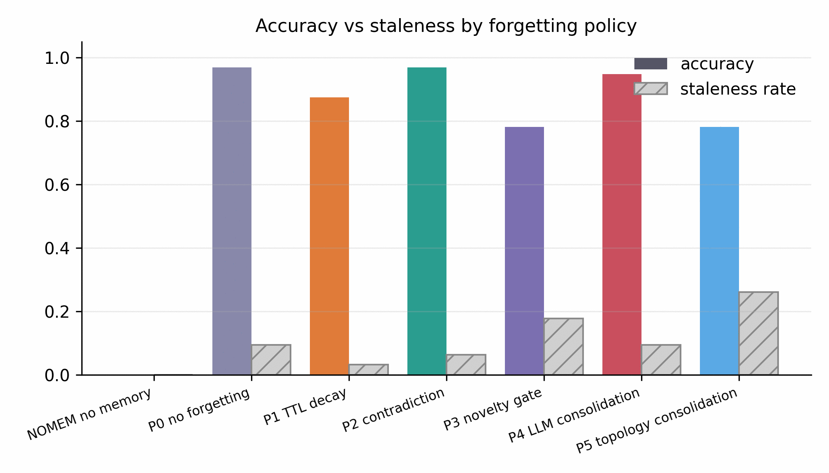
RESULTS
Accuracy and staleness by policy
DRIFT — Nandan Hemanth — Stevens Institute of Technology
11

Slide 13
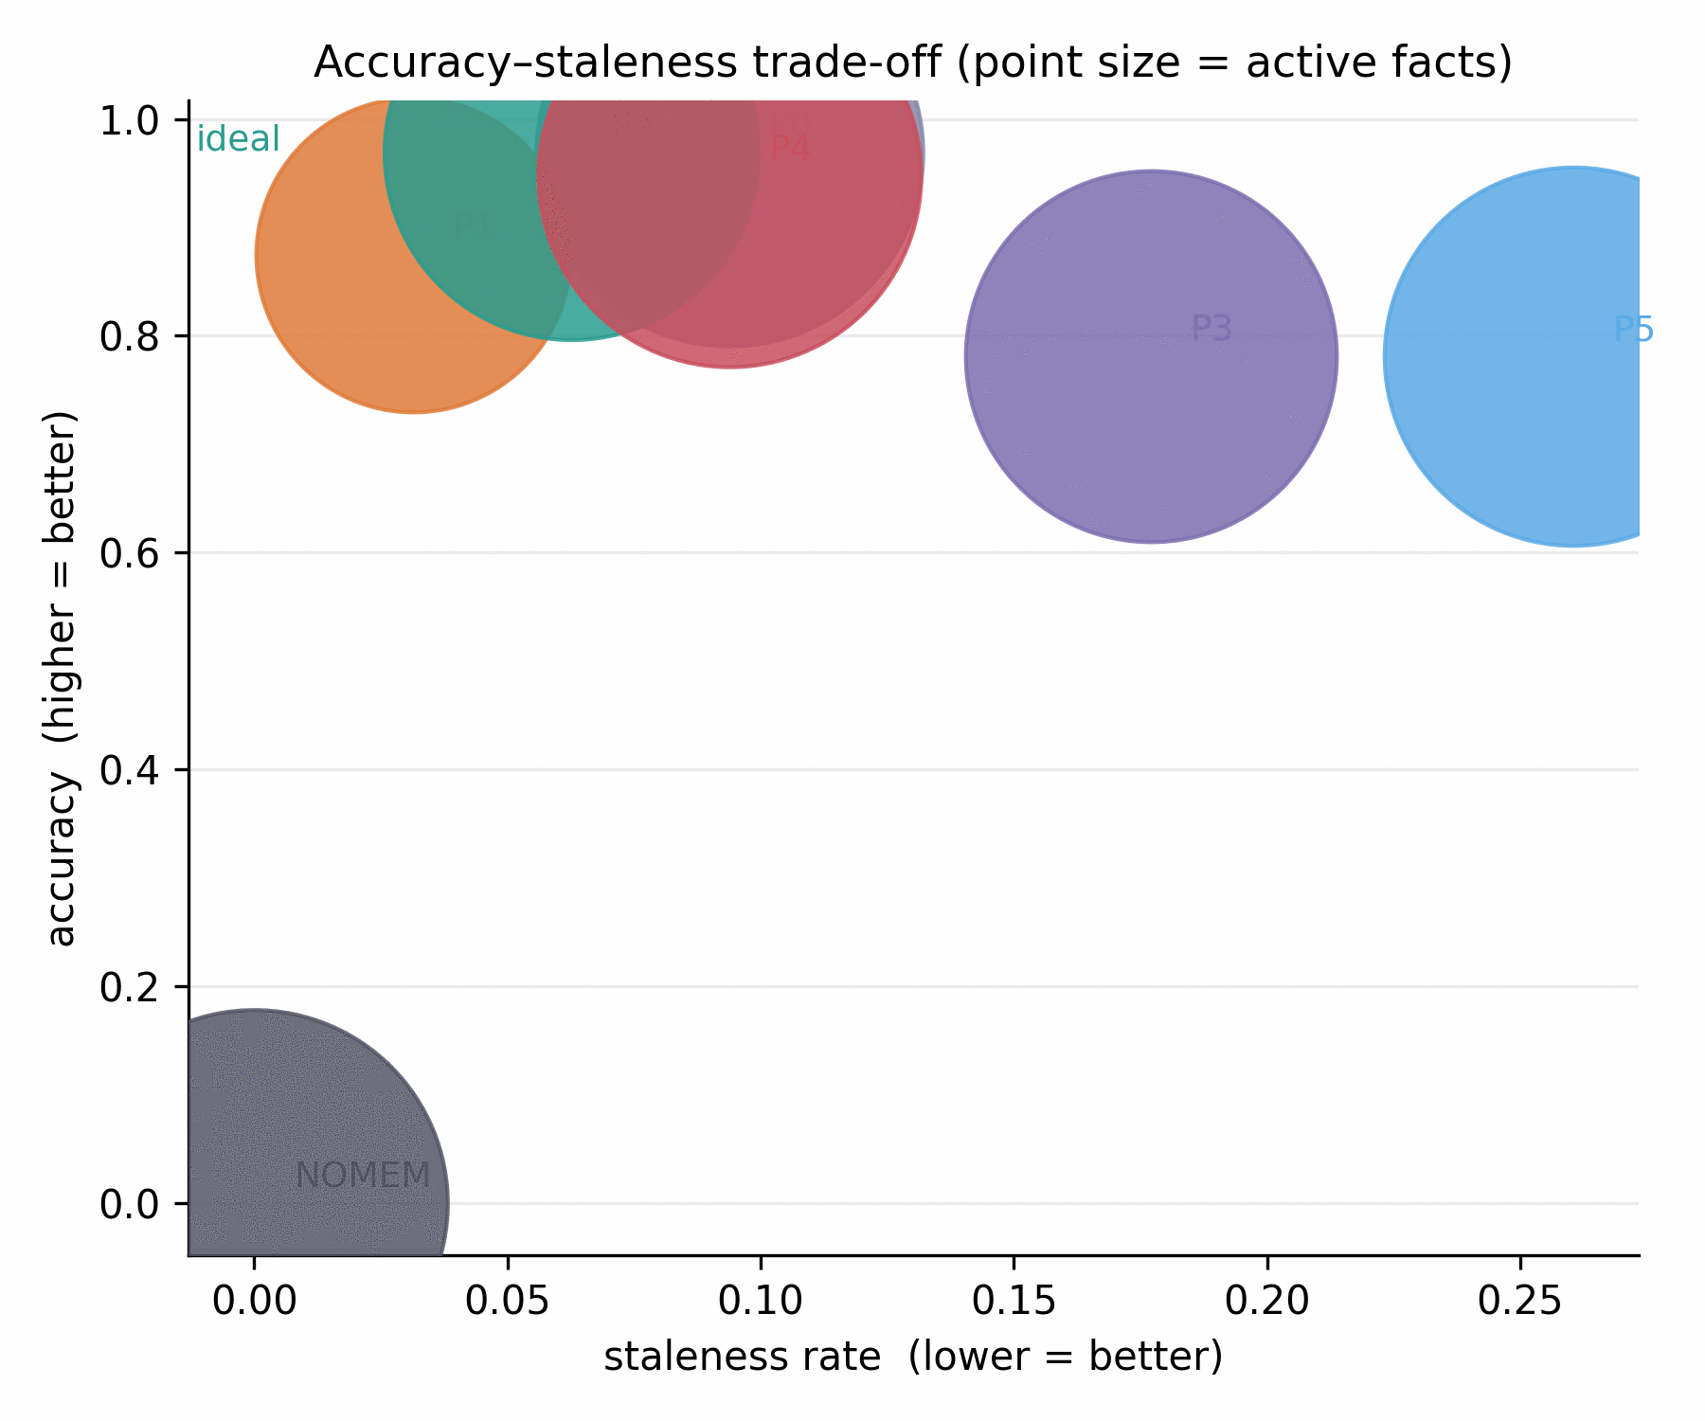
RQ1 & RQ2
Append-only memory surfaces stale facts — and bitemporal invalidation is free
RQ1. P0 staleness excludes zero on both benchmarks — 4.2 to 4.8 stale facts surface per retrieval, out of k=25.
RQ2. P2 matches P0's accuracy exactly (paired Δ = +0.000, 95% CI [−0.021, +0.021]) while spending 12% fewer tokens and storing 6.5–15% fewer facts.
This is an equivalence claim, not a null result.
The paired-bootstrap interval bounds the true gap — it doesn't just fail to reject zero. That's what licenses “forgetting is free.”
DRIFT — Nandan Hemanth — Stevens Institute of Technology
12

Slide 14
RQ3 — THE STRONGEST RESULT
Bitemporal semantics beat structure alone: P2 vs. P5
P2 and P5 share everything — substrate, retrieval, extraction, answer model, judge. Both consolidate. P5 alone is denied valid time and must infer currency from corroboration count.
Metric | P2 | P5 | p
Accuracy | 0.969 | 0.802 | <0.001
Staleness | 0.036 | 0.214 (5.9×) | <0.001
Structural corroboration measures how established a fact is — not whether it is current.
On FactConsolidation (arbitrary entities, uniform corroboration) the same comparison is p=0.022 — real, but noisy. On MQuAKE-T (real office-holders) corroboration is systematically biased, and the mechanism becomes visible.
The mechanism.
A head of state who served 8 years accumulates more corroborating mentions than a successor who took office last month. Corroboration count is systematically biased toward the past — exactly where currency matters.
South Korea, head of state:
P5 → “Moon Jae-in” (wrong) P2 → “Yoon Suk-yeol” (correct)
+16.7 points accuracy, −17.7 points staleness — P2 over P5, both p < 0.001
DRIFT — Nandan Hemanth — Stevens Institute of Technology
13

Slide 15
RQ2 CONTINUED — THE TRANSFERABLE CLAIM
Novelty gating: a bounded saving for an unbounded liability
A correction is, by construction, a near-duplicate of the fact it corrects:
"Thomas Kyd was born in the city of London"
"Thomas Kyd was born in the city of Leeds" ← rejected: cosine similarity too high
The correction never enters memory. No downstream retrieval, reranking, or prompting can recover a value that was never stored.
4.7×
4.5×
14
P3's staleness vs. P2, FactConsolidation
P3's staleness vs. P2, MQuAKE-T
questions, MQuAKE-T, answered wrong from a value P0 got right
Generalizes beyond this implementation: it follows from the definition of a novelty gate and the textual form of a correction, not from any specific design choice made here.
DRIFT — Nandan Hemanth — Stevens Institute of Technology
14

Slide 16
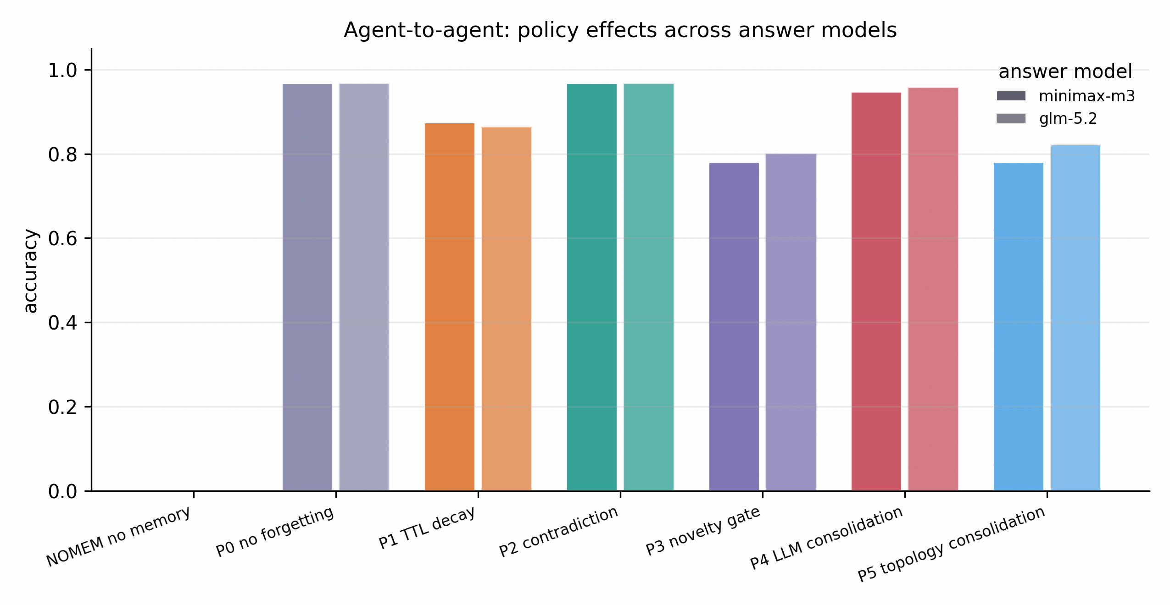
GENERALIZATION ACROSS BENCHMARKS
The ranking mostly holds — and where it moves is informative
Spearman's ρ = 0.891 across all seven policies, both benchmarks
Top and bottom of the ranking are completely stable (P0/P2 lead, P3/NOMEM trail). P1 (TTL decay) moves two places — rank 6 on FactConsolidation, rank 4 on MQuAKE-T.
Why P1 moves.
MQuAKE-T: 100% of questions concern a fact that changed — pruning by age is nearly always safe. FactConsolidation: only 65% are updates — TTL destroys stable, still-answerable facts too.
P1's rank is a property of the workload's update ratio — not an intrinsic property of TTL as a policy.
DRIFT — Nandan Hemanth — Stevens Institute of Technology
15

Slide 17
TWO METHODOLOGICAL FINDINGS
Catching the study's own confounds before reporting them as effects
Configuration ablation
Judge-reliability audit
Reran MQuAKE-T with functional_predicates left undeclared — invalidations dropped 59 → 1, the mechanism essentially off.
P2 accuracy: unchanged (0.969 either way).
Tokens/q: +14.4% worse undeclared.
Active facts: +7.0% worse undeclared.
The setting buys P2 none of its accuracy and all of its efficiency — safe to enable untuned, only pays for itself if configured.
One cell's 96/96 answers were byte-identical to the main run — yet scored 0.844 vs. 0.969. 12 verdicts flipped, all one direction, on verbatim-correct answers.
Root cause: a rotating 3-provider judge pool. One provider drew that cell.
12.5-point artifact identified and corrected before it was reported as a policy effect. Gaps under ~3 points are inside judge noise.
DRIFT — Nandan Hemanth — Stevens Institute of Technology
16

Slide 18
RQ4 — MULTI-AGENT
A real-data pilot found a genuine boundary condition
Synthetic harness validation (14q, mock provider, all 3 topologies x 7 policies): P2 leads every topology, staleness 0.000 throughout — this validates the harness, not the real-data claim.
The finding: P2 records zero invalidations.
Identical to P0's untouched 140 facts. Directly visible in the graph: the same relation gets extracted under different surface forms depending on which model wrote it —
head_of_government (28) vs. is_head_of_government_of (9) vs. head_of_government_of (7)
P2 matches on exact predicate string — a correction under a different surface form never triggers a match, so the window never closes. Only P1 (TTL), which needs no string agreement, keeps working (0.135 vs. 0.271).
16 of 21 cells (both other topologies, plus P4/P5) were not run — a deliberate stop given the defense timeline, not an accident.
Policy | Accuracy | Staleness | Invalid. | Active
NOMEM | 0.000 | 0.000 | 0 | 140
P0 | 0.333 | 0.271 | 0 | 140
P1 (TTL 20d) | 0.281 | 0.135 | 0 | 79
P2 | 0.365 | 0.271 | 0 | 140
P3 | 0.365 | 0.271 | 0 | 140
Real pilot: shared topology, MQuAKE-T, 96 real questions, 5 heterogeneous extraction models (GLM-5.2, MiniMax-M3, Gemini-3.1-Flash-Lite, Nemotron-3-Ultra, Hunyuan).
DRIFT — Nandan Hemanth — Stevens Institute of Technology
17

Slide 19
PRACTICAL RECOMMENDATION
If your agent tracks facts that get corrected over time —
Use bitemporal contradiction invalidation. Declare your domain's functional predicates. Do not use a write-time novelty gate.
Free at the margin
Fails safe
Names what to configure
Statistically equivalent accuracy to never forgetting, at 12% lower cost.
A misconfigured P2 degrades to append-only — never below it.
One inspectable list of predicates — not a hyperparameter search.
Beyond the recommendation: memory hygiene is a correctness problem (18-point accuracy gap), not primarily a cost problem (~12% cost gap) — and a bitemporal record is exactly the structure right-to-be-forgotten and audit requirements need.
DRIFT — Nandan Hemanth — Stevens Institute of Technology
18

Slide 20
THREATS TO VALIDITY
Stated directly — in order of severity
1
Both real-data benchmarks are fact corpora, not natural conversation — extraction is never noisy
2
MQuAKE-T's relations are narrow: mostly head-of-government / head-of-state edits
3
Sample size ≈ 100 questions per benchmark — bounds detectable effect size to ±2.5 points
4
Judge noise: 1–2% baseline, one 15% outlier cell — gaps under ~3 points aren't interpretable
5
RQ4 real-data pilot covers 1 of 3 topologies, 5 of 7 policies (see slide 18)
6
functional_predicates is a per-domain configuration burden, chosen by looking at the data
7
Two mid-size answer models, one provider — neither is a frontier model
DRIFT — Nandan Hemanth — Stevens Institute of Technology
19

Slide 21
CONCLUSION
Four claims, replicated across two benchmarks of different provenance
1
Append-only memory measurably surfaces superseded facts — 4.2 to 4.8 stale facts per retrieval.
2
Bitemporal contradiction invalidation is free — bounded within ±2.5 points of the ceiling, at 12% lower cost.
3
The advantage is attributable to bitemporal semantics specifically, not graph structure in general (+16.7 pts, p<0.001).
4
Novelty-gated writing causes unrecoverable staleness — a transferable claim, not an implementation quirk.
Choosing a forgetting policy without measuring it on the target workload is not a safe default — and the cost of measuring it is now an afternoon.
DRIFT — Nandan Hemanth — Stevens Institute of Technology
20

Slide 22
Thank you
Questions
DRIFT: Decay Rates in Forgetful Bitemporal Memory · Nandan Hemanth · Stevens Institute of Technology

