Slide 1
Weekly update 4
What the full retrieval-weight grid taught me, the three benchmarks, and the final model line-up
Nandan Hemanth · 1 October 2026

Slide 2
This week: every weighting, run end to end
The full 10 x 10 x 10 grid. Every value from 0.1 to 1.0 for semantic, lexical and recency: 1,000 weightings, each answered and graded.
Two benchmarks, two answer models. MQuAKE-T and ConvoMem; Llama 3.1 8B (fast, no reasoning) and Qwen3 8B (reasoning).
Measured at two levels. Retrieval (does the correct or the outdated fact reach the prompt) for P0 and P2, and real answers for P2.
Output. 37,572 graded answers, a full analysis report, and a recommendation for how the weights should be chosen.
Cost and time. About $5 of OpenRouter credit and roughly 10 hours. The same run on the laptop was on course for about 7.5 days.
Headline. The weights matter, almost entirely through one knob (recency), and no weighting can replace a forgetting policy.
1

Slide 3
How the experiment was built
item | value
grid | 10 x 10 x 10 = 1,000 weightings
benchmarks | MQuAKE-T (96 q), ConvoMem (100 q)
policies | P2 answered; P0 and P2 at retrieval
answer models | Llama 3.1 8B, Qwen3 8B (reasoning)
judge | gpt-oss 20B, plus a rule for clear cases
retrieval depth | k = 25 facts
graded answers | 37,572
What made it affordable
Only the ratio matters. Of 1,000 weightings, 841 rank facts differently.
Facts listed by date. Prompts depend only on which facts are picked: 111,500 prompts became 17,036.
Rule grader. Clear cases graded without a model; agrees with the judge on 98.9% of audited answers.
Hosted models. Qwen3 took 32 s per answer locally, 1.2 s on OpenRouter.
One caveat to state. Facts were listed by date, so this measures which facts the weights let in, not whether their order matters. Every retrieval number is identical under either order.
2

Slide 4
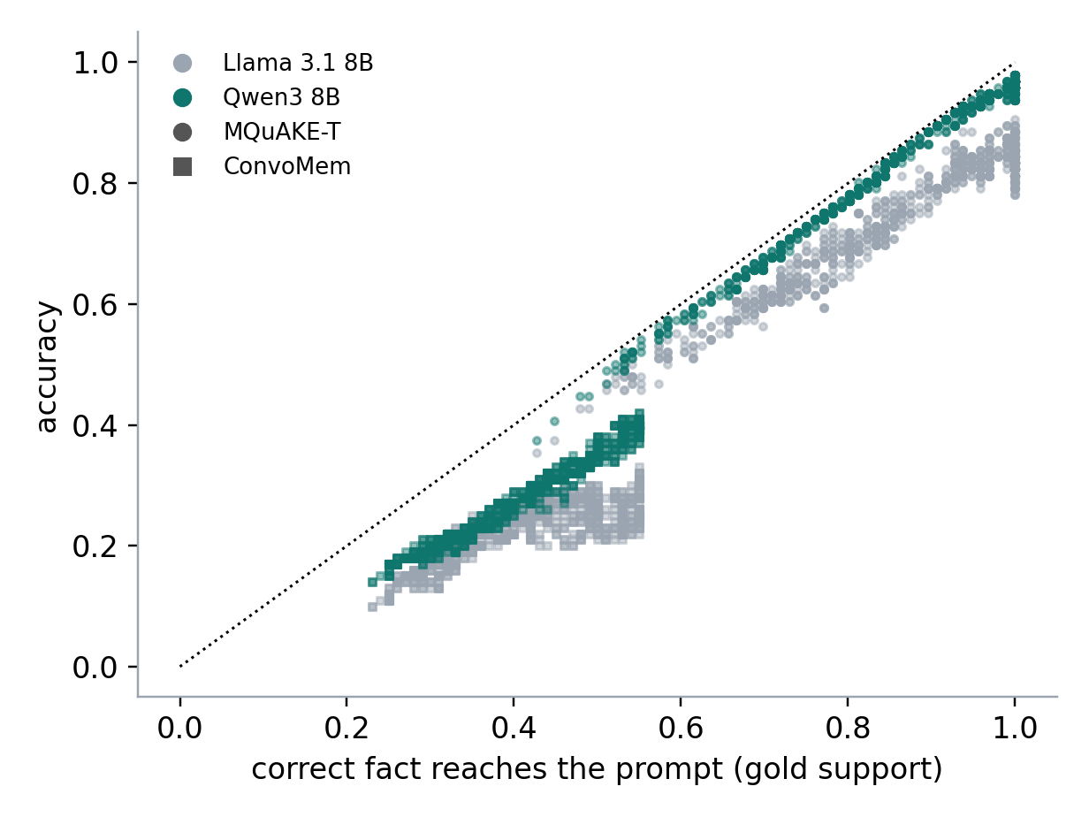
Accuracy is retrieval times reading
 | correct, if fact present | correct, if fact absent | stale, if old fact present
MQuAKE-T, Llama | 0.86 | 0.00 | 0.16
MQuAKE-T, Qwen3 | 0.97 | 0.00 | 0.08
ConvoMem, Llama | 0.48 | 0.05 | 0.32
ConvoMem, Qwen3 | 0.57 | 0.08 | 0.33
The weights only decide whether the right fact arrives. Across weightings, that predicts accuracy at r = 0.99 and 0.96.
No pretraining leakage on MQuAKE-T: without the fact, accuracy is 0.00.
A stale answer never happens unless the old fact is in the prompt.
So the whole problem has two levers: get the correct fact into the prompt (retrieval), and keep the outdated one out (forgetting). The model only decides how well it reads what it is given.
3

Slide 5
Recency is the knob, and it has a cliff at 20%
Accuracy by recency's share of the total weight
Share of the variation each weight explains
outcome | semantic | lexical | recency
MQuAKE-T accuracy | 20% | 14% | 50%
ConvoMem accuracy | 34% | 5% | 48%
MQuAKE-T, fact present | 19% | 16% | 54%
ConvoMem, fact present | 29% | 5% | 60%
Interactions between weights explain at most 6% of accuracy: they act mostly independently.
Why recency hurts. It favours whatever arrived last, which is usually not the fact the question is about. Raising recency alone from 0.1 to 1.0 (others at 0.6 and 0.3) drops MQuAKE-T accuracy from 0.91 to 0.61, significant from 0.5 upward (p = 0.003 and below).
4

Slide 6
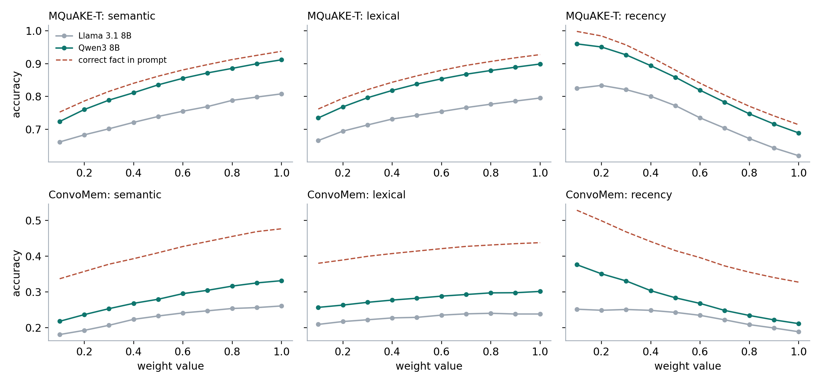
Every value of every weight, both models
Semantic and lexical: more is better, gently.
Recency: more is worse, steeply.
Accuracy follows the dashed line (correct fact present) in every panel.
Qwen3 sits closer to the line: it reads better, but cannot exceed it.
Reading the chart. Each point averages the 100 weightings that share that value, so it includes every combination of the other two weights. This is the direct answer to 'what does changing this weight do'.
5

Slide 7
Semantic and lexical are interchangeable, except in conversation
Accuracy with recency share below 0.2, by semantic share of (semantic + lexical)
MQuAKE-T: flat. Templated facts share their wording with the question, so either signal finds them.
ConvoMem: +7 points from leaning semantic. In conversation the same fact is worded differently each time, and word-matching misses it.
This is a mechanism, not a tuned number: lexical matching fails exactly when phrasing varies.
Practical rule. For conversational memory, give semantic matching the larger share of the two. For entity-keyed facts, the balance does not matter.
6

Slide 8
0.6 / 0.3 / 0.1 survives the full search
 | MQuAKE-T | ConvoMem
accuracy at 0.6 / 0.3 / 0.1 | 0.911 | 0.320
best of 1,000 (picked on the same data) | 0.938 | 0.370
rank of 0.6 / 0.3 / 0.1 | 66 of 1,000 | 80 of 1,000
significantly better, uncorrected | 0 | 1
significantly better, corrected for 999 tests | 0 | 0
significantly worse | 560 | 467
+0.05
how much the 'best' looks better than it is, from picking it on the same questions
21% / 68%
how often the picked best beats 0.6/0.3/0.1 on unseen questions (MQuAKE-T / ConvoMem)
Defensible, not optimal. No alternative beats it once you correct for testing 999 of them, it is in the top 7 to 8% on both benchmarks, and it is significantly better than about half the grid.
The one real edge: on ConvoMem a more semantic-heavy weighting is about 1.4 points better on unseen questions, consistent with the previous slide.
7

Slide 9
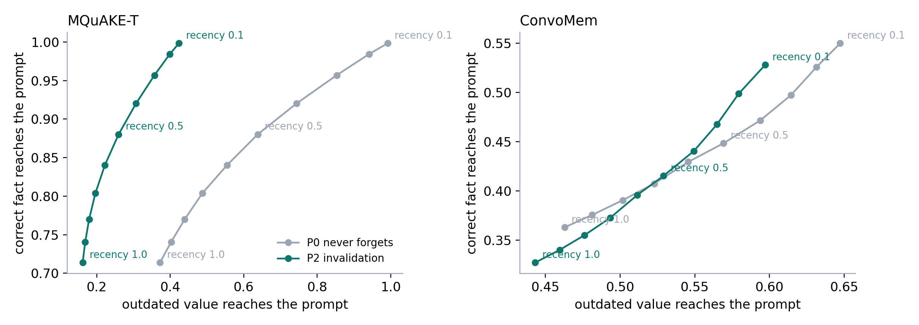
Invalidation does what recency tries to do, without the cost
MQuAKE-T | P0 fact / stale | P2 fact / stale
recency 0.1 | 1.00 / 0.99 | 1.00 / 0.42
recency 0.5 | 0.88 / 0.64 | 0.88 / 0.26
recency 1.0 | 0.71 / 0.37 | 0.71 / 0.16
fact = correct fact in the prompt; stale = outdated value in the prompt
The strongest thesis result this week. Without invalidation, the only way to keep outdated facts out is to turn recency up, and that throws away 26 to 29 points of correct facts. P2 reaches the same low staleness with every correct fact kept. On MQuAKE-T its curve is above P0's everywhere.
ConvoMem: the curves cross, because P2's false invalidations also remove some true facts. Same boundary as before.
8

Slide 10
Staleness: it only happens when the old fact is in the prompt
 | stale answers, range over 1,000 | at 0.6/0.3/0.1 | repeats old fact when present
MQuAKE-T | 0.005 to 0.068 | 0.042 | Llama 16%, Qwen3 8%
ConvoMem | 0.075 to 0.235 | 0.195 | Llama 32%, Qwen3 33%
P2 against P0, every one of the 1,000 weightings
outdated fact in prompt | P2 better | tie | worse
MQuAKE-T | 1000 | 0 | 0
ConvoMem | 993 | 7 | 0
Recency lowers staleness a little, at a big price: on MQuAKE-T from 0.051 to 0.023 while accuracy falls 24 points.
On ConvoMem, lexical weight drives staleness (33% of its variation): the old and new values sit in similar sentences.
A reasoning model halves stale reading on clean facts, but not in conversation.
Conclusion. Staleness is a retrieval problem first: keep the old fact out and the model cannot repeat it. That is the job P2 does, and the weights cannot do it cheaply.
9

Slide 11
Token cost: the weights barely move it; the policy and model do
 | MQuAKE-T | ConvoMem
prompt tokens, range over 1,000 weightings | 367 to 415 | 464 to 500
prompt tokens at 0.6/0.3/0.1, P2 | 378 | 496
same, P0 (never forgets) | 436 | 563
tokens per answer, Llama 3.1 8B | 593 | 641
tokens per answer, Qwen3 8B (thinks) | 999 | 1,012
~50
most prompt tokens any weighting adds or saves
12-13%
fewer prompt tokens with P2 than P0, at the same weights
~$5
for the whole 34,000-answer run (Qwen3 about 90% of it)
For cost, choose the policy and the model, not the weights. A reasoning model spends about 400 extra tokens thinking per answer, roughly 8 times what the weights can change.
10

Slide 12
The model changes how well facts are used, not whether they arrive
 | Llama 3.1 8B | Qwen3 8B (reasoning)
uses the correct fact when present (MQuAKE-T) | 0.86 | 0.97
repeats the outdated fact when present (MQuAKE-T) | 0.16 | 0.08
accuracy spread inside the good region | 0.026 | 0.009
mean accuracy, MQuAKE-T / ConvoMem | 0.74 / 0.23 | 0.83 / 0.28
rank agreement between the two models (MQuAKE-T / ConvoMem) | 0.91 / 0.76
A better reader is three times less sensitive to the exact weights.
Both fail the same way when the correct fact is missing.
Answers the frontier question: stronger models help, but retrieval and forgetting stay the bottleneck.
Why this matters for the final runs. Testing across model sizes should show the forgetting-policy effect holding as models get stronger, while the gap between policies narrows only where reading, not retrieval, was the weakness.
11

Slide 13
How to choose the weights, by scenario
scenario | recommended weights | why
memory with invalidation (P2) | recency share about 0.1 | invalidation already removes outdated facts; recency only loses correct ones
memory without invalidation, staleness costly | recency share 0.2 to 0.3, or add invalidation | recency is the only defence there, and costs accuracy fast past 0.3
conversational, paraphrase-heavy memory | semantic share 0.6 to 0.8, lexical low | semantic worth about 7 points on ConvoMem
templated, entity-keyed facts | any semantic / lexical balance | the balance does not matter on MQuAKE-T
small or weak answer model | stay well inside the good region | three times more sensitive to the exact weights
prompt-cost constrained | ignore the weights for cost | they move prompt size by under 50 tokens
The good region, on both benchmarks and both models: recency at most 20% of the total, and semantic at least equal to lexical. Inside it, MQuAKE-T averages 0.90 and ConvoMem 0.33; outside, 0.77 and 0.25.
For the thesis, keep 0.6 / 0.3 / 0.1. It was fixed before these results and sits inside the region. Changing it now would be choosing on test data.
12

Slide 14
Three benchmarks, three different tests
 | MQuAKE-T | FactConsolidation | ConvoMem
source | temporal knowledge edits (MQuAKE) | MemoryAgentBench, single-hop | changing-facts subset of ConvoMem
made of | real Wikidata facts that changed between snapshots (heads of government, CEOs) | templated facts, each later overwritten by a counterfactual edit | multi-session user and assistant conversations where a detail (time, day, number) changes
size in our runs | 96 questions, 38 sessions, ~380 facts | 100 questions, 38 sessions, ~380 facts | 100 questions, 10 conversations, 200 sessions
outdated answer known for | 96 of 96 questions | 65 of 100 questions | 100 of 100 questions
what it tests | returning the current value after a real-world change | maximum staleness pressure: nearly every fact is superseded | realistic dialogue: extraction, paraphrase, noisy updates
how it helps the thesis | clean, templated facts isolate the policy effect | counterfactual, so the model cannot answer from pretraining | shows where invalidation breaks (fact naming) and still helps (staleness)
Together: one real-world, one adversarial, one conversational. A result that holds on all three is not an artefact of one data format.
13

Slide 15
Proposed model line-up for the final thesis experiments
tier | model | price per 1M tokens (in / out) | why this one | est. cost, full matrix
frontier | OpenAI GPT-6.1 Sol | $2 / $10 | frontier tier at 1/5 the flagship price | $3 to $9
frontier | Anthropic Claude Sonnet 5.5 | $2 / $10 | frontier tier from a second family | about $3
mid | Google Gemini 3.8 Flash | $0.75 / $3.75 | third family, strong and cheap | $1 to $3
small | Meta Llama 3.1 8B | $0.02 / $0.04 | already run; fast, no reasoning | under $0.05
small, reasoning | Qwen3 8B | $0.12 / $0.46 | already run; shows the effect of thinking | about $0.55
judge | DeepSeek V4.1 Flash | $0.03 / $0.60 | a family none of the answer models share | about $0.25
Full matrix per model: 7 policies x 296 questions across the three benchmarks = 2,072 answers. Extraction is already cached and reused, so only answering and grading cost money.
Total: about $8 to $16 for every model on every benchmark. Before the full run, the new judge would be checked against Claude Opus on 200 answers. Prices are OpenRouter's as of 1 October 2026.
14

Slide 16
What I learned this week
Accuracy is retrieval times reading. The weights only control whether the right fact arrives; that predicts accuracy at r = 0.99.
Recency is the only weight that really matters, and past 20% of the total it costs accuracy fast.
No weighting replaces forgetting. Recency removes outdated facts only by removing correct ones too; P2 removes just the outdated ones.
0.6 / 0.3 / 0.1 is defensible, not optimal: never beaten after correction, top 7 to 8% on both benchmarks.
Stronger models read better but cannot fix missing facts, so retrieval and forgetting remain the bottleneck as models improve.
Engineering lesson: deduplicating prompts and moving answers to hosted models turned a 55-day experiment into a 10-hour, $5 one.
15

