Slide 1
Weekly update 7
DRIFT: Detecting and Retiring Invalidated Facts over Time
Week 6 feedback addressed: new name, pipeline, correctness of the forgetting policies, checkpoint 2 across all 1,000 weightings
Nandan Hemanth · 29 October 2026

Slide 2
Previously (Week 6), and the feedback this week addresses
WEEK 6 final run complete: 7 policies x 5 answer models x 3 benchmarks, 105 cells, 10,360 graded answers; all four RQs answered.
P2 best on both fact benchmarks: accuracy 93.5% → 98.5% and 67.4% → 79.4%.
Small models gain most; the timeline, not the graph, is what helps.
RQ4: rankings transfer to multi-agent memory.
ConvoMem: negative result, limited by extraction.
feedback from the meeting | slide
Name and story: does DRIFT fit the thesis? | 2
Pipeline and workflow, general takeaways | 3
What exactly is a forgetting policy? | 4
RQ2 as a bar chart, P2 highlighted | 5
RQ3 in percentages, y-axis to 100% | 6
Checkpoint 3: 'close to' the frontier | 7
Spearman for RQ4: formula, why, reference | 8
Checkpoint 2: all 1,000 weightings, mean, variance, min, max | 9, 10
Justify correctness: empirical and theoretical | 11, 12
Observe decay; ConvoMem retrieval question | 13, 14
All values are the final run. Accuracy and staleness are shown as percentages throughout.
1

Slide 3
A name that tells the thesis story
WHY CHANGE 'Decay Rates' suggests memory should fade with age, but deleting by age (P1) made memory worse. What helps is removing facts that are no longer true.
word | what it is in DRIFT | where it is measured
Detecting | noticing that a new fact replaces a stored one (same subject and relation, new value) | matching study: rules catch 95 of 96 changes; LLM check needed across writers
Retiring | hiding the replaced fact from retrieval at once, deleting it after the grace period | P2 vs the other five policies; grace-period study
Invalidated Facts | facts whose validity window has closed: still stored, no longer current | staleness: answers that repeat an invalidated value
over Time | the bitemporal timeline: when a fact was true, and when the agent learned it | P2 vs P5 (same graph, no dates): +23.5 and +15.2 points
The story in one line: memory should detect when a fact has been replaced and retire the old one using its timeline; the thesis measures how much that matters, compared with five other forgetting rules.
2

Slide 4
The DRIFT pipeline: everything is fixed except the forgetting policy
HOOKS the three highlighted points are where a forgetting policy can act; every other stage is identical in every experiment.
Sessions
dated conversation text
Extraction
DeepSeek turns text into facts
Write hook
on_write: P3 may refuse
Bitemporal graph
contradiction closes the old fact
Maintenance hook
after_session: P1 P2 P4 P5 delete
Retrieval
0.6 meaning + 0.3 words + 0.1 recency, top 25
Retrieval hook
on_retrieve: P2 hides closed facts
Answer + grading
answer model; rules + judge
→
→
→
→
→
→
→
DETECTING
RETIRING (P2: hide now, delete after the grace period)
One question through the pipeline (MQuAKE-T, Llama 3.1 8B)
 | what reaches the prompt | answer | prompt tokens
P0 append-only | Hipkins (29 Jan) and Ardern (7 Jan); 8 of 25 lines outdated | Ardern (stale) | 609
P2 bitemporal | Hipkins only; 0 outdated lines | Hipkins (correct) | 531
General takeaways: retrieval cannot separate old from new (they differ in one value); the policy must. Hiding replaced facts removes the problem before the model sees it, and also cuts prompt tokens.
3

Slide 5
What a forgetting policy is: refuse, hide or delete (closing is not forgetting)
DEFINITION a forgetting policy decides which stored facts the answer model can no longer see. Closing a fact's validity window happens in the store for every policy, including P0, which forgets nothing.
action | when | reversible? | policies | example
close (not forgetting) | a later fact replaces it | yes: still stored and visible | all, in the store | Ardern fact gets an end date
refuse | at write | no: never stored | P3 | the Hipkins correction is rejected as a duplicate
hide | at retrieval | yes | P2 (closed facts), NOMEM (all) | Ardern stays stored, never shown
delete | after a session | no | P1 (age), P2 (after grace), P4 (LLM), P5 (support) | Ardern removed after 7 days (P2)
Why P2 hides first and deletes later: hiding gives the accuracy benefit immediately and is reversible, so questions about the past can still be answered; deleting saves storage once the grace period has passed (slide 13).
4

Slide 6
RQ2: P2 is the most accurate policy on both fact benchmarks
HOW TO READ accuracy by policy, mean over the five answer models; P2 highlighted. Gains are in percentage points; every one has p < 0.01 after Holm correction.
MQuAKE-T accuracy (%)
FactConsolidation accuracy (%)
P2 gain over | P0 keep all | P1 time decay | P3 novelty gate | P4 LLM review | P5 topology
MQuAKE-T | +5.0 pts | +14.0 pts | +20.2 pts | +7.1 pts | +23.5 pts
FactConsolidation | +12.0 pts | +22.2 pts | +25.2 pts | +37.8 pts | +15.2 pts
5

Slide 7
RQ3: it is the timeline that helps, not the graph
P5 sees the same facts and graph as P2 but not the dates, so it must guess which of two conflicting facts is current.
MQuAKE-T accuracy (%), P2 vs P5
FactConsolidation accuracy (%), P2 vs P5
Answer: P2 beats P5 for every model: +23.5 points on MQuAKE-T (113 questions won, 0 lost) and +15.2 points on FactConsolidation, both p < 0.001. Structural support favours the value mentioned longest, which is the old one.
6

Slide 8
Checkpoint 3: with P2, small models come close to the frontier
COST PER CORRECT ANSWER list-price USD for 1,000 correct answers under P2 on MQuAKE-T.
FactConsolidation accuracy (%), P0 → P2
model | P2 acc. MQuAKE-T | $ / 1k correct
Claude Sonnet 5.5 | 99.0% | $1.73
GPT-6.1 Sol | 99.0% | $1.10
Gemini 3.8 Flash | 99.0% | $0.47
Qwen3 14B | 97.9% | $0.12
Llama 3.1 8B | 97.9% | $0.01
Answer: P2 adds +12.0 points (MQuAKE-T) and +26.5 points (FactConsolidation) for small models, against +0.5 and +3.0 for frontier models. Llama 3.1 8B comes close to the frontier on real updates (97.9% vs 99.0%) at about 1/160 of Claude's cost per correct answer; a gap remains on invented facts (62% vs 86%).
7

Slide 9
RQ4: Spearman correlation, what it measures and why it is used
SPEARMAN'S ρ compares two rankings of the same items: 1 = identical order, 0 = unrelated, −1 = reversed (Spearman, 1904, American Journal of Psychology 15(1), 72 to 101).
Formula: ρ = 1 − 6·Σd² / (n(n² − 1)), where d is a policy's rank difference and n = 6 policies.
Why this metric: RQ4 asks whether the order of policies holds, not whether the scores stay the same; Spearman uses ranks only, so a lower overall accuracy does not count as disagreement.
What it measures: agreement between the single-agent ranking and each multi-agent ranking (accuracy).
rank | single agent | independent agents
1 | P2 (98.5%) | P2 (73.3%)
2 | P0 (93.5%) | P0 (73.1%)
3 | P4 (91.5%) | P4 (72.3%)
4 | P1 (84.6%) | P1 (64.8%)
5 | P3 (78.3%) | P5 (64.0%)
6 | P5 (75.0%) | P3 (63.5%)
Worked example: only P3 and P5 swap, so Σd² = 1 + 1 = 2 and ρ = 1 − 12/210 = 0.94.
Result: ρ = 0.94 (independent), 0.93 (orchestrator, shared): the policy order transfers; P2 is best or tied-best everywhere. With only 6 items, one swapped pair costs about 0.06.
8

Slide 10
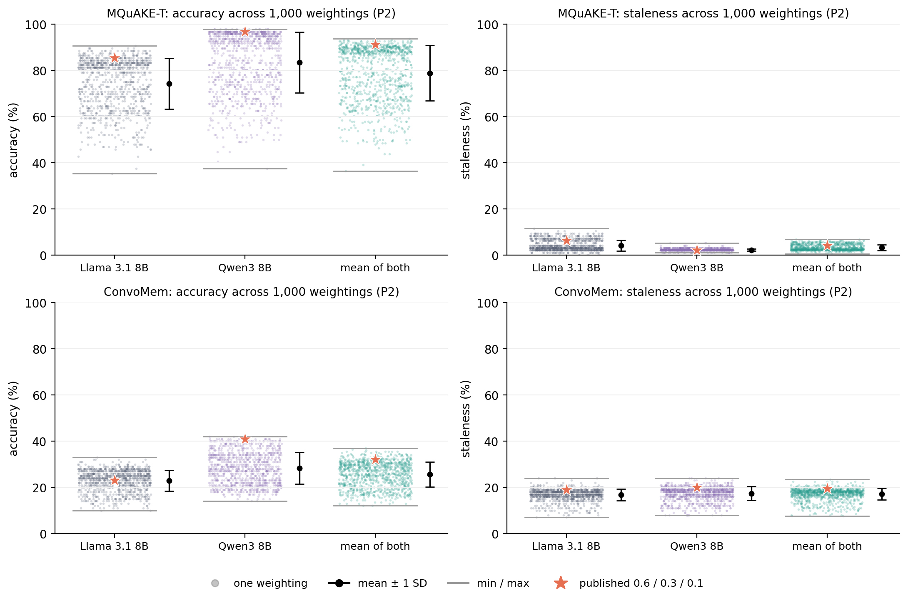
Checkpoint 2: results across all 1,000 retrieval weightings
THE SWEEP every weighting with semantic, lexical and recency each from 0.1 to 1.0 (10 x 10 x 10), P2, two small models, MQuAKE-T and ConvoMem: 37,572 graded answers.
mean of both models | mean | SD | min | max | published
MQuAKE-T acc. | 78.8% | 12.0% | 36.5% | 93.8% | 91.1%
ConvoMem acc. | 25.6% | 5.4% | 12.0% | 37.0% | 32.0%
MQuAKE-T stale | 3.2% | 1.2% | 0.5% | 6.8% | 4.2%
ConvoMem stale | 17.1% | 2.5% | 7.5% | 23.5% | 19.5%
Accuracy: only 6.5% (MQuAKE-T) and 7.9% (ConvoMem) of weightings score higher; none significantly after Holm.
Variance: 0.0144 and 0.0029 (accuracy as a fraction).
Staleness is higher at 0.6/0.3/0.1 than with heavy recency, which costs accuracy; P2, not the weights, removes staleness.
9

Slide 11
Checkpoint 2: the retrieval weights hold on unseen data
RETRIEVAL SCORE 0.6 x cosine (meaning) + 0.3 x word overlap + 0.1 x recency; the 25 best-scoring facts reach the prompt.
weighting (FactConsolidation, P2) | Llama 3.1 8B | Qwen3 14B
0.6 / 0.3 / 0.1 (thesis setting) | 62% | 77%
0.9 / 0.1 / 0.2 (MQuAKE-T winner) | 62% (p = 1.0) | 81% (p = 0.34)
0.8 / 0.1 / 0.1 (ConvoMem winner) | 56% (p = 0.21) | 78% (p = 1.0)
Search (Week 5): 1,000 weightings, none better after Holm correction.
Held-out (now): FactConsolidation was never searched; neither winner is significantly better.
Holm correction: adjusts p-values when many weightings are tested, so luck does not look like a win.
What I will claim: not 'the best weights' but a robust setting: not beaten anywhere it has been tested, inside the safe region (recency share at most 0.2), and confirmed on data it was never tuned on.
10

Slide 12
Is a forgetting policy correct? Definition and theoretical analysis
CORRECT sound = never hides a fact that is still true (protects accuracy); complete = hides every fact that is no longer true (protects against staleness).
policy | what the rule decides on | prediction from the rule
P2 bitemporal | has a later fact replaced this one? | sound and complete whenever contradiction detection is correct; its errors are detection errors
P1 time decay | is the fact older than 20 days? | age is not truth: deletes true old facts, keeps recent replaced ones
P3 novelty gate | is the new fact too similar to a stored one? | a correction above 0.9 similarity can never be stored
P4 LLM consolidation | does the model believe the fact? | sound only when the world matches the model's training
P5 topology | which value has more support in the graph? | no dates, so it favours the longest-mentioned (old) value
Staleness bound: P(stale) = P(old value in the prompt) x P(model repeats it). The sweep measured P(stale | old value not shown) = 0%, so a complete policy gives zero staleness for any model; that is why small models gain most.
11

Slide 13
Correctness, empirically: P2 never hid a true fact
MEASURED for every changed fact, the memory at the end of the run: is the old value still visible, is the current value still visible? Mean over the five models.
policy | MQuAKE-T complete | MQuAKE-T sound | FactCons. complete | FactCons. sound
P0 append-only | 0.0% | 100.0% | 0.0% | 100.0%
P1 time decay | 41.7% | 89.6% | 61.5% | 82.8%
P2 bitemporal | 96.9% | 100.0% | 82.7% | 100.0%
P3 novelty gate | 1.0% | 87.5% | 1.9% | 75.0%
P4 LLM consolidation | 0.0% | 99.0% | 0.4% | 47.2%
P5 topology | 1.9% | 81.0% | 3.8% | 92.2%
P2: 100% sound on both; 96.9% and 82.7% complete. The misses are relation names written two ways (created_in_country vs created_in), which the LLM check fixes.
P3 loses corrections (75 to 88% sound); P4 deleted half the true values on FactConsolidation (47.2% sound).
P5 and P4 almost never retire the old value (0 to 4% complete).
Exception, ConvoMem: false contradictions make P2 unsound in dialogue: it hid 4 of the 14 relevant current facts, which matches its 3.8-point accuracy loss. Values matched by rule from the saved graphs; treat as close estimates.
12

Slide 14
Observing decay: how each policy's memory evolves over 38 sessions
OUTDATED AND VISIBLE facts whose validity has closed but which retrieval can still return. P2 hides them, so the count it exposes is zero by design (MQuAKE-T).
Facts kept in memory
Outdated facts still visible to retrieval
Grace period (P2): current accuracy stays 96.9% to 97.9% at every setting (Qwen3 14B); history accuracy rises 12.5% (0 days) → 53.1% (7) → 90.6% (21) → 99.0% (never), with storage 296 → 382 facts.
13

Slide 15
ConvoMem: is retrieval the reason it fails?
CHECKED where each ConvoMem question is lost, from the saved final-run graphs and the 1,000-weighting sweep.
stage (100 questions, mean over models) | P0 | P2
current value anywhere in memory | 30% | 30%
... in a fact about the question | 14% | 14%
... reaches the top 25 retrieved | 14% | 10%
answered correctly | 11.0% | 7.2%
Extraction is the ceiling: the answer is stored for only 14 of 100 questions.
Retrieval ranking loses nothing: under P0 all 14 reach the prompt; the best of 1,000 weightings finds the gold value for 58% vs 57% for 0.6/0.3/0.1 (sweep).
P2's loss happens at retrieval time: its filter hid 4 of the 14 after false contradictions.
Answer: retrieval ranking is not the bottleneck; extraction is. P2's 3.8-point loss is its retrieval filter acting on false contradictions, so the fix is better detection and extraction in dialogue, not different weights.
14

Slide 16
Thesis status and next steps
THESIS the final document is being written by me, line by line, in Overleaf on the Stevens template.
item | status
Overleaf project: chapters, tables and final-run figures in place | done
Title updated to Detecting and Retiring Invalidated Facts over Time | done
Chapters 1 to 3 rewritten in my own words with the comments addressed | in progress
Chapter 4 results and Chapter 5 analysis, including correctness and the 1,000-weighting sweep | in progress
Chapter 6 discussion and conclusion | next
Defense: 3 December, 2:00 pm (Zoom) | date set
Questions for the committee: is the new title acceptable, and is the soundness and completeness analysis the right form of correctness argument for Chapter 5?
15

