Slide 1
A CONTROLLED STUDY OF FORGETTING POLICIES
IN LLM AGENT MEMORY
DRIFT: Decay Rates in Forgetful Bitemporal Memory
Nandan Hemanth
Advisor: Dr. Hao Wang · Reader: Dr. Joseph Helsing
Master of Science in Applied Artificial Intelligence
Stevens Institute of Technology

Slide 2
THE PROBLEM
Memory that never forgets keeps answering with facts that are no longer true
“I live in Boston.”
session 1
“I moved to Seattle.”
session 47, three months later
“Where do I live?”
Both facts are retrieved: similar, both recent enough.
Answer: “Boston.”
The correct fact was found and stored, so this is not a retrieval failure. It is a failure of memory hygiene: nothing in the system ever marked the old fact as no longer current, and nothing removed it.
The failure compounds with time. An agent running for a year accumulates thousands of facts, an increasing fraction of them superseded.
DRIFT · Nandan Hemanth · Stevens Institute of Technology
1

Slide 3
WHY THIS HASN'T BEEN SETTLED
Production memory systems address storage and retrieval, not forgetting
MemGPT
Zep
Mem0
A-MEM
Pages context in and out like an OS, and treats the window as physical memory.
Temporal knowledge graph for agent memory: records validity, but does not compare policies for acting on it.
Scalable long-term store, aimed at production deployment cost and latency.
An LLM agentically decides memory structure and linking.
In every one of these, the treatment of superseded information is secondary, and where a forgetting mechanism exists, it was chosen by the system's authors rather than measured against alternatives.
The confound: compare two published systems and a difference could come from the substrate, retrieval, extraction, prompt, or model, not the forgetting rule. What's missing is a controlled comparison.
DRIFT · Nandan Hemanth · Stevens Institute of Technology
2

Slide 4
HYPOTHESIS & RESEARCH QUESTIONS
One question, isolated
H: Selective forgetting grounded in bitemporal structure improves an agent's answer quality and cost profile relative to append-only memory and to structure-blind or novelty-based forgetting.
RQ1
Does append-only memory measurably surface superseded facts?
RQ2
Which forgetting policy offers the best accuracy / staleness / cost trade-off?
RQ3
Does bitemporal structure specifically win, or would any graph-aware consolidation do?
RQ4
Do policy rankings survive multi-agent use, where the reader isn't the writer?
DRIFT · Nandan Hemanth · Stevens Institute of Technology
3

Slide 5
NOVELTY & POSITIONING
Not a new data structure, a new experimental design
Bitemporal modeling is decades old in database research, and Zep already applies a version of it to agent memory. The novelty is in what a controlled design makes visible.
N1
Forgetting policy as the isolated variable
N2
The bitemporal-vs-structure-blind ablation
First study holding substrate, extraction, retrieval, answer model, and judge fixed, varying only the forgetting rule across seven conditions.
P5 is exactly as structure-aware as P2, minus valid time. This isolates bitemporal semantics from graph structure in general.
N3
Novelty gating named as a measured failure mode
N4
A negative result about the standard benchmarks
First controlled demonstration that write-side novelty gating trades a bounded saving for an unbounded correctness liability.
LoCoMo and LongMemEval carry zero superseded-answer annotations, so they cannot support this measurement at all.
DRIFT · Nandan Hemanth · Stevens Institute of Technology
4

Slide 6
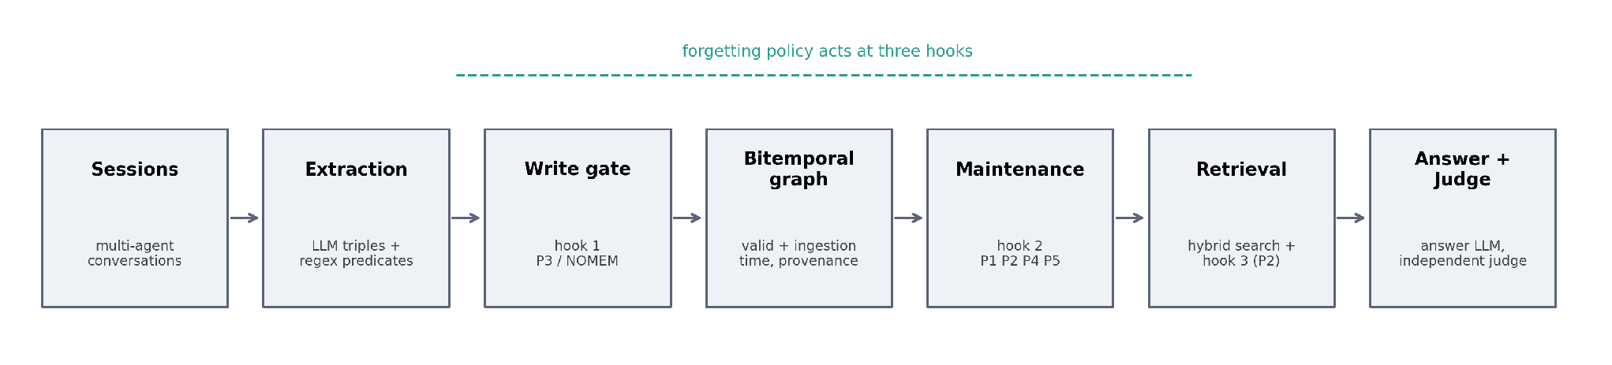
METHOD
The pipeline: one substrate, one variable
extraction → policy.on_write() → bitemporal graph → policy.after_session()
→ hybrid retrieval → policy.on_retrieve() → answer → judge
DRIFT · Nandan Hemanth · Stevens Institute of Technology
5

Slide 7
METHOD
A policy is exactly three hooks over a bitemporal fact
Every fact carries two timelines
class Policy:
t_valid_start when the fact became true of the world
t_invalid_at when it stopped being true, null while current
def on_write(fact, graph) -> bool:
t_ingested when the agent learned it
# False rejects the write
t_pruned when a policy removed it, null while retained
def after_session(graph, provider, now):
provenance which agent wrote it
# periodic maintenance
Contradictions on functional predicates close the old window non-destructively. The fact stays; only a policy removes or hides data. This is what guarantees any measured difference comes from the policy.
def on_retrieve(facts, now) -> list:
# filter or rerank
Adding a policy = one subclass + one registry line.
The runner, substrate, providers, and analysis code
never need to change.
DRIFT · Nandan Hemanth · Stevens Institute of Technology
6

Slide 8
METHOD
Seven policies, one substrate
Policy | Mechanism | Role
NOMEM | Retrieval returns nothing | floor baseline
P0 | Append-only; nothing gated, pruned, or filtered | ceiling baseline
P1 | TTL decay: prune facts older than ttl_days by valid time | classical
P2 | Exclude superseded facts at retrieval; prune after 7-day grace | bitemporal
P3 | Reject writes whose neighborhood cosine exceeds 0.9 | after SAGE
P4 | Every 3rd session an LLM decides keep/drop, plus dedup merge | after Zhang et al.
P5 | Resolve conflicts by corroboration count, denied valid time | ablation partner to P2
DRIFT · Nandan Hemanth · Stevens Institute of Technology
7

Slide 9
EXPERIMENTAL SETUP
The benchmark negative result, and the two that work
Staleness requires knowing the wrong (superseded) answer for each question. Auditing the field's standard benchmarks:
Benchmark | Questions | stale_answer coverage | Used?
LoCoMo | 300 | 0 percent | no
LongMemEval | 150 | 0 percent | no
FactConsolidation | 100 | 65 percent | yes
MQuAKE-T | 96 | 100 percent | yes
On the first campaign, staleness read 0.000 across all 42 cells. It briefly looked like a finding. It wasn't: the metric structurally could not fire on that data.
FactConsolidation
Later facts overwrite earlier ones on the same subject and predicate. Gold answers are counterfactual, so parametric knowledge is actively unhelpful.
MQuAKE-T
Real Wikidata snapshots, April 2021 versus April 2023. Updates are real, not injected: the generalization test.
DRIFT · Nandan Hemanth · Stevens Institute of Technology
8

Slide 10
EXPERIMENTAL SETUP
Models, providers, and what was actually configurable
DRIFT trains nothing. It evaluates already-trained models as pipeline components.
Role | Models
Answer | GLM-5.2, MiniMax-M3 (OpenRouter)
Extraction | GLM-5.2, MiniMax-M3, gpt-oss-120b, Llama-3.3-70B, Llama-3.1-8B, Mistral Small
Judge | gpt-oss:20b, gpt-oss-20b, Command-R7B (a different family than the answer model)
Embedding | nomic-embed-text, 768-dim, local via Ollama
Held fixed across every cell:
Retrieval weighting (0.6 cosine + 0.3 lexical + 0.1 recency), k = 25. Never varied as a condition.
The one thing a new deployment must configure:
functional_predicates: which relations in a domain are single-valued. Quantified precisely in the ablation (slide 17).
DRIFT · Nandan Hemanth · Stevens Institute of Technology
9

Slide 11
RESULTS
Headline results : MQuAKE-T, pooled across both answer models
Policy | Accuracy | Staleness | Tok/q | Facts
NOMEM | 0.000 | 0.000 | 233 | n/a
P0 | 0.969 | 0.052 | 816 | 382
P1 (TTL 20d) | 0.870 | 0.026 | 807 | 251
P2 | 0.969 | 0.036 | 716 | 357
P3 | 0.792 | 0.161 | 805 | 351
P4 | 0.953 | 0.057 | 804 | 372
P5 | 0.802 | 0.214 | 816 | 365
+0.000
P2 minus P0 accuracy, MQuAKE-T: statistically equivalent
–12%
tokens per question, P2 vs. P0
6.5–15%
fewer facts stored, P2 vs. P0
DRIFT · Nandan Hemanth · Stevens Institute of Technology
10

Slide 12
RESULTS
Headline results : FactConsolidation, pooled across both answer models
Policy | Accuracy | Staleness | Tok/q | Facts
NOMEM | 0.000 | 0.000 | 250 | n/a
P0 | 0.840 | 0.030 | 812 | 380
P1 (TTL 20d) | 0.630 | 0.020 | 799 | 210
P2 | 0.840 | 0.025 | 715 | 324
P3 | 0.665 | 0.140 | 806 | 334
P4 | 0.800 | 0.060 | 814 | 374
P5 | 0.795 | 0.035 | 812 | 365
+0.000
P2 minus P0 accuracy, FactConsolidation: statistically equivalent
–12%
tokens per question, P2 vs. P0
14.7%
fewer facts stored, P2 vs. P0
DRIFT · Nandan Hemanth · Stevens Institute of Technology
11

Slide 13
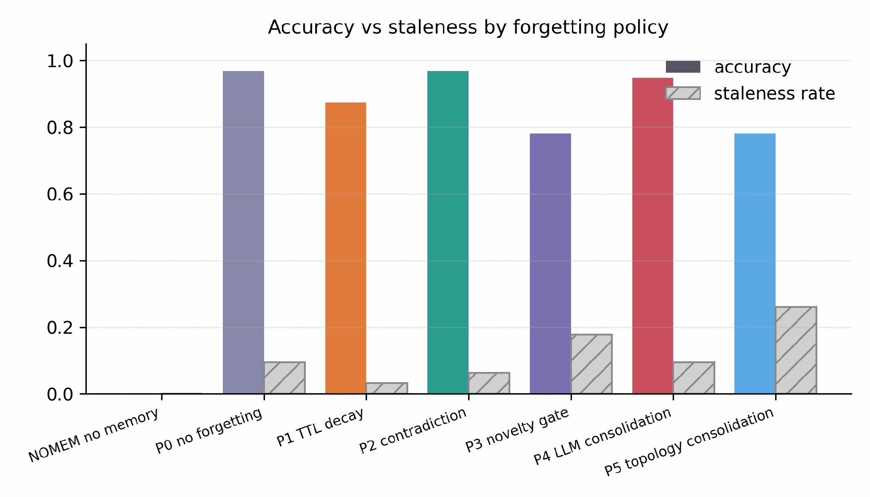
RESULTS
Accuracy and staleness by policy
DRIFT · Nandan Hemanth · Stevens Institute of Technology
12

Slide 14
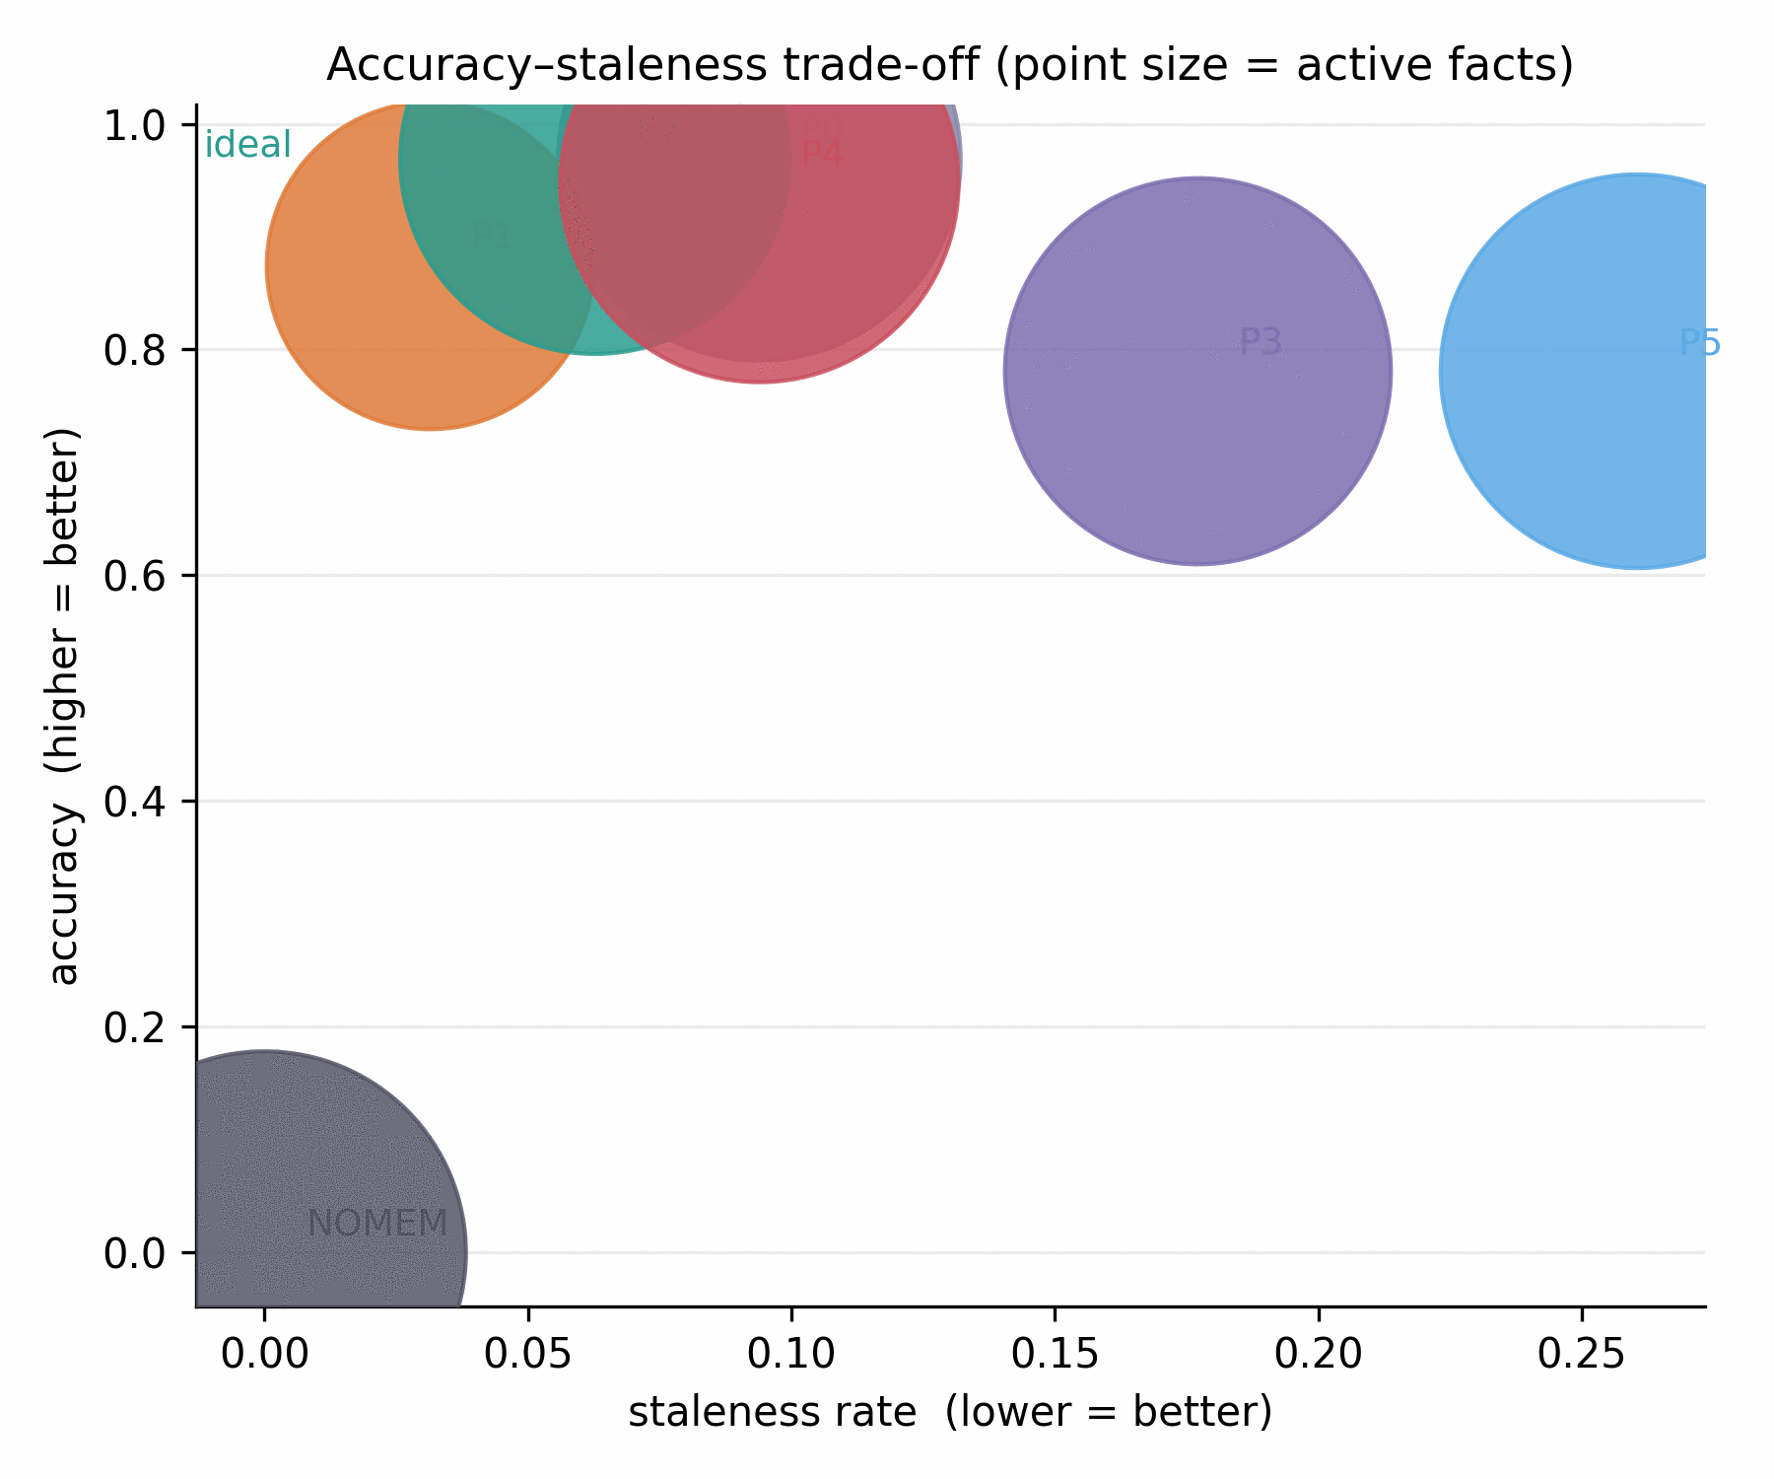
RQ1 & RQ2
Append-only memory surfaces stale facts and bitemporal invalidation is free
RQ1. P0 staleness excludes zero on both benchmarks: 4.2 to 4.8 stale facts surface per retrieval, out of k = 25.
RQ2. P2 matches P0's accuracy exactly (paired Δ = +0.000, 95% CI [−0.021, +0.021]) while spending 12% fewer tokens and storing 6.5–15% fewer facts.
This is an equivalence claim, not a null result.
The paired-bootstrap interval bounds the true gap. It doesn't just fail to reject zero. That's what licenses “forgetting is free.”
DRIFT · Nandan Hemanth · Stevens Institute of Technology
13

Slide 15
RQ3: THE STRONGEST RESULT
Bitemporal semantics beat structure alone: P2 vs. P5
P2 and P5 share everything: substrate, retrieval, extraction, answer model, judge. Both consolidate. P5 alone is denied valid time and must infer currency from corroboration count.
Metric | P2 | P5 | p
Accuracy | 0.969 | 0.802 | <0.001
Staleness | 0.036 | 0.214 (5.9×) | <0.001
Structural corroboration measures how established a fact is, not whether it is current.
On FactConsolidation (arbitrary entities, uniform corroboration) the same comparison is p = 0.022, real but noisier. On MQuAKE-T (real office-holders) corroboration is systematically biased, and the mechanism becomes visible.
The mechanism.
A head of state who served 8 years accumulates more corroborating mentions than a successor who took office last month. Corroboration count is systematically biased toward the past, exactly where currency matters.
South Korea, head of state:
P5 → “Moon Jae-in” (wrong) P2 → “Yoon Suk-yeol” (correct)
+16.7 % accuracy, −17.7 % staleness
-> P2 over P5, both p < 0.001
DRIFT · Nandan Hemanth · Stevens Institute of Technology
14

Slide 16
RQ2 CONTINUED: THE TRANSFERABLE CLAIM
Novelty gating: a bounded saving for an unbounded liability
A correction is, by construction, a near-duplicate of the fact it corrects:
"Thomas Kyd was born in the city of London"
"Thomas Kyd was born in the city of Leeds" ← rejected: cosine similarity too high
The correction never enters memory. No downstream retrieval, reranking, or prompting can recover a value that was never stored.
4.7×
4.5×
14
P3's staleness vs. P2, FactConsolidation
P3's staleness vs. P2, MQuAKE-T
questions, MQuAKE-T, answered wrong from a value P0 got right
Generalizes beyond this implementation: it follows from the definition of a novelty gate and the textual form of a correction, not from any specific design choice made here.
DRIFT · Nandan Hemanth · Stevens Institute of Technology
15

Slide 17
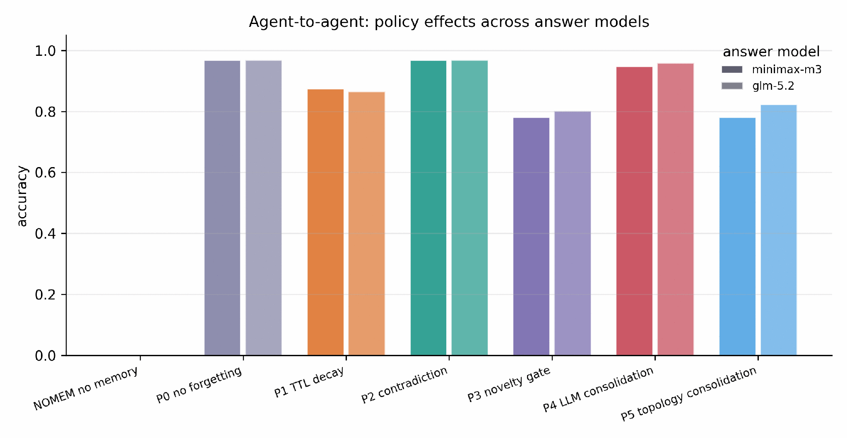
GENERALIZATION ACROSS BENCHMARKS
The ranking mostly holds and where it moves is informative
Spearman's ρ = 0.891 across all seven policies, both benchmarks
Top and bottom of the ranking are completely stable (P0/P2 lead, P3/NOMEM trail). P1 (TTL decay) moves two places i.e rank 6 on FactConsolidation, rank 4 on MQuAKE-T.
Why P1 moves.
MQuAKE-T: 100% of questions concern a fact that changed, so pruning by age is nearly always safe. FactConsolidation: only 65% are updates, so TTL also destroys stable, still-answerable facts.
P1's rank is a property of the workload's update ratio, not an intrinsic property of TTL as a policy.
DRIFT · Nandan Hemanth · Stevens Institute of Technology
16

Slide 18
TWO METHODOLOGICAL FINDINGS
Catching the study's own confounds before reporting them as effects
Configuration ablation
Judge-reliability audit
Reran MQuAKE-T with functional_predicates left undeclared. Invalidations dropped from 59 to 1, the mechanism essentially off.
P2 accuracy: unchanged (0.969 either way).
Tokens/q: +14.4% worse undeclared.
Active facts: +7.0% worse undeclared.
The setting buys P2 none of its accuracy and all of its efficiency. It is safe to enable untuned, and only pays for itself if configured.
One cell's 96 of 96 answers were byte-identical to the main run, yet scored 0.844 versus 0.969. 12 verdicts flipped, all one direction, on verbatim-correct answers.
Root cause: a rotating 3-provider judge pool. One provider drew that cell.
12.5-point artifact identified and corrected before it was reported as a policy effect. Gaps under ~3 points are inside judge noise.
DRIFT · Nandan Hemanth · Stevens Institute of Technology
17

Slide 19
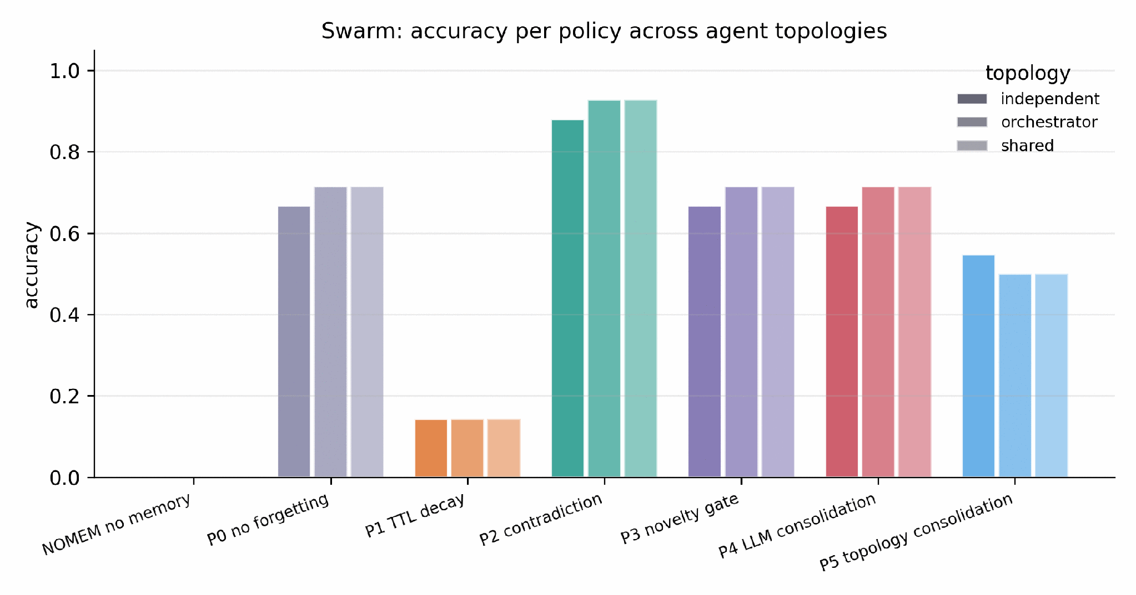
RQ4: MULTI-AGENT
Do rankings survive when the reader isn't the writer?
shared 5 writers round-robin into one graph. Contradictions arrive cross-writer.
independent 5 private graphs, each seeded with 80% partial observation. Tests robustness.
orchestrator 1 graph, router LLM assigns questions to 5 specialists. The production coordinator pattern.
Status, stated precisely:
Validated on synthetic data (14 questions, mock provider): P2 leads all 3 topologies with staleness at 0.000. That validates the harness, not the claim on real data.
A real-data pilot (96 questions, five extraction models) is complete for 5 of 7 policies on the shared topology. Heterogeneous extraction fragments predicate strings and breaks exact-match contradiction detection; see the next slide. Sixteen cells remain untested.
DRIFT · Nandan Hemanth · Stevens Institute of Technology
18

Slide 20
RQ4
Real-data pilot results : shared topology, MQuAKE-T, 96 questions, five extraction models
Policy | Accuracy | Staleness | Tok/q | Inval.
NOMEM | 0.000 | 0.000 | 156 | 0
P0 | 0.333 | 0.271 | 710 | 0
P1 (TTL 20d) | 0.281 | 0.135 | 729 | 0
P2 | 0.365 | 0.271 | 710 | 0
P3 | 0.365 | 0.271 | 710 | 0
P4 | not run | not run | not run | not run
P5 | not run | not run | not run | not run
0
P2 invalidations in this pilot, versus 59 on the single-extractor run
140 = 140
P2 active facts, identical to P0: the mechanism never engaged
3
surface forms of one relation split contradiction detection (head_of_government)
DRIFT · Nandan Hemanth · Stevens Institute of Technology
19

Slide 21
PRACTICAL RECOMMENDATION
If your agent tracks facts that get corrected over time:
Use bitemporal contradiction invalidation. Declare your domain's functional predicates. Do not use a write-time novelty gate.
Free at the margin
Fails safe
Names what to configure
Statistically equivalent accuracy to never forgetting, at 12% lower cost.
A misconfigured P2 degrades to append-only, never below it.
One inspectable list of predicates, not a hyperparameter search.
Beyond the recommendation: memory hygiene is primarily a correctness problem (an 18-point accuracy gap), not a cost problem (a roughly 12% cost gap). A bitemporal record is also exactly the structure that right-to-be-forgotten and audit requirements need.
DRIFT · Nandan Hemanth · Stevens Institute of Technology
20

Slide 22
THREATS TO VALIDITY
Stated directly in order of severity
1
Both real-data benchmarks are fact corpora, not natural conversation, so extraction is never a bottleneck here
2
MQuAKE-T's relations are narrow: mostly head-of-government / head-of-state edits
3
FactConsolidation's gold answers are deliberately counterfactual, making its zero-memory floor maximal by construction
4
Sample size is about 100 questions per benchmark, bounding detectable effect size to roughly 2.5 points
5
Judge noise is 1 to 2% baseline, with one 15% outlier cell; gaps under about 3 points are not interpretable
6
RQ4 is validated in full only offline; a 5-cell real-data pilot on one topology is complete, sixteen cells remain
7
functional_predicates is a per-domain configuration burden, chosen by looking at the data
8
Two mid-size answer models, accessed through one provider; neither is a frontier-scale model
DRIFT · Nandan Hemanth · Stevens Institute of Technology
21

Slide 23
CONCLUSION
Four claims are replicated across two benchmarks of different provenance
1
Append-only memory measurably surfaces superseded facts: 4.2 to 4.8 stale facts per retrieval.
2
Bitemporal contradiction invalidation is free: bounded within about 2.5 points of the ceiling, at 12% lower cost.
3
The advantage is attributable to bitemporal semantics specifically, not graph structure in general (+16.7 pts, p<0.001).
4
Novelty-gated writing causes unrecoverable staleness. This is a transferable claim, not an implementation quirk.
Choosing a forgetting policy without measuring it on the target workload is not a safe default, and the cost of measuring it is now an afternoon.
DRIFT · Nandan Hemanth · Stevens Institute of Technology
22

Slide 24
Thank you
Questions
DRIFT: Decay Rates in Forgetful Bitemporal Memory · Nandan Hemanth · Stevens Institute of Technology

