Slide 1
BeauteCart Online Cosmetics Shop

Slide 2
Introduction
The "Online Cosmetics Shopping" project is a comprehensive web-based platform designed to provide users with an immersive and convenient online shopping experience for cosmetics and beauty products. This project aims to provide a sophisticated yet user-friendly interface for cosmetics enthusiasts to discover, explore, and purchase beauty products online. By presenting a curated collection of products and incorporating user-centric features, the platform seeks to redefine the cosmetics shopping experience in the digital age. The project is divided into two phases: a mini project and a main project, each designed to showcase different stages of development and functionality.

Slide 3
Users
• Admin
➢ Admin Login: Provide a secure login for administrators to
access the admin dashboard.
➢ Dashboard : Display an overview of key statistics such as total
sales, active orders, and new users.
➢ Product Management
➢ User Management
➢ Order Management
➢ Packing Management

Slide 4
Users
➢ User Registration: Allow new users to create accounts with
their email and password.
➢ User Login: Provide a secure login for users to access their
accounts.
➢ Password Reset: Include a "Forgot Password" feature for users
to reset their passwords.
➢ Shopping Cart: Enable users to add products to their cart, see
the cart summary, and update quantities.
➢ Order Tracking: Allow users to track the status of their current
orders.
➢ Profile Information: Allow users to view and update their
profile information, including name, email, and contact details.
➢ Change Password: Enable users to change their account
password.
➢ Payment

Slide 5
SELLERS
Product Management:
Sellers can easily add new products to their inventory using a user-friendly interface.
CRUD operations enable efficient creation, reading, updating, and deleting of product details.
Editing and Deactivation:
Sellers have the ability to edit product details, ensuring that their listings remain accurate and up-to-date.
Deactivation options provide control over product availability, allowing sellers to temporarily or permanently remove items as needed.
Comprehensive CRUD Operations:
CRUD operations empower sellers to perform essential actions on their product data, maintaining flexibility and control.
Create: Add new products to the platform.
Read: Access detailed information about existing products.
Update: Modify product details to reflect changes or improvements.
Delete: Remove products from the inventory when necessary.
User Order Tracking:
Sellers can easily monitor and track user orders for the products they added to the platform.
This feature enhances sellers' understanding of product popularity and facilitates efficient order fulfillment.
Intuitive User Interface:
The module is designed with a user-friendly interface to ensure sellers can navigate and utilize these functionalities effortlessly.
Streamlined processes contribute to an efficient and pleasant user experience for sellers interacting with the platform.

Slide 6
TECHNOLOGIES
FRONTEND – HTML ,CSS, JavaScript
BACKEND – Python Django , SQLite

Slide 7
FUTURE SCOPE
There is a scope for further development in this project to a great extend where this project can be extended to add tracking system . A number of features can be added to this system in future like providing classification over products that each customer frequently buys and make them more available . System may keep track of history of purchases of each customer and provide suggestions based on their history. These features could have implemented unless the time did not limited us. It can be extended for added benefits of ease for vendors to easily sell their products. Customers can be rewarded with coupons or promo code for promoting the business.

Slide 8
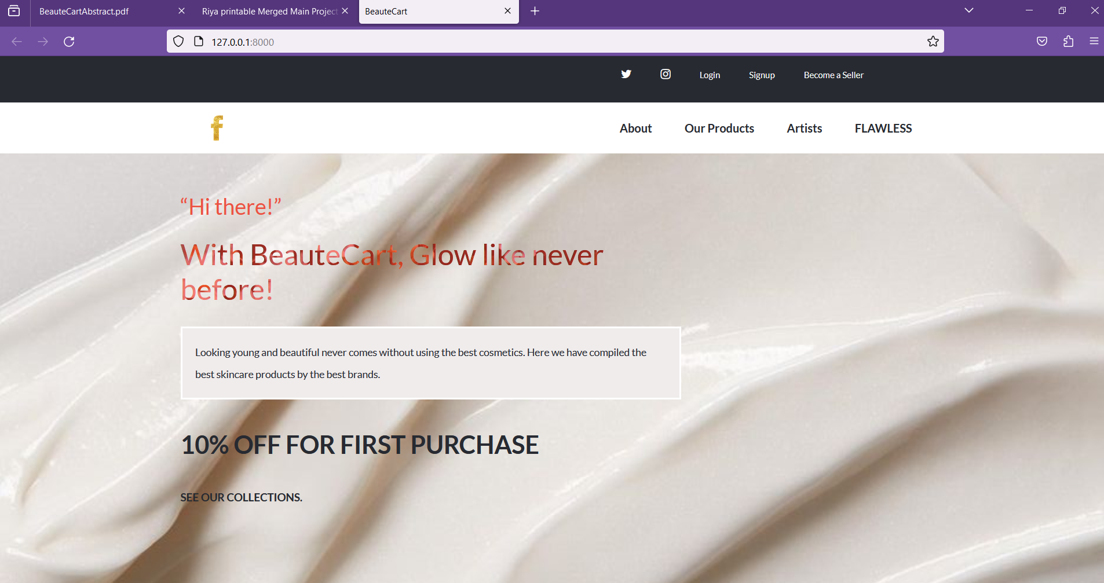
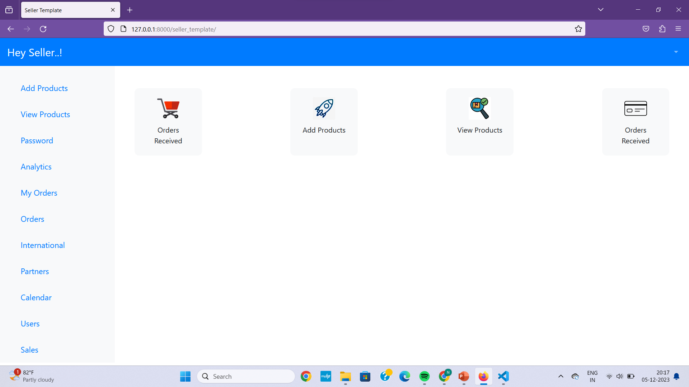
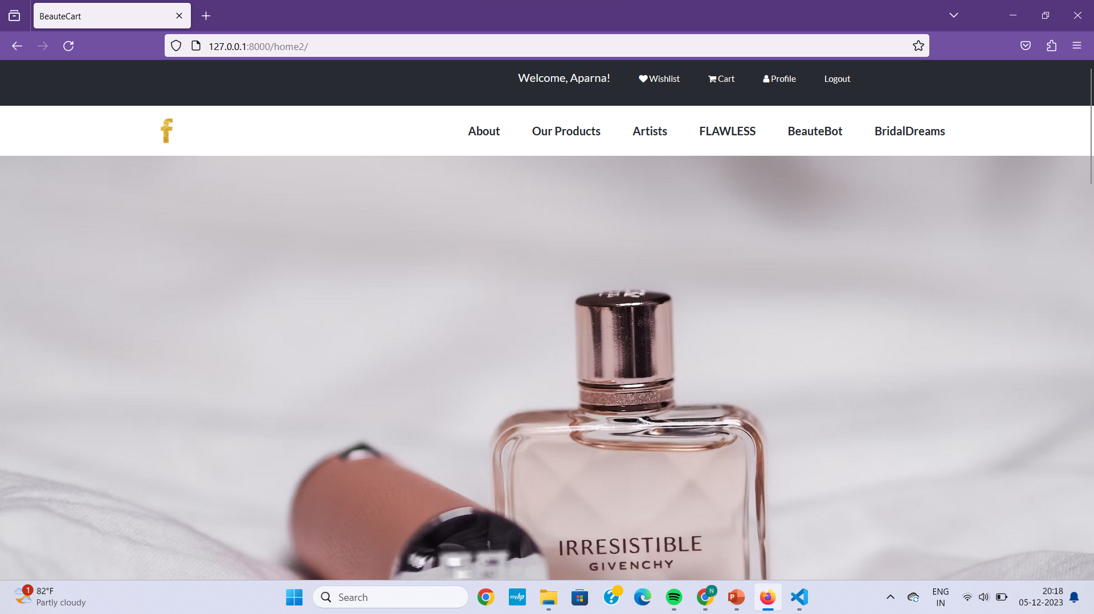
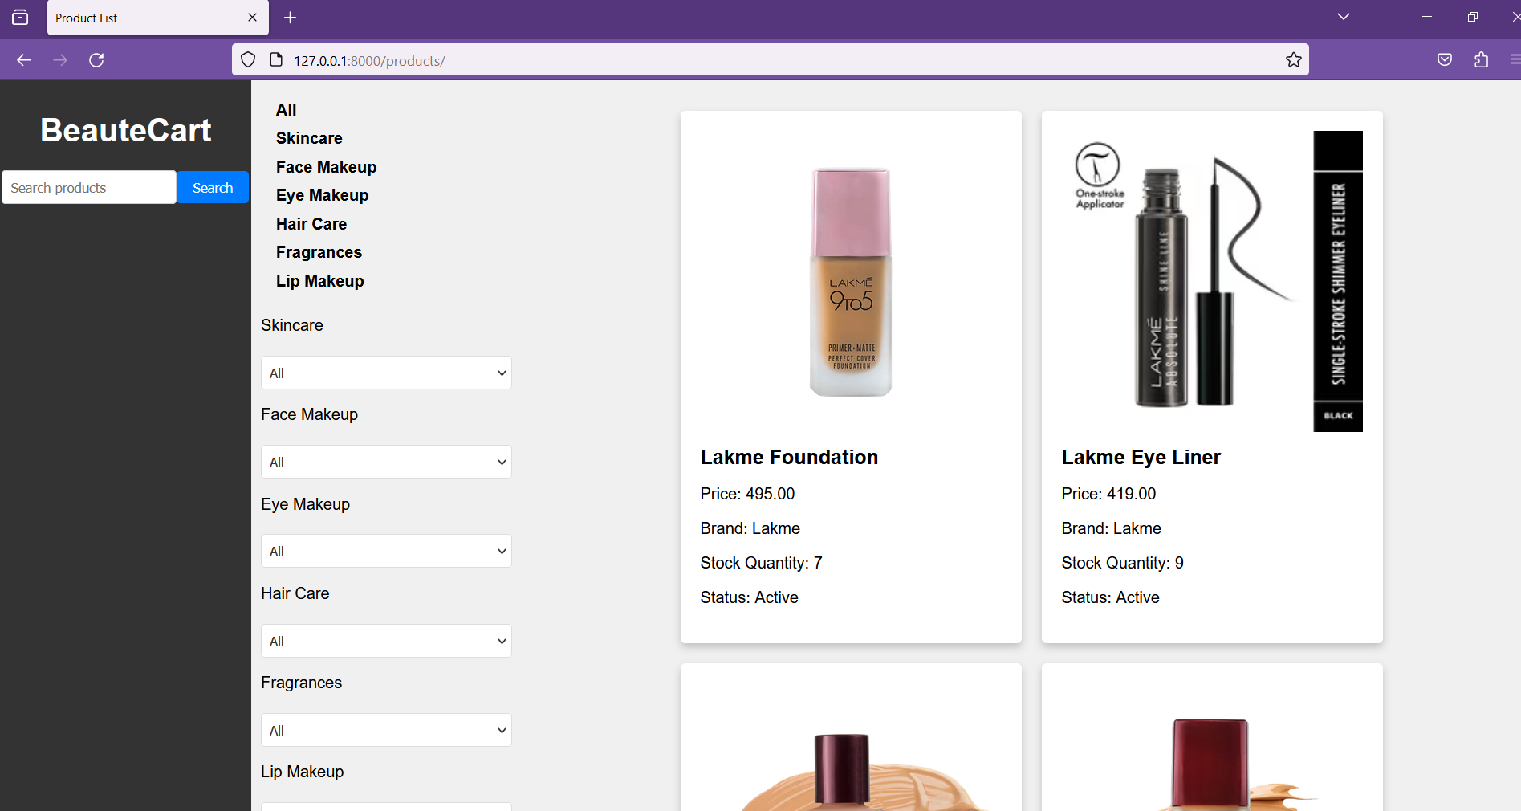
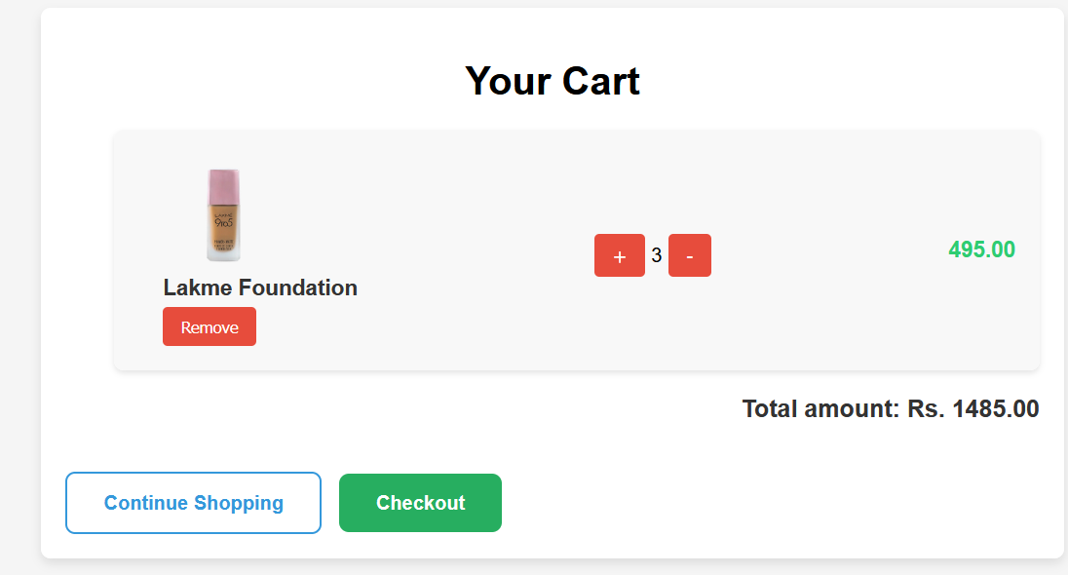
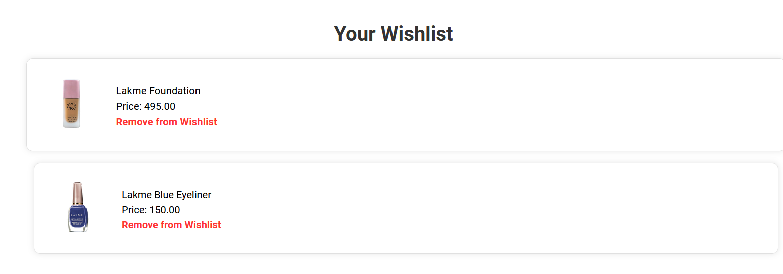
ScreenShots

Slide 9
thank you

