Slide 1

Evaluating the Effectiveness of SMOTE and SMOTE-ENC in Class Imbalance Medical Data

Slide 2

Background
Class imbalance is a common challenge in medical datasets, often leading for minority classes. This issue is particularly critical in COPD diagnosis, where underrepresented cases to biased predictions and reduced model performance may go undetected. Traditional oversampling techniques struggle with mixed data types, making it difficult to generate realistic synthetic samples.

Slide 3
Aim
The main focus of this research is to propose oversampling techniques, SMOTE and SMOTE-ENC (SMOTE- Encoded Nominal and Continuous), in the context of classification tasks using the ExaSens dataset, which contains saliva samples of COPD (Chronic Obstructive Pulmonary Disease) patients.

Slide 4
Research Question
How does SMOTE or SMOTE-ENC techniques perform in balancing datasets with both nominal and continuous features for COPD classification using the ExaSens dataset?

Slide 5
Relevance to Identified Literature
Drawing from the methodology proposed by Mukherjee and Khushi (2021), who introduced SMOTE-ENC for datasets with mixed (nominal and continuous) features, it is extended to improve prediction accuracy for COPD classification. The ExaSens dataset, which combines both continuous and categorical data, represents a suitable test case for the applicability of SMOTE as well as SMOTE-ENC. By applying both techniques to this dataset, the goal is to balance the minority class and improve the performance of machine learning models, particularly in the prediction of underrepresented COPD conditions.
Reference
Mukherjee, M. and Khushi, M., 2021. SMOTE-ENC: A novel SMOTE-based method to generate synthetic data for nominal and continuous features. Applied system innovation, 4(1), p.18.

Slide 6
Research Objectives
To conduct a comprehensive literature review on class imbalance in datasets with mixed nominal and continuous features and identify existing gaps.
To gather and preprocess the ExaSens dataset, which contains saliva samples from COPD patients, ensuring that both continuous and nominal features are properly formatted for machine learning analysis.
To apply SMOTE as well as SMOTE-ENC seperately in addressing class imbalance in the preprocessed data for COPD classification task.
To implement machine learning models, such as Decision Trees, SVM, and Random Forest, on both SMOTE and SMOTE-ENC balanced data.
To compare the performance of various classifiers on both SMOTE and SMOTE-ENC balanced data by performance metrics such as accuracy, precision, recall, F1-score, Area Under the Precision-Recall Curve (AUC-PR), Matthews Correlation Coefficient (MCC) and balanced accuracy.

Slide 7
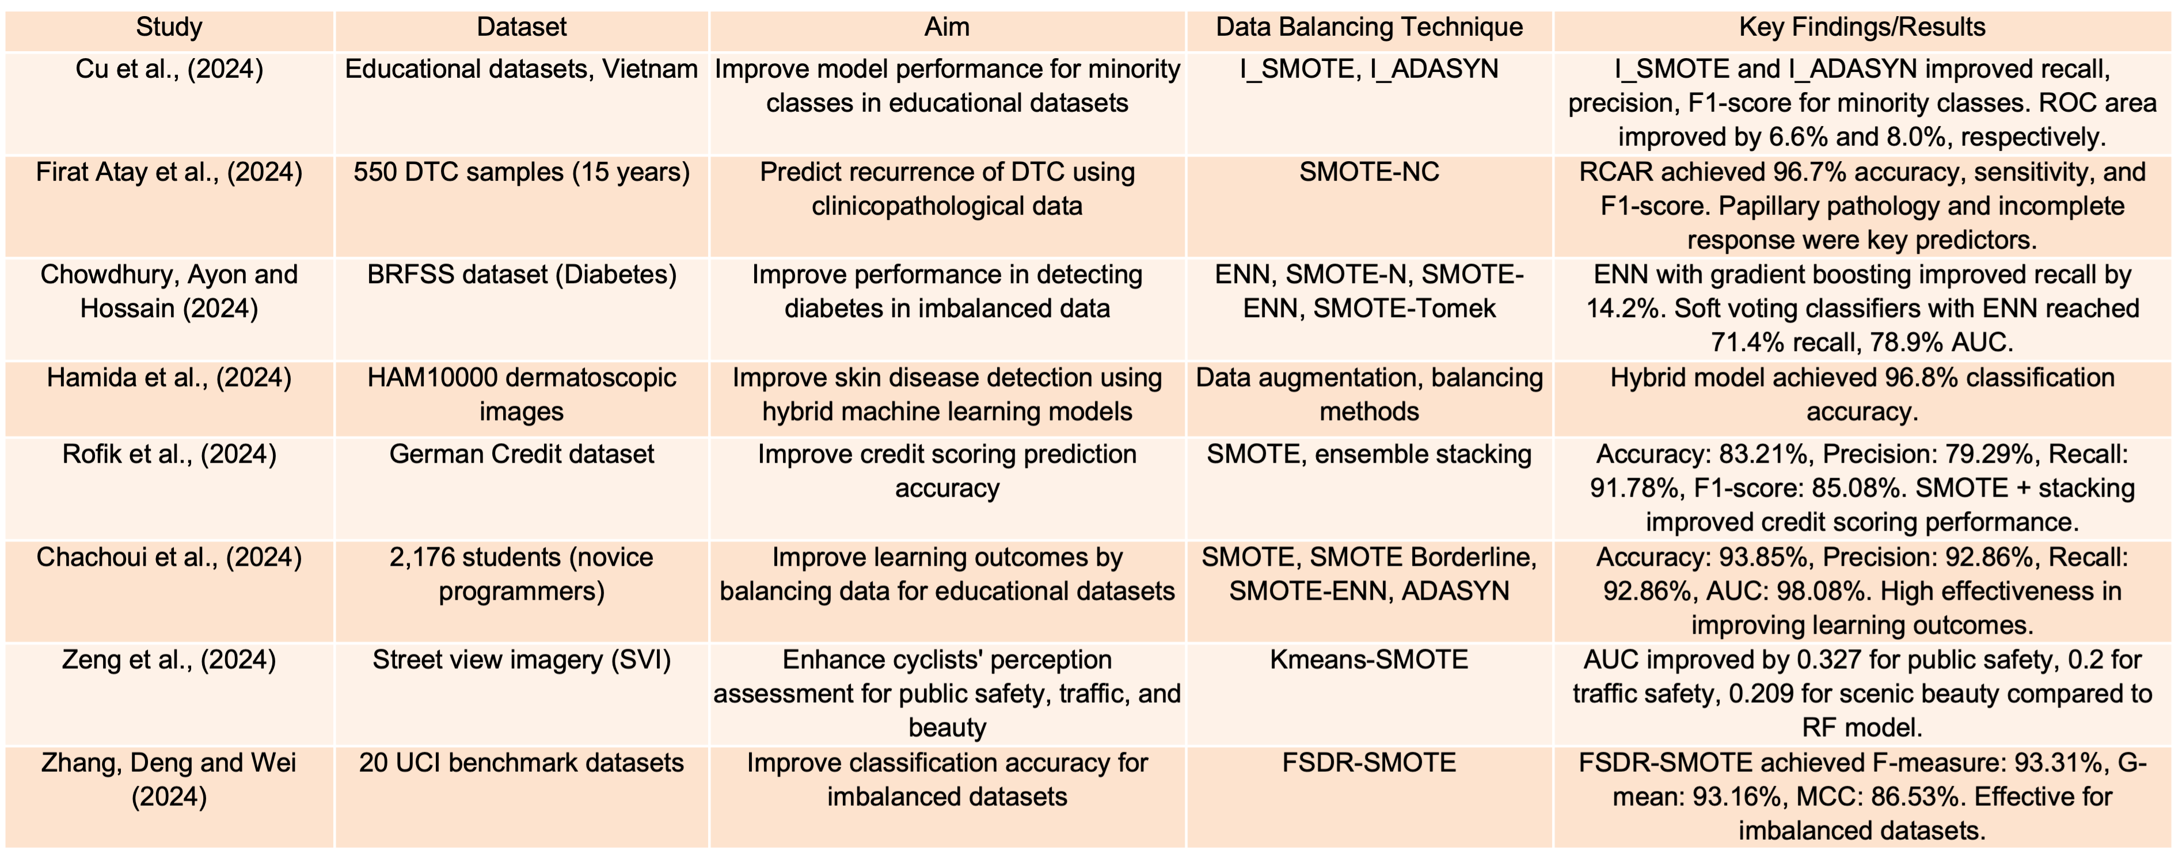
Literature Review

Slide 8
Identification of Gaps
Previous studies focus on SMOTE and ADASYN for either continuous or nominal datasets, not mixed-feature datasets.
Limited exploration of SMOTE-ENC in medical datasets, especially for COPD classification.
No comprehensive assessments have been made comparing SMOTE with SMOTE-ENC in advanced classifiers like Random Forest or SVM in COPD detection.

Slide 9

Linkage to Aim
This research introduces SMOTE-ENC to address the gap in handling mixed-feature medical datasets.
Aims to improve classification precision and balance class distribution in COPD detection.
Supports predictive modeling improvements in healthcare by evaluating the ExaSens dataset.

Slide 10

Rationale for choosing Dataset
Relevance to Medical Research: Focuses on COPD and respiratory diseases, aligning with the research goal.
1
Imbalance in Data: Contains class imbalance, suitable for applying balancing techniques like SMOTE-ENC.
2
Classified Data: Clearly labeled with groups (COPD, asthma, respiratory infections, healthy controls) for classification tasks.
3
No Legal or Ethical Issues: Publicly available through IEEE Dataport, complying with ethical guidelines.
4
Public Access: Openly accessible to the public via IEEE Dataport.
5
Genuine Data Source: Sourced from IEEE, ensuring data integrity and quality.
6

Slide 11
Dataset Details
ExaSens Dataset Overview:
399 instances with 4 features each
Contains saliva samples from patients with COPD, asthma, respiratory infections, and healthy controls.
Download in CSV format, with a file size of approximately 13.7 KB.
Valuable for classification tasks in medical research.
Dataset Citation: Pouya Soltani Zarrin, Niels Roeckendof, Christian Wenger, May 28, 2020, “Exasens: a novel dataset for the classification of saliva samples of COPD patients”, IEEE Dataport,doi: https://dx.doi.org/10.21227/7t0z-pd65.
Link:https://ieee-dataport.org/open-access/exasens-novel-dataset-classification-saliva-samples-copd-patients

Slide 12

Dataset Description
Sample Groups:
COPD Patients- Without acute respiratory infection.
Asthma patients- Without respiratory infections.
Individuals with respiratory infections– Without COPD or asthma.
Healthy Controls- No respiratory conditions.
Key Attributes:
Diagnosis: COPD, Asthma, Infected, Healthy Control(HC)
Patient ID, Age, Gender.
Smoking Status: Non-smoker, Ex-smoker, Active smoker.
Saliva Permittivity: Real and imaginary parts (measured as minimum and average values)

Slide 13
Ethical Requirements
The chosen dataset does not fall under the scope of the GDPR as it does not include any personal data or data that can be used to identify a person. The research does not pose any ethical issues and is in compliance with the University of Hertfordshire’s ethical principles. The dataset is obtained from IEEE Dataport, and there are no restrictions to using the dataset for research. As the dataset used in this research was a fictional dataset and no people were involved in the data collection process and therefore adherence to ethical considerations was not an issue.

Slide 14
Tools and Technologies
Python: Main programming language for machine learning and data analysis.
Scikit-learn: For machine learning models and performance evaluation.
Imbalanced-learn: Managed SMOTE-ENC oversampling process.
Matplotlib & Seaborn: Data visualization and result analysis.
Numpy & Pandas: Data preprocessing and manipulation.
Google Colab: Cloud- based environment for coding and collaboration.

Slide 15

Research Methodology
Download
Data Collection & Preprocessing: Download ExaSens dataset, handle missing values, encode nominal features, and normalize/scale continuous features for machine learning.
Implement
SMOTE-ENC Application: Implement SMOTE and SMOTE-ENC to balance the dataset, encoding nominal features as numeric values for effective oversampling.
Model
Model Implementation: Apply Decision Trees, SVM, and Random Forest classifiers to both SMOTE and SMOTE-ENC balanced datasets.
Evaluate
Performance Evaluation: Evaluate models using accuracy, precision, recall, F1-Score, AUC-PR, MCC, and balanced accuracy to compare results on unbalanced Vs. balanced datasets.

Slide 16
Project Plan
Phase 1: Preparation & Data Preprocessing (Weeks 1-4)
1
Literature review, dataset exploration, handling missing values, feature encoding, and normalization.
Phase 2: SMOTE-ENC Implementation & Model Development (Weeks 5-9)
2
Apply SMOTE, SMOTE-ENC, train Decision Trees, SVM, and Random Forest on original and balanced datasets, and perform hyperparameter tuning.
Phase 3: Evaluating & Analysis (Weeks 10-13)
3
Assess model performance using multiple metrics, compare results, and conduct statistical validation.
Phase 4 : Documentation & Finalization (Weeks 14-15)
4
Draft, review, and finalize the research report for submission.

Slide 17

Expected Outcomes
Improved Recall and F1-Score: Expect higher recall and F1-score values for the COPD class after applying SMOTE-ENC.
Balanced Class Distribution: Achieve better class balance in the ExaSens dataset, resulting in more accurate model predictions.
Enhanced Model Performance: Expect improved classification accuracy for Random Forest and SVM models using the balanced dataset.
Optimized Performance Metrics: Improved AUC-PR, MCC, and balanced accuracy for the models after oversampling with SMOTE and SMOTE-ENC.

Slide 18
THANK YOU

