Slide 1
PITCH DECK
Presenters: Nandana Harikumar, Dias Amitullayev

Slide 2
INTRODUCTION
The Public Warning System (PWS) is an essential part of cellular networks and a country’s civil protection.
PWS operates across two message types: ETWS (Earthquake and Tsunami Warning System) and CMAS (Commercial Mobile Alert System). The former is designed for rapid natural disaster notifications, while the latter for everything else including Presidential Alerts, and Imminent Extreme or Severe Threat warnings.
Delivery is via System Information Block (SIB) messages broadcast by base stations to all UEs (User Equipments) in range. SIB is are broadcast messages transmitted by base stations to all UEs in range.
Reception is mandatory for certain alert categories - users cannot opt out of Presidential Alerts for instance .
PWS is globally deployed and expanding - all EU member states are obliged to have a public warning system in place by 21 June 2022. Deployment exists across the US, Japan, South Korea, China, Australia, and many others.
The system was designed for maximum reach and minimum latency, and security and privacy was explicitly traded off to achieve this.

Slide 3
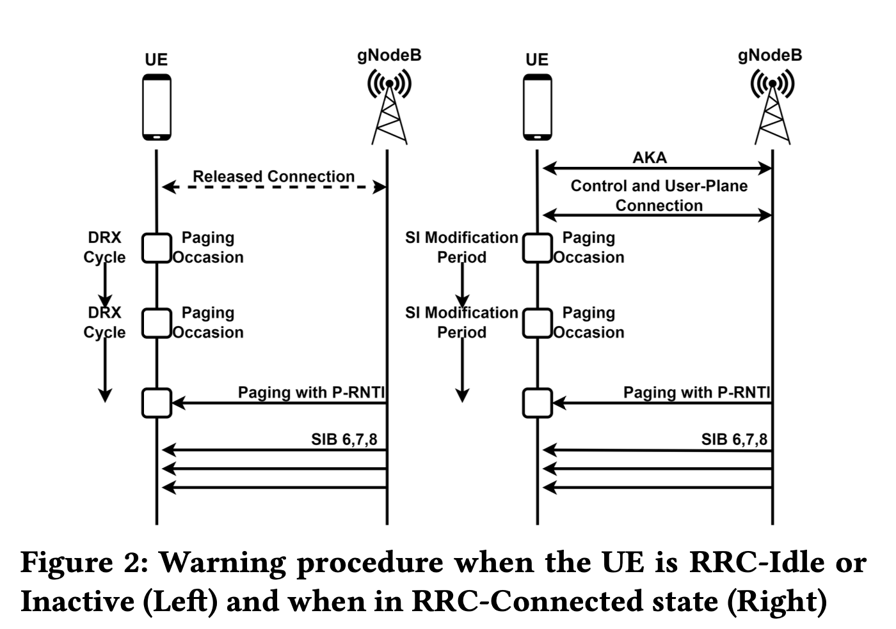
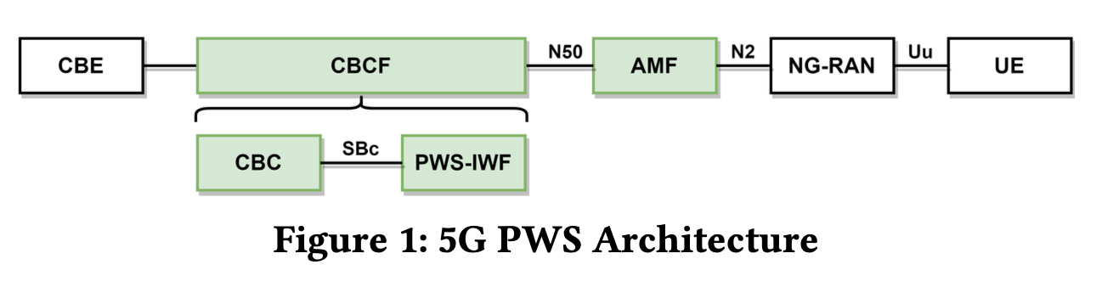
HOW PWS ACTUALLY WORKS
A public authority sends a warning to a Cell Broadcast Entity.
This propagates through the core network to base stations (gNodeBs in 5G).
The gNodeB sends a paging message to all UEs in the cell with cause "Emergency".
UEs in RRC-Idle or RRC-Inactive state wake up on their paging occasion and receive the SIB carrying the alert.
UEs in RRC-Connected state receive it via the System Information modification period.
The UE displays the alert. There is no verification of source, no cryptographic check, no authentication.
Cell Broadcast Entity -> Cell Broadcast Center/ Function -> Access and Mobility Management Function -> NG-RAN -> User Equipment.

Slide 4
The Known Threat: PWS Spoofing and Suppression
Lee et al. (2019, republished 2021) demonstrated the first practical spoofing of Presidential Alerts on LTE using commodity SDR hardware, showing 90% success rate across 49,300 seats of a 50,000-seat stadium with just four 1W base stations.
Bitsikas and Pöpper (2022) extended this comprehensively to 5G Standalone networks, validating spoofing and suppression attacks across five commercial devices from different manufacturers, proving the flaw is in the 3GPP protocol, not the hardware.
Both works confirm: spoofing is practical, cheap and works on real deployed networks today
Interesting Question: If the phone is forced to display an alert, it is forced to move from RRC-Idle to an Active state. If yes, could this be a privacy issue?
Notes:
Both works also confirm: the core vulnerability unauthenticated broadcast persists in 5G despite othersecurity improvements it is protocol-mandated to process the emergency notification

Slide 5
The Parallel Thread: Side-Channel Localization via Paging
The ToRPEDO Attack (Hussain et al., 2019): Established that cellular paging is a deterministic side-channel. Because paging occasions are mathematically tied to a device's identity, an attacker can verify a target's presence in a cell with 100% accuracy in as few as 8 silent calls. This attack verifies "coarse-grained" location.
Physical Uplink Leakage: Crucially, this work proved that uplink signals - the physical radio transmissions a device makes when "waking up"- are measurable and observable side-channels that bypass high-level software protections.
The 5G Paradox: While 5G introduced SUCI (Subscription Concealed Identifier) to encrypt identities, Hussain et al. proved that encryption is irrelevant if the timing remains predictable. The "when" you speak is as revealing as "what" you say.

Slide 6
The Gap: What Happens When You Combine These Two Threads
The Universal Trigger : Unlike targeted paging, PWS uses the fixed identifier 0xFFFE. This forces every idle device in the cell to process the alert simultaneously, regardless of individual sleep cycles.
Mandatory State Transition: To display the notification, the protocol mandates a transition from RRC_Idle toward RRC_Connected
The Physical Leak (PRACH): This transition triggers a PRACH preamble - a raw, unencrypted radio "knock" on the uplink. It is a physical event observable by any passive receiver in range.
Zero-Knowledge Detection: By observing the synchronized burst of uplink energy, they confirm mass device presence in a specific geographic area.

Slide 7
LOGIC CHAIN
5G PWS spoofing is practical and forces mandatory from RRC_Idle toward RRC_Connected state transitions (Bitsikas et al., 3GPP).
Physical uplink transmissions (PRACH) are established, measurable side-channels for localization (Hussain et al.).
By spoofing System Information (SIB1), an attacker dictates the exact Uplink Frequency and Response Timing for the target cell.
The Hypothesis: A spoofed PWS alert acts as a Bulk Surveillance Primitive, forcing all "silent" devices to simultaneously reveal their presence.
RESEARCH QUESTIONS:
Does the 3GPP PWS architecture structurally guarantee a mandatory uplink leak from compliant UEs?
Can an eavesdropper verify mass presence with zero-knowledge of device identities or phone numbers?

Slide 8
REFERENCES
[1] Jihoon Lee, Gyuhong Lee, Jinsung Lee, Youngbin Im, Max Hollingsworth, Eric Wustrow, DirkGrunwald, and Sangtae Ha. 2021. Securing the wireless emergency alerts system. Commun.ACM 64, 10 (October 2021), 85–93. https://doi.org/10.1145/3481042
[2] Tomasin S, Centenaro M, Seco-Granados G, Roth S, Sezgin A. Location-Privacy Leakage and Integrated Solutions for 5G Cellular Networks and Beyond. Sensors (Basel). 2021 Jul 30;21(15):5176. doi: 10.3390/s21155176. PMID: 34372414; PMCID: PMC8348191.
[3] Hussain, Syed & Echeverria, Mitziu & Chowdhury, Omar & Li, Ninghui & Bertino, Elisa. (2019). Privacy Attacks to the 4G and 5G Cellular Paging Protocols Using Side Channel Information. 10.14722/ndss.2019.23442.
[4]Evangelos Bitsikas and Christina Pöpper. 2022. You have been warned: Abusing 5G’sWarning and Emergency Systems. In Proceedings of the 38th Annual Computer SecurityApplications Conference (ACSAC '22). Association for Computing Machinery, New York, NY, USA,561–575. https://doi.org/10.1145/3564625.3568000

