Slide 1

Aurora H-Function: Illuminating Signals from the Noise

Slide 2
ABSTRACT
Noise reduction is critical in gravitational-wave detection and real-world audio processing, where signals are often hidden under complex, unpredictable noise. Traditional filters (Bandpass, Notch, Wiener, Wavelet, Matched) work only in limited scenarios and fail against irregular, heavy-tailed, and multi-scale noise.
This project introduces a Fox H-function–inspired filter, leveraging one of the most general special functions. Its flexible parameterization enables adaptive, frequency-dependent noise suppression, removing strong disturbances while preserving weak underlying signals.

Slide 3
Applications:
Gravitational-wave time-series
Noisy speech recordings
Key Results:
Outperforms classical filters in non-Gaussian, colored, and time-varying noise
Enhances subtle gravitational-wave features
Achieves strong speech noise reduction without voice distortion
This work bridges advanced mathematical theory and practical signal processing, offering pathways for real-time systems, multi-channel designs, and ML-based hybrid models.

Slide 4
INTRODUCTION
Gravitational Waves (GWs) are extremely weak spacetime ripples produced by events like black hole and neutron star mergers. Although first detected by LIGO/Virgo in 2015, their signals are easily buried under strong detector noise such as non-stationary seismic drift, colored frequency-dependent noise, transient glitches, and broadband quantum/electronic disturbances. Similar challenges occur in real-world audio, where speech is corrupted by multi-scale, unpredictable, heavy-tailed noise.
Traditional filters (Bandpass, Notch, Wiener, Wavelet, Matched) struggle with bursty, time-varying, and multi-scale noise, especially when the underlying signal is very weak. To address this, the project explores a Fox H-function–inspired filter—an approach based on a highly general mathematical function capable of power-law shaping, adaptive frequency attenuation, and multi-scale noise control.
The aim is to develop and evaluate this H-function filter for both LIGO/Virgo gravitational-wave data and noisy speech, using time-frequency analysis, SNR improvement, and comparisons with classical filters.

Slide 5
LITERATURE REVIEW
1. DeepGRAV (Yan et al.)
2. VAE-Based Detection (Fayad)
ResNet learns latent GW noise features.
High anomaly-detection accuracy (A3D3 challenge).Better performance than matched filtering for unknown signals.
VAE trained on noise → GW appears as reconstruction anomaly.
Robust, template-free method (AUC ≈ 0.89).
3. DeepClean (Ormiston et al.)
4. Dilated Convolutional Autoencoders (Bacon et al.)
Uses auxiliary sensors to subtract noise from GW strain.
Models nonlinear couplings; SNR ↑ by ~21%.
Outperforms classical regression approaches.
Dilated CNNs capture long-range temporal patterns.
Effective for denoising BBH signals under real LIGO noise.
Strong reconstruction quality for O1/O2 events.

Slide 6
TRADITIONAL NOISE FILTERS
Bandpass Filter (BPF)
Purpose
Allows only a specific frequency range to pass
Rejects noise outside the band
Why Important for GW?
GW signals lie mainly in 20–1000 Hz
BPF suppresses:
  Low-frequency seismic noise
  High-frequency quantum noise
Why Important for Audio?
Speech band: 300–3400 Hz
Removes rumble & hiss
Bandpass Filter Applications
In GW Processing
Removes seismic noise
Removes quantum/shot noise
Preserves astrophysical chirp band
In Audio Processing
Speech enhancement
Removing rumble (low freq)
Removing hiss (high freq)

Slide 7
Notch Filter
Purpose
Removes a very narrow frequency band
Used for precise interference removal
Where Used?
Remove hum (50/60 Hz)
Remove mechanical resonances
Remove tonal noise
Notch Filter Applications
In GW Processing
Removes:
  50/60 Hz electrical hum
  Suspension violin modes
  Calibration tones
In Audio
Hum removal
Whistle, alarm noise suppression
Hearing aids, music restoration

Slide 8
Wiener Filter
Purpose
Optimal filter that minimizes Mean Squared Error
Uses statistical knowledge of noise
Interpretation
Signal dominant → H ≈ 1
Noise dominant → H ≈ 0
Wiener Filter Applications
In GW Processing
Noise regression using auxiliary sensors
Creating cleaner strain data
SNR improvement for weak GW signals
In Audio
Ideal for stationary noise (fan, engine)
LMS/RLS = adaptive versions for real-time noise changes
Used in telephony, ASR, hearing aids
Limitations
Needs accurate PSD estimates
Performs poorly for non-stationary noise

Slide 9
Wavelet Filter
Purpose
Time–frequency decomposition
Excellent for non-stationary and transient signals
Key Concept
Wavelet Transform = Localized analysis using scaling (a) & shifting (b)
Denoising Technique
Soft-threshold wavelet coefficients.
Wavelet Filter Applications
In GW Processing
Burst detection (cWB, Omicron)
Glitch identification
Time-frequency analysis
In Audio
Effective for:
  Intermittent noise
  Street noise
  Rain/crowd noise
Preserves speech transients

Slide 10
Matched Filter
Purpose
Best detector for known signals in Gaussian noise
Core of gravitational-wave detection
Matched Filter Applications
In GW Processing
Primary tool for compact binary coalescence (CBC)
Used in PyCBC, GstLAL
Provides SNR time series
Essential for detection significance
In Audio
Keyword spotting
Template-based detection
Not used for generic noise removal

Slide 11
EXPERIMENTAL EVALUATION OF BENCHMARK FILTERS
We evaluate 5 classical filters on:
Gravitational-Wave (GW) signals
Noisy Voice/Audio signals
Filters Tested
Bandpass Filter
Notch Filter
Wiener Filter
Wavelet Filter
Matched Filter
Goal
To compare the performance of these filters using:
Time- and frequency-domain analysis,SNR improvement,Visual waveform/FFT plots

Slide 12

EXPERIMENTAL SETUP (GW DATA)
Gravitational-Wave Signals
Source: LOSC real events + simulations
Sampling: 4096 Hz
Noise Types Present
Broadband Gaussian noise
Narrowband peaks (mains hum, violin modes)
Non-stationary glitches
Frequency-Domain PSD-Weighted SNR (GW)
$$ρ^{2}=4\int_{0}^{∞}{\frac{∣\tilde{s}\left(f\right)∣^{2}}{S_{n}\left(f\right)}}df$$

Slide 13
FILTER COMPARISON TABLE
Dataset (Event Name) | Filters Applied | Best Filter | SNR (dB)
GW200209_085452 | Raw, Bandpass, Notch, Wiener, Wavelet, Matched | Wavelet | 2.59
GW200225_060421 | Raw, Bandpass, Notch, Wiener, Wavelet, Matched | Wiener | 13.08
GW200128_022011 | Raw, Bandpass, Notch, Wiener, Wavelet, Matched | Matched | 9.13
GW200216_220804 | Raw, Bandpass, Notch, Wiener, Wavelet, Matched | Wiener | 5.05
GW191230_180458 | Raw, Bandpass, Notch, Wiener, Wavelet, Matched | Matched | 11.95
GW191222_033537 | Raw, Bandpass, Notch, Wiener, Wavelet, Matched | Matched | 6.26

Slide 14
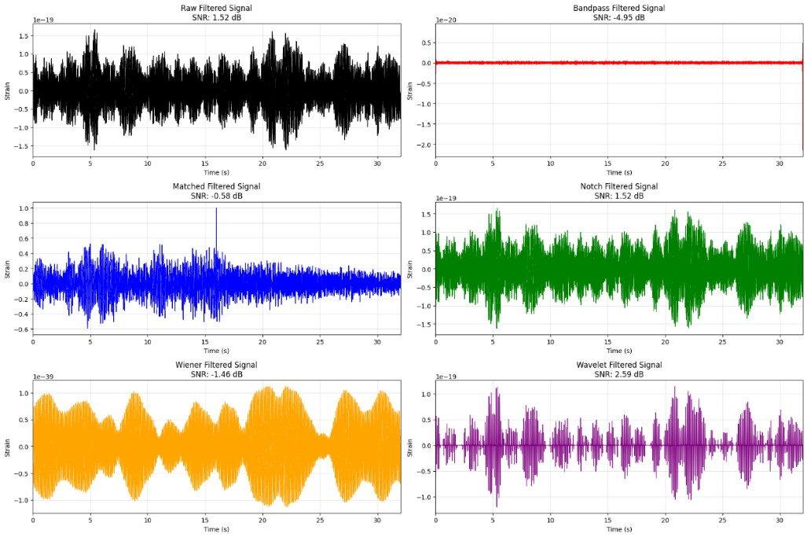
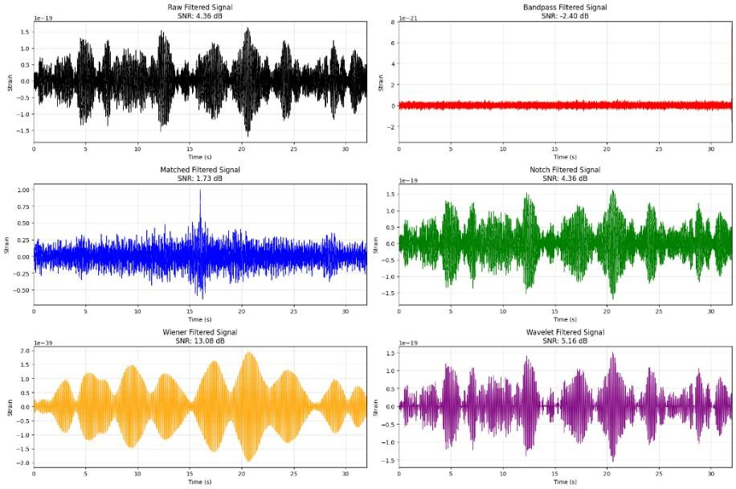
1)GW200209_085452
2)GW200225_060421

Slide 15
EXPERIMENTAL SETUP (AUDIO DATA)
Voice/Audio Signals
Clean file: orgnoise.opus
Noisy files: Injected noise at –10 dB, 0 dB, +10 dB
Sampling rate: 16 kHz
Detected Noise Type: White Noise
Equal energy across frequencies
Hard to remove using narrow filters
Requirement
Use adaptive filters → Wiener / Wavelet

Slide 16
SNR Calculation Methods
1. Time-Domain SNR (Audio)
Measures how close the filtered signal is to the clean signal.
SNR(dB) = 10 · log10( Σ (s[i] − ŝ[i])² / Σ s[i]² )
SNR Improvement for Audio Signals
Noise Level | Bandpass | Notch | Wiener | Wavelet | Matched
–10 dB | 0.07 | –0.12 | 2.55 | –1.31 | –2.51
0 dB | 6.07 | 5.67 | 8.08 | 3.66 | –2.48
10 dB | 13.55 | 13.26 | 10.15 | 7.88 | –2.47

Slide 17

FOX H-FUNCTION: OVERVIEW
The Fox H-function $H_{p,q}^{m,n}\left(x\right)$is one of the most general special functions.
Introduced by C. Fox (1961) using a Mellin–Barnes integral.
Unifies many known functions:
  Meijer-G, Hypergeometric, Mittag–Leffler
  Bessel functions
  Lévy/Stable distributions
Widely used in modeling complex, non-classical behaviors such as long-memory, multi-scale effects, and heavy tails.

Slide 18

BASIC DEFINITION & STRUCTURE
Integral Definition
$$H_{p,q}^{m,n}\left(x\right)=\frac{1}{2πi}\int_{L}{Θ}\left(s\right) x^{−s} ds$$
Where
$$Θ\left(s\right)=\frac{\prod_{j=1}^{m}{Γ}\left(b_{j}+B_{j}s\right) \prod_{j=1}^{n}{Γ}\left(1−a_{j}−A_{j}s\right)}{\prod_{j=m+1}^{q}{Γ}\left(1−b_{j}−B_{j}s\right) \prod_{j=n+1}^{p}{Γ}\left(a_{j}+A_{j}s\right)}$$
Parameters
$a_{j},b_{j}∈ℂ$
$A_{j},B_{j}>0$
Contour $L$: separates Gamma-function poles ensuring convergence.

Slide 19

KEY PROPERTIES
Includes many classical functions as special cases:
  Meijer G (when $A_{j}=B_{j}=1)$
  Hypergeometric & Mittag–Leffler
  Bessel functions
Closed under transforms:
  Mellin, Laplace, Fourier
Asymptotics:
  Exponential or algebraic decay (heavy tails)
Series Forms:
  Power series (small $x$)
  Asymptotic series (large $x$)

Slide 20
APPLICATIONS
1. Fractional Calculus
Solutions of fractional differential equations.
Appears in relaxation, viscoelastic models, and anomalous diffusion.
2. Probability & Statistics
Heavy-tailed distributions (Lévy, α-stable).
Useful in finance, queuing, and risk modeling.
3. Physics & Engineering
Long-memory heat transfer, turbulence, and statistical mechanics.

Slide 21
4. Signal Processing
Used to model non-Gaussian noise (impulsive, heavy-tailed noise).
Appears in fading channel models (e.g., generalized K-distribution).
Provides analytic forms for error rates, SNR distributions, and filter responses in non-classical environments.
Helps describe signals in fractal, fractional, or multi-scale systems

Slide 22
H FUNCTION IMPLEMENTATION
Why Do We Need a New Filter?
  Gravitational-Wave Noise Challenges
  Non-stationary seismic drift
  Colored, frequency-dependent noise
  Transient glitches
  Broadband high-frequency artifacts
Traditional Filters Fail When:
  Noise is multi-scale
  Noise follows power-law decay
  Noise shows fractal/complex patterns
  Weak signals get suppressed

Slide 23

THE PROPOSED H-FUNCTION–INSPIRED FILTER
Frequency-Domain Form
$$H\left(f\right)={\left(\frac{1}{1+\left(∣f∣/f_{c}{\left.)\right.}^{α}\right.}\right)}^{β}\exp\left[−γ{\left(\frac{∣f∣}{f_{c}}\right)}^{1+δ}\right]$$
Parameter | Meaning
α | Controls power-law decay (heavy-tail suppression)
β | Mid-frequency shaping
γ | High-frequency roll-off
δ | Smoothness & non-linearity
f_{c} | Normalization cutoff

Slide 24

Steps
Convert signal to frequency domain using FFT
$$X\left(f\right)=ℱ\left\{s\left(t\right)\right\}$$
Apply filter
$$Y\left(f\right)=X\left(f\right)⋅H\left(f\right)$$
Convert back
$$\hat{s}\left(t\right)=ℱ^{−1}\left\{Y\left(f\right)\right\}$$
Perform SNR evaluation (audio + GW)

Slide 25
EXPERIMENTAL RESULTS GRAVITATIONAL-WAVE SIGNALS
Event Name | α | β | γ | δ | SNR After H-Filter (dB)
GW191222_033537 | 6.0 | 0.1 | 0.0 | 0.0 | 38.95
GW191113_071753 | 6.0 | 0.1 | 0.0 | 0.0 | 35.45
GW200225_060421 | 6.0 | 0.1 | 0.0 | 0.0 | 29.85
GW200128_022011 | 6.0 | 0.1 | 0.0 | 0.0 | 29.23
GW200216_220804 | 6.0 | 0.1 | 0.0 | 0.0 | 29.57

Slide 26
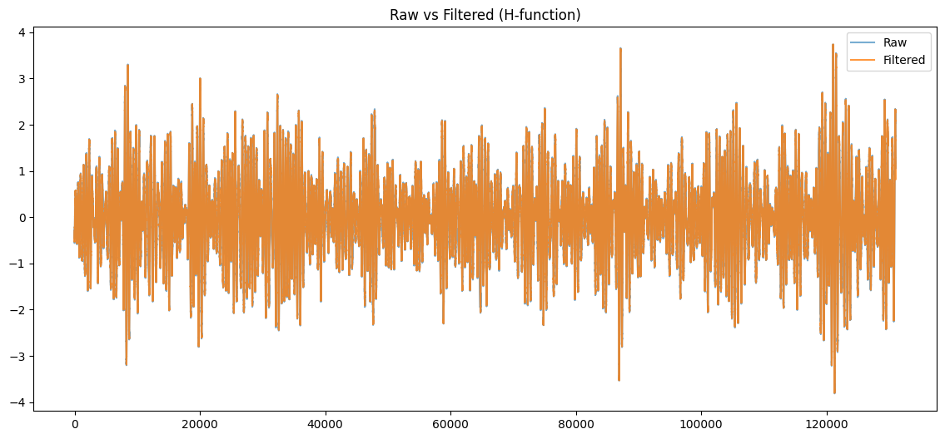
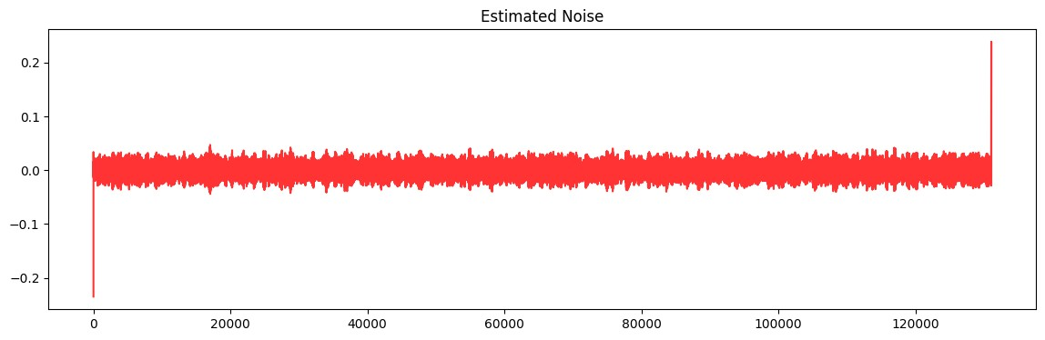
GW RESULTS

Slide 27
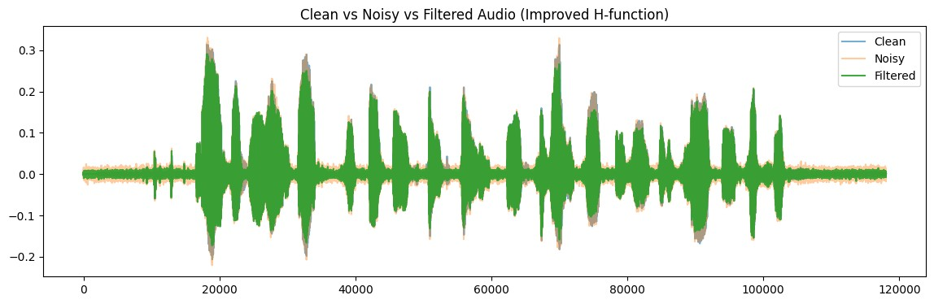
REAL-WORLD AUDIO DENOISING
Input file: voice_noisy_10dB.wav
Noise type: White Noise
Noise Level | H-Filter
–10 dB | 2.44
0 dB | 9.51
10 dB | 14.12

Slide 29
CONCLUSION
Project Goal:
Designed an H-function–inspired noise filter for:
  Gravitational-wave anomaly detection
  Real-world audio denoising
Why H-Function?
Handles multi-scale, non-stationary, colored, and heavy-tailed noise.
More flexible than traditional filters.
Key Result:
Converts advanced mathematical theory into a practical and superior signal-processing tool.

Slide 30
IMPACT IN TWO DOMAINS
1. Gravitational-Wave Signals
Enhances faint waveform details
Improves SNR
Complements matched filtering
2. Audio Denoising
Reduces environmental & white noise
Keeps speech natural
Performs better than standard linear filters

Slide 31
FUTURE WORK
Real-time implementation (GPU/FPGA)
Multi-channel/spatial filtering (beamforming)
Adaptive models for heavy-tailed noise
AI hybrid methods (CNN/RNN/Transformer + H-function)
Extend to new fields: biomedical signals, seismic data, radar/sonar, vibrations

Slide 32
REFERENCES
J. Yan et al., DeepGRAV, 2024
A. Fayad, Unsupervised GW Anomaly Detection, MIT, 2024
R. Ormiston et al., Noise Reduction via Deep Learning, 2020
P. Bacon et al., Denoising BBH Signals, 2022
LIGO Open Science Center
S. Mallat, Wavelet Tour of Signal Processing, 2008
Oppenheim & Schafer, Discrete-Time Signal Processing, 2009
P. Welch, Power Spectral Estimation, 1967
C. Fox, The H-Function, 1961

Slide 33
THANK YOU

