Slide 1

Nandana Rajesh
Roll No: 44
GUIDE: Mr.Sivadas T Nair

Slide 2
Problem Statement
Sl. No | Citation | Methodology
1 | IMD Weather Monitoring System | Collects real-time meteorological data using sensors and satellites
2 | NDMA Disaster Alert System | Issues alerts based on predefined disaster thresholds
3 | Weather Apps (e.g., AccuWeather) | Provides real-time forecasts using API-based data aggregation
4 | Research on Climate Risk Models | Uses statistical and threshold-based models for risk classification
5 | Flood Prediction Systems | Uses rainfall and water-level data for predictive analysis

Slide 3
EXISTING SYSTEMS
Weather applications provide temperature, humidity, and rainfall data
Disaster management systems issue alerts during extreme conditions
Basic forecasting systems predict short-term weather patterns

Slide 4
Problems Identified
No integrated risk classification system
Lack of localized analysis (city-specific like Kochi)
Alerts are not actionable or user-friendly
No connection between weather data and emergency preparedness
Systems are reactive rather than proactive

Slide 5
Proposed System
To convert raw weather data into meaningful risk levels
To provide early warnings with actionable insights
To integrate risk analysis + alerts + preparedness
To improve public awareness and safety
To support decision-making during extreme weather events

Slide 6
Project Objectives
Develop a system to analyze weather data and classify risk levels
Provide real-time alerts based on risk conditions
Integrate emergency preparedness guidelines
Ensure accurate and consistent risk prediction
Design a scalable and user-friendly system

Slide 7
Scope
Covers weather-based risk analysis for a specific region (e.g., Kochi)
Includes alert generation and emergency recommendations
Supports both simulated and real API-based data integration
Designed for future expansion to multiple regions

Slide 8
Expected Users
General public
Local residents in risk-prone areas
Disaster management authorities
Researchers and analysts

Slide 9
Requirement Analysis
Non-Functional Requirements
Functional Requirements
User registration and authentication
Fetch and store weather data
Perform risk analysis using multiple parameters
Classify risk levels (Low / Medium / High)
Generate and display alerts
Provide emergency preparedness recommendations
Store and manage historical data
Performance: System should respond within 2 seconds
Scalability: Should handle increasing user load
Reliability: Accurate and consistent risk predictions
Security: Protect user data and system access
Usability: Simple and intuitive interface
Maintainability: Easy to update thresholds and logic

Slide 10
Overall Architecture
Weather Guard follows a 3-tier client-server architecture:
Presentation Layer (Frontend) – React.js Handles UI rendering and user interaction, and communicates with the backend over HTTP/HTTPS. It does not call external APIs directly; all requests go through the backend.
Application Layer (Backend) – Spring Boot Exposes REST APIs and contains all business logic, including authentication, risk computation, and alert handling. This is the only layer that communicates with external services and the database.
Data Layer – MySQL Stores users, weather records, computed risk data, alerts, and emergency guidelines.
External Dependency: Open-Meteo weather API, accessed only by the backend, never exposed to the frontend directly.

Slide 11
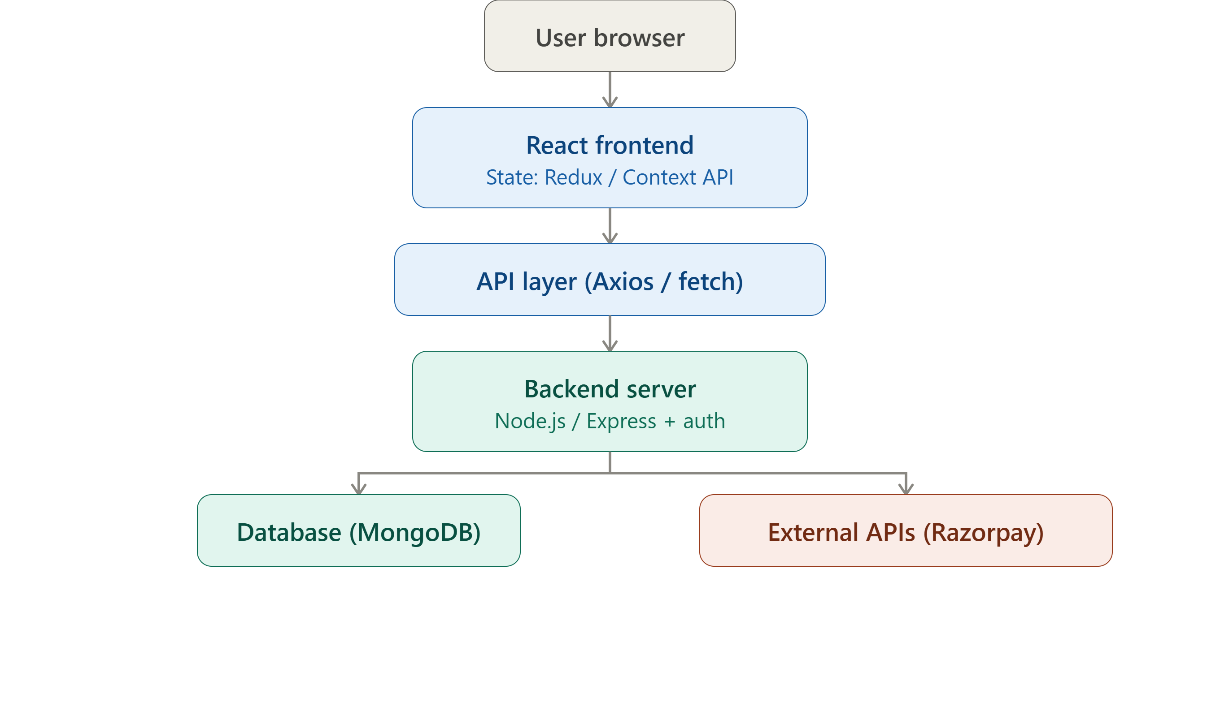
Architecture Diagram

Slide 12
Modules
User Module – handles registration, login, JWT-based authentication, and profile/location preferences.
Weather Data Module – fetches live weather data from Open-Meteo and formats it for the frontend.
Risk Analysis Module – uses the RiskAnalysisService to process weather data, apply seasonal baselines and threshold/compound rules, and output a risk level (Low, Medium, or High) with a reason.
Alerts Module – generates and categorizes alerts by severity, using a hybrid mechanism of real API data where available and admin-managed alerts otherwise.
Emergency Preparedness Module – serves safety guidelines matched to the current risk level and disaster type.
Data Visualization Module – formats historical and trend weather data for charts on the frontend.
Admin Module – allows admins to manage alerts and monitor system activity, restricted to users with an admin role.

Slide 13
Tables

Slide 14
User
Field Name | Data Type / Constraint | Description
user_id | INT, Primary Key, Auto Increment | Unique identifier for each user
username | VARCHAR, UNIQUE, NOT NULL | Username of the user
email | VARCHAR, UNIQUE, NOT NULL | Email address of the user
password_hash | VARCHAR, NOT NULL | Encrypted password for authentication
role | ENUM ('user', 'admin') | Defines user role (normal user or admin)
location_id | INT, Foreign Key | References Location(location_id)
created_at | TIMESTAMP | Timestamp of account creation

Slide 15
Location
Field Name | Data Type / Constraint | Description
location_id | INT, Primary Key, Auto Increment | Unique identifier for location
city | VARCHAR | Name of the city
state | VARCHAR | Name of the state
latitude | DECIMAL | Latitude coordinate
longitude | DECIMAL | Longitude coordinate

Slide 16
Weather data
Field Name | Data Type / Constraint | Description
weather_id | INT, Primary Key, Auto Increment | Unique identifier for weather record
location_id | INT, Foreign Key | References Location(location_id)
temperature | DECIMAL | Temperature value
humidity | DECIMAL | Humidity level
rainfall | DECIMAL | Rainfall measurement
wind_speed | DECIMAL | Wind speed value
timestamp | TIMESTAMP | Time of data recording

Slide 17
Risk data
Field Name | Data Type / Constraint | Description
risk_id | INT, Primary Key, Auto Increment | Unique identifier for risk record
weather_id | INT, Foreign Key | References WeatherData(weather_id)
risk_level | ENUM ('Low', 'Medium', 'High') | Classified risk level
temperature | DECIMAL | Temperature used for risk calculation
rainfall | DECIMAL | Rainfall used for risk calculation
wind_speed | DECIMAL | Wind speed used for risk calculation
humidity | DECIMAL | Humidity used for risk calculation
description | VARCHAR | Explanation of risk level
timestamp | TIMESTAMP | Time of risk evaluation

Slide 18
Alert
Field Name | Data Type / Constraint | Description
alert_id | INT, Primary Key, Auto Increment | Unique identifier for alert
location_id | INT, Foreign Key | References Location(location_id)
alert_type | VARCHAR | Type of alert (e.g., Rain, Heatwave, Storm)
severity | ENUM ('Low', 'Medium', 'High') | Severity level of alert
message | VARCHAR | Alert message content
source | ENUM ('API', 'Admin') | Source of alert (external API or admin)

Slide 19
Emergency Guidelines
Field Name | Data Type / Constraint | Description
guideline_id | INT, Primary Key, Auto Increment | Unique identifier for each guideline
risk_level | ENUM ('Low', 'Medium', 'High') | Associated risk level
disaster_type | VARCHAR | Type of disaster (e.g., Flood, Heatwave, Storm)
description | TEXT | Detailed emergency instructions
timestamp | TIMESTAMP | Time of guideline creation/update

Slide 20
ER Diagram

Slide 21
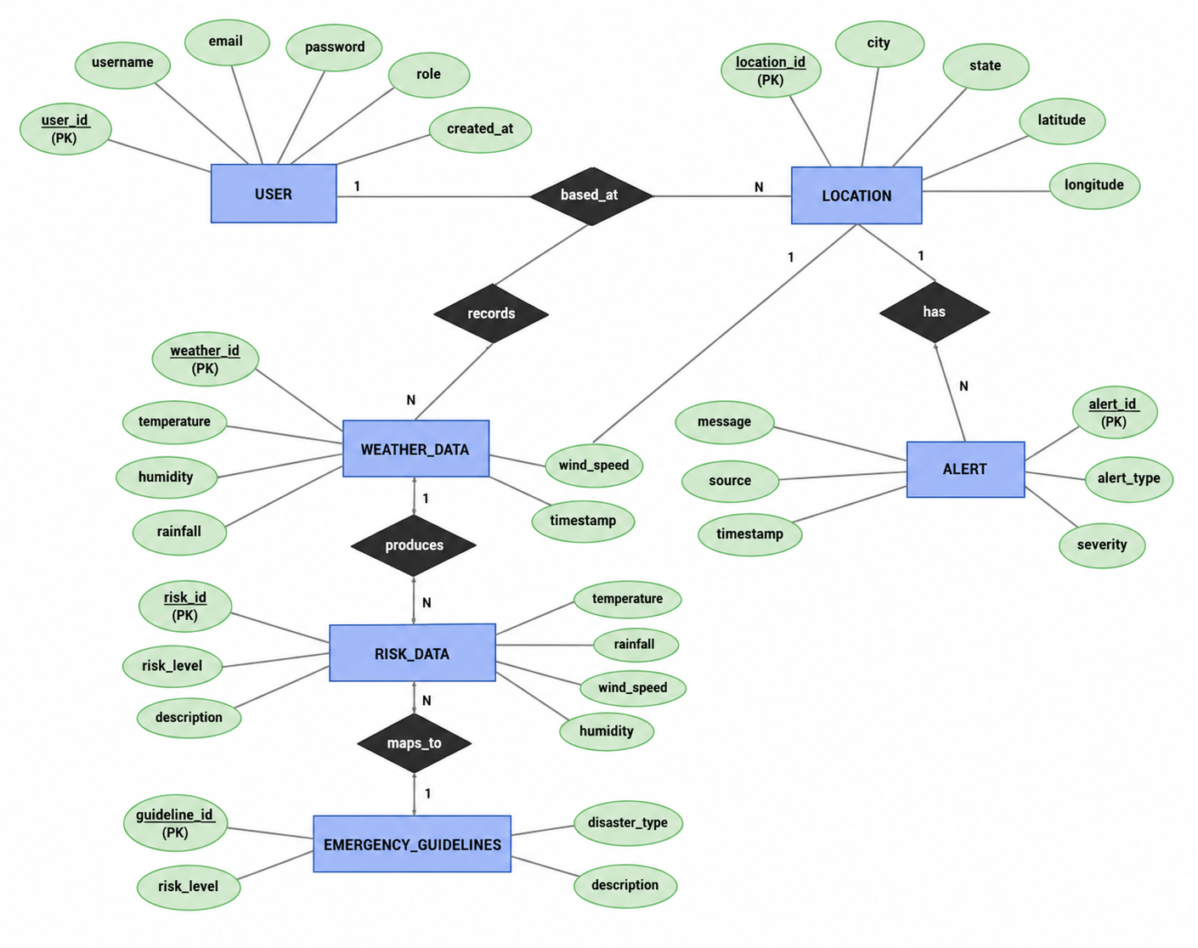

Slide 22
Technology Stack

Slide 23
Product Backlog
ID | User Story
US1 | As a user, I want to view real-time weather updates so that I can stay informed
US2 | As a user, I want to receive alerts for extreme weather conditions
US3 | As a user, I want to see risk levels (Low/Medium/High) for my location
US4 | As an admin, I want to manage weather and alert data
US5 | As a user, I want emergency preparedness guidelines during disasters
US6 | As a system, I want to analyze weather data to generate risk indicators

Slide 24
Thankyou

