Slide 1
CipherBook
Subject: Security Algorithms and protocols
Authors: Professor:
Vikas Nandanam Dr. Pablo Rivas
Vikram Patil
May 3,2016

Slide 2
Contents
i) About the CipherBook
ii) How to use application
iii) AES Encryption
iv) AES Decryption
v) Future Enhancement

Slide 3
About CipherBook
CipherBook is a single user android application that protects the confidential data by saving them in the in file.
The application stores the encrypted cipher text into a file, the saved file is stored in internal memory of android.
The application follows AES 128 bit technique, the key and text for encryption are strictly restricted to 16 characters(mandatory) for the current version of the application.

Slide 4
How to use application
Device Specification
Android 6.3 - Marshmallow,
Nexus 7
SDK-API 23
- Brief Demonstration video
- User Manual

Slide 5
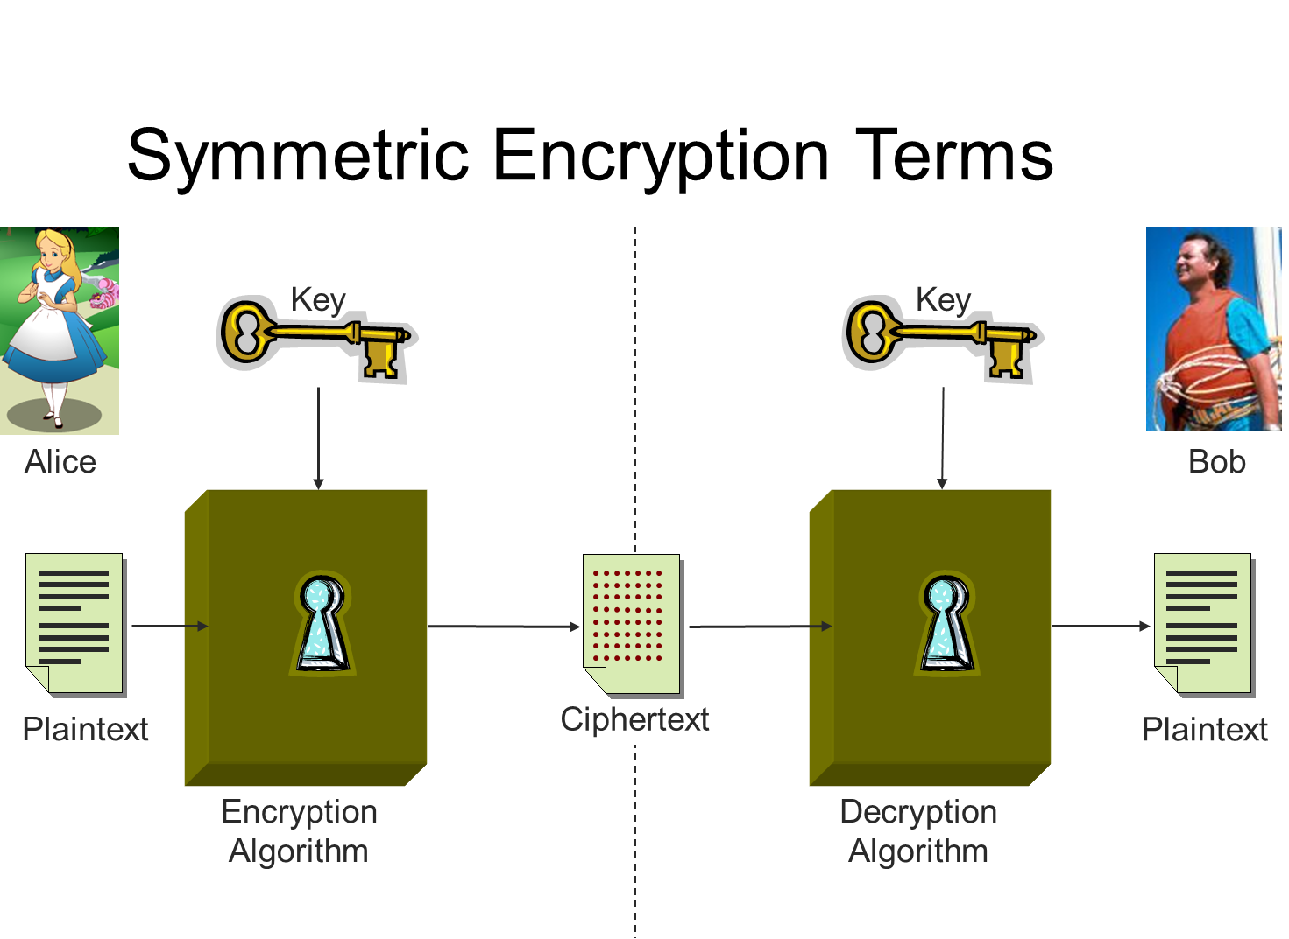

Slide 6
The AES Cipher
Block length is limited to 128 bit
The key size can be independently specified to 128, 192 or 256 bits
Key size (words/bytes/bits) | 4/16/128 | 6/24/192 | 8/32/256
Number of rounds | 10 | 12 | 14
Expanded key size (words/byte) | 44/176 | 52/208 | 60/240

Slide 7
The AES Cipher Key Generation
Key received as input array of 4 rows and Nk columns
Input key is expanded into an array of 44/52/60 words of 32 bits each 4 different words serve as a key for each round
k0
k4
k8
k12
k1
k5
k9
k13
w0
w1
w2
……
w42
w43
k2
k6
k10
k14
k3
k7
k11
k15

Slide 8
AES Functions
AddRoundKey() – round key is added to the State using XOR operation
MixColumns() – takes all the columns of the State and mixes their data, independently of one another, making use of arithmetic over GF(2^8)
ShiftRows() – processes the State by cyclically shifting the last three rows of the State by different offsets
NibbleSub() – uses S-box to perform a byte-by-byte substitution of State

Slide 9
The AES Cipher
plaintext
Add round key
Substitute bytes
Substitute bytes
Substitute bytes
Shift rows
Shift rows
Shift rows
Round 1
Round 9
Mix columns
Mix columns
Add round key
Add Round key
Add round key
Cipher text
W[4,7]
W[36,39]
W[40,43]
key

Slide 10
The AES Inverse Cipher
ciphertext
Add round key
Inv. Shift rows
Inv. Shift rows
Inv. Shift rows
Inv. Sub bytes
Inv. Sub bytes
Inv. Sub bytes
Round 1
Round 9
Add round key
Add round key
Add round key
Inv. Mix Columns
Inv. Mix columns
plaintext
W[36,39]
W[4,7]
W[0,3]
key

Slide 11
Future Enhancement
The application Cipherbook is a basic version for encryption and decryption using AES 128 bit technique. The current application is a single user application, where encryption and decryption is processed on the same device. In future, the application will be enhanced for AES 192 and 256 bit encryption and decryption techniques. The other versions of the application will be for multi users and even authentication will also be enabled.
There is also a scope for introducing authentication in the application.

Slide 12
