Slide 1
DEVOPS CAPSTONE | SESSION 21 EVALUATION
BugBoard
Cloud-Native Bug Tracking & Deterministic Code Analysis
Transforming how engineering teams triage defects with automated root-cause analysis and shift-left CI/CD pipelines.
Presenter: Nandani Kumari | Scaler School of Technology
Stack: React 18 • FastAPI • PostgreSQL • Docker • GitHub Actions • Trivy • Terraform • Kubernetes • Helm • Prometheus

Slide 2
EXECUTIVE CONTEXT
The Problem & The Solution: Why BugBoard?
THE PROBLEM WE SOLVE
• Expensive Production Failures:
Defects caught in production are 15x more expensive to resolve and disrupt user trust.
• Slow & Manual Triage:
Engineers spend hours manually reproducing bug reports without immediate access to code context.
• Siloed Toolchains:
Traditional issue trackers are disconnected from code repositories and deployment pipelines.
THE BUGBOARD PLATFORM
• Deterministic Code Analyzer:
Unpacks project archives, extracts code snippets, and pinpoints exact lines with actionable fixes.
• Automated Quality Gates:
Every commit is verified through isolated unit tests, frontend builds, and vulnerability scans.
• Production Cloud Delivery:
Self-healing Kubernetes clusters running resilient multi-replica deployments with zero downtime.

Slide 3
SYSTEM ARCHITECTURE
End-to-End Automation Lifecycle: From Code to Cloud
1. WRITE & COMMIT
Developer commits code to GitHub repository with branch protection rules.
2. TEST & SECURE
Automated Pytest unit tests, Vite compilation, and Trivy CVE scanning in CI.
3. PACKAGE & RELEASE
Hardened non-root containers built & dual-pushed to GHCR and Docker Hub.
4. DEPLOY & MONITOR
Helm deploys 2 replicas to Kubernetes; Prometheus scrapes live metrics.

Slide 4
ARCHITECTURE EVALUATION
Technology Choices & Strategic Trade-offs
Architecture Tier | Chosen Solution | Alternative Considered | Strategic Business Rationale
Container Orchestration | Kubernetes & Helm | Standalone Docker / EC2 | Enables self-healing pods, automated rolling updates, and declarative cluster scaling.
Microservices Stack | FastAPI + React 18 | Django Monolith | Decoupled frontend & backend scale independently; delivers sub-second API execution.
Persistence & Schema | PostgreSQL + Alembic | Raw SQLite / MongoDB | Enforces ACID relational integrity for bug audit trails with trackable schema migrations.
Telemetry Pipeline | Prometheus + Grafana | Standard Server Logs | Provides real-time visibility into traffic volume and P95 latency percentiles.

Slide 5
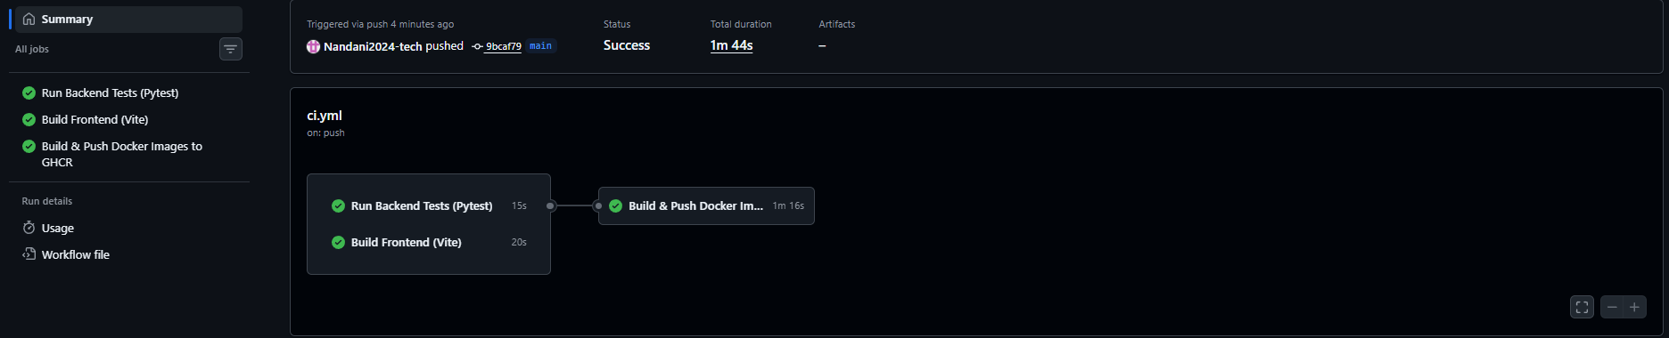
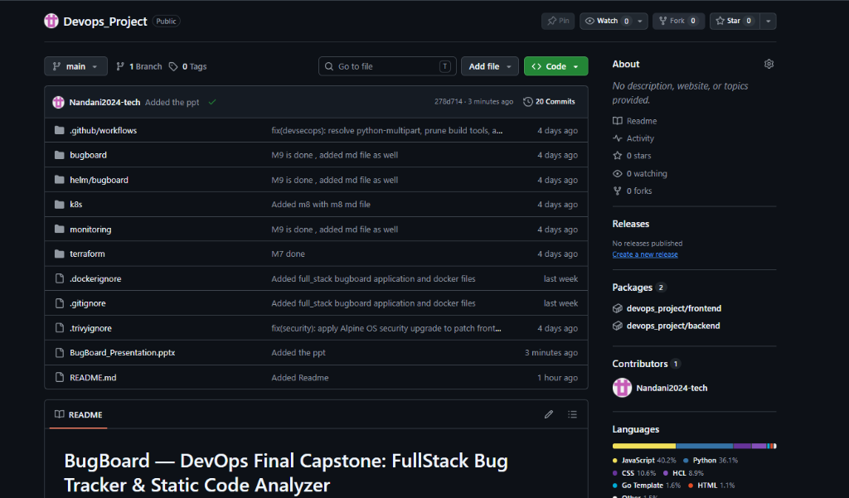
OPERATIONAL PROOF 1 & 2
Mandatory Evidence: Automated CI/CD Pipeline & GitHub Repository
1. GitHub Actions CI/CD Pipeline (All Green)
Parallel Pytest quality gates, Vite frontend compilation, and Trivy security gate.
2. GitHub Code Repository & Git Hygiene
Clean monorepo structure, zero committed secrets, and conventional commit logs.

Slide 6
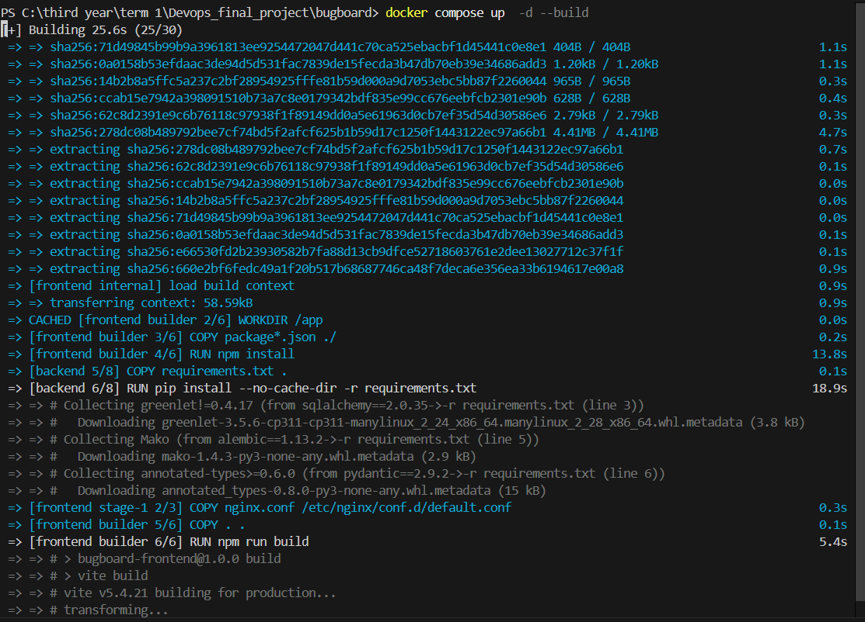
OPERATIONAL PROOF 3 & 4
Mandatory Evidence: Docker Compose Stack & Kubernetes Cluster
3. Docker Compose Local Stack
Single-command developer onboarding running PostgreSQL, Backend, and Frontend.
4. Kubernetes Cluster & Pod Health
kubectl get pods,svc showing 2 replicas per tier and healthy ClusterIP services.

Slide 7
OPERATIONAL ROI
Measurable Business Outcomes & Production Stability
0 BROKEN RELEASES
100% Quality Gate Enforcement
• Every push validated with automated Pytest suites.
• Failed unit tests immediately halt CI pipeline.
• Eliminates broken builds and customer-facing downtime.
SHIFT-LEFT SECURITY
0 Actionable CVEs in Registries
• Aqua Trivy scans container layers before image push.
• High/Critical vulnerabilities blocked by exit code 1.
• Hardened base OS and unprivileged runtime containers.
99.9% RESILIENCE
Self-Healing Cloud Architecture
• 2 replicas per microservice tier with rolling updates.
• Real-time Prometheus scraping tracks P95 latencies.
• Grafana dashboards visualize traffic patterns & health.

Slide 8
CONCLUSION & NEXT STEPS
Capstone Summary: Production-Ready DevOps Lifecycle
WHAT WE DELIVERED ACROSS 10 MILESTONES (100 / 100 PTS)
✔ Full-Stack Cloud-Native SaaS: React 18 frontend + FastAPI backend + PostgreSQL with deterministic static code analysis.
✔ Enterprise CI/CD Automation: GitHub Actions with parallel testing, Vite compilation, and multi-registry publishing (GHCR & Docker Hub).
✔ Hardened DevSecOps & IaC: Trivy vulnerability scan gate, multi-AZ AWS VPC & EKS codified in modular Terraform.
✔ Kubernetes & Observability: Production Helm chart deployment with 2 replicas per tier and real-time Prometheus/Grafana dashboards.
Ready to proceed to live demonstration and evaluator Q&A!

