Slide 1

WEATHER FORCASTING SYSTEM
Submitted by
Name | USN
Nagesh Bhavi | 01JST21IS029
Nandan K N | 01JST21IS030
Submitted to
Nagarjun A
(Assistant Professor)
Department of Information Science and Engineering

Slide 2
INTRODUCTION
The Weather Forecasting Project develops a reliable and user-friendly system for accurate weather forecasts. It utilizes advanced technologies and data analysis techniques to gather real-time data from various sources. Through processing and analysis, it generates precise forecasts for temperature, humidity, wind speed, and more. Users access forecasts through an intuitive interface, including current conditions, hourly and daily forecasts, and alerts for severe weather. The system enhances decision-making efficiency in industries like outdoor planning, transportation management, and public safety during severe weather events.

Slide 3
Functional Requirements
1.User Registration and Authentication:
The system shall provide user registration functionality, allowing users to create an account by providing their personal information.
The system shall store user account information securely, including usernames, passwords (hashed and salted), and email addresses.
The system shall support password reset functionality, allowing users to recover their accounts through email verification.
The system shall authenticate users based on their credentials before granting access to the system's features.

Slide 4
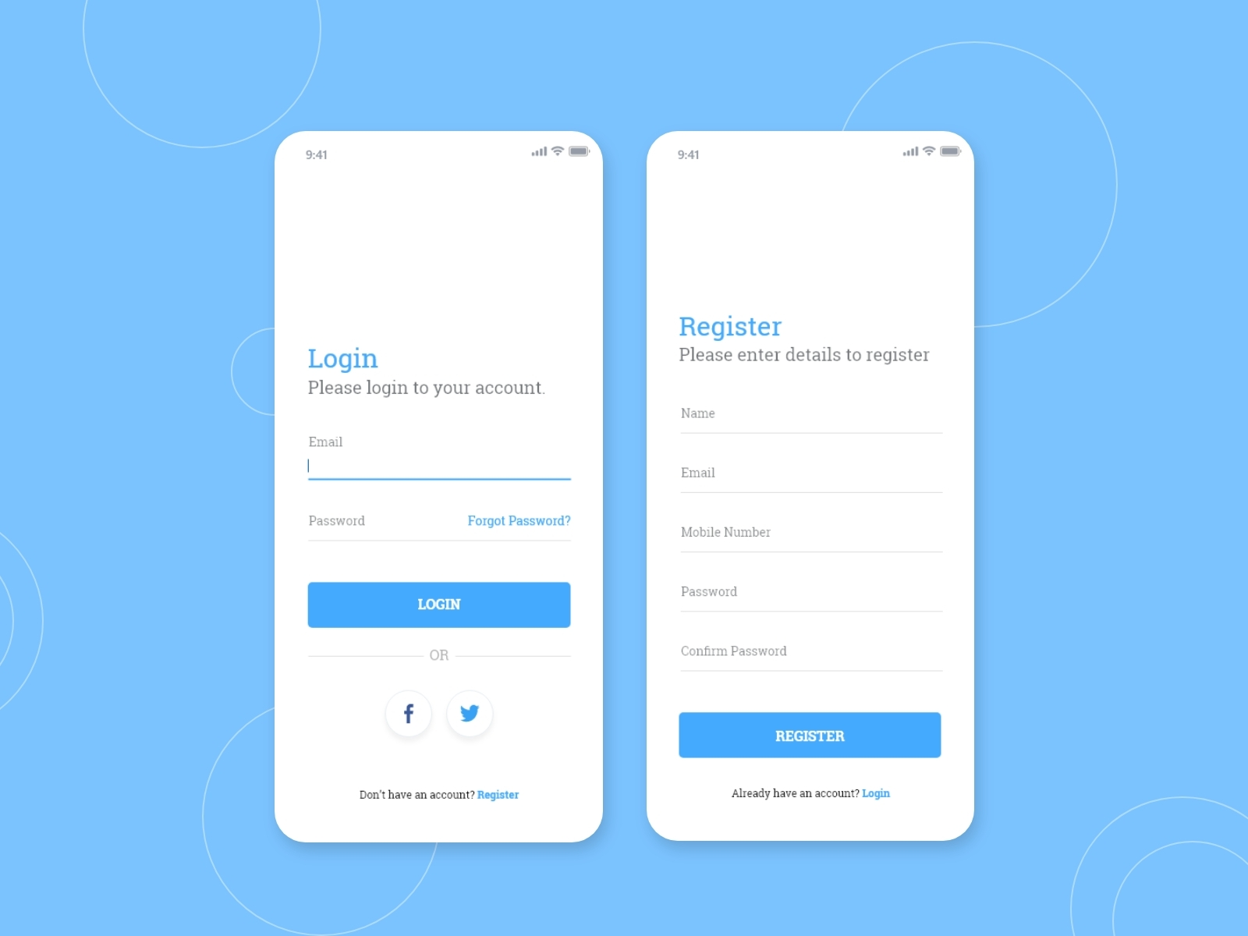
Registration and login

Slide 5
2. Location Selection :
The system shall provide a user-friendly interface for users to select their desired location for weather forecasting.
The system shall support both manual location entry, where users can input their desired location information, and automatic location detection, where the system uses geolocation services to determine the user's current location.
The system shall validate the user's location inputs and provide suggestions or error messages as appropriate.

Slide 6
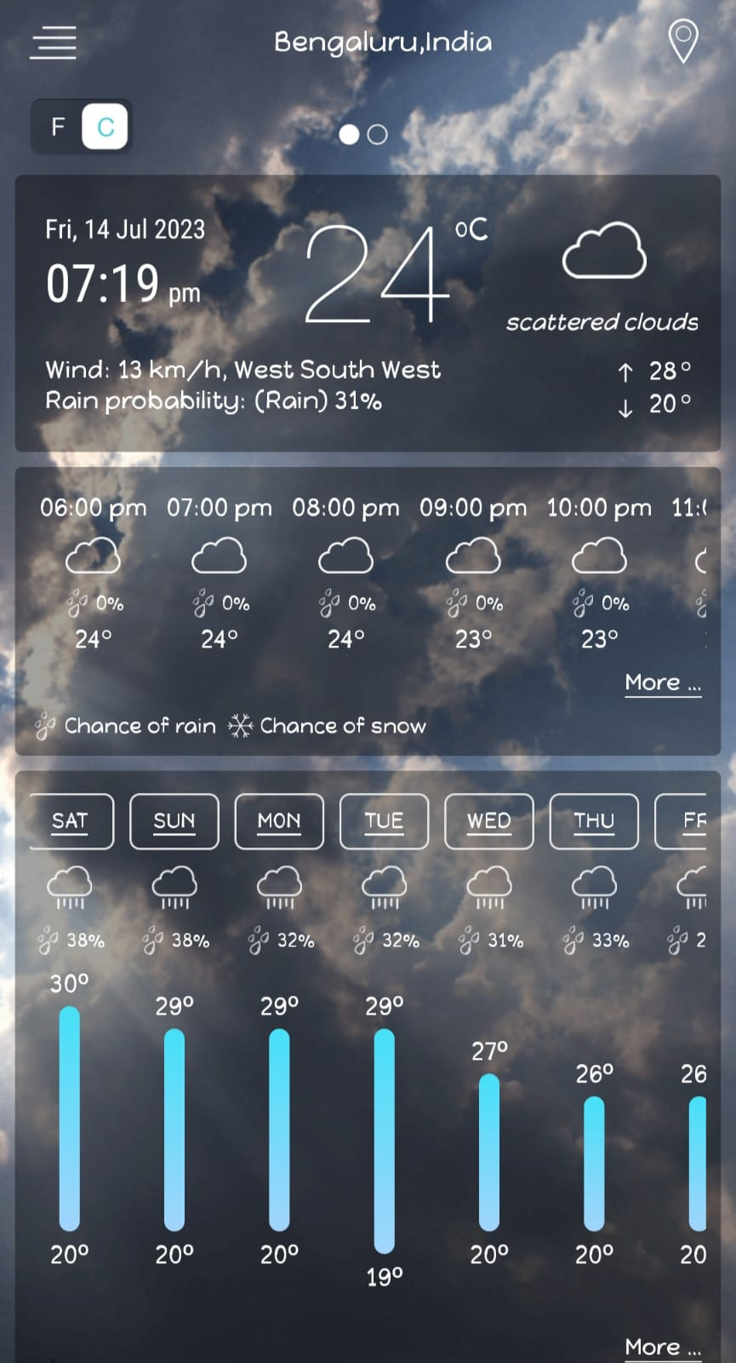


Slide 7
3. Weather Data Retrieval:
The system shall retrieve weather data from reliable and trusted sources, such as national meteorological services or reputable weather data APIs.
The system shall integrate with these data sources through appropriate interfaces or APIs to obtain weather data for the selected locations.
The system shall retrieve data for various weather parameters, including but not limited to temperature, humidity, wind speed and direction, precipitation, atmospheric pressure, visibility, and UV index.

Slide 8
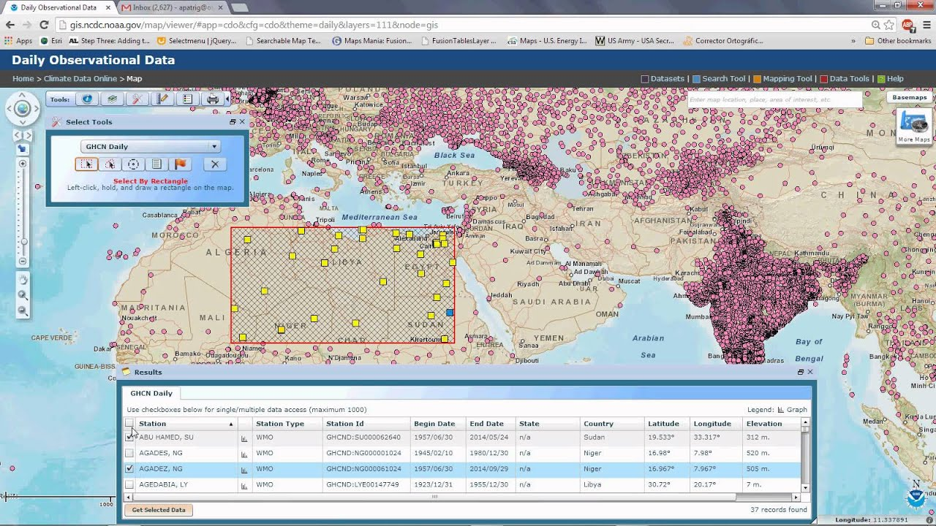

Slide 9
4. Weather Forecast Generation :
The system shall employ advanced data processing algorithms and forecasting models to generate accurate weather forecasts for the selected locations.
The system shall provide short-term forecasts, such as hourly forecasts for the next 24 hours, and long-term forecasts, such as daily or weekly forecasts.
The system shall consider historical weather patterns and trends, as well as real-time data updates, in generating the forecasts.
The system shall account for uncertainties and provide probabilistic forecasts where applicable.

Slide 10
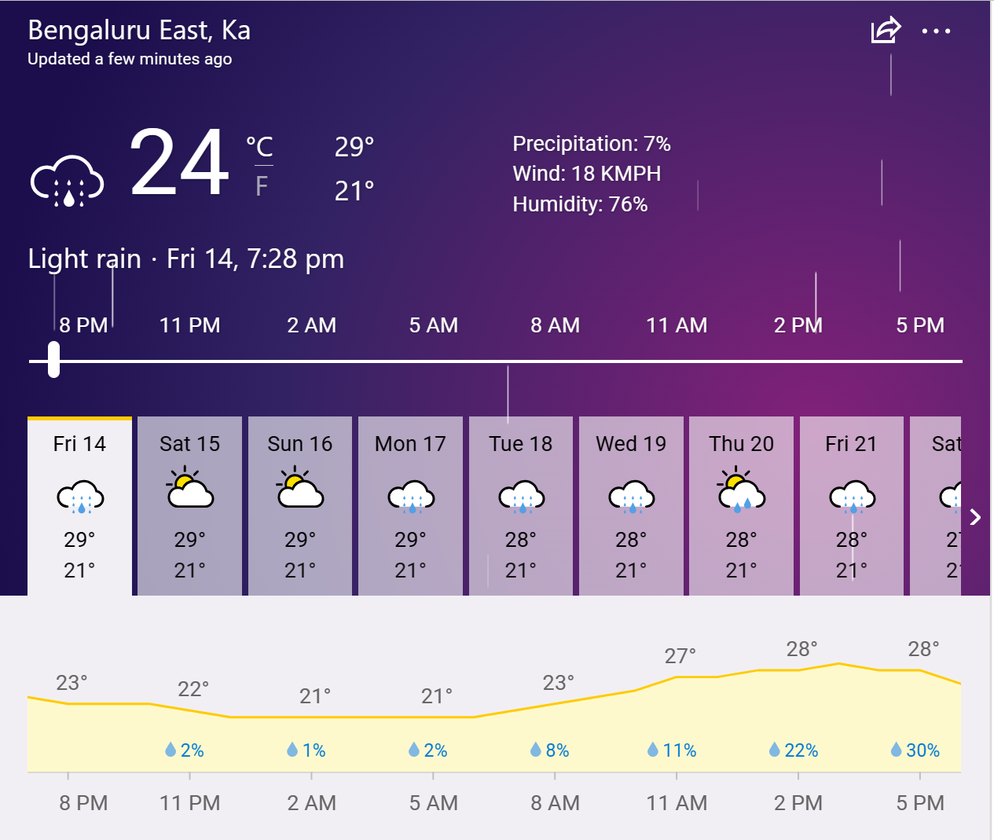

Slide 11
5. Weather Alerts and Notifications
The system shall provide real-time weather alerts and notifications to users for severe weather conditions, such as storms, hurricanes, heatwaves, or extreme temperatures.
The system shall monitor incoming weather data and issue alerts based on predefined thresholds or criteria.
The system shall allow users to customize their alert preferences, such as selecting the types of weather alerts they want to receive and their preferred communication channels (e.g., email, SMS, push notifications).
The system shall send timely notifications to users based on their preferences and the occurrence of severe weather events.

Slide 12
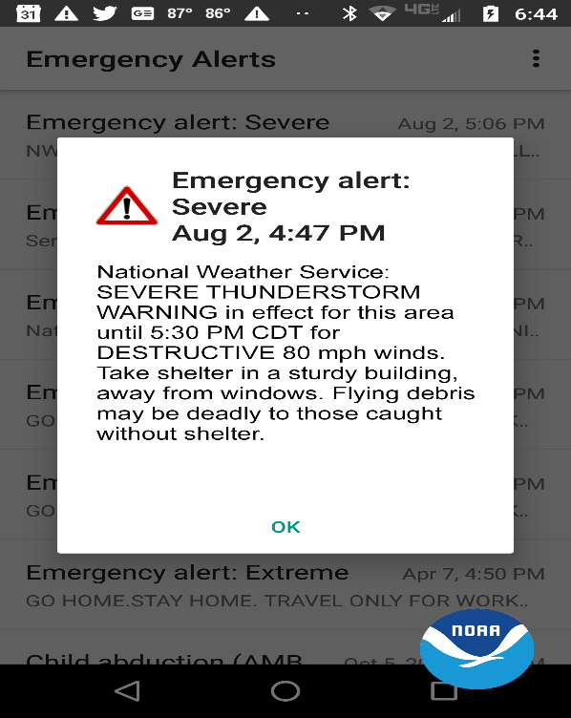
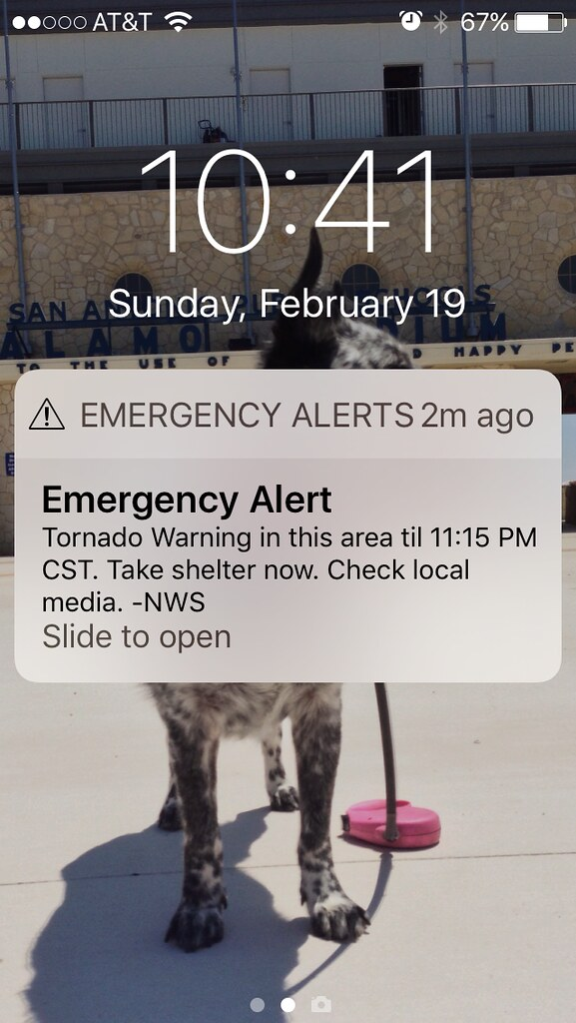

Slide 13
6. User Settings and Preferences
The system shall provide a user profile section where users can manage their settings and preferences.
The system shall allow users to customize their temperature units (e.g., Celsius, Fahrenheit) and measurement systems (e.g., metric, imperial).
The system shall allow users to set their preferred language for the user interface and weather information.
The system shall store and maintain user preferences for future sessions.

Slide 14
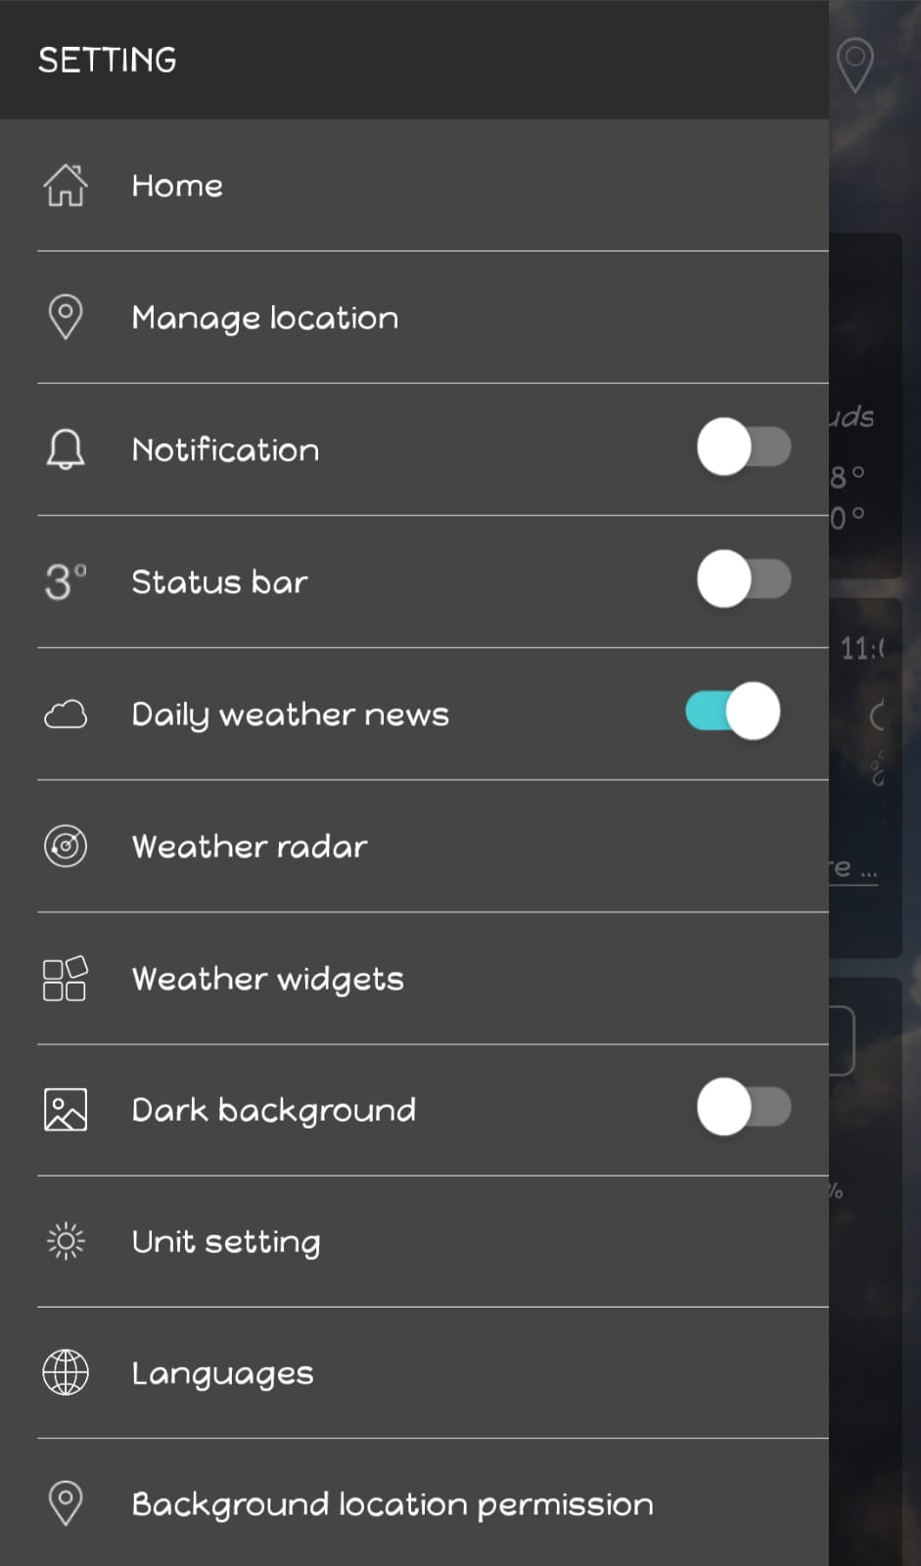
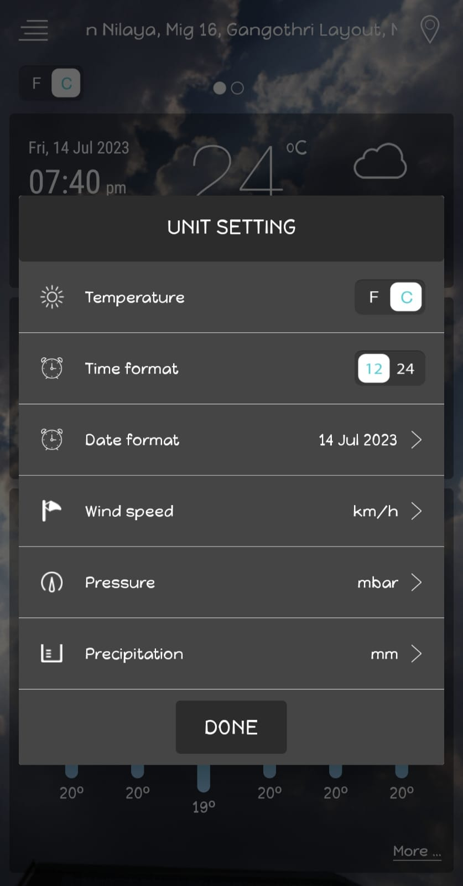

Slide 15
Non-Functional Requirements
1. Performance
The system shall provide weather forecasts and data retrieval with minimal latency to ensure a responsive user experience.
The system shall be capable of handling a large number of concurrent user requests without significant performance degradation.
The system shall optimize data retrieval and processing algorithms to minimize computational resource usage.

Slide 16
2. Reliability
The system shall ensure high availability and uptime to provide uninterrupted weather forecasts and services.
The system shall implement mechanisms for data source redundancy and failover to minimize disruptions in data retrieval.
The system shall handle data retrieval failures or delays gracefully and provide appropriate error messages to users.

Slide 17
3. Security
The system shall implement secure user authentication mechanisms, including password hashing, to protect user accounts from unauthorized access.
The system shall utilize encryption protocols (e.g., SSL/TLS) when transmitting sensitive data, such as user credentials and location information, over the network.
The system shall adhere to relevant security standards and best practices to safeguard user data and prevent data breaches.

Slide 18
4. Usability
The system shall have an intuitive and user-friendly interface that is easy to navigate and understand.
The system shall provide clear and concise weather information, presented in a visually appealing manner, to enhance user comprehension.
The system shall ensure proper contrast, readability, and accessibility standards for users with disabilities.

Slide 19
Working Principle :
1. Data Collection
The application collects real-time weather data from various sources, such as weather sensors, satellites, and meteorological models. These sources provide information on temperature, humidity, wind speed, precipitation, and other relevant weather parameters.
2. Data Processing
The collected weather data undergoes processing and analysis using advanced algorithms. This step involves cleaning and organizing the data, applying statistical methods, and utilizing machine learning techniques to extract meaningful patterns and trends.

Slide 20
3. Forecast Generation
Based on the processed data, the application generates accurate weather forecasts. The forecasting algorithms consider factors such as historical patterns, current weather conditions, and atmospheric models to predict future weather conditions.
4. User Interface
The application presents the weather forecasts to users through an intuitive and user-friendly interface. Users can access current weather conditions, view hourly and daily forecasts, and receive alerts for severe weather events. The interface may include visualizations, charts, and graphical representations to enhance the understanding of weather information.

Slide 21
5. Location-based Forecasting
The application supports location-based forecasts, allowing users to obtain weather information tailored to specific regions or cities. This feature enables users to access localized forecasts based on their geographical preferences.
6. Reliability and Validation
The application undergoes rigorous testing and validation procedures to ensure the reliability and accuracy of the forecasts. This includes evaluating the performance of the algorithms, comparing the forecasts with ground truth data, and continuously refining and improving the forecasting models.

Slide 22
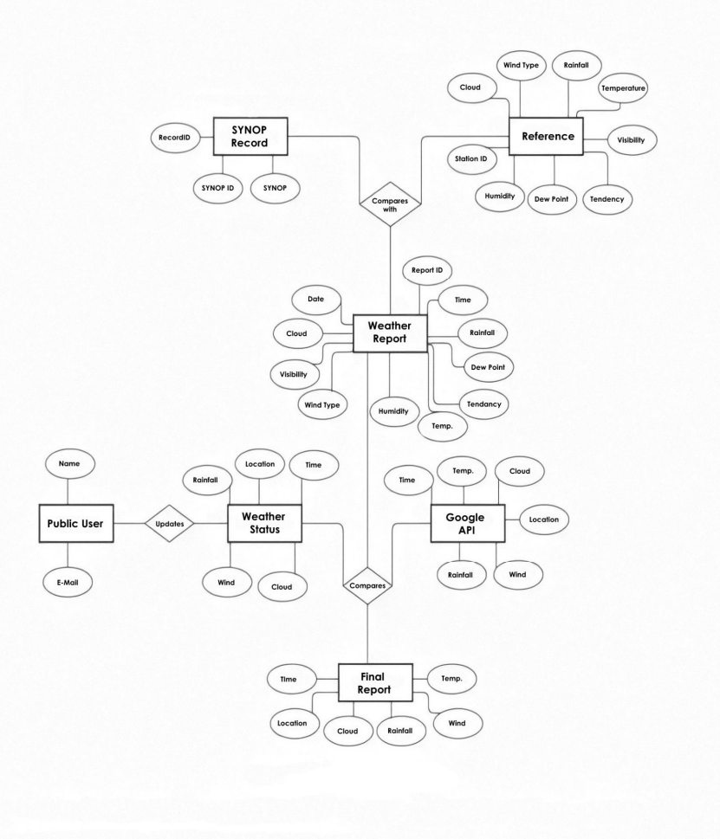

Slide 23
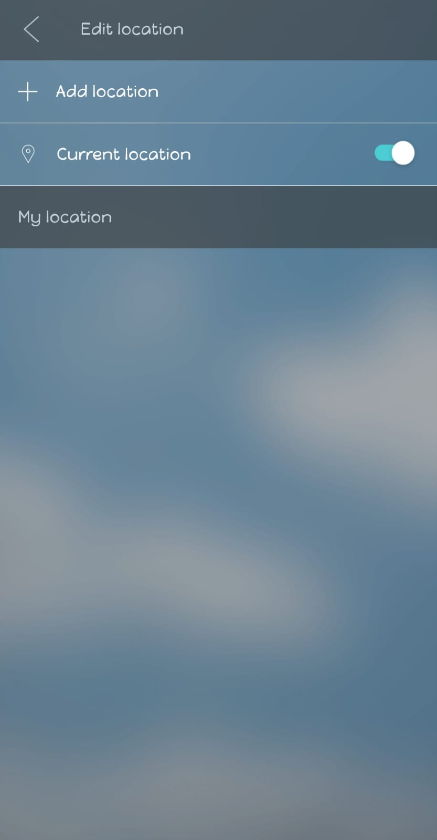
DESIGN SPECIFICATION
User Interface:
It simplifies the complex background process to the user with the attractive display.

Slide 24
Settings:
Access permission for the location, notification… ,will be asked once the user logged in.

Slide 25
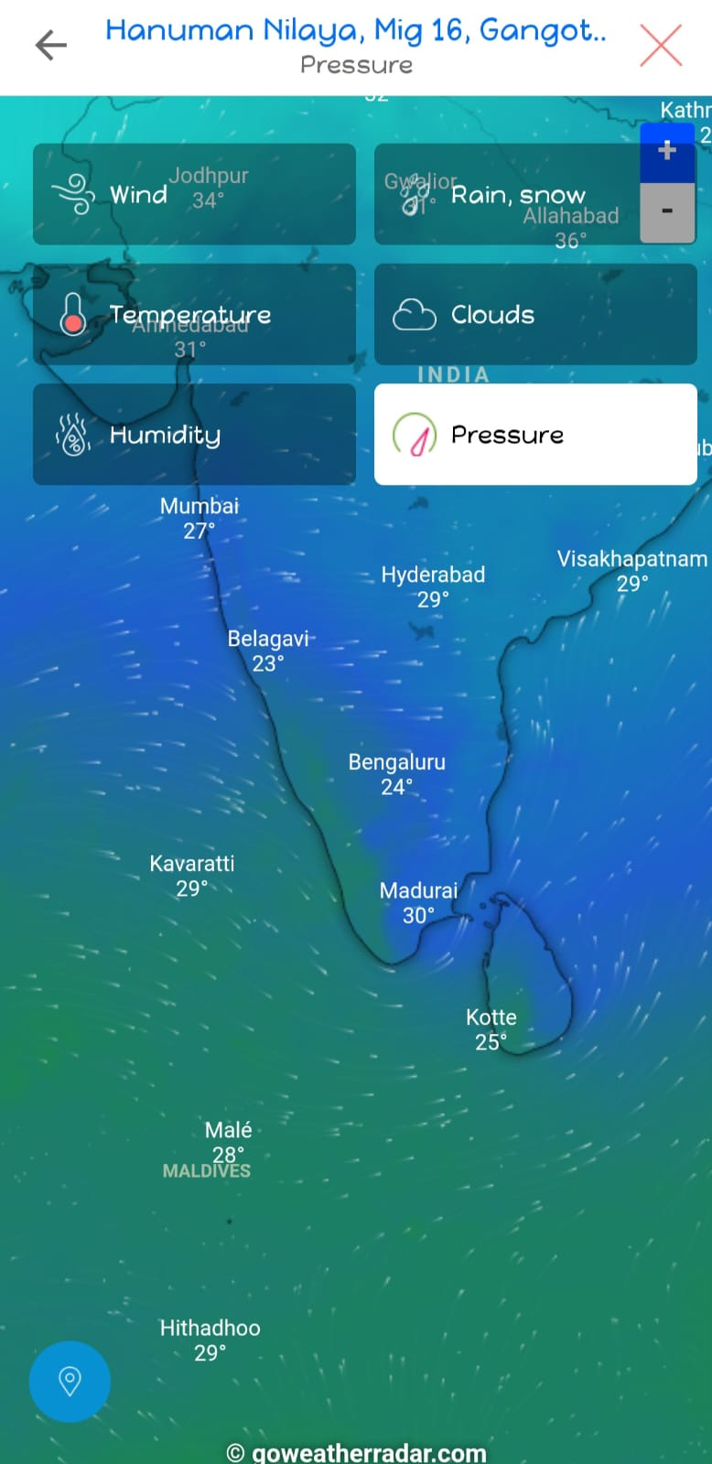
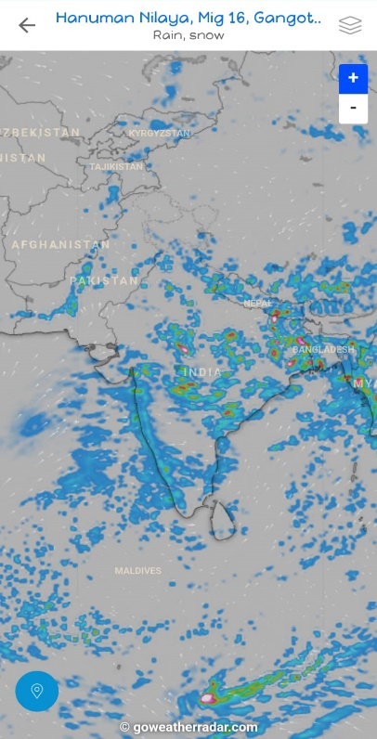
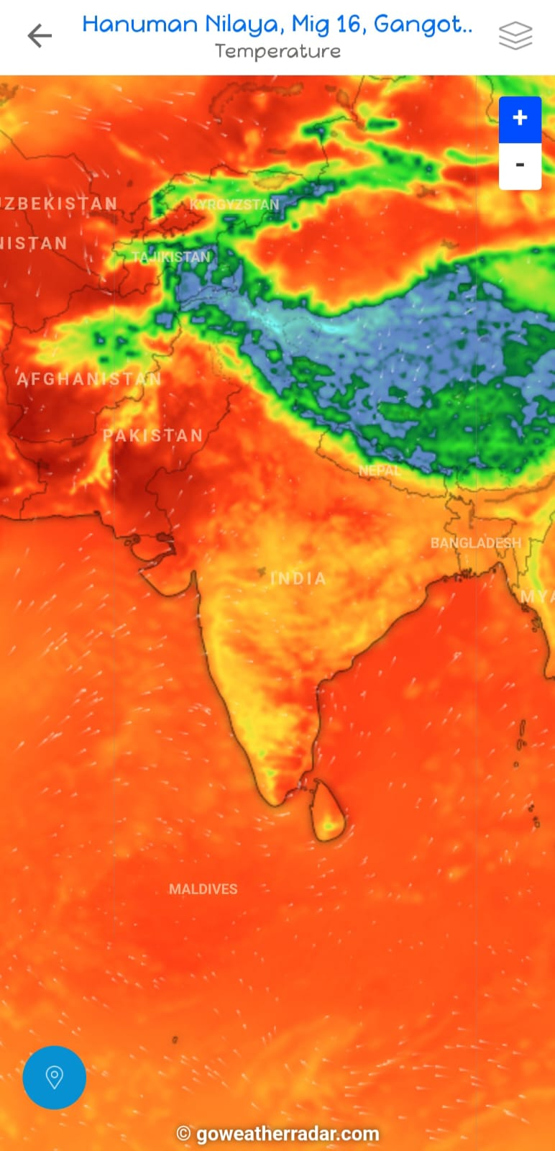
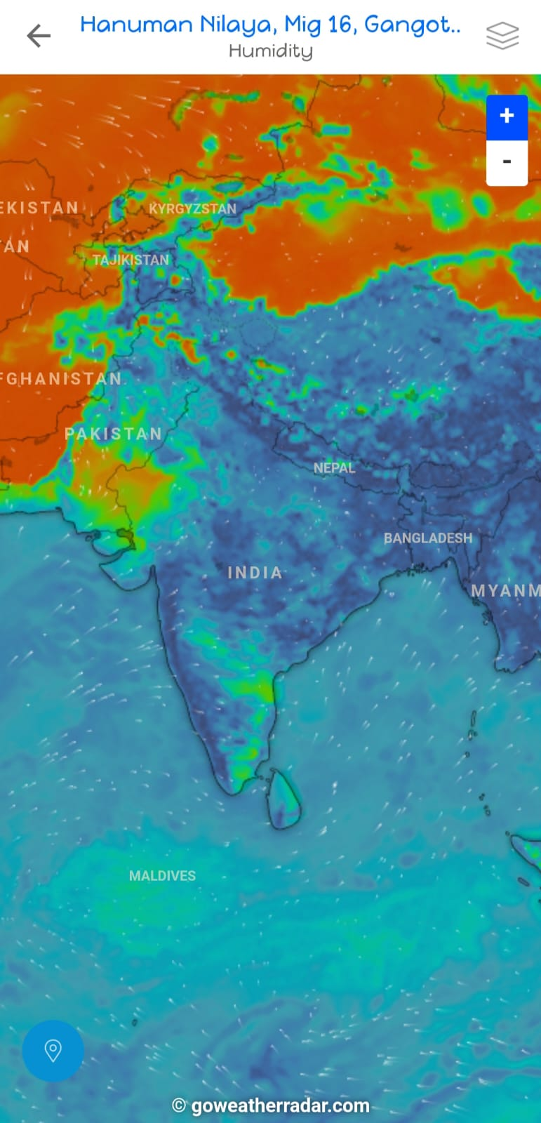
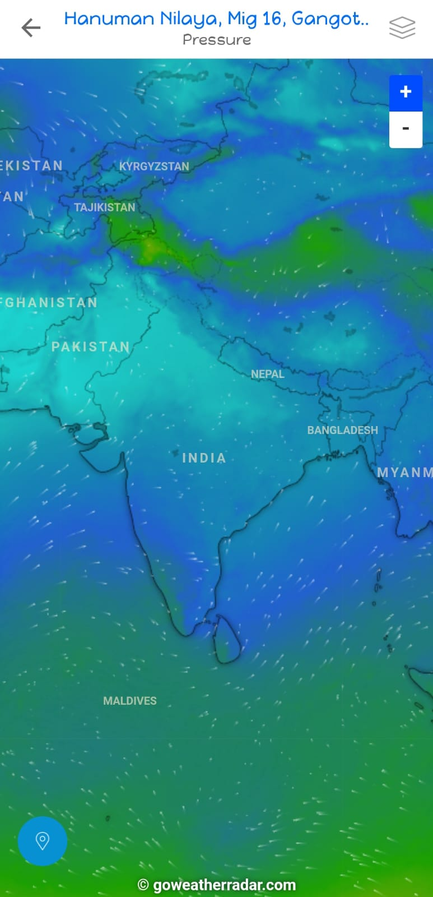
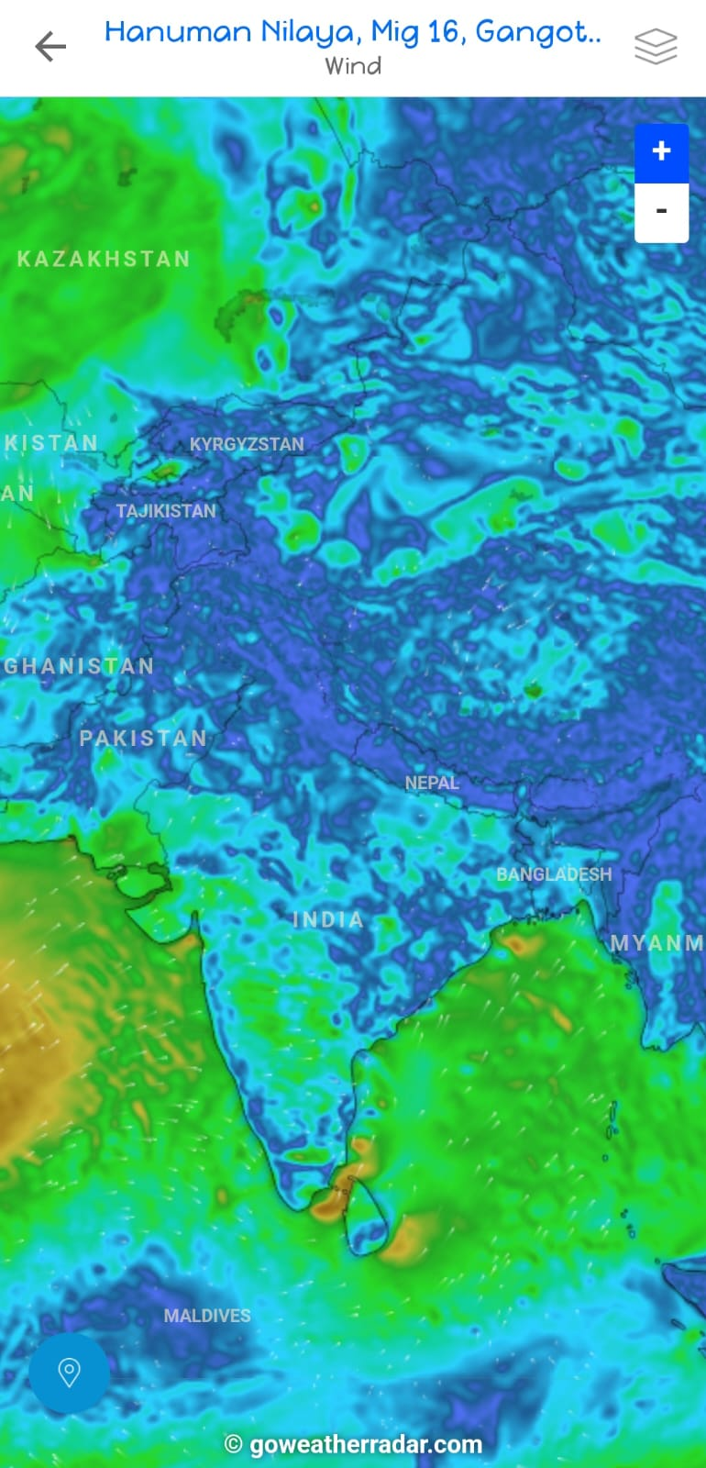
Different Weather Radars:
Options Rain Temperature Humidity Pressure Wind
Use of IOT for interaction between the radar of all places is done. With IOT everything is easy for the communication.

Slide 26
SYSTEM CONSTRAINTS:
Platform-Specific Requirements and Features
1. Android
The Android application shall target devices running Android OS version 5.0 (Lollipop) and above.
The application shall utilize native Android components and adhere to Material Design guidelines for a consistent and user-friendly interface.
The application shall support push notifications to deliver weather alerts and updates even when the application is not actively running.
The application shall leverage platform-specific capabilities, such as geolocation services, to enhance location detection accuracy.

Slide 27
2. iOS
The iOS application shall target devices running iOS version 12 and above.
The application shall follow Apple's Human Interface Guidelines to ensure a seamless and intuitive user experience.
The application shall utilize native iOS components and support dark mode for improved visibility in low-light environments.
The application shall integrate with Apple Push Notification service to deliver weather alerts and updates to users.

Slide 28
3. Windows
The Windows application shall support Windows 10 and above, including both desktop and tablet devices.
The application shall follow Microsoft's design principles, such as the Fluent Design System, to provide a visually appealing and consistent user interface.
The application shall support live tiles and toast notifications to provide real-time weather updates on the Windows Start menu and desktop.

Slide 29
4. macOS
The macOS application shall support macOS version 10.13 (High Sierra) and above.
The application shall comply with Apple's design guidelines, including the use of standard macOS controls and interface elements.
The application shall integrate with macOS Notification Centre to deliver weather alerts and notifications

Slide 30
CONCLUSION
The Weather Forecasting Project developed a reliable and user-friendly system for accurate weather forecasts. Users can access real-time information, including current conditions, forecasts, and alerts. Rigorous testing ensures reliability, empowering decision-making across sectors. The Weather Forecasting Project remains committed to enhancing decision-making efficiency and effectiveness in diverse sectors. Overall, the project has successfully delivered a valuable tool for accessing accurate weather forecasts, contributing to productivity, safety, and planning.

Slide 31
Thank you….

