Slide 1
Electronic Thesis and Dissertation

Slide 2
Supervisor-Dr. Ei Ei Mon
Present By
Ma Ei Po Po Aung
Ma April Su
Ma Myo Myo
Ma Htet Htet Htun
Ma Su Sandi Myint Naing
Ma Shun Lei Nadi Moe

Slide 3
Words From Heard
We truly thank U Kyaw Swar Soe , Rector , ComputerUniversity (Mandalay) for his kind permission to send us internship Program.
Then, We would like to express any special thanks to Dr. Ei Ei Mon, Processor, Head of Software Department for her helpful recommendations and suggestions.
Then also thanks to U Ravi Chhabra , GEO Mandalar Co.Ltd ,for his trust to give us such a heavy responsibility project.

Slide 4
Abstract
Electronic Thesis and Dissertation System is a work submitted in support of candidature for a doctorate or master’ a degree.
Electronic versions of theses and dissertations are called ETDs.
This system is kind of Educational website.
In our system , users can search theses and dissertations of CU(MDY)by Tear , and can see abstract of the thesis, author name.
Users can also search books and theses of otago university and Global ETD for more references.
For Admin Panel , admins can insert data into database , delete data and retrieve data for database.
Users can use our system with both smart phones and computer.
For Front End , the system was implemented using material design(HTML,CSS).
For Back End , the system was implemented using javascript and jQuery.
And we also used Firebase Hosting and Database.

Slide 5
Objectives
To save time
Helping students be better prepared as knowledge workers
To develop university digital llibrary services and infrasture
Increasing sharing and collaboration among university and students
Enhancing access to university research

Slide 6
Introduction of Electronic Thesis and Dissertation
Electronic Thesis and Dissertation will involve two stateholders (Admin , User).
In our system , users can search theses with their abstracts from 2008 to 2016.
In our project , users can also search theses reference books and global theses and dissertations from other universities around the world for various fields and major.
For Admin Panel , admins can insert data into database , delete data and retrieve data for database.
The aims of our project is to save time and energy , to reduce paper works and familiar with electronic library.

Slide 7
Background
Our Software Company has received
Moreover , we want to know the profit and loss of our system.
So there are many processes to develop manual system and it may be more cost ant time waste . So we decide to develop our system to reduce the problem.

Slide 8
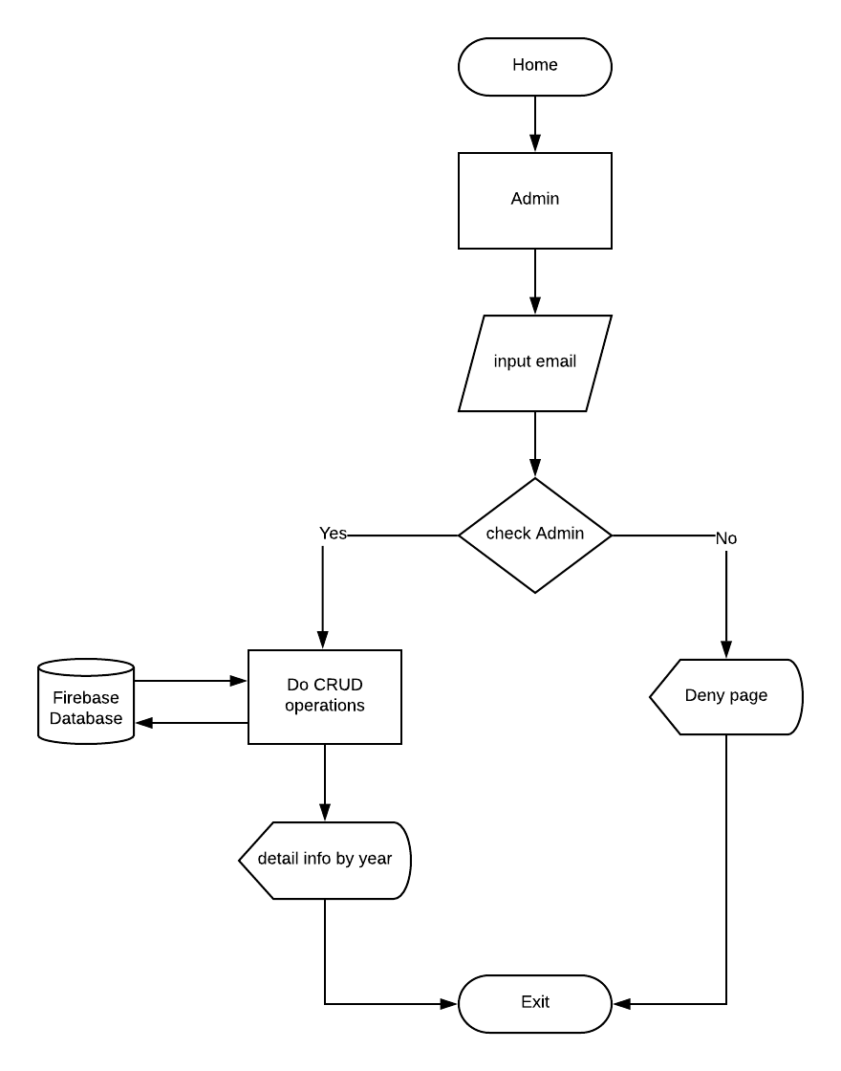
Flowchart Diagram For Admin

Slide 9
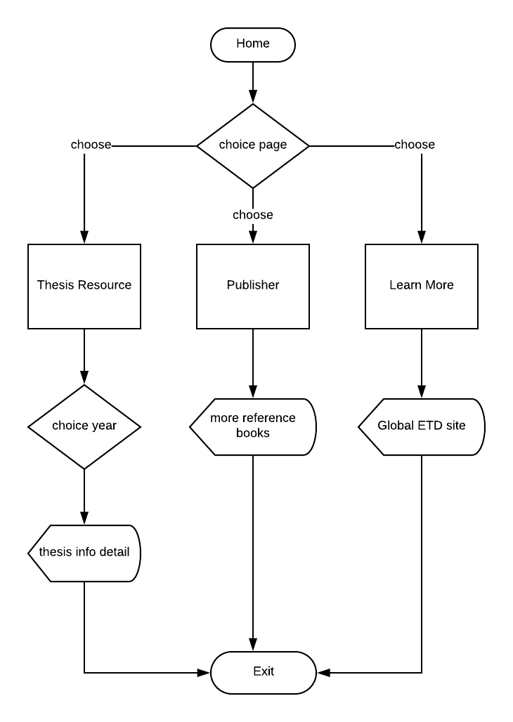
Flow chart diagram for User

Slide 10
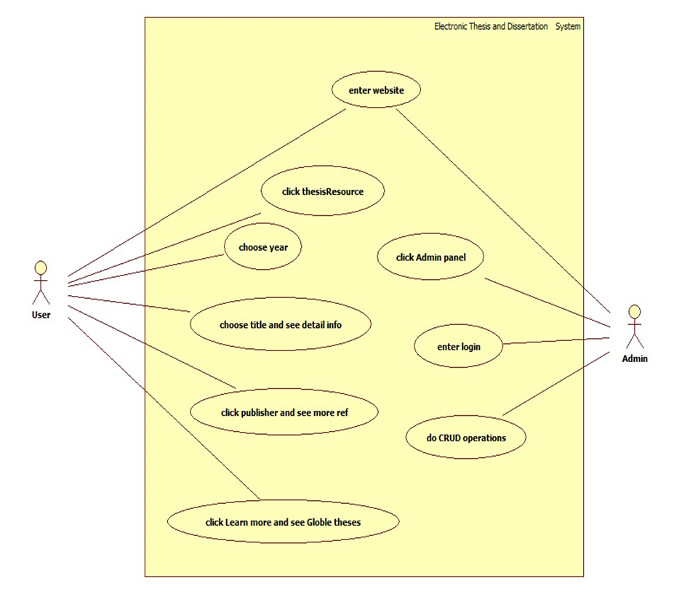
Use case Diagram For ETD

Slide 11
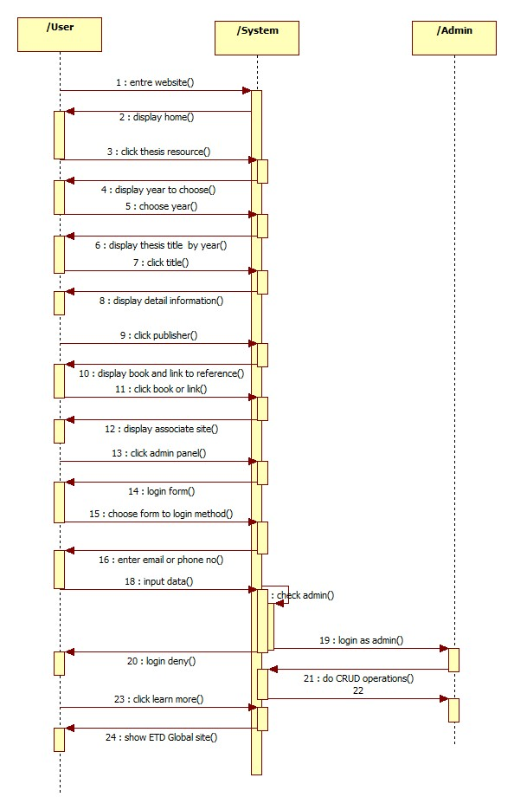
Sequence Diagram For ETD

Slide 12
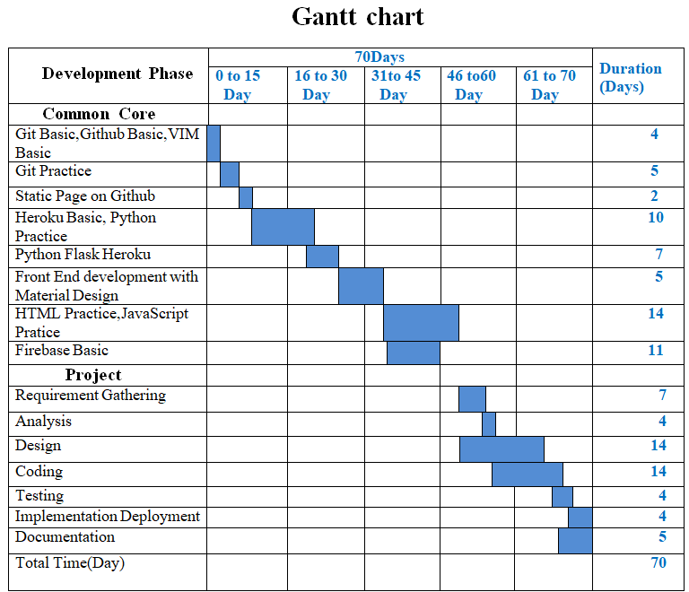
Minestones and job distribution

Slide 13
Conclusion
This system provides users to search easily CU(Mdy) theses from 2008-2016 with abstract.
Our project has a weakness. It don’t show full data of all thesis because our data are collected from CU (Mdy) library and there is no soft copy of theses.
But we make our ETD system to find global theses and dissertations for more reference.
Users can search 5,111,718 electronic theses and dissertation at Global ETD site where can find any field that you want.
At admin panel, admin can create, retrieve , update and delete data from firebase database.
And also do permissions for login users.
For our project future plan , we aim to do more useful site for our university.
We want to make from ETD mini project to CU(Mdy) e-Library.

Slide 14
Thanks For Your Attention!

