Slide 1


Slide 2


E-RETAIL FACTORS FOR CUSTOMER ACTIVATION AND RETENTION: AN EMPIRICAL STUDY FROM INDIAN E-COMMERCE CUSTOMERS :
Customer satisfaction has emerged as one of the most important factors that guarantee the success of online store; it has been posited as a key stimulant of purchase, repurchase intentions and customer loyalty
Studies show, It is important to Retain customers, since attracting new customers
is more expensive
Websites should understand their customers and improve their
services as per the existing customers feedback in order to retain them
and get new customers through them

Slide 3
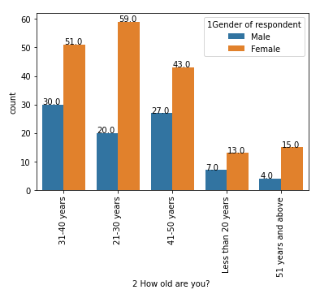
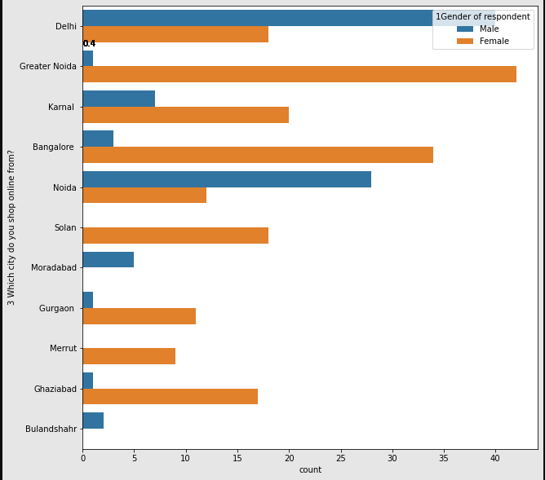
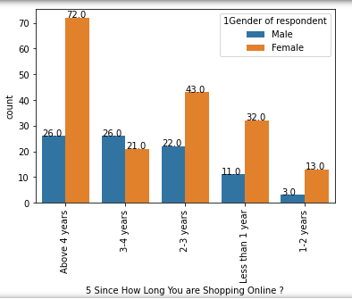
TRENDS OF USERS
Majority of users responded are: Female
Online shopping is preferred by users from cities: Delhi, Noida, Bangalore.
In Delhi major users are male.
We can see the number of users opting online shopping is increasing comparatively.

Slide 4
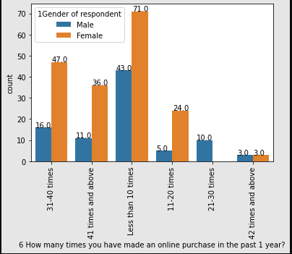
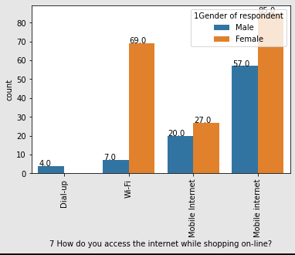
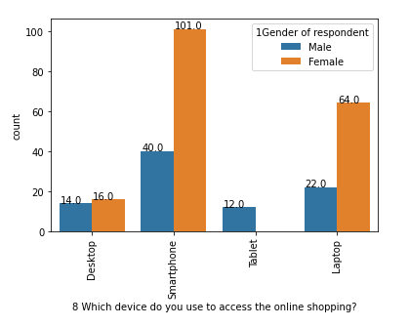
TRENDS OF USERS
58% users are buying more than 10 times a year.
55.8% users using Smart Phones & 32% users using Laptop.
70.6% users accessing website through mobile network.

Slide 5
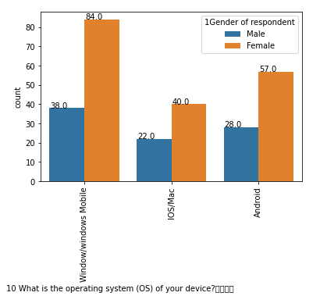
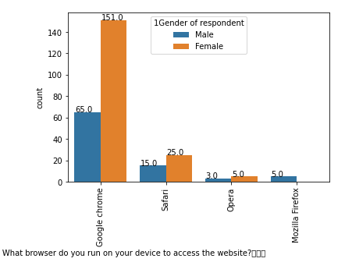
TRENDS OF USERS
OS type : 45% users are using Windows & 32% using Android
Browser: 80% users are using Chrome.

Slide 6

KEY POINTS TO RETENTION OF CUSTOMERS
Easy and Simple UI of website
Should offer variety of payment methods
Provide complete details of product along with seller information
Display wide range of products in selected category along with relevant products to compare
Quick delivery & good customer support will make more impact in retention of customer
Implement different loyalty schemes, provide monetary or other benefits to users
Maintaining website to respond and load quickly

Slide 7

BASED ON OBSERVED TRENDS
RANKINGS OF INDIAN WEBSITES:
AMAZON
FLIPKART
MYNTRA
PAYTM
SNAP DEAL

