Slide 1
LENDING CLUB
– CASE STUDY
By,
Nandha Kishore
Alok Narayan
Date: 06/12/2022

Slide 2
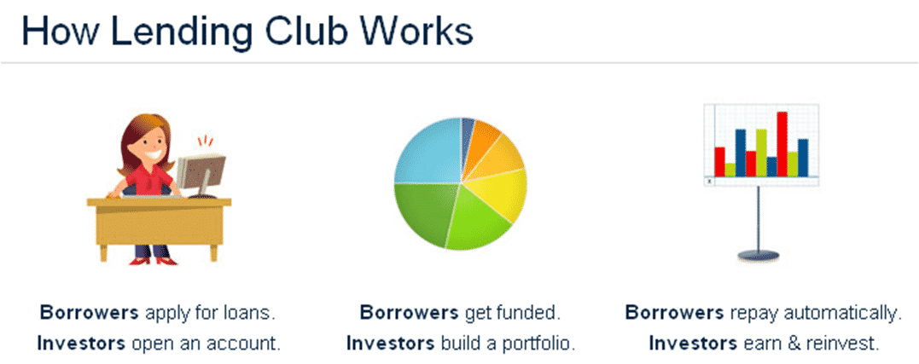
Lending Club Case Study: Agenda
What is Lending Club?
Lending Club is a marketplace for personal loans that matches borrowers who are seeking a loan with investors looking to lend money and make a return.
When the company receives a loan application, the company has to make a decision for loan approval based on the applicant’s profile. Two types of risks are associated with the bank’s decision:
If the applicant is likely to repay the loan, then not approving the loan results in a loss of business to the company.
If the applicant is not likely to repay the loan, i.e. he/she is likely to default, then approving the loan may lead to a financial loss for the company.
Agenda: | To identify driving factors (or driver variables) behind loan default, i.e. the variables which are strong indicators of default which the company can utilize for its portfolio and risk assessment.

Slide 3
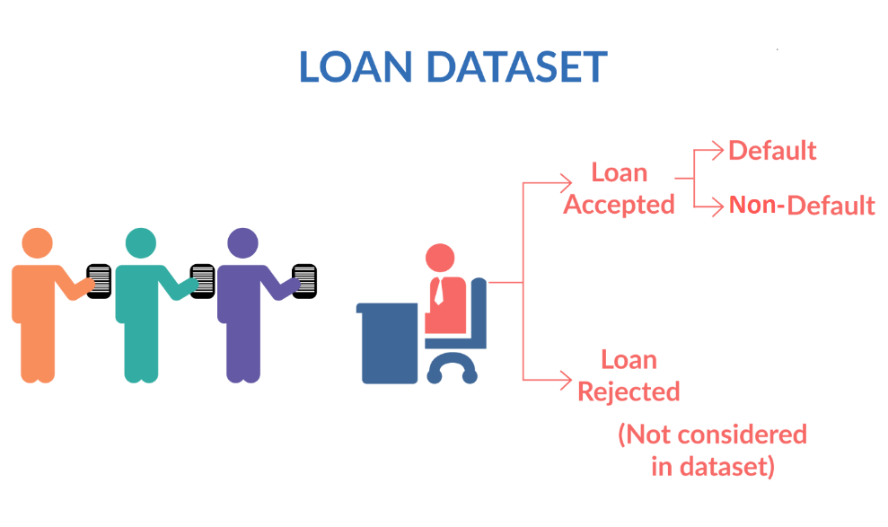
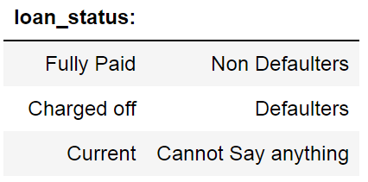
Loan Status
Fully paid: Applicant has fully paid the loan (the principal and the interest rate)
Current: Applicant is in the process of paying the instalments, i.e. the tenure of the loan is not yet completed. These candidates are not labelled as 'defaulted'.
Charged-off: Applicant has not paid the instalments in due time for a long period of time, i.e. he/she has defaulted on the loan.

Slide 4
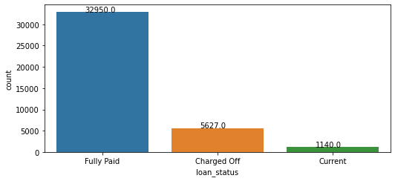
Analysis of data: Based on loan Status
Out of 39717, 5627 loans have been charged off. They are defaulters.
Comparatively the number of loans that have been charged off is far lesser than the Fully Paid.

Slide 5
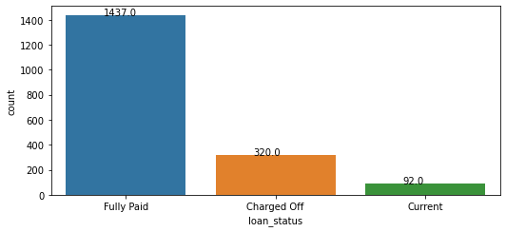

Analysis of data: Based on loan Status
1849 people received less approved funded amount.
After checking loan status.
Out of 1849, 320 are charged off. These are defaulters.
Out of 1849, 92 are current.
19842 people received less approved funded amount from investors.
After checking loan status.
Out of 19842, 2867 are charged off. These are defaulters.
Out of 19842, 612 are current.

Slide 6
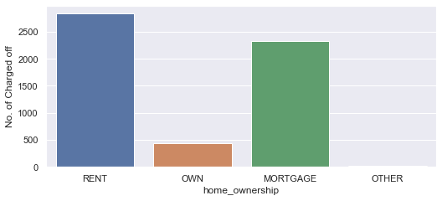
Defaulters: Based on home ownership
People who lives on Rent or whose home are mortgaged are among the majority of the defaulters.

Slide 7
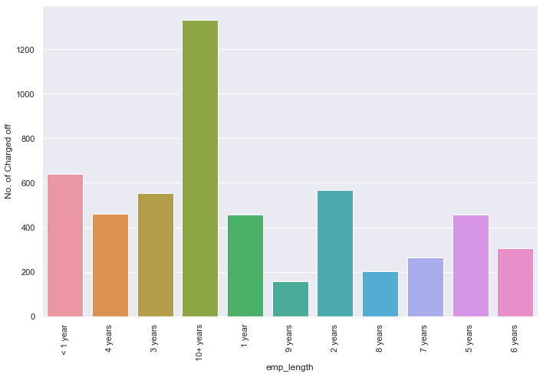
Defaulters: Based on employee total experience
People with more than 10+ years of experience are among the majority of the defaulters.

Slide 8
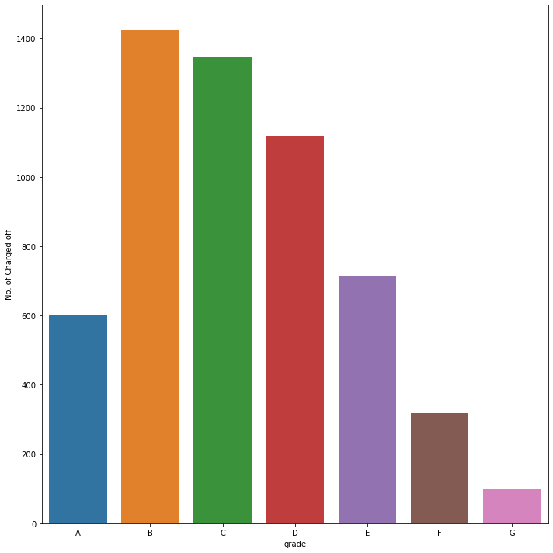
Defaulters: Based on grade
Loans with Grade B,C and D are among the majority of the defaulters .
More care needs to be taken while approving loans for these category.

Slide 9
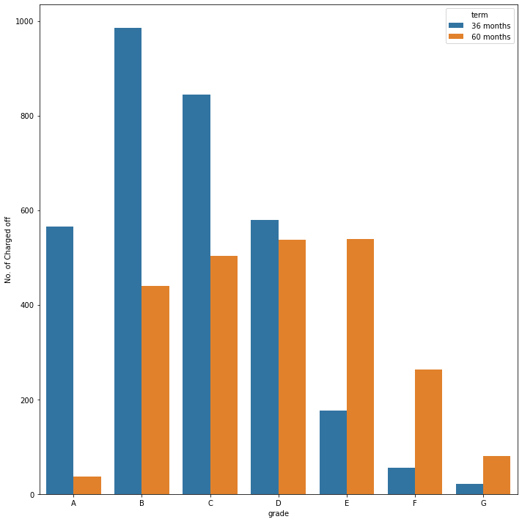
Defaulters: Based on grade and loan term
Upon analyzing the term for defaulters among various grades it is observed that the A, B , C and D grade have defaulted mostly on a 36 month duration.

Slide 10
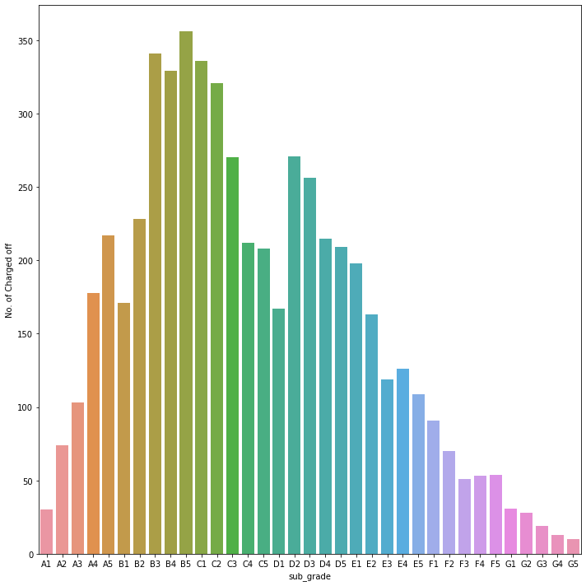
Defaulters: Based on sub-grade
Loans with Sub-Grade B3, B4, B5, C1, C2, C3, D2 and D3 are among the majority of the defaulters.

Slide 11
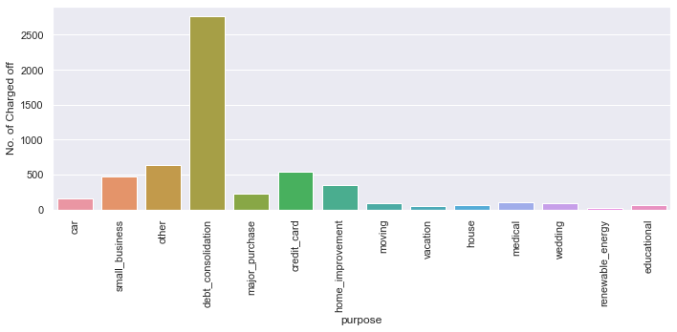
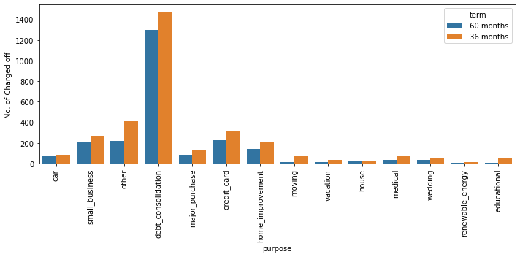
Defaulters: Based on purpose of loan and term
People who have taken loan for debt consolidation are among the majority of the defaulters.

Slide 12
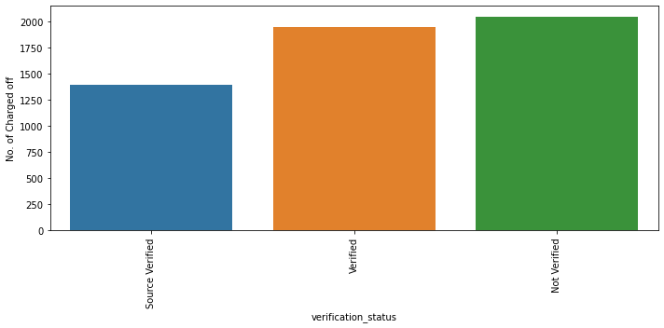
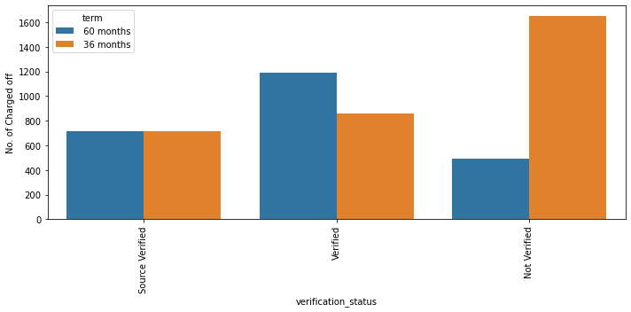
Defaulters: Based on purpose of loan and term
Comparing with the percentage of charged off loans against the verification status , Source Verified loans have comparatively less chance to default. It is recommended to better verify at source.
Extra observation:
The verification status when compared against the defaulters in basis of terms, it is observed that loan which are not verified are more likely to default for a loan with term of 36 months.

Slide 13
Conclusion
Below are driving category with defaulted variable, lending club company needs to observe more while approving/giving loans.
Driving Category | Defaulted variable
Home ownership | Rented & Morgaged
Employee total experience | 10+ years
Grade | B, C and D
Sub-Grade | B3, B4, B5, C1, C2, C3, D2 and D3
Purpose of loan | Debt consolidation

