Slide 1
HackerEarth
Prototype Submission Template For Participants

Slide 2
TEAM DEEPFLOW
THEME:
Nandakishor M Anjali M
AI in Capacity Management

Slide 3
PROBLEM STATEMENT
Define the exact PROBLEM that you intend to solve.
Currently, demand-supply matching is a very manual process.
It takes significant time to perform the interventions, perform various matching screens and different service lines may have different demand heuristics.
The data comes from multiple sources and is heterogeneous in nature.
The final results of the match may vary on the basis of the individual performing the activity.
Once the check is performed, the resourcing team member allocates the resource if the fitment % is high or else reviews with the business if the fitment % is low.
There is a lack of a defined algorithm to compute the fitment %..

Slide 4
SOLUTION
Our solution is creating a simulation environment, where there are employees are an agent who was constantly interacting with the environment.
The job of each of the agents is to communicate and gather together for a given demand.
Each agent or employee has experience value as an integer, skill, and competency as a string, grade/rank as an integer, service line as a tuple, bench aging as an integer, and location as a string. Let’s define a dictionary called “performance” which includes these variables
when the demand has given to the environment. We change the items in “performance” for our need. The job of the first agent is to find other agent that satisfies the criteria's.
If any other agent satisfies the criteria, they join together to find the next agent. Adding each agent increases the overall match percentage.

Slide 5
SOLUTION(Cont...)
The agents achieve a goal when the overall match percentage greater than 85% otherwise it will stop after the defined iteration value and give us the overall match percentage for fitment.
Since the process is non-linear and dynamic nature simple statistical approach such as linear regression, logistic regression, SVM may fail
Libraries used: TensorFlow, openCV, numpy, matplotlib
How it can be deployed: Using Flask RESTful API

Slide 6
CHECKLIST
List of features incorporated from the problem statement
Finding match percentage
Introduced a novel approach to find the best fitment
Automated the matching process

Slide 7
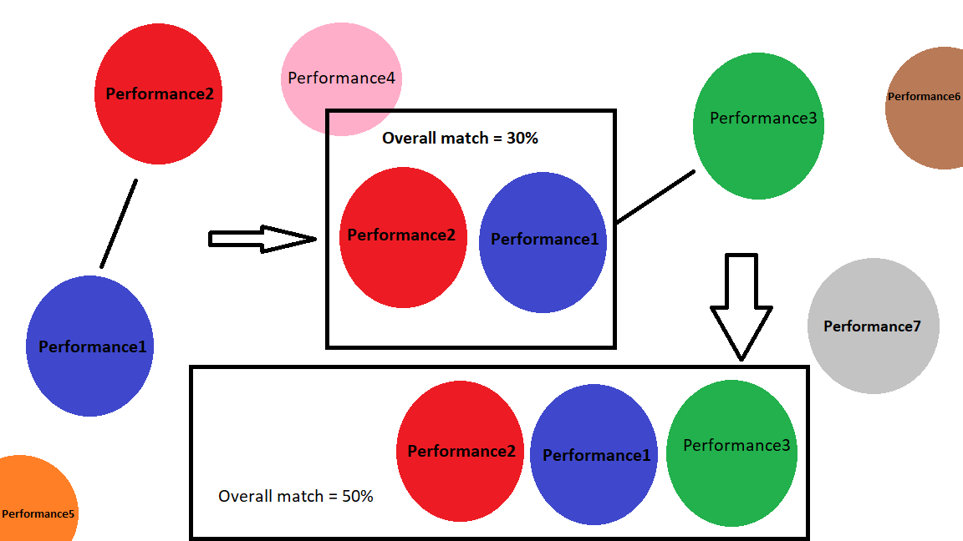
METHODOLOGY

Slide 8
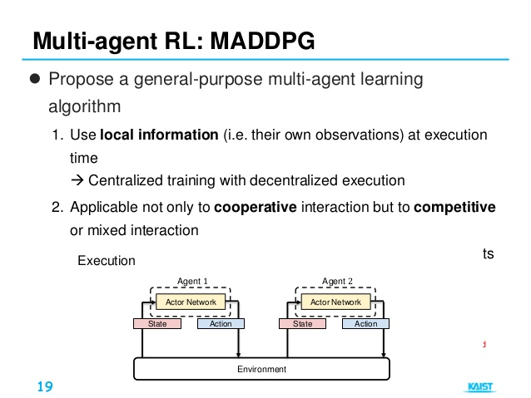
System Architecture Proposal

Slide 9
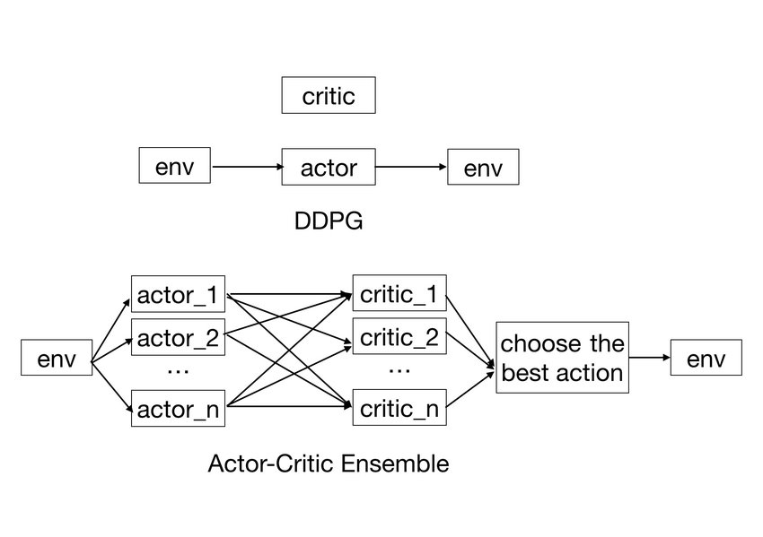
System Architecture Proposal

Slide 10
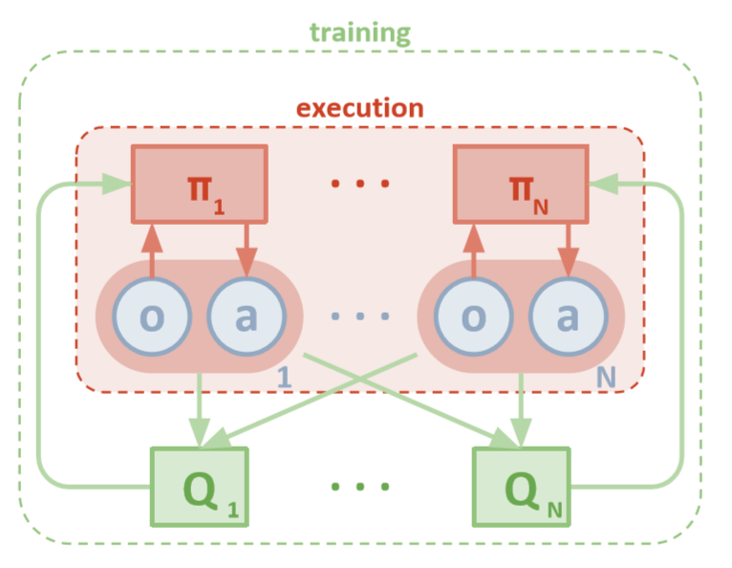
System Architecture Proposal

Slide 11
WORKING PROTOTYPE
[ attach Video, link for demo ]

Slide 12
ATTACHMENTS
[ App wireframe, Screenshots, ER Diagrams,Github repo, etc. ]

Slide 13
THANK YOU

