Slide 1
IBM APPLIED DATA SCIENCE CAPSTONE
SpaceX Falcon 9
First-Stage Landing Prediction
A data science pipeline for predicting reusable booster landing outcomes
[Your Name]
Prepared for the IBM Applied Data Science Capstone • [Add date]
github.com/Nandhakishore-A/DATA_SCIENCE_CAPSTONE_PROJECT
SpaceX Falcon 9 Landing Prediction | IBM Applied Data Science Capstone

Slide 2
EXECUTIVE SUMMARY
Why this project, and what it found
Business Problem
Objective
SpaceX advertises Falcon 9 launches at a fraction of competitors' prices, largely because it reuses the first-stage booster. Whether a competitor — or SpaceX itself — can predict if a booster will land successfully has direct cost implications.
Build an end-to-end pipeline (API + web-scraped data collection → wrangling → SQL & visual EDA → geospatial analysis → dashboard → ML) to predict first-stage landing success from launch parameters.
Key Results
Best ML Model
90 historical Falcon 9 launches were analyzed. Overall observed landing success rate: 66.7%. Four classification models were tuned with GridSearchCV (10-fold CV).
Decision Tree Classifier: 87.5% cross-validated accuracy, 94.4% accuracy on the held-out test set — the highest test accuracy of the four models compared.
SpaceX Falcon 9 Landing Prediction | IBM Applied Data Science Capstone
02

Slide 3
INTRODUCTION
SpaceX, reusability, and why landing matters
1
2
3
SpaceX Background
Falcon 9 Reusability
Why Landing Prediction Matters
Falcon 9 is SpaceX's two-stage orbital rocket.
This project's dataset (built in Data Collection API.ipynb) covers 90 past Falcon 9 launches retrieved from the SpaceX REST API.
The Data Wrangling notebook labels each launch's Outcome (e.g. ‘True ASDS’, ‘False Ocean’, ‘None None’).
A binary Class column (1 = booster landed, 0 = did not land) is derived from these outcome strings.
A landed booster can be refurbished and reused, lowering launch cost.
Predicting landing outcome from launch parameters (payload, orbit, site) lets stakeholders estimate that cost advantage before a launch.
SpaceX Falcon 9 Landing Prediction | IBM Applied Data Science Capstone
03

Slide 4
DATA COLLECTION METHODOLOGY
Two collection paths: REST API and web scraping
API Workflow — Data Collection API.ipynb
Web Scraping Workflow — Data Collection with Web Scraping.ipynb
GET request to api.spacexdata.com/v4/launches/past
pd.json_normalize() converts the JSON response to a DataFrame
Auxiliary functions getBoosterVersion / getLaunchSite / getPayloadData / getCoreData call the rocket, launchpad, payloads and cores sub-APIs to enrich each record
Dataset filtered to Falcon 9 launches only; FlightNumber assigned 1–90
requests.get() on the static Wikipedia “List of Falcon 9 and Falcon Heavy launches” page
BeautifulSoup(response.content, 'html.parser') parses the HTML
soup.find_all('table') isolates the launch-record tables
Column headers and row cells extracted into a pandas DataFrame
Dataset Summary (after wrangling)
90 launch records • 3 launch sites: CCAFS SLC 40 (55), KSC LC 39A (22), VAFB SLC 4E (13)
⚠ No notebook cell-output screenshots were found in the ZIP for the API or web-scraping steps. Insert your own notebook screenshots here before submission.
SpaceX Falcon 9 Landing Prediction | IBM Applied Data Science Capstone
04

Slide 5
DATA WRANGLING
Cleaning, labeling, and finalizing the dataset
Missing Values (raw API dataset)
Feature Engineering
PayloadMass: 5 missing values
LandingPad: 26 missing values (expected — not every launch attempted a ground/drone-ship landing)
df.isnull().sum()/df.count()*100 confirmed 0% missing in the final wrangled feature set
Outcome.value_counts() produced 8 unique landing-outcome strings
bad_outcomes = {'False ASDS','False Ocean','False RTLS','None ASDS','None None'}
Binary Class label derived: 1 = landed, 0 = did not land
Final Dataset Description
90 rows total • LaunchSite: CCAFS SLC 40 (55), KSC LC 39A (22), VAFB SLC 4E (13) Orbit: GTO (27), ISS (21), VLEO (14), PO (9), LEO (7), SSO (5), MEO (3), HEO (1), SO (1), GEO (1), ES-L1 (1) Overall Class mean (success rate): 0.667 → 66.7% of launches in the dataset landed successfully
SpaceX Falcon 9 Landing Prediction | IBM Applied Data Science Capstone
05

Slide 6
EDA METHODOLOGY
Two complementary approaches: SQL and Python
SQL EDA
Python Visual EDA
Exploratory Data Analysis.ipynb
EDA with Data Visualization.ipynb
Dataset loaded into an IBM Db2 (cloud) table Spacextbl
Connected via the %sql ipython-sql magic
10 targeted business questions answered with direct SQL aggregation/filtering (totals, averages, rankings, subqueries)
Why SQL: fast, declarative answers to specific numeric questions (e.g. total payload by customer) without loading the full frame into memory logic
pandas + seaborn/matplotlib used to explore FlightNumber, PayloadMass, LaunchSite, Orbit vs. Class
Categorical columns one-hot encoded and numeric columns cast to float64 for modeling
Why Python/visual: scatter, bar and line plots reveal trends (e.g. success rate over time, clustering by orbit) that are hard to see in tabular SQL output alone
SpaceX Falcon 9 Landing Prediction | IBM Applied Data Science Capstone
06

Slide 7
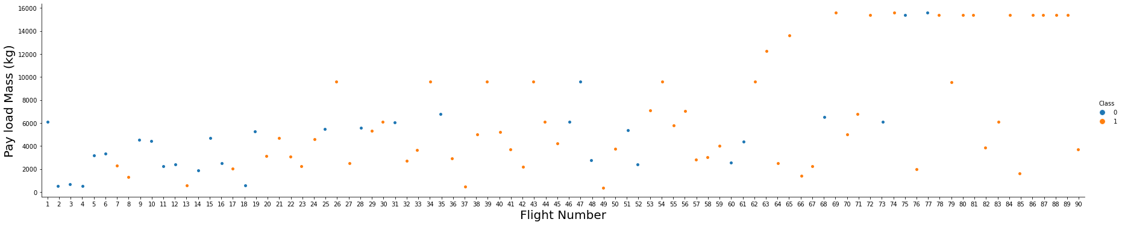
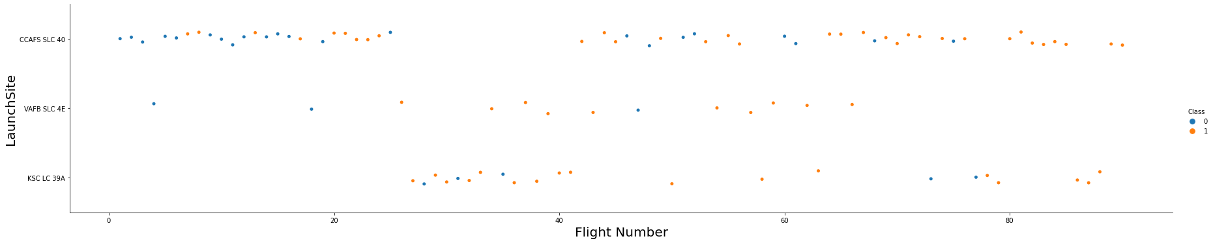
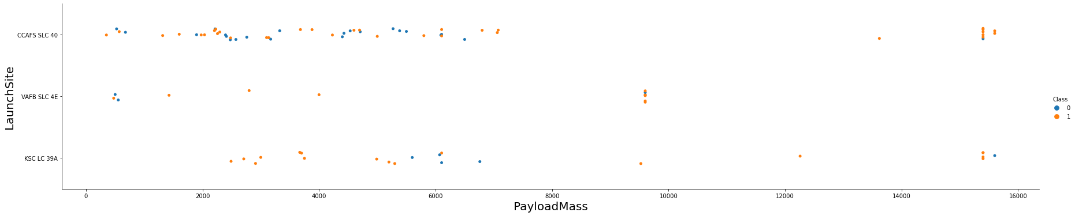
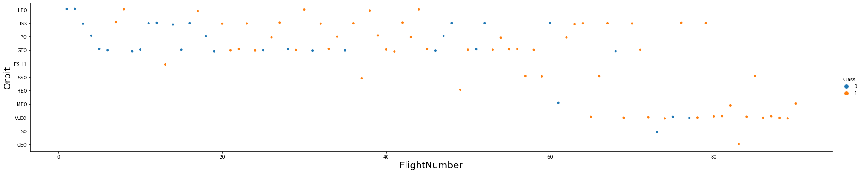
EDA VISUALIZATIONS · PART 1
Scatter analysis — flight number, payload, site & orbit
Payload Mass vs Flight Number
Flight Number vs Launch Site
Later flights (higher FlightNumber) carry a wider range of payload mass, and successful landings (orange) become more frequent among later flights.
KSC LC-39A only enters use from higher flight numbers onward; CCAFS SLC 40 is active across the full flight-number range.
Payload Mass vs Launch Site
Flight Number vs Orbit Type
VAFB SLC 4E is used for a narrower payload-mass range than CCAFS SLC 40, which handles the heaviest payloads (~15,600 kg).
GTO and ISS orbits appear across the whole flight range; VLEO orbit launches are concentrated in later flights only.
SpaceX Falcon 9 Landing Prediction | IBM Applied Data Science Capstone
07

Slide 8
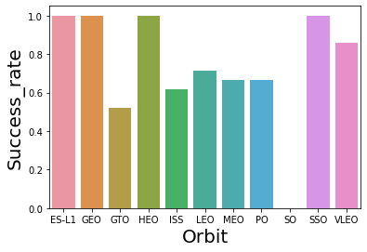
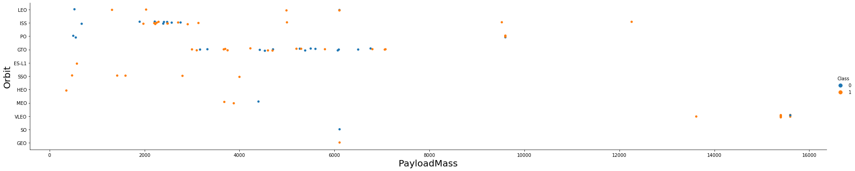
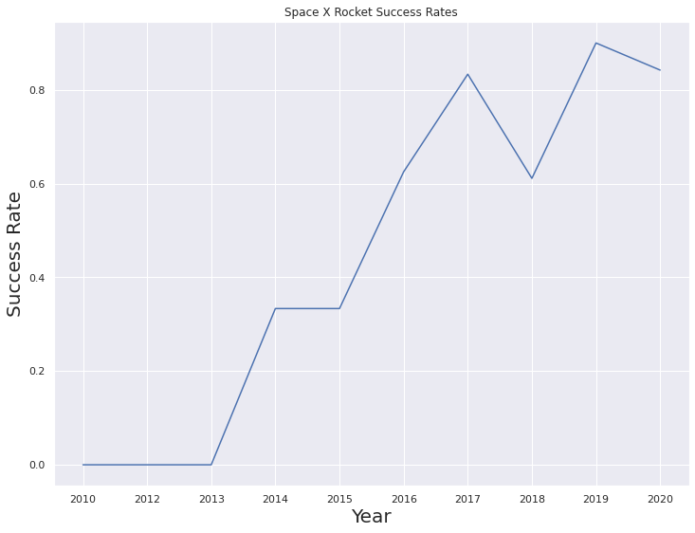
EDA VISUALIZATIONS · PART 2
Success-rate distribution and yearly trend
Success Rate by Orbit (bar chart)
Payload Mass vs Orbit Type (scatter)
Launch Success Rate by Year (line chart)
GTO and ISS orbits span a wide payload range; VLEO carries the heaviest payloads among frequently-used orbits.
ES-L1, GEO, HEO and SSO orbits show a 100% observed success rate in this dataset; GTO is lowest at ~52%.
Success rate rose from 0% in 2010/2013 to roughly 83–90% by 2019–2020.
⚠ Pie Chart & Correlation Plot were NOT found as static outputs in any notebook. A pie chart exists only as an interactive Plotly component in the Dash app (Slide 11). Insert a correlation heatmap / pie chart here if you add one.
SpaceX Falcon 9 Landing Prediction | IBM Applied Data Science Capstone
08

Slide 9
EDA USING SQL
10 business questions, answered directly against Spacextbl
#
Business Question
Result
1
Distinct launch sites
CCAFS LC-40, CCAFS SLC-40, KSC LC-39A, VAFB SLC-4E
2
Records where site LIKE 'CCA%' (first 5)
5 rows returned, e.g. F9 v1.0 B0003 — CCAFS LC-40 — 2010-06-04
3
Total payload mass, customer = NASA (CRS)
45,596 kg
4
Average payload mass, booster F9 v1.1
2,928 kg
5
First successful ground-pad landing date
2015-12-22
6
Boosters: drone-ship success, 4,000–6,000 kg payload
F9 FT B1022, B1026, B1021.2, B1031.2
7
Total successful vs. failed mission outcomes
100 success / 1 failure
8
Booster version(s) with maximum payload mass
15,600 kg — carried by 12 F9 B5 boosters
9
Failed drone-ship landings in 2015
F9 v1.1 B1012 (2015-01-10), B1015 (2015-04-14) — both CCAFS LC-40
10
Landing-outcome ranking, 2010-06-04 to 2017-03-20
No attempt (10) → ... → Precluded/drone ship (1)
Interpretation: NASA CRS missions carried a substantial payload share; F9 B5 boosters were used for the heaviest (15,600 kg) payloads; ground-pad landing success only began in Dec 2015; nearly all missions succeeded at their primary objective (100/101) even when the booster itself did not land.
SpaceX Falcon 9 Landing Prediction | IBM Applied Data Science Capstone
09

Slide 10
FOLIUM MAPPING
Geospatial analysis of launch sites and proximities
Launch Site Map & Landing Sites
Distance Analysis
folium.Map() centered on NASA Johnson Space Center [29.5597, -95.0831]
folium.Circle() markers placed at each of the 3 launch sites
MarkerCluster() groups per-launch markers, color-coded by success/failure at each site
calculate_distance(lat1, lon1, lat2, lon2) implements the haversine formula
Used to measure distance from each launch site to its nearest coastline, railway, highway, and the city of Cape Canaveral
Markers + PolyLines annotate each measured distance on the map
Source notebook: interactive_visual_analytics_with_folium_final.ipynb
⚠ No static screenshot of the Folium map was found in the ZIP — Folium maps render as interactive HTML/JS inside the notebook and were not exported as an image. Insert your own screenshot of the rendered map here.
SpaceX Falcon 9 Landing Prediction | IBM Applied Data Science Capstone
10

Slide 11
PLOTLY DASH DASHBOARD
Interactive launch-records dashboard — spacex_dash_app.py
Components
Interactivity
Dropdown (site-dropdown): “All Sites” + each unique Launch Site
Pie Chart (success-pie-chart): px.pie of successful launches by site, or success/fail split for one selected site
RangeSlider (payload_slider): filters by payload mass, 0–10,000 kg
Scatter Chart (success-payload-scatter-chart): px.scatter of Payload Mass vs. class, colored by Booster Version Category
Callback 1: site-dropdown → success-pie-chart
Callback 2: site-dropdown + payload_slider → success-payload-scatter-chart
Selecting a site or dragging the payload slider re-renders both charts live
⚠ No dashboard screenshot was found in the ZIP. The app also reads spacex_launch_dash.csv, which is not included — add that CSV and a live screenshot before submission.
SpaceX Falcon 9 Landing Prediction | IBM Applied Data Science Capstone
11

Slide 12
MACHINE LEARNING METHODOLOGY
Pipeline: features → split → scale → four tuned classifiers
Feature Selection
One-hot encoded categorical columns from EDA with Data Visualization.ipynb (Task 7), cast to float64 (Task 8).
Train / Test Split
train_test_split() used in SpaceX_Machine Learning Prediction_Part_5.ipynb to hold out a test set.
StandardScaler
Features standardized with StandardScaler().fit_transform() prior to model training.
Models compared (GridSearchCV, cv = 10, scoring = 'accuracy')
Logistic Regression
SVM
Decision Tree
KNN
C: [0.01, 0.1, 1] • penalty: l2 • solver: lbfgs
C, gamma grid • kernel options incl. sigmoid
criterion, max_depth, max_features, min_samples_leaf/split, splitter
algorithm • n_neighbors • p (distance metric)
SpaceX Falcon 9 Landing Prediction | IBM Applied Data Science Capstone
12

Slide 13
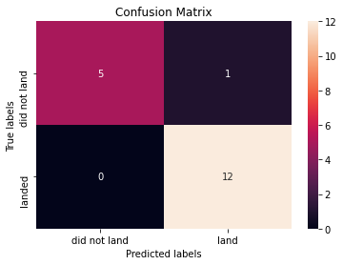
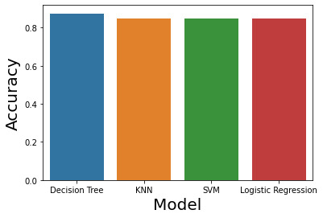
MACHINE LEARNING RESULTS
Decision Tree wins on the held-out test set
Accuracy Comparison
Confusion Matrix — Decision Tree (test set)
Cross-Validated Accuracy by Model
Model
CV Accuracy
Test Accuracy
Decision Tree
0.8750
0.9444
KNN
0.8482
0.8333
SVM
0.8482
0.8333
Logistic Regression
0.8464
0.8333
Best hyperparameters (Decision Tree): criterion = gini, max_depth = 4, max_features = sqrt, min_samples_leaf = 2, min_samples_split = 10, splitter = best
All 12 “landed” cases correctly classified; 5 of 6 “did not land” cases correctly classified (1 false positive).
⚠ Classification Report (precision/recall/F1) and ROC Curve were NOT found in the notebook — only confusion matrices were generated. Add sklearn.metrics.classification_report() / roc_curve() output if required by your grader.
SpaceX Falcon 9 Landing Prediction | IBM Applied Data Science Capstone
13

Slide 14
KEY INSIGHTS
What the data shows
1
Historical first-stage landing success rate across all 90 launches is 66.7%.
2
Landing success rate climbed from 0% in 2010/2013 to roughly 83–90% by 2019–2020.
3
ES-L1, GEO, HEO and SSO orbits show a 100% success rate in this dataset, while GTO is lowest at ~52%.
4
Ground-pad landing success was not achieved until December 22, 2015 (SQL Task 5).
5
The Decision Tree model generalized best to the held-out test set (94.4%) despite ranking 2nd on cross-validation — its shallow depth (4) may reduce overfitting to the small (90-row) dataset.
6
CCAFS SLC 40 was used far more than the other two sites (55 of 90 launches, 61%).
SpaceX Falcon 9 Landing Prediction | IBM Applied Data Science Capstone
14

Slide 15
CONCLUSION
From raw API data to a tuned landing-outcome classifier
Summary
This capstone implemented the full required pipeline — SpaceX REST API collection, Wikipedia web scraping, data wrangling, SQL-based EDA, Python visual EDA, Folium geospatial analysis, a Plotly Dash dashboard, and four tuned classification models — culminating in a Decision Tree classifier with 94.4% test accuracy.
Business Value
Future Improvements
A reliable landing-outcome predictor lets a launch provider estimate whether a mission's first stage is likely to be reused — informing bid pricing and manifest planning ahead of launch.
Add classification_report / ROC-AUC evaluation; capture Folium & Dash screenshots; supply the missing spacex_launch_dash.csv and raw dataset files; try ensemble models (Random Forest, XGBoost).
Bottom line: Decision Tree Classifier — 87.5% CV accuracy, 94.4% test accuracy — best model produced by this project.
SpaceX Falcon 9 Landing Prediction | IBM Applied Data Science Capstone
15

Slide 16
GITHUB REPOSITORY
Submission checklist, based on the ZIP contents found
✓ Found in ZIP
✗ Missing — supply before submitting
GitHub Repository: github.com/Nandhakishore-A/DATA_SCIENCE_CAPSTONE_PROJECT
README.md (present, but minimal — replace with the generated README.md)
Data Collection API.ipynb
Data Collection with Web Scraping.ipynb
Data Wrangling lab week 1.ipynb
Exploratory Data Analysis.ipynb (SQL)
EDA with Data Visualization.ipynb
interactive_visual_analytics_with_folium_final.ipynb
SpaceX_Machine Learning Prediction_Part_5.ipynb
spacex_dash_app.py
ds-capstone-template-coursera.pdf (assignment template)
Dashboard & Folium map screenshots
Raw / processed dataset CSVs (e.g. spacex_launch_dash.csv, required by spacex_dash_app.py)
This presentation, exported as .pptx / .pdf (upload to the repo above)
SpaceX Falcon 9 Landing Prediction | IBM Applied Data Science Capstone
16

Slide 17
RUBRIC CROSS-CHECK
Coverage against the required rubric items
Rubric Item
Status
Notes
Executive Summary
✓ Covered
Slide 2
Introduction
✓ Covered
Slide 3
Data Collection
✓ Covered
Slide 4 — API & scraping code confirmed; no notebook screenshots found
Data Wrangling
✓ Covered
Slide 5 — real missing-value and value_counts figures
EDA Methodology
✓ Covered
Slide 6
EDA with Visualization
⚠ Partial
Slides 7–8 — pie chart & correlation plot not present in any notebook
EDA with SQL
✓ Covered
Slide 9 — all 10 queries executed with real results
Folium Mapping
⚠ Partial
Slide 10 — code confirmed; no static screenshot in ZIP
Plotly Dash
⚠ Partial
Slide 11 — app code confirmed; no screenshot; CSV data file missing
ML Methodology
✓ Covered
Slide 12
ML Results
⚠ Partial
Slide 13 — confusion matrices present; classification report & ROC curve not found
Conclusion
✓ Covered
Slide 15
SpaceX Falcon 9 Landing Prediction | IBM Applied Data Science Capstone
17

