Slide 1

AgoraHub: Empowering Communities through Collaborative Governance and Intelligent Decision-Making
Team Members:
2303717610421072 - BALAGANESH K
2303717610421102 - NANDHAKUMAR D
2303717610422117 - SHAKE ASHIYA M
2303717610421121 - SIBIRAJAN A
Guided by
Ms.V. PRIYANKA M.E.,
Assistant Professor,
Department of Computer Science and Engineering

Slide 2
AGENDA
Introduction
Problem Statement
Literature Survey
Proposed Work/Proposed Methodology
System/Architecture Design
Project Modules
Project Implementation
References

Slide 3
INTRODUCTION
Communities (hostels, apartments, clubs, towns) need organized participation and management.
Our project is a digital community management platform that adapts to different community needs.
It provides a customizable space for announcements, complaints, petitions,
and voting.

Slide 4
PROBLEM STATEMENT
Communities rely on manual and fragmented systems for communication and decision-making.
Challenges:
Delays in addressing complaints and petitions.
Civic engagement is limited as current approaches fail to encourage broad involvement.
Identity misuse and disputes in voting/decisions.
One-size-fits-all tools fail, as different communities need different levels of privacy, transparency, and security.

Slide 5
LITERATURE SURVEY
S.No | Title | Authors | Journal Name with Year of Publication | Methodology/Algorithm Used
1 | CitizenConnect: Real-Time Grievance Management App | MiteshShinde, Shubhangi Teli, Mr.Nilesh V. Kamble | International Journal of Innovative Research in Science, Engineering and Technology (IJIRSET) 2024 | Secure authentication & real-time data handling; image uploads; user/admin dashboards for complaint submission, tracking & resolution.
2 | ESPE Security: Mobile and Web Application to Manage Community Emergency Alerts | Veronica Isabel Martinez-Cepeda, Maria Jose Parraga Moreira | International Journal of Interactive Mobile Technologies (iJIM), 2024 | Incident categorization; Geolocation-based alerts; Real-time emergency reporting
3 | RE-GrievanceAssist: Enhancing Customer Experience through ML-Powered Complaint Management | Venkatesh C., Harshit Oberoi, Anurag Kumar Pandey, Anil Goyal, Nikhil Sikka | arVix 2024 | The system uses machine learning and NLP to automatically classify, prioritize, and route customer complaints for faster resolution.

Slide 6
LITERATURE SURVEY
4 | Supporting Online Discussions: Integrating AI Into the adhocracy+ Participation Platform To Enhance Deliberation | Maike Behrendt, Stefan Sylvius Wagner, Stefan Harmeling | ARXIV preprint, 2024 | Stance detection(BERT) for messages; Quality scoring (AQuA) ; Synthetic data generation (Mistral-7B);
5 | Smart City Governance and Digital Platforms: A Framework for Inclusive Community Engagement and Real-Time Decision-Making | James Paul Onoja, Olakunle Abayomi Ajala | GSC Advanced Research and Reviews 2023 | Tamper-proof digital voting; NLP-based complaint handling; Participatory budgeting; Federated microservices architecture;
6 | iCommunity: Public Participation in Museums and Cultural Heritage Sites | A. Nasrolahi, V. Messina, C. Gena | Journal Name with Year of Publication: AVIC2CH, ACM, 2020 | Voting & commenting system ; Dashboards with demographic insights ; Gamification incentives

Slide 7
Design Methodology
Functional Workflow
The app enables citizen-to-admin interaction through structured data flow:
Group Chat: Facilitates real-time discussions within community groups for collaboration and transparency.
Petition/Complaint Submission: members post complaints/petitions public/private chat interface.
AI Processing: NLP module classifies, prioritizes, and summarizes issues automatically.
Head Response & Announcement: AI-assisted replies are validated and proceeded.

Slide 8
Design Methodology
Intelligence & Security Layer
Text Classification & Sentiment Analysis: Uses NLP and LLM model to automatically identify the type of issue and its urgency.
AI-Based Content Moderation: Detects spam, offensive language, and inappropriate content using NLP/LLM techniques to maintain healthy community communication.
Summarization Engine: Uses an LLM to extract key highlights from long texts for faster Head review.
Smart Suggestion System: Uses AI/LLM to provide solution recommendations and response suggestions for complaints and petitions.
Secure Authentication: JWT tokens, AES encryption, and bcrypt password hashing.
Role Management: Restricts privileges based on Head, or Member roles.

Slide 9
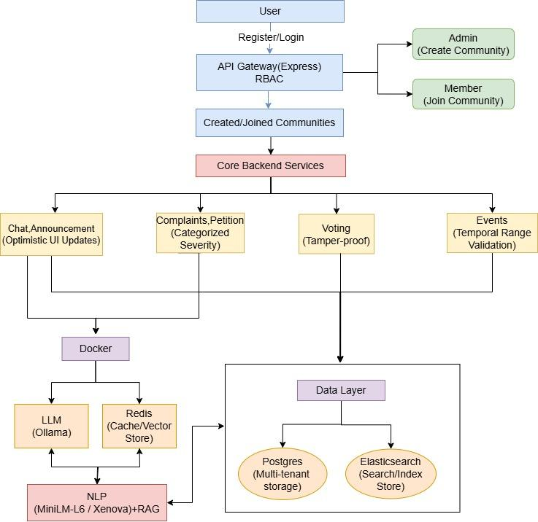
ARCHITECTURE

Slide 10
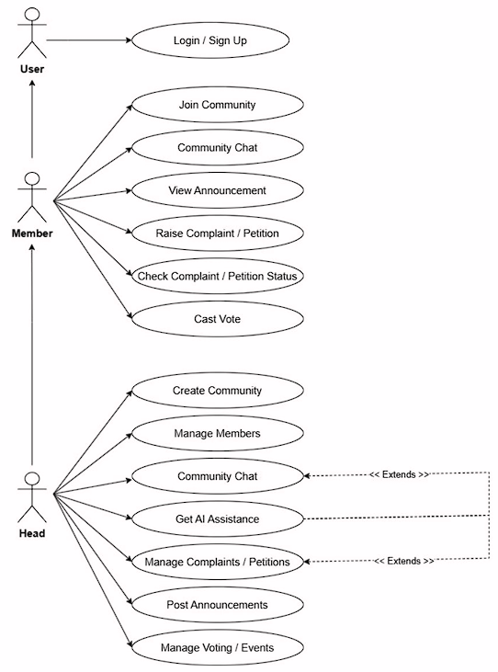
USE CASE DIAGRAM

Slide 11
MODULES
User Authentication & Registration Module
Provides secure registration and login for all users.
Implements JWT-based authentication to ensure protected access to system features.
Maintains session management to enhance system security and user experience.
Community Management Module (Create / Join Space)
Allows the Head to create a new community space (e.g., Hostel, Apartment, or Club).
Enables members to join existing spaces using invite codes or approval from the Head.
Ensures each user is associated with one or more spaces, allowing flexible participation.
Facilitates structured communication and access control within each community.

Slide 12
MODULES
Chat & Announcement Module
Provides an in-app chat system for members to communicate effectively within the community.
Supports real-time messaging for better coordination among members.
Allows Admins or Heads to post official announcements visible to all users in the space.
Helps maintain smooth internal communication without the need for external platforms.
Complaint & Petition Module
Enables members to raise complaints or petitions related to community issues.
Admins or Heads can review, update, or mark complaints as resolved.
Maintains complete records of all issues to ensure transparency and accountability.
Provides an organized interface for tracking complaint progress
3.

Slide 13
MODULES
Events Module
Allows Heads or Admins to create and manage community events such as meetings, celebrations, or maintenance schedules.
Stores event details like title, date, time, and description.
Displays all upcoming and past events to members for better participation.
Helps build stronger community engagement through planned activities.
AI Module
Detects sentiment and toxic language from user messages using NLP techniques.
Uses Ollama LLM with PostgreSQL-based RAG for context-aware responses.
Uses Redis caching for high performance.
Stores analysis and moderation logs securely in the database.
Provides summarizations, recommendations, and solution suggestions for administrative support.

Slide 14
MODULES
Voting Module
Provides secure digital voting for authorized community members.
Ensures tamper-proof voting with voter validation and duplicate prevention.
Supports flexible voting rules, schedules, and privacy settings.
Maintains transparent and auditable voting records.
Displays voting results using charts for easy understanding.

Slide 15
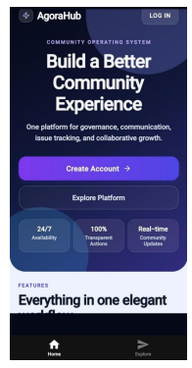
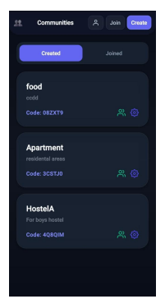
IMPLEMENTATION

Slide 16
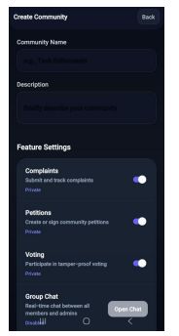
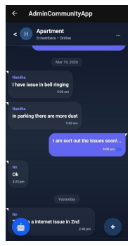
IMPLEMENTATION

Slide 17
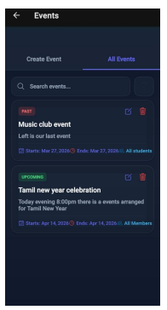
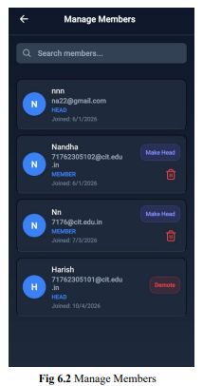
IMPLEMENTATION

Slide 18
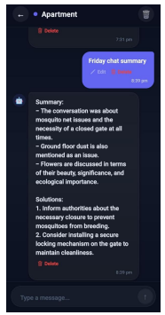
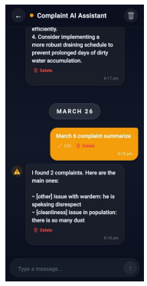
IMPLEMENTATION

Slide 19
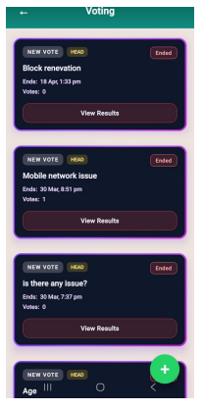
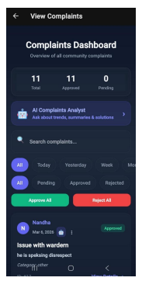
IMPLEMENTATION

Slide 20
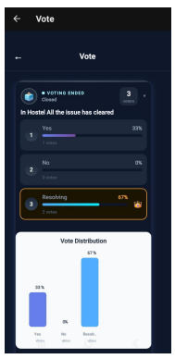
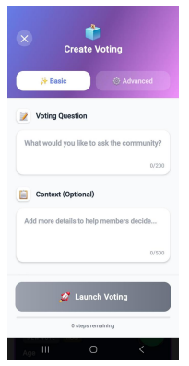
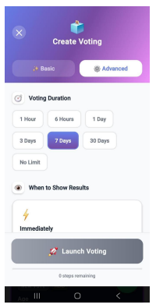
IMPLEMENTATION

Slide 21
REFERENCES
1. M. Shinde, S. Teli, and N. V. Kamble, “CitizenConnect: Real-TimeGrievance Management App,” International Journal of InnovativeResearch in Science, Engineering and Technology (IJIRSET), 2024,pp4-5.
2. V. M. Cepeda and M. Parraga, “ESPE Security: Mobile andWebEmergency Alerts,” International Journal of Interactive MobileTechnologies (iJIM), 2024,pp5-6.
3. V. C., H. Oberoi, A. Pandey, A. Goyal, and N. Sikka, “RE-Grievance Assist: ML-powered Complaint Management,”arXivpreprint, 2024,pp6

Slide 22
REFERENCES
4. M. Behrendt, S. Wagner, and S. Harmeling, “SupportingOnlineDiscussions with AI in adhocracy+,” arXiv preprint, 2024,pp6-7.
5. J. P. Onoja and O. A. Abayomi, “Smart City GovernanceFramework,” GSC Advanced Research and Reviews, 2023,pp7.
6. A. Nasrolahi, V. Messina, and C. Gena, “iCommunity: PublicParticipation in Museums,” in Proc. ACMAVI Conference(AVIC2CH), 2020,pp7-8.

Slide 23
THANK YOU!

