Slide 1

MEDICAL STORE MANAGEMENT SYSTEM
COIMBATORE INSTITUTE OF TECHNOLOGY
(Government Aided Autonomous Institution Affiliated to Anna University)
COIMBATORE – 641014
Name : Nandhakumar D
Register No : 2303717610421102
Degree : Bachelor of Engineering
Branch : Computer Science and Engineering

Slide 2
AGENDA
Introduction
Problem Statement
Objectives of the Proposed system
Tech Stack
System/Architecture Design
Project Modules
Output Screenshots
References

Slide 3
INTRODUCTION
The Medical Store Management System is an online platform for managing medicines, sales, billing, and reports.
It reduces human error, removes manual record-keeping, and enables faster billing with accurate inventory tracking.
With features like login, medicine registration, stock monitoring, automated billing, and reports, it overcomes the limits of traditional pharmacy systems.

Slide 4
PROBLEM STATEMENT
Traditional pharmacy management faces challenges such as:
Errors in manual record-keeping.
Difficulty in tracking stock and expiry dates.
Delays in billing and report generation.
Increased chances of financial mismanagement.

Slide 5
OBJECTIVES OF THE PROPOSED SYSTEM
To provide real-time sales tracking and automated report generation.
To design and implement a secure, efficient, and user-friendly medical store management system.
To simplify medicine registration, stock management, and billing processes.
To provide real-time monitoring and automated result declaration.
To reduce manual effort, errors, and time in managing pharmacy operations.
To ensure accurate inventory monitoring and prevent stock shortages or expiries.

Slide 6
TECH STACK
Frontend: HTML, CSS, JavaScript
Backend: FastAPI (Python), Pydantic, psycopg2
Database: PostgreSQL
Additional Tools: VS Code, pgAdmin

Slide 7
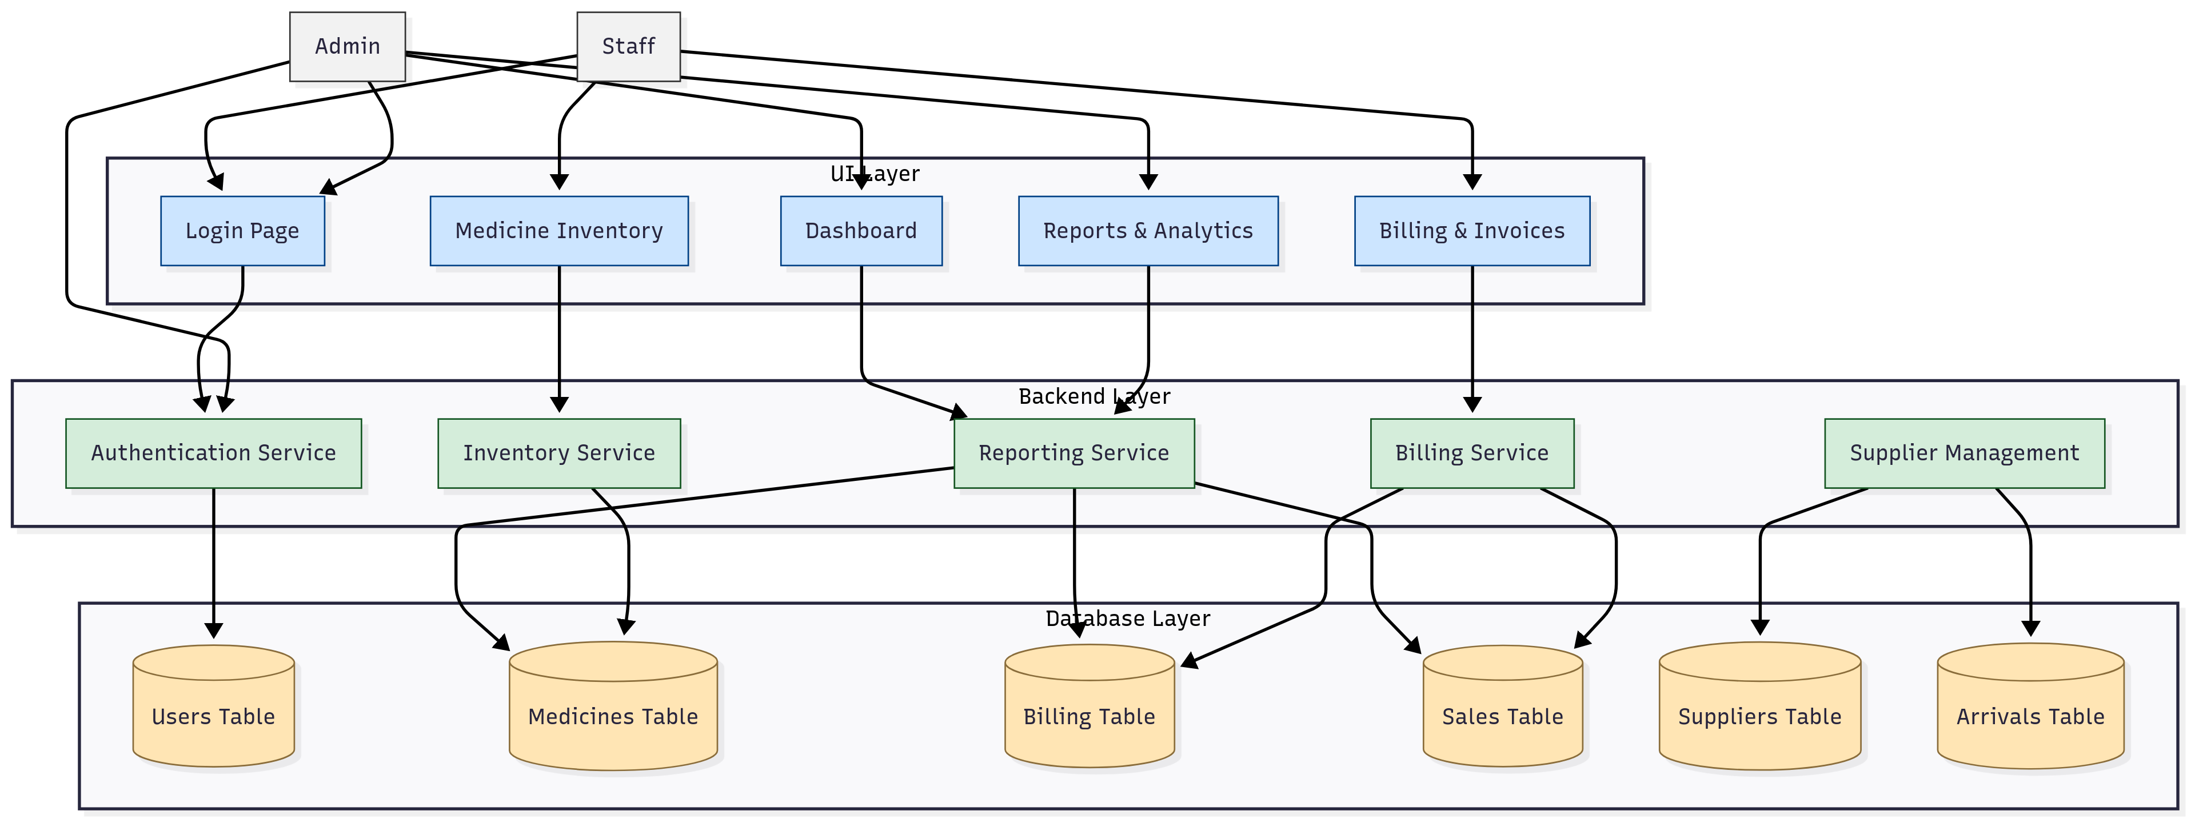
ARCHITECTURE
Architecture FOR MEDICAL STORE

Slide 8
MODULES
User Module – Register, log in, manage profiles
Medicine Module – Add, update, and view medicines with expiry tracking and stock
Billing Module – Generate bills, calculate totals, update stock automatically
Sales & Report Module – Track sales, generate daily/monthly reports
Database Module – Store all details securely with constraints

Slide 9
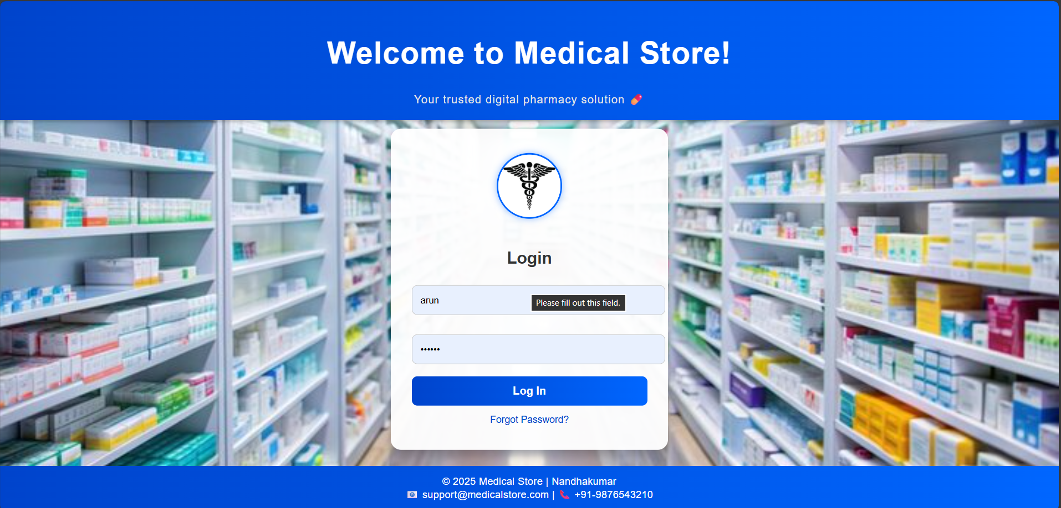
OUTPUT SCREENSHOTS
Login page

Slide 10
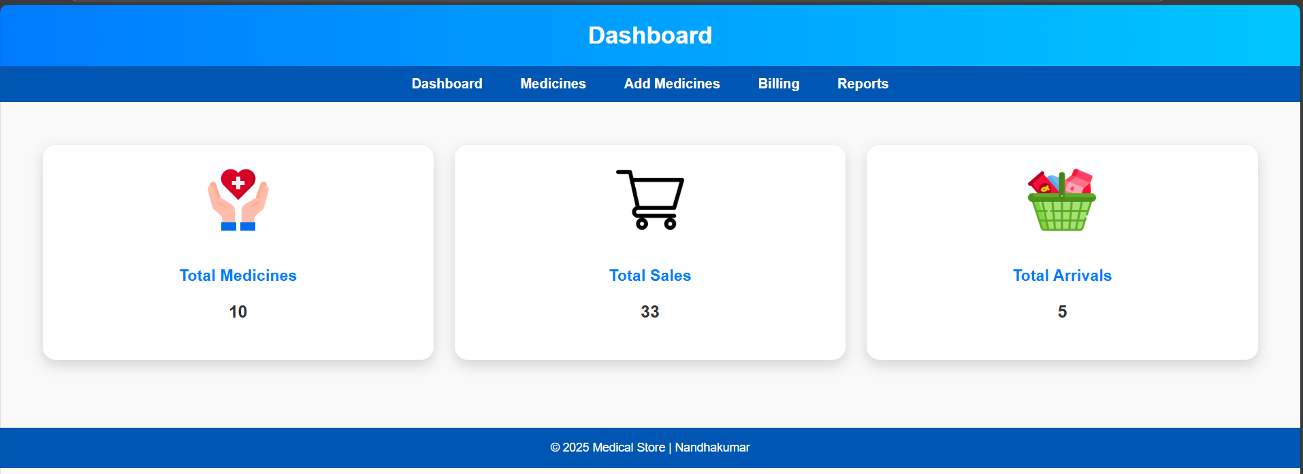
Dashboard

Slide 11
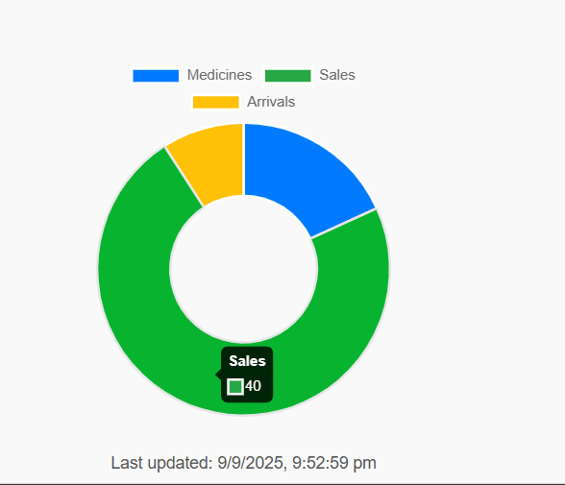
Dashboard

Slide 12
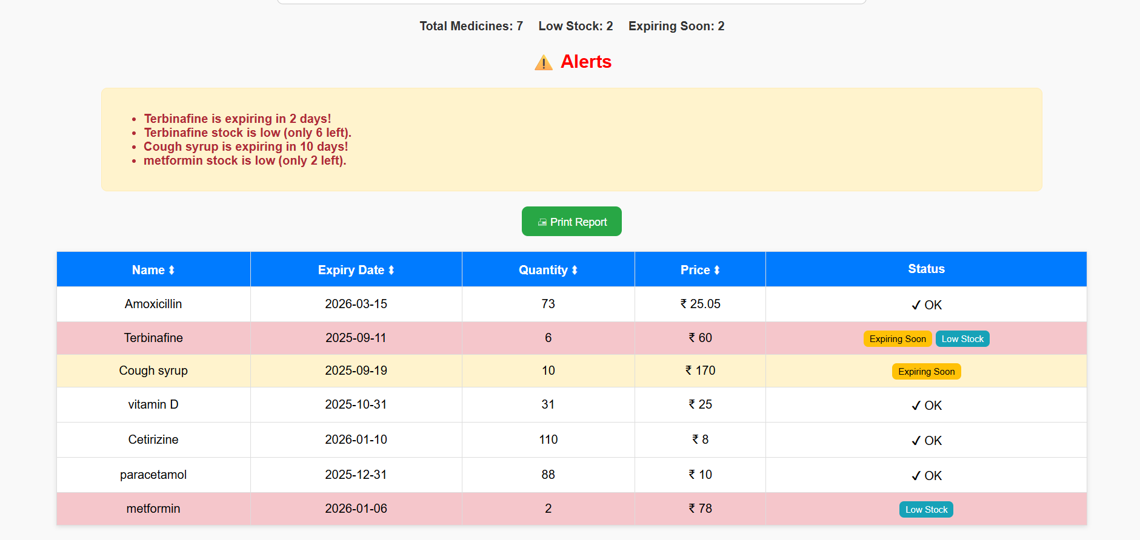
Medicine Details

Slide 13
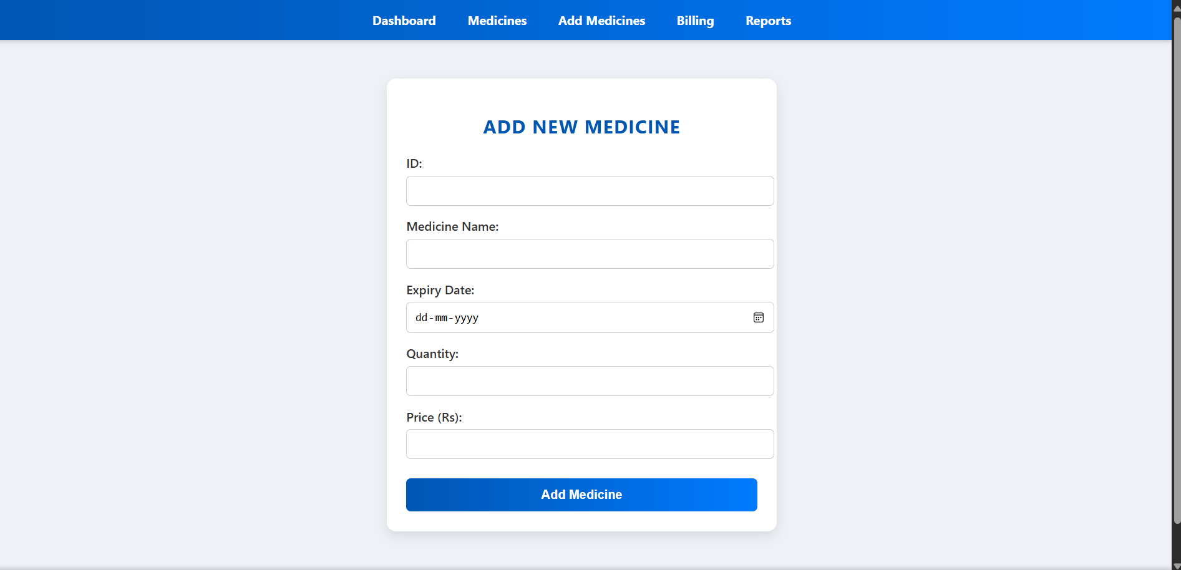
New Medicine

Slide 14
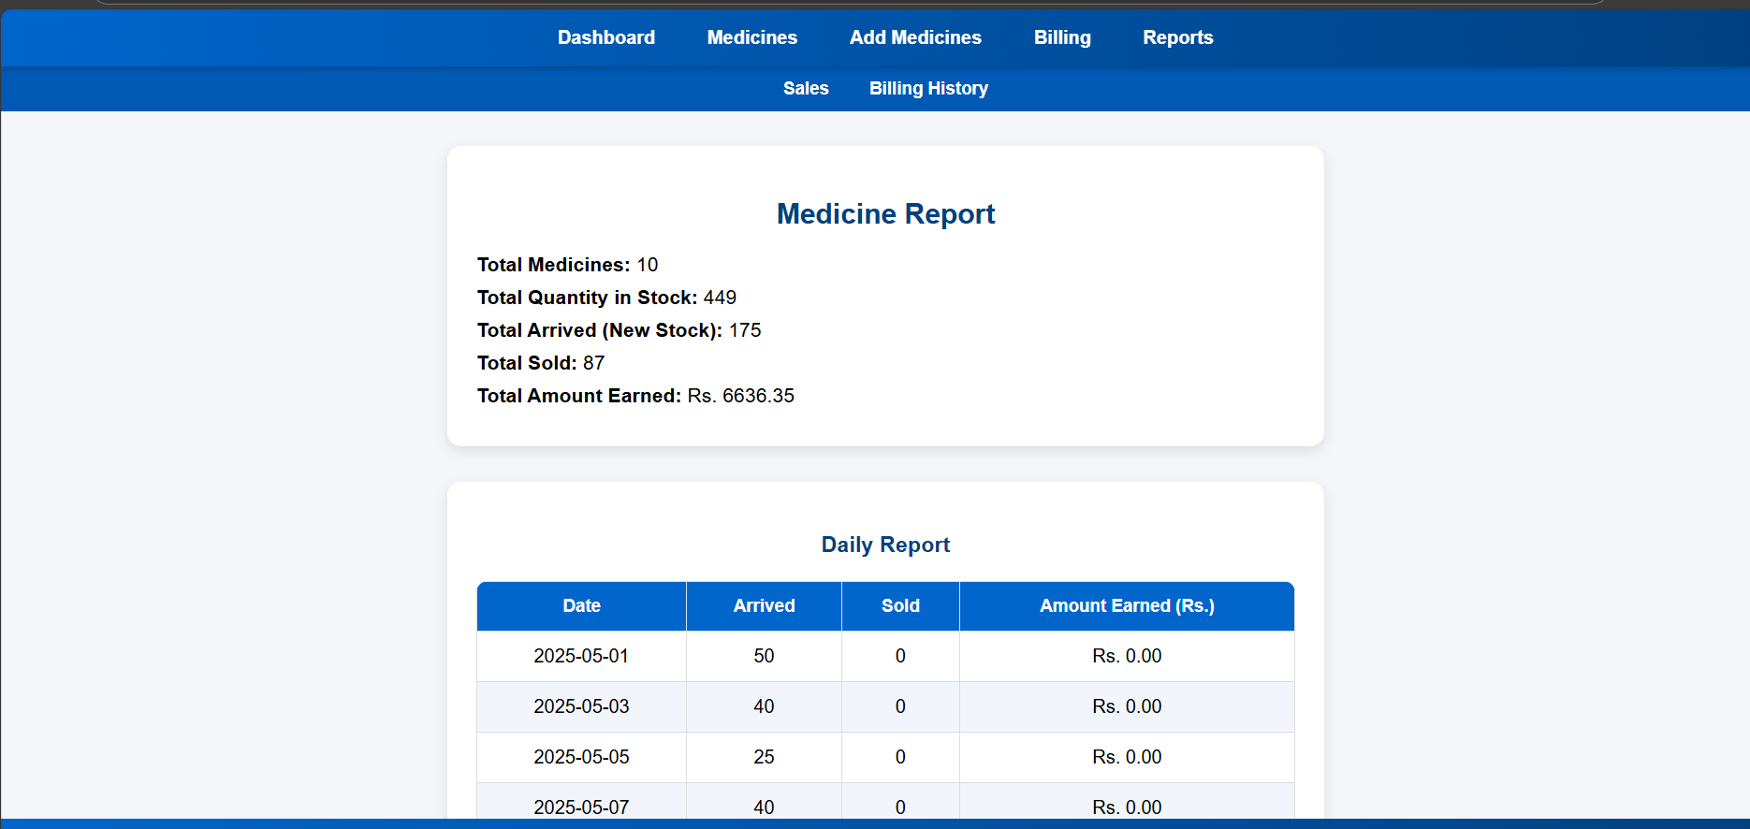
Report

Slide 15
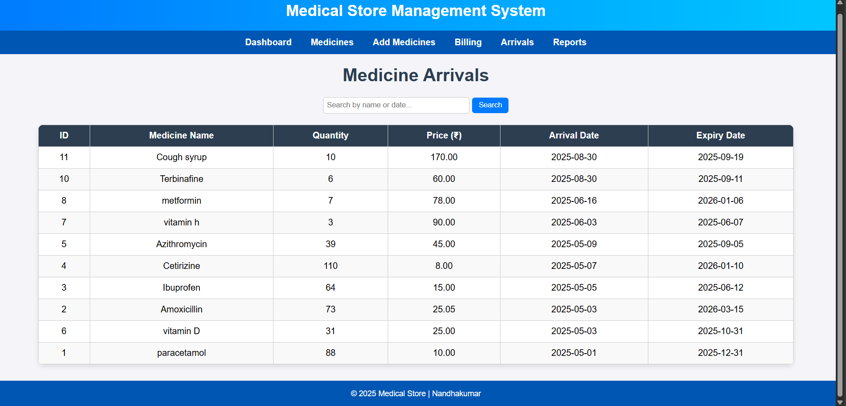
Arrival Medicine Record

Slide 16
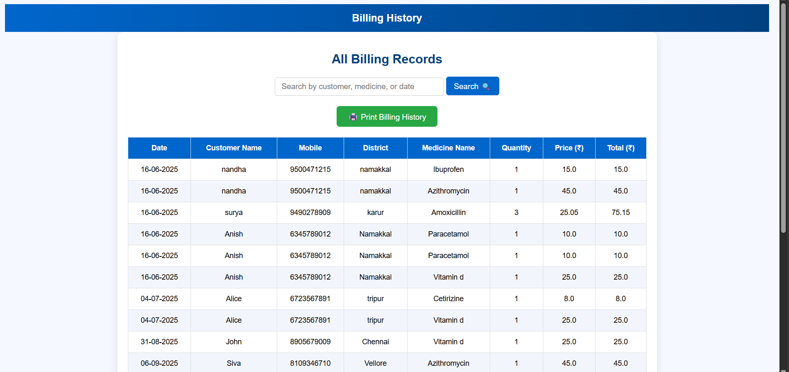
Billing Record

Slide 17
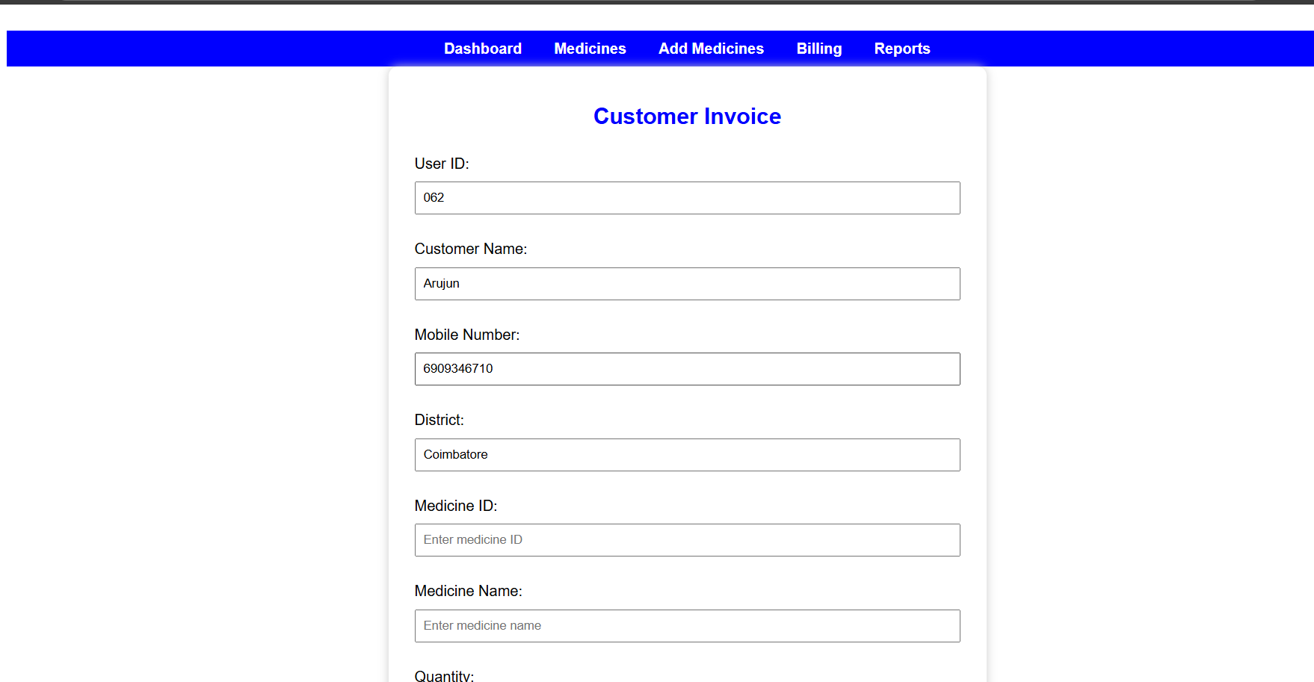
Billing Form

Slide 18
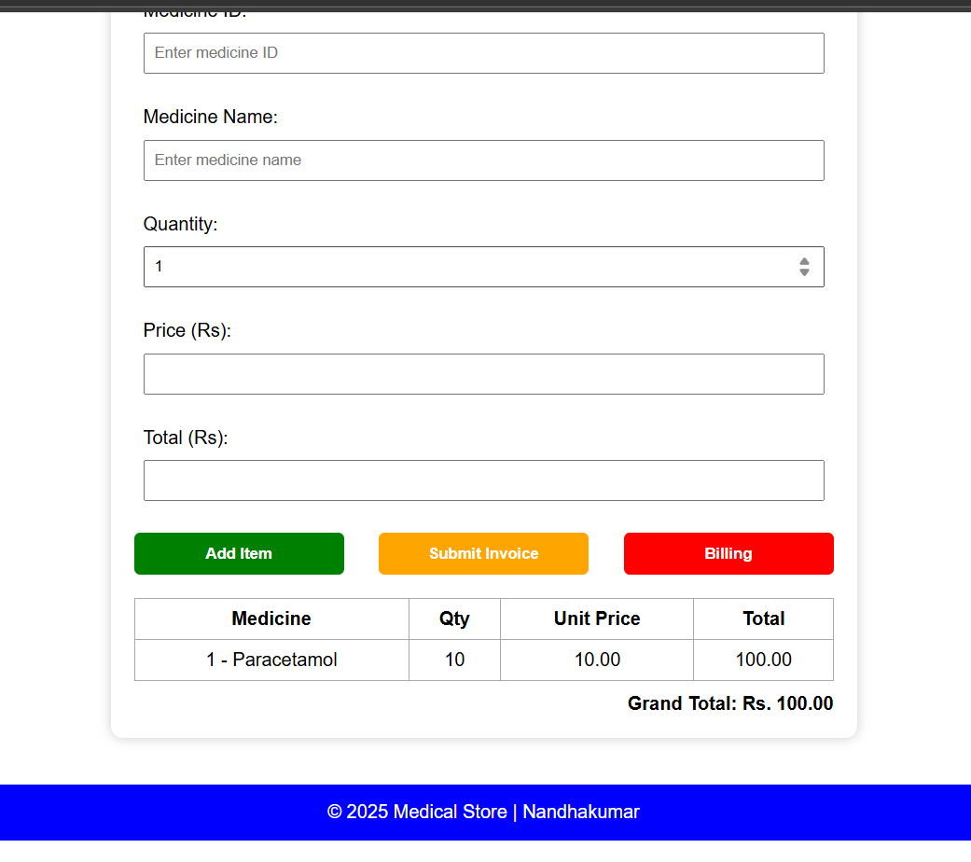
Billing Form

Slide 19
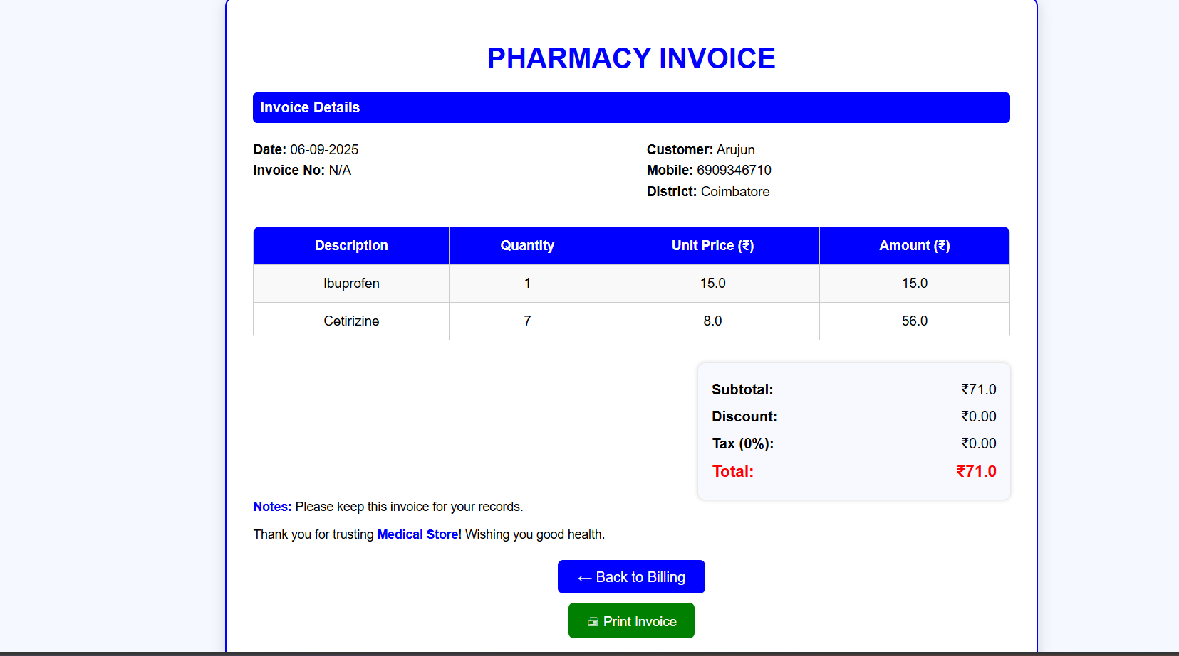
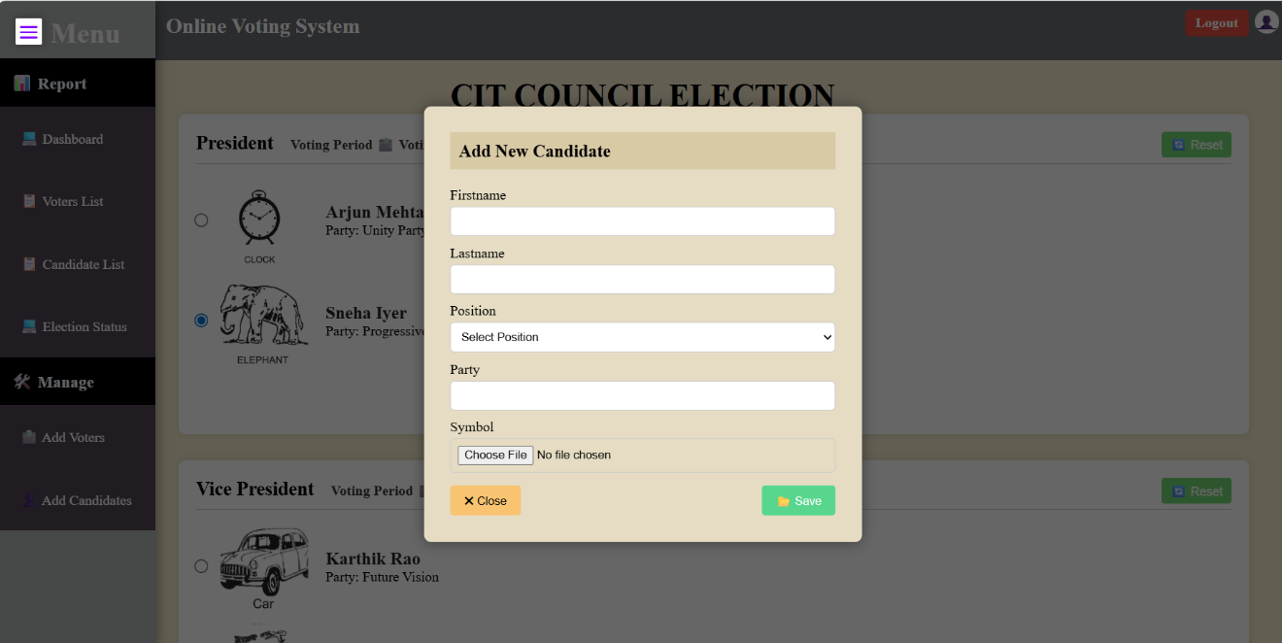
Bill

Slide 20
REFERENCES
Ramírez, S. FastAPI Documentation. Available: https://fastapi.tiangolo.com
W3Schools. HTML, CSS, and JavaScript Tutorials. Available: https://www.w3schools.com
Bootstrap Team. Bootstrap Official Documentation. Available: https://getbootstrap.com
PostgreSQL Global Development Group. PostgreSQL Official Documentation. Available: https://www.postgresql.org/docs
Stack Overflow Community. Programming Q&A. Available: https://stackoverflow.com
GeeksforGeeks. Python and Web Development Tutorials. Available: https://www.geeksforgeeks.org

