Slide 1
PREDICTING HOUSE PRICES USING MACHINE LEARNING

Slide 2
INTRODUCTION
The machine learning model is given the test
Data but without the price of the properties in
Order to predict the price for them given the
Various features for the properties. The
Predicted price is then compared to the actual
Price in the test data.

Slide 3
SAMPLE CODE
import pandas as pd import numpy as np import seaborn as sns import matplotlib.pyplot as plt
%matplotlib inline
HouseDF = pd.read_csv('USA_Housing.csv') HouseDF.head() HouseDF=HouseDF.reset_index() HouseDF.head() HouseDF.info() HouseDF.describe() HouseDF.columns sns.pairplot(HouseDF) sns.distplot(HouseDF['Price’]) sns.heatmap(HouseDF.corr(), annot=True)
X = HouseDF[['Avg. Area Income', 'Avg. Area House Age', 'Avg. Area Number of Rooms', 'Avg. Area
Number of Bedrooms', 'Area Population']]
y = HouseDF['Price’]
from sklearn.model_selection import train_test_split
X_train, X_test, y_train, y_test = train_test_split(X, y, test_size=0.4, random_state=101)
from sklearn.linear_model import minmaxscaler
lm = minmaxscaler(feature_range=(0,1))
lm.fit_transform(X_train,y_train)
print(lm.intercept_)
coeff_df = pd.DataFrame(lm.coef_,X.columns,columns=['Coefficient’]) coeff_df

Slide 4
from keras.layers import Dense,Dropout,LSTM
from keras.models import Sequential model = Sequential() model.add(LSTM(units = 50,activation = 'relu',return_sequences = True,input_shape = (x_train.shape[1], 1)))
model.add(Dropout(0.2))
model.add(LSTM(units = 60,activation = 'relu',return_sequences = True))
model.add(Dropout(0.3))
model.add(LSTM(units = 80,activation = 'relu',return_sequences = True)) model.add(Dropout(0.4))
model.add(LSTM(units = 120,activation = 'relu')) model.add(Dropout(0.5))
model.add(Dense(units = 1))
model.compile(optimizer='adam', loss = 'mean_squared_error’) model.fit(x_train, y_train,epochs=50)
print(lm.intercept_)

Slide 5
coeff_df = pd.DataFrame(lm.coef_,X.columns,columns=['Coefficient’])
coeff_df
predictions = lm.predict(X_test)
scale_factor = 1/0.02099517 y_predicted = y_predicted * scale_factor y y_test = y_test * scale_factor
plt.scatter(y_test,predictions)
sns.distplot((y_test-predictions),bins=50);
plt.figure(figsize=(12,6)) plt.plot(y_test,'b',label = 'Original Price') plt.plot(y_predicted,'r',label = 'Predicted Price') plt.xlabel('Time') plt.ylabel('Price') plt.legend() plt.show()
from sklearn import metrics
print('MAE:', metrics.mean_absolute_error(y_test, predictions)) print('MSE:', metrics.mean_squared_error(y_test, predictions)) print('RMSE:', np.sqrt(metrics.mean_squared_error(y_test, predictions)))

Slide 6
INNOVATION
GRADIENT BOOSTING FOR IMPROVED PREDICTING ACCRACY:
SYSTEM ARCHITECTURE:
The first step in this is collection of raw data from the various sources and dataset can be of any historical data of the organization. From the raw data we can extract the attributes which are used for the prediction. After extraction, we can train the data model using these previous datasets. Here we should give Testing data as input to data analytical tool.

Slide 7
Gradient Boosting Regressor:
ALGORITHM:
GRADIENT BOOST REGRESSOR:
We used the python pandas library for data processing which combined different datasets into a data frame. The raw data makes us to prepare the data for feature identification. Gradient Boosting for regression builds an additive model in a forward stage wise fashion. It allows for the optimization of arbitrary differentiable loss functions. A weak hypothesis is defined as one whose performance is at least slightly better than random chance.

Slide 8
Step 1: Load the data set df = pd.read_ csv(“ml_house_ data_set.csv”
Step 2: Replace categorical data with one-hot encoded data.
Step 3: Remove the sale price from the feature data .
Step 4: Create the features and labels X and Y arrays. Step 5: Split the data set in a training set (70%) and a test set (30%).
Step 6: Fit regression model.
Step 7: Save the trained model to a file trained_house_classifier_model.pkl
Step 8: Predict house worth using predict function

Slide 9
LOADING AND DATASET
MACHINE LEARNING ALGORITHM:
In this study two machine learning algorithms were compared against each other in order to investigate which one is more successful in predicting housing prices. As mentioned in the previous section, Baldominos et al. [3] performed a similar study in which they compare four machine learning algorithms for housing prices. In their study they found that the Random forest regression algorithm predicted with the smallest error followed by k-Nearest neighbours regression Machine learning algorithms In this study two machine learning algorithms were compared against each other in order to investigate which one is more successful in predicting housing prices. As mentioned in the previous section, Baldominos et al. [3] performed a similar study in which they compare four machine learning algorithms for housing prices. In their study they found that the Random forest regression algorithm predicted with the smallest error followed by k-Nearest neighbours regression.

Slide 10
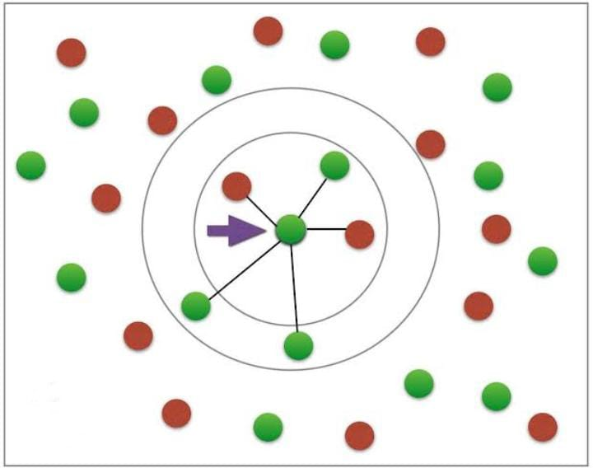
K Nearest Neighbours

Slide 11
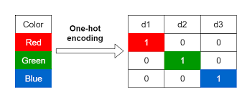
Encoding categorical data

Slide 12
MODEL TRAINING
METHODS:
In order to answer the question about what machine learning method is better to use for the house price problem the algorithms k-NN and Random Forest, as motivated in section 2.1, have been compared in terms of their prediction accuracy. Instead of implementing the algorithms from scratch for this study, algorithms from the scikit-learn library have been used. It is a state-of-the-art library part of the scikit suite of scientific toolkits for Python. We have also used the “Our Python” data analysis library Pandas.

Slide 13
ENCODING CATEGORICAL DATA
Many of the variables of the data set are categorical, and take on a limited set of values. One example is the nominal variable ”Street” which represents the type of road access to the property and takes on the values ”Grvl” for gravel and ”Pave” for paved.

Slide 14
Splitting the data
The data set is used in two ways. First to train the algorithm, and then to test it, and for these intents we have split the set in two. The ratio between the number of rows in the training data and the test data needs to be carefully selected. If the test data is too small the result is less convincing since it is not tested on a large variety of rows. Increasing the test data size improves reliability but reduces the number of rows in the training data which causes the model to predict worse. A way of mitigating the effects of a larger test set is to use cross-validation, which is used for this experiment.

Slide 15
Training Validation
Run 1
Run 2
Run 3
Run 4
Run 5

Slide 16
THANK YOU!

