Slide 1


Explainable Hierarchical Temporal Graph Neural Network for Early Intrusion Detection in 5G/6G Networks
Department Of Information Technology
Madras Institute Of Technology
Anna University
Status Presentation
TEAM MEMBERS: GUIDED BY
Kumaran S (2023506091) Dr. G. Rajesh
Gnanendhiran V (2023506103) Associate Professor,
Janardhanam B (2023506108) Department of Information Technology
Nandhakumar V (2023506308)

Slide 2
IMPLEMENTATION RESULTS
Madras Institute of Technology |Dept. of IT
Module 1 – Data Preprocessing & Progressive Flow Extraction
1,215,890 5G-NIDD network-flow records processed.
3,343 duplicate rows identified during data-quality analysis.
10,954,825 NaN feature values converted to 0 during graph preprocessing.
91 network-traffic features prepared for graph-node representation.
Progressive temporal windows generated:
5 packets: 243,178 windows
10 packets: 121,589 windows
20 packets: 60,794 windows
50 packets: 24,317 windows
Output Files: Saved as progressive_windows (CSV format)

Slide 3
IMPLEMENTATION RESULTS
Madras Institute of Technology |Dept. of IT
Module 2 – Multi-Scale Temporal Graph Construction
243,178 graph snapshots constructed from the 5-packet windows.
Each graph contains 5 nodes and 10 k-NN edges.
k = 2 used for graph connectivity.
2,431,780 total edges generated.
Each node contains 91 normalized features.
91,518 benign graphs and 151,660 malicious graphs generated.

Slide 4
IMPLEMENTATION RESULTS
Madras Institute of Technology |Dept. of IT
Module 2 – PyTorch Geometric
graph_dataset.pt successfully created.
243,178 graphs, 1,215,890 nodes, and 2,431,780 edges.
48,635 temporal sequences created.
Each sequence contains 5 consecutive graph snapshots.
17,738 benign sequences and 30,897 malicious sequences.
No downsampling or oversampling applied.

Slide 5
IMPLEMENTATION RESULTS
Madras Institute of Technology |Dept. of IT
Module 2 – Temporal Dataset Preparation
48,635 temporal sequences created.
Label Distribution:
Benign Sequences → 17,738
Malicious Sequences → 30,897
Average Composition:
Malicious Graphs per sequence → 3.12
Benign Graphs per sequence → 1.88
Malicious Nodes per sequence → 15.18
Benign Nodes per sequence → 9.82
Output File: graph_sequences.pt (ready for HTSTCL-GNN training)

Slide 6
IMPLEMENTATION RESULTS
Madras Institute of Technology |Dept. of IT
Graph Visualization
Snapshots Visualized: 20 sample graphs
Benign Example: Graph with 5 benign nodes, 10 edges
Malicious Example: Graph with 2 benign + 3 malicious nodes
Visualization Output: PNG snapshots saved for dashboard integration

Slide 7
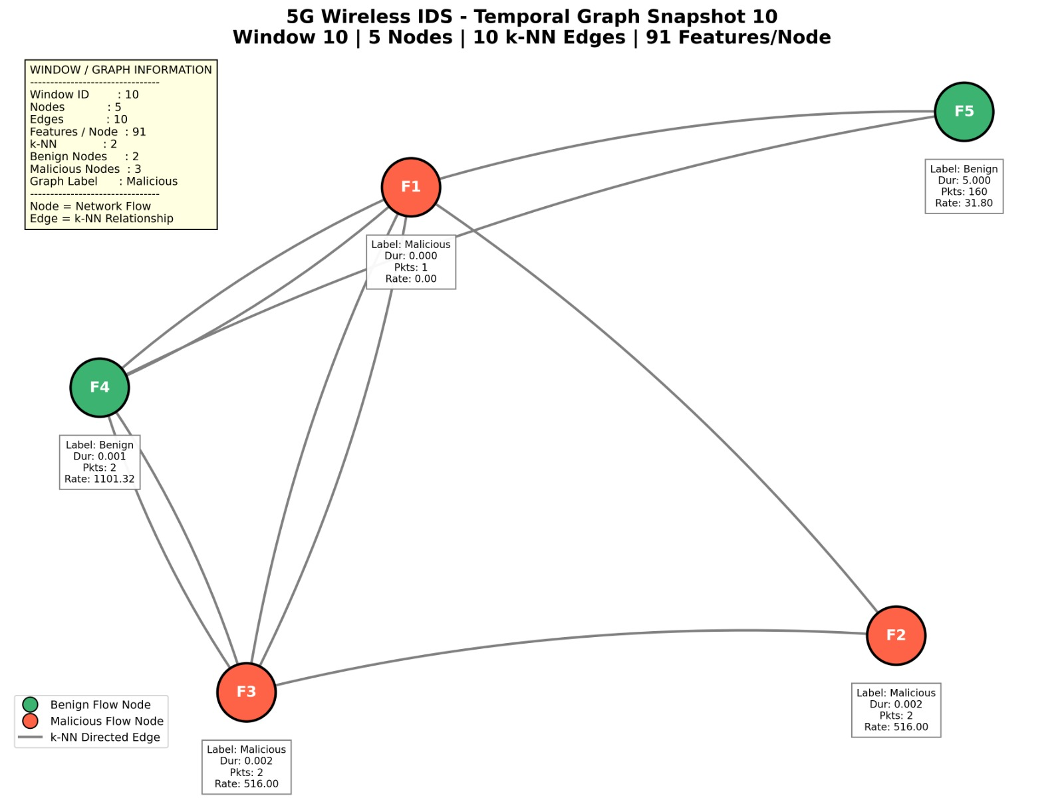
OUTPUTS
Madras Institute of Technology |Dept. of IT

Slide 8
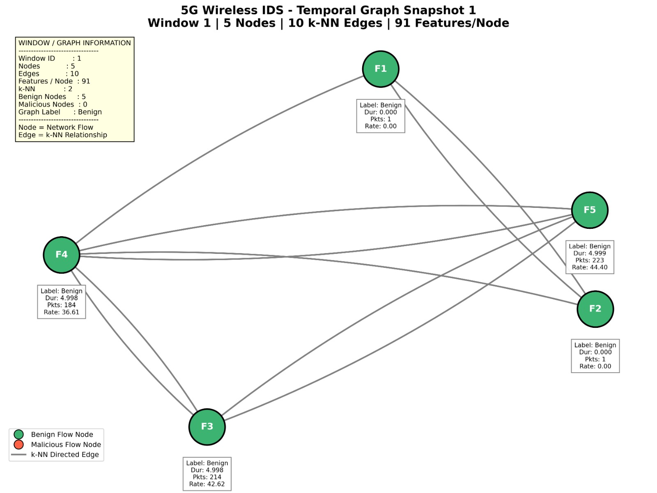
OUTPUTS
Madras Institute of Technology |Dept. of IT

Slide 9
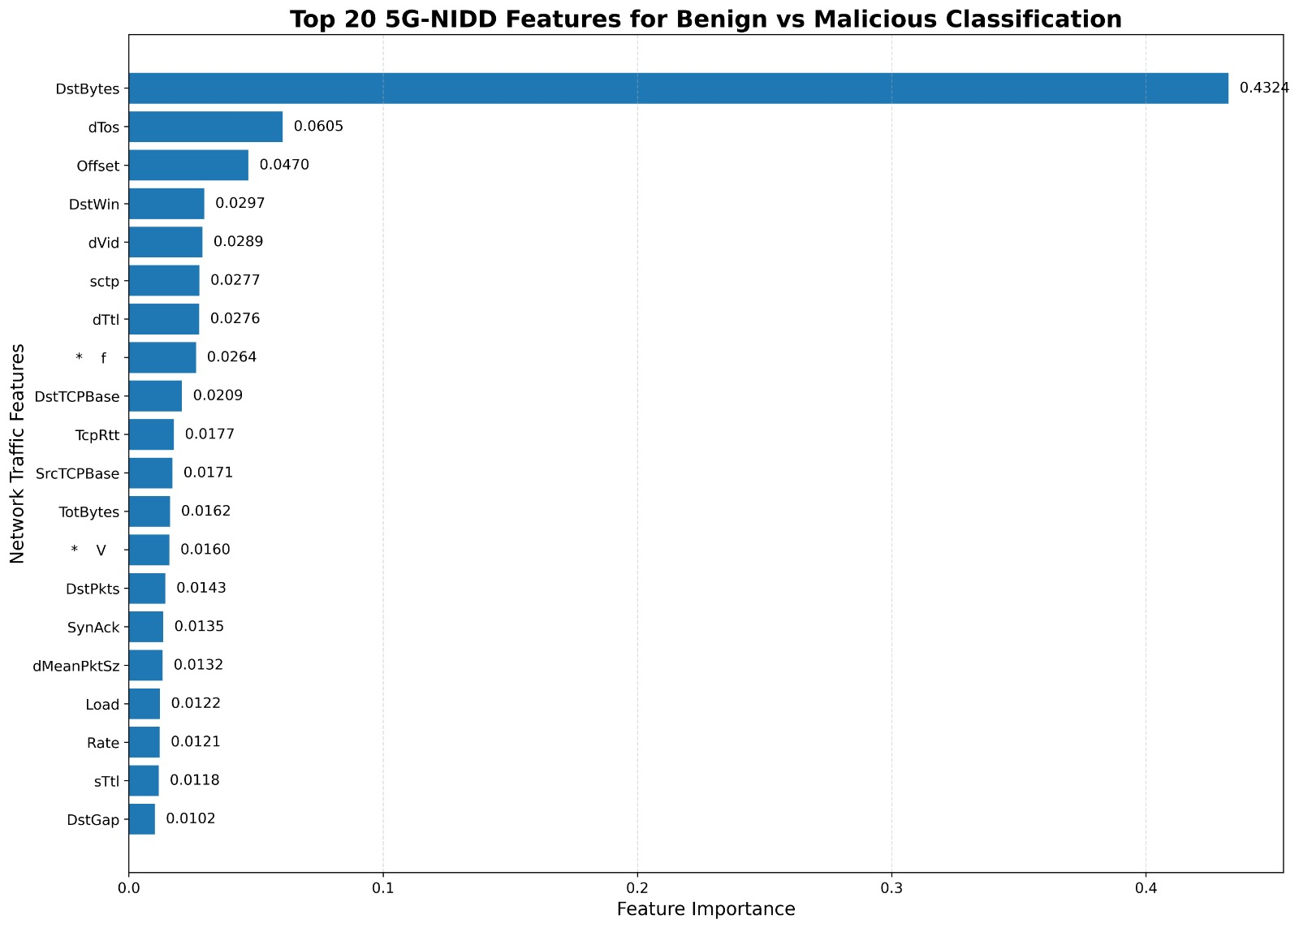
DATASET
Madras Institute of Technology |Dept. of IT

Slide 10
IMPLEMENTATION TOOLS
Madras Institute of Technology |Dept. of IT
Component | Specification/Tool | Purpose
Programming Language | Python 3.x | Core implementation and data processing
Dataset | 5G-NIDD | Normal and malicious 5G network traffic
Feature Scaling & Edge Construction | Pandas, NumPy, Scikit-learn | Feature normalization and k-NN graph edge construction
Graph Processing | PyTorch Geometric, NetworkX | Graph construction, representation and processing
Spatial Learning | GAT (Graph Attention Network) | Learn spatial relationships between network-flow nodes
Temporal Learning | GRU (Gated Recurrent Unit) | Learn temporal dependencies across graph sequences
5G Network Simulation | ns-3 | Simulate 5G wireless network traffic
Explainable AI | GNNExplainer / SHAP | Explain model predictions
Dashboard | Streamlit | Display detection results and security insights
Development Environment | VS Code / Google Colab | Development, experimentation and computationally intensive training

Slide 11
TIMELINE
Madras Institute of Technology |Dept. of IT
Phase | Start Date | End date | Status
Literature Review and Problem Finalization | 10 Jul 2026 | 20 Jul 2026 | 10%
Dataset Collection and Preprocessing | 21 Jul 2026 | 26 Jul 2026 | 20%
Progressive Flow Extraction | 27 Jul 2026 | 1 Aug 2026 | 30%
Multi-Scale Temporal Graph Construction | 2 Aug 2026 | 10 Aug 2026 | 45%
Hierarchical Spatio-Temporal Graph Learning | 11 Aug 2026 | 18 Aug 2026 | 60%
Adaptive Intrusion Detection | 19 Aug 2026 | 28 Aug 2026 | 70%
Explainable AI Model | 29 Aug 2026 | 15 Sep 2026 | 80%
Security Dashboard | 16 Sep 2026 | 5 Oct 2026 | 90%
Testing and Perfomance Evaluation | 6 Oct 2026 | 20 Oct 2026 | 95%
Documentation and Final Review | 21 Oct 2026 | 31 Oct 2026 | 100%

Slide 12
Madras Institute of Technology |Dept. of IT
THANK YOU

