Slide 1


DEPARTMENT OF INFORMATION TECHNOLOGY
ANNA UNIVERSITY
ZEROTH REVIEW
ACADEMIC YEAR 2023-2027
Explainable Hierarchical Temporal Graph Neural Network for Early Intrusion Detection in 5G/6G Networks
TEAM MEMBERS
Kumaran S(2023506091)
Gnanendhiran V (2023506103)
Janardhanam B (2023506108)
Nandha Kumar V (2023506308)
GUIDED BY
Dr. G. Rajesh
Associate Professor,
Department of Information Technology

Slide 2
Problem Statement
Modern Graph-Based Intrusion Detection Systems have achieved remarkable success in accurately identifying malicious network activities. However, these systems treat all detected attacks with equal importance, generating hundreds or thousands of alerts every hour in large-scale enterprise networks. This creates a critical operational challenge for Security Operations Center (SOC) analysts who must manually sift through numerous alerts to identify which threats require immediate attention.
The Core Problem:
Existing intrusion detection systems lack an intelligent mechanism to:
Prioritize attacks based on their severity, network context, and potential business impact
Estimate attack propagation risk to predict how an intrusion might spread through the network
Adapt threat priorities dynamically using historical attack behavior and emerging patterns
Provide explainable prioritization to help analysts understand why certain alerts are critical

Slide 3
Literature Survey
No | Title | Authors | Year / Journal | Objective
1. | TCG-IDS: Robust Network Intrusion Detection via Temporal Contrastive Graph Learning | Cong Wu, Jianfei Sun, Jing Chen, Mamoun Alazab Yang Liu and Yang Xiang | IEEE Transactions on Information Forensics and Security (TIFS), VOL.20, 2025 | Achieves excellent detection accuracy using self-supervised temporal contrastive learning, but requires enhancement for attack prioritization and SOC decision-support.
2. | Secure Handover in 5G-V2X: Detecting and Localizing DoS Attack to Ensure Reliable Communication | Meenu Rani Dey, Moumita Patra | IEEE Transactions on Intelligent Transportation Systems, Vol.26, No.6, 2025 | Proposes HFR and RLF-based attack detection with multi-class classification for DoS attack localization during handover.
3. | An Innovative Secure and Privacy-Preserving Federated Learning-Based Hybrid Deep Learning Model for Intrusion Detection in Internet-Enabled Wireless Sensor Networks | Soumya Ranjan Jena ,et al. | IEEE Transactions on Consumer Electronics, Vol.71, No.1, 2025 | The approach achieves 99.93% accuracy but requires enhancement for scalability in larger IoT deployments.

Slide 4
Literature Survey
No | Title | Authors | Year / Journal | Objective
4. | FeCoGraph: Label-Aware Federated Graph Contrastive Learning for Few-Shot Network Intrusion Detection | Qinghua Mao, Xi Lin, Wenchao Xu et al. | IEEE Transactions on Information Forensics and Security, Vol.20, 2025 | would benefit from alert ranking and prioritization mechanisms.
5. | IF²-STG: Enhancing Intrusion Detection via Interpretable Inter-Flow Spatio-Temporal Graphs and Intra-Flow Features | Xiaowei Zhao, Mingshu He, Liu Yang et al. | IEEE Transactions on Network Science and engineering, Vol.13,2026 | requires extension for real-time prioritization and propagation risk analysis.
6. | CAPTOR: Continuous Adaptive Privacy-Preserving Threat-Oriented Network Intrusion Detection Framework | Bishal Lakha, Janet Layne, Edoardo Serra, et al. | IEEE Transactions on Big Data,Vol.12, No.2, 2026 | Demonstrates strong online detection with excellent scalability, but would benefit from SOC decision-support

Slide 5
Research gap Identified:
Existing detection systems generate alerts without determining which attacks require immediate attention. Security analysts receive hundreds of alerts with equal importance, delaying response to critical threats.
High false positive rates overwhelm SOC analysts, causing critical attacks to be delayed while low-priority alerts consume valuable response time.
Network traffic graphs are used only for detection without analyzing attack spread through interconnected systems.
Detection models show high false positive rates for specific attack types. This is a detection-level issue outside our prioritization scope.
Temporal contrasting is less effective for regular traffic patterns like nightly or weekend activities. This is a limitation of the temporal learning strategy.

Slide 6
Objectives
Primary Objective:
Develop an Adaptive Context-Aware Threat Prioritization Framework (ACTPF) that extends TCG-IDS to dynamically prioritize detected cyberattacks based on severity, network context, and security impact.
Secondary Objective:
Design a context-aware threat scoring mechanism that combines attack confidence, asset criticality, graph relationships, and temporal attack behaviour.
Tertiary Objective:
Develop an attack propagation analysis module to predict the spread of attacks across interconnected network entities using graph-based relationships.
Final Objective:
Implement an explainable security dashboard that provides prioritized alerts, adaptive risk assessment, and actionable insights to support faster and more effective SOC incident response.

Slide 7
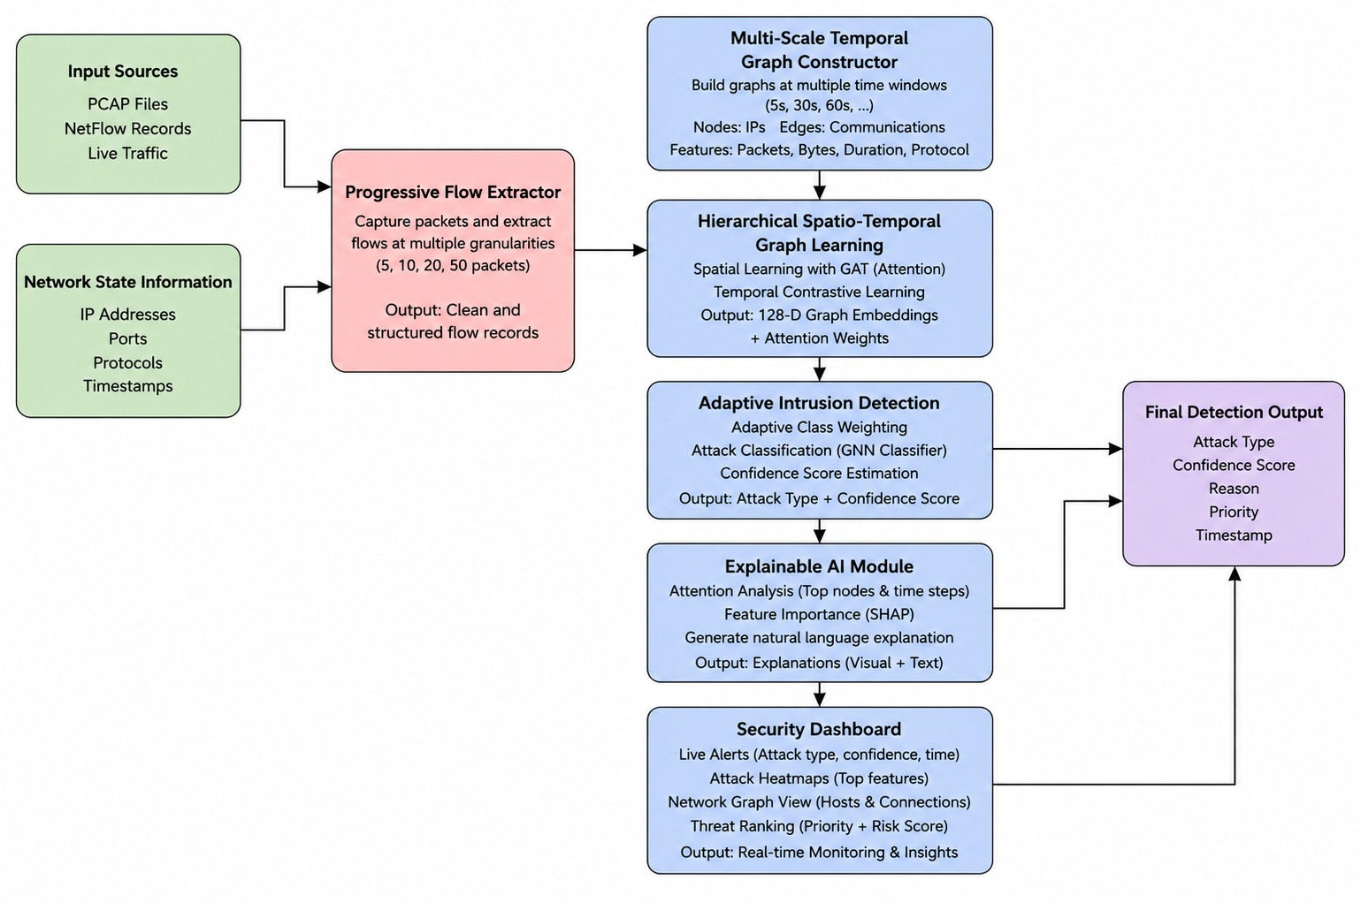
Architecture of Proposed framework

Slide 8
Algorithms
Algorithm | Core Method | How it Detects the Attack
TCG-IDS ( Temporal Contrastive Graph Learning) | Graph Neural Network (GNN) + Temporal Contrastive Learning | Converts network traffic into a graph. The GNN learns relationships between devices over time. If a node or communication pattern deviates from normal graph behavior, it is detected as an attack.
Algorithm 1: Progressive Threat Prioritization Network (PTPN) | Transformer Network | Treats network flows as a sequence. The Transformer learns normal traffic behavior over time. If a flow's sequence differs from normal patterns, it detects an intrusion and assigns a threat priority score.
Algorithm 2: Temporal Graph Threat Ranking Network (TGTR-Net) | Graph Attention Network (GAT) | Builds a graph of communicating devices. The attention mechanism identifies which neighboring nodes have the greatest influence. Abnormal or malicious connections receive higher attention scores and are detected as attacks.
Algorithm 3: Adaptive Confidence Intrusion Detector (ACID-Net) | CNN + BiLSTM | CNN extracts important traffic features (packet size, protocol, flow statistics), while BiLSTM learns temporal behavior. If both spatial and temporal patterns are abnormal, the traffic is classified as an attack with a confidence score.
Algorithm 4: Multi-Level Threat Assessment Network (MTAN) | Autoencoder + XGBoost | The Autoencoder learns normal network behavior. Large reconstruction errors indicate anomalies. XGBoost then classifies the anomaly into attack types (DoS, DDoS, Probe, Botnet, etc.) and assigns a severity level.

Slide 9
Timeline Diagram
Phase | Duration | Cumulative Progress
Phase 1: Literature Review & Problem Finalization | 1 Week | 10%
Phase 2: System Design & Base Detection Integration | 2 Weeks | 25%
Phase 3: Graph Construction & Core GNN Implementation | 3 Weeks | 50%
Phase 4: ACTPF Scoring & Propagation Module Development | 4 Weeks | 75%
Phase 5: Explainable AI & Dashboard Implementation | 2 Weeks | 85%
Phase 6: Testing, Integration & Performance Evaluation | 2 Weeks | 95%
Phase 7: Final Review, Documentation | 1 Week | 100%

Slide 10
Contributions
Team Members | Contributions
KUMARAN S | Provides progressive flow extraction and temporal graph construction framework for early multi-resolution network representation.
JANARDHANAM B | Implements hierarchical spatio-temporal graph learning and adaptive detection framework with attention mechanisms.
GNANENDHIRAN V | Designs context-aware scoring and propagation analysis framework for dynamic threat prioritization and risk prediction.
NANDHA KUMAR V | Builds explainable AI and SOC dashboard framework for heatmaps, rationales, prioritized alerts, and real-time visualization.

Slide 11
References
[1] Q. Mao, X. Lin, W. Xu, Y. Qi, X. Su, G. Li, and J. Li, "FeCoGraph: Label-Aware Federated Graph Contrastive Learning for Few-Shot Network Intrusion Detection," IEEE Transactions on Information Forensics and Security, vol. 20, pp. 1-14, 2025, doi: 10.1109/TIFS.2025.3541890.
[2] X. Zhao, M. He, L. Yang, J. Zhao, and X. Wang, "IF²-STG: Enhancing Intrusion Detection via Interpretable Inter-Flow Spatio-Temporal Graphs and Intra-Flow Features," IEEE Transactions on Network Science and Engineering, vol. 13, no. 4, pp. 7112-7128, 2026, doi: 10.1109/TNSE.2026.3664905.
[3] M. Wang, N. Yang, and N. Weng, "K-GetNID: Knowledge-Guided Graphs for Early and Transferable Network Intrusion Detection," IEEE Transactions on Information Forensics and Security, vol. 20, pp. 1-14, 2025, doi: 10.1109/TIFS.2025.3565080.
[4] B. Lakha, J. Layne, E. Serra, F. Gullo, and S. Jajodia, "CAPTOR: Cyber Attack Protection via Temporal Online Graph Representation Learning," IEEE Transactions on Information Forensics and Security, vol. 20, pp. 1-14, 2025, doi: 10.1109/TIFS.2025.3565080.
[5] T. Xu, Z. Wen, X. Zhao, Q. Hu, Y. Li, and C. Liu, "GTCN-G: A Residual Graph-Temporal Fusion Network for Imbalanced Intrusion Detection," in Proceedings of the IEEE International Conference on Trust, Security and Privacy in Computing and Communications (TrustCom), 2025, pp. 210-217, doi: 10.1109/TrustCom.2025.3565080.
6] E. M. Rudd, F. N. Ducau, C. Wild, K. Berlin, and R. Harang, “ALOHA: Auxiliary loss optimization for hypothesis augmentation,” in Proc. USENIX Secur. Symp., Jan. 2019, pp. 303–320. [7] M. Sarhan, S. Layeghy, and M. Portmann, “Towards a standard feature set for network intrusion detection system datasets,” Mobile Netw. Appl., vol. 27, no. 1, pp. 357–370, Feb. 2022
[7] H.-T. Pai, Y.-H. Kang, and W.-C. Chung, "An Interpretable Generalization Mechanism for Accurately Detecting Anomaly and Identifying Networking Intrusion Techniques," IEEE Transactions on Information Forensics and Security, vol. 19, pp. 10300-10314, 2024, doi: 10.1109/TIFS.2024.3488967.
8] A. Boualouache and T. Engel, “A survey on machine learning-based misbehavior detection systems for 5G and beyond vehicular networks,” IEEE Commun. Surveys Tuts., vol. 25, no. 2, pp. 1128–1172, 2nd Quart., 2023.
[9] S. Anbalagan, G. Raja, S. Gurumoorthy, R. D. Suresh, and K. Dev, “IIDS: Intelligent intrusion detection system for sustainable development in autonomous vehicles,” IEEE Trans. Intell. Transp. Syst., vol. 24, no. 12, pp. 15866–15875, Dec. 2023.
[10] A. Boualouache, T. E. T. Djaidja, S.-M. Senouci, Y. Ghamri-Doudane, B. Brik, and T. Engel, “Deep learning-based intra-slice attack detection for 5G-V2X sliced networks,” in Proc. IEEE 95th Veh. Technol. Conf., Jun. 2022, pp. 1–5.

Slide 12
Thank you

