Slide 1


DEPARTMENT OF INFORMATION TECHNOLOGY
ANNA UNIVERSITY
BASE PAPER REVIEW
ACADEMIC YEAR 2023-2027
TCG-IDS: Robust Network Intrusion Detection via Temporal Contrastive Graph Learning
TEAM MEMBERS
Kumaran S(2023506091)
Gnanendhiran V (2023506103)
Janardhanam B (2023506108)
Nandha Kumar V (2023506308)
GUIDED BY
Dr. G. Rajesh
Associate Professor,
Department of Information Technology

Slide 2
Problem Statement
In the era of zero trust security models and next-generation networks (NGN), network nodes may be untrusted even after verification, necessitating continuous validation and scrutiny. Traditional IDS approaches struggle to keep pace with evolving threats due to their reliance on extensive supervised training on labeled datasets. This leads to high false positive rates, low detection accuracy, and failure to provide real-time detection, thereby undermining the security of NGNs.
Core Problem
Existing detection systems stop at generating alerts without determining which attacks require immediate attention. Security analysts receive hundreds of alerts with equal importance, delaying response to critical threats.

Slide 3
Research gap Identified:
1.High false positive rates - "The relatively high FPRs for classes such as DoS (12.61%) and Reconnaissance (8.20%) highlight areas for improvement" .
2.Periodic patterns not handled - "Temporal contrasting may be less effective in the presence of periodic patterns... nightly or weekend activities" .
3.No comparison with non-GNN methods - "Another limitation is the lack of comparison with existing non-GNN methods" .
4.Lower performance on complex datasets - "The lower performance on NF-UNSW-NB15-v2 dataset compared to NF-CSE-CIC-IDS2018-v2" .
5.Stops at detection (No prioritization) System ends at detector component.

Slide 4
Objectives
Primary Objective:
Develop a self-supervised learning-based IDS on a temporal contrastive Graph Neural Network (GNN) that learns robust representations of network entities without requiring labeled data.
Secondary Objective:
Integrate three contrastive learning strategies — temporal contrasting, asymmetric contrasting, and masked contrasting — to capture temporal network dynamics, node relationships, and multi-facet features.
Tertiary Objective:
Model network traffic as a continuous dynamic graph with temporal encoding to enable real-time, fine-grained detection with minimal false positives.
Final Objective:
Evaluate the proposed framework on two public benchmark datasets (NF-CSE-CIC-IDS2018-V2 and NF-UNSW-NB15-V2) to demonstrate its effectiveness and efficiency.

Slide 5
Algorithms Used:
Temporal Contrasting :
Make node embeddings similar at nearby time steps and different at distant time steps.
Compares a node's behavior at different times by pulling together embeddings from close time points while pushing apart embeddings from far time points. This captures temporal evolution patterns in network behavior.
2. Asymmetric Contrasting :
Learn relationships between nodes by predicting neighbor embeddings.
For each node, predicts its neighbor's embedding and if the prediction is wrong, it indicates an unusual relationship. This captures asymmetric connections in the network and helps identify abnormal interaction patterns.

Slide 6
3. Masked Contrasting :
Learn multi-facet features by hiding parts of embeddings during training.
Divides embedding into 4 factors and hides one factor at a time. The model must learn from incomplete information, which improves robustness and generalization.
4. LightGBM Detector :
Classify nodes as benign or malicious based on learned embeddings.
Uses learned embeddings as input features and outputs a detection score between 0 and 1. Handles large-scale datasets efficiently with fast training and inference

Slide 7
Algorithm
for each node vi do
for t = 1 to T − max(k, n) do
Sample pairs (h't, h't+n) and (h't, h't−n)
Compute temporal contrastive loss Ltemp
for each node vi ∈ Vt do
for each neighboring node v'j ∈ N(vi) do
Predict neighbor embeddings ĥ'j ← fθ(h'i)
Compute asymmetric contrastive loss Lasym
for each node vi ∈ Vt do
for m = 1 to M do
H'm ← [c'1, ..., [MASK], ..., c'M]
H''m ← [c''1, ..., [MASK], ..., c''M]
Compute masked contrastive loss Lmask
L ← Ltemp + λ1Lasym + λ2Lmask
Update parameters:
θ ← θ − η · ∇θL
end for
Input:
Sequence of graph snapshots G = {G1, G2, ..., GT},
learning rate η,
epochs E
Output:
Trained model parameters θ
for epoch = 1 to E do
Initialize gradient accumulators dθ = 0
for t = 1 to T do
Extract Gt = (Vt, Et, Xt, Yt)
for each node vi ∈ Vt do
h'i ← TGN(Gt, Xt)[i]

Slide 8
Mathematical Model
Input: Temporal Graphs G = {G₁, G₂, ..., G_T}
Step 1: Generate Node Embeddings
hᵢᵗ = TGNθ(Gₜ, Xₜ)[i] ∈ ℝᴰ
Step 2: Temporal Contrasting Loss
ℒ_temp = (1/|V|) Σᵢ Σₜ max(0, Δ + sim(neg) - sim(pos))
Step 3: Asymmetric Contrasting Loss
ℒ_asym = (1/|V|) Σₜ Σᵢ Σⱼ ||ĥⱼᵗ - hⱼᵗ||₂²
Step 4: Masked Contrasting Loss
ℒ_mask = (1/|V|) Σₜ Σᵢ Σₘ max(0, Δ + sim(masked, random) - sim(masked, hᵢᵗ))
Step 5: Total Loss
ℒ = ℒ_temp + 0.5ℒ_asym + 0.5ℒ_mask
Step 6: Parameter Update
θ = θ - 0.001·∇θℒ
Output: Detection Score sᵢᵗ ∈ [0,1]

Slide 9
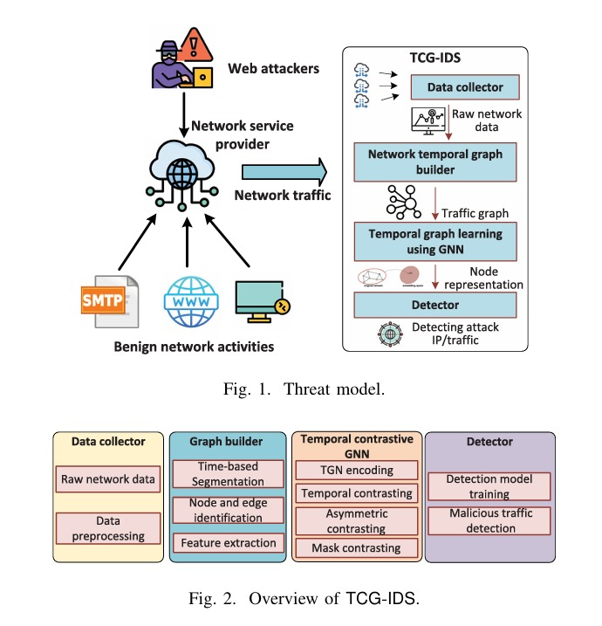
Architecture of BASE PAPER

Slide 10
Technologies Used
Category | Technology | Purpose
Framework
Build and train Graph Neural Network (GNN) models
PyTorch, PyTorch Geometric (PyG)
Graph Learning
Capture the temporal evolution of network nodes and interactions
Temporal Graph Network (TGN)
Graph Construction
Construct temporal graph snapshots from network traffic
NetworkX
Temporal, Asymmetric, and Masked Contrastive Learning
Learn robust self-supervised graph representations
Contrastive Learning
Classifier
Classify network traffic as benign or malicious efficiently
LightGBM
NF-CSE-CIC-IDS2018-V2
NF-UNSW-NB15-V2
Train, validate, and evaluate the intrusion detection model to ensure accurate detection.
DataSet

Slide 11
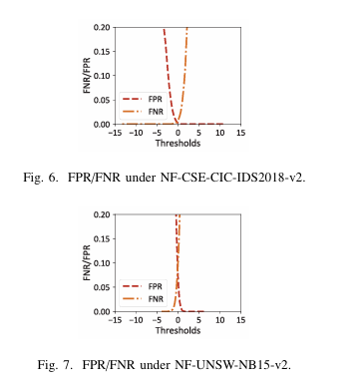
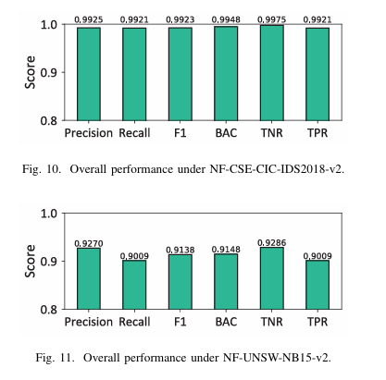
RESULTS:

Slide 12
References
[1]A. Ridhawi and M. Aloqaily, “Zero-trust UAV-enabled and DT supported 6G networks,” in Proc. IEEE Global Commun. Conf. (GLOBECOM), Dec. 2023, pp. 6171–6176.
[2] I. Al Ridhawi, S. Otoum, and M. Aloqaily, “Decentralized zero-trust framework for digital twin-based 6G,” 2023, arXiv:2302.03107.
[3] M. Aloqaily, S. Otoum, I. A. Ridhawi, and Y. Jararweh, “An intrusion detection system for connected vehicles in smart cities,” Ad Hoc Netw., vol. 90, Jul. 2019, Art. no. 101842.
[4] D. Arp et al., “Dos and don’ts of machine learning in computer security,” in Proc. USENIX Secur. Symp., 2022, pp. 3971–3988.
[5] F. Pendlebury, F. Pierazzi, R. Jordaney, J. Kinder, and L. Cavallaro, “TESSERACT: Eliminating experimental bias in malware classifica tion across space and time,” in Proc. USENIX Secur. Symp., 2019, pp. 729–746.
[6] E. M. Rudd, F. N. Ducau, C. Wild, K. Berlin, and R. Harang, “ALOHA: Auxiliary loss optimization for hypothesis augmentation,” in Proc. USENIX Secur. Symp., Jan. 2019, pp. 303–320.
[7] M. Sarhan, S. Layeghy, and M. Portmann, “Towards a standard feature set for network intrusion detection system datasets,” Mobile Netw. Appl., vol. 27, no. 1, pp. 357–370, Feb. 2022.
[8] K. He, D. D. Kim, and M. R. Asghar, “Adversarial machine learning for network intrusion detection systems: A comprehensive survey,” IEEE Commun. Surveys Tuts., vol. 25, no. 1, pp. 538–566, 1st Quart., 2023.
[9] J. Vitorino, I. Prac¸a, and E. Maia, “SoK: Realistic adversarial attacks and defenses for intelligent network intrusion detection,” Comput. Secur., vol. 134, Nov. 2023, Art. no. 103433.
[10] Z. Li, A. L. G. Rios, and L. Trajkovi´c, “Machine learning for detecting anomalies and intrusions in communication networks,” IEEE J. Sel. Areas Commun., vol. 39, no. 7, pp. 2254–2264, Jul. 2021.
[11] S. Muneer, U. Farooq, A. Athar, M. A. Raza, T. M. Ghazal, and S. Sakib, “A critical review of artificial intelligence based approaches in intrusion detection: A comprehensive analysis,” J. Eng., vol. 2024, no. 1, Jan. 2024, Art. no. 3909173.

Slide 13
Thank you

