Slide 1

_{PREDICTIVE MODEL}
28/07/2024

Slide 2
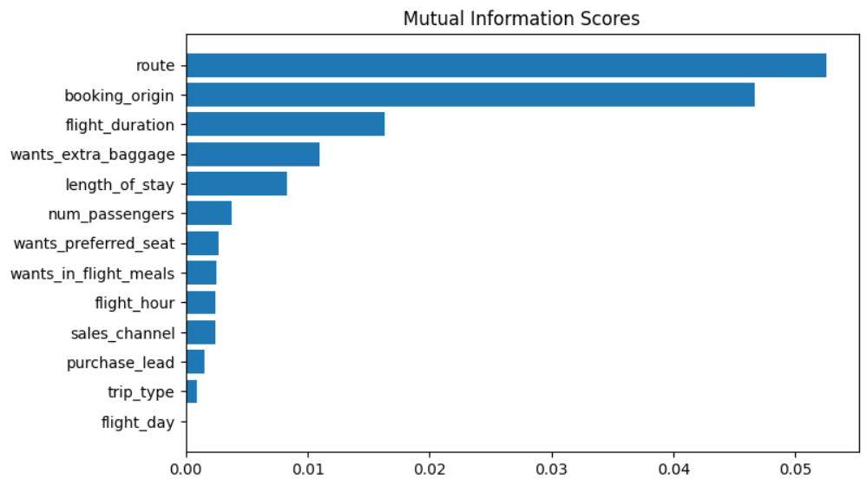
UNDERSDTANDING FACTOR STHAT INFLUENCE BUYING BEHAVIOURS
The data has been trained with the data set with Random Forest Classifier
and we have obtained
ACCURACY : 85.09
AUC SCORE : 0.557
The AUC score must be increased.
Route
Booking origin
Flight duration
Wants extra baggage
Length of stay
These are the Top 5 Features which
influence customer buying behaviour

