Slide 1

_{CUSTOMER RATINGS}
_{ANALYSIS AND INSIGHTS}
28/07/2024

Slide 2
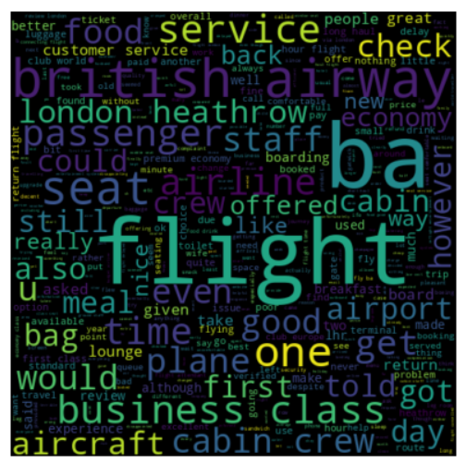
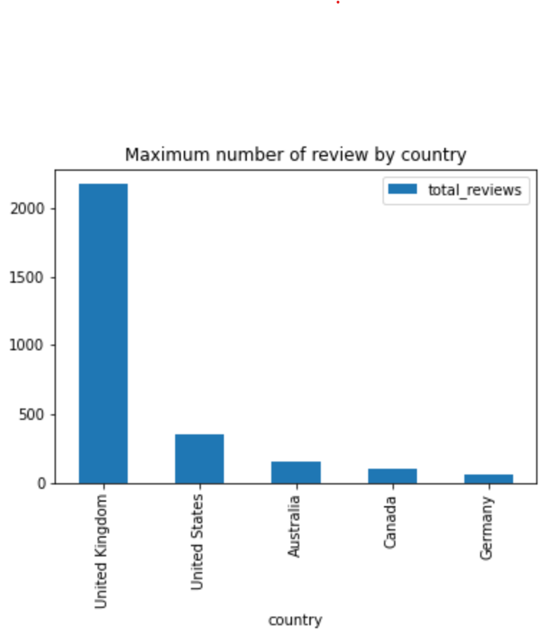
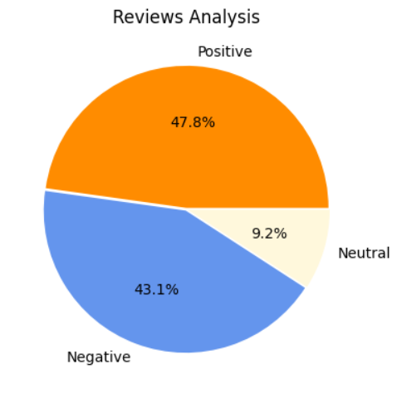
Analysis & INSIGHTS from CUSTOMER REVIEWS
What customers are happy and unsatisfied about for different ratings class:
7-10 ratings wrote about comfortable seats, good inflight entertainment, descent food quality.
4-6 ratings faced problem with small entertainment screen, long passport check queue, bad business class experience.
1-3 ratings wrote dissatisfaction on congested middle seat and small screen while they liked the seats and the food.
Average Overall Review : ✰ 5/10
No. of Countries Included in the Survey : 69
Total Reviews Collected : 3411
Reviews analysis : Reviews by Countries :
Concentrate on – Economy class service, seating, upgrading inflight entertainment, and particularly addressing delays. Enhance the business class experience, as customers appear to seek better value for money.
Improve customer service regarding refund requests and the overall process.

