Slide 1
Project 1 EMPLOYEE ATTRITION DASHBOARD

Slide 2
PROBLEM STATEMENT
XYZ company which was established a few years back is facing around a 15% attrition rate for a couple of years. And it's majorly affecting the company in many aspects. In order to
understand why employees are leaving the company and reduce the attrition rate XYZ
company has approached an HR analytics consultancy for analyzing the data they have. You
are playing the HR analyst role in this project and building a dashboard which can help the
organization in making data-driven decisions.

Slide 3
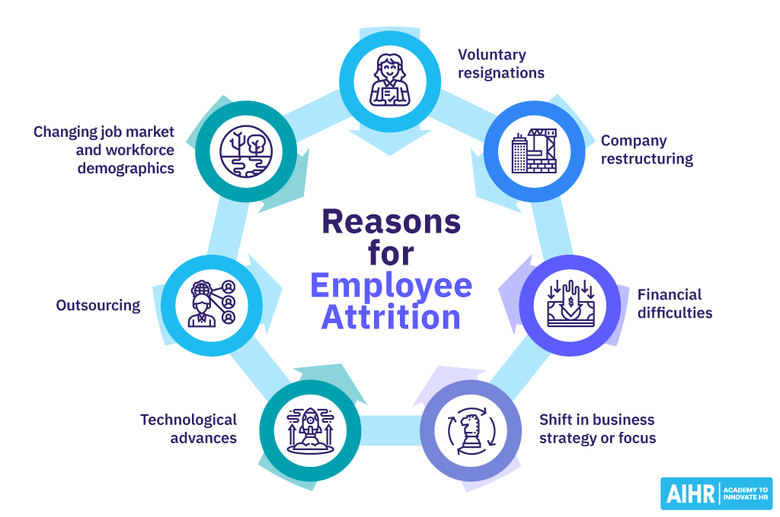
EMPLOYEE ATTRITION
Employee attrition is defined as employees leaving their organizations for unpredictable or uncontrollable reasons. Many terms make up attrition, the most common being termination, resignation, planned or voluntary retirement, structural changes, long-term illness, layoffs.

Slide 4
PROCESS
Data Retrieval – Load the data from the csv file and convert it into a data frame.
Describe the DataSet through funtions like head(), tail(), describe(), isnull() etc.
Data Cleaning – fill in the null values with mean (for numeric data) and with mode (for string datatype). Do IQR detection and remove the outliers
EDA – Exploratory Data Analysis – Plot graphs to extract relationship between different fields from your dataset.
Model Training – choose the right model and calculate accuracy scores

Slide 5
My model
I have chosen RandomForestClassifier as my ML Model for this dataset.
In the specific case of predicting employee attrition, Random Forests can effectively handle categorical variables such as job role or department, numerical variables like salary or years of service, and interactions between these variables (e.g., salary satisfaction ratio). The ability to handle these diverse types of data and capture complex relationships makes Random Forests a suitable choice for building a predictive model to identify employees at risk of leaving the company.

Slide 6

Accuracy
Using this model, I was able to achieve an accuracy of 97% in predicting if/not an employee will leave the company based on several related categories.

Slide 7
Feasible solutions from the insights from eda
Targeted Retention Strategies: Focus on departments, job roles, and tenure periods with higher attrition.
Compensation Review: Ensure competitive salaries and benefits, especially for lower-income roles.
Work-Life Balance: Implement policies to reduce overtime and enhance work-life balance.
Employee Development: Provide career development opportunities and clear advancement paths.
Employee Well-being: Offer programs that support employee well-being, such as flexible work arrangements and wellness programs.
Family-Friendly Policies: Consider implementing policies that support employees with families, such as parental leave and childcare support.

Slide 8
THANK YOU!
Done by:
Nandhana AM
SNU Chennai
Project done in association with Unified Mentor
Link to my work: https://github.com/Nandhana-AM/Unified_Mentor_Projects/tree/main/Project_1

