Slide 1
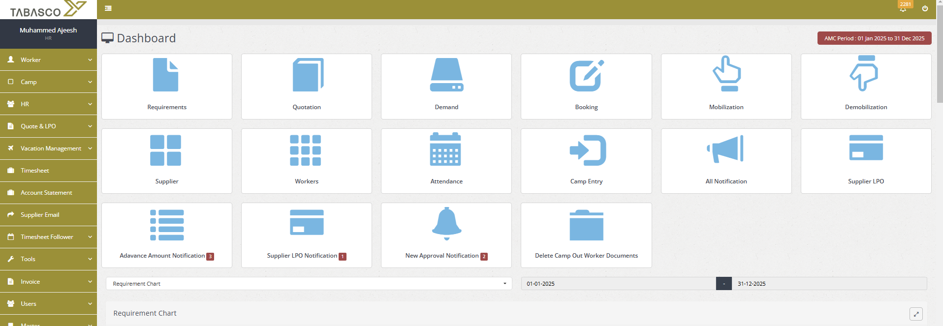

Slide 2
ADD
S/NO | Collection Date Time | Marketing | Client | Cheqe Amount | Date | Collected | Image
Summery
Marketing | Amount
Total

Slide 3
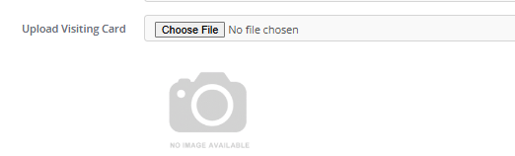
Current Time
Marketing
Client
Cheque Type
Cheque Date
Cheque Amount
Submit

Slide 4
ADD
S/NO | Collection Date Time | Marketing | Client | Cheqe Amount | Date | Collected | Image
Summery
Marketing | Amount
Total

