Slide 1
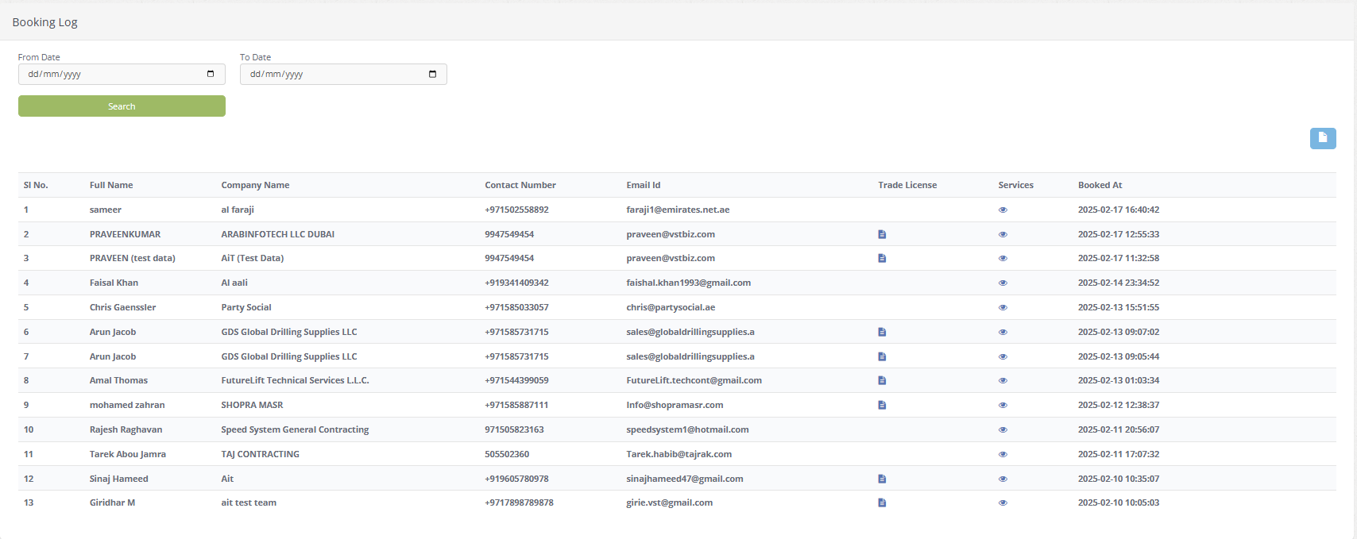

ADD Search OPTION
Remark | Status

Slide 2
Existing client
Add QUOTATION

Slide 3
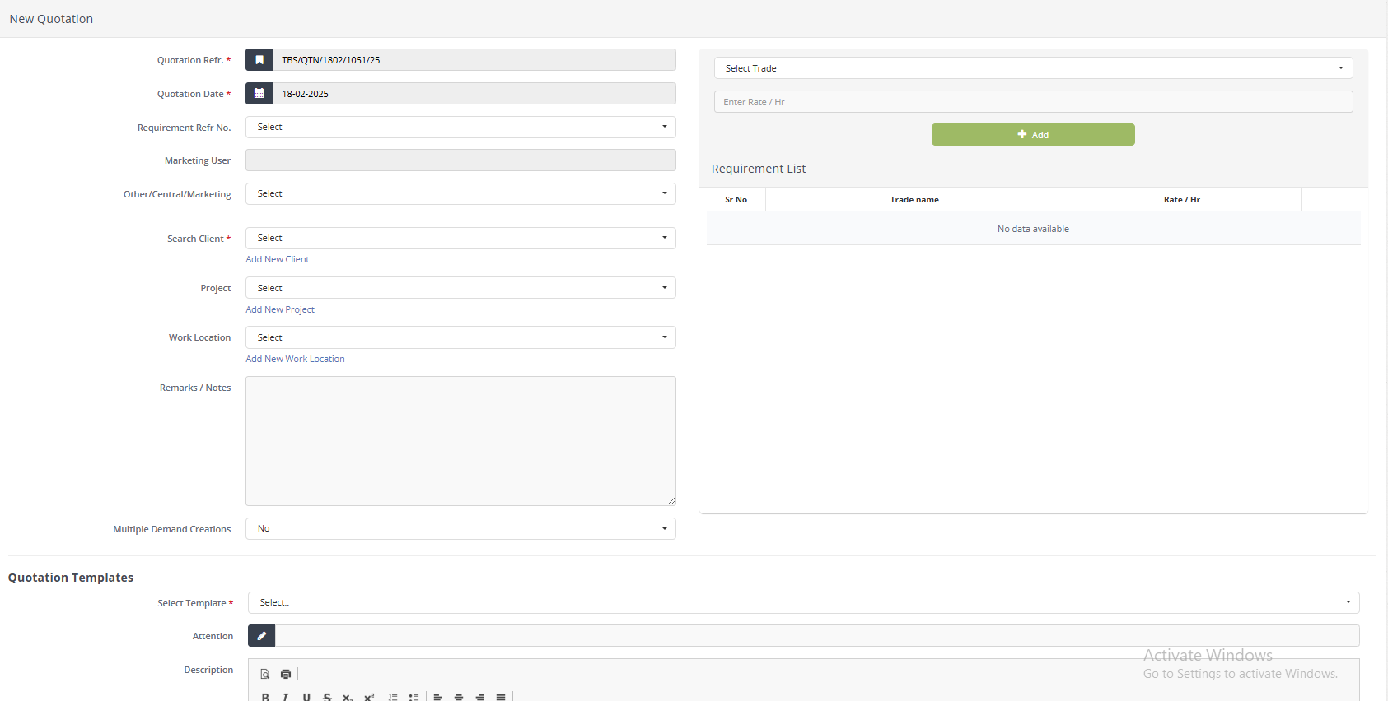

Slide 4
New client
Create Client

Slide 5
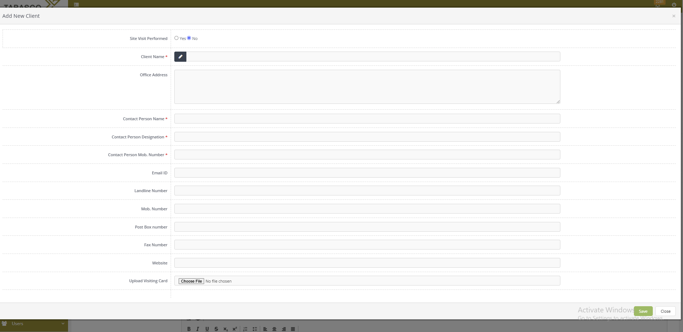

Slide 6
