Slide 1
Project title: Online Shopping Behaviour , Purchase patterns And Transaction Data Analysis
Nandhana Krishna .c
AI Data Engineer Student
Learn Logic Manjeri
Date Of Presentation:05/04/2025

Slide 2
Introduction
Problem statement:
This project aims to analyze online shopping behavior to understand how customers respond to discounts and what factors drive purchases. By exploring transaction data, product details, and customer demographics, we uncover patterns that impact sales and engagement.
Why This Matters
Avoids offering unnecessary discounts to customers who would purchase without them saving marketing
Helps identify which customers respond best to discounts
ML Solutions
Predicts customer responsiveness to discounts using , discount_pct , Coupon_Status , and Tresure_month.
Segments customers for targeted marketing based on , Gender, location, Online_spend.
Forecasts future sales trends using Month , Quantity and Transaction_date.

Slide 3
Objectives
Goal:
The goal of this project is to analyze online shopping transaction data to understand the factors that influence discount percentages (Discount_pct) and build a foundation for predictive modeling to optimize discount strategies.
Aim:
The aim is to predict the discount percentage (Discount_pct) for future transactions based on customer behavior,product details, and transaction attributes.

Slide 4
Dataset
The dataset used in this project was collected from Kaggle
Total Records: 52955 rows
Total Features: 21
Key Feature Include : CustomerID, Gender, Location – Customer Demographics,
Transaction_ID, Transaction_Date, Product_SKU – Transaction Details,
Product_Category, Quantity, Avg_Price – Product Info,
Discount_pct, Coupon_Status, Coupon_Code – Promotion Data,
Online_Spend, Offline_Spend, Tenure_Months – Spending Behavior,
The dataset is structured (tabular) and includes a mix of numerical, categorical, text, and date features.
Challenges: The dataset contained missing values, imbalanced categories, duplicate records, and inconsistent data formatting.

Slide 5
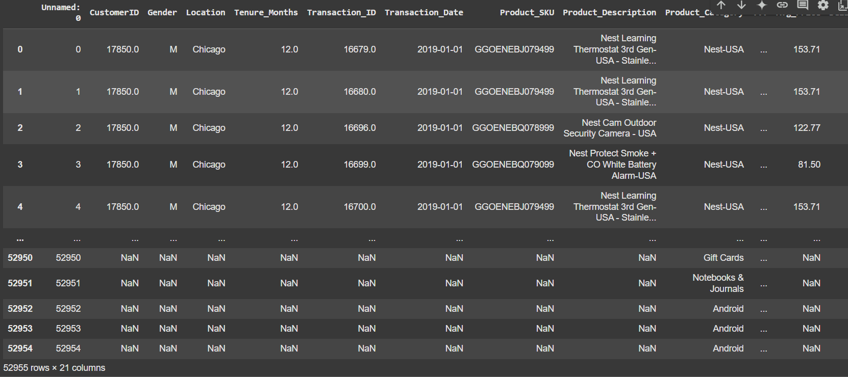

Slide 6
Methodology
Project Workflow (Step-by-Step)
1.Import Libraries & Load Data
2.Initial Data Exploration
3.Data Cleaning
4.Descriptive Statistics
5.Data Visualization
6.Outlier Detection & Handling
7.Feature Engineering
8.Data Scaling
9.Modeling & Hypothesis Testing
Preprocessing Steps
Data Cleaning:
Feature Engineering:
Feature Selection:

Slide 7
Model Selection & Implementation
Algorithms Used:
Linear Regression – For baseline prediction of Discount_pct.
Random Forest Regressor – To handle nonlinear relationships and improve accuracy.
KNN
Why These Models
Linear Regression: Simple, interpretable, and effective as a baseline on tabular data.
Random Forest: Handles feature interactions well, robust to outliers and nonlinearity, and suitable for medium-sized datasets.
Training Process
Train-Test Split: Data split into 80% training and 20% testing set for model evaluation.
Cross-Validation: 5-fold cross-validation used to ensure generalizability.

Slide 8
Evaluation & Results
Metrics Used (Regression Task):
MAE
RMSE
R² Score
Model | MAE | RMSE | R² Score
Linear Regression | 6.69 | 8.1159 | 0.0038
Random Forest Regressor KNN | 0.11 1.06 | 0.69 3.04 | 0.99 0.85

Slide 9
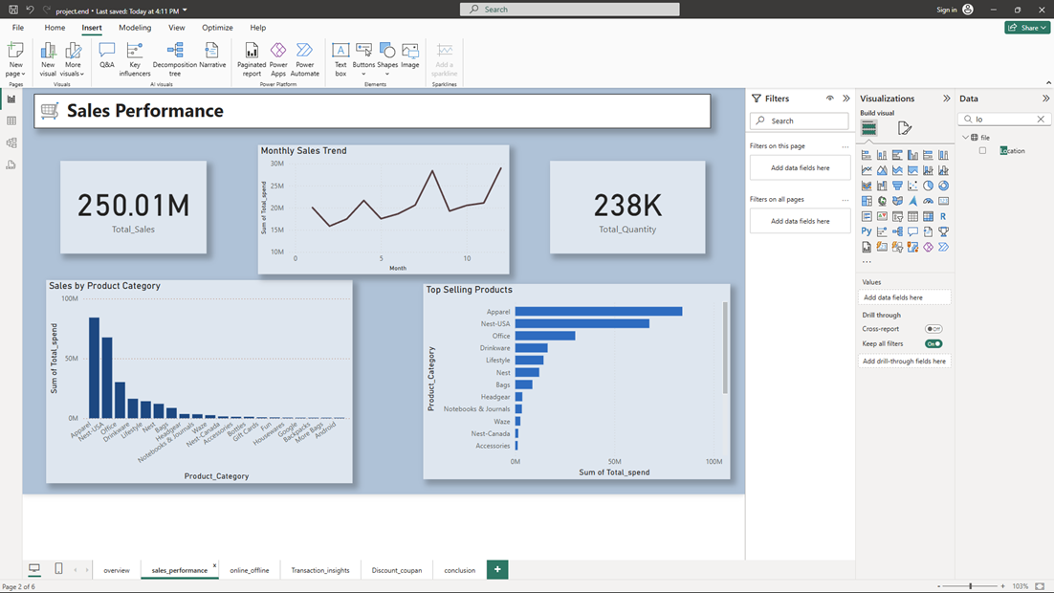
Dashboard overview

Slide 10
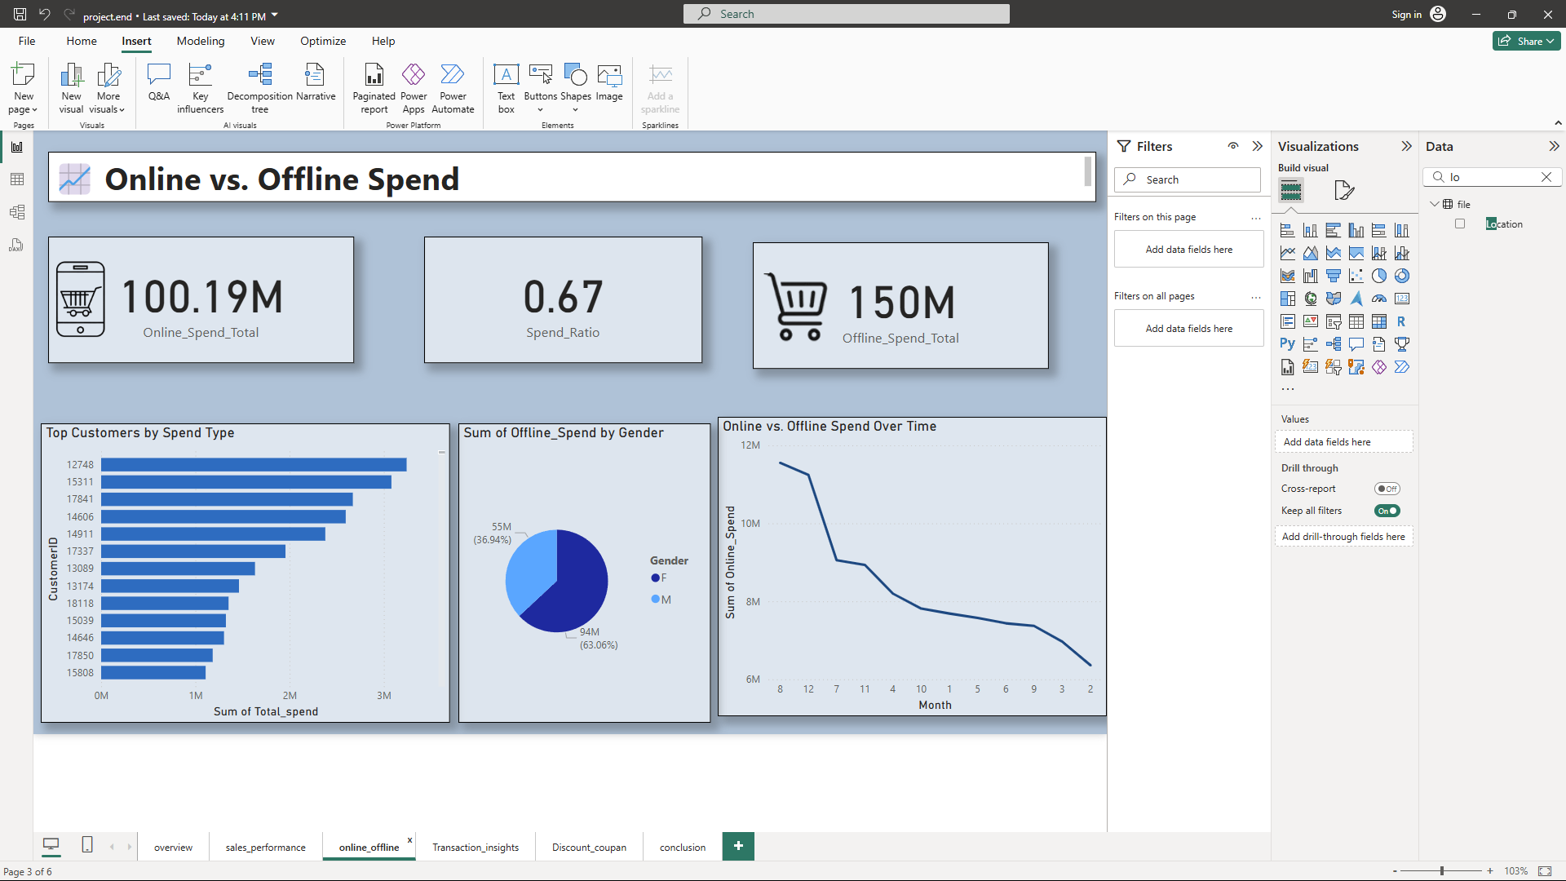

Slide 11
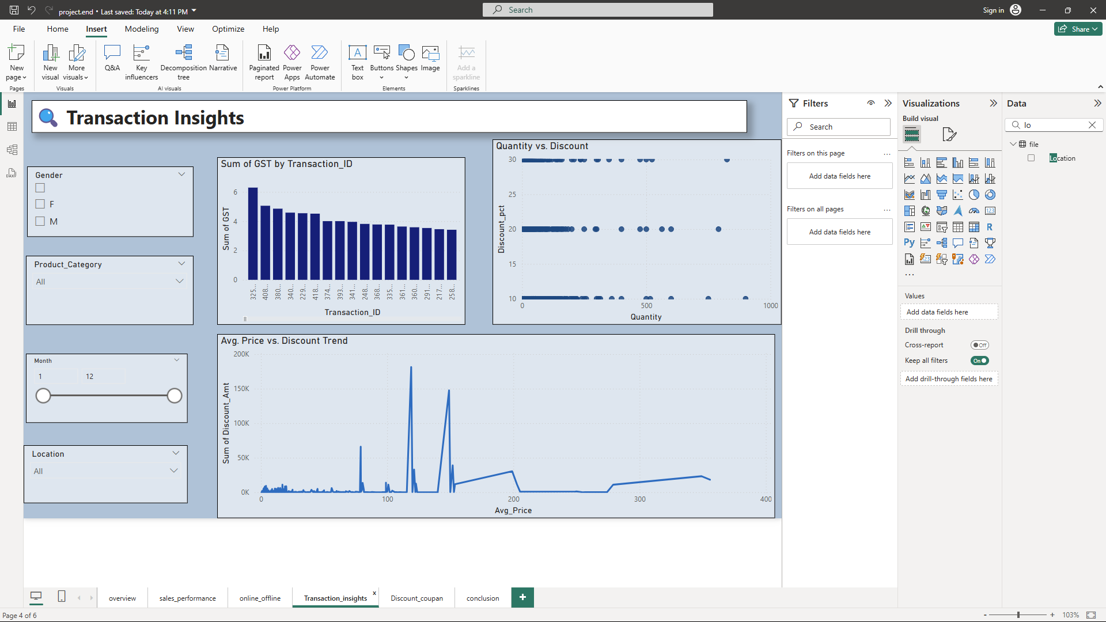

Slide 12
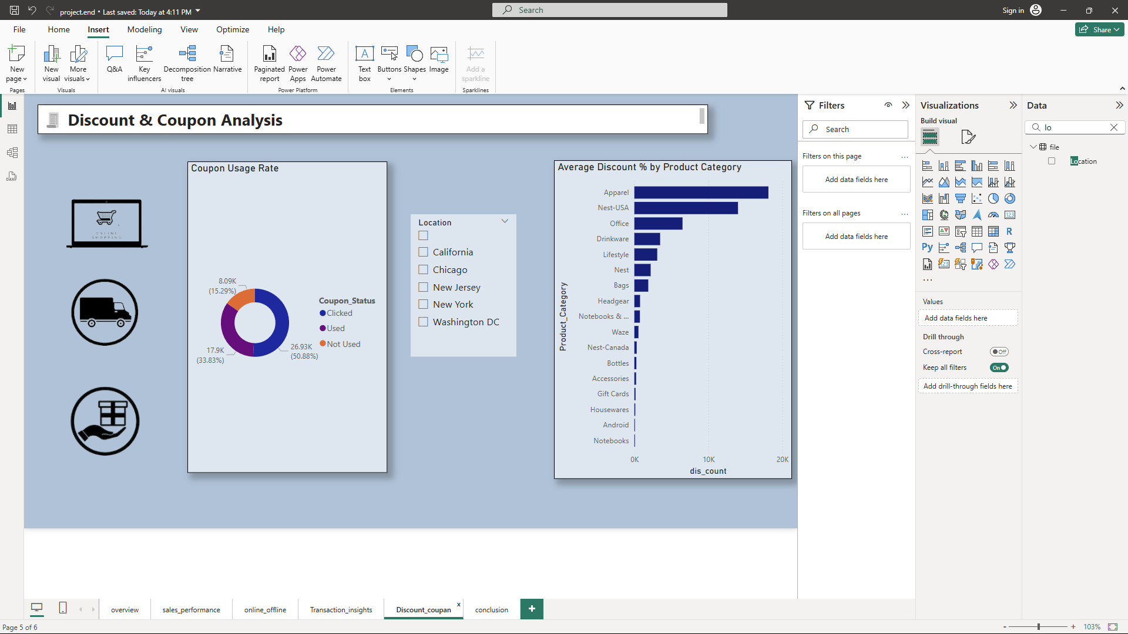

Slide 13
Challenges & Limitations
* Missing values and inconsistent entries required cleaning and imputation.
* Categorical encoding challenges for variables like Gender, Location, and Coupon_Status.

Slide 14
Conclusion & Future Work
The project successfully utilized machine learning techniques to predict discount percentages based on customer shopping behaviors and transaction details. Feature importance analysis provided business insights into which variables most influence discount distribution. Models like KNN outperformed simpler models, showing better accuracy and lower error rates (e.g., RMSE).

Slide 15
References & Acknowledgments
Data Source : Kaggle (https://www.kaggle.com/datasets/jacksondivakarr/online-shopping-dataset)
Libraries & Tools Used: Pandas , NumPy ,Matplotlib , Seaborn , scikit learn

