Slide 1
IMAGE STEGANOGRAPHY USING LSB AND XOR ENCRYPTION
CAPSTONE PROJECT
Presented By:
Nandhika M-Shiv Nadar University Chennai-Department of CSE

Slide 2
OUTLINE
Problem Statement
System Development Approach
Algorithm & Deployment
Result
Conclusion
Future Scope
References

Slide 3
Problem Statement
In the digital age, securing communication is a growing concern.
This project implements an image steganography system that hides secret messages within image files using Least Significant Bit (LSB) technique.
To enhance security, XOR encryption is applied before embedding.
The objective is to demonstrate a method that makes the message visually undetectable and resistant to direct extraction.
This system ensures basic data confidentiality using simple yet effective logic.

Slide 4
System Approach
System Requirements :
Python 3
Flask (for web interface)
Pillow
NumPy
Libraries Used :
PIL (Pillow) – for image I/O
NumPy – pixel manipulation
Flask – GUI frontend
Strategy :
LSB-based embedding
XOR encryption for message security
Flask-based browser GUI for usability

Slide 5
Algorithm & Deployment
🔐 ENCODING :
Read the cover image (JPG).
XOR-encrypt the input message using a secret key.
Embed message length (16-bit header).
Embed encrypted bits into the LSBs of pixels.
Save stego.png image.
🔓 DECODING :
Read the stego image.
Extract 16-bit length header.
Read only that many bits.
Convert bits to bytes.
XOR-decrypt to retrieve message.
---------------------------------------------------------------------------------------------------------------------------------------------------------------------------------------------------------------------
DEPLOYMENT : python app.py to launch web GUI

Slide 6
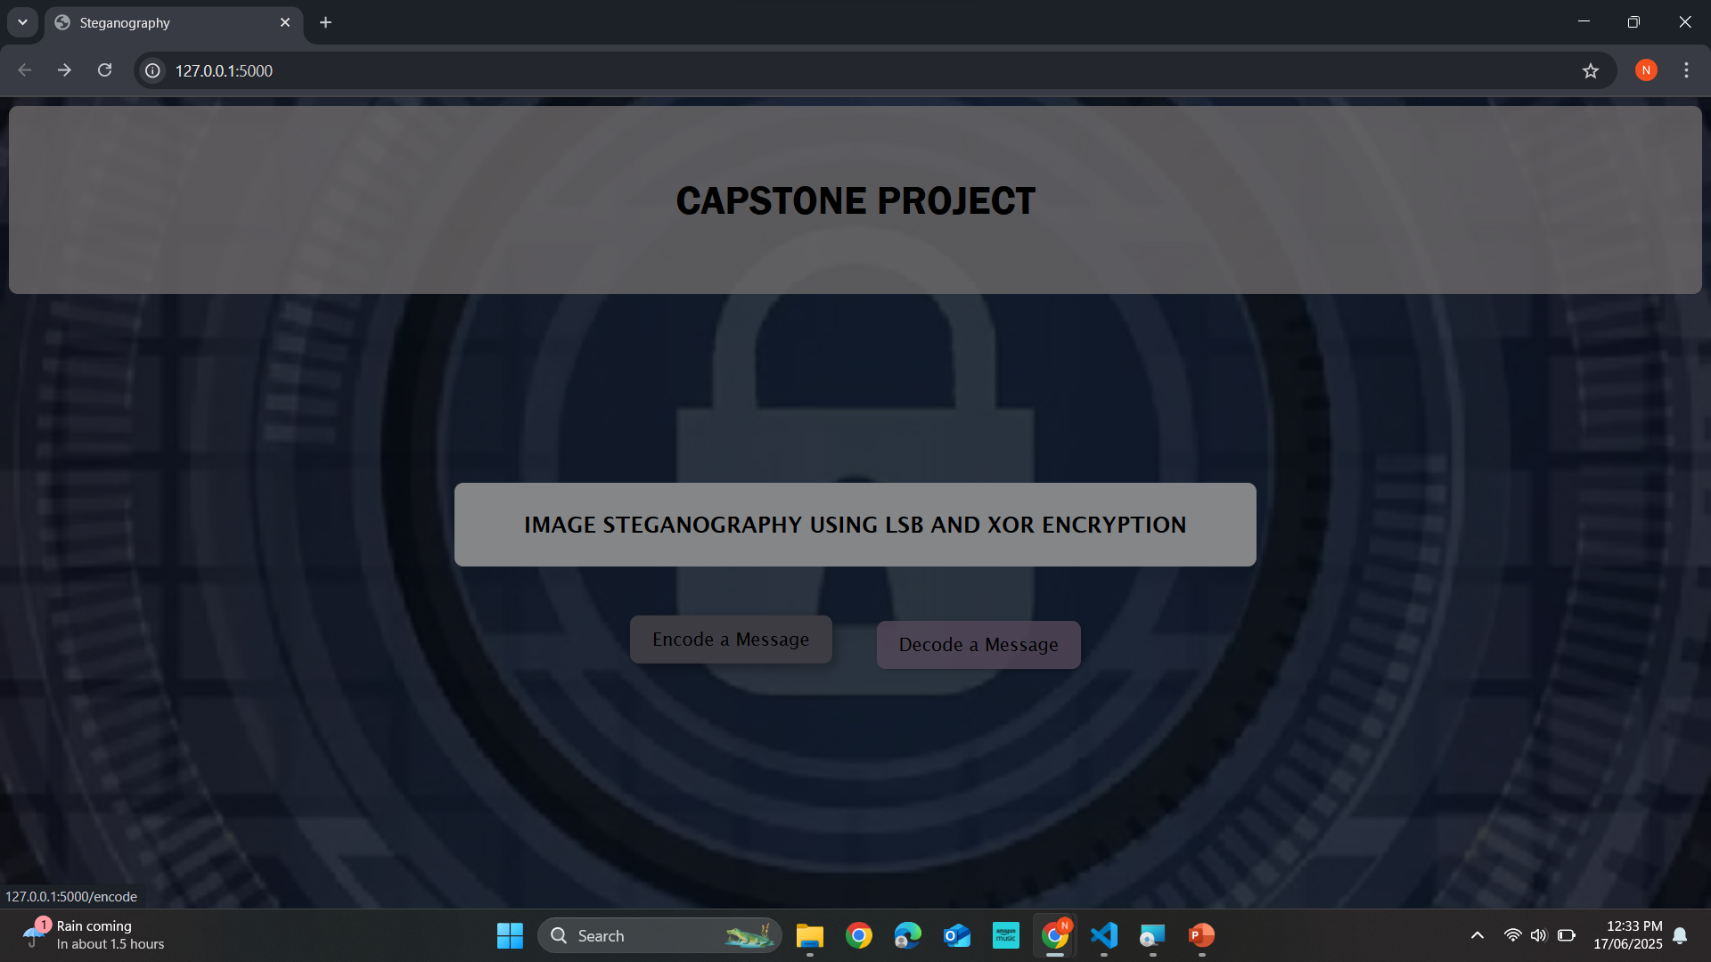
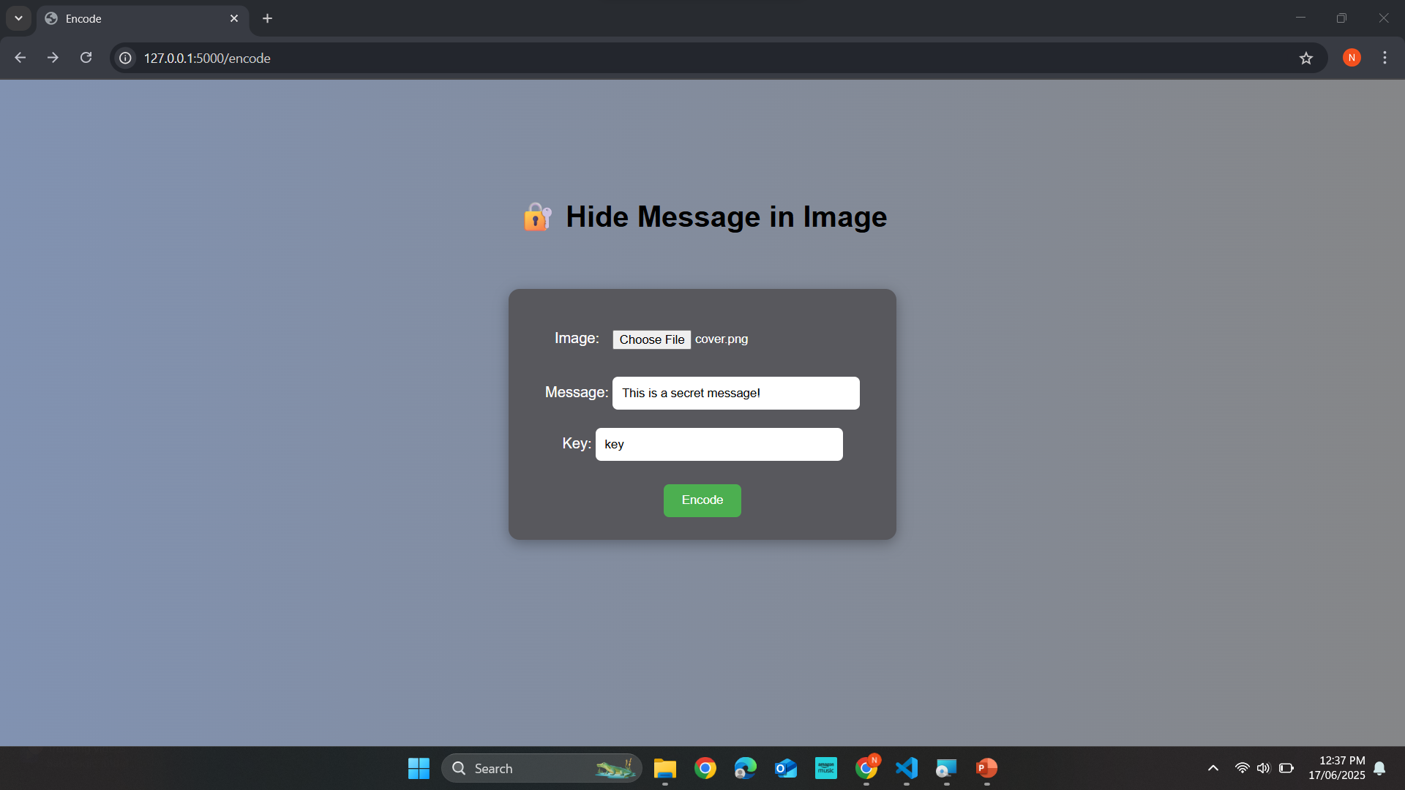
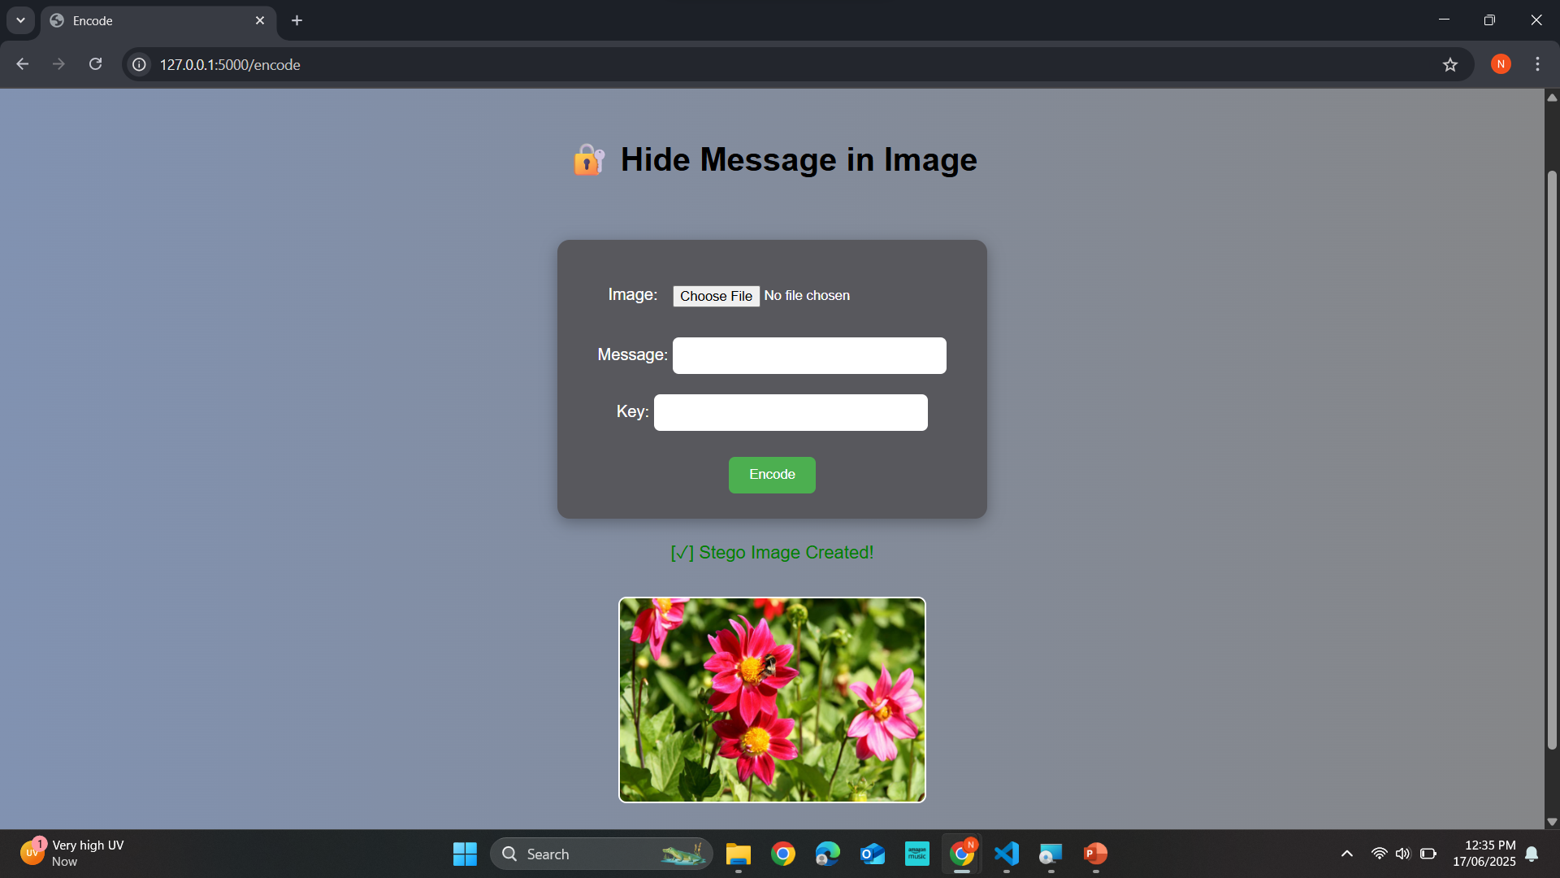
Result
Basic UI for the project, which on selection directs to the appropriate task page
Encode a message with a key

Slide 7
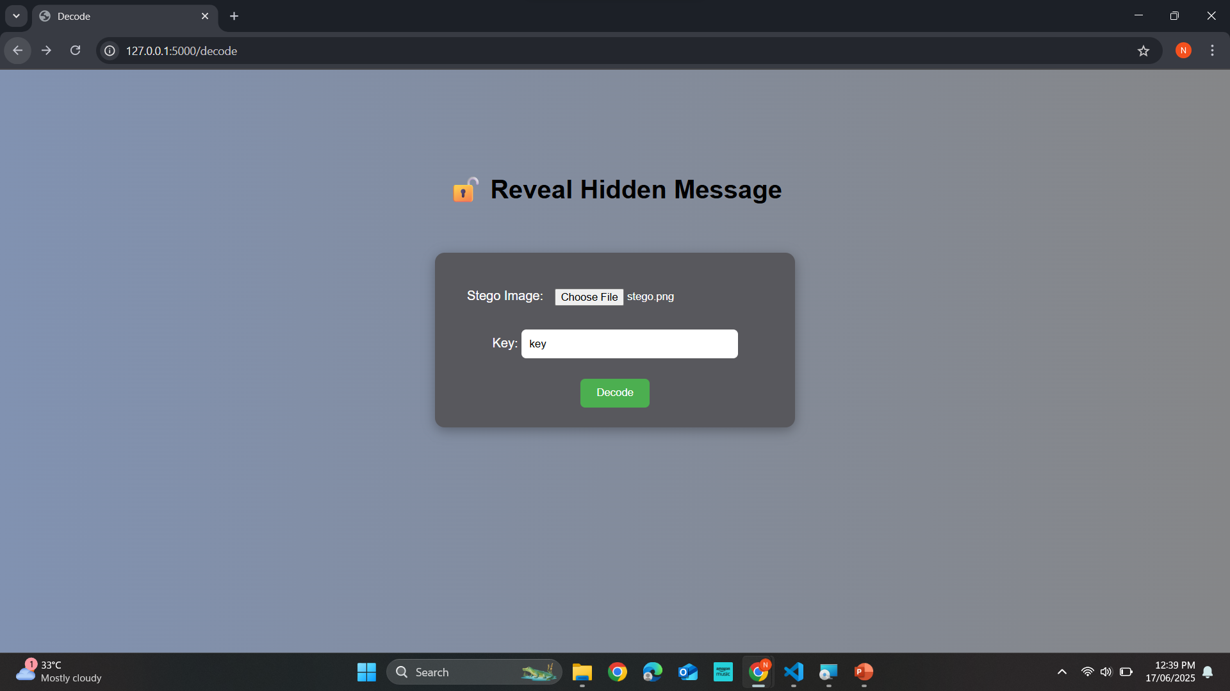
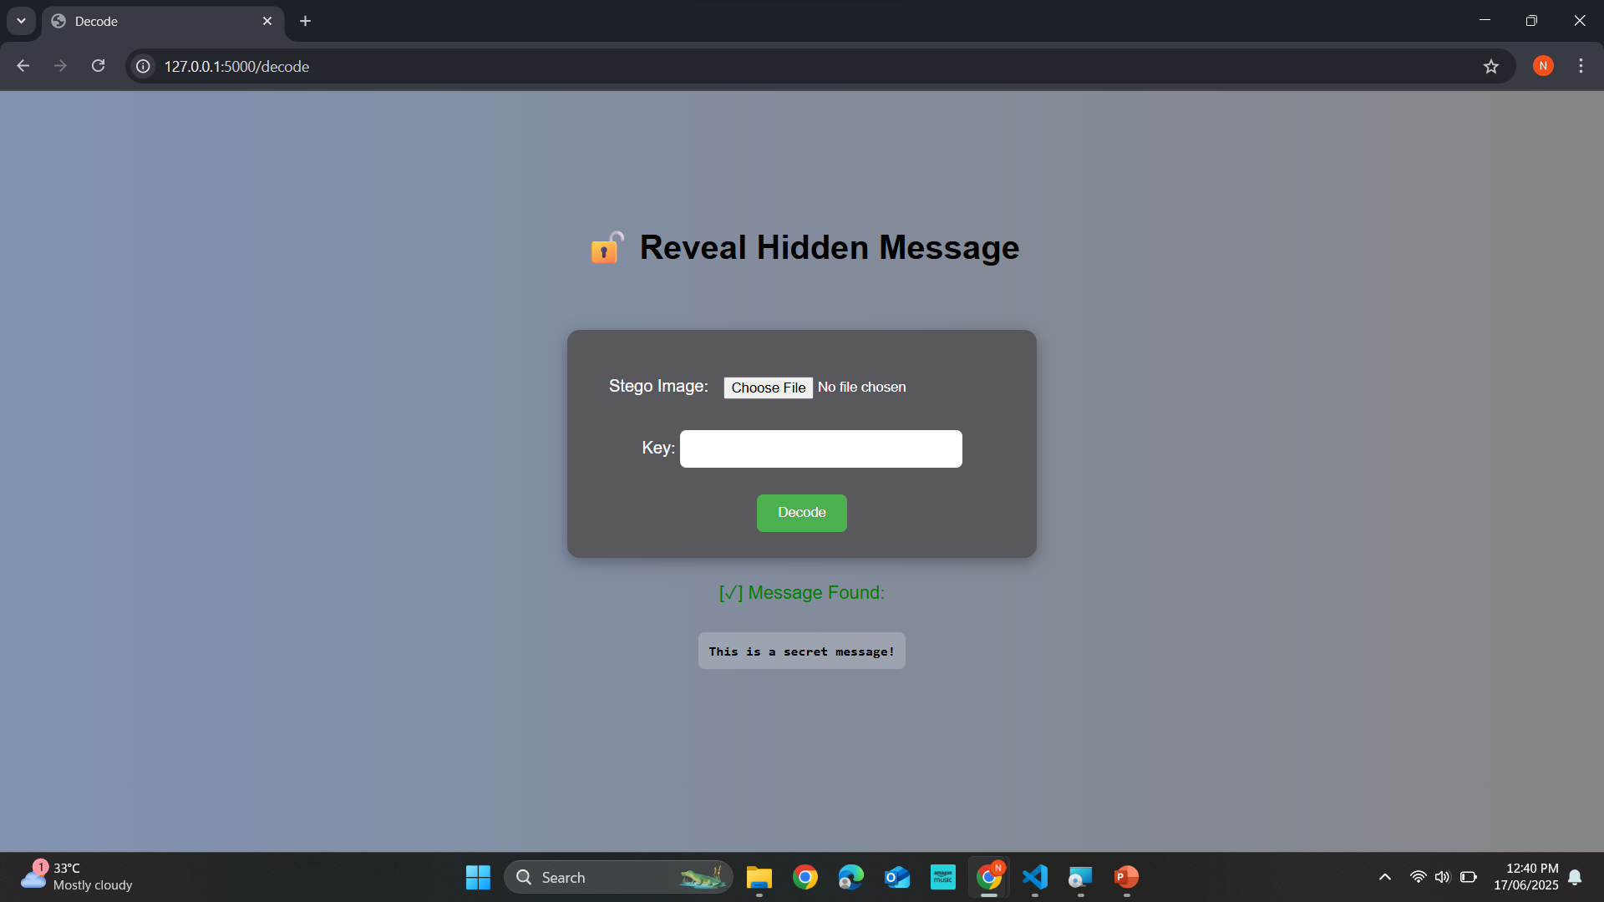
Decode a message when key is known
GITHUB LINK TO PROJECT:
https://github.com/NandhikaM/Image-Steganography-using-LSB-and-XOR-encryption

Slide 8
Conclusion
The project successfully demonstrates image steganography using LSB method along with XOR encryption for enhanced security.
The system hides text messages within images in a way that’s invisible to the human eye.
A Flask-based GUI makes the tool user-friendly and accessible.
This method offers basic confidentiality and can be extended for more robust use cases.

Slide 9
Future scope
Add AES/RSA encryption
Embed files, not just text
Add steganalysis detection/prevention
Host web GUI on Replit/Vercel

Slide 10
References
https://en.wikipedia.org/wiki/Steganography
https://flask.palletsprojects.com/
https://pillow.readthedocs.io/
https://numpy.org/
Class notes

Slide 11
THANK YOU

