Slide 1
XII Standard
Chapter-13
Python and CSV Files

Slide 2
Creating a CSV file using Notepad

Slide 3
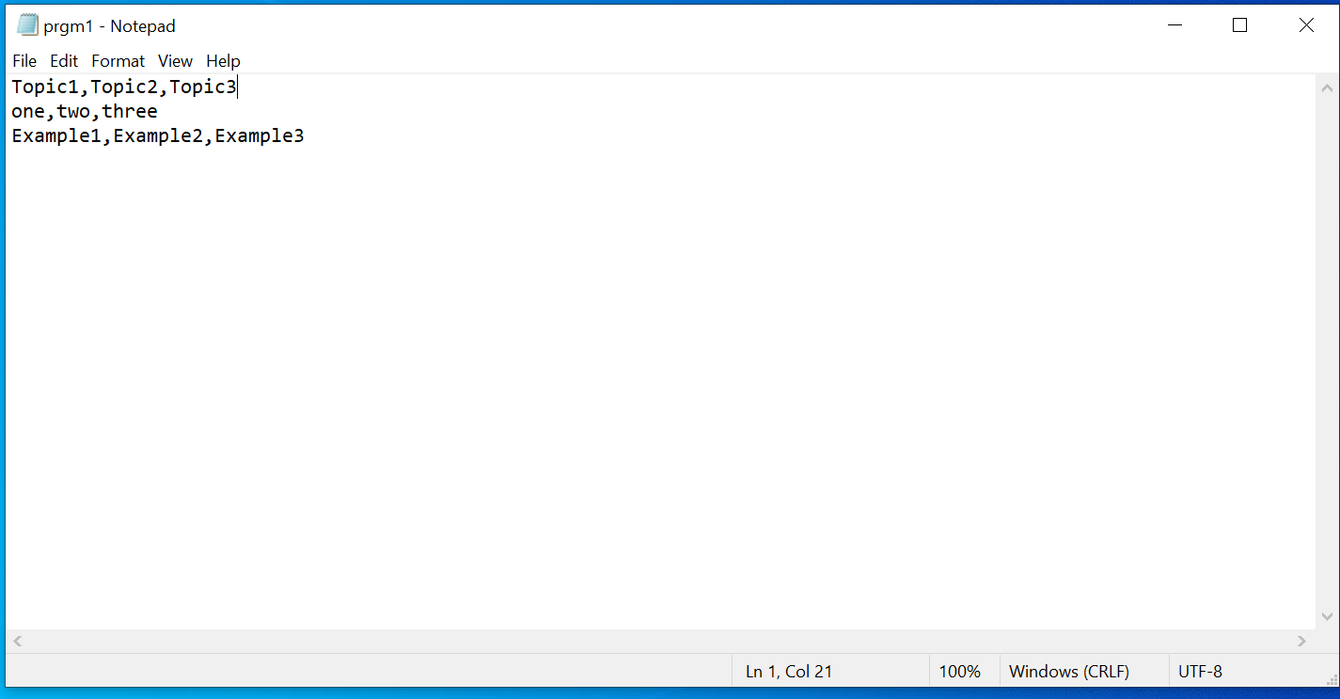

Slide 4
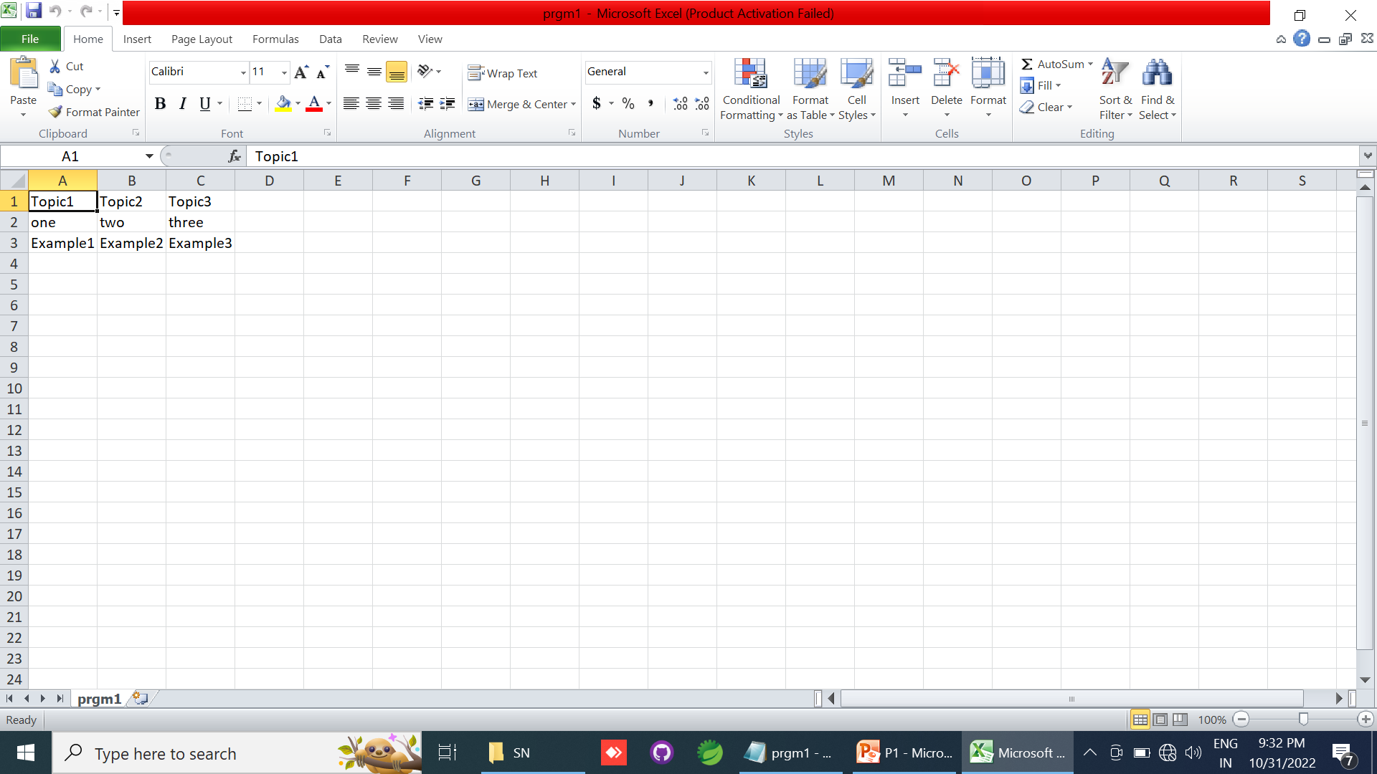

Slide 5
Creating a CSV file that contains Comma with data

Slide 6
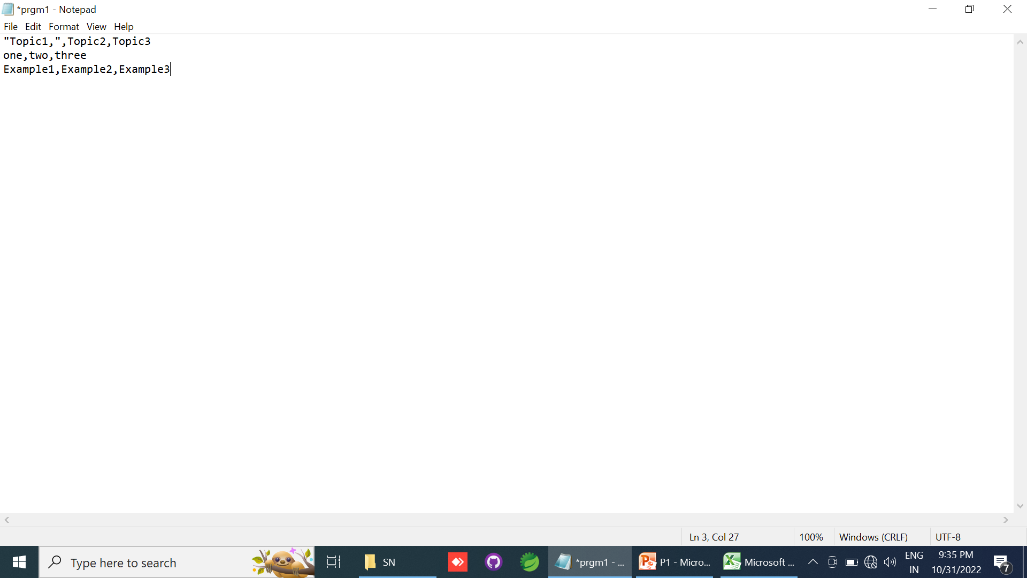

Slide 7
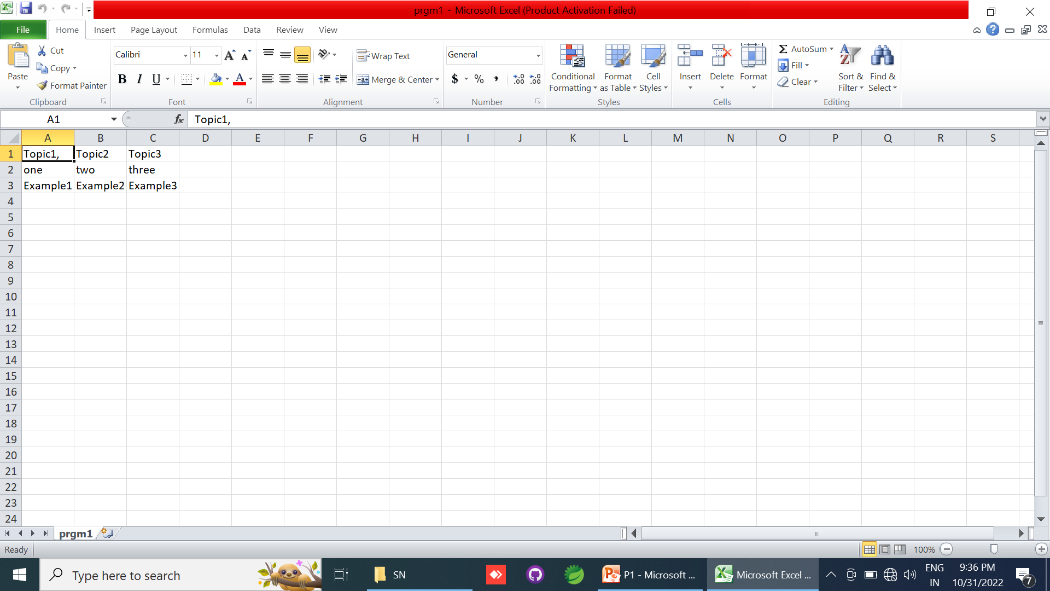

Slide 8


Slide 9
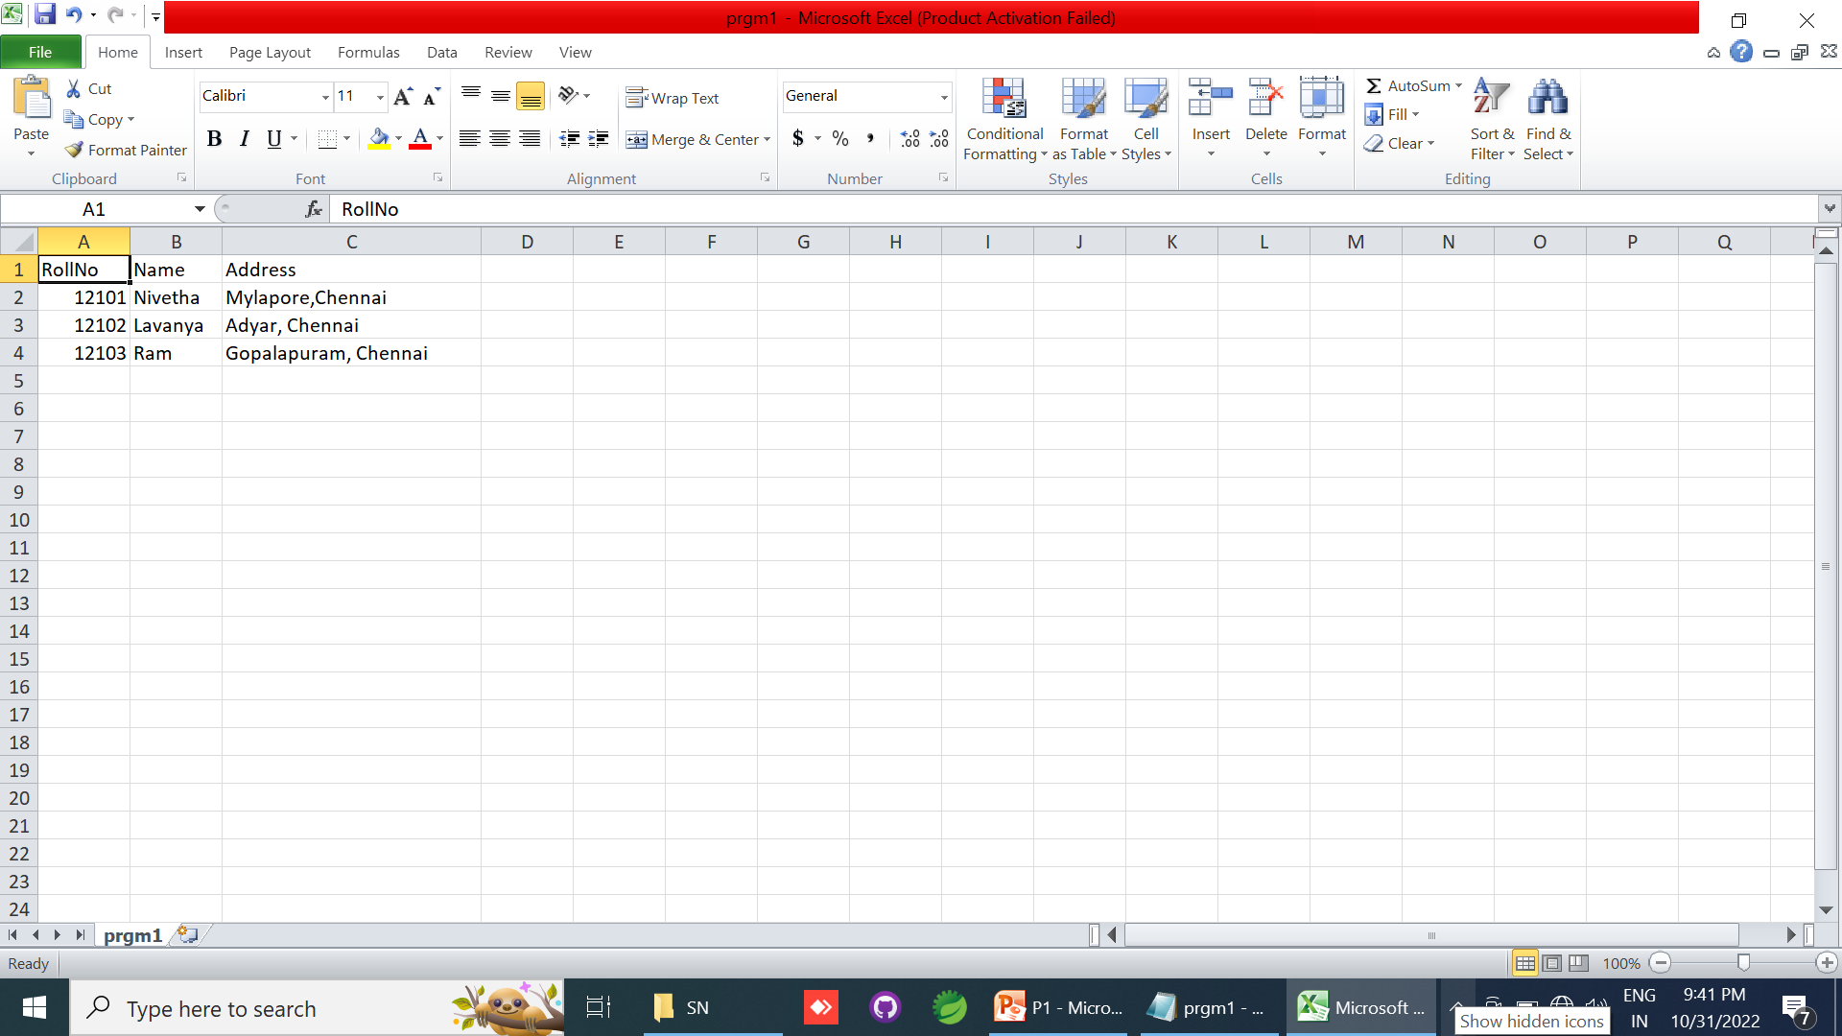

Slide 10
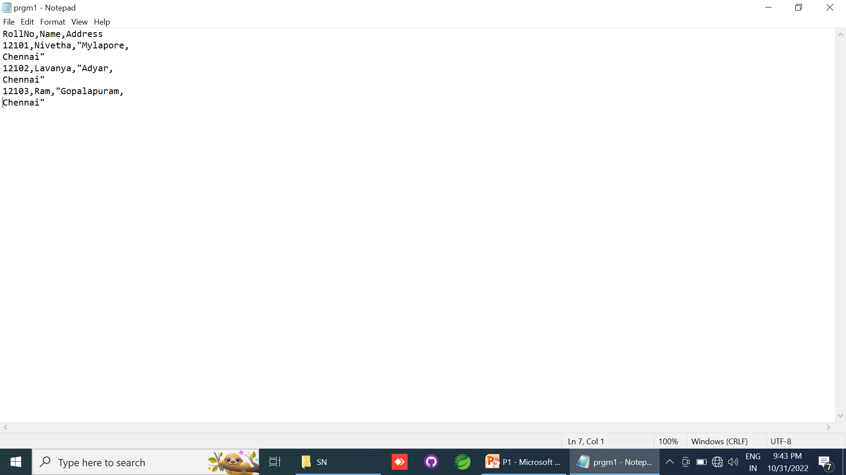

Slide 11
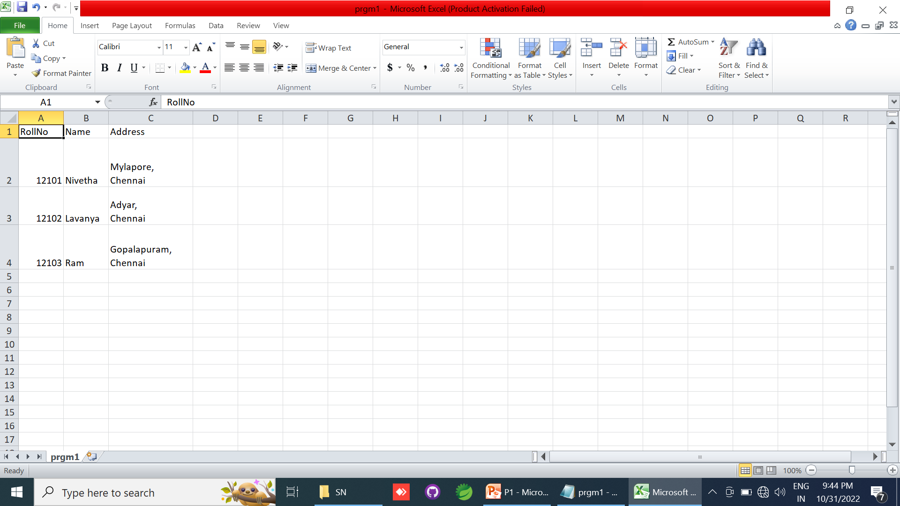

Slide 12
Creating a CSV file that contains Double Quotes With Data

Slide 13

“Mylapore”, “Chennai”
“”Mylapore””,””Chennai””
“””Mylapore””,””Chennai”””

Slide 14
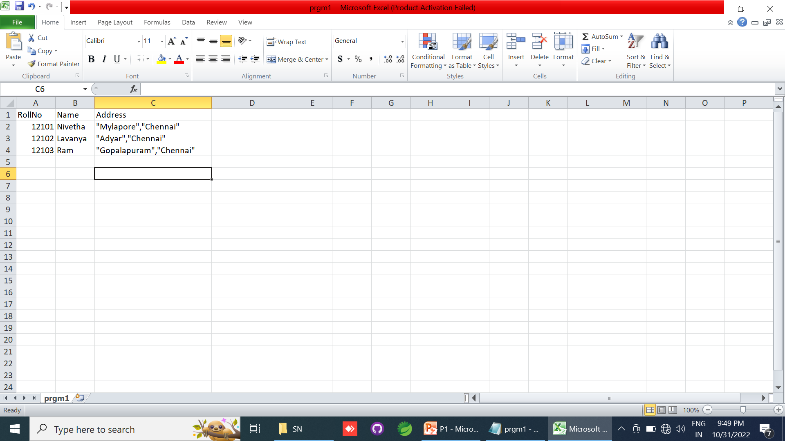

Slide 15
Rules to be followed to format data in a CSV file

Slide 16
topic1,topic2
topic3,topic4

Slide 17
Name,Roll No,City
1001,Raja,Erode

Slide 18
“Red”, “Blue”
Black, White

Slide 19
Red,Blue,Green
Red,”,”,Green

Slide 20
“Red”, “Blue”

Slide 21
,,White

Slide 22
Create a CSV File Using Microsoft Excel

Slide 23
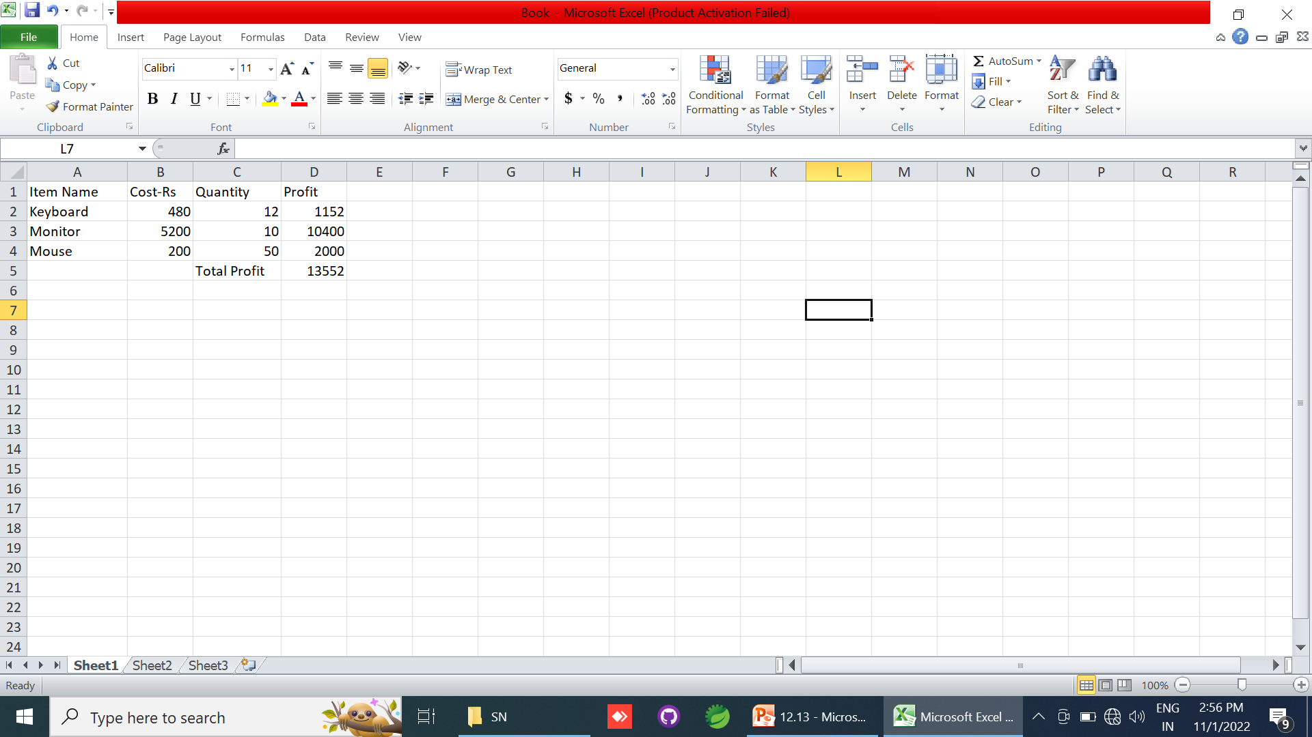

Slide 24


Slide 25
CSV file with default delimiter comma(,)

Slide 26


Slide 27


Slide 28
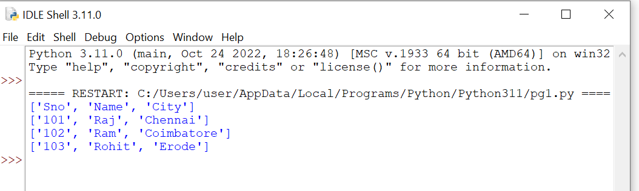

Slide 29
CSV file-data with Spaces at the beginning

Slide 30
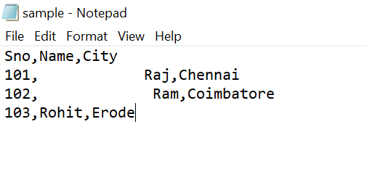

Slide 31
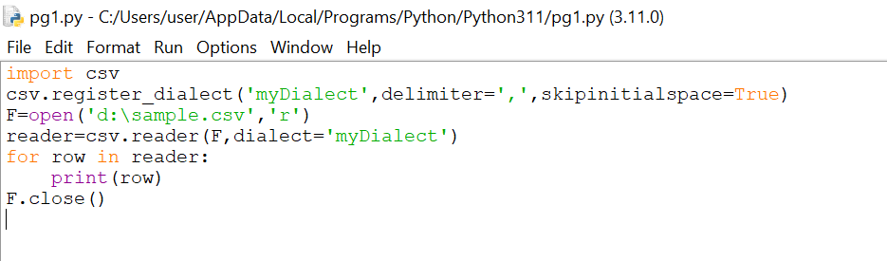

Slide 32


Slide 33
Thank You

