Slide 1

DJANGO
MS.NANDHINI
SOFTWARE DEVELOPER

Slide 2
Introduction to Django​
What is Python?​
What is Django?
Advantages of Django​
Django vs other web frameworks​
Setting up Django environment​
Models and Databases​
Introduction to Models and databases​
Setting up database​
Creating models​
Querying data from database​
Relationships between models​
SYLLABUS​

Slide 3
Views and Templates​
Introduction to Models and databases​
Setting up database​
Creating models​
Querying data from database​
Relationships between models​
Forms​
Introduction to Views and Templates​
Creating views and templates​
Passing data to templates​
Rendering templates​
SYLLABUS​

Slide 4
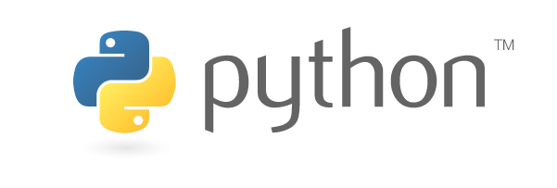
INTRODUCTION
Python is a high-level, versatile, and easy-to-read programming language. It is known for its simplicity and readability, making it an excellent choice for beginners and experienced developers alike. Python was created by Guido van Rossum and first released in 1991

Slide 5




Why we learn python?
Python is a beginner-friendly, versatile programming language with an easy-to-read syntax. It's widely used in fields like web development, data science, and automation. Key reasons to learn Python include its simplicity, extensive community support, and broad range of applications, making it a valuable skill for various industries and roles.

Slide 6
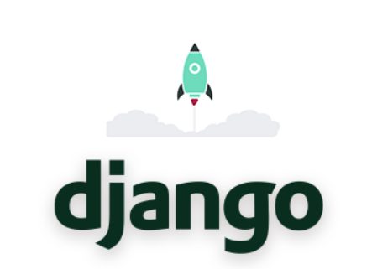
INTRODUCTION
Django is a high-level Python web framework that allows developers to create web applications quickly and easily. It follows the Model-View-Controller (MVT) architectural pattern and includes a set of built-in features that simplify common web development tasks, such as authentication, URL routing, database management, and more.​

Slide 7

INTRODUCTION
Django provides an Object-Relational Mapping (ORM) system that allows developers to interact with databases using Python objects, making it easier to manage and manipulate data. It also includes a templating engine that enables the creation of reusable templates for building web pages.

Slide 8
Advantages of Django
Easy and Fast Development: Django makes it easy to develop web applications quickly with minimal coding effort.
1
Scalability: Django can handle high-traffic sites and can scale up or down to meet the needs of the application.
2
Security: Django has built-in security features to protect against common web application security issues.
3
Versatility: Django can be used to build a wide range of web applications.
4
Community and Support: Django has a large and active community of developers who provide support and regularly update the framework.
5
Compatibility: Django works well with other technologies and can be easily integrated with other databases, front-end frameworks, and programming languages.
6

Slide 9
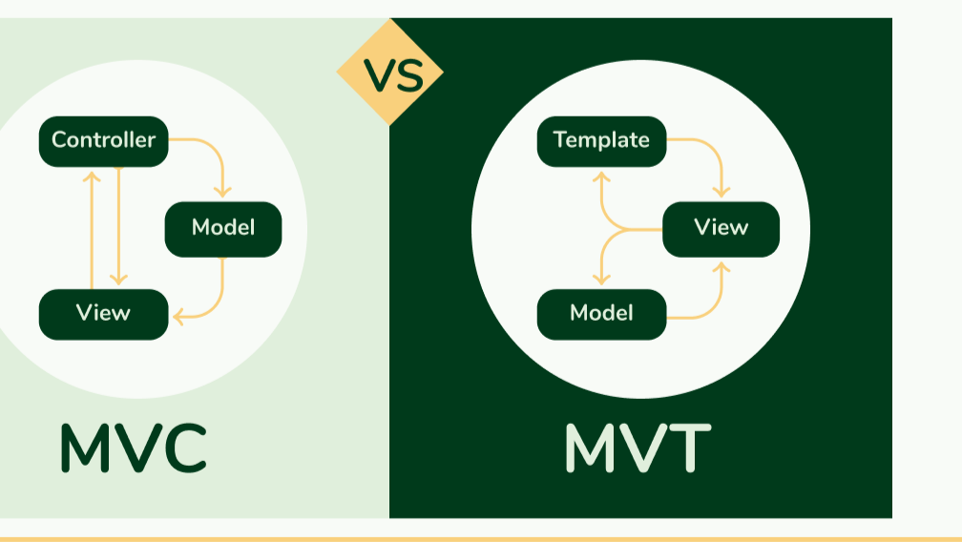

Slide 10
MVC VS MVT
In MVC, the Model represents the data and business logic, the View is responsible for presenting the data to the user, and the Controller handles user input and updates the Model and View accordingly.
In MVT, the Model represents the data and business logic, the View is responsible for presenting the data to the user, and the Template handles how the data is rendered in the HTML.

Slide 11
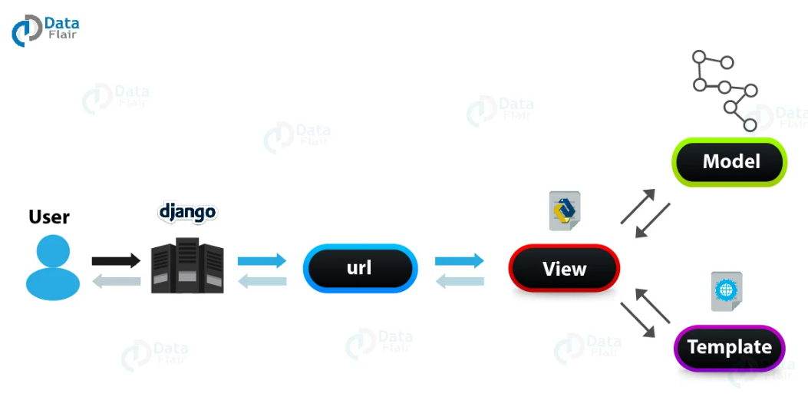

Slide 12
Virtual environment
A virtual environment in Django is a self-contained directory that contains all the necessary packages and dependencies for a specific Python project. It allows you to work on different projects with different requirements without conflicts between packages or versions.​
​
When you create a virtual environment, it creates a local copy of Python and pip (the package installer for Python) in a separate directory. You can then install packages and dependencies for your project within this environment, without affecting the global installation of Python on your system.​

Slide 13
Create virtual environment
Open a terminal or command prompt and navigate to the directory where you want to create your virtual environment.
Enter the following command to create a new virtual environment:
python -m venv myenv
Activate : myenv/bin/activate
Deactivate : myenv/bin/deactivate

Slide 14
SETTING UP DJNAGO ENVIRONMENT
Install Python
Install Django : pip install django
Choose a code editor - Visual Studio Code, PyCharm, Sublime Text, and Atom.
Create a new Django project:
django-admin startproject projectname
Run the development server:
python manage.py runserver
http://localhost:8000/

Slide 15
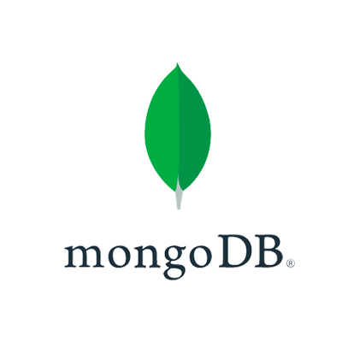
MongoDb
MongoDB is a popular NoSQL database that uses a document-oriented data model. It is designed to store, manage, and query large amounts of unstructured or semi-structured data. MongoDB is often used for a variety of applications, including web and mobile app development, content management systems, and more

Slide 16
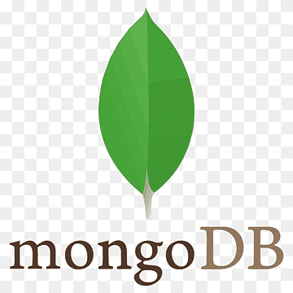
Db connection to MongoDB
To connect a Django project to a MongoDB database, you'll need to follow these steps:
You can download it from the official MongoDB website (https://www.mongodb.com/try/download/community) an
Make sure you have Django installed in your project. You can install Django using pip:
pip install pymongo=3.12.3 pip install djongo

Slide 17
Db connection to MongoDB
Configure the database settings in Django: In your Django project's settings.py file, you'll need to configure the DATABASES setting to use Mongodb. Here's an example:
DATABASES = {
'default': {
'ENGINE': 'djongo',
'NAME': 'your db name',
}
}

Slide 18
Step 1: Create Virutual Environment
To create a Python virtual environment using venv, you need to use the command-line interface, and the steps may vary slightly depending on your operating system. Below, I'll provide instructions for different operating systems.
python –m venv venvname
venvname\Scripts\activate
venvname\Scripts\decativate

Slide 19
Step 2: Install Django
Before you can use Django commands, you need to have Django installed. You can install it using pip:
pip install Django

Slide 20
Step 3: Create a Django Project
A Django project is the top-level container for your web application. To create a new project, use the following command (replace project name with your desired project name):
Django-admin startproject appname

Slide 21
Step 4: Create a Django Project
A Django project is the top-level container for your web application. To create a new project, use the following command (replace project name with your desired project name):
Django-admin startproject projectname

Slide 22
Step 5: Navigate to the Project Directory
Change your current directory to the project directory you just created:
Cd projectname

Slide 23
Step 6: Run the development runserver
You can start a development server to test your project locally. Run the following command:
python manage.py runserver

Slide 24
Step 7: Define Models
In your app's directory, define your data models in the models.py file. Models represent the structure of your database tables.

Slide 25
Step 8: Create a Django App
Django projects consist of one or more apps. An app is a self-contained module with its models, views, templates, and URLs. To create a new app, use this command:
python manage.py startapp appname

Slide 26
Step 9: Create Migrations
To create database tables based on your models, generate migrations using:
python manage.py makemigrations

Slide 27
Step 10: Apply Migrations
Apply the migrations to create the database tables
python manage.py migrate

Slide 28
Step 11: Create Superuser
Create an administrative superuser for the Django admin panel:
python manage.py createsuperuser

Slide 29
Python must know topics to learn django
Python syntax and basic concepts
Object-Oriented Programming (OOP)
Python data structures
Functions
File handling
String manipulation and regular expressions
Exception handling
Python modules and packages

Slide 30


THANK YOU

