Slide 1
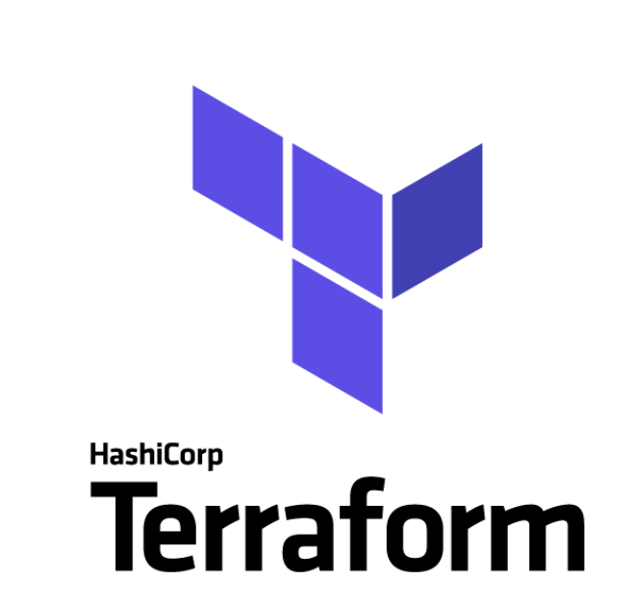
Terraform Training
Roshan Vadagovanur Chandrasekhar SM – Infra Dev Expert - CNAIP

Slide 2
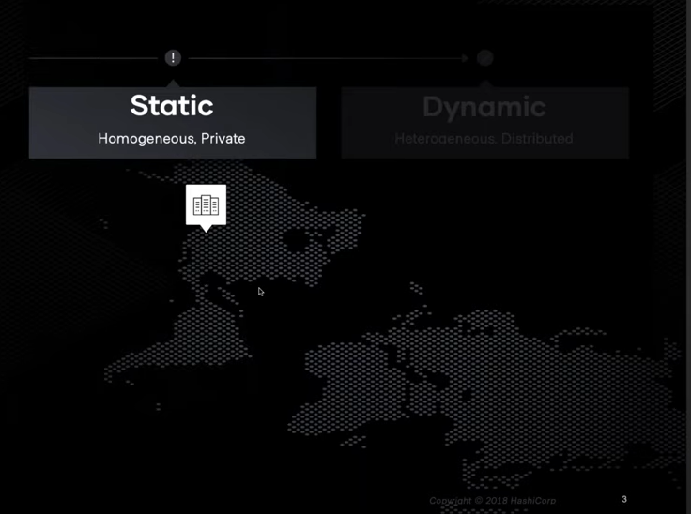
Why Infrastructure as Code
Traditional Infrastructure
Raise a Request very early for any infrastructure needs with operations team
Long waiting period
Difficult to make changes to the hardware once provisioned
Long workflows to provision new infrastructure
Scaling In/Out was difficult

Slide 3
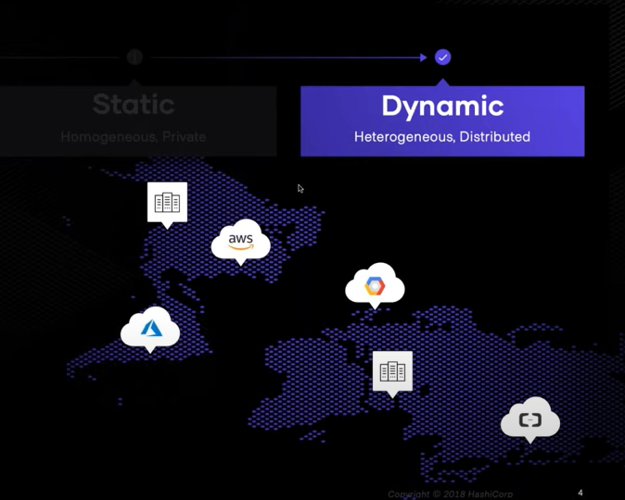
Why Infrastructure as Code
Dynamic Infrastructure
Infrastructure provision automated using code
No waiting period
Easy to make changes in the infrastructure
Reliable and tested infrastructure for applications to use
Scaling In/Out can be easily achieved

Slide 4
What is Infrastructure as Code?
Infrastructure as Code (IaC) is the process of managing and provisioning cloud infrastructure with machine-readable definition files.
It allows users to easily edit and distribute configurations while ensuring the desired state of the infrastructure
Create reproducible infrastructure configurations.
Allows infrastructure to be easily integrated into version control mechanisms
Provides the ability to introduce extensive automation for infrastructure management
Eliminates the need for manual infrastructure provisioning and management.

Slide 5
What is Infrastructure as Code?
Different approaches of IaC
An imperative approach allows users to specify the exact steps to be taken for a change, and the system does not deviate from the specified steps.
A declarative approach essentially means users only need to define the end requirement, and the specific tool or platform handles the steps to take in order to achieve the defined requirement.

Slide 6
Introduction to Terraform
History of Terraform
Terraform was created based on the idea of having an open source, cloud-agnostic solution; a tool that could provide the same workflows, no matter what cloud you were using.
Terraform 0.1 version was first released in July 2014
An Enterprise version of Terraform was first released in 2018.
Most impactful release of Terraform was 0.12

Slide 7
Introduction to Terraform
What is Terraform ?
HashiCorp Terraform is an infrastructure as code tool
Define both cloud and on-prem resources in human-readable configuration files
Version the configuration files in any version control system
Reuse the configuration files
Share the code and collaborate with different teams
Consistent workflow to provision and manage all of your infrastructure throughout its lifecycle.
It ships as a single binary which is written in Go. Terraform is cross platform and can run on Linux, Windows, or MacOS.
Installing terraform is easy. You simply download a zip file, unzip it, and run it.

Slide 8
Why Terraform?
Manage any infrastructure (multi cloud, Hybrid, On Prem )
Track your infrastructure
Automate changes
Standardize configurations
Collaborate
Migrate from other cloud providers
Increase provisioning speed
Improve efficiency
Reduce risk
Apply incremental changes
Destroy when needed
Preview Changes
Scale Easily

Slide 9
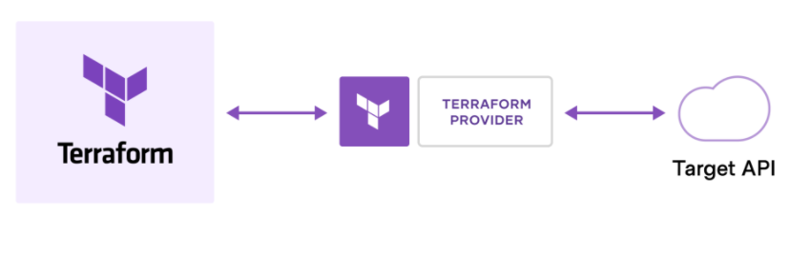
How Terraform Works?
Terraform creates and manages resources on cloud platforms and other services through their application programming interfaces (APIs)
Providers enable Terraform to work with virtually any platform or service with an accessible API.
HashiCorp and the Terraform community have already written more than 1700 providers to manage thousands of different types of resources and services

Slide 10
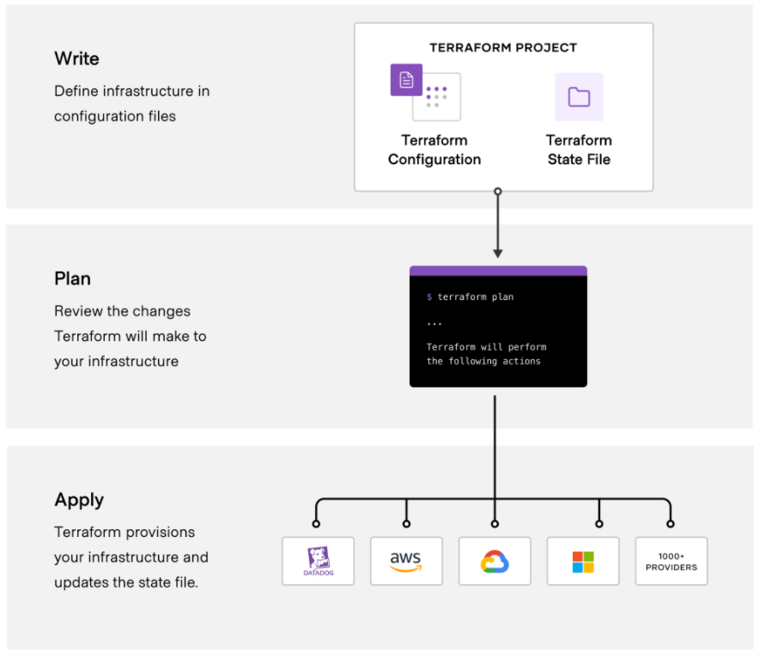
How Terraform Works?

Slide 11
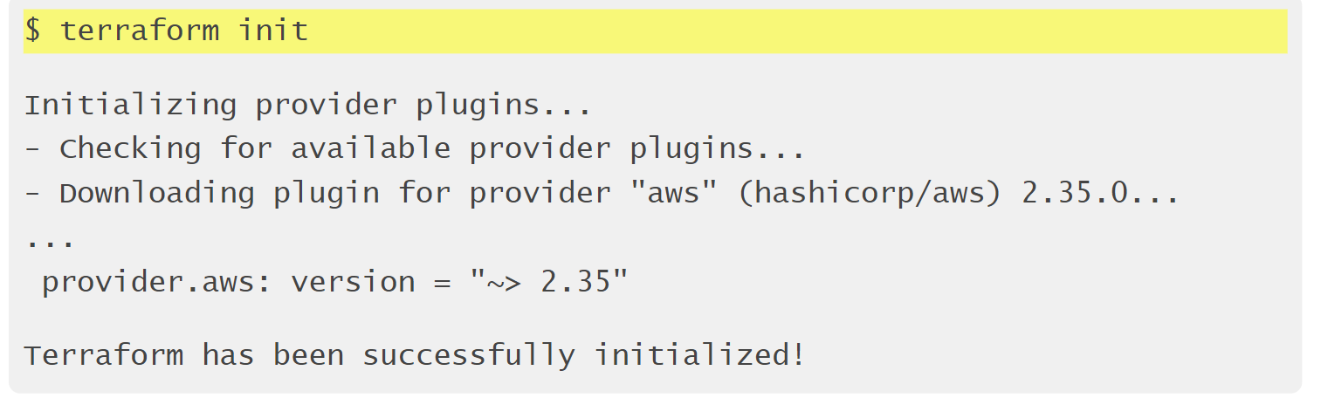
Terraform init
Terraform fetches any required providers and modules and stores them in the .terraform directory. If you add, change or update your modules or providers you will need to run init again

Slide 12
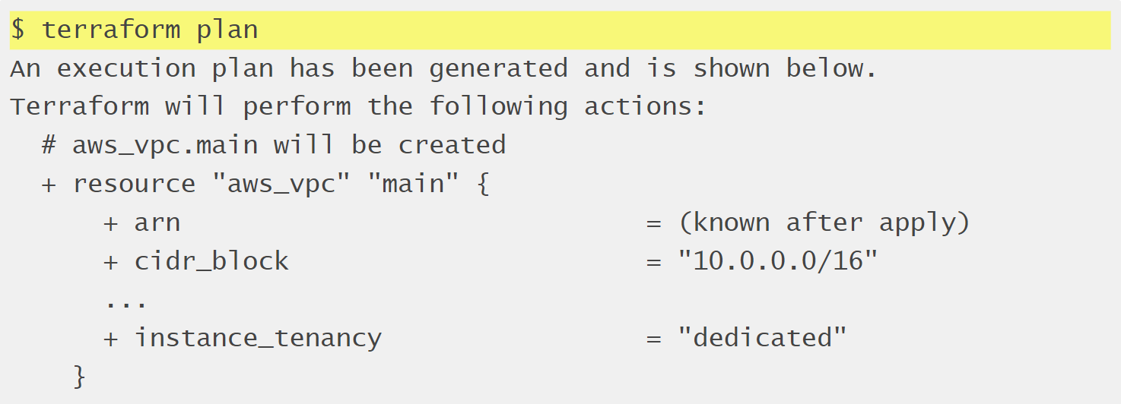
Terraform plan
Preview your changes with terraform plan before you apply them.
+ - New changes
- deletions
~ - updation

Slide 13
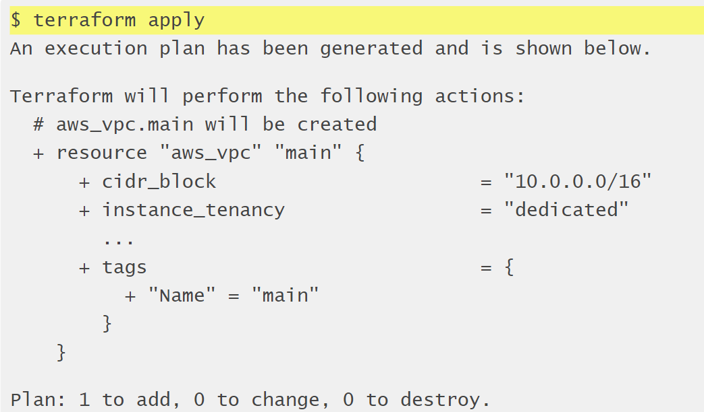
Terraform Apply
terraform apply runs a plan and then if you approve, it applies the changes.

Slide 14
Terraform vs Alternatives
 | Chef | Puppet | Ansible | CloudFormation | Terraform
Cloud |  | All | All | AWS | All
Type | Configuration management | Configuration management | Configuration management | Provisioning | Provisioning
Infrastructure | Mutable | Mutable | Mutable | Immutable | Immutable
Language | Procedural | Declarative | Procedural | Declarative | Declarative
Architecture | Client-Server | Client-Server | Client Only | Client only | Client only
Lifecycle management(State) | No | No | No | No | Yes
VM provisioning | Partial | Partial | Partial | Partial | Yes
Networking | Partial | Partial | Partial | Partial | Yes
Storage Management | Partial | Partial | Partial | Partial | Yes
Configuration
Packaging | Yes | Yes | Yes | Partial | Partial
Templating | Yes | Yes | Yes | Partial | Partial

Slide 15
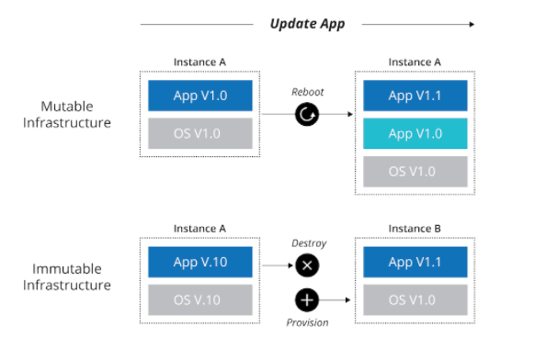
Mutable vs Immutable

Slide 16
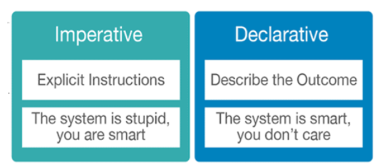
Procedural vs Declarative

Slide 17
Terraform Installation & Validation
Terraform can be downloaded from the HashiCorp Terraform website :
https://www.terraform.io/
Installation steps in RHEL/Amazon Linux/CentOS
sudo yum install -y yum-utils
sudo yum-config-manager --add-repo https://rpm.releases.hashicorp.com/AmazonLinux/hashicorp.repo
sudo yum -y install terraform

Slide 18
Terraform Installation & Validation
Configuration steps in Windows
Go to Control Panel -> System -> System settings -> Environment Variables.
Scroll down in system variables until you find PATH.
Click edit and add the path where you have placed the Terraform Binary
BE SURE to include a semicolon at the end of the previous as that is the delimiter, i.e. c:\path;c:\path2
Launch a new console for the settings to take effect.

Slide 19
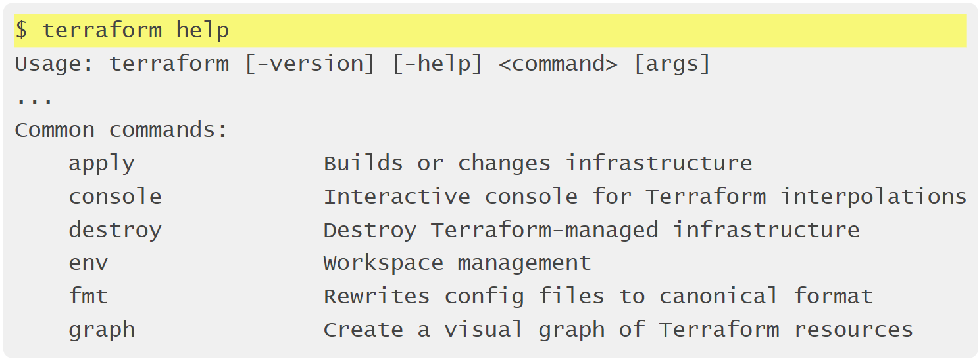
Terraform Installation & Validation
Type terraform subcommand help to view help on a particular subcommand.

Slide 20
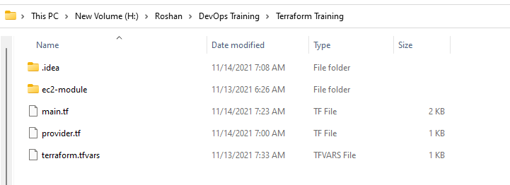
Terraform Language
Files and Directories
File Extension
Code in the Terraform language is stored in plain text files with the .tf file extension
Text Encoding
Configuration files must always use UTF-8 encoding
Directories/Modules
A module is a collection of .tf files kept together in a directory.
A Terraform module only consists of the top-level configuration files in a directory; nested directories are treated as completely separate modules, and are not automatically included in the configuration.

Slide 21
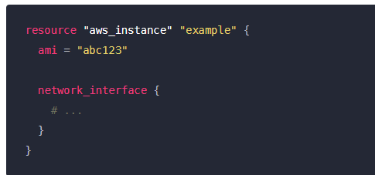

Terraform Language
Syntax
Configuration Syntax
The native syntax of the Terraform language, which is a rich language designed to be relatively easy for humans to read and write.
This low-level syntax of the Terraform language is defined in terms of a syntax called HCL
Arguments
An argument assigns a value to a particular name
Blocks
A block is a container for other content:

Slide 22
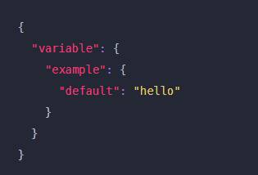
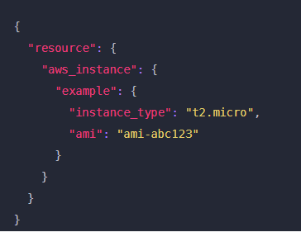
Terraform Language
Json Configuration Syntax
Terraform also supports an alternative syntax that is JSON-compatible.
This syntax is useful when generating portions of a configuration programmatically, since existing JSON libraries can be used to prepare the generated configuration files.
Terraform expects native syntax for files named with a .tf suffix, and JSON syntax for files named with a .tf.json suffix.

Slide 23
Terraform Providers
Terraform relies on plugins called "providers" to interact with remote systems. Terraform configurations must declare which providers they require, so that Terraform can install and use them.
What Providers Do
Each provider adds a set of resource types and/or data sources that Terraform can manage.
Every resource type is implemented by a provider; without providers, Terraform can't manage any kind of infrastructure.
Where Providers Come From
Providers are distributed separately from Terraform itself, and each provider has its own release cadence and version numbers.

Slide 24
Terraform Providers
Provider Configuration
Providers allow Terraform to interact with cloud providers, SaaS providers, and other APIs.
Provider configurations belong in the root module of a Terraform configuration.
Every resource type is implemented by a provider; without providers, Terraform can't manage any kind of infrastructure.
provider "aws" {
region = "us-east-1"
access_key = “A2wdf033”
secret_key = “032ksdf932332434”
}

Slide 25
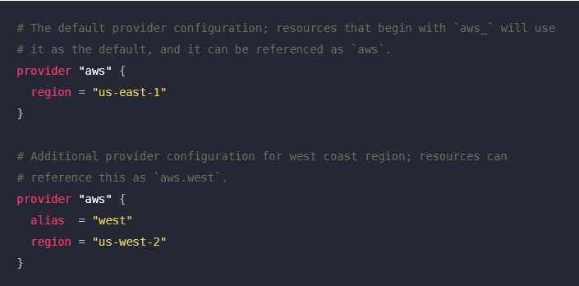
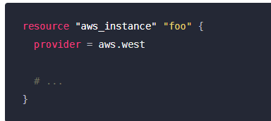
Terraform Providers
alias: Multiple Provider Configurations
A provider block without an alias argument is the default configuration for that provider
To use an alternate provider configuration for a resource or data source, set its provider meta-argument to a <PROVIDER NAME>.<ALIAS> reference:

Slide 26
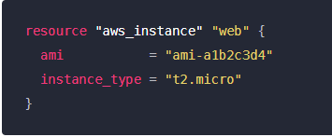
Terraform Resources
Resources are the most important element in the Terraform language
Each resource block describes one or more infrastructure objects, such as virtual networks, compute instances, or higher-level components such as DNS records.
Resource Syntax
Resource Types
Each resource is associated with a single resource type, which determines the kind of infrastructure object it manages and what arguments and other attributes the resource supports.

Slide 27
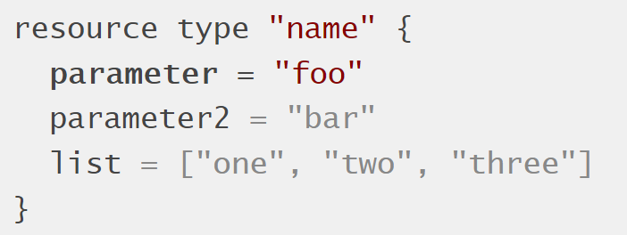
Terraform Resources
Anatomy of a Resource
Every terraform resource is structured exactly the same way
resource = Top level keyword
type = Type of resource. Example: aws_instance.
name = Arbitrary name to refer to this resource. Used internally by terraform. This field cannot be a variable.

Slide 28
Terraform Resources
Resource Behavior
Create resources that exist in the configuration but are not associated with a real infrastructure object in the state.
Destroy resources that exist in the state but no longer exist in the configuration.
Update in-place resources whose arguments have changed.
Destroy and re-create resources whose arguments have changed but which cannot be updated in-place due to remote API limitations.
Resource Dependencies
Most resources in a configuration don't have any particular relationship, and Terraform can make changes to several unrelated resources in parallel.
Resource dependencies are handled automatically by Terraform

Slide 29
Terraform Resources
Meta-Arguments
Terraform language defines several meta-arguments, which can be used with any resource type to change the behavior of resources.
depends_on
count
for_each
provider
lifecycle
provisioner

Slide 30
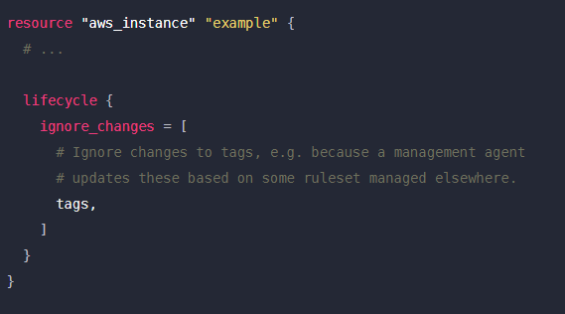
Terraform Resources
Meta-Argument: lifecycle
Syntax and Arguments
create_before_destroy – boolean
prevent_destroy – boolean
ignore_changes - list
resource "aws_instance“ “ec2instance” {
#.....
lifecycle {
create_before_destroy = true
}
}

Slide 31
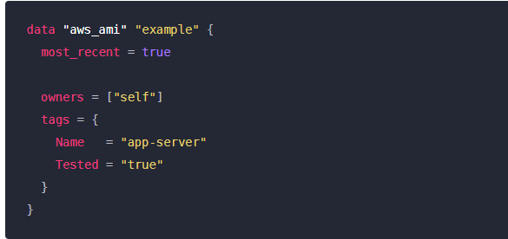
Terraform DataSources
Data sources allow Terraform to use information defined outside of Terraform, defined by another separate Terraform configuration, or modified by functions.
A data source is accessed via a special kind of resource known as a data resource, declared using a data block
If the query constraint arguments for a data resource refer only to constant values or values that are already known, the data resource will be read prior to creating a plan.
Query constraint arguments may refer to values that cannot be determined until after configuration is applied. In this case, reading from the data source is deferred until the apply phase

Slide 32
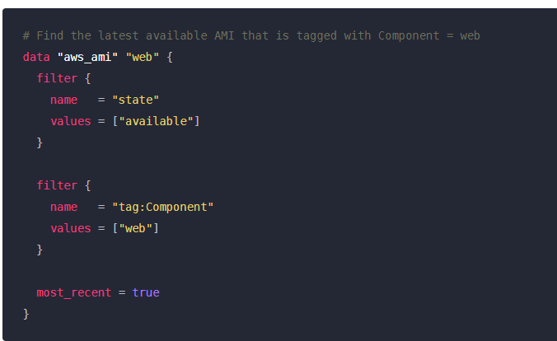
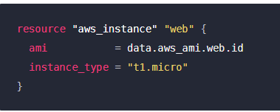
Terraform DataSources
Example
Each data instance will export one or more attributes, which can be used in other resources as reference expressions of the form data.<TYPE>.<NAME>.<ATTRIBUTE>.

Slide 33
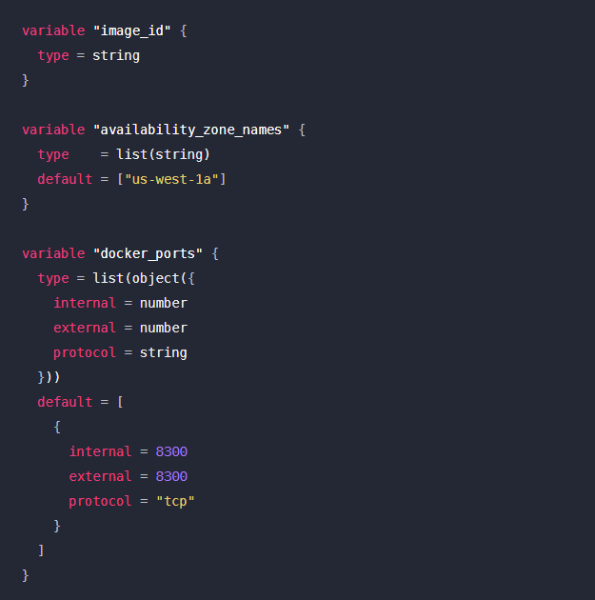
Terraform Variables
Declaring an Input Variable
Each input variable accepted by a module must be declared using a variable block
The label after the variable keyword is a name for the variable, which must be unique among all variables
The name of a variable can be any valid identifier except the following: source, version, providers, count, for_each, lifecycle, depends_on, locals.

Slide 34
Terraform Variables
Arguments
default - A default value which then makes the variable optional.
type - This argument specifies what value types are accepted for the variable.
description - This specifies the input variable's documentation.
validation - A block to define validation rules, usually in addition to type constraints.
sensitive - Limits Terraform UI output when the variable is used in configuration.
nullable - Specify if the variable can be null within the module.

Slide 35
Terraform Variables
Type constraints
The type argument in a variable block allows you to restrict the type of value that will be accepted as the value for a variable.
If no type constraint is set then a value of any type is accepted.
Type constraints are created from a mixture of type keywords and type constructors. The supported type keywords are:
string a sequence of Unicode characters representing some text, like "hello"
number a numeric value. The number type can represent both whole numbers like 15 and fractional values like 6.283185.
bool a boolean value, either true or false

Slide 36
Terraform Variables
Type constraints
The type constructors allow you to specify complex types such as collections:
list(<TYPE>) a sequence of values, like ["us-west-1a", "us-west-1c"]
set(<TYPE>) a sequence of values
map(<TYPE>) a group of values identified by named labels, like {name = "Mabel", age = 52}.
object({<ATTR NAME> = <TYPE>, ... }) a group of values identified by named labels, like {name = "Mabel", age = 52}.
tuple([<TYPE>, ...]) a sequence of values, like ["us-west-1a", "us-west-1c"]
any

Slide 37
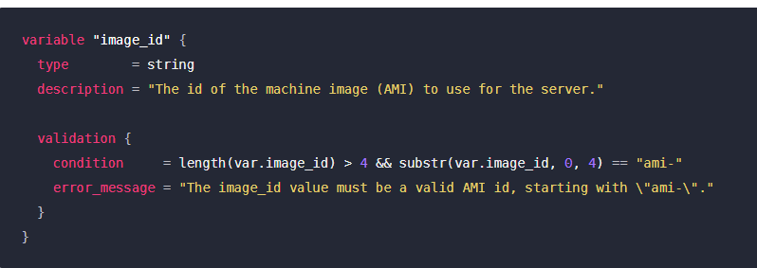
Terraform Variables
Variable Value Validation
In addition to Type Constraints, custom validation rules for a particular variable can be specified using a validation block nested within the corresponding variable block
The condition argument is an expression that must use the value of the variable to return true

Slide 38
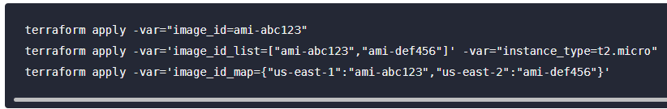
Terraform Variables
Variables on the Command Line
To specify individual variables on the command line, use the -var option when running the terraform plan and terraform apply commands:

Slide 39
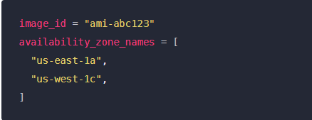
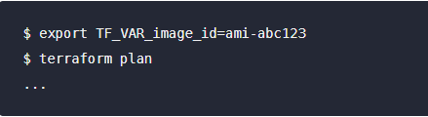
Terraform Variables
Variable Definitions (.tfvars) Files
To set lots of variables, it is more convenient to specify their values in a variable definitions file (with a filename ending in either .tfvars or .tfvars.json) and then specify that file on the command line with -var-file:
A variable definitions file uses the same basic syntax as Terraform language files, but consists only of variable name assignments
Terraform also automatically loads a number of variable definitions files if they are present:
Files named exactly terraform.tfvars or terraform.tfvars.json.
Any files with names ending in .auto.tfvars or .auto.tfvars.json.
Environment Variables
Terraform searches the environment of its own process for environment variables named TF_VAR_ followed by the name of a declared variable.

Slide 40
Terraform Variables
Variable precedence
Terraform loads variables in the following order, with later sources taking precedence over earlier ones:
Environment variables
The terraform.tfvars file, if present.
The terraform.tfvars.json file, if present.
Any *.auto.tfvars or *.auto.tfvars.json files, processed in lexical order of their filenames.
Any -var and -var-file options on the command line, in the order they are provided.

Slide 41
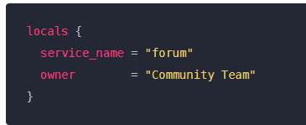
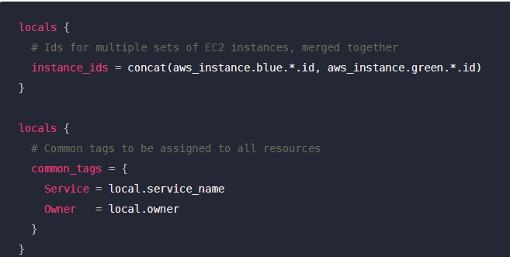
Terraform Variables
Local Values
Declaring a Local Value
A set of related local values can be declared together in a single locals block:
Local Values
Using Local Values
Once a local value is declared, you can reference it as local.<NAME>.

Slide 42
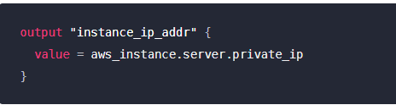
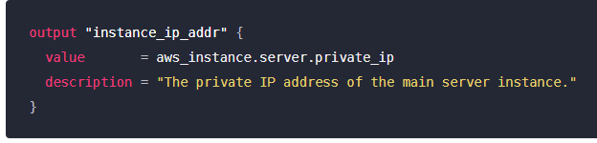
Terraform Output
Output values are similar to return values in programming languages.
Declaring an Output Value
Each output value exported by a module must be declared using an output block
output blocks can optionally include description, sensitive, and depends_on arguments, which are described in the following sections.

Slide 43
Terraform String Templates
Interpolation
A ${ ... } sequence is an interpolation, which evaluates the expression given between the markers, converts the result to a string if necessary, and then inserts it into the final string

Slide 44

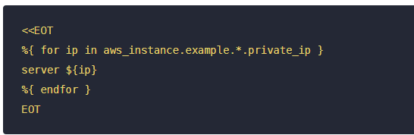
Terraform String Templates
Directives
A %{ ... } sequence is a directive, which allows for conditional results and iteration over collections, similar to conditional and for expressions.
The following directives are supported:
The %{if <BOOL>}/%{else}/%{endif} directive chooses between two templates based on the value of a bool expression:
The %{for <NAME> in <COLLECTION>} / %{endfor} directive iterates over the elements of a given collection or structural value and evaluates a given template once for each element, concatenating the results together

Slide 45
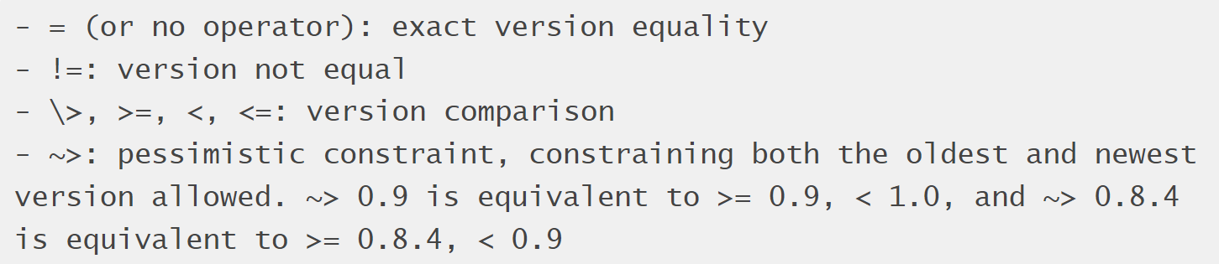
Terraform Operators
Arithmetic Operators : +, -, *, /, %
Equality Operators: ==, !=
Comparison Operators : < , <=, >,>=
Logical Operators: ||, &&, !
Versioning Operators :

Slide 46


Terraform For Expression
A for expression creates a complex type value by transforming another complex type value.
Each element in the input value can correspond to either one or zero values in the result
Filtering Elements
A for expression can also include an optional if clause to filter elements from the source collection, producing a value with fewer elements than the source value

Slide 47
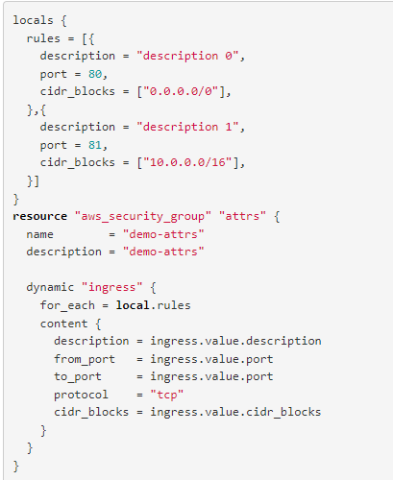
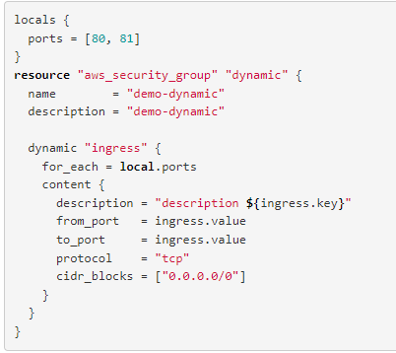
Terraform Dynamic blocks
A dynamic block acts much like a for expression, but produces nested blocks instead of a complex typed value.
It iterates over a given complex value, and generates a nested block for each element of that complex value.

Slide 48
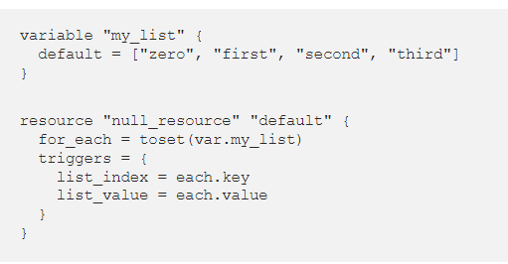
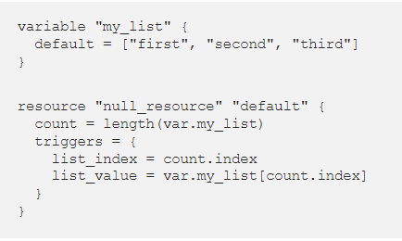
Terraform count and for_each
count is a meta-argument defined by the Terraform language.
It can be used with modules and with every resource type.
The count meta-argument accepts a whole number, and creates that many instances of the resource or module.
count is sensible for any changes in list order, this means that if for some reason order of the list is changed, terraform will force replacement of all resources of which the index in the list has changed
for_each is a meta-argument defined by the Terraform language.
It can be used with modules and with every resource type.
The for_each meta-argument accepts a map or a set of strings, and creates an instance for each item in that map or set.
for_each helps to avoid accidental / unwanted recreation of resource instances when a input list (or just it’s order) has been modified.

Slide 49
Terraform Built in Functions
The Terraform language includes a number of built-in functions that you can call from within expressions to transform and combine values.
The general syntax for function calls is a function name followed by comma-separated arguments in parentheses:
max(5, 12, 9)
The Terraform language does not support user-defined functions, and so only the functions built in to the language are available for use.
Available functions
Numeric Functions : min(), max(),ceil(), floor()
String functions: chomp(),join(),substr(),split(),lower(),upper()
Collection functions : concat(), distinct(),length(),lookup()
Filesystem functions: dirname(),basename(),file(),fileexists(),templatefile()
Date and Time functions: timestamp()
Type conversion functions : toset(),tolist(),tostring(),tonumber(), tomap()

Slide 50
Terraform modules
What are modules for?
Organize configuration: Modules make it easier to navigate, understand, and update your configuration by keeping related parts of your configuration together
Encapsulate configuration - Another benefit of using modules is to encapsulate configuration into distinct logical components
Re-use configuration - Writing all of your configuration from scratch can be time consuming and error prone.
Provide consistency and ensure best practices - Modules also help to provide consistency in your configurations.

Slide 51
Terraform modules
Modules are containers for multiple resources that are used together.
A module consists of a collection of .tf and/or .tf.json files kept together in a directory.
Modules are the main way to package and reuse resource configurations with Terraform.
The Root Module: Every Terraform configuration has at least one module, known as its root module, which consists of the resources defined in the .tf files in the main working directory
Child Modules : A Terraform module (usually the root module of a configuration) can call other modules to include their resources into the configuration. A module that has been called by another module is often referred to as a child module.

Slide 52
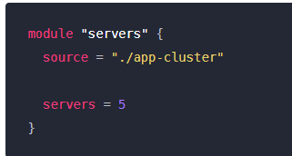
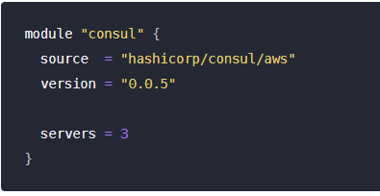
Terraform modules
Calling a Child Module
A module that includes a module block like this is the calling module of the child module.
The label immediately after the module keyword is a local name,
Within the block body (between { and }) are the arguments for the module. Module calls use the following kinds of arguments:
The source argument is mandatory for all modules.
The version argument is recommended for modules from a registry.
Most other arguments correspond to input variables defined by the module.
Terraform defines a few other meta-arguments that can be used with all modules, including for_each and depends_on

Slide 53
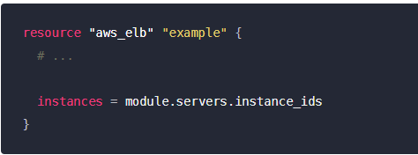
Terraform modules
Accessing Module Output Values
The resources defined in a module are encapsulated, so the calling module cannot access their attributes directly. However, the child module can declare output values to selectively export certain values to be accessed by the calling module.

Slide 54
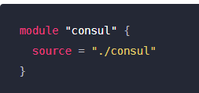
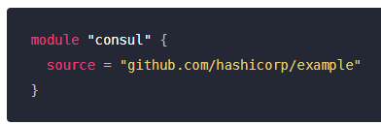
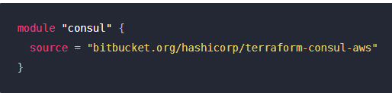
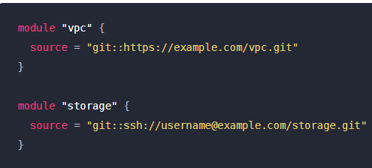
Terraform modules
Module Sources
The module installer supports installation from a number of different source types, as listed below.
Local paths
Terraform Registry
GitHub
Bitbucket
Generic Git, Mercurial repositories
HTTP URLs
S3 buckets
GCS buckets
Modules in Package Sub-directories

Slide 55
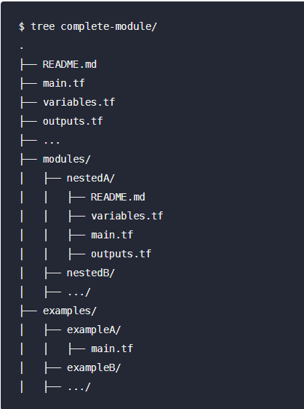
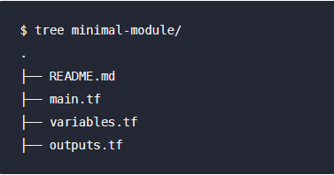
Terraform modules
Standard Module Structure

Slide 56
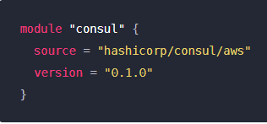
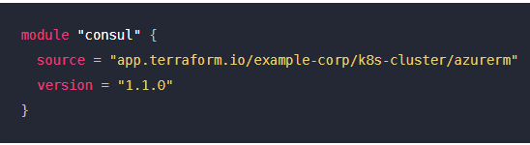
Terraform modules
Terraform Registry
A module registry is the native way of distributing Terraform modules for use across multiple configurations, using a Terraform-specific protocol that has full support for module versioning.
Terraform Registry is an index of modules shared publicly using this protocol. This public registry is the easiest way to get started with Terraform and find modules created by others in the community.

Slide 57
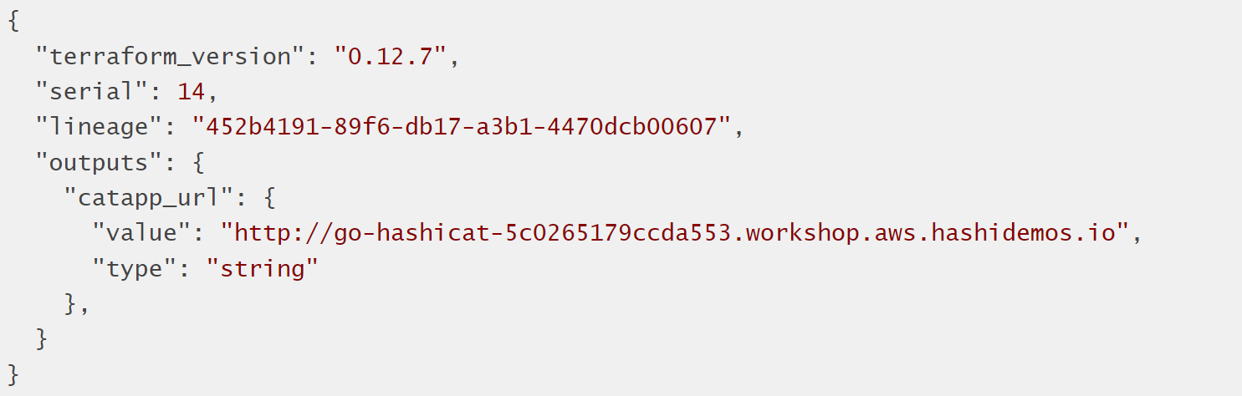
Terraform State
Terraform must store state about your managed infrastructure and configuration.
This state is used by Terraform to map real world resources to your configuration, keep track of metadata, and to improve performance for large infrastructures.
This state is stored by default in a local file named "terraform.tfstate", but it can also be stored remotely, which works better in a team environment.
Terraform uses this local state to create plans and make changes to your infrastructure. Prior to any operation, Terraform does a refresh to update the state with the real infrastructure.
The primary purpose of Terraform state is to store bindings between objects in a remote system and resource instances declared in your configuration

Slide 58
Terraform State
Purpose of Terraform State
Mapping to the Real World
Terraform requires some sort of database to map Terraform config to the real world. When you have a resource "aws_instance" "foo" in your configuration, Terraform uses this map to know that instance i-abcd1234 is represented by that resource.
Metadata
Terraform typically uses the configuration to determine dependency order. However, when you delete a resource from a Terraform configuration, Terraform must know how to delete that resource. Terraform can see that a mapping exists for a resource not in your configuration and plan to destroy.
Performance
In addition to basic mapping, Terraform stores a cache of the attribute values for all resources in the state. This is the most optional feature of Terraform state and is done only as a performance improvement.
Syncing
With a fully-featured state backend, Terraform can use remote locking as a measure to avoid two or more different users accidentally running Terraform at the same time, and thus ensure that each Terraform run begins with the most recent updated state.

Slide 59



Terraform State
Manipulating State
The terraform state list command shows the resource addresses for every resource Terraform knows about in a configuration, optionally filtered by partial resource address.
The terraform state show command displays detailed state data about one resource.
The terraform refresh command updates state data to match the real-world condition of the managed resources. This is done automatically during plans and applies, but not when interacting with state directly.

Slide 60

Terraform Settings
The special terraform configuration block type is used to configure some behaviors of Terraform itself, such as requiring a minimum Terraform version to apply your configuration.
Terraform Block Syntax
Each terraform block can contain a number of settings related to Terraform's behavior.
Within a terraform block, only constant values can be used; arguments may not refer to named objects such as resources, input variables, etc, and may not use any of the Terraform language built-in functions.
Specifying a Required Terraform Version
Specifying Provider Requirements

Slide 61

Terraform Settings
Backends
Backends define where Terraform's state snapshots are stored.
What Backends Do
Backends primarily determine where Terraform stores its state.
Terraform uses this persisted state data to keep track of the resources it manages.
By default, Terraform implicitly uses a backend called local to store state as a local file on disk
Every other backend stores state in a remote service of some kind, which allows multiple people to access it.
Using a Backend Block

Slide 62
Terraform Settings
Backend Types
Terraform's backends are divided into two main types, according to how they handle state and operations:
local : The local backend stores state on the local filesystem, locks that state using system APIs, and performs operations locally.
terraform {
backend "local" {
path = "relative/path/to/terraform.tfstate"
}
}

Slide 63
Terraform Settings
remote:
The remote backend stores Terraform state and may be used to run operations in Terraform Cloud.
Standard Backends
artifactory
azurerm
consul
kubernetes
s3
etcd

Slide 64

Terraform Provisioners
Provisioners can be used to model specific actions on the local machine or on a remote machine in order to prepare servers or other infrastructure objects for service.
Provisioners are a Last Resort
file Provisioner : used to copy files or directories from the machine executing Terraform to the newly created resource. The file provisioner supports both ssh and winrm type connections

Slide 65

Terraform Provisioners
local-exec Provisioner: invokes a local executable after a resource is created. This invokes a process on the machine running Terraform, not on the resource

Slide 66

Terraform Provisioners
remote-exec Provisioner: invokes a script on a remote resource after it is created. This can be used to run a configuration management tool, bootstrap into a cluster, etc

Slide 67

Terraform Provisioners
Provisioners Without a Resource
If you need to run provisioners that aren't directly associated with a specific resource, you can associate them with a null_resource.

Slide 68
Terraform Format
Terraform comes with a built in code formatter/cleaner. It can make all your margins and list indentation neat and tidy. Beauty works better.
terraform fmt
Simply run it in a directory containing *.tf files and it will tidy up your code for you.

Slide 69
Terraform validate
The terraform validate command validates the configuration files in a directory, referring only to the configuration and not accessing any remote services such as remote state, provider APIs, etc.
Validate runs checks that verify whether a configuration is syntactically valid and internally consistent, regardless of any provided variables or existing state
terraform validate

Slide 70
Terraform workspaces
workspaces are separate instances of state data that can be used from the same working directory. You can use workspaces to manage multiple non-overlapping groups of resources with the same configuration.
Every initialized working directory has at least one workspace
The terraform workspace command is used to manage workspaces.
terraform workspace list
terraform workspace select
terraform workspace new
terraform workspace delete
terraform workspace show

Slide 71

Terraform Cloud
Terraform Cloud is a free to use SaaS application that provides the best workflow for writing and building infrastructure as code with Terraform.
State storage and management
Web UI for viewing and approving Terraform runs
Private module registry
Version Control System (VCS) integration
CLI, API or GUI driven actions
Notifications for run events
Full HTTP API for automation

Slide 72
Terraform Cloud or Terraform Enterprise?
Terraform Cloud is a hosted application that provides features like remote state management, API driven runs, policy management and more. Many users prefer a cloud-based SaaS solution because they don't want to maintain the infrastructure to run it.
Terraform Cloud for Business utilizes the same hosted environment as Terraform Cloud, but you get the features more applicable to larger teams. Single Sign-on, Audit Logging, and the ability to Terraform on-prem resources from the cloud.
Terraform Enterprise is the same application, but it runs in your own cloud environment or data center. Some users require more control over the Terraform Cloud application, or wish to run it in restricted networks behind corporate firewalls.
The feature list for these offerings is nearly identical.

Slide 73
Integrate Jenkins & Terraform

