Slide 1
PUBLIC TRANSPORT AND OPTIMIZATION
Done by,
Nandhini P
Manjuladevi S
Swetha G
Chinnathai A
Guided by,
Vaitheki S

Slide 2
Content
Abstract
Introduction
Problem description
System requirement
System design
Coding for smart transport
Conclusion

Slide 3
Abstract
To develop a Smart system that could benefit RTC (Road Transport Corporation) as well as the passengers.
To develop a business model where operator can act as an Enterprise Service Provider.
To encourage the passenger to use public transport for commuting there by reducing traffic congestion, air pollution etc.
The main objective of public transportation optimization using IOT is to enhance the operational efficiency of transportation systems.
By deploying IOT sensors and devices, real-time data can be collected and analyzed to optimize routes, schedules, and resources, reducing delays and improving overall system performance.

Slide 4
Introduction
The Internet of Things (IOT) refers to a vast network of interconnected devices that collect and exchange data via the internet.
Internet of Things (IOT) based public transportation optimization is a smart and innovative approach to improve the efficiency, safety, and overall quality of public transportation systems.
To implement these IOT-based optimizations, a robust network infrastructure, secure data handling practices, and collaboration among transportation authorities, technology providers, and data analysts are crucial.

Slide 5
Problem description
As per RTA(Road Traffic Accident) records most of the public transport accidents are occurred by carrying heavy loads.
In our city our transports and roads are not maintained properly, because of this people may suffer.
Most of the popular routes are crowded during the festival and vacation period, people may endure by waiting for transport.
Waiting time for transport is extended due to heavy traffic.
Service distribution are not optimized by our people.

Slide 6
System Design
Hardware requirement:
GPS tracker
Smart card for monitoring the transport
Software requirement:
Python in machine learning

Slide 7
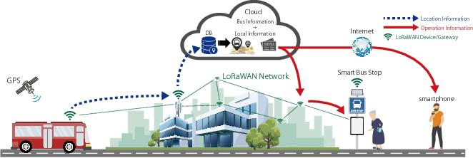
System Design

Slide 8
Coding for smart transport
def loraReceive():
global loraM
count = 0
while True:
print "LoRa Packet Receive Start“
try:
data = str (loraM.recv())
If data == "01": #Code 01 indicates primary communication failure
print "Received LoRa Signal from Emergeny Vehicle“
emergencyVehicleState["state"] = 1
count = 0
else:
count = count + 1
if count == 20:
count = 0
emergencyVehicleState["state"] = 0
except Exception as error:
print error

Slide 9
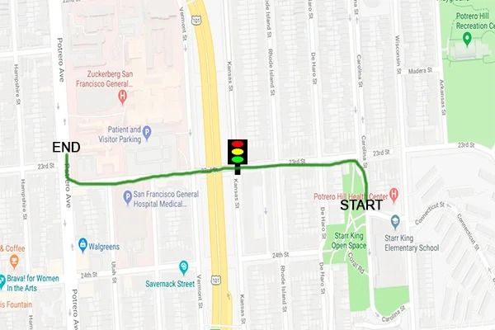
Output

Slide 10
Benefits and challenges
BENEFITS:
Improved efficiency
Accurate passenger load management
Cost saving
Enhanced passenger experience
Reduction in vehicle downtime
CHALLENGES :
High initial investment
Interoperability
Cybersecurity risks
Data overload
Scalability issues

Slide 11
Conclusion
In conclusion, IOT-based public transportation optimization holds immense promise for revolutionizing urban mobility.
By harnessing the power of Internet of Things technologies, cities and transportation authorities can unlock a wide array of benefits, including enhanced efficiency, improved passenger experience, reduced congestion, cost savings, and environmental sustainability.
By working together, they can build robust, interconnected systems that leverage real-time data to create safer, more efficient, and sustainable transportation networks.

Slide 12
THANK YOU.

