Slide 1


Version Control System, Git - Devansh Sharma
© Copyright 2021 Accolite. All Rights Reserved
‹#›

Slide 2
Agenda
World without VCS
Introducing VCS
Types of VCS
Introducing SVN
Introducing Git
Git Concepts
Git Workflow
Git Basics
Introducing Github
Working with Remotes
Git Branches
Git Tagging
Git Stash
Github Pull Requests
Merge conflicts
Best Practices
© Copyright 2021 Accolite. All Rights Reserved
‹#›

Slide 3
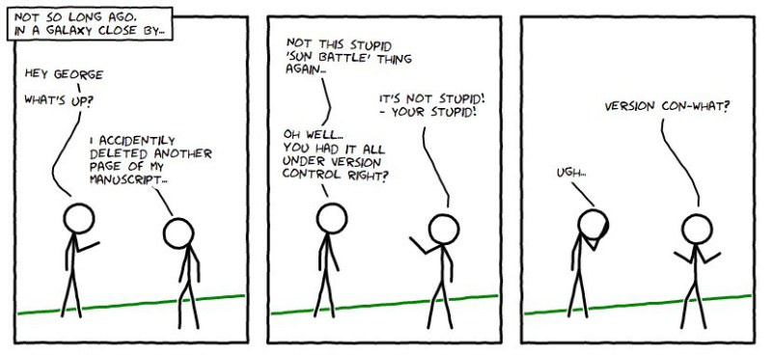
World without VCS
© Copyright 2021 Accolite. All Rights Reserved
‹#›

Slide 4
Problems working alone
Working code stops working after making changes and saving
Accidentally deleted a critical file, hundreds of lines of code lost
Even worse, a Hard Drive Crash !!
© Copyright 2021 Accolite. All Rights Reserved
‹#›

Slide 5
Problems working in teams
Whose computer stores the “official” copy of the code ?
How do you collaborate efficiently and share changes ?
What happens when two or more people need to work on the same file ?
Possibility of changes getting overwritten
How do you keep a track of who is working on what ?
No easy way of finding who made what changes
© Copyright 2021 Accolite. All Rights Reserved
‹#›

Slide 6
Motivations of VCS
Solution to all the problems presented in the previous slides
Allows developers to work simultaneously
Prevents overwriting of each other’s changes
Version Control works as a time capsule
Maintains history of every revision
© Copyright 2021 Accolite. All Rights Reserved
‹#›

Slide 7
What is VCS ?
Software that tracks and manages changes to a set of files and resources.
Keeps a shared copy of all files for intended users to access
Keeps the current versions of files as well as backups of previous versions
Facilitates managing & viewing changes made by other people
Manages conflicts when multiple people have modified one file
© Copyright 2021 Accolite. All Rights Reserved
‹#›

Slide 8
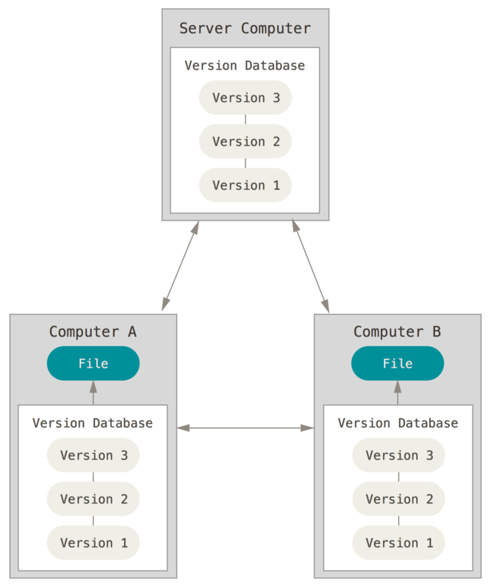
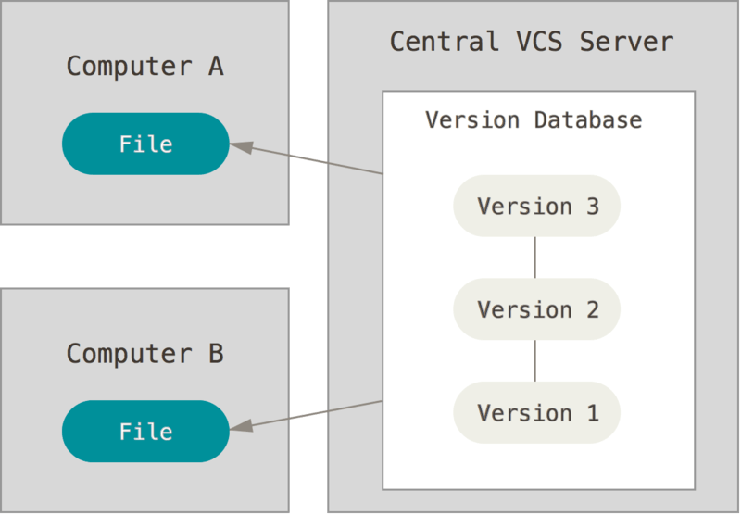
Types of VCS
Centralized VCS
Distributed VCS
© Copyright 2021 Accolite. All Rights Reserved
‹#›

Slide 9
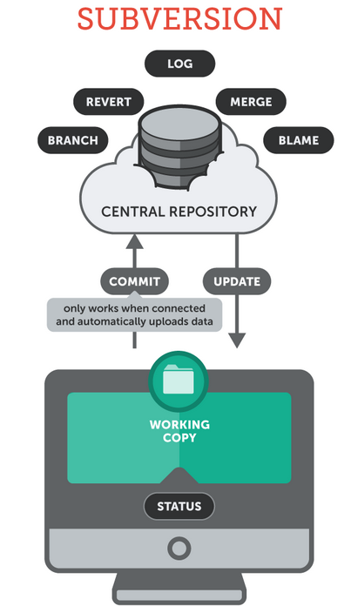
Centralized VCS
One centralized server and a number of clients
It holds all the files under revision control
The clients access the files from the centralized server
Eg: SVN (Subversion)
© Copyright 2021 Accolite. All Rights Reserved
‹#›

Slide 10
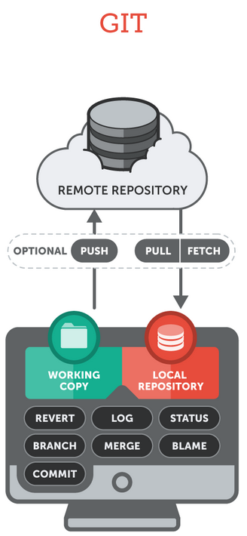
Distributed VCS
Each client (essentially) holds a complete copy of the code base.
Code is shared between clients by push/pulls
Advantages over the centralized model
Allows us to work offline
Branching is generally cheaper and merging is smoother
Faster workflow in general
Eg: Git, Mercurial, BitKeeper
© Copyright 2021 Accolite. All Rights Reserved
‹#›

Slide 11

Subversion
A centralized Version Control System distributed under the Apache License
Contains a central repository typically located on a remote machine, on an svn server
Connectivity to the server is absolutely mandatory for performing any operation
© Copyright 2021 Accolite. All Rights Reserved
‹#›

Slide 12
Subversion Concepts
Repository
Master copy of code is separate from what you work on
Working copy
Snapshot of the repository. The repository is shared by all the teams, but people do not modify it directly
Commit
Making changes in your local codebase (working copy) reflect on the repository
Trunk
Directory where all the main development happens
© Copyright 2021 Accolite. All Rights Reserved
‹#›

Slide 13
Subversion Commands
To checkout a working copy from a repository
svn checkout
To add modified files to the pending-changes list
svn add
To add the files to the repository
svn commit
To synchronize the working copy with the repository.
svn update
© Copyright 2021 Accolite. All Rights Reserved
‹#›

Slide 14
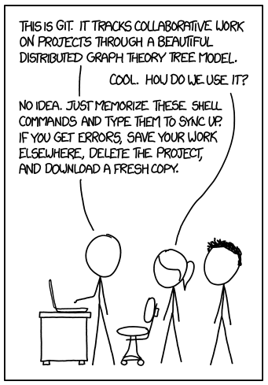
Introducing Git
© Copyright 2021 Accolite. All Rights Reserved
‹#›

Slide 15

Git
The most popular implementation of a distributed version control system
Originates from the Linux kernel development and was founded in 2005 by Linus Torvalds
Free and open source
The core of Git was originally written in the programming language C
© Copyright 2021 Accolite. All Rights Reserved
‹#›

Slide 16
Git vs SVN
A centralized VCS vs a Decentralized VCS
SVN has better file compression and storage capabilities than Git
Git has better branching and code merging support
At the end, it comes down to preference
© Copyright 2021 Accolite. All Rights Reserved
‹#›

Slide 17
Git Concepts: Snapshots
The way git keeps track of your code history
Essentially records what all your files look like at a given point in time
You decide when to take a snapshot, and of what files
Have the ability to go back to visit any snapshot
© Copyright 2021 Accolite. All Rights Reserved
‹#›

Slide 18
Git Concepts: Commits
The act of creating a snapshot
Can be a noun or verb
“I commited code”
“I just made a new commit”
Essentially, a project is made up of a bunch of commits
Commits contain three pieces of information:
Information about how the files changed from previously
A reference to the commit that came before it
Called the “parent commit”
A hash code name
Will look something like:
fb2d2ec5069fc6776c80b3ad6b7cbde3cade4e
© Copyright 2021 Accolite. All Rights Reserved
‹#›

Slide 19
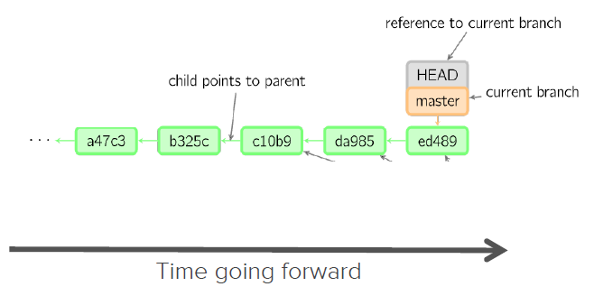
Git Concepts: HEAD
A reference to the most recent commit
© Copyright 2021 Accolite. All Rights Reserved
‹#›

Slide 20
Git Concepts: Branches
Basically a movable pointer to a commit (which is HEAD for the branch)
Allows maintaining multiple flows for development process
Eg: Different branches for development of new features or for fixing bugs or for deployment
© Copyright 2021 Accolite. All Rights Reserved
‹#›

Slide 21
Git Concepts: Master
The main branch in your project
Doesn’t have to be called master, but almost always is!
Created as default branch when initializing a new repo (git init)
© Copyright 2021 Accolite. All Rights Reserved
‹#›

Slide 22
Git Concepts: Repositories
Often shortened to ‘repo’
A collection of all the files and the history of those files
Consists of all your commits
Consists of multiple branches
Can live on a local machine or on a remote server (GitHub!)
The act of copying a repository from a remote server is called cloning
Cloning from a remote server allows teams to work together
The repo directory in the local machine contains the .git directory
© Copyright 2021 Accolite. All Rights Reserved
‹#›

Slide 23
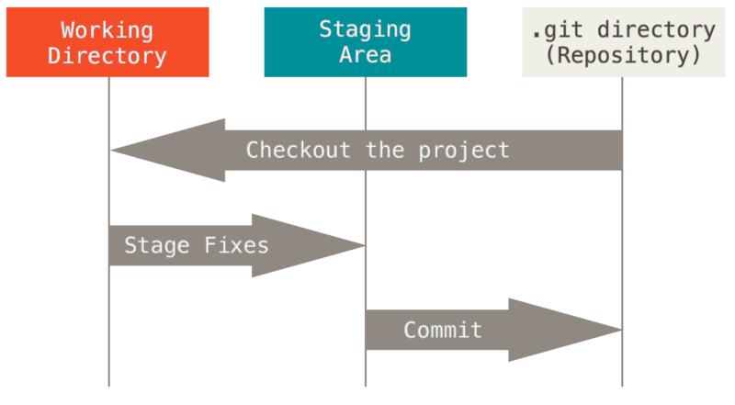
Local Git Workflow
© Copyright 2021 Accolite. All Rights Reserved
‹#›

Slide 24
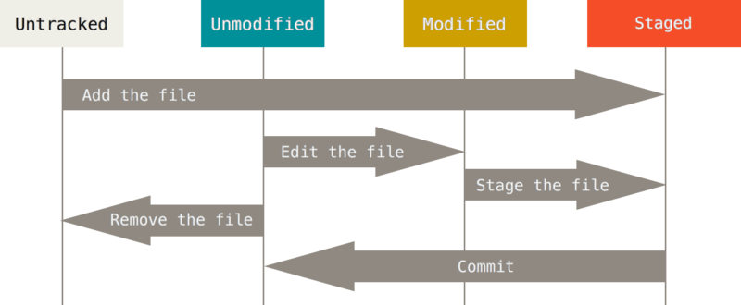
File Lifecycle in Git Repo
© Copyright 2021 Accolite. All Rights Reserved
‹#›

Slide 25
Steps in Git Local Workflow
Modify files in your working directory.
Stage files, adding snapshots of them to your staging area.
Do a commit, which takes the files as they are in the staging area and stores that snapshot permanently to your Git directory (your local copy of the repo).
In case of newly created files (untracked), stage the files and then commit to the repo.
Untrack files that should not be stored in the repo.
© Copyright 2021 Accolite. All Rights Reserved
‹#›

Slide 26
Basic Git Commands
Create a local repository
git init
Add all files to the staging area
git add .
git add <files>
Commit the files from staging into the repository
git commit
git commit -m “<message>”
© Copyright 2021 Accolite. All Rights Reserved
‹#›

Slide 27
Basic Git Commands
View change of a file between the working tree and the repo
git diff
git diff <file-name>
Overall status of the working directory
git status
A history of all the revisions in the repository
git log
© Copyright 2021 Accolite. All Rights Reserved
‹#›

Slide 28
Basic Git Commands
Get list of or create new branches
git branch
git branch <branch-name>
Change branch or jump to commits in working directory
git checkout <branch-name>
git checkout <revision-number>
Move working directory changes to temporary stack
git stash
© Copyright 2021 Accolite. All Rights Reserved
‹#›

Slide 29
Basic Git Commands
Made changes to a file in the working tree and want to restore it from the repository
git checkout -- <filename>
Revert the changes made by a commit (makes new commit)
git revert <revision-number>
Revert changes by recent commit
git reset --soft
git reset --hard
Revert will leave a new commit
Reset will not leave a new commit
Reset will leave the changes in staging (soft)
Reset will delete the changes (hard)
© Copyright 2021 Accolite. All Rights Reserved
‹#›

Slide 30
Basic Git Commands
Remove a file from the repository
git rm <filename> (Don’t forget to commit afterwards)
Rename a file in the repository
git mv <old-filename> <new-filename> (Don’t forget to commit afterwards)
Pop changes from stash to working directory
git stash pop stash@{<stash-index>}
© Copyright 2021 Accolite. All Rights Reserved
‹#›

Slide 31
Local Git Setup
Let’s get ready to use GIT
git config --global user.name “Test User”
git config --global user.email “test.user@gmail.com”
© Copyright 2021 Accolite. All Rights Reserved
‹#›

Slide 32

GitHub
Largest web-based Git repository hosting service
Aka, hosts ‘remote Git repositories’
Allows for code collaboration with anyone online
Adds extra functionality on top of git
UI, documentation, bug tracking, feature requests, pull requests, and more!
© Copyright 2021 Accolite. All Rights Reserved
‹#›

Slide 33
Try yourself
Create a Github account using Accolite ID
Create a new empty repository
© Copyright 2021 Accolite. All Rights Reserved
‹#›

Slide 34
Github Terminologies
Fork
A fork is a copy of a repository.
Forking a repository allows you to freely experiment with changes without affecting the original project.
Pull Request
Lets you tell others about changes you've pushed to a repository on GitHub.
Helps efficiently merge changes into other branches.
© Copyright 2021 Accolite. All Rights Reserved
‹#›

Slide 35
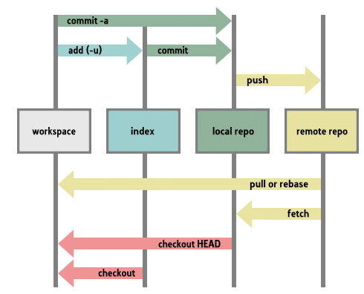
Git Remote Workflow
© Copyright 2021 Accolite. All Rights Reserved
‹#›

Slide 36
Remote Git Commands
Obtain a copy of the remote repository onto your local machine
git clone <github-repo-url>
To add a remote to your existing local repository
git remote add <remote_name> <url>
(“origin” is the name of the default remote repo)
© Copyright 2021 Accolite. All Rights Reserved
‹#›

Slide 37
Remote Git Commands
To make your changes reflect on the remote repo
git push
To update your local repository with any changes that are made to the remote repository
git fetch
To incorporate changes on the remote to your local working tree
git pull
Note: A git pull is equivalent to a git fetch followed by a git merge.
© Copyright 2021 Accolite. All Rights Reserved
‹#›

Slide 38
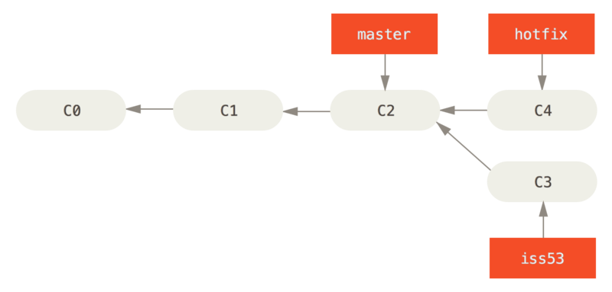
Git Branches
A branch represents an independent line of development
Essentially it’s a way to request a brand new working directory and staging area
Commits are recorded in the history of the current branch
© Copyright 2021 Accolite. All Rights Reserved
‹#›

Slide 39
Git Branches: Commands
To create a branch called experimental:
git branch experimental
To create new branch from current branch:
git checkout -b experimental
To switch to the experimental branch:
git checkout experimental
To merge changes into another branch (say, master):
git checkout master
git merge experimental
© Copyright 2021 Accolite. All Rights Reserved
‹#›

Slide 40
Git Branches: Commands
To push changes of a new local branch to the remote repo:
git push --set-upstream origin <branch-name>
To delete local branch:
git branch -d <branch-name>
To delete remote branch:
git push <remote-name> --delete <branch-name>
© Copyright 2021 Accolite. All Rights Reserved
‹#›

Slide 41
Git Tagging
Use git tag to mark specific points in the repo history, such as release points.
Git allows two types of tags – Lightweight and Annotated.
Lightweight tags are just pointers to commits and have a name only.
Annotated tags allow storing more information such as name, email, message etc.
© Copyright 2021 Accolite. All Rights Reserved
‹#›

Slide 42
Git Tagging: Commands
To list all tags:
git tag -l
To search for pattern in tag name:
git tag -l “<pattern>”
To create an annotated tag:
git tag -a v1.0 -m “Initial release”
To create a lightweight tag:
git tag v1.0
© Copyright 2021 Accolite. All Rights Reserved
‹#›

Slide 43
Git Stash: Commands
Use git stash when you want to record the current state of the working directory and the index, but want to go back to a clean working directory.
Saves you local modifications and reverts the working tree to match the HEAD commit
To view the modifications stashed away use:
git stash list
To restore your changes in to your working tree:
git stash pop
© Copyright 2021 Accolite. All Rights Reserved
‹#›

Slide 44
Git Stash: Use case
Pulling into a dirty tree
Scenario: You are in the middle of something but there are changes in upstream possible relevant to what you are doing
You try to git pull but your local changes conflict with the upstream changes
Solution ?
git stash
git pull
git stash pop
© Copyright 2021 Accolite. All Rights Reserved
‹#›

Slide 45
Github: Pull Requests
Used to easily merge branches from Github web interface
A PR is created for requesting to merge compare branch into the base branch
Eg:
You have made code changes for a new feature in the feature branch; which was originally branched from master branch.
Now once you are done with development of the feature and have pushed your code to feature branch you need to get it merged to master.
So you now create a PR with base as master and compare as feature.
© Copyright 2021 Accolite. All Rights Reserved
‹#›

Slide 46
Github: Pull Requests
Github will show the difference in the commits and code between the branches being merged for review before actually merging them.
Merge conflicts will also be reported here if any.
In case merge conflicts are reported, ideal solution is to merge the base branch onto your compare branch locally and resolve the conflicts. Then push the changes again. This will update the PR with the new commits.
PR’s are updated with new commits which are pushed, till they are merged and closed.
Also known as Merge Requests.
© Copyright 2021 Accolite. All Rights Reserved
‹#›

Slide 47
Merge Conflicts
Git automatically handles merging of code if changes are in different files or different lines in same file.
But if there are competing changes in the same lines then Git cannot automatically merge them and reports a merge conflict.
This can occur when 2 or more people may have made changes to the code in the same line.
© Copyright 2021 Accolite. All Rights Reserved
‹#›

Slide 48
Merge Conflicts
Files with merge conflicts can be seen in git status output.
At the location of conflict Git specifies the code as:
If you have questions, please
<<<<<<< HEAD
open an issue
=======
ask your question in IRC.
>>>>>>> branch-a
This means “open an issue” is code in current branch (HEAD) and “ask your question in IRC.” is the code from branch-a
© Copyright 2021 Accolite. All Rights Reserved
‹#›

Slide 49
Fixing Merge Conflicts
Fixing merge conflicts involves manually editing the files to select the code that is needed and remove the extra headers (<<<<<, >>>>>, ====....).
Most modern editors/IDE (such as VS Code, IntelliJ Idea etc.) with Git integration allow fixing conflicts easily using the UI.
Once all conflicts are fixed, the changes should be commited and the merge process should continue (git commit && git merge).
© Copyright 2021 Accolite. All Rights Reserved
‹#›

Slide 50
Git Rewriting History
Rewriting git history is done by:
git commit --amend
git rebase
git reflog
This process allows modifying you project history and so must be done with care as there is potential of losing or overwriting commits.
© Copyright 2021 Accolite. All Rights Reserved
‹#›

Slide 51
Git Amend Commit
Allows changing/amending most recent commit.
Commands:
git commit --amend -m “<new-message>” Allows changing the message of most recent commit
git add <forgotten-file> && git commit --amend --no-edit Allows adding a forgotten file to recent commit --no-edit leaves the message untouched
© Copyright 2021 Accolite. All Rights Reserved
‹#›

Slide 52
Git Rebase
Used to modify history across multiple older commits.
Combines a sequence of commits and moves to one base commit at index.
Run using:
git rebase <base>
git rebase --interactive <base>
Running by interactive allows checking each commit individually while rebasing. Commits can also be amended using git amend in this process.
© Copyright 2021 Accolite. All Rights Reserved
‹#›

Slide 53
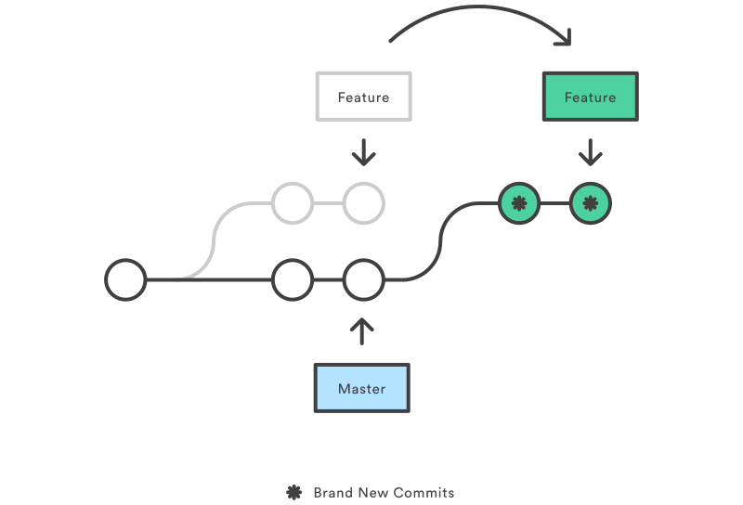
Git Rebase
© Copyright 2021 Accolite. All Rights Reserved
‹#›

Slide 54
Git Reflog
A safety-net utility that helps going back to old states of project’s commits.
Reflog records all updates as new entries that happen to the branch tip.
Branch tips are updated when you switch branches, pull changes, commit files or rewrite history.
You can run git reflog to get the list of entries showing updates with the commit hash as well. Using the commit hash one can make the needed changes.
Reflog entries are stored upto 90 days.
© Copyright 2021 Accolite. All Rights Reserved
‹#›

Slide 55
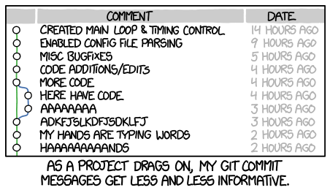
Best Practices: Commit Messages
© Copyright 2021 Accolite. All Rights Reserved
‹#›

Slide 56
Best Practices: Standards
Commits should be
Minimal - contain changes related to only one problem
Complete - should solve the problem it claims to solve
Commit messages should be
Concise, yet evocative - Should be able to understand what the commit does at a glance
Generally don’t track files that can be generate by other files in the repo. Use the .gitignore file to handle this
Object files, jars, .class files, IDE specific files
© Copyright 2021 Accolite. All Rights Reserved
‹#›

Slide 57
Best Practices: Standards
The master branch should always be stable. Do not commit code to master that breaks the build
Avoid pushing changes directly to master. Branch out for a feature, push your changes there, then create a Pull Request
Always git pull before editing a file. (Keep your local copy updated with the remote
Don't forget to git push after you have made and committed changes.
© Copyright 2021 Accolite. All Rights Reserved
‹#›

