Slide 1


Spring AU 2021
NoSQL Basics/Fundamentals - Arjuna Pandian Nehru

Slide 2
Agenda
Evolution of Database Management System
CAP Theorem
Relational Database
ACID Vs BASE
No-SQL : What, Why, Where??
No-SQL : Types
Couchbase
- Overview
- Data Types & Operations
- N1QL, Map Reduce, Eventing, Admin Console
- Analytics & Applications
- Data Modelling
- Practical Assessments

Slide 3
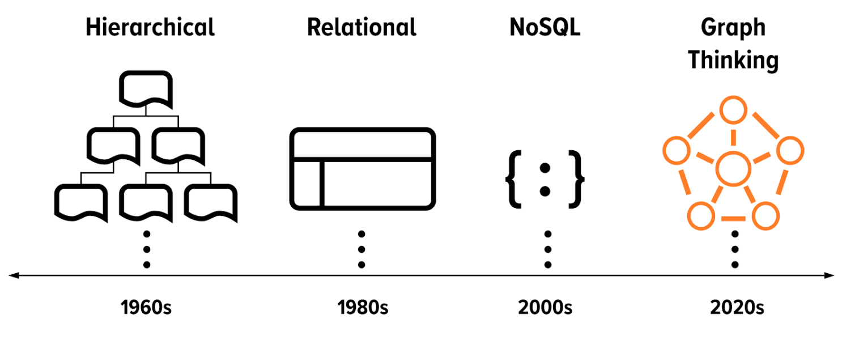
Evolution Of Database Management System
Flat Files
Hierarchical
SQL (RDBMS)
NoSQL

Slide 4
CAP Theorem
A distributed system can deliver only two of three desired characteristics:
Consistency: Whenever data is written to one node, it must be instantly forwarded or replicated to all the other nodes in the system.
Availability: Any client making a request for data gets a response, even if one or more nodes are down.
Partition-Tolerance: The cluster must continue to work despite any number of communication breakdowns

Slide 5
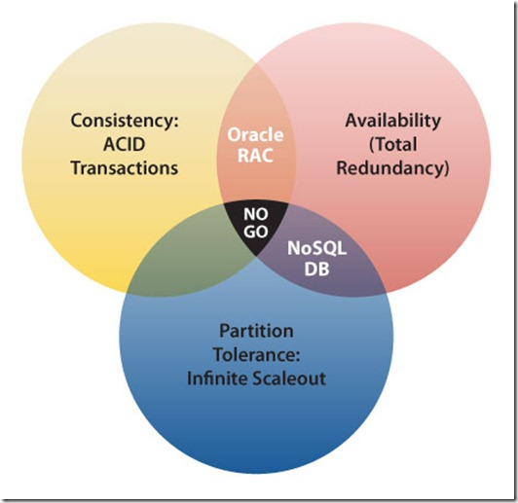
CAP Theorem
Pick Two...!!

Slide 6
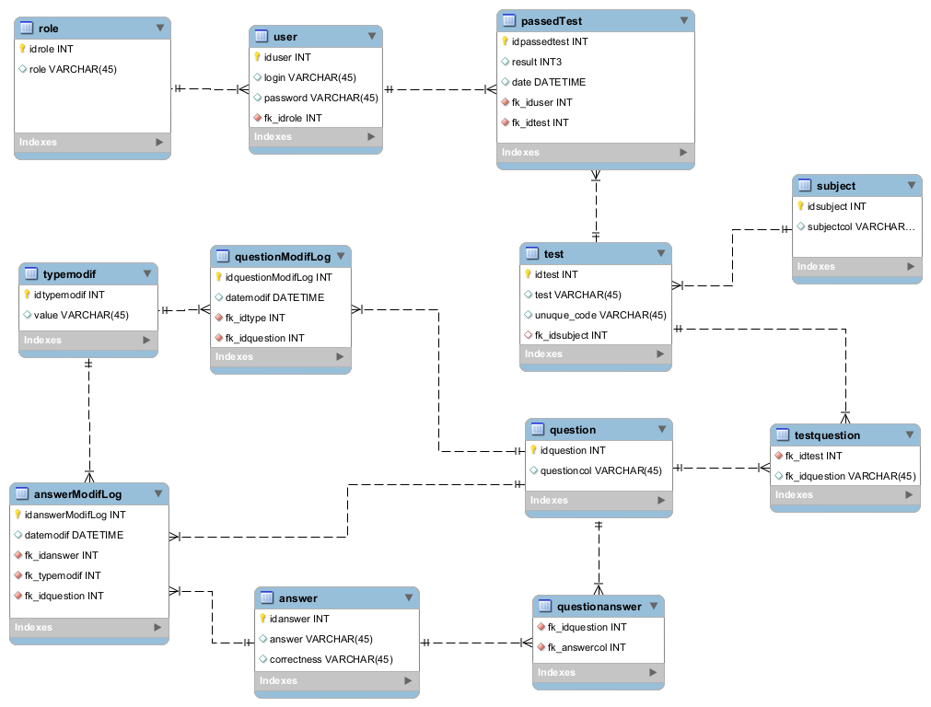
Relational Database
A structure that allows us to identify and access data in relation to another piece of data in the database.
One to One
One to Many
Many to Many
Self Referencing

Slide 7
Relational Database
Where is Relational DB a limitation?
Data Complexity
Data Variety
Hardware Performance
Broken Keys and Records
Data Translation required between UI and Storage
Developer Expertise

Slide 8

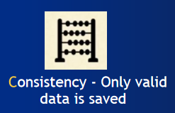
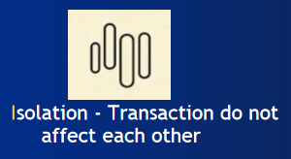
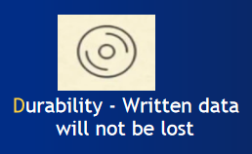
ACID

Slide 9

ACID
Why ACID?
Where ACID?
Why not ACID?
Where not ACID?

Slide 10

If not ACID, what else?
ACID ➔ BASE?

Slide 11


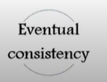
BASE
Guaranteed Availability
State of the system might change, even without a input
System will become consistent over time

Slide 12
No-SQL: What???
No SQL = Not SQL
/
No SQL = Not ONLY SQL

Slide 13
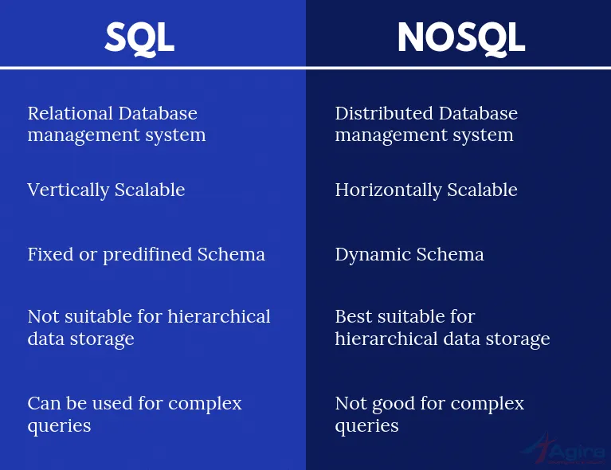
SQL Vs No-SQL

Slide 14
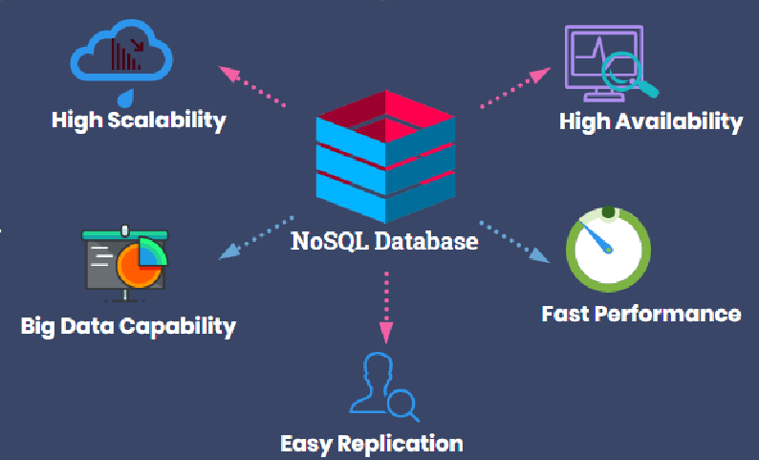
No-SQL: Why???

Slide 15
No-SQL: Where???
High volume Data Feeds
Metadata
Machine Generated Data
More machine forms, sensors & data
Variably structured
Securities Data
High frequency trading
Daily closing price
Social media/ General Public
Multiple Data sources which changes their format consistently
Usage logs
Ad Targeting
Large volume of users
Very strict latency requirements
Sentiment Analysis
Real time dashboards
Expose data to millions of customers
Reports on large volumes of data
Reports that update real time
Social media Monitoring
Join the conversation
Games
Customized Surveys
News site
Comments and user generated content
Personalization of content and layout
Multi-device rendering
Generate layout on the fly
No need to cache static pages
Sharing
Store large objects
Simpler modeling of metadata
Content Management
Product Catalogs
Diverse product portfolio, Complex querying
Multi-faceted product attributes
Data analysis
Data mining, Call records
Insurance Claims
Biometric
Retina Scans
Fingerprints

Slide 16
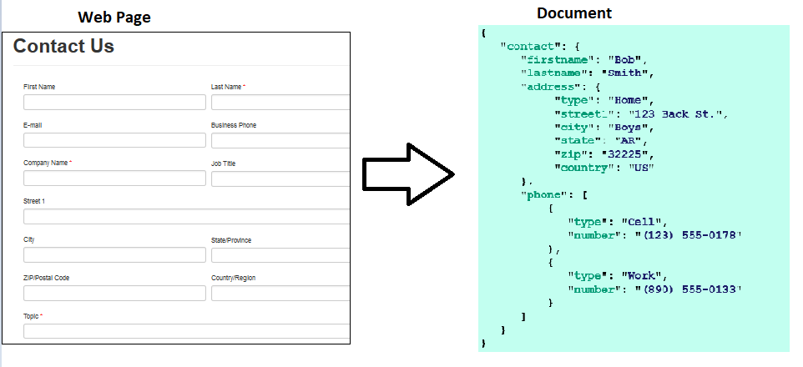
No-SQL: How???

Slide 17
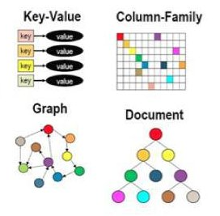
No-SQL: Types
Key-value stores: Every single item in the database is stored as an attribute name (key)
Document Based: Pair each key with a complex data structure called document
Graph Based: Stores data in nodes, relationships stored along with data
Column Stores: Store Data in columns together instead of row

Slide 18
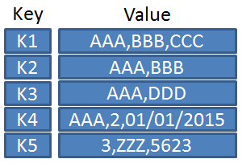
Key-value Store
Every single item in the database is stored as an attribute name (key)
Value – Single Opaque object
No Fixed Schema
Conforms to Object Orient Design
Flexibility with structure of value
Amazon DynamoDB, Redis, Oracle NoSQL DB, Voldemort, CouchDB

Slide 19
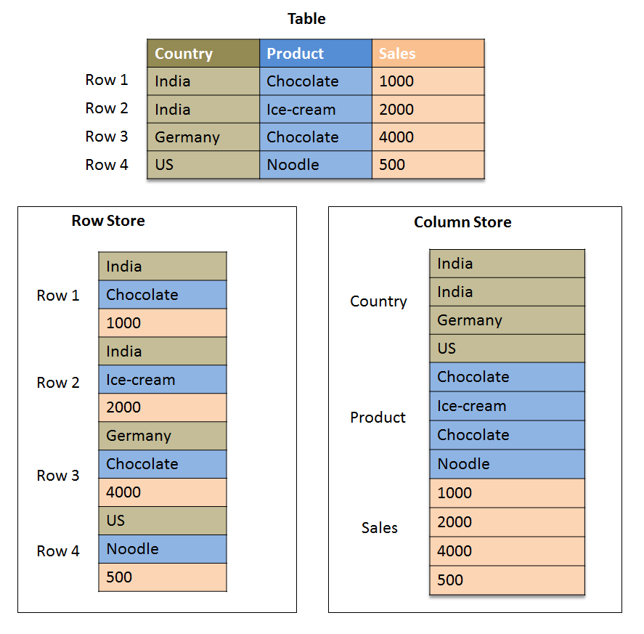
Column Store
Store Data in columns together instead of row
Data stored in columns instead of rows
Columns are grouped into Column Families
Ideal for fetches for multiple rows such as to display a list
Performance is best for large fetches
Cassandra, HBase, Google Bigtable, Apache Druid

Slide 20
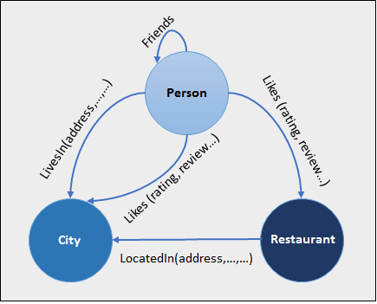
Graphs Database
Stores data in nodes, relationships stored along with data
Nodes store data, Edges store relationships
Data can be fetched using relationship as a filter
E.g. Find all friends of XXX who has at least one family member is in YYY
FlockDB, Amazon Neptune, Neo4j, OrientDB

Slide 21
Document Based
{
"contact": {
"firstname": "Bob",
"lastname": "Smith",
"address": {
"type": "Home",
"street1": "123 Back St.",
"city": "Boys",
"state": "AR",
"zip": "32225",
"country": "US"
},
"phone": [
{
"type": "Cell",
"number": "(123) 555-0178"
},
{
"type": "Work",
"number": "(890) 555-0133"
}
]
}
}
Key with Structured Value e.g: complex document
Pair each key with a complex data structure called document
No Fixed Schema
Individual properties can be fetched
Filters can be applied on properties
Indexes on properties
MongoDB, Couchbase, Apache CouchDB

Slide 22
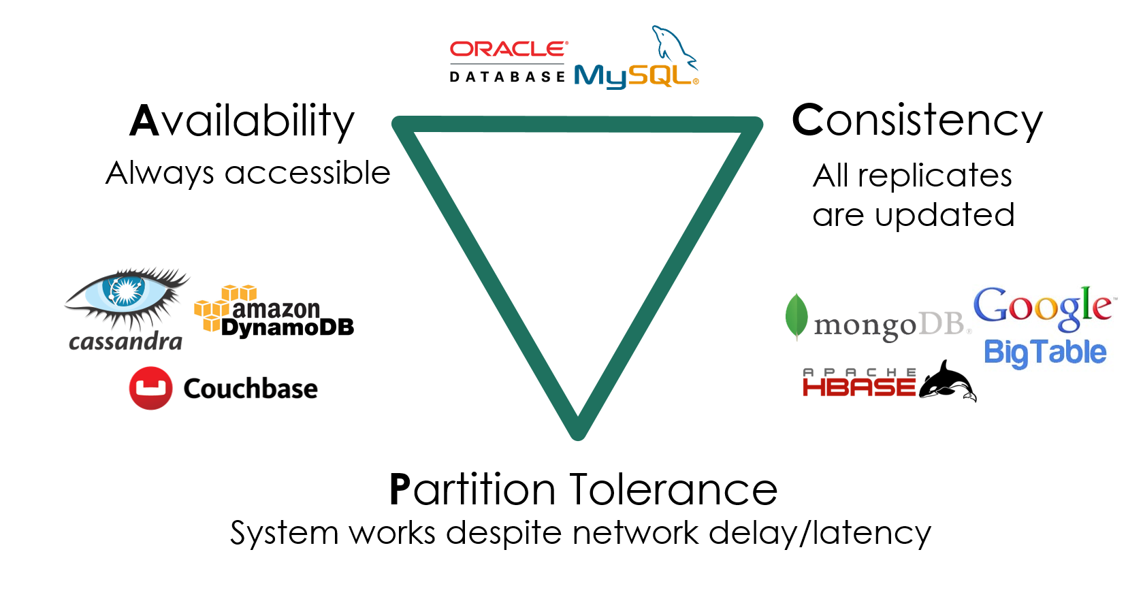
CAP Theorem

Slide 23

Now lets discuss about,

Slide 24
Data Types and Structures
{
"id": "x-1234-qwe",
"is_active": true,
"name": "Bob Smith",
"department_id":12
"phone":[
"+91-980-915-7849",
"+91-80-68712353"
],
"address": {
"address_line_1": "100"
"address line 2": "Baker Street",
"zip": "33452-87646"
}
}
Text
Numbers
Boolean
Array
Object

Slide 25
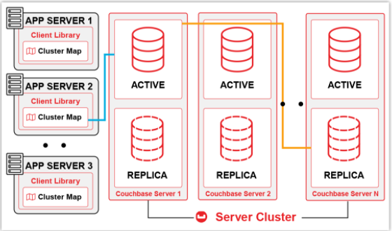
Architecture - Overview

Slide 26
Architecture - Services & Terminology
Core Data Access and Data Service
Indexing and Index Service
Querying Data and Query Service
Eventing Service
Full Text Search Service
Cluster
Node
Bucket
vBucket
Document
Failover
Rebalance
Active
Replica
Admin

Slide 27
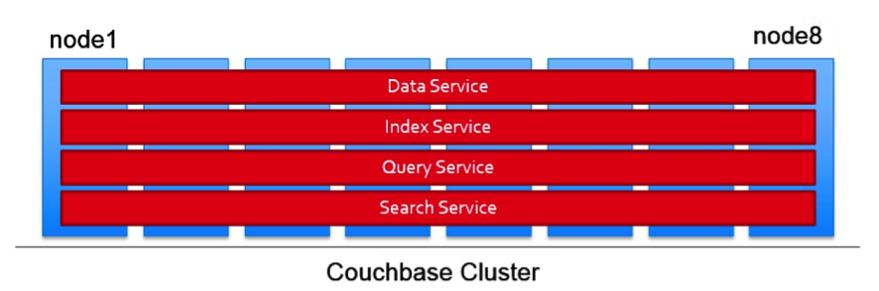
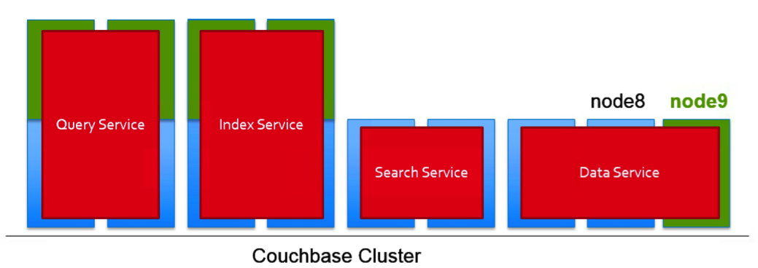
Architecture - Multi-dimensional Scaling

Slide 28
Basic Operations
Write
Update
Upsert
Read

Slide 29
N1QL (pronounced "Nickel")
SQL for No-SQL
SELECT Statement
Data Manipulation Language (DELETE, INSERT, UPDATE, and UPSERT)
Indexes: CREATE and DROP INDEX
Primary Key Access
Aggregation: SQL aggregation operators like MIN, MAX, COUNT, GROUP BY with HAVING.
Joins: JOIN between documents.
Nesting: NEST enable you to retrieve sub-records for a record.
Un-nesting: UNNEST function extracts nested sub-records into separate records.
Subqueries: Multi-part queries through subqueries.
UNION, INTERSECT, and EXCEPT

Slide 30
Indexes
Creating the right index - with the right keys, in the right order, and using the right expressions, is critical to query performance in any database system
Types:
- Standard global secondary index
- Memory-optimized global secondary index

Slide 31
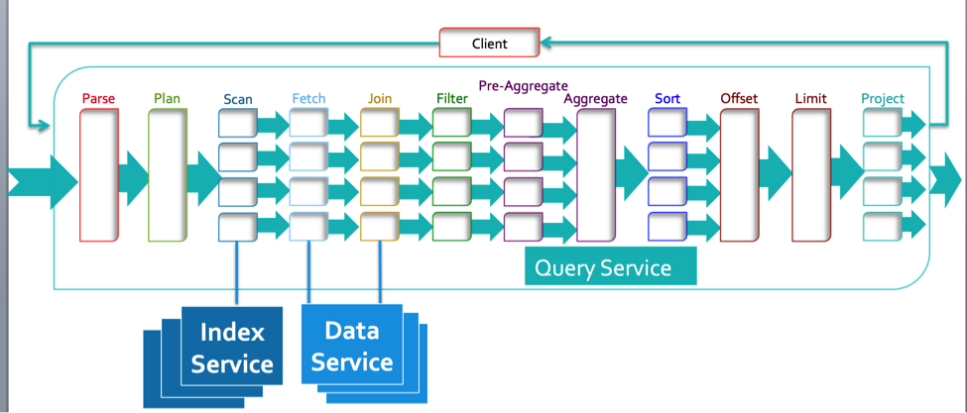
N1QL - Execution Flow

Slide 32
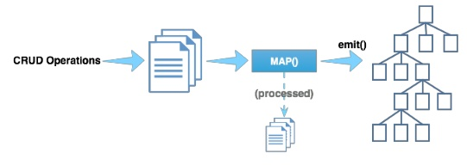
Views & Map Reduce
Couchbase views enable indexing and querying of data.
During the view creation process, the output structure, field order, content, and any summary or grouping information desired in the view is defined.
- Map Function
- Reduce Function

Slide 33
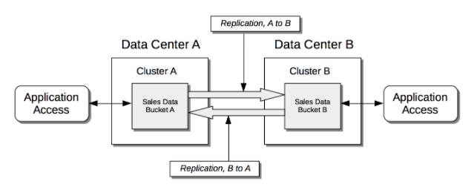
Cross Data Center Replication (XDCR)
Cross Data Center Replication (XDCR) allows data to be replicated across clusters that are potentially located in different data centers.
Filtering Expressions can be used in XDCR replications

Slide 34
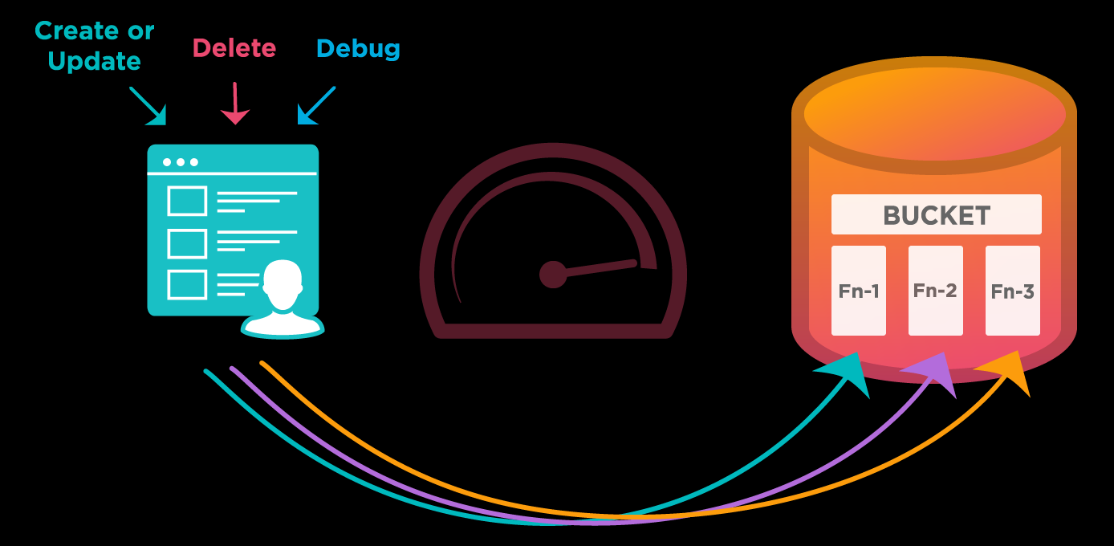
Eventing Service
Eventing Service is a framework to operate on changes to data in real time. Events are changes to data in the Couchbase cluster.
Using the Eventing Service, you can:
- Monitor specific parameters in a document
- Propagate changes to other systems
- Enrich a document in real time
- Cascade deletes to avoid orphaned documents

Slide 35
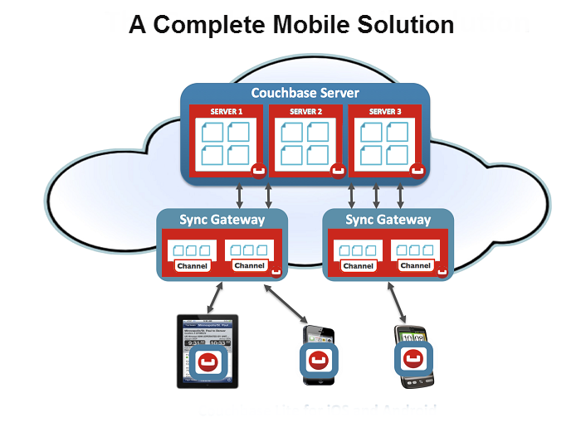
Couchbase Mobile

Slide 36
Couchbase in Big Data

Slide 37
Couchbase Analytics Developer Preview
Operational Analytics
SQL++ Query Language
High data freshness
Federated Queries
Improved Performance on huge data sets

Slide 38
Practical Assessment

Slide 39
Installation & Setup
Set up and verify local learning environment
Getting Familiar with Couchbase
Configure single-node Couchbase cluster

Slide 40
N1QL
Working with N1QL and JSON
Selecting, filtering, and indexing using N1QL
Selecting documents and limiting results
Using aliases, un-nesting results, and concatenating values
Selecting by key or value, and accessing document keys via metadata
Creating and using secondary indexes, and using multiple filters
Working with JSON focused extensions in N1QL
Using functions in queries
Joining and combining documents in N1QL
Join foreign documents by surrogate and natural key references
Combine data by nesting foreign documents
Implement the Lookup Key pattern using JOIN syntax
Implement a sub-query
Insert and delete a document
Update with fixed or calculated values

Slide 41
Views & MapReduce
Development vs. Production Views
View Code
Query Result Ordering
Indexing and Querying
Range Querying
XDCR & Eventing Service
Configuring XDCR
Create an Eventing service & Deploying it.

Slide 42
Data Modelling
Implementing entities in JSON
- Objects
- Array of Objects
Implementing relationships in JSON
- Referencing Documents
- Embedding Documents
Types of document structures
Child with Parent ID
Child with Parent Partial Info
Parent with Child Id
Parent with Partial Child Info
Parent with Complete Child Info

Slide 43
Admin Console
Understanding metrics in Web Console
Understanding Command Line Interface (CLI) Tools:
- cbq
- cbexport
- cbimport
- cbbackup

Slide 44
References
NoSQL - https://www.w3schools.in/definition/what-is-nosql/
Couchbase - https://docs.couchbase.com/server/current/introduction/intro.html
N1QL Documentation - https://docs.couchbase.com/server/current/n1ql/n1ql-language-reference/index.html
N1QL Tutorial - https://query-tutorial.couchbase.com/tutorial/#1
CLI Tools- https://docs.couchbase.com/server/current/cli/cli-intro.html

Slide 45
Thank You:)

