Slide 1


RDBMS - Tarun K
© Copyright 2021 Accolite. All Rights Reserved

Slide 2
Agenda
Introduction
Schema
Keys and Constraints
Data Models
E-R Model
ACID Properties
Normalisation
© Copyright 2021 Accolite. All Rights Reserved

Slide 3





RDBMS Introduction
DBMS (Database management system) - A collection of programs that enables user to store, retrieve, update and delete information from a database.
RDBMS (Relational Database Management System) – Is a database management system (DBMS) that is based on the relational model.
In relational model, data is represented in terms of tuples(rows).
Popular RDBMS softwares.

Slide 4
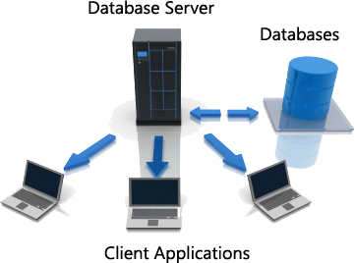
The term database server may refer to both hardware and software used to run a database, according to the context. As software, a database server is the back-end portion of a database application, following the traditional client-server model. This back-end portion is sometimes called the instance. It may also refer to the physical computer used to host the database. When mentioned in this context, the database server is typically a dedicated higher-end computer that hosts the database.
What is database Server ?

Slide 5
Topic 1
RDBMS Concepts
Structured Query Language(SQL) : Is a language designed specifically for communicating with databases. SQL is an ANSI (American National Standards Institute) standard.
What is Table ?
Collection of data elements organised in terms of rows and columns.
Most simplest form of data storage.
Convenient representation of relations.
What is a Record ?
A single entry in a table.
Represents set of related data.

Slide 6
Topic 1
RDBM Concepts
What is Field ?
Table consists of several records(row).
Each record can be broken into several smaller entities known as Fields.
What is a Column ?
Column is a set of value of a particular type.
The term Attribute is also used to represent a column.

Slide 7
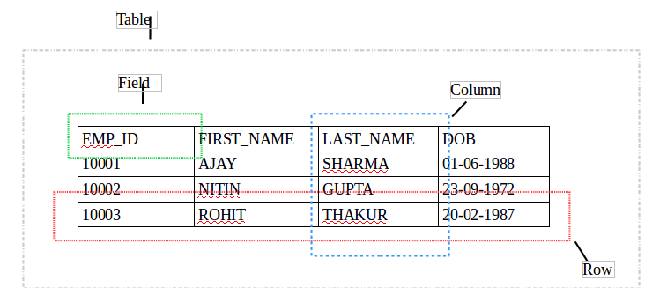
Topic 1
RDBM Concepts
Notes:
Create Table USER ADD ATTRIBUTES
-> USER_ID
-> NAME
-> PHONE
-> EMAIL
-> DATE OF BIRTH

Slide 8
Topic 1
Database View
In SQL, a VIEW is a virtual relation based on the resultset of a SELECT statement.
A view contains rows and columns, just like a real table. The fields in a view are fields from one or more real tables in the database. In some cases, we can modify a view and present the data as if the data were coming from a single table.
Syntax:
CREATE VIEW view_name AS
SELECT column_name(s)
FROM table_name
WHERE condition

Slide 9
Topic 1
Database View
DROP view: All views can be dropped, whether or not the view is updatable.
DROP VIEW <VIEW_NAME>;
DROP VIEW does not affect any tuples of the underlying relation (table) Movie.
However, DROP TABLE will delete the table and also make the view MarvelMovie unusable.
DROP TABLE <TABLE_NAME>;

Slide 10
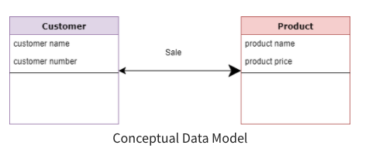
Conceptual Data Model
A conceptual data model identifies the highest-level relationships between the different entities. Features of conceptual data model include:
Includes the important entities and the relationships among them.
No attribute is specified.
No primary key is specified.
Data Modeling Concepts
Notes:
Conceptual Data Model
A Conceptual Data Model is an organized view of database concepts and their relationships. The purpose of creating a conceptual data model is to establish entities, their attributes, and relationships. In this data modeling level, there is hardly any detail available on the actual database structure. Business stakeholders and data architects typically create a conceptual data model.
The 3 basic tenants of Conceptual Data Model are
Entity: A real-world thing
Attribute: Characteristics or properties of an entity
Relationship: Dependency or association between two entities
Characteristics of a conceptual data model
————
Offers Organisation-wide coverage of the business concepts.
This type of Data Models are designed and developed for a business audience.
The conceptual model is developed independently of hardware specifications like data storage capacity, location or software specifications like DBMS vendor and technology. The focus is to represent data as a user will see it in the "real world.”
Conceptual data models known as Domain models create a common vocabulary for all stakeholders by establishing basic concepts and scope.

Slide 11
Data Modeling Concepts
Logical Data Model
A logical data model describes the data in as much detail as possible, without regard to how they will be physical implemented in the database. Features of a logical data model include:
Includes all entities and relationships among them.
All attributes for each entity are specified.
The primary key for each entity is specified.
Foreign keys (keys identifying the relationship between different entities) are specified.
Normalization occurs at this level.
The steps for designing the logical data model are as follows:
Specify primary keys for all entities.
Find the relationships between different entities.
Find all attributes for each entity.
Resolve many-to-many relationships.
Normalization.
Notes:
The Logical Data Model is used to define the structure of data elements and to set relationships between them. The logical data model adds further information to the conceptual data model elements. The advantage of using a Logical data model is to provide a foundation to form the base for the Physical model. However, the modeling structure remains generic.
Characteristics of a Logical data model
Describes data needs for a single project but could integrate with other logical data models based on the scope of the project.
Designed and developed independently from the DBMS.
Data attributes will have datatypes with exact precisions and length.
Normalization processes to the model is applied typically till 3NF.

Slide 12
Physical Data Model
Physical data model represents how the model will be built in the database. A physical database model shows all table structures, including column name, column data type, column constraints, primary key, foreign key, and relationships between tables. Features of a physical data model include:
Specification all tables and columns.
Foreign keys are used to identify relationships between tables.
Denormalization may occur based on user requirements.
Physical considerations may cause the physical data model to be quite different from the logical data model.
Physical data model will be different for different RDBMS. For example, data type for a column may be different between MySQL and SQL Server.
Notes:
A Physical Data Model describes a database-specific implementation of the data model. It offers database abstraction and helps generate the schema. This is because of the richness of meta-data offered by a Physical Data Model. The physical data model also helps in visualizing database structure by replicating database column keys, constraints, indexes, triggers, and other RDBMS features.
Characteristics of a physical data model: ———-
The physical data model describes data need for a single project or application though it maybe integrated with other physical data models based on project scope.
Data Model contains relationships between tables that which addresses cardinality and nullability of the relationships.
Developed for a specific version of a DBMS, location, data storage or technology to be used in the project.
Columns should have exact datatypes, lengths assigned and default values.
Primary and Foreign keys, views, indexes, access profiles, and authorizations, etc. are defined.

Slide 13
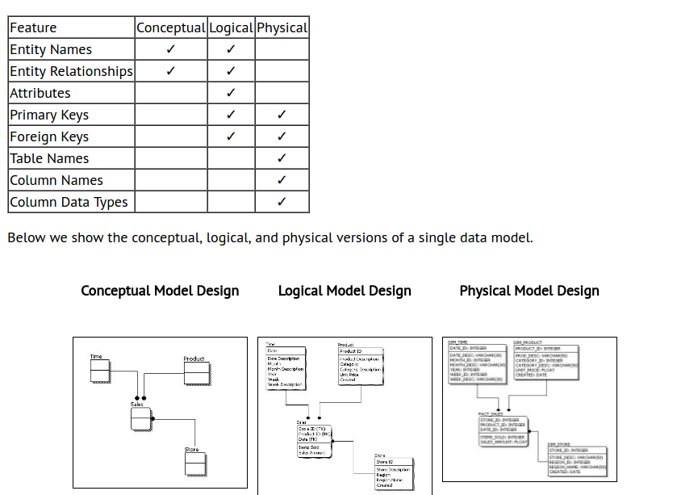
Notes:
Url of the image
https://i1.wp.com/generalassemb.ly/blog/wp-content/uploads/2014/11/Types-of-Data-Models.jpg?ssl=1

Slide 14
Topic 1
Database Keys
Used to establish and identify relation between tables.
Ensure that each record within a table can be uniquely identified.
Classification of Keys :
Super Key > Uniquely identifies each record within a table.
Superset of Candidate key.
Candidate Key > Set of fields from which primary key can be selected.
It is an attribute or set of attribute that can act as a primary key for a table.
Primary Key > Is a candidate key that is most appropriate to become main key of the table.
Uniquely identify each record in a table.
A table can have only one primary key.

Slide 15
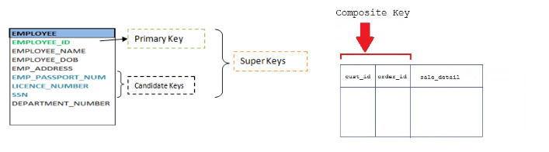
Topic 1
Database Keys
Composite Key > Key that consist of two or more attributes that uniquely identify an entity occurrence.
Any attribute that makes up the Composite key is not a simple key in its own.
Secondary/Alternative key > Candidate key which are not selected for primary key are known as secondary/ Alternative keys.

Slide 16
Topic 1
Constraints
NOT NULL constraint
Ensures that column does not accept nulls
UNIQUE constraint
Ensures that all values in column are unique
DEFAULT constraint
Assigns value to attribute when a new row is added to table
CHECK constraint
Validates data when attribute value is entered

Slide 17
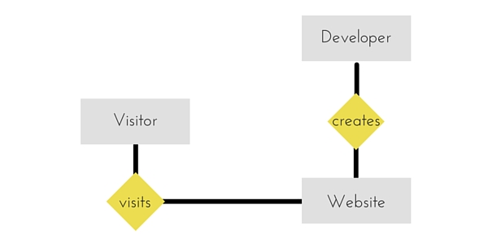
Topic 1
ER - Diagram
E-R Diagrams : Entity Relation Diagram
ER-Diagram is a visual representation of data that describes how data is related to each other.

Slide 18
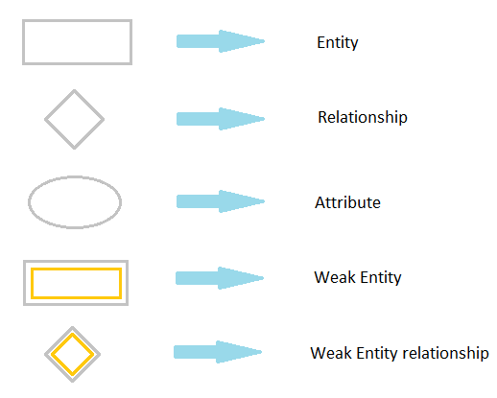
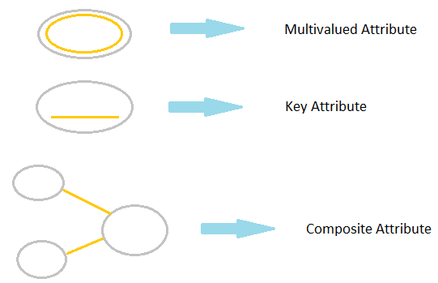
Topic 1
ER: Symbols and Notations
Notes:
A weak entity is one that can only exist when owned by another one. For example: a ROOM can only exist in a BUILDING. On the other hand, a TIRE might be considered as a strong entity because it also can exist without being attached to a CAR.

Slide 19


Topic 1
ER Diagram Components
1)Entity : An Entity can be any object, place, person or class.
Represented using rectangles.
Weak Entity: Entity that depends on another entity.
Weak entity doesn't have key attribute of their own.
Double rectangle represents weak entity.

Slide 20
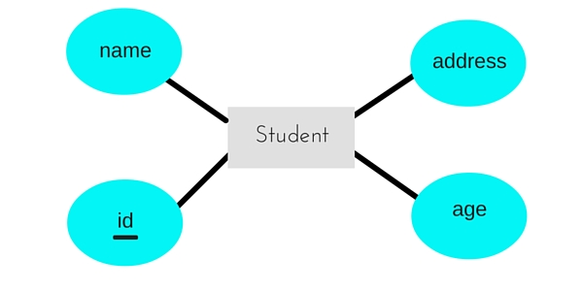
Topic 1
ER Diagram Components
2) Attribute : An Attribute describes a property or characteristic of an entity.
An attribute is represented using eclipse.
Key Attribute > Represents the main characteristic of an Entity.
It is used to represent Primary key.
Ellipse with underlying lines represent Key Attribute.

Slide 21
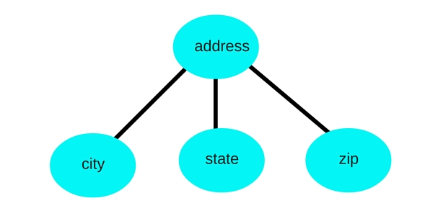
Topic 1
ER Diagram Components
Composite Attribute > An attribute can also have their own attributes. These attributes are known as composite attribute

Slide 22
Functional Dependency
Functional Dependency is a constraint between two sets of attributes in a relation from a database. A functional dependency is denoted by arrow (→). If an attributed A functionally determines B, then it is written as A → B.
For example, employee_id → name means employee_id functionally determines the name of the employee.
A function dependency A → B means for all instances of a particular value of A, there is the same value of B.
A B
------
1 3
2 3
4 0
1 3
4 0

Slide 23
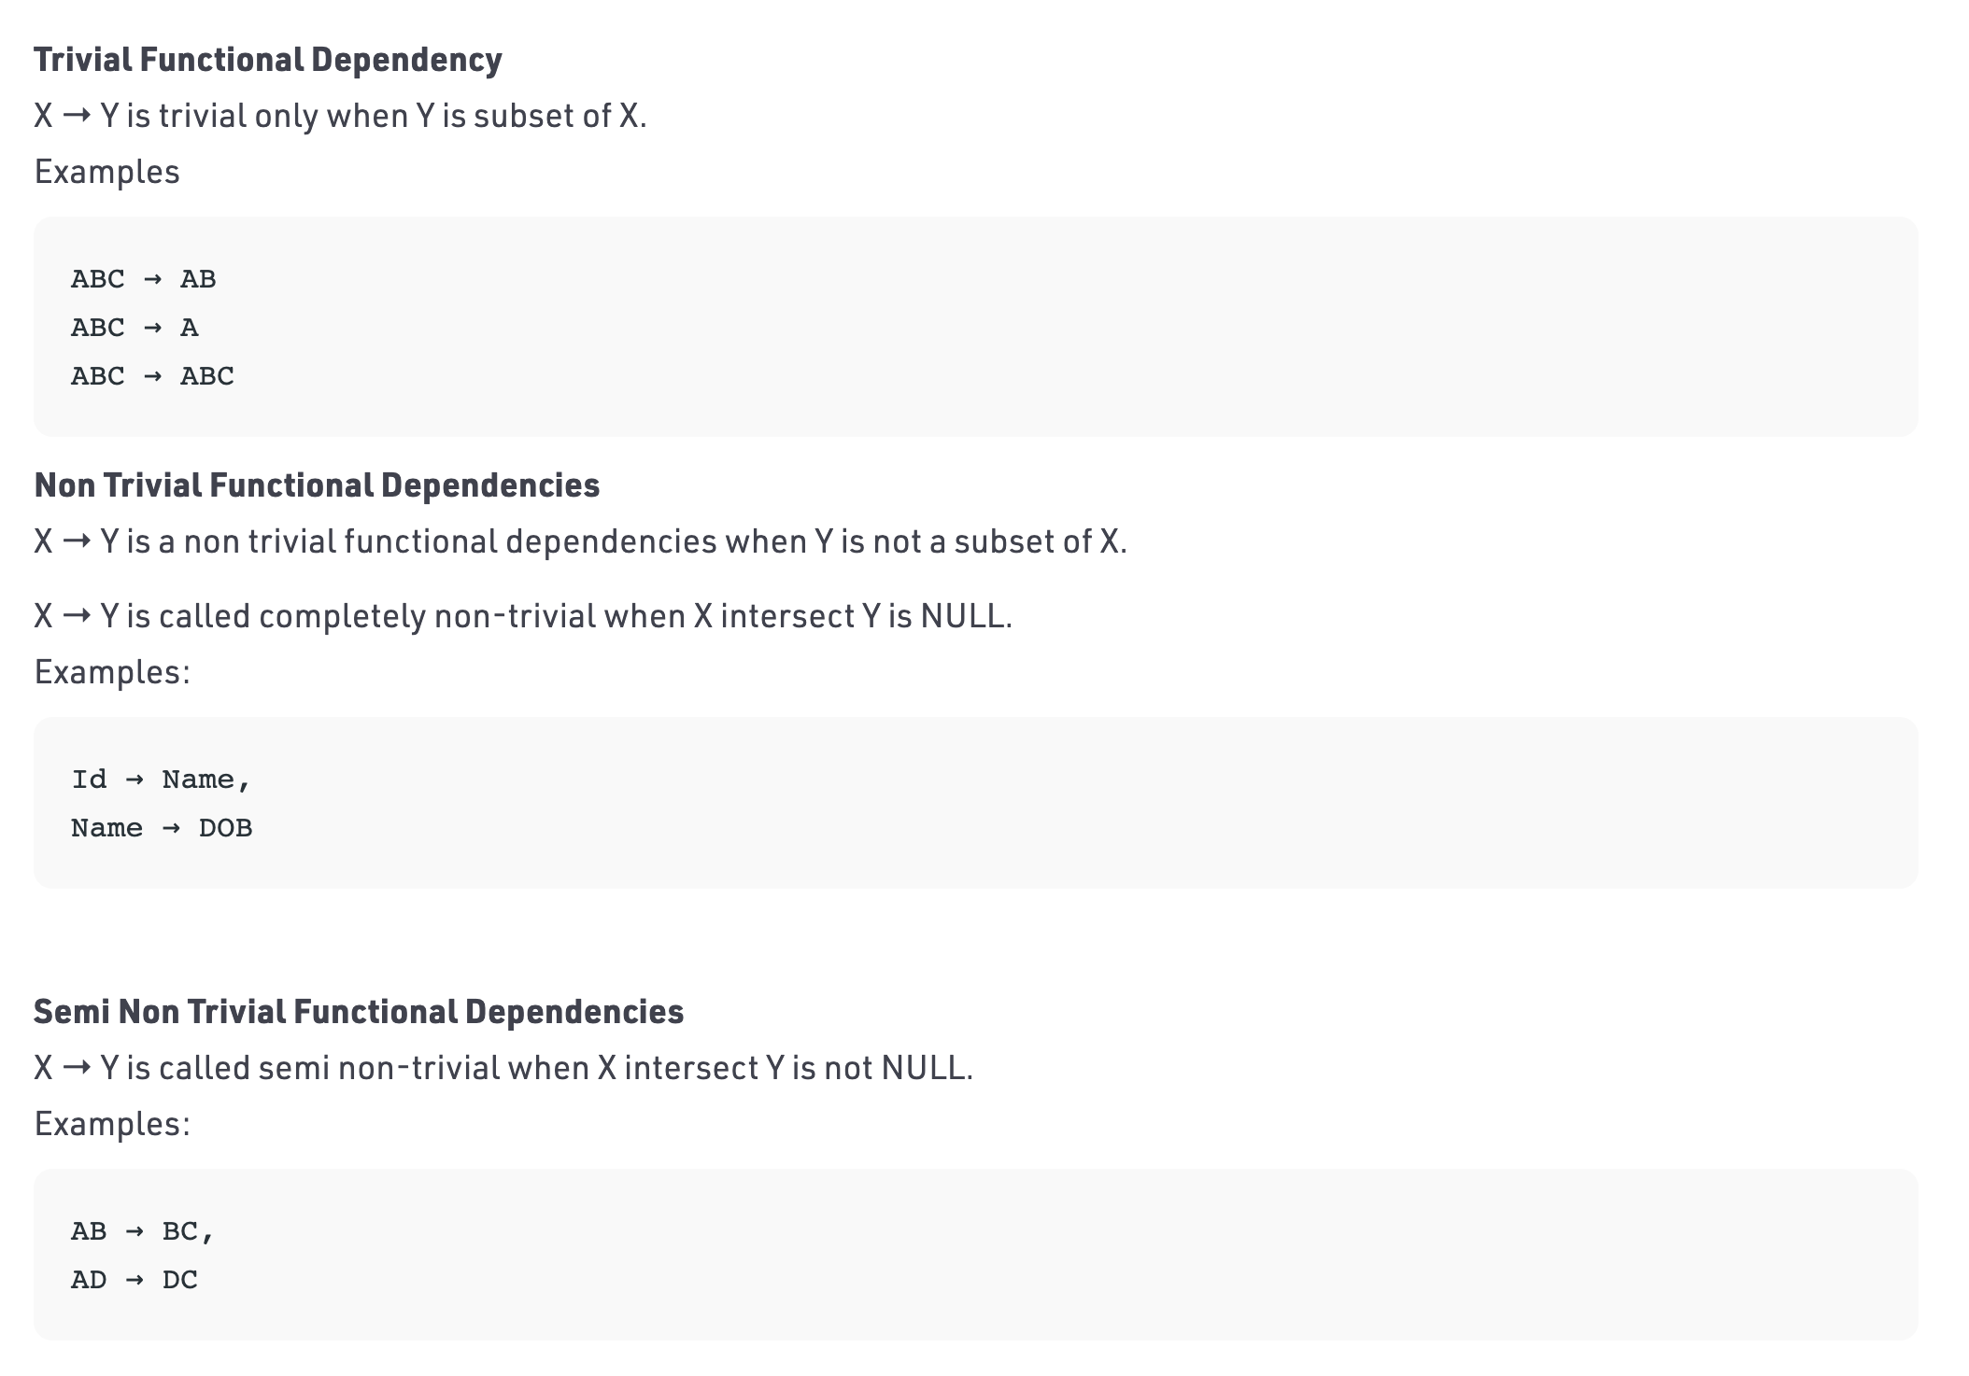
Types of Functional Dependencies

Slide 24
Normal Forms
Normalization is the process of minimizing redundancy from a relation or set of relations. Redundancy in relation may cause insertion, deletion and updation anomalies. So, it helps to minimize the redundancy in relations. Normal forms are used to eliminate or reduce redundancy in database tables.

Slide 25
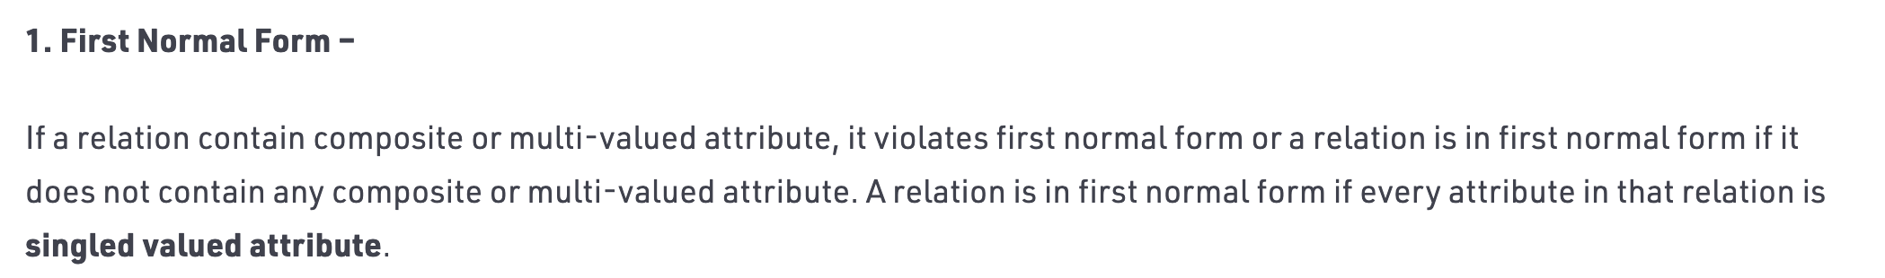
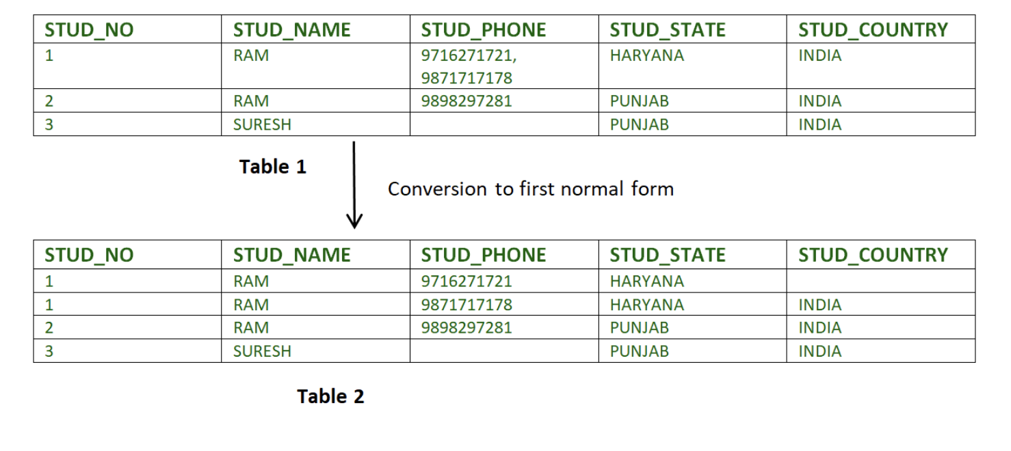

Slide 26
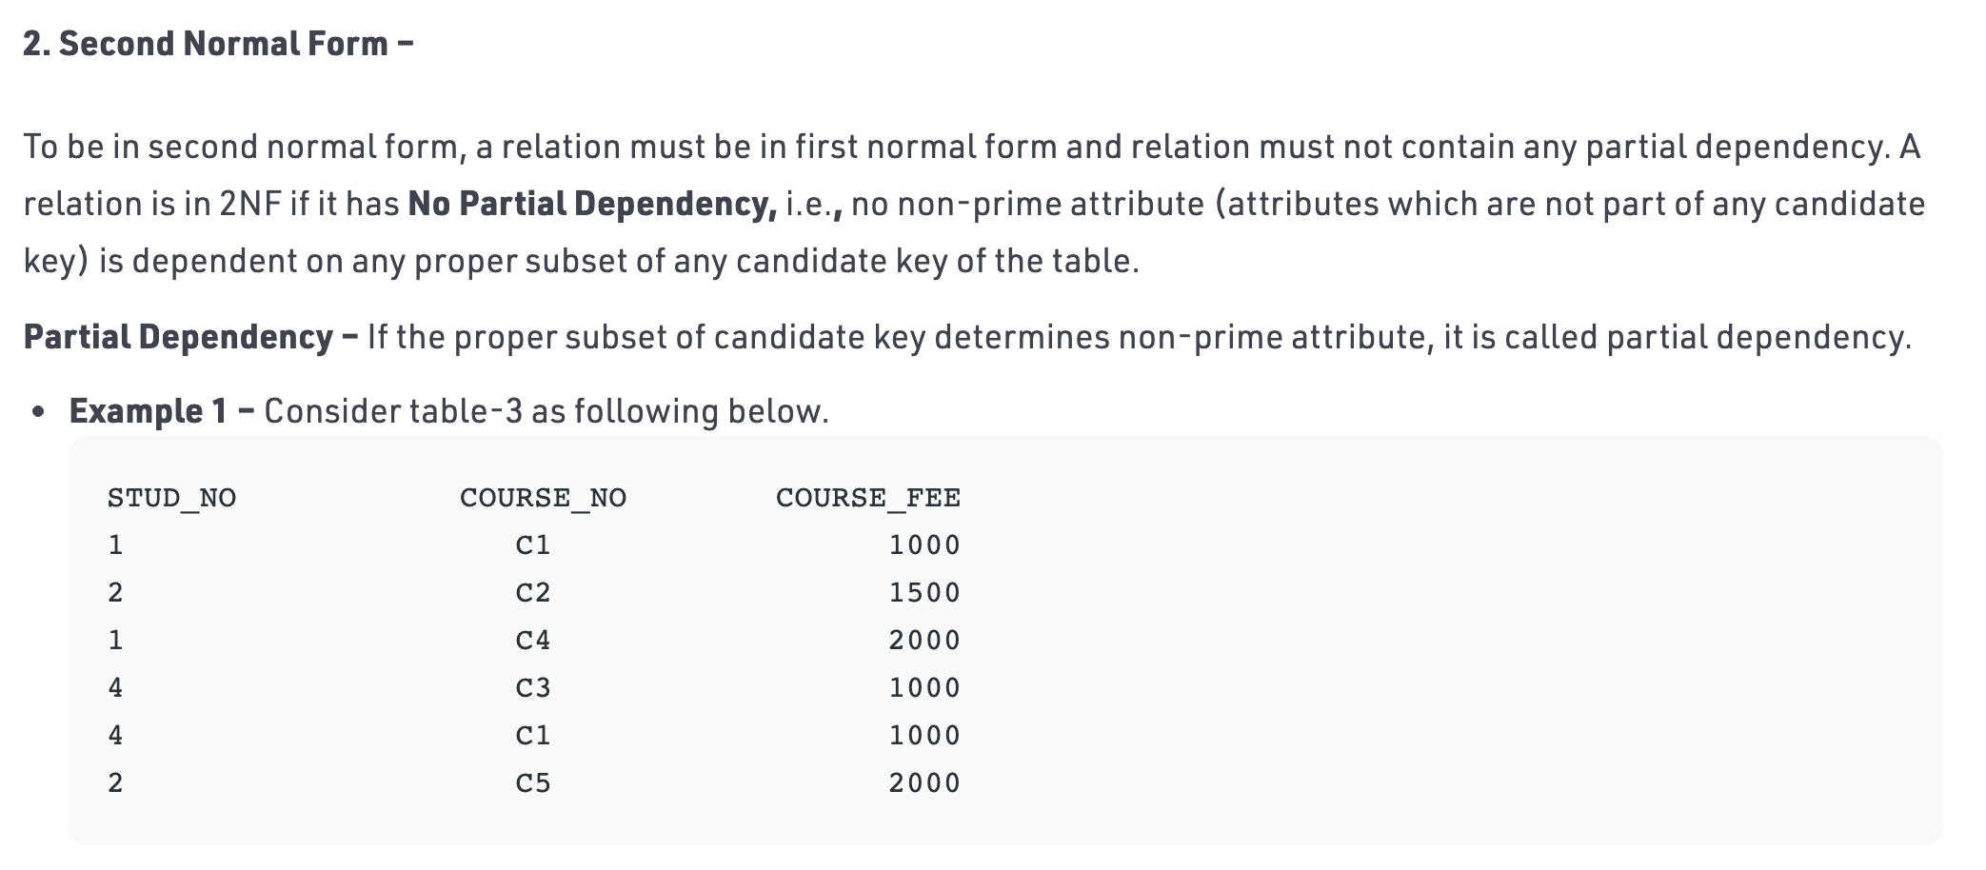

Slide 27
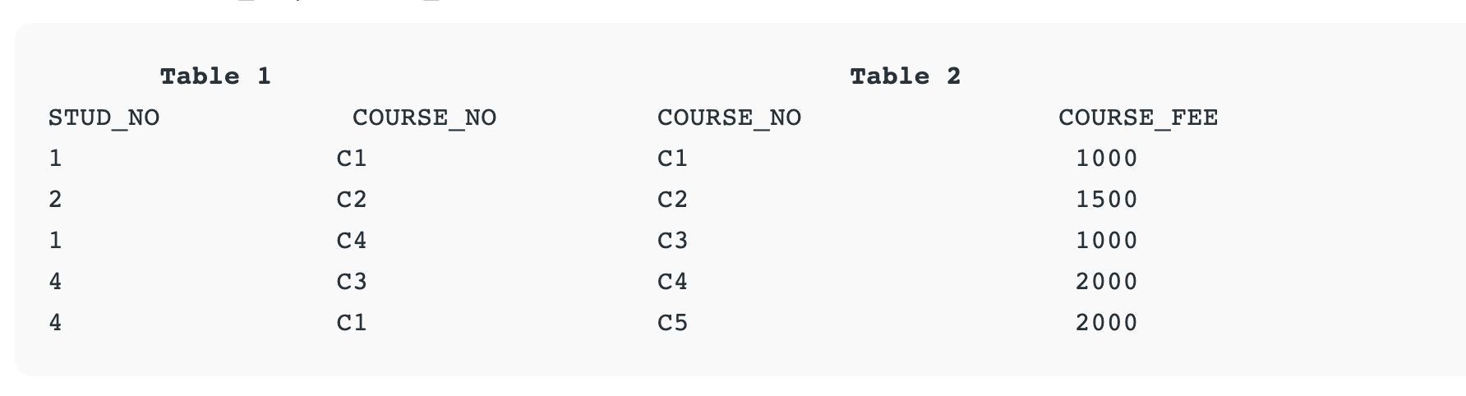
Notes:
NOTE: 2NF tries to reduce the redundant data getting stored in memory. For instance, if there are 100 students taking C1 course, we dont need to store its Fee as 1000 for all the 100 records, instead once we can store it in the second table as the course fee for C1 is 1000.

Slide 28
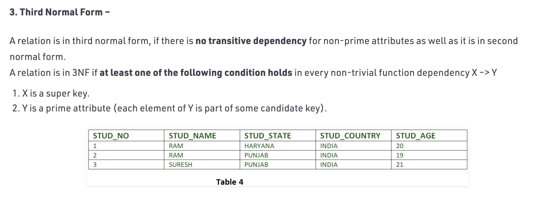

Slide 29
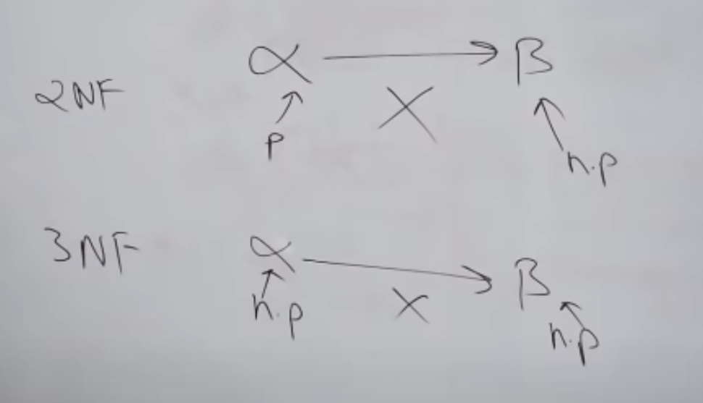
2. Boyce-Codd Normal Form (BCNF) : BCNF stands for Boyce-Codd normal form and was made by R.F Boyce and E.F Codd in 1947.A functional dependency is said to be in BCNF if these properties hold:
It should already be in 3NF.
For a functional dependency say P->Q, P should be a super key.

Slide 30
ACID Properties
ACID Properties : To ensure the integrity of data during a transaction (A transaction is a unit of program that updates various data items), the database system must maintains the following properties.
A - Atomicity − By this, we mean that either the entire transaction takes place at once or doesn’t happen at all. There is no midway i.e. transactions do not occur partially. Each transaction is considered as one unit and either runs to completion or is not executed at all. It involves following two operations.
—Abort: If a transaction aborts, changes made to database are not visible.
—Commit: If a transaction commits, changes made are visible.
Atomicity is also known as the ‘All or nothing rule’.
C- Consistency − The database must remain in a consistent state after any transaction. No transaction should have any adverse effect on the data residing in the database. If the database was in a consistent state before the execution of a transaction, it must remain consistent after the execution of the transaction as well.
Notes:
EXAMPLE FOR CONSISTENCY
For example, in an application that transfers funds from one account to another, the consistency property ensures that the total value of funds in both the accounts is the same at the start and end of each transaction.

Slide 31
Topic 1
ACID Properties
I- Isolation − In a database system where more than one transaction are being executed simultaneously and in parallel, the property of isolation states that all the transactions will be carried out and executed as if it is the only transaction in the system. No transaction will affect the existence of any other transaction.
D- Durability − The database should be durable enough to hold all its latest updates even if the system fails or restarts. If a transaction updates a chunk of data in a database and commits, then the database will hold the modified data. If a transaction commits but the system fails before the data could be written on to the disk, then that data will be updated once the system springs back into action.

Slide 32
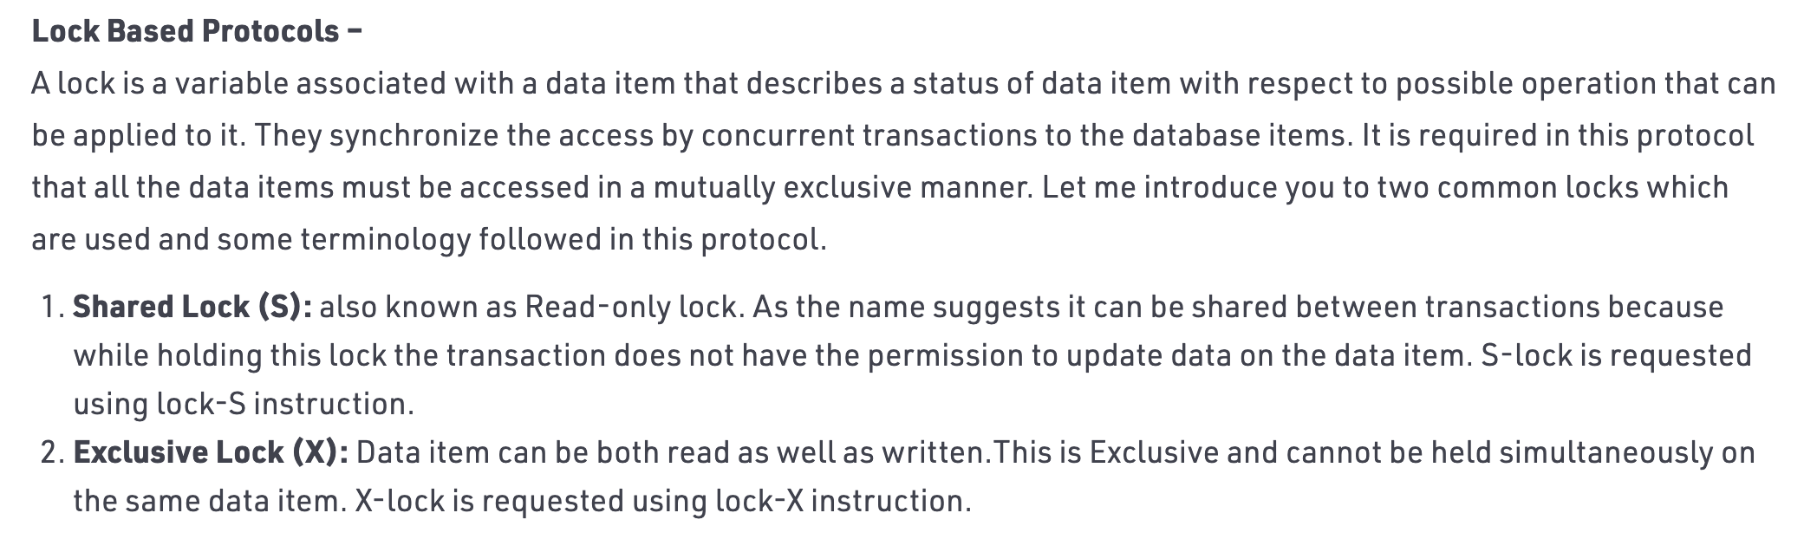

Slide 33
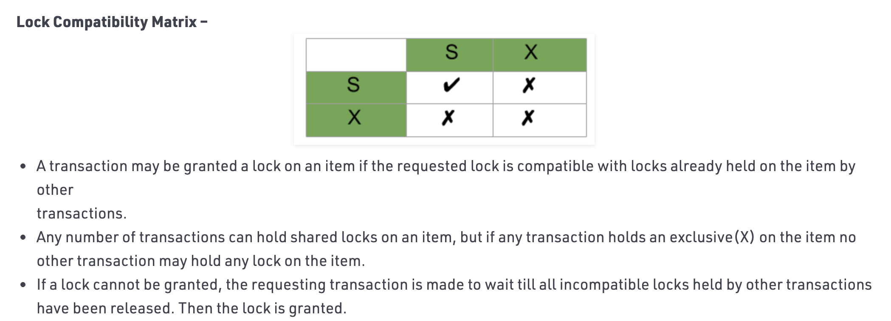
Upgrade / Downgrade locks : A transaction that holds a lock on an item A is allowed under certain condition to change the lock state from one state to another.
Upgrade: A S(A) can be upgraded to X(A) if Ti is the only transaction holding the S-lock on element A.
Downgrade: We may downgrade X(A) to S(A) when we feel that we no longer want to write on data-item A. As we were holding X-lock on A, we need not check any conditions.

Slide 34

Q & A
Any Question?

