Slide 1
Clustering

Slide 2
TYPES
Bisecting K-means clustering
Agglomerative clustering
BIRCH clustering
Mean shift clustering
Affinity propagation clustering
DBSCAN clustering
K-means clustering
HDBSCAN clustering
Optics clustering
Spectral clustering

Slide 3
Bisecting Kmeans clustering
Bisecting K-means is like repeatedly cutting a big group into smaller groups, each time improving the clustering by splitting the most suitable cluster. It combines the simplicity of K-means with a hierarchical approach to create clusters step-by-step.
How it works:
Start with One Big Cluster: Begin by treating all data points as a single cluster.
Bisect (Split) the Cluster: Divide this cluster into two smaller clusters using the K-means algorithm.
Choose the Best Cluster to Split: Pick one of the resulting clusters and split it further into two new clusters
Repeat: Continue this process of splitting and refining clusters until you reach the desired number of clusters or until further splitting doesn’t improve the results.

Slide 4
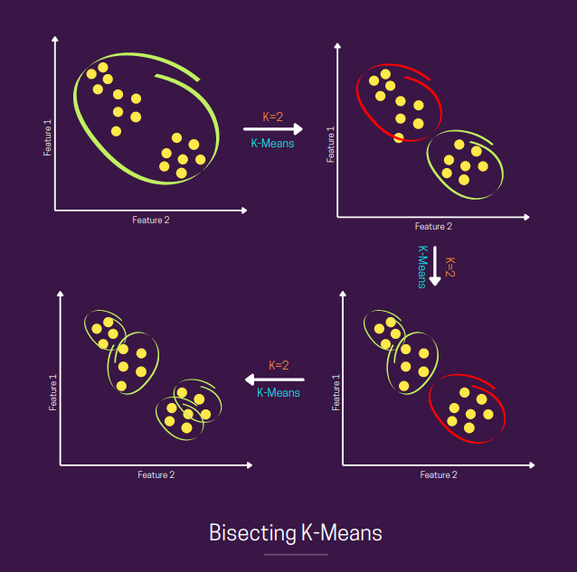

Slide 5
Advantages:
Improved Clustering Quality
Better Handling of Non-Spherical Clusters
Interpretability
Scalability
Disadvantages:
Computational Cost
Choice of Initial Splits
Fixed Number of Clusters
Complexity in Interpretation
Local Minima

Slide 6
Agglomerative clustering
Agglomerative Clustering is a type of hierarchical clustering method that builds clusters by progressively merging smaller clusters into larger ones.
Goal : To group data points into clusters by starting with each point as its own cluster and then combining clusters step-by-step.
How it works:
Start with Individual Points: Begin with each data point as its own separate cluster
Merge Closest Clusters: Find the two closest clusters and merge them into a single cluster.
Repeat: Continue merging the closest clusters until all points are grouped into a single cluster or until a desired number of clusters is achieved.
Create a Dendrogram: The process can be visualized using a dendrogram, a tree-like diagram showing how clusters are merged.

Slide 7
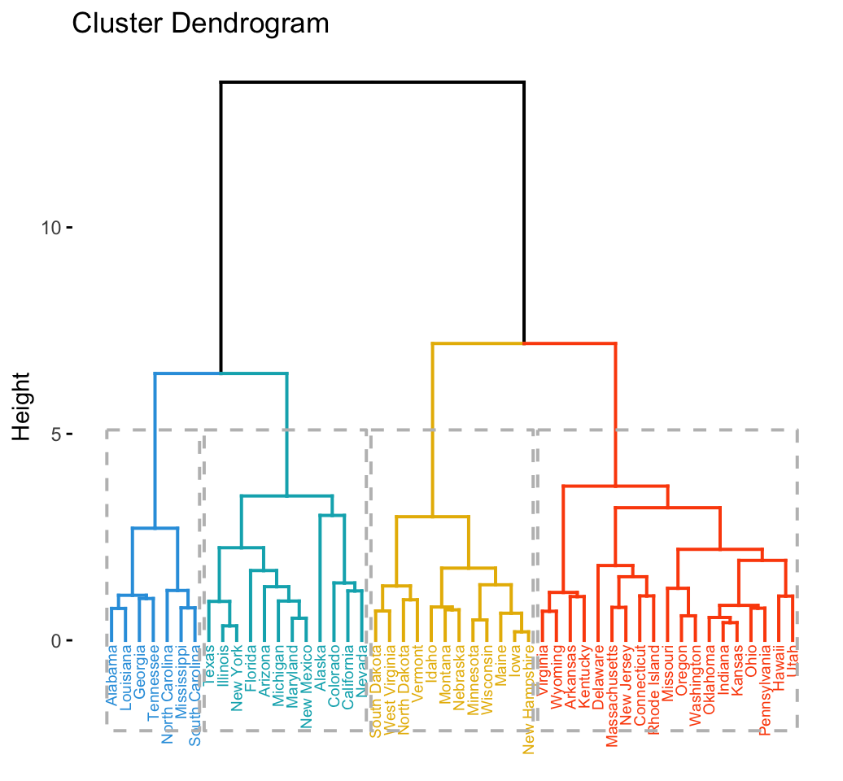

Slide 8
Advantages :
No Need to Specify Number of Clusters
Hierarchical Structure
Flexibility
Intuitive and Simple
Disadvantages :
Computational Complexity
Memory Usage
Sensitivity to Noise and Outliers
Lack of Scalability
Potential for Suboptimal Clustering
Fixed Clustering Structure

Slide 9
BIRCH Clustering
BIRCH (Balanced Iterative Reducing and Clustering using Hierarchies) is a clustering algorithm designed for large datasets. It aims to handle large-scale data efficiently and perform clustering in a memory-efficient way.
BIRCH is a hierarchical clustering algorithm that creates a clustering feature tree (CF Tree) to summarize and manage the dataset
BIRCH clusters large datasets by:
Balancing memory and computation,
Iteratively processing the data,
Reducing the data to manageable summaries (CF Tree),
Clustering the summarized data,
Using a hierarchical structure to efficiently organize and process the data.
This combination of techniques allows BIRCH to handle large-scale clustering problems effectively.

Slide 10
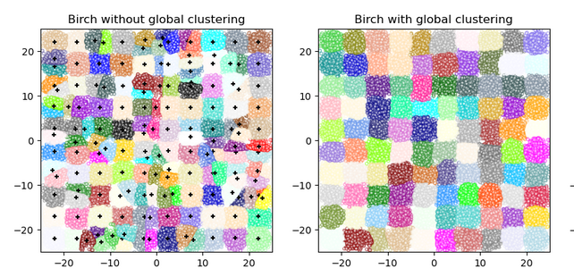

Slide 11
Advantages:
Scalability: Efficient for large datasets.
Memory Efficiency: Compact data representation with CF Tree.
Incremental Learning: Handles dynamic and streaming data.
Hierarchical Structure: Provides a hierarchical view of clusters.
Handling Noise and Outliers: More robust to noise and outliers.
Disadvantages:
Sensitivity to Parameters: Requires careful parameter tuning.
Not Ideal for All Data Types: Assumes spherical and evenly sized clusters.
Initial CF Tree Construction: Requires an initial pass over data.
Limited to Numerical Data: Primarily designed for numerical data.
Quality of Final Clustering: Depends on the subsequent clustering step (e.g., K-means).

Slide 12
MeanShift Clustering
Mean Shift Clustering is a clustering algorithm that identifies clusters by finding areas of high density in the data.
Goal: To group data points into clusters by moving to regions with the highest concentration of points(it's where data points are clustered closely together.).
How It Works:
Start with Data Points: Each data point is initially treated as a center of a cluster.
Shift Towards High Density: Move each center to the average position of nearby points within a certain distance (window or kernel).
Repeat: Continue shifting until the centers stabilize and no longer move significantly.
Form Clusters: Data points that converge to the same center are grouped into the same cluster.

Slide 13
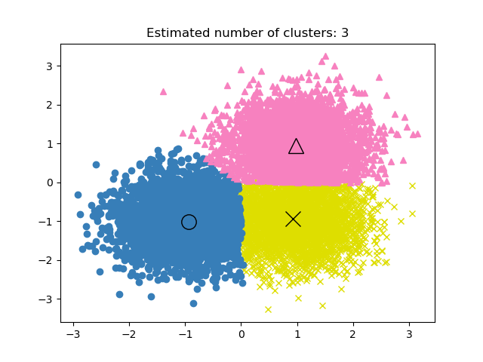

Slide 14
Advantages:
No Need to Specify Number of Clusters: Automatically determines the number of clusters.
Effective for Arbitrarily Shaped Clusters: Can find clusters of varying shapes.
Robust to Outliers: Less sensitive to outliers compared to some other algorithms.
Non-Parametric: Does not assume any specific distribution of the data.
Intuitive: The concept of moving to higher density regions is straightforward.
Disadvantages:
Computationally Intensive: Can be slow, especially for large datasets.
Bandwidth Sensitivity: Performance is sensitive to the choice of bandwidth (window size).
Requires Distance Metric: Performance depends on the choice of distance metric.
Can Struggle with Dense Regions: May have difficulties distinguishing between closely packed clusters.
Memory Usage: May require significant memory for large datasets due to the density estimation.

Slide 15
Affinity Propagation Clustering
Affinity Propagation is a clustering algorithm that identifies clusters by finding representative data points, called exemplars, and grouping other points around these exemplars based on similarity.
Goal: To group data points into clusters by choosing representative points (exemplars) and then assigning other points to these exemplars.
Here’s how it works:
Start with Similarity Matrix: Calculate how similar each data point is to every other point.
Message Passing: Exchange two types of messages between points:
Responsibility: Indicates how well a point fits as an exemplar for another point.
Availability: Indicates how suitable it is for a point to be an exemplar based on the overall data.
Update Messages: Iteratively update these messages until they stabilize.
Determine Clusters: Points that are assigned to the same exemplar form a cluster
Affinity Propagation is like finding the best representatives (exemplars) from the data and then grouping other points around these representatives based on how similar they are

Slide 16
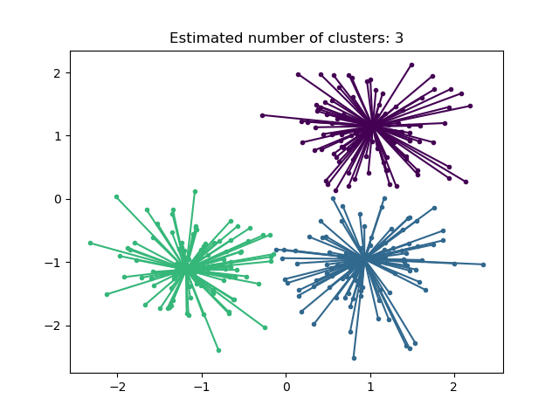

Slide 17
Advantages:
No Need to Specify Number of Clusters: Automatically determines the number of clusters.
Flexible to Different Shapes: Can handle clusters of various shapes and sizes.
Robust to Noise: Less sensitive to noise compared to some other clustering methods.
Handles Large Datasets: Can be effective for large datasets with appropriate tuning.
No Assumptions on Cluster Shape: Does not assume a specific shape for clusters.
Disadvantages:
Computationally Intensive: Can be slow and require significant computational resources.
Memory Usage: High memory usage due to the need for maintaining a similarity matrix.
Sensitive to Similarity Matrix: Performance is sensitive to the choice of similarity measure and parameters.
Convergence Issues: May converge to suboptimal solutions depending on initialization.
Complexity: More complex to understand and implement compared to some other clustering methods.

Slide 18
DBSCAN clustering
DBSCAN (Density-Based Spatial Clustering of Applications with Noise) is a clustering algorithm that groups together data points that are close to each other based on density and identifies points that are too far from any cluster as outliers.
Simple Meaning:
Goal: To find clusters by grouping together points that are densely packed and separating points that are sparse or isolated.
How It Works:
Define Density: Set two parameters:
Epsilon (ϵ\epsilonϵ): The maximum distance to consider for points to be neighbors.
MinPts: The minimum number of points required to form a dense region (cluster).
Find Core Points: Identify core points that have at least MinPts\text{MinPts}MinPts points within their ϵ\epsilonϵ-radius.
Expand Clusters: Group all neighboring points within the ϵ\epsilonϵ-radius of core points into clusters.
Identify Outliers: Mark points that are not part of any cluster as noise or outliers.
Summary
DBSCAN is like finding groups of data points that are closely packed together and separating those that are alone or far from any dense group, making it easy to spot clusters and outliers.

Slide 19
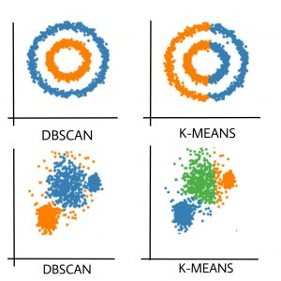

Slide 20
Advantages:
Can Find Arbitrarily Shaped Clusters: Handles clusters of various shapes and sizes.
No Need to Specify Number of Clusters: Automatically determines the number of clusters.
Robust to Noise: Effectively identifies and excludes outliers.
Flexible with Parameters: Allows for flexible density parameters (ϵ\epsilonϵ and minPts\text{minPts}minPts) to adapt to different datasets.
Handles Large Datasets: Can be efficient for large datasets with appropriate parameter tuning.
Disadvantages:
Parameter Sensitivity: Performance heavily depends on the choice of ϵ\epsilonϵ and minPts\text{minPts}minPts.
Difficulty with Varying Densities: Struggles with clusters of varying density.
Computational Complexity: Can be computationally intensive, especially for large datasets.
High-Dimensional Data: May perform poorly with high-dimensional data due to the curse of dimensionality.
Memory Usage: Requires substantial memory for large datasets due to neighbor searches.

Slide 21
K-means Clustering
K-means Clustering is a method for grouping data points into clusters based on their similarity by finding the center points (centroids) of clusters.
Simple Meaning:
Goal: To divide a set of data points into a specified number of clusters, where each cluster is centered around a central point.
How It Works:
Choose Number of Clusters: Decide how many clusters (K) you want.
Initialize Centers: Start by picking K initial center points randomly.
Assign Points: Assign each data point to the nearest center point, forming K clusters.
Update Centers: Recalculate the center of each cluster based on the points assigned to it.
Repeat: Repeat the assignment and update steps until the centers no longer change significantly.
Summary
K-means Clustering is like finding K central points in your data and grouping all nearby points around each central point, iteratively refining these central points to better represent each cluster.

Slide 22
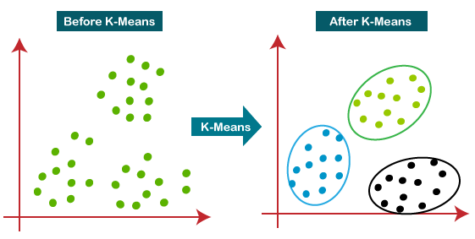

Slide 23
Advantages:
Simple and Easy to Implement: Straightforward and intuitive algorithm.
Efficient: Computationally efficient with a time complexity of O(n⋅k⋅d)O(n \cdot k \cdot d)O(n⋅k⋅d), where nnn is the number of points, kkk is the number of clusters, and ddd is the dimensionality.
Scalable: Works well with large datasets.
Clear Objective: Minimizes within-cluster variance, providing a clear objective function.
Convergence: Converges quickly in practice.
Disadvantages:
Requires Number of Clusters: Number of clusters kkk must be specified in advance.
Assumes Spherical Clusters: Assumes clusters are spherical and equally sized, which may not fit all data distributions.
Sensitive to Initialization: Results can vary depending on the initial choice of centroids.
Not Robust to Outliers: Outliers can disproportionately affect the cluster centroids.
Local Minima: May converge to local minima rather than the global optimum.

Slide 24
HDBSCAN clustering
HDBSCAN (Hierarchical Density-Based Spatial Clustering of Applications with Noise) is a clustering algorithm that groups data points based on density, while also creating a hierarchical structure to handle varying densities.
Simple Meaning:
Goal: To find clusters of different shapes and densities and identify outliers, while also providing a hierarchical view of the clusters.
How It Works:
Build Hierarchy: Create a hierarchy of clusters by progressively merging or splitting clusters based on density.
Identify Clusters: Use the hierarchy to find the most stable clusters that are consistent across different density levels.
Detect Noise: Mark points that don't fit well into any cluster as outliers or noise.
Summary
HDBSCAN is like finding clusters by looking at how dense areas of data points are, creating a layered structure of clusters, and then picking the most stable clusters while identifying points that don't belong to any cluster.

Slide 25
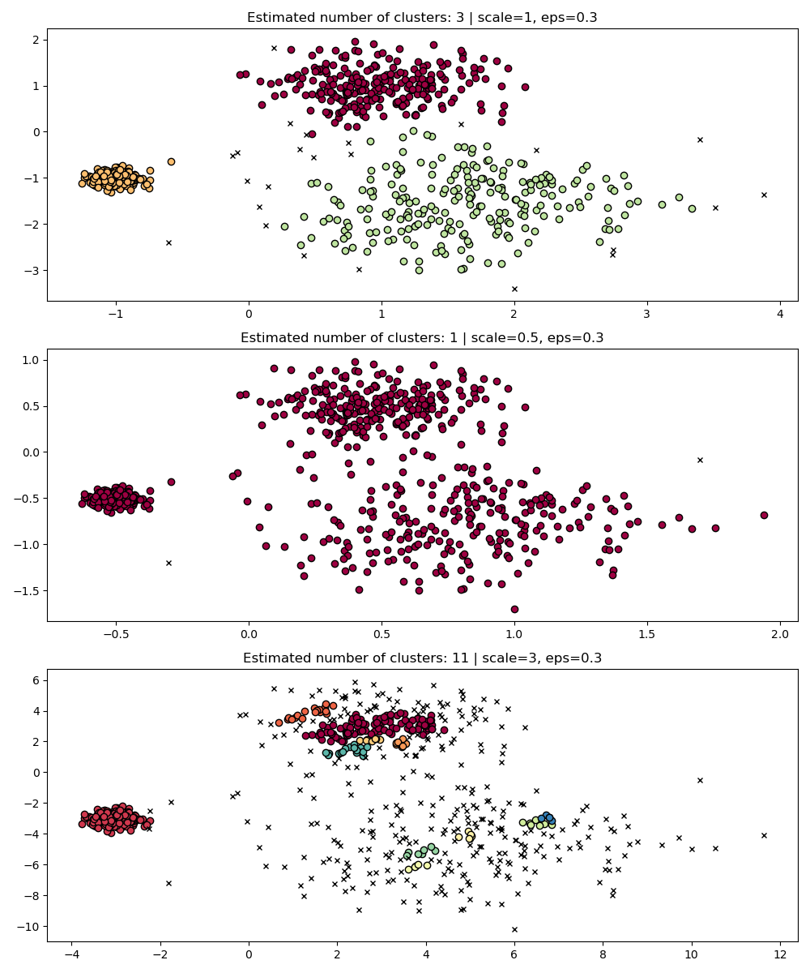

Slide 26
Advantages:
Can Find Clusters of Varying Shapes and Densities: Handles clusters of different shapes and densities.
No Need to Specify Number of Clusters: Automatically determines the number of clusters.
Robust to Noise: Effectively identifies and excludes outliers.
Hierarchical Clustering: Provides a hierarchical structure for cluster analysis.
Adaptive to Data Structure: Adapts to the local density variations in the dataset.
Disadvantages:
Computational Complexity: Can be computationally intensive, especially for large datasets.
Parameter Sensitivity: Performance depends on parameters like minimum cluster size and minimum samples.
Memory Usage: Requires significant memory for large datasets due to the need for distance matrices and hierarchical data structures.
Complexity in Interpretation: The hierarchical structure and stability measures can be complex to interpret.
High-Dimensional Data: May perform poorly with high-dimensional data due to the curse of dimensionality.

Slide 27
Optics clustering
OPTICS (Ordering Points To Identify the Clustering Structure) is a clustering algorithm that finds clusters based on density and creates an ordered list of points to reveal the structure of clusters at different density levels.
Simple Meaning:
Goal: To identify clusters of varying densities and provide a detailed view of how clusters are structured.
How It Works:
Compute Reachability: Calculate how far each data point is from its neighbors to understand the density.
Order Points: Create a sequence of points based on their reachability distance, showing how clusters form and change.
Extract Clusters: Analyze the ordered list to identify clusters of different shapes and densities.
Summary
OPTICS is like sorting data points by how dense their neighborhoods are and then using this sorted order to reveal the structure and relationships between clusters at various densities.

Slide 28
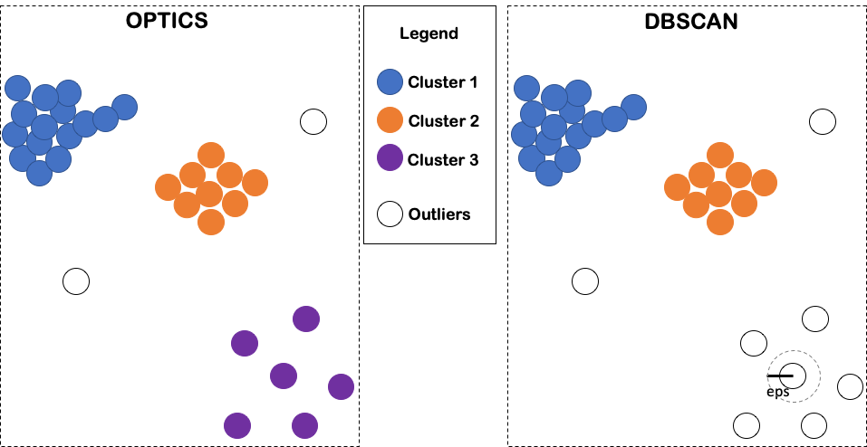

Slide 29
Advantages:
Can Find Clusters of Varying Shapes and Densities: Handles clusters with different shapes and densities.
No Need to Specify Number of Clusters: Automatically determines the number of clusters.
Robust to Noise: Effectively identifies and excludes outliers.
Flexible Density Handling: Adapts to varying density within the dataset.
Hierarchical Clustering Information: Provides a reachability plot that shows the clustering structure and hierarchy.
Disadvantages:
Computational Complexity: Can be computationally expensive for large datasets.
Parameter Sensitivity: Performance depends on parameters like minimum points and the reachability distance threshold.
Memory Usage: Requires significant memory due to storing the reachability distances.
Complexity in Interpretation: The reachability plot can be complex to interpret and analyze.
High-Dimensional Data: May struggle with high-dimensional data due to the curse of dimensionality.

Slide 30
Spectral clustering
Spectral Clustering is a method that uses the properties of a similarity matrix to find clusters in data, often revealing complex cluster structures.
Simple Meaning:
Goal: To group data points into clusters by analyzing the structure of the data’s similarity relationships.
How It Works:
Compute Similarity: Create a similarity matrix showing how similar each pair of data points is.
Use Graph Theory: Construct a graph from the similarity matrix and analyze its properties using matrix calculations.
Dimensionality Reduction: Transform the data into a lower-dimensional space using the results from the matrix calculations.
Cluster: Apply a clustering algorithm (like K-means) to the transformed data to identify clusters.
Summary
Spectral Clustering is like using the structure of a graph created from similarity information to simplify and uncover the cluster structure in the data.

Slide 31
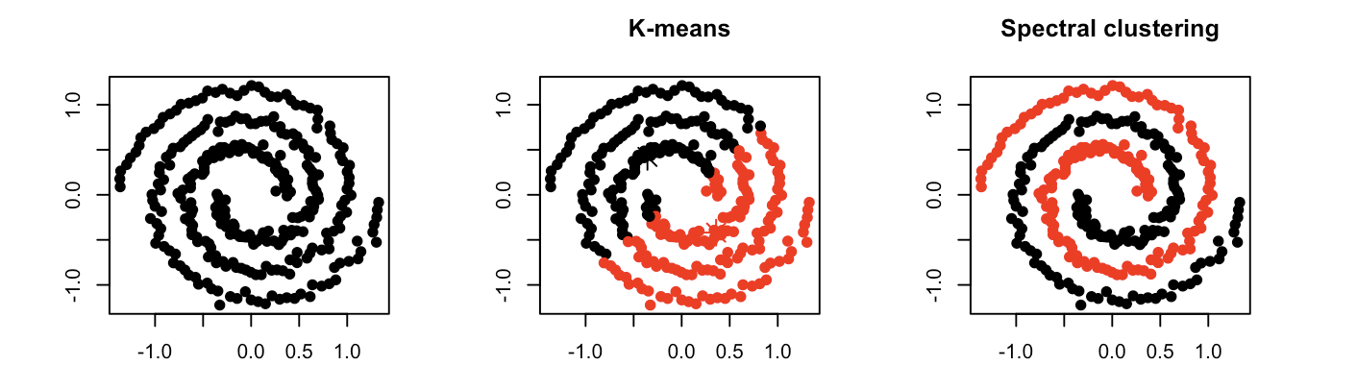

Slide 32
Advantages:
Effective for Complex Shapes: Can find clusters that are not necessarily spherical or convex.
Handles Non-linearly Separable Data: Suitable for datasets where clusters are connected in a non-linear way.
No Need to Specify Number of Clusters in Advance: Sometimes provides better results when combined with algorithms that automatically determine the number of clusters.
Robust to Noise: Less sensitive to noise compared to some other methods.
Disadvantages:
Computational Complexity: Computationally expensive, especially for large datasets.
Memory Usage: High memory usage due to the need to compute and store the similarity matrix.
Parameter Sensitivity: Sensitive to the choice of similarity measure and parameters (e.g., the number of eigenvectors).
High-Dimensional Data: May not perform well with very high-dimensional data due to the curse of dimensionality.
Complexity: Requires multiple steps and intermediate calculations, making it more complex to implement and tune.

