Slide 1
Boosting Algorithm
Adaboost
XGBoost
LightGBM

Slide 2
Adaboost
Description: Overview of how Adaboost works (iterative training, emphasis on misclassified examples).
Image: Diagram illustrating the boosting process in Adaboost.
Advantages:
Improved generalization.
Versatility with different base learners.
Disadvantages:
Sensitivity to noisy data and outliers.
Applications:
Face detection, object detection, text classification.

Slide 3
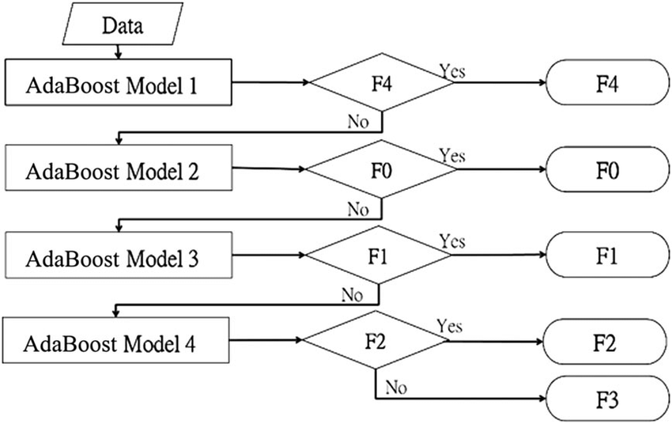
AdaBoost

Slide 4
XGBoost (Extreme Gradient Boosting)
Description: Explanation of XGBoost (gradient boosting framework, regularization, parallel processing).
Image: Visual representation of decision tree boosting in XGBoost.
Advantages:
High performance and efficiency.
Feature importance estimation.
Disadvantages:
Requires careful tuning of parameters.
Potential for overfitting.
Applications:
Kaggle competitions, structured data analysis, customer churn prediction.

Slide 5
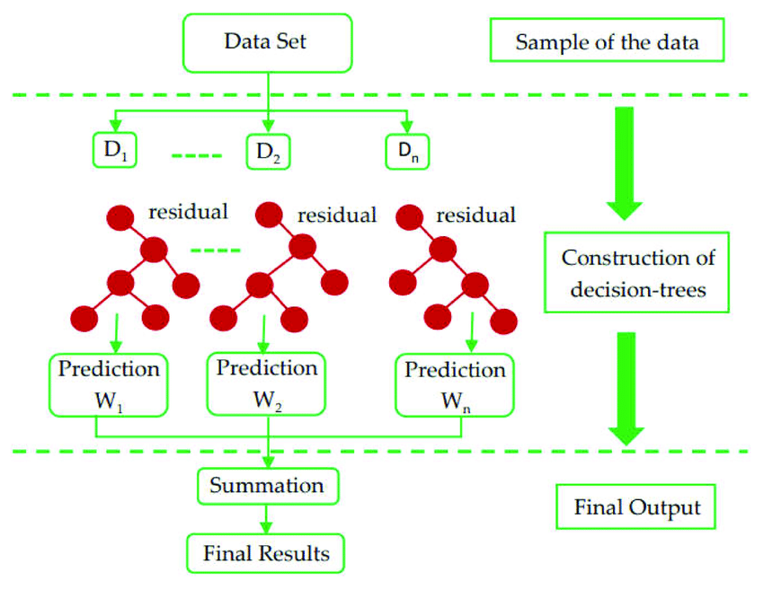
XGBoost

Slide 6
LightGBM (Light Gradient Boosting Machine)
Description: Overview of LightGBM (histogram-based algorithm, leaf-wise growth strategy).
Image: Diagram illustrating the leaf-wise growth in LightGBM.
Advantages:
Fast training speed and low memory usage.
Effective handling of large-scale data.
Disadvantages:
More sensitive to overfitting.
Applications:
Click-through rate prediction, recommendation systems, ranking tasks.

Slide 7
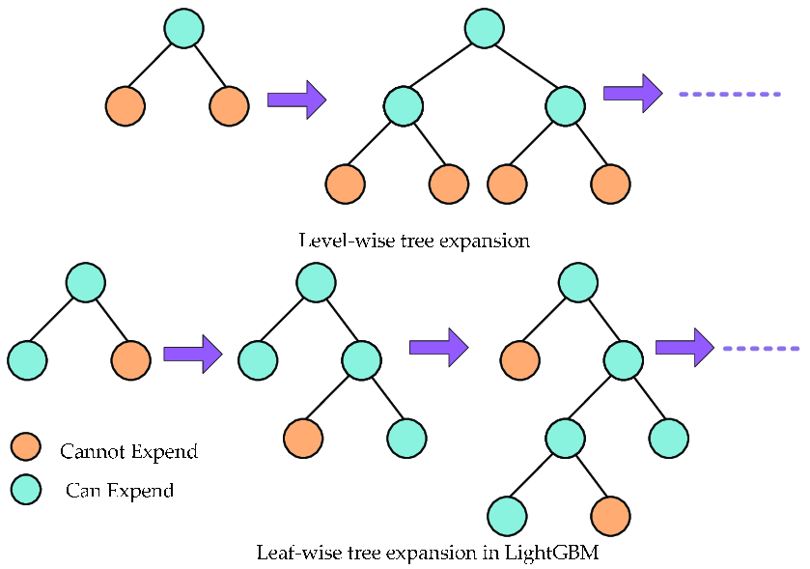
LightGBM

