Slide 1
Gender disparity in microfinance
Nandhini Sridhar

Slide 2
How does the money supply impact the gender ratio of micro-loan recipients?
Original goals of microfinance
Alleviate poverty by providing people with credit to increase earnings through self employment
Economic emancipation for women
Now: Microfinancing not only used for enterprises
Studies show male borrowers see greater profits
Could be because female borrowers invest into other areas

Slide 3
How has lending changed and why
Are Microfinancing Institutions (MFIs) lending to women?
World Bank MIX Market data on MFIs
Supply of money – Gross Loan Portfolio (GLP)
Percentage of female borrowers

Slide 4
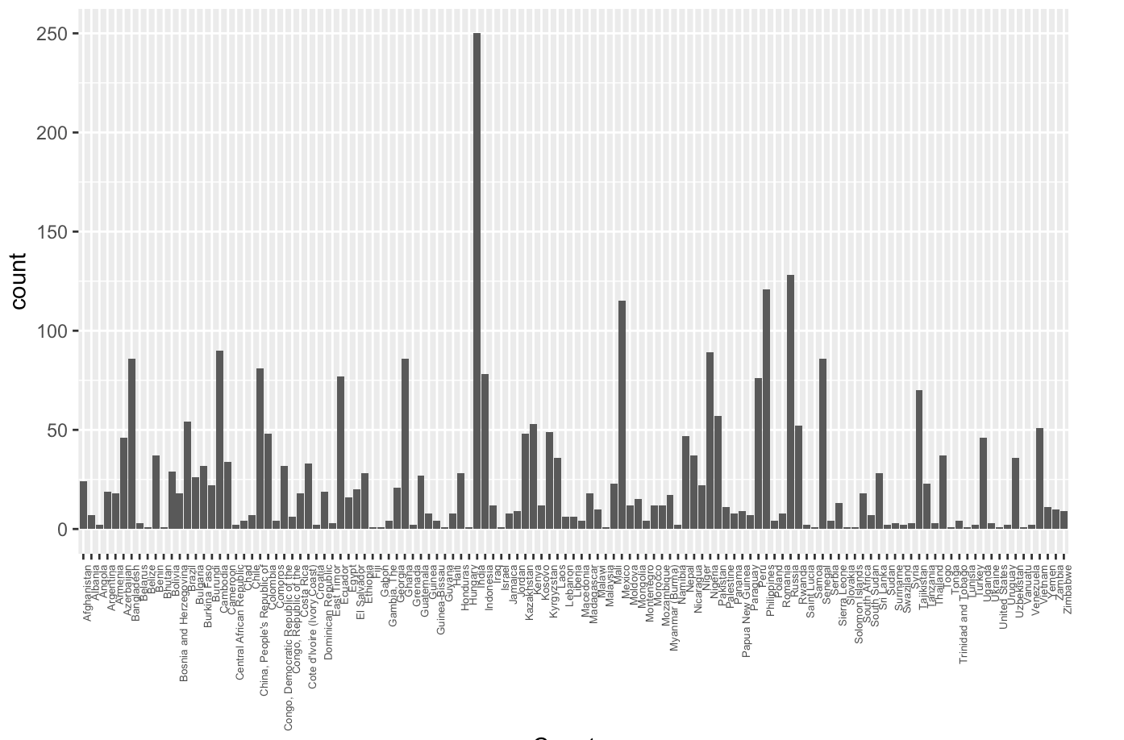
Number of MFIs
Highest number: India
Highs in counties in South Asia, Latin America, Africa

Slide 5
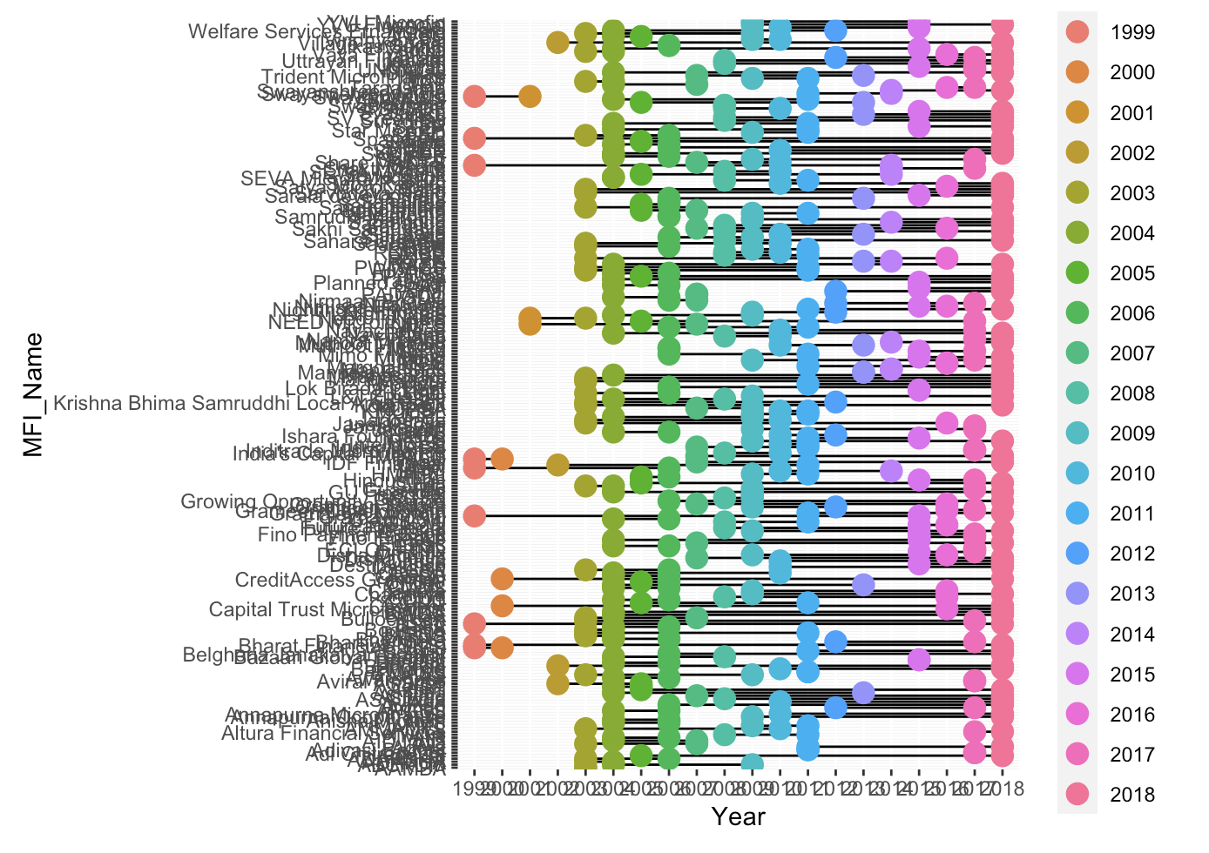
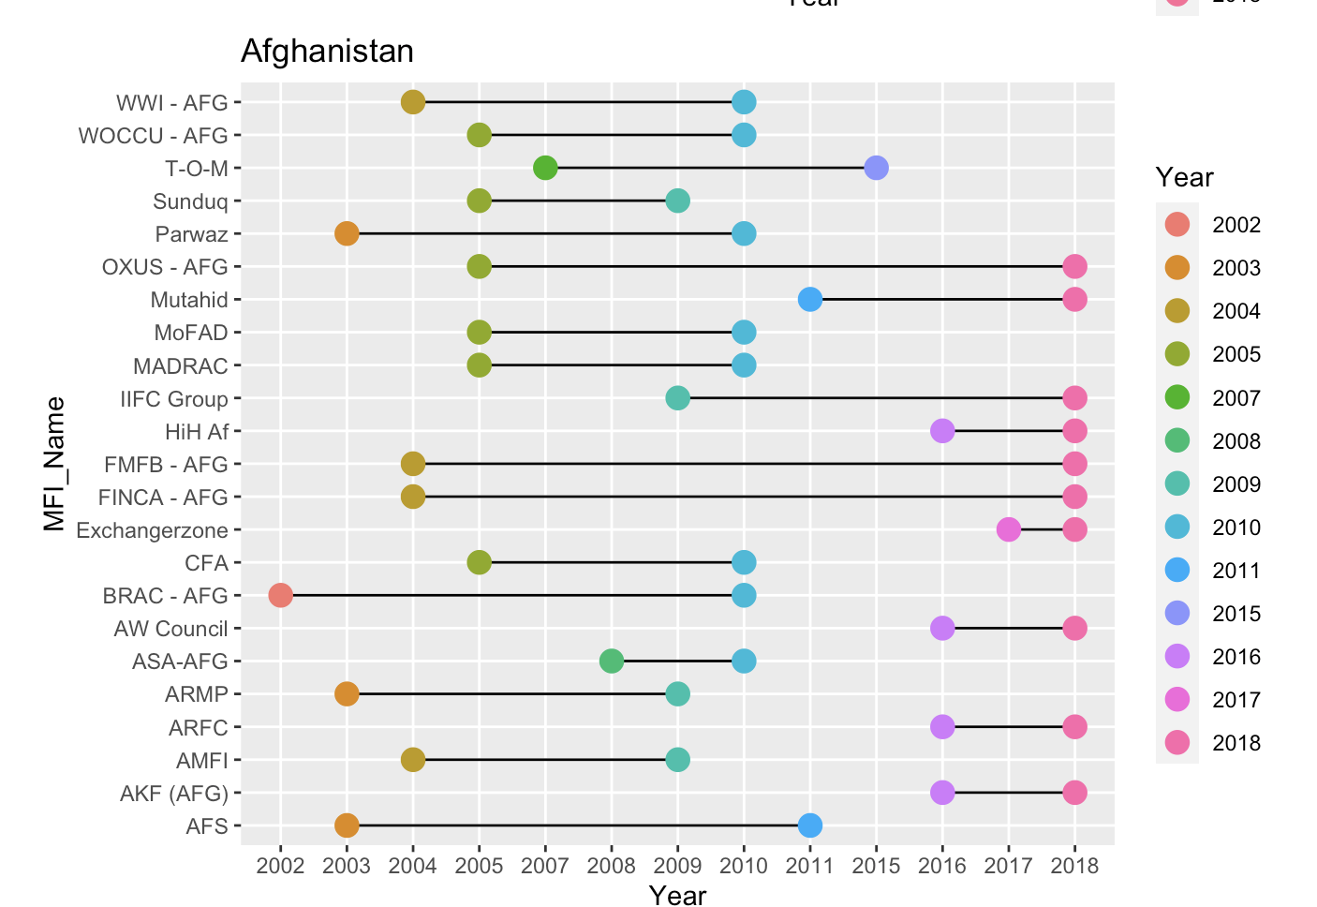
Unbalanced Panel

Slide 6
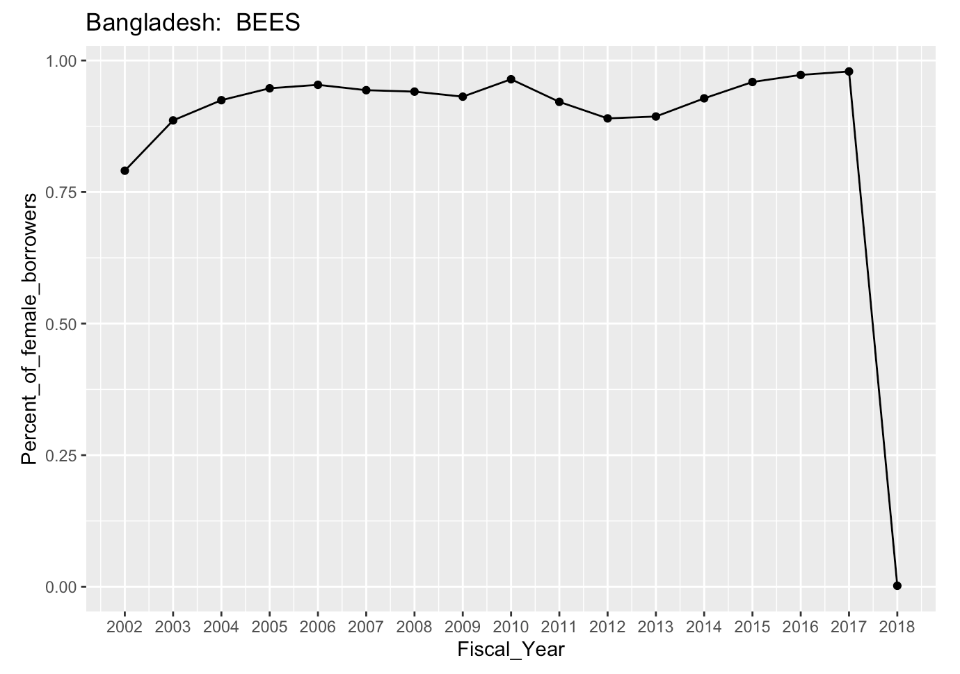
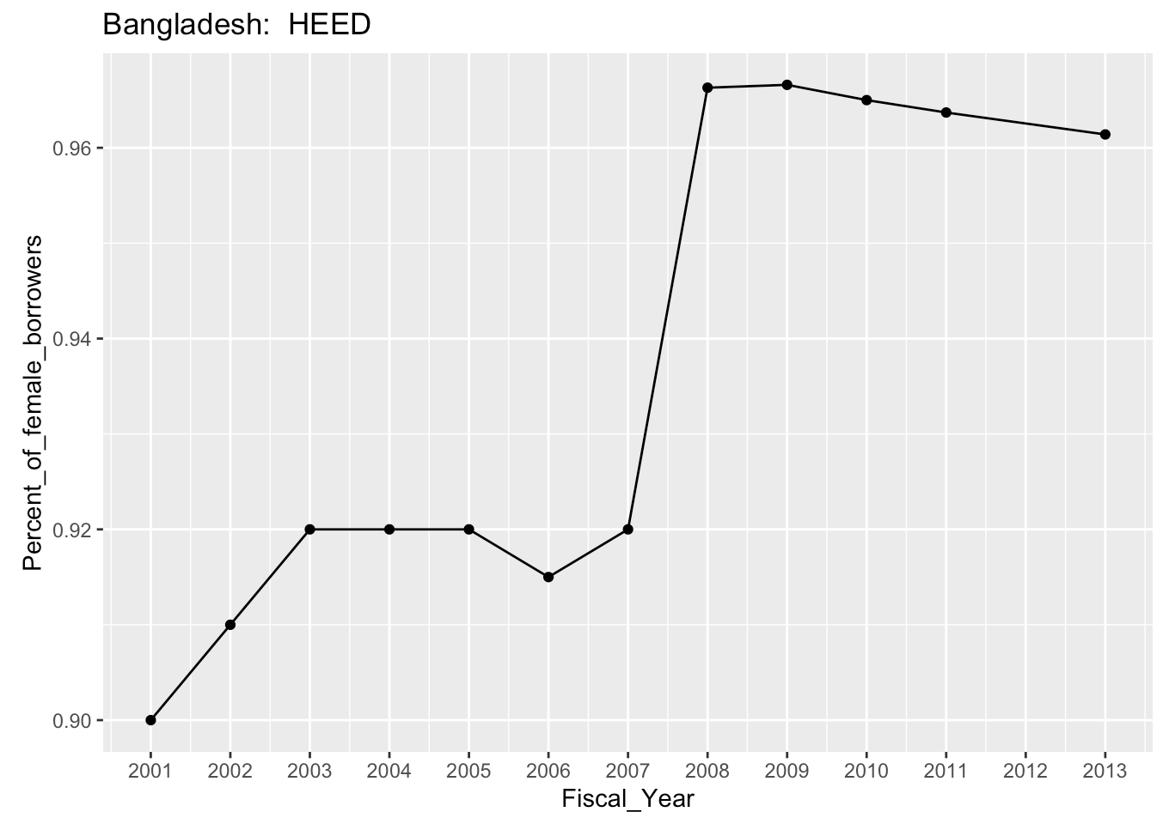
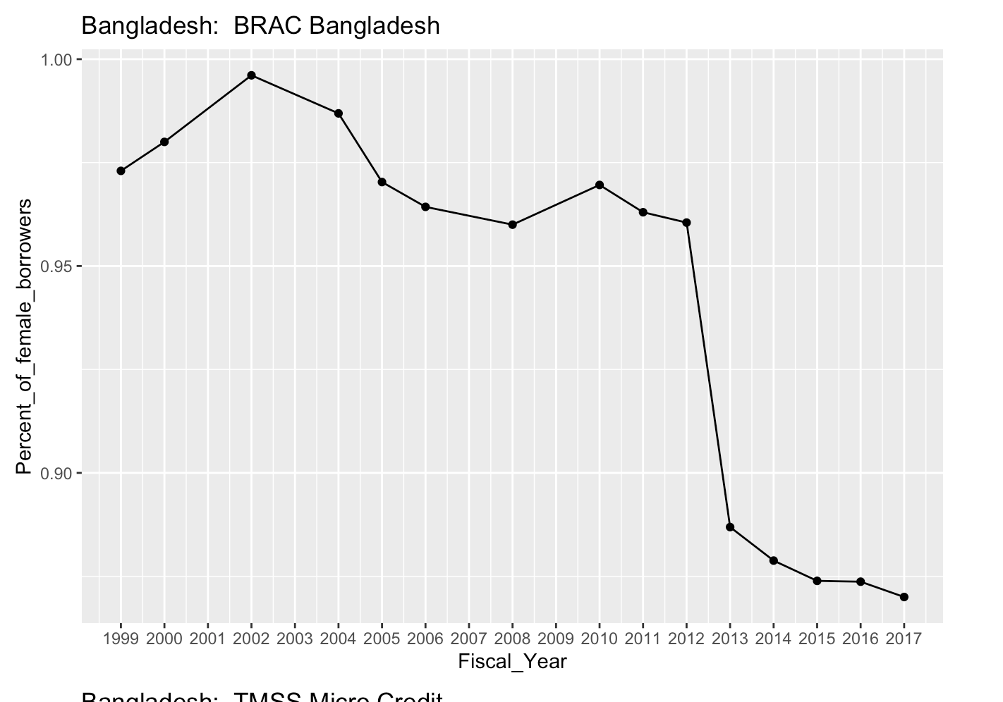
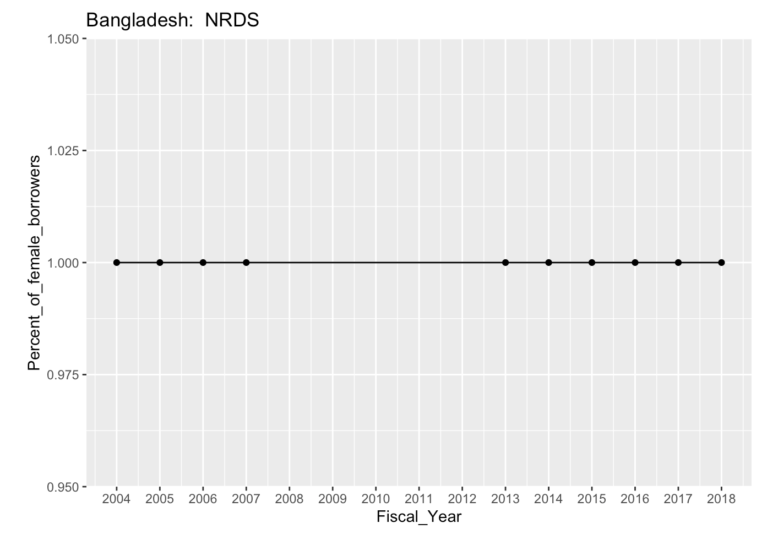
Fluctuating Trends in percentage of female borrowers

Slide 7

Empirical Model
Fixed Effects
$$Y_{it}= β_{0}+ β_{1}∗log\left(GLP\right)+ α_{i}+ λ_{t}+ ε_{it}$$

Slide 8
Results
Impact of log GLP on percentage of female borrowers currently fairly small (-0.353) and not statistically significant
MFI Fixed Effects
Even smaller with region fixed effects (-0.0357)
Limited to Latin America, South Asia, Sub Saharan Africa
Impact of Interest Rates on log GLP: statistically significant but small (-0.059)
Without instrument:
Country fixed effects: small but statistically significant (-0.014)
Region fixed effects: small but statistically significant (-0.0136)
Looking for better instrument, may have to tweak model

Slide 9
Questions/Comments

