Slide 1
Employee Data Analysis using Excel
STUDENT NAME: NANDHINI. P
REGISTER NO: 312217009 (5D3114284058CBBB6C1402F207025881)
DEPARTMENT: B. Com (GENERAL)
COLLEGE: SHRI KRISHNASWAMY COLLEGE FOR WOMEN,
ANNA NAGAR.

Slide 2
PROJECT TITLE EMPLOYEE PERFORMANCE ANALYSIS

Slide 3


AGENDA
Problem Statement
Project Overview
End Users
Our Solution and Proposition
Dataset Description
The wow in our solution
Modelling Approach
Results and Discussion
Conclusion
3/21/2024 Annual Review

Slide 4

PROBLEM STATEMENT
The purpose of finding employees performance analysis is to Evaluate individual performance by their Work quality, productivity and contribution towards the organisation.
By using employee performance analysis we can Conduct training program for those who have skill gaps and Knowledge deficiencies.

Slide 5

PROJECT OVERVIEW
Employee analysis involves collecting and examining data to understand an employee’s strength, weakness and areas of improvement.
The performance of the employee is analysed by considering the various factors like Gender, score, ratings, achievements, type of work, etc.

Slide 6


WHO ARE THE END USERS?
HR Professionals
Managers and supervisors
Employees
Leaders and executives
Training and development teams
Compensation and benefit teams
Succession planning teams
External stake holders

Slide 7

OUR SOLUTION AND ITS VALUE PROPOSITION
Conditional formatting ( to find the blank column)
Filtering( to remove the blank elements in the column)
Pivot table
Graph data visualization (Column chart)

Slide 8
Dataset Description
Employee ID
Name
Gender
Department
Performance score
Current employee rating
Employee performance
Employee type
Employee status

Slide 9

THE "WOW" IN OUR SOLUTION
PERFORMANCE LEVEL
=IFS(F2=5,”Very high”,F2=4,”High”,F2=3,”Medium”,F2=2,”Low”,True,”Very low”)
3/21/2024 Annual Review
9

Slide 10
MODELLING
DATA COLLECTION
Identification
Gathering
Preparation
DATA CLEANING
Standardization
Correction
Validation
SUMMARY
Data analysis involves examining, transforming, and modelling data to Extract insights, identify patterns, and support decisions-making.
10

Slide 11
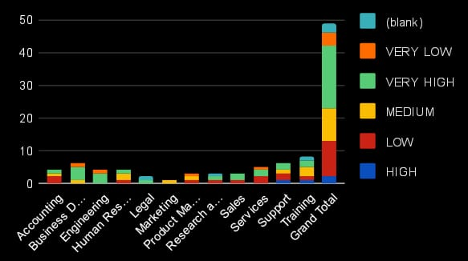
RESULTS
11

Slide 12
conclusion
In conclusion, the employee data analysis conducted using Excel Provided valuable insights into workforce trends enabling more Informed decision-making. The use of Excel allowed efficient data organization. Visualization and reporting, ultimately helping to enhance HR strategies, improve and employee satisfaction and optimize overall organizational performance.

Slide 13
THANK YOU

