Slide 1
Customer Engagement
Platform
Capstone Project
Developed By: Nandhini Mogane
ASP.NET Core MVC (.NET 8)
SQL Server
EF Core
JWT Auth
Docker
Swagger

Slide 2
Problem Statement
Business Problem
Proposed Solution
Manage customer information centrally
Customer Engagement Platform
Track service requests & tickets
Improve support team efficiency
Modern
Secure
CEP
Secure REST APIs from unauthorized access
Enable future cloud deployment
Efficient
Scalable

Slide 3
Project Objectives
✔
Customer Management
✔
Ticket Management
Add, view, edit & delete customer records
Full CRUD for service ticket operations
✔
REST API Development
✔
JWT Authentication
Well-documented APIs via Swagger
Secure token-based login system
✔
Role-Based Authorization
✔
Database Integration
Admin & Support Executive roles
SQL Server with EF Core & ADO.NET
✔
DevOps Readiness
Docker containerization & CI/CD pipeline

Slide 4
Technology Stack
Frontend
Backend
Database
Security
DevOps
Razor Views
ASP.NET Core MVC
SQL Server
JWT Authentication
Docker Container
HTML / CSS
C# Language
EF Core
Role-Based Auth
GitHub Actions CI/CD
AJAX
REST Controllers
ADO.NET
Password Hashing
Azure App Service

Slide 5
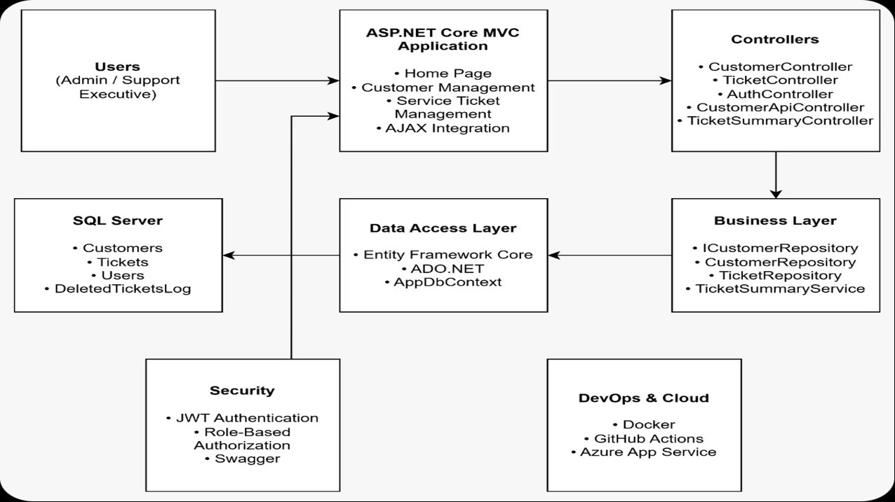
System Architecture

Slide 6
Data Flow Diagram (DFD)
User
MVC View
Controller
Repository
Database
Admin / Support Exec
Razor / HTML / AJAX
Request Handling
Business Logic
SQL Server
▶
▶
▶
▶
Smooth, layered communication between UI and Database through clean separation of concerns.
← Response flows back to user after DB processing

Slide 7
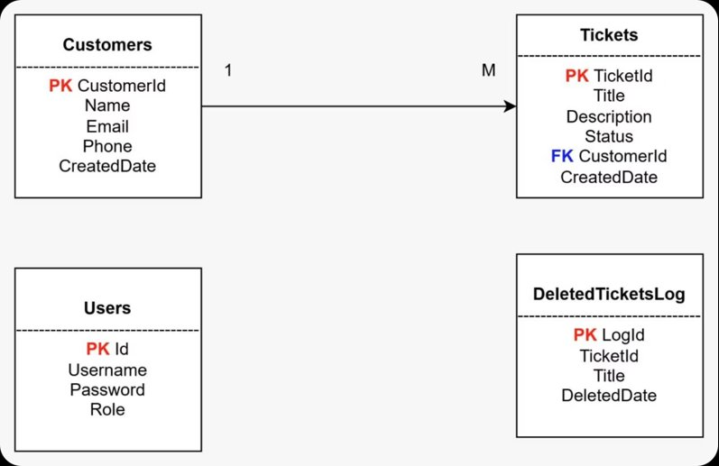
Entity Relationship Diagram

Slide 8
Database Design
Customers
Tickets
🔑 CustomerId (PK)
🔑 TicketId (PK)
Name
Title
Email
Description
Phone
Status
CreatedDate
🔗 CustomerId (FK)
CreatedDate
Users
DeletedTicketsLog
🔑 Id (PK)
🔑 LogId (PK)
Username
TicketId
Password (Hashed)
Title
Role
DeletedDate

Slide 9
Customer Management Module
➕
Add Customer
👁
View Customer
Register new customer with name, email, phone
List all customers with search & filter
✏️
Edit Customer
🗑
Delete Customer
Update customer details in real-time
Remove customer & associated data
Benefit: Centralized customer data management for efficient business operations.

Slide 10
Ticket Management Module
🎫
Create Ticket
📋
View Ticket
Raise a new support ticket for a customer
Browse all tickets with status indicators
🔄
Update Ticket
🗑
Delete Ticket
Update ticket status: Open / In-Progress / Closed
Remove ticket; trigger logs to audit table
Benefit: Efficiently tracks and manages all customer service requests in real-time.

Slide 11
Frontend to Database Connectivity
Razor View (UI)
⚙
Layered Architecture
Separates UI, business logic, and data access layers clearly
▼
Controller
▼
⚙
Loose Coupling
Repository Interface
Components interact through interfaces, not concrete classes
▼
EF Core / ADO.NET
▼
⚙
Dependency Injection
SQL Server
Services injected via constructor, making testing easy

Slide 12
Authentication & Authorization
JWT Authentication Flow
Role-Based Authorization
1. Login
🔑 Admin
User sends credentials (username + password)
• Full Customer CRUD
2. Validate
Server verifies credentials against DB
• Full Ticket CRUD
• Access Swagger APIs
3. Generate Token
Server generates signed JWT token
• Delete Operations
4. Return Token
Token sent back to the client
🔑 Support Executive
5. Authorize
• View Customers
Client sends token in Authorization header
• Create & Update Tickets
6. Access APIs
• Cannot Delete
Protected endpoints validate & allow access
• Limited API Access

Slide 13
API Documentation (Swagger)
Authentication API
POST
/api/auth/login
Generate JWT Token
Customer API
GET
/api/customers
Get all customers
POST
/api/customers
Create customer
PUT
/api/customers/{id}
Update customer
DELETE
/api/customers/{id}
Delete customer
Ticket API
GET
/api/tickets
Get all tickets
POST
/api/tickets
Create ticket
PUT
/api/tickets/{id}
Update ticket
DELETE
/api/tickets/{id}
Delete ticket

Slide 14
End-to-End Walkthrough
1
2
3
4
5
▶
▶
▶
▶
👤
🎫
💾
🔍
🖥
Create Customer
Raise Ticket
Store in Database
Retrieve Data
Display in MVC UI
Fill in customer form → submit → stored in Customers table
Assign ticket to customer → set title & description
EF Core / ADO.NET persists records to SQL Server
Repository queries DB → returns typed objects
Controller passes model to Razor View → renders HTML
Complete flow from UI interaction to database persistence and back — all in real-time.

Slide 15
SQL Trigger Implementation
SQL Trigger Code
🗑
Delete Ticket
CREATE TRIGGER trg_TicketDelete
ON Tickets
AFTER DELETE
AS
BEGIN
INSERT INTO DeletedTicketsLog
(TicketId, Title, DeletedDate)
SELECT
d.TicketId,
d.Title,
GETDATE()
FROM deleted d;
END
User triggers DELETE from UI
▼
⚡
Trigger Fires
trg_TicketDelete executes automatically
▼
📋
Log Updated
DeletedTicketsLog records the event
▼
✅
Audit Complete
Data preserved for compliance & review

Slide 16
SOLID Principles & Design Patterns
S
Single Responsibility
Controller handles requests, Repository handles data access. Each class has one job.
O
Open/Closed Principle
Repositories can be extended with new implementations without modifying existing controllers.
D
Dependency Inversion
Controllers depend on ICustomerRepository interface, not concrete CustomerRepository class.
Design Patterns Used:
✔ Repository Pattern
✔ Dependency Injection
✔ MVC Pattern

Slide 17
Top 10 Concepts & Best Practices
1
2
3
4
5
ASP.NET Core MVC
Entity Framework Core
ADO.NET
SQL Server
Repository Pattern
6
7
8
9
10
Dependency Injection
JWT Authentication
Role-Based Authorization
Swagger API Docs
SQL Trigger
Industry Best Practices:
✔ Layered Architecture
✔ Repository Pattern
✔ Dependency Injection
✔ JWT Security
✔ API Documentation
✔ Database Normalization

Slide 18
Future Scope
Conclusion
→ ASP.NET Identity Login System
Successfully developed a secure
and scalable platform.
→ Email Notifications for Tickets
✔ Customer Management
→ AI Ticket Summarization
✔ Ticket Management
→ Analytics Dashboard
✔ JWT Security
→ Full Azure Deployment
✔ REST APIs
✔ SQL Server DB
→ Microservices Architecture
✔ Docker Support
✔ CI/CD Readiness
Thank You — Questions & Answers

Slide 19
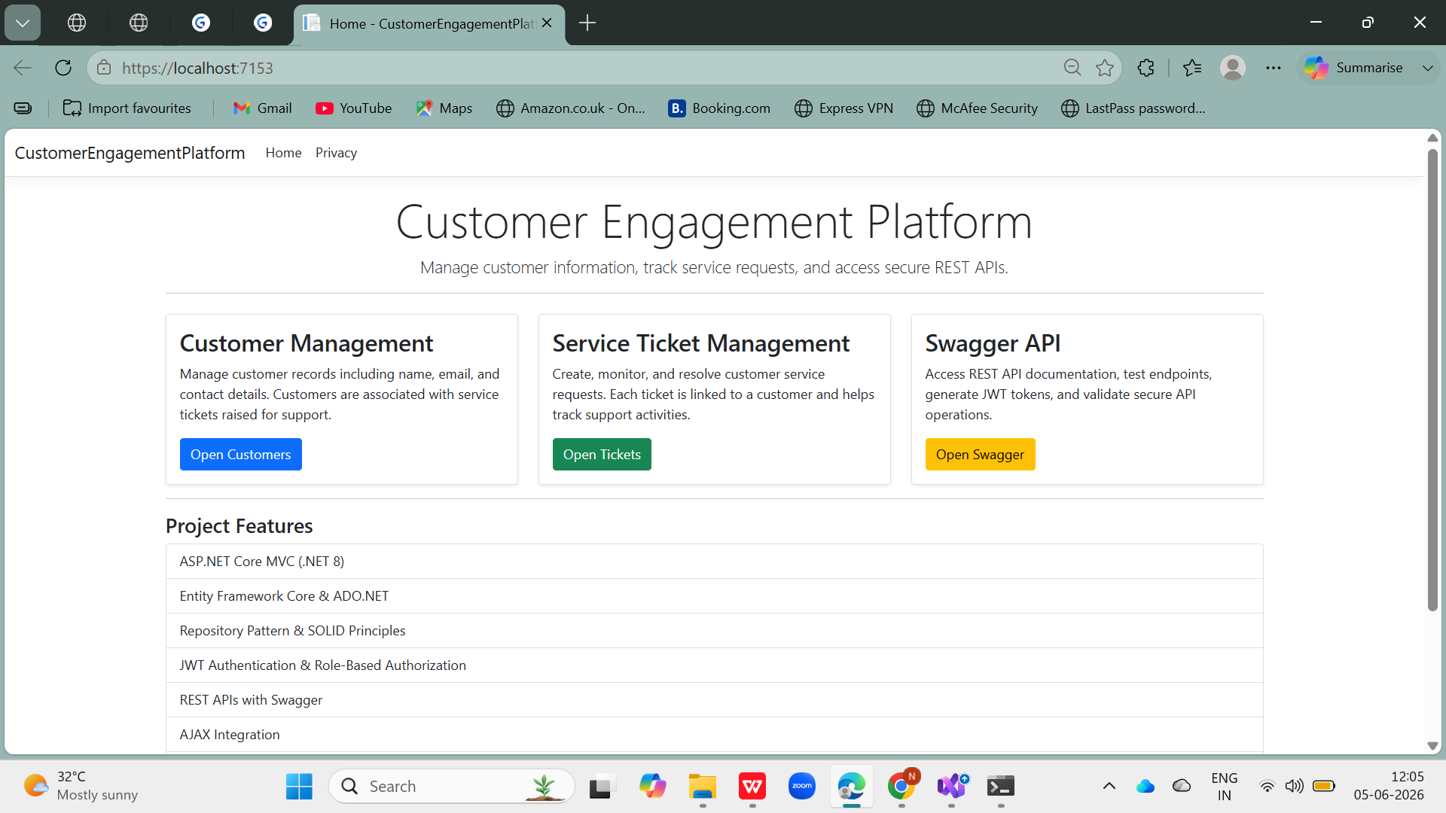
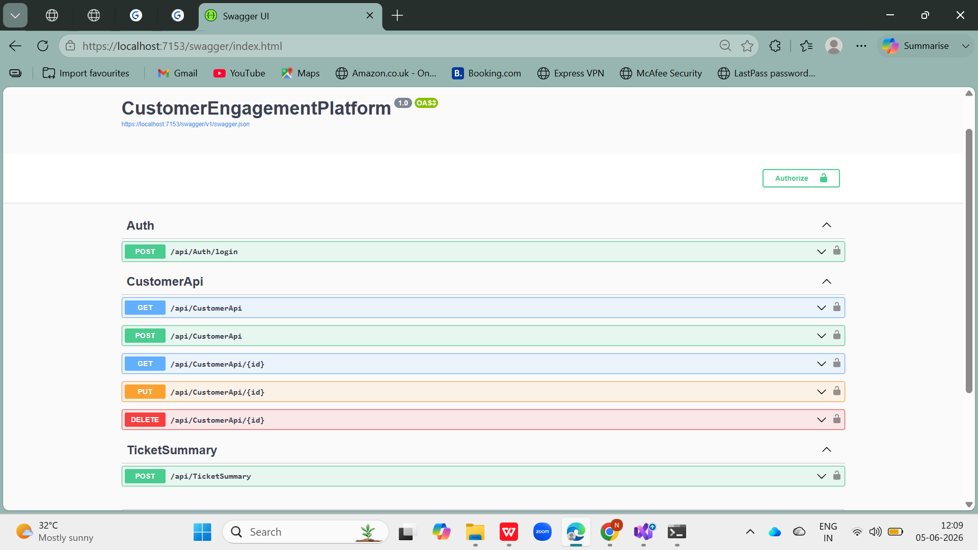
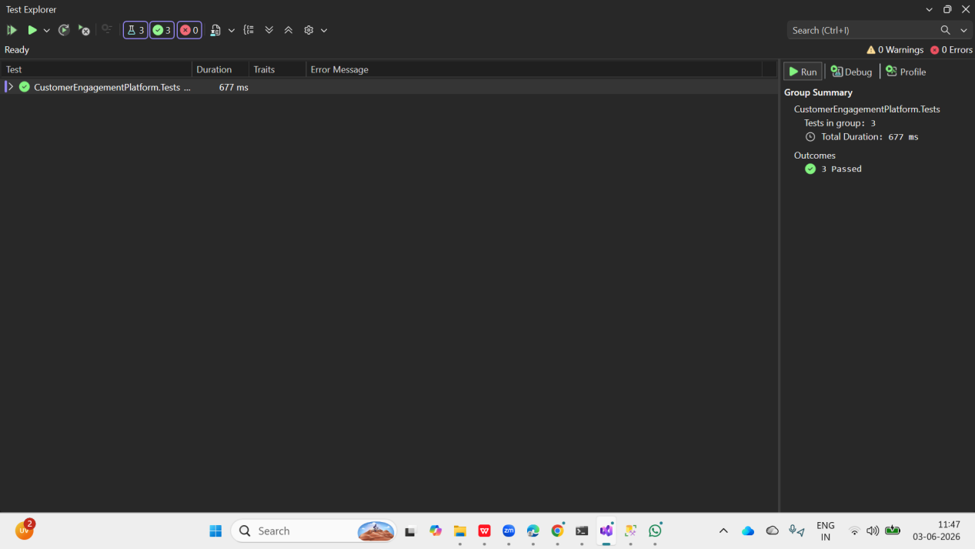
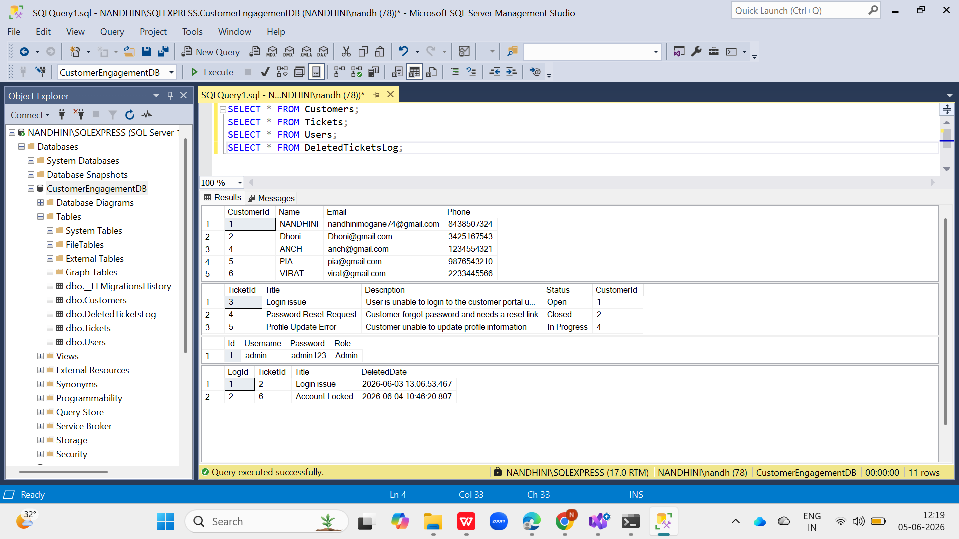

Slide 20
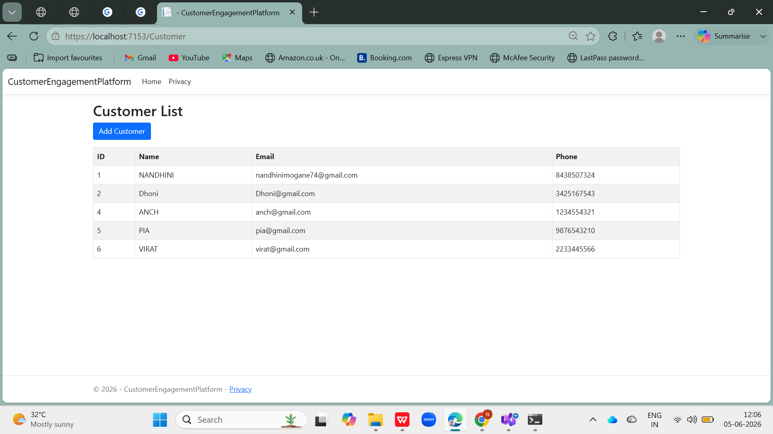
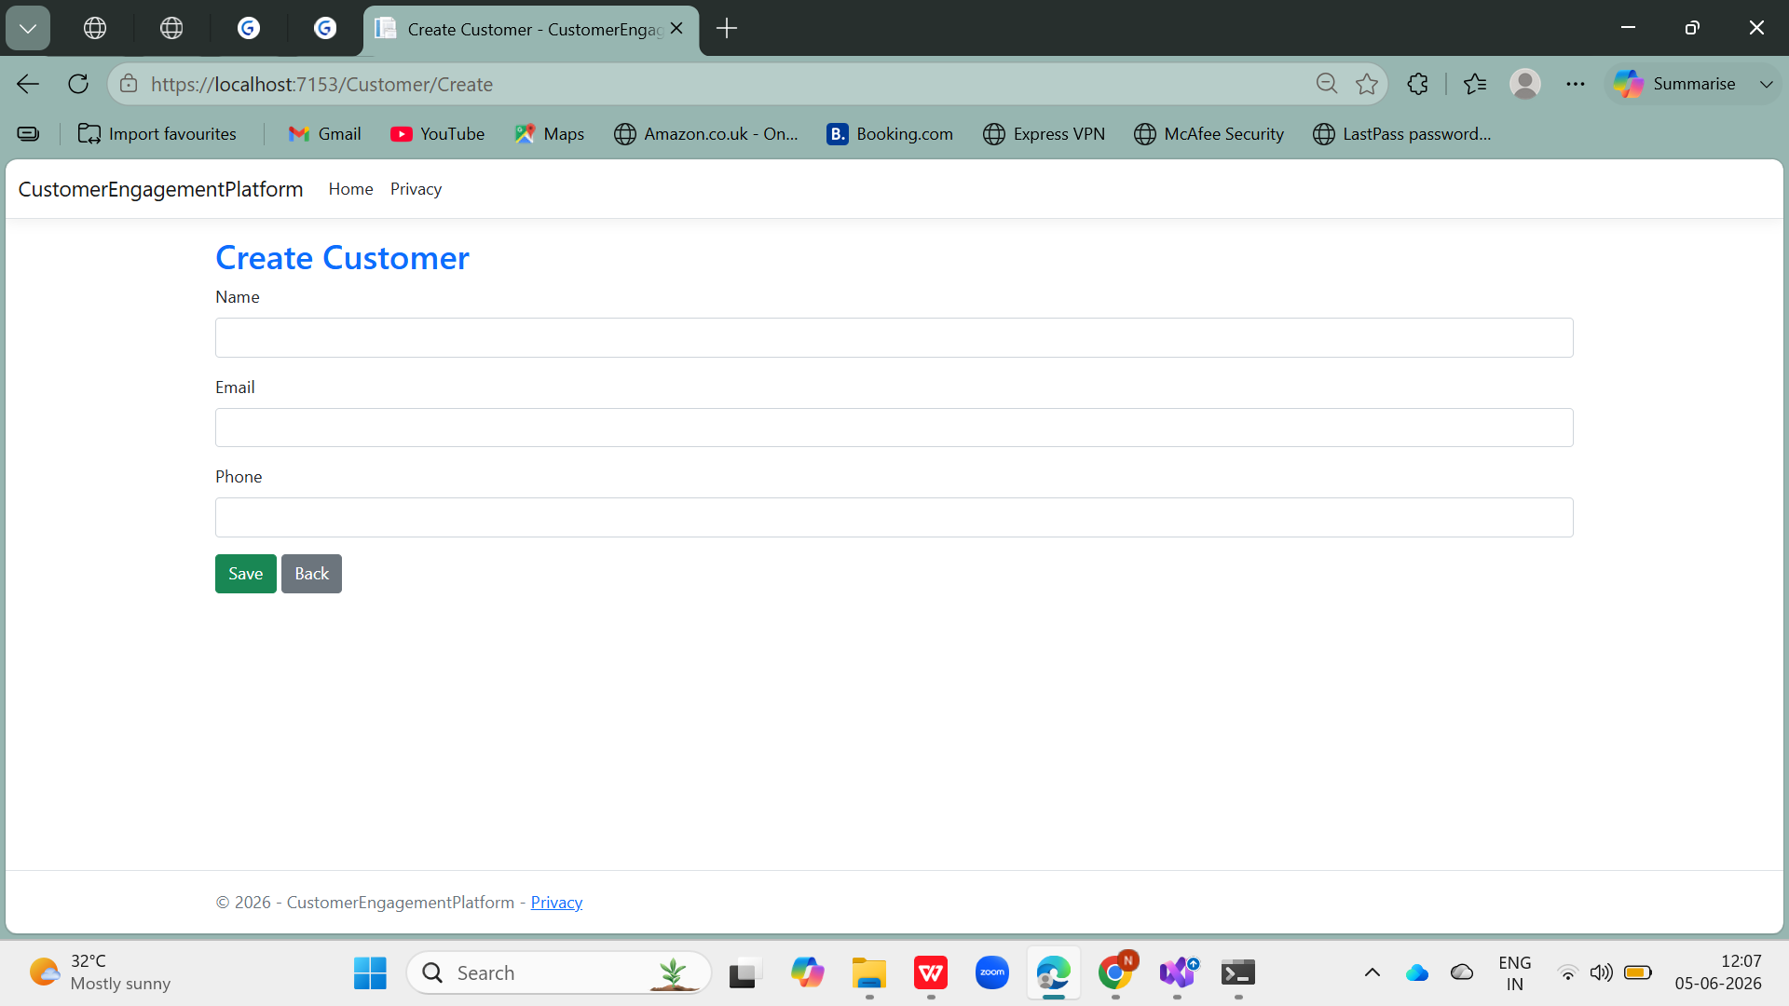
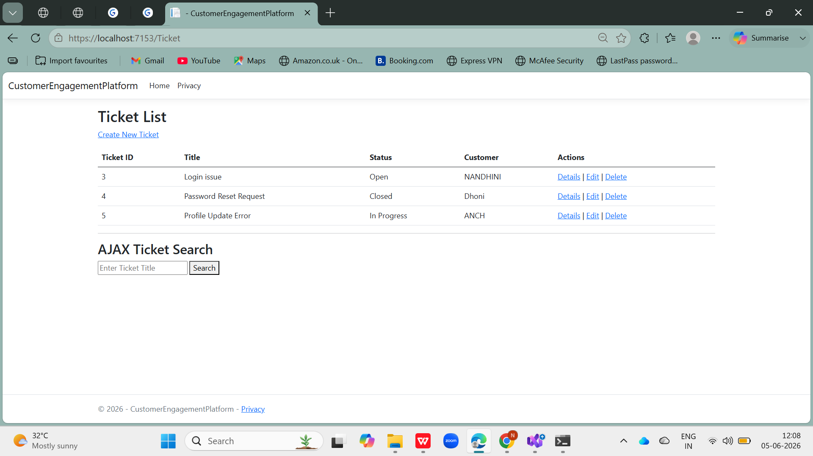
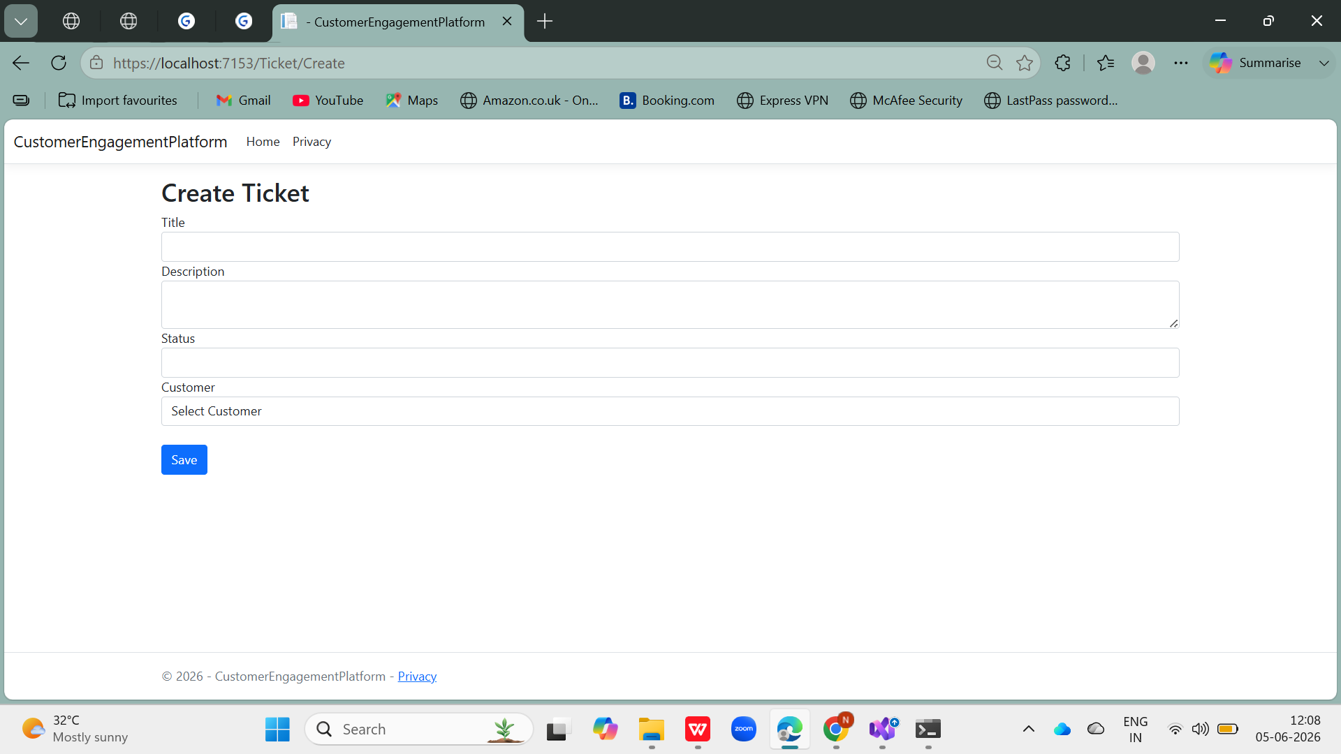

Slide 21
THANK YOU

