Slide 1
Conference Management System
Instructor : Jia Zhang
Team 5 : Anton Sergeyev
Assya Dyussenova
Nandhiny Duraikannu
Ritvik Gautam
[18-655] Service Oriented Computing, Spring 2017

Slide 2
Roadmap
Introduction
Motivation
Related Work
System Design
System Implementation
Demo
Experiments and Analysis
Conclusion
Future Work

Slide 3

Introduction
An IEEE conference management system.
Serves the functionality of online paper submission, review and registration.
Built using Service Oriented Architecture
Every function is a Service
Use Java Play framework

Slide 4
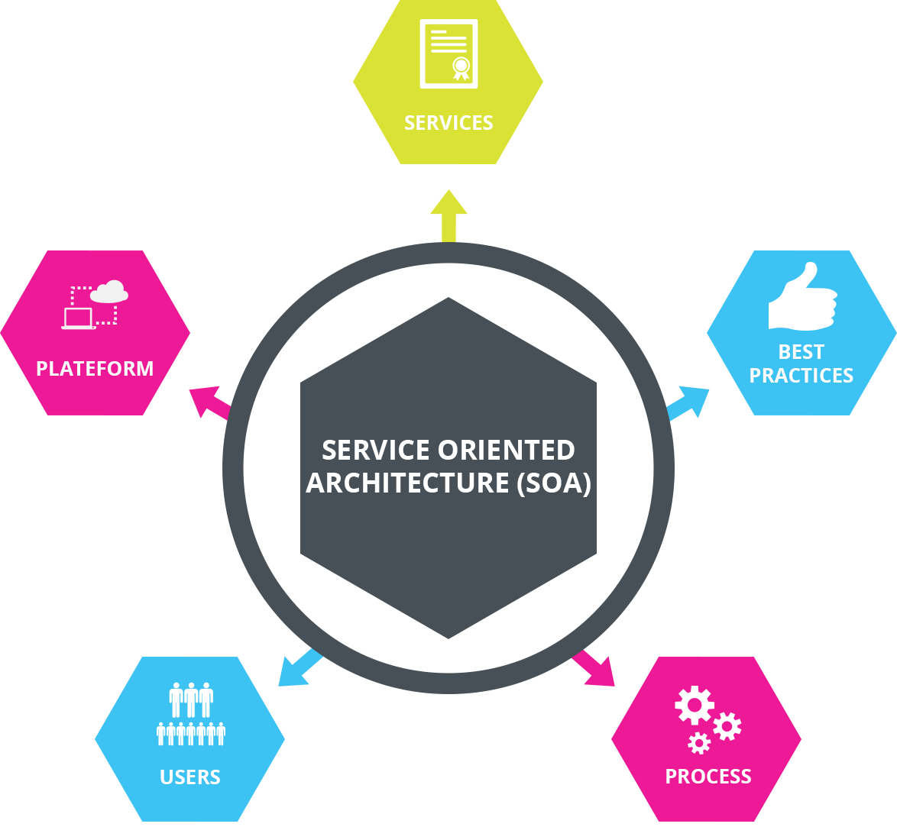
Motivation
Implement the various service oriented architecture concepts into a real world application.
Implement service architecture
Use the Java Play framework, which is one of the most popular to implement SOA.

Slide 5
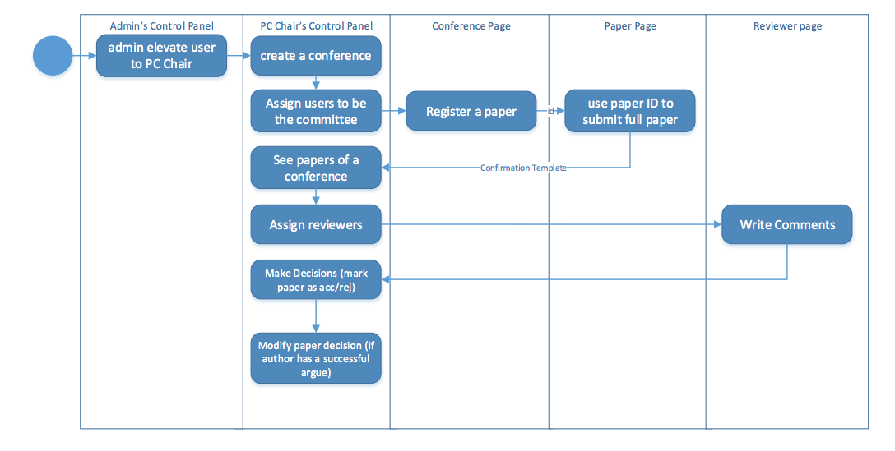
Related Work
Reference application architecture.

Slide 6
Project
A conference management system that supports…
Login & signup functionality
Profile Management
Submitting Paper
Reviewing Paper
Conference Page
Admin Page
Email notifications
Implemented as a Service in Java Play

Slide 7
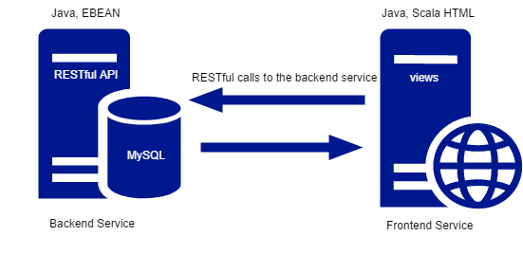
System Design
Backend Service
RESTful Implementation
Java
Frontend Service
Makes RESTful calls to the backend service
Java, Scala HTML

Slide 8
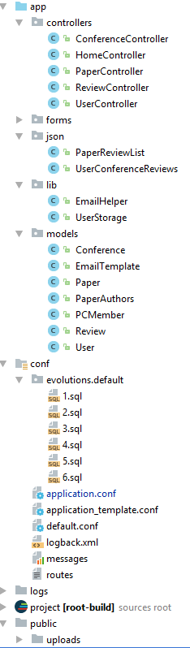
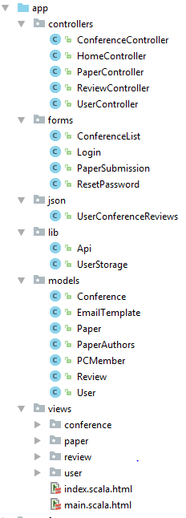
System Implementation
API
FRONTEND
2 Java Play projects for frontend and backend communicating via REST API
MVC approach at both levels!

Slide 9
How to Run
Setup database connection by copying and editing api/conf/application_template.conf Database credentials are not kept in git.
Create a database soc_conf_system
Run both projects (api and frontend) from console with sbt run. Then the API should be available at localhost:9000 and web interface at localhost:9001.
Tested on the Google Chrome browser.

Slide 10
Demo
https://drive.google.com/file/d/0B-oo_6Oe1e9rNFNTeHRtal82UjQ/view?usp=sharing

Slide 11
Known Issues
Add more functionality for the PC Chair
Performance and stability concerns - need to implement error handling, validation, and reduce the number of API requests

Slide 12
Experiments and Analysis
Data exchange rules and format We settled on Ebean objects transformed to JSON in API, and then on frontend they are transformed back from JSON to plain java objects
Ebean functionality Learned and applied Ebean functions like migrations and automatic joins via annotations

Slide 13
Conclusion
Developed a conference management system making use of service oriented architecture
Learned SOA in practice
Appreciated the concept of separating concerns among services
Prepared for development of real world applications

Slide 14
Future Work
More use cases
Test the current implementation
Implement CI/CD
Deploy on Cloud

Slide 15

Questions

Slide 16
Resources
GitHub: https://github.com/cmusv-sc/18655-Spring-2017-Team-5/
REST API Documentation: http://docs.18655team5.apiary.io/#

Slide 17
Contact
Anton Sergeyev - anton.sergeyev@sv.cmu.edu
Assya Dyussenova - assya.dyussenova@sv.cmu.edu
Nandhiny Duraikannu - nandhiny.duraikannu@sv.cmu.edu
Ritvik Gautam - ritvik.gautam@sv.cmu.edu

